Slide 1
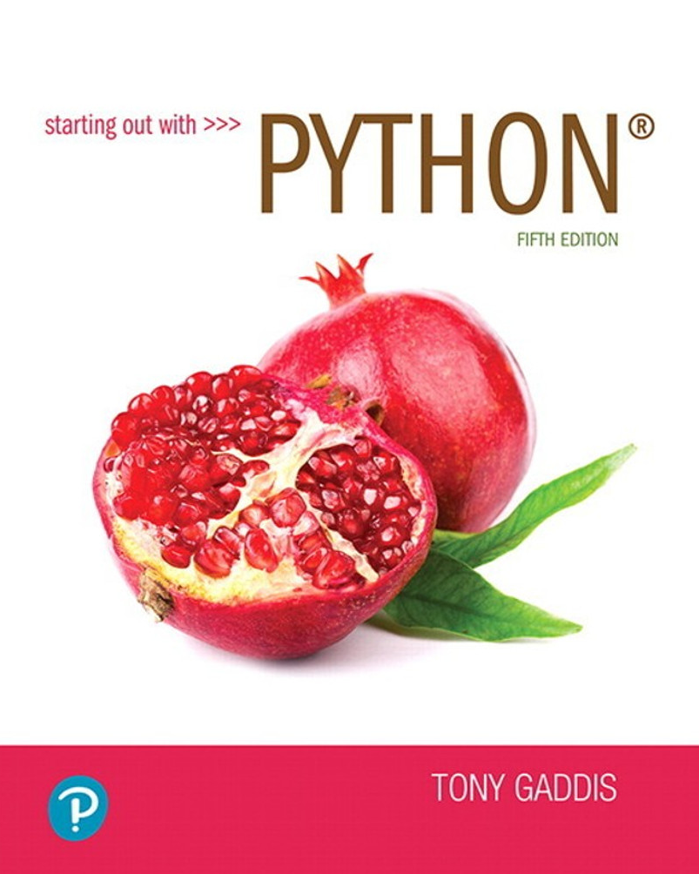

Slide 2
Tuples
Tuple: an immutable sequence
similar to a list, but ….
Once it is created it cannot be changed
Format: tuple_name = (item1, item2)
Notice the use of ( ) instead of [ ]
Tuples have operations similar to lists
Subscript indexing for retrieving elements
Methods such as index
Built in functions such as len, min, max
Slicing expressions
The in, +, and * operators

Slide 3
Tuples (cont’d.)
Tuples do not support the methods:
append
remove
insert
reverse
sort
Why not? They are immutable.

Slide 4
Tuples (cont’d.)
Advantages for using tuples over lists:
Processing tuples is faster than processing lists
Tuples can be safer (immutable)
Some operations in Python require use of tuples
list() function: converts tuple to list
tuple() function: converts list to tuple
Fun fact, a function that returns 2 or more values returns them in a tuple

Slide 5
Basic String Operations
Many types of programs perform operations on strings
In Python, many tools for examining and manipulating strings
Strings are sequences, so many of the tools that work with sequences (such as ranges, lists, and tuples) also can be used with strings

Slide 6
Accessing the Individual Characters in a String
To access an individual character in a string:
Use a for loop
Format: for character in string:
Useful when need to iterate over the whole string, such as to count the occurrences of a specific character
Each ‘character’ is simply a string of length 1
Use indexing
Each character has an index specifying its position in the string, starting at 0
Format: character = my_string[i]

Slide 7
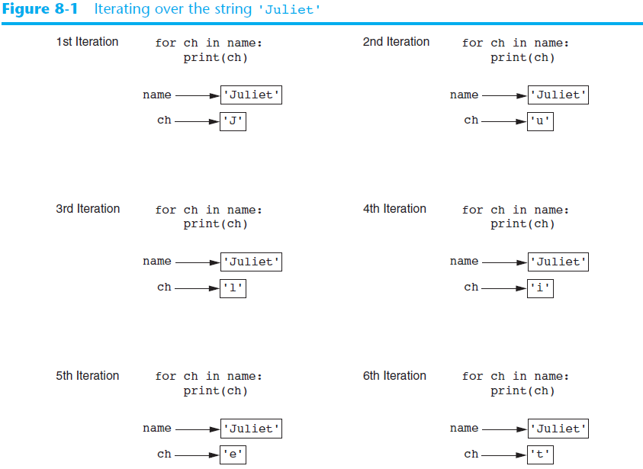

Slide 8
Accessing the Individual Characters in a String (cont’d.)
-13 -12 -11 -10 -9 -8 -7 -6 -5 -4 -3 -2 -1
ch = my_string[6]

Slide 9
Accessing the Individual Characters in a String (cont’d.)
IndexError exception will occur if:
You try to use an index that is out of range for the string
Likely to happen when loop iterates beyond the end of the string
use the len(string) function to obtain the length of a string
Useful to prevent loops from iterating beyond the end of a string

Slide 10
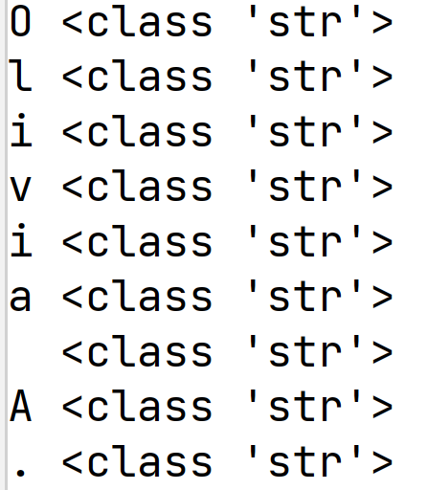
Accessing the Individual Characters in a String
How to access the individual elements of the string using a for loop and the range function?
name = 'Olivia A.' for in range(len(name)): print(name[i], type(name[i])
Or for ch in string_var: if we don’t care about position

Slide 11
String Concatenation
Concatenation: appending one string to the end of another string
Use the + operator to produce a string that is a combination of its operands
The augmented assignment operator += can also be used to concatenate strings
The operand on the left side of the += operator must be an existing variable; otherwise, an exception is raised

Slide 12
Strings Are Immutable
Strings are immutable
Once they are created, they cannot be changed
Concatenation doesn’t actually change the existing string, but rather creates a new string and assigns the new string to the previously used variable
Cannot use an expression of the form
string[index] = new_character
Statement of this type will raise an exception

Slide 13
Strings Are Immutable, Variables Are Not

Slide 14
String Slicing
Slice: span of items taken from a sequence, known as substring
Slicing format: string[start : end]
Expression will return a string containing a copy of the characters from start up to, but not including, end
If start not specified, 0 is used for start index
If end not specified, len(string) is used for end index
Slicing expressions can include a step value and negative indexes relative to end of string

Slide 15
Testing, Searching, and Manipulating Strings
You can use the in operator to determine whether one string is contained in another string
General format: string1 in string2
string1 and string2 can be string literals or variables referencing strings
Similarly you can use the not in operator to determine whether one string is not contained in another string

Slide 16
String Methods
Strings in Python have many types of methods, divided into different types of operations
General format: mystring.method(arguments)
Some methods test a string for specific characteristics
Generally Boolean methods, that return True if a condition exists, and False otherwise

Slide 17
String Methods (cont’d.)
Implement a function that prompts the user for an int
and error checks it. Keep prompting until they enter an int

Slide 18
String Methods (cont’d.)
Some methods create and return a modified version of the string
Simulate strings as mutable objects
String comparisons are case-sensitive
Uppercase characters are distinguished from lowercase characters
lower and upper methods can be used for making case-insensitive string comparisons

Slide 19
String Methods (cont’d.)

Slide 20
String Methods (cont’d.)
Programs commonly need to search for substrings
Several methods to accomplish this:
endswith(substring): checks if the string ends with substring
Returns True or False
startswith(substring): checks if the string starts with substring
Returns True or False

Slide 21
String Methods (cont’d.)
Several methods to accomplish this (cont’d):
find(substring): searches for substring within the string
Returns lowest index of the substring, or if the substring is not contained in the string, returns -1
replace(substring, new_string):
Returns a copy of the string where every occurrence of substring is replaced with new_string

Slide 22
String Methods (cont’d.)

Slide 23
The Repetition Operator
Repetition operator: makes multiple copies of a string and joins them together
The * symbol is a repetition operator when applied to a string and an integer
String is left operand; number is right
General format: string_to_copy * n
Variable references a new string which contains multiple copies of the original string

Slide 24
Splitting a String
split method: returns a list containing the words in the string
By default, uses space as separator
Can specify a different separator by passing it as an argument to the split method
Also referred to as parsing a string.

Slide 25
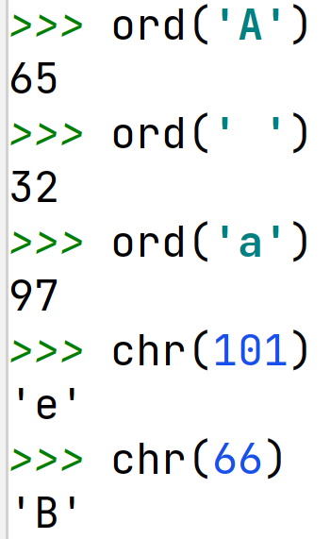
chr and ord Functions
Recall, the vast majority of computer systems store data in a binary form, 0's and 1's
We have encoding schemes to specify what a given sequence of 0's and 1's represents, such as characters, colors, sound
In Python, the built in chr and ord functions can be used to see the encoding for strings of length 1

