Slide 1
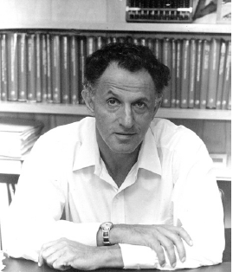
Topic 26
Dynamic Programming
"Thus, I thought dynamic programming was a good name. It was something not even a Congressman could object to. So I used it as an umbrella for my activities"
- Richard E. Bellman

Slide 2
Origins
A method for solving complex problems by breaking them into smaller, easier, sub problems
Term Dynamic Programming coined by mathematician Richard Bellman in early 1950s
  employed by Rand Corporation
  Rand had many, large military contracts
  Secretary of Defense, Charles Wilson “against research, especially mathematical research”
  how could any one oppose "dynamic"?

Slide 3
Dynamic Programming
Break big problem up into smaller problems ...
Sound familiar?
Recursion?
N! = 1 for N == 0
N! = N * (N - 1)! for N > 0

Slide 4


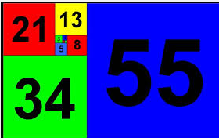
Fibonacci Numbers
1, 1, 2, 3, 5, 8, 13, 21, 34, 55, 89, 114, …
F₁ = 1
F₂ = 1
F_{N} = F_{N - 1} + F_{N - 2}
Recursive Solution?

Slide 5
Failing Spectacularly
Naïve recursive method
Clicker 1 - Order of this method?
A. O(1) B. O(log N) C. O(N) D. O(N²) E. O(2^{N})
// pre: n > 0
// post: return the nth Fibonacci number
public int fib(int n) {
if (n <= 2)
return 1;
else
return fib(n – 1) + fib (n – 2);
}

Slide 6
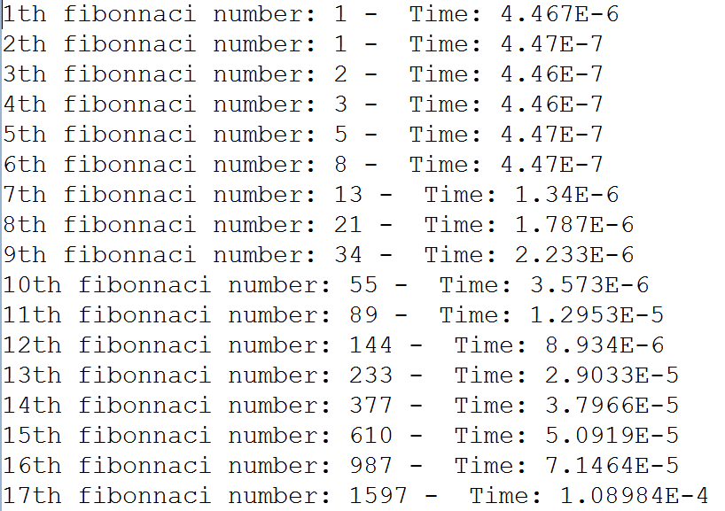
Failing Spectacularly

Slide 7
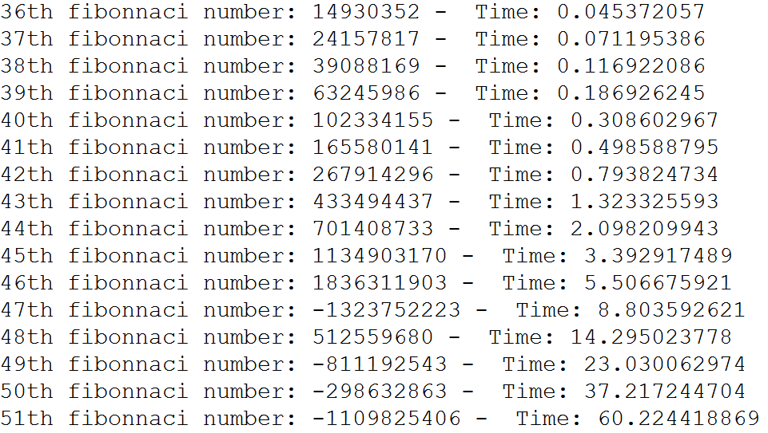
Failing Spectacularly

Slide 8
Clicker 2 - Failing Spectacularly
How long to calculate the 70th Fibonacci Number with this method?
37 seconds
74 seconds
740 seconds
14,800 seconds
None of these

Slide 9
Aside - Overflow
at 47th Fibonacci number overflows int
Could use BigInteger class instead
private static final BigInteger one
= new BigInteger("1");
private static final BigInteger two
= new BigInteger("2");
public static BigInteger fib(BigInteger n) {
if (n.compareTo(two) <= 0)
return one;
else {
BigInteger firstTerm = fib(n.subtract(two));
BigInteger secondTerm = fib(n.subtract(one));
return firstTerm.add(secondTerm);
}
}

Slide 10
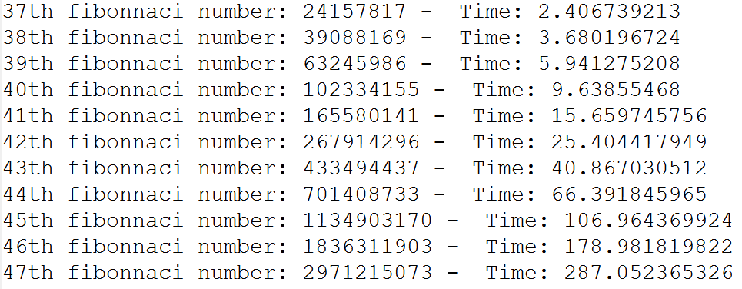
Aside - BigInteger
Answers correct beyond 46th Fibonacci number
Even slower, math on BigIntegers,
object creation, and garbage collection

Slide 11
Slow Fibonacci
Why so slow?
Algorithm keeps calculating the same value over and over
When calculating the 40th Fibonacci number the algorithm calculates the 4th Fibonacci number 24,157,817 times!!!

Slide 12
Fast Fibonacci
Instead of starting with the big problem and working down to the small problems
... start with the small problem and work up to the big problem
public static BigInteger fastFib(int n) {
BigInteger smallTerm = one;
BigInteger largeTerm = one;
for (int i = 3; i <= n; i++) {
BigInteger temp = largeTerm;
largeTerm = largeTerm.add(smallTerm);
smallTerm = temp;
}
return largeTerm;
}

Slide 13
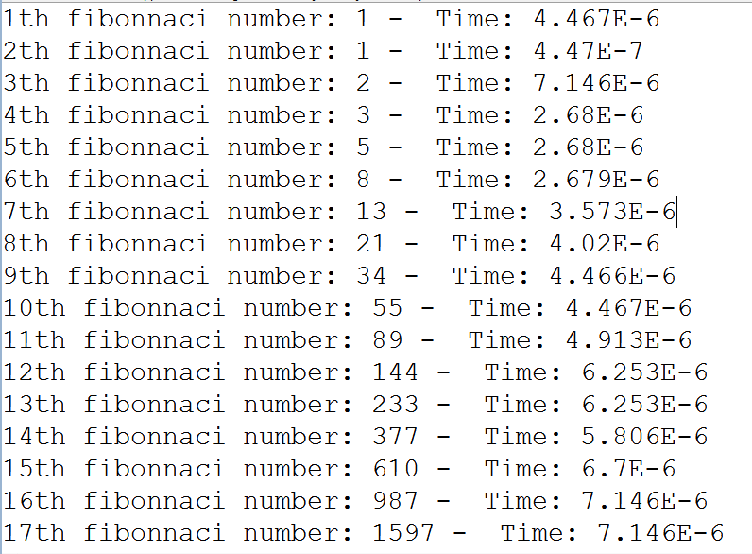
Fast Fibonacci

Slide 14
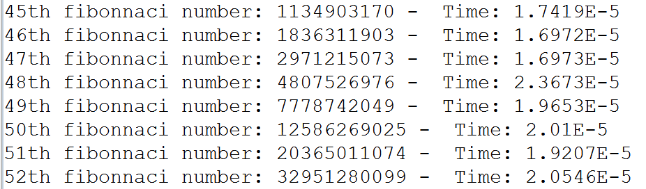
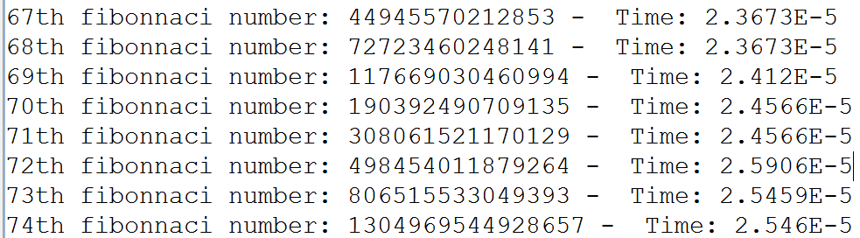
Fast Fibonacci

Slide 15
Memoization
Store (cache) results from computations for later lookup
Memoization of Fibonacci Numbers
public class FibMemo {
private static List<BigInteger> lookupTable;
private static final BigInteger ONE
= new BigInteger("1");
static {
lookupTable = new ArrayList<>();
lookupTable.add(null);
lookupTable.add(ONE);
lookupTable.add(ONE);
}

Slide 16
Fibonacci Memoization
public static BigInteger fib(int n) {
// check lookup table
if (n < lookupTable.size()) {
return lookupTable.get(n);
}
// Calculate nth Fibonacci.
// Don't repeat work. Start with the last known.
BigInteger smallTerm
= lookupTable.get(lookupTable.size() - 2);
BigInteger largeTerm
= lookupTable.get(lookupTable.size() - 1);
for(int i = lookupTable.size(); i <= n; i++) {
BigInteger temp = largeTerm;
largeTerm = largeTerm.add(smallTerm);
lookupTable.add(largeTerm); // memo
smallTerm = temp;
}
return largeTerm;
}

Slide 17
Dynamic Programming
When to use?
When a big problem can be broken up into sub problems.
Solution to original problem can be calculated from results of smaller problems.
  larger problems depend on previous solutions
Sub problems must have a natural ordering from smallest to largest (simplest to hardest)
Multiple techniques within DP

Slide 18
DP Algorithms
Step 1: Define the *meaning* of the subproblems (in English for sure, Mathematically as well if you find it helpful).
Step 2: Show where the solution will be found.
Step 3: Show how to set the first subproblem.
Step 4: Define the order in which the subproblems are solved.
Step 5: Show how to compute the answer to each subproblem using the previously computed subproblems. (This step is typically polynomial, once the other subproblems are solved.)

Slide 19
Dynamic Programming Requires:
overlapping sub problems:
  problem can be broken down into sub problems
  obvious with Fibonacci
  Fib(N) = Fib(N - 2) + Fib(N - 1) for N >= 3
optimal substructure:
  the optimal solution for a problem can be constructed from optimal solutions of its sub problems
  In Fibonacci just sub problems, no optimality
  min coins opt(36) = 1₁₂ + opt(24) [1, 5, 12]

Slide 20
Dynamic Programing Example
Another simple example
Finding the best solution involves finding the best answer to simpler problems
Given a set of coins with values (V₁, V₂, … V_{N}) and a target sum S, find the fewest coins required to equal S
What is Greedy Algorithm approach?
Does it always work?
{1, 5, 12} and target sum = 15 (12, 1, 1, 1)
Could use recursive backtracking …

Slide 21
Minimum Number of Coins
To find minimum number of coins to sum to 15 with values {1, 5, 12} start with sum 0
  recursive backtracking would likely start with 15
Let M(S) = minimum number of coins to sum to S
At each step look at target sum,
coins available, and previous sums
  pick the smallest option

Slide 22
Minimum Number of Coins
M(0) = 0 coins
M(1) = 1 coin (1 coin)
M(2) = 2 coins (1 coin + M(1))
M(3) = 3 coins (1 coin + M(2))
M(4) = 4 coins (1 coin + M(3))
M(5) = interesting, 2 options available:
1 + others OR single 5
if 1 then 1 + M(4) = 5, if 5 then 1 + M(0) = 1
clearly better to pick the coin worth 5

Slide 23
Minimum Number of Coins
M(0) = 0
M(1) = 1 (1 coin)
M(2) = 2 (1 coin + M(1))
M(3) = 3 (1 coin + M(2))
M(4) = 4 (1 coin + M(3))
M(5) = 1 (1 coin + M(0))
M(6) = 2 (1 coin + M(5))
M(7) = 3 (1 coin + M(6))
M(8) = 4 (1 coin + M(7))
M(9) = 5 (1 coin + M(8))
M(10) = 2 (1 coin + M(5))
options: 1, 5
M(11) = 2 (1 coin + M(10))
options: 1, 5
M(12) = 1 (1 coin + M(0))
options: 1, 5, 12
M(13) = 2 (1 coin + M(12))
options: 1, 12
M(14) = 3 (1 coin + M(13))
options: 1, 12
M(15) = 3 (1 coin + M(10))
options: 1, 5, 12

Slide 24
Knapsack problem -
Recursive BACKTRACKING AND Dynamic Programming

Slide 25
Knapsack Problem
A variation of a bin packing problem
Similar to fair teams problem from
recursion assignment
You have a set of items
Each item has a weight and a value
You have a knapsack with a weight limit
Goal: Maximize the value of the items you put in the knapsack without exceeding the weight limit

Slide 26
Knapsack Example
Items:
Weight
Limit = 8
One greedy solution: Take the highest ratio item that will fit: (1, 6), (2, 11), and (4, 12)
Total value = 6 + 11 + 12 = 29
Clicker 3 - Is this optimal? A. No B. Yes
Item Number | Weight of Item | Value of Item | Value per unit Weight
1 | 1 | 6 | 6.0
2 | 2 | 11 | 5.5
3 | 4 | 1 | 0.25
4 | 4 | 12 | 3.0
5 | 6 | 19 | 3.167
6 | 7 | 12 | 1.714

Slide 27
Knapsack - Recursive Backtracking
private static int knapsack(ArrayList<Item> items,
int current, int capacity) {
int result = 0;
if (current < items.size()) {
// don't use item
int withoutItem
= knapsack(items, current + 1, capacity);
int withItem = 0;
// if current item will fit, try it
Item currentItem = items.get(current);
if (currentItem.weight <= capacity) {
withItem += currentItem.value;
withItem += knapsack(items, current + 1,
capacity - currentItem.weight);
}
result = Math.max(withoutItem, withItem);
}
return result;
}

Slide 28
Knapsack - Dynamic Programming
Recursive backtracking starts with max capacity and makes choice for items:
choices are:
  take the item if it fits
  don't take the item
Dynamic Programming, start with
simpler problems
Reduce number of items available
… AND Reduce weight limit on knapsack
Creates a 2d array of possibilities

Slide 29
Knapsack - Optimal Function
OptimalSolution(items, weight) is best solution given a subset of items and a weight limit
2 options:
OptimalSolution does not select i^{th} item
  select best solution for items 1 to i - 1with weight limit of w
OptimalSolution selects i^{th} item
  New weight limit = w - weight of i^{th} item
  select best solution for items 1 to i - 1with new weight limit

Slide 30
Knapsack Optimal Function
OptimalSolution(items, weight limit) =
0 if 0 items
OptimalSolution(items - 1, weight) if weight of ith item is greater than allowed weight
w_{i} > w (In others i^{th} item doesn't fit)
max of (OptimalSolution(items - 1, w),
value of i^{th} item +
OptimalSolution(items - 1, w - w_{i})

Slide 31
Knapsack - Algorithm
Create a 2d array to store
value of best option given
subset of items and
possible weights
In our example 0 to 6
items and weight limits of of 0 to 8
Fill in table using OptimalSolution Function
Item Number | Weight of Item | Value of Item
1 | 1 | 6
2 | 2 | 11
3 | 4 | 1
4 | 4 | 12
5 | 6 | 19
6 | 7 | 12

Slide 32
Knapsack Algorithm
Given N items and WeightLimit
Create Matrix M with N + 1 rows and WeightLimit + 1 columns
For weight = 0 to WeightLimit
M[0, w] = 0
For item = 1 to N
for weight = 1 to WeightLimit
if(weight of ith item > weight)
M[item, weight] = M[item - 1, weight]
else
M[item, weight] = max of
M[item - 1, weight] AND
value of item + M[item - 1, weight - weight of item]

Slide 33
Knapsack - Table
Item | Weight | Value
1 | 1 | 6
2 | 2 | 11
3 | 4 | 1
4 | 4 | 12
5 | 6 | 19
6 | 7 | 12
items / capacity | 0 | 1 | 2 | 3 | 4 | 5 | 6 | 7 | 8
{} | 0 | 0 | 0 | 0 | 0 | 0 | 0 | 0 | 0
{1}
{1,2}
{1, 2, 3}
{1, 2, 3, 4}
{1, 2, 3, 4, 5}
{1, 2, 3, 4, 5, 6}

Slide 34
Knapsack - Completed Table
Item | Weight | Value
1 | 1 | 6
2 | 2 | 11
3 | 4 | 1
4 | 4 | 12
5 | 6 | 19
6 | 7 | 12
items / weight | 0 | 1 | 2 | 3 | 4 | 5 | 6 | 7 | 8
{} | 0 | 0 | 0 | 0 | 0 | 0 | 0 | 0 | 0
{1} [1, 6] | 0 | 6 | 6 | 6 | 6 | 6 | 6 | 6 | 6
{1,2} [2, 11] | 0 | 6 | 11 | 17 | 17 | 17 | 17 | 17 | 17
{1, 2, 3} [4, 1] | 0 | 6 | 11 | 17 | 17 | 17 | 17 | 18 | 18
{1, 2, 3, 4} [4, 12] | 0 | 6 | 11 | 17 | 17 | 18 | 23 | 29 | 29
{1, 2, 3, 4, 5} [6, 19] | 0 | 6 | 11 | 17 | 17 | 18 | 23 | 29 | 30
{1, 2, 3, 4, 5, 6} [7, 12] | 0 | 6 | 11 | 17 | 17 | 18 | 23 | 29 | 30

Slide 35
Knapsack - Items to Take
items / weight | 0 | 1 | 2 | 3 | 4 | 5 | 6 | 7 | 8
{} | 0 | 0 | 0 | 0 | 0 | 0 | 0 | 0 | 0
{1} [1, 6] | 0 | 6 | 6 | 6 | 6 | 6 | 6 | 6 | 6
{1,2} [2, 11] | 0 | 6 | 11 | 17 | 17 | 17 | 17 | 17 | 17
{1, 2, 3} [4, 1] | 0 | 6 | 11 | 17 | 17 | 17 | 17 | 17 | 17
{1, 2, 3, 4} [4, 12] | 0 | 6 | 11 | 17 | 17 | 18 | 23 | 29 | 29
{1, 2, 3, 4, 5} [6, 19] | 0 | 6 | 11 | 17 | 17 | 18 | 23 | 29 | 30
{1, 2, 3, 4, 5, 6} [7, 12] | 0 | 6 | 11 | 17 | 17 | 18 | 23 | 29 | 30

Slide 36
Dynamic Knapsack
// dynamic programming approach
public static int knapsack(ArrayList<Item> items, int maxCapacity) {
final int ROWS = items.size() + 1;
final int COLS = maxCapacity + 1;
int[][] partialSolutions = new int[ROWS][COLS];
// first row and first column all zeros
for(int item = 1; item <= items.size(); item++) {
for(int capacity = 1; capacity <= maxCapacity; capacity++) {
Item currentItem = items.get(item - 1);
int bestSoFar = partialSolutions[item - 1][capacity];
if( currentItem.weight <= capacity) {
int withItem = currentItem.value;
int capLeft = capacity - currentItem.weight;
withItem += partialSolutions[item - 1][capLeft];
if (withItem > bestSoFar) {
bestSoFar = withItem;
}
}
partialSolutions[item][capacity] = bestSoFar;
}
}
return partialSolutions[ROWS - 1][COLS - 1];
}

Slide 37
Dynamic vs. Recursive Backtracking Timing Data
Number of items: 32. Capacity: 123
Recursive knapsack. Answer: 740, time: 10.0268025
Dynamic knapsack. Answer: 740, time: 3.43999E-4
Number of items: 33. Capacity: 210
Recursive knapsack. Answer: 893, time: 23.0677814
Dynamic knapsack. Answer: 893, time: 6.76899E-4
Number of items: 34. Capacity: 173
Recursive knapsack. Answer: 941, time: 89.8400178
Dynamic knapsack. Answer: 941, time: 0.0015702
Number of items: 35. Capacity: 93
Recursive knapsack. Answer: 638, time: 81.0132219
Dynamic knapsack. Answer: 638, time: 2.95601E-4

Slide 38
Clicker 4
Which approach to the knapsack problem uses more memory?
the recursive backtracking approach
the dynamic programming approach
they use about the same amount of memory

