Slide 1
CS324e - Elements of Graphics and Visualization
Images

Slide 2
Images
Treated as just another Graphic Primitive in Java 2D
Image class in Java library
Hold the contents of an actual image file
OR can be drawn on like a panel

Slide 3
Image Formats
Image files store the colors of each pixel
Other information stored such as
dimensions
colors
Popular image file formats:
GIF, JPEG, PNG, BMP, TIFF, and many more

Slide 4
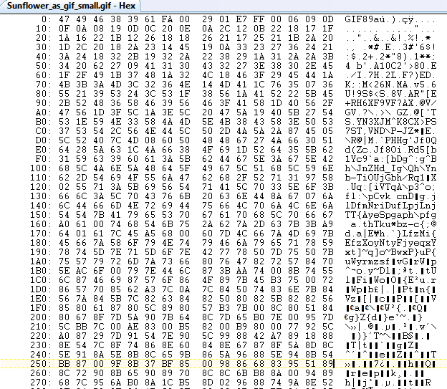
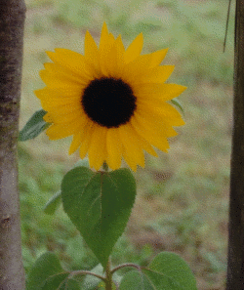
Image Files
Just numbers

Slide 5
GIF
Graphics Interchange Format
8 bits per pixel for color
256 colors
file stores color palette or table
chose from 2²⁴ colors
One of the "colors" can be labeled transparent
displayed as white and gray grid in most image editors

Slide 6
JPEG
Joint Photographic Experts Group
most common file format for digital cameras and other image cpature devices
Multiple color spaces possible
typically RGB model with 1 byte per pixel per channel
2²⁴ = 16,777,216 colors
JPEG files are typically compressed to save space
compression is lossy meaning the uncompressed version is not guaranteed to match the original
some details lost
No transparent pixels

Slide 7
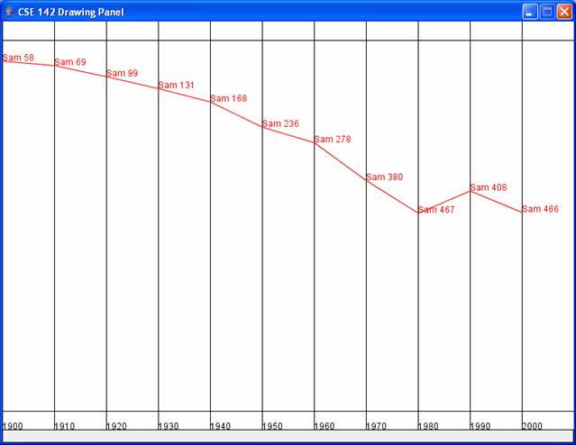
JPEG Compression "Artifacts"

Slide 8
JPEG Compression "Artifacts"

Slide 10
PNG
Portable Network Graphics
RGB color spaces
Typically 8 bits per channel plus an 8 bit alpha channel
transparent pixels possible
other resolutions possible
32 bits per pixels
uses lossless compression

Slide 11
Images in Java
Image: abstract class. super class to other image classes
VolatileImage: designed for use with hardware acceleration and video memory storage
not used in our course
BufferedImage: represents a rectangular image in memory
contains a color model and raster
workhorse for our class

Slide 12
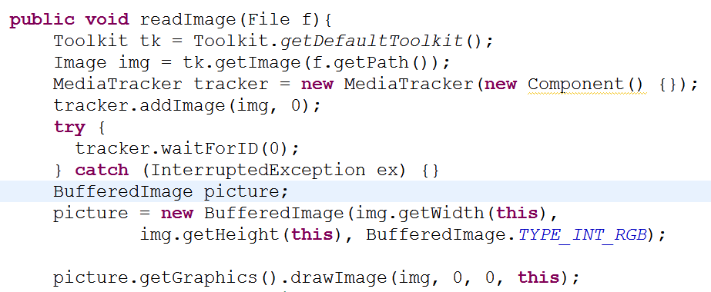
Loading Images
Old way:

Slide 13
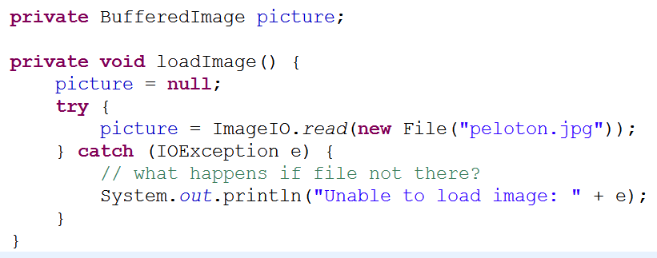
Loading Images
new way:
path to file must be known

Slide 14
Loading Images from the Web
Load from url on web:
better method would be to have String as parameter to method

Slide 15
Loading Images as Resources
If creating a stand alone application images may be included as resources
Java stand alone applications typically packaged as jar files
images store in directory

Slide 16
Displaying Images
Images are similar to other graphic primitives (shapes, areas, paths)
Multiple methods to display the images in Graphics and Graphics2D class
Any transform that has been applied to the graphics object affects the image as well
Highlight a few of them

Slide 17
drawImage methods
simplest version:
ImageObserver is an object that is notified as image is constructed, changed, or drawn
We will always send in null for observer

Slide 18
drawImage Methods
draw scaled version of image

Slide 19
drawImage Methods
draw image and supply different background color for transparent pixels (instead of what is already on the panel)

Slide 20
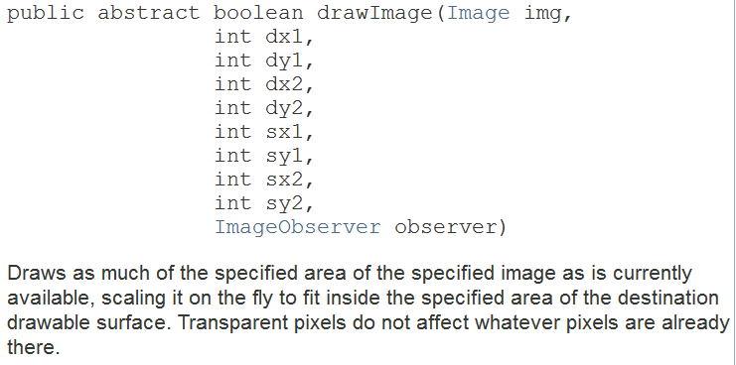
drawImage Methods
draw only part of an image
d = destination, s = source

Slide 21
drawImage Methods
draw using a BufferedImageOp
BufferedImageOp is another class that applies a filter to the image
like image editing software
multiple types of BufferedImageOps

Slide 22
Demo
Simple Image Op Program loads an image from a URL and then draws it
position only
scaled
translate and rotate graphics objects and draw image again

Slide 23
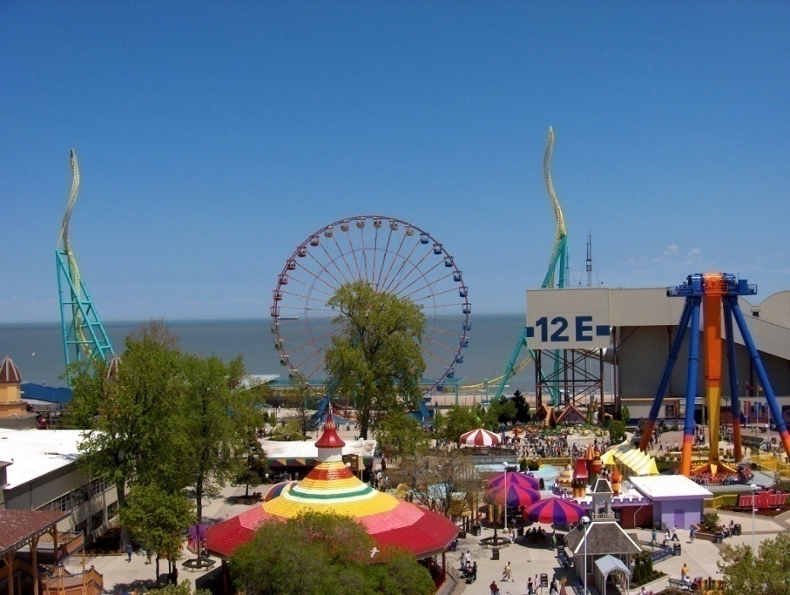
Altering Images
digital images are just a bunch of numbers that represent the color at each pixel

Slide 24
Image Processing
Image processing and filtering is the result of mathematical operations on the image data, numbers representing colors at each pixel which has a location in the image
BufferedImageOp
Java interface with several implementations already completed
We will also create our own custom filters

Slide 25
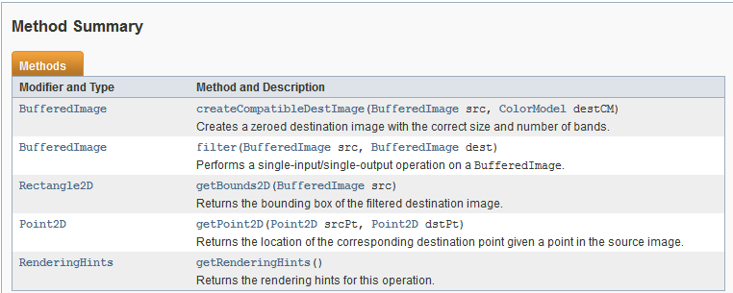
BufferedImageOp
Most important method for us is BufferedImage filter(BufferedImage src, BufferedImage dest)

Slide 26
Example Program
Examples in ImageExamples program
two menus
one for buffered image ops
one for our custom filters
Button to load new image
original image displayed on left, filtered on right
rescales if images too big for display
doesn’t scale images up (yet)
Assignment 5, you will add menu options

Slide 27
Built in Buffered Image Ops
AffineTransformOp
RescaleOp
LookupOp
ConvolveOp
ColorConvertOp

Slide 28
AffineTransformOp
A geometry filter
Doesn't change color of image
Applies an affine transform
Something of a convenience, don't have to apply transform to graphics object and undo
or maybe we want to process images before drawing

Slide 29
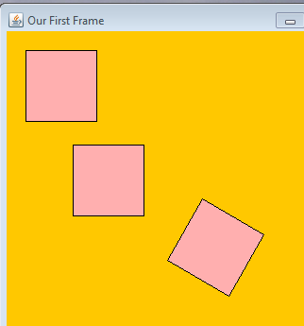
Affine Transforms
Methods to apply an affine transformation
affine transformations alter the coordinates of an object but preserve straight lines and proportions between points on a straight line

Slide 30
Example - Reverse Image
Along horizontal access
Create an AffineTransform
Translate the width of the image in the x direction (or we get negative coordinates for image)
set scale to (-1, 1)
filter image

Slide 31
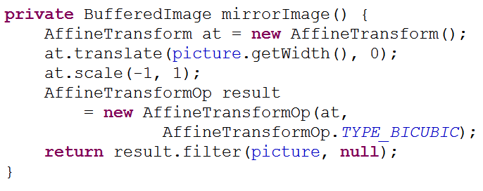
Mirror Image Code
AffineTransformOp.TYPE_BICUBIC is a constant for how to interpolate between if image size changes

Slide 32
RescaleOp
Implements BufferedImageOp interface
Specify values
either one for every channel
or scale value for each channel
and offsets
offset added to each result after multiplied by scale
final values clamped at 0 and 255 (for standard RGB)

Slide 33
RescaleOp example
scale, offset, rendering hints
example: given color (255, 255, 0)
red = 255 * -1 + 255 = 0
green = 255 * -1 + 255 = 0
blue = 0 * -1 + 255 = 255
result (0, 0, 255)
What about (0, 0, 0) ? (255, 255, 255)

Slide 34
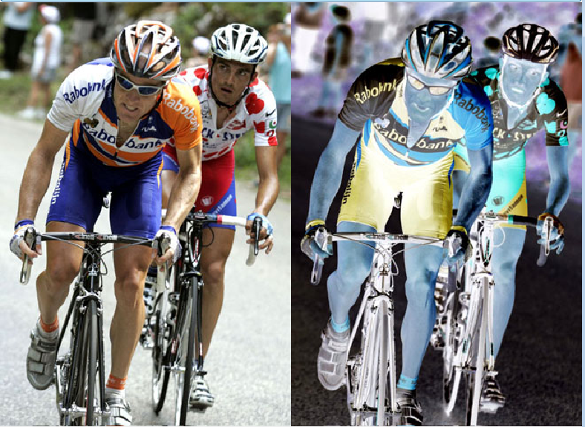
Sample RescaleOp
Invert

Slide 35
Rescale Op
What will this rescale op do?
f for float.
literals with a decimal are doubles
RescaleOp constructor expects floats. not doubles

Slide 36
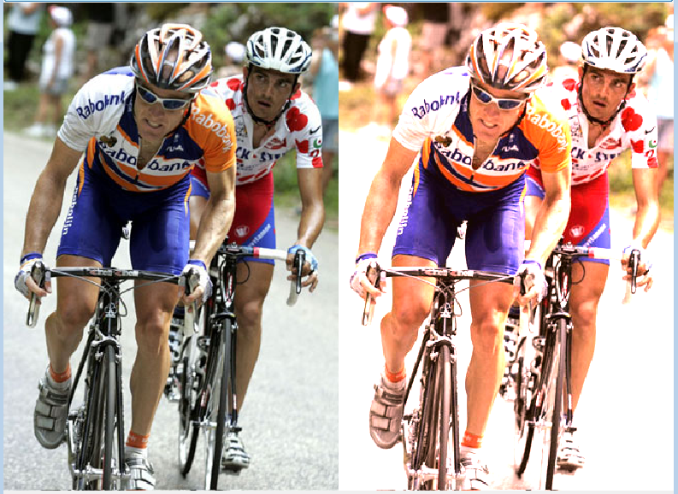
RescaleOp Brighten

Slide 37
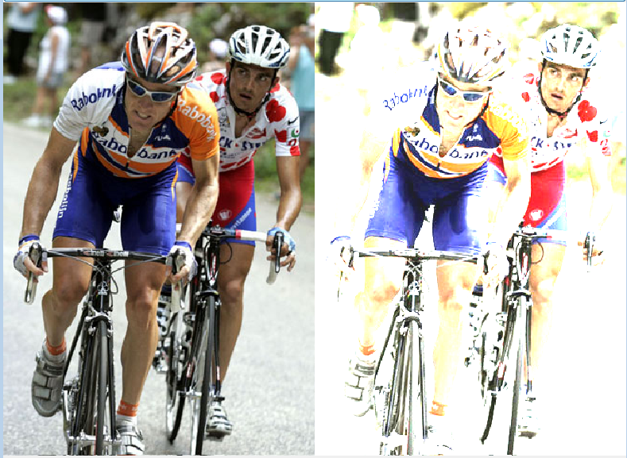
RescaleOp Washout
Scale of 3, offset of 30

Slide 38
Rescale Op GUI
Make a GUI with slides for scales and offsets
Build RescaleOp on the fly as sliders adjusted
ChangeListener and stateChanged method instead of ActionListener and actionPerformed

Slide 39
LookupOp
Color changes based on a look up table
Essentially an array
original color is input and the index
value in the table (array) is the resulting color
for RGB can be a single array that all colors refer to
or 3 arrays, one for each channel

Slide 40
Creating a LookupOp
Must first create a LookupTable
either a ByteLookupTable or a ShortLookupTable
includes an offset that is subtracted from values before indexing into array

Slide 41
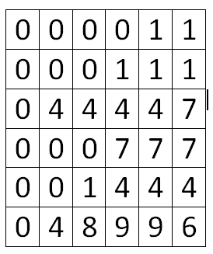
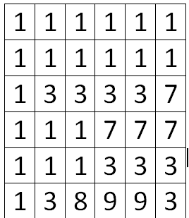
LookupOp Simple Example
Assume grayscale image with 10 shades
colors are 0 to 9
index | 0 | 1 | 2 | 3 | 4 | 5 | 6 | 7 | 8 | 9
value | 1 | 1 | 2 | 2 | 3 | 3 | 3 | 7 | 8 | 9
original image resulting image

Slide 42
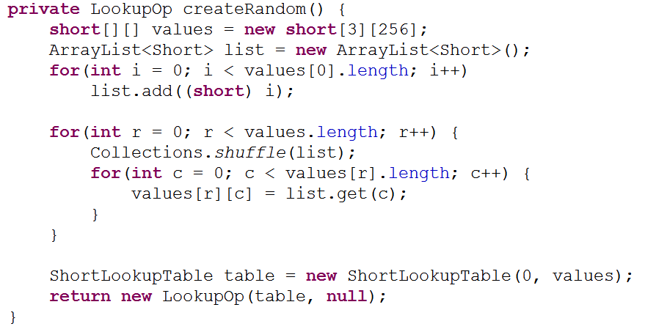
LookupOp
Randomize table

Slide 43
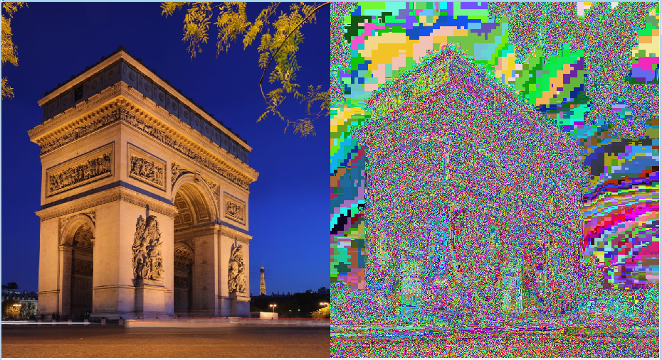
Randomize Result

Slide 44
Threshold LookupOp
For all color values less than some threshold set the intensity to 0
For all color values greater than or equal to the same threshold values set intensity to 255
for threshold 70
(140, 198, 65) -> (255, 255, 0)
surprising result (Image reduced to 8 colors)

Slide 45
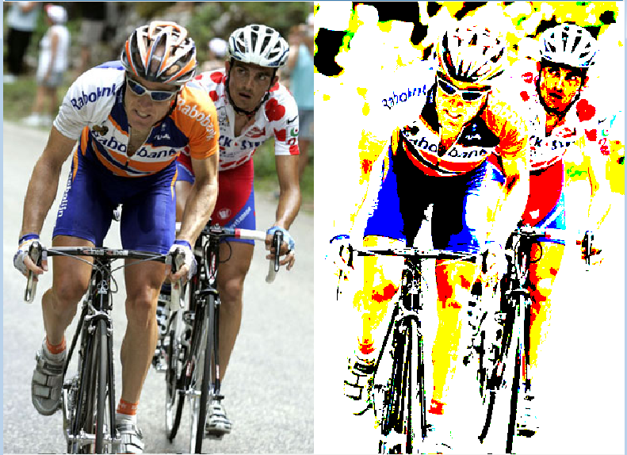
Threshold

Slide 46
Bands LookupOp
bands of intensities that are unchanged followed by bands of intensities that are reduced
Bands are input intensity raised to the 0.75 power and truncated
index | 0 | 1 | 2 | 3 | 4 | 5 | 6 | 7 | 8 | 9 | 10 | 11 | 12 | 13 | 14 | 15
value | 0 | 1 | 2 | 3 | 2 | 3 | 3 | 4 | 8 | 9 | 10 | 11 | 6 | 6 | 7 | 7

Slide 47
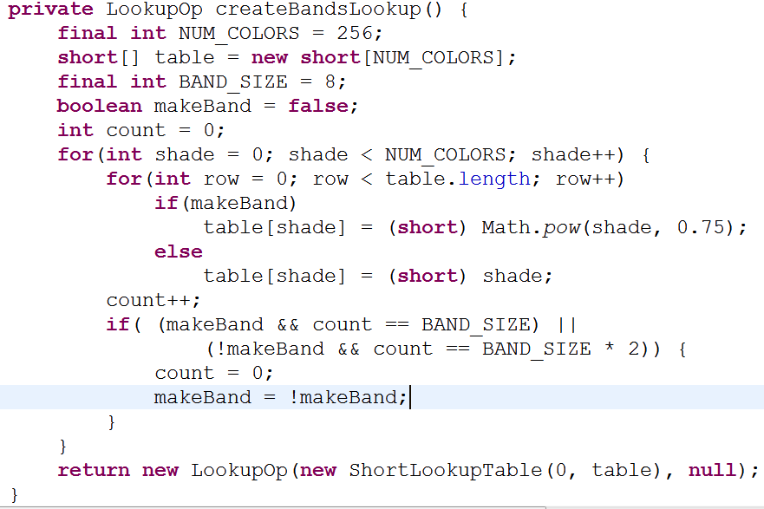
Bands Code

Slide 48
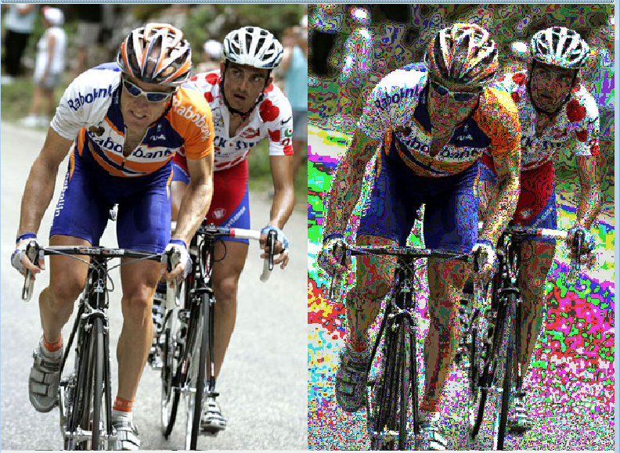
Bands Result
Band size = 8

Slide 49
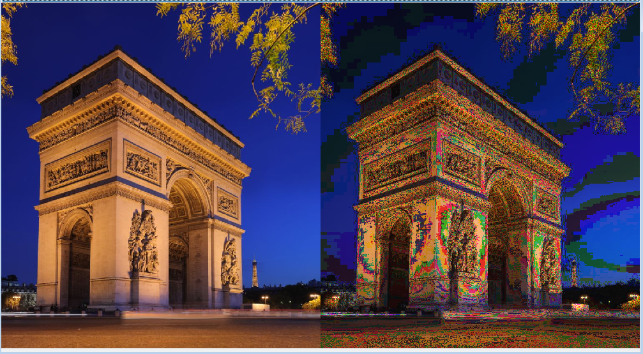
Bands Result

Slide 50
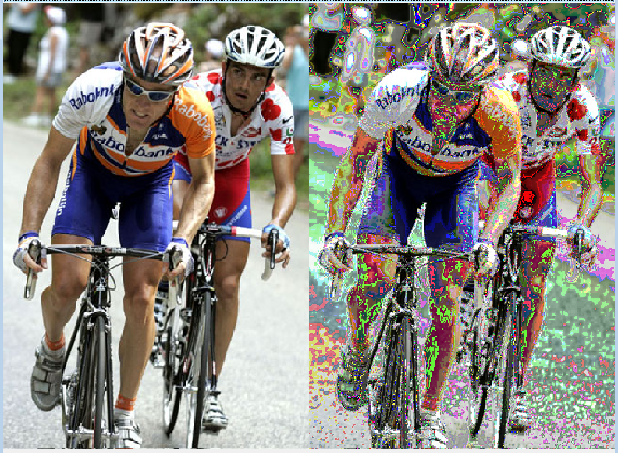
Bands Changed
Band Size = 16, exponent = 1.25

Slide 51
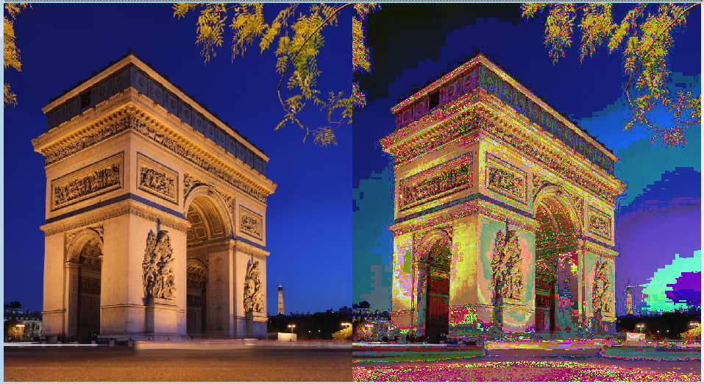
Bands Changed

Slide 52
ConvolveOp
A neighborhood filter
The color of a pixel depends on the color of the pixels around it
define a matrix called a kernel
usually a square matrix with an odd number of rows (and thus columns)
color of resulting pixel obtained by laying kernel over original matrix and multiplying kernel values by original colors

Slide 53
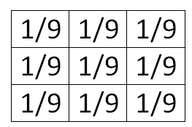
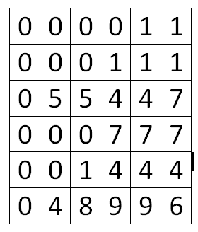
Kernel and Convolve Example
kernel
original image
pixel in result at location (1,1) = 1/9 * 0 + 1/9 * 0 + 1/9 * 0 1/9 * 0 + 1/9 * 0 + 1/9 * 0
1/9 * 0 + 1/9 * 5 + 1/9 * 5
= 10 / 9 = 1

Slide 54
Kernel and Convolve Example
What does the kernel on the previous slide do?
if components of kernel sum to less than 1 image will be darkened
if components of kernel sum to more than 1 image will be brightened

Slide 55
Example Code
kernel actually a 1d array
values in kernelValues in row major order
rows, columns

Slide 56
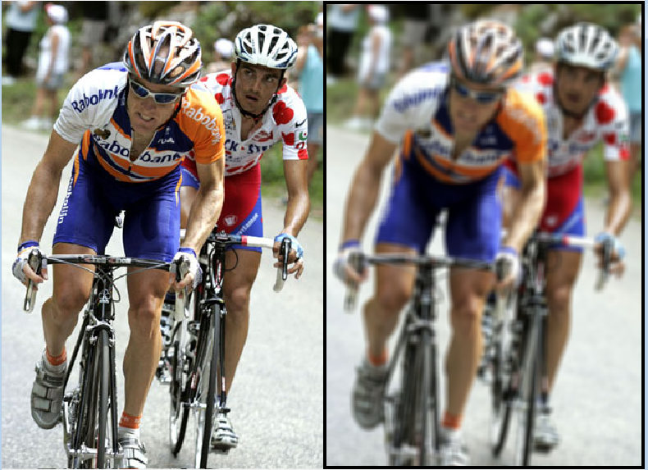
Result
Border due to ConvolveOp not handling edge cells gracefully

Slide 57
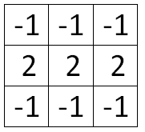
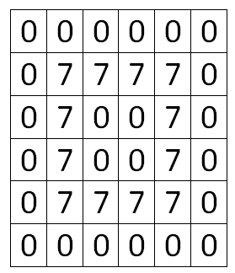
Another Convolve Op
kernel
original image
Calculate Resulting image. Border cells set to 0, results clamped between 0 an 9

Slide 58
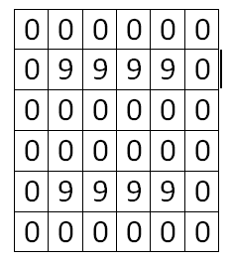
Result
What does this filter do?
Will this brighten or darken an image?

Slide 59
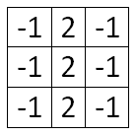
Edge Detection
Vertical Lines
to see lines more cleanly:
-apply kernel
-set all pixels above some threshold to white

Slide 60
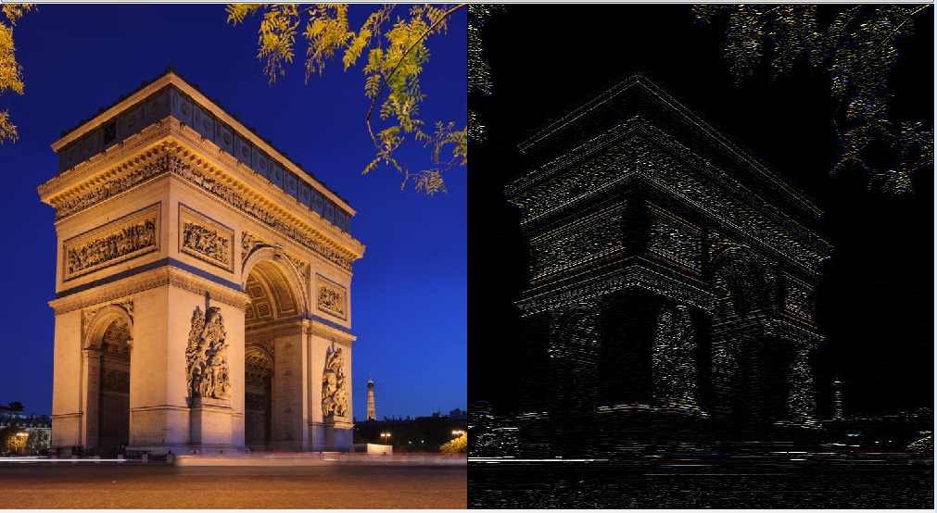
Horizontal Line

Slide 61
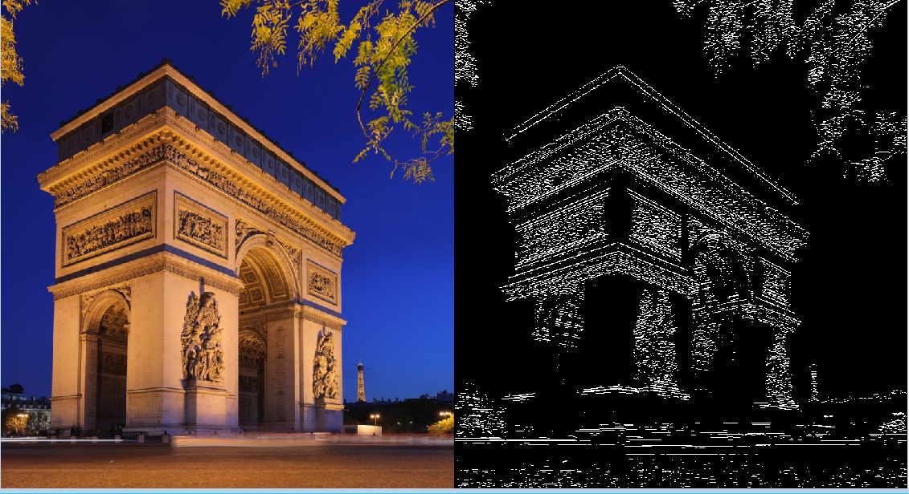
Horizontal Line
Threshold at 125 total (sum of rgb after convolve op

Slide 62
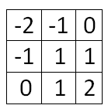
Convolve Op
Emboss
Will this brighten or darken the image?

Slide 63
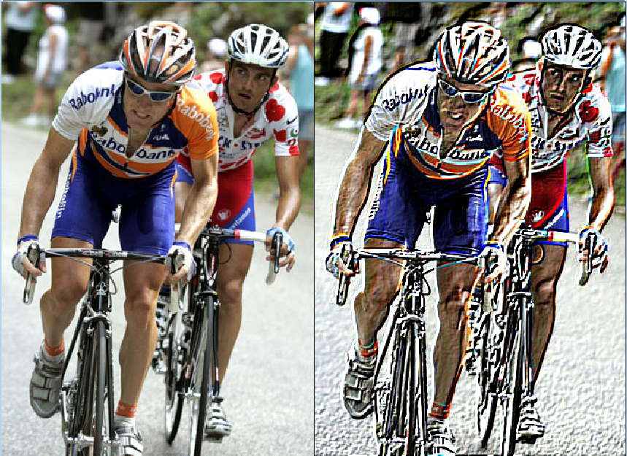
Emboss

Slide 64
Making Our Own Filters
Create our own abstract class to create filters
Filthy Rich Clients shows how to create a new class that implements BufferedImageOp
For assignment use our own FilterOp class

Slide 65
FilterOp
abstract class
some methods defined, some abstract
abstract method declared, but no implementation
class that extends FilterOp must implement the abstract methods or be abstract itself

Slide 66
FilterOp
methods:
public BufferedImage filter(BufferedImage src)
// pull out part of color
public static int getRed(int pixel)
public static int getGreen(int pixel)
public static int getBlue(int pixel)
// get all components
public static int[] getRGB(int pixel)
public static int makePixel(int red, int green, int blue)

Slide 67
FilterOp
public abstract int filterOp(int pixel, BufferedImage src);
abstract method
no body or implementation
class that extends FilterOp must implement the abstract methods or be abstract itself

Slide 68
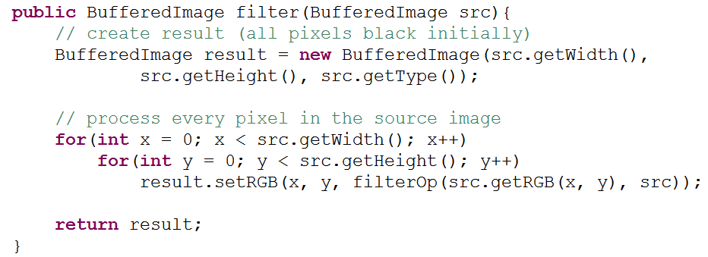
FilterOp
Some filters will required overriding the filter method in the FilterOp class

Slide 69
FilterOp Example
Grayscale
naïve:

Slide 70
Grayscale
Naïve approach: average together red, green, and blue to get a shade of gray
problem: our eye is more sensitive to green and red than blue
(0,255,0) should be "brighter" than (0,0,255)
Sensitivity
Wavelength (nm)

Slide 71
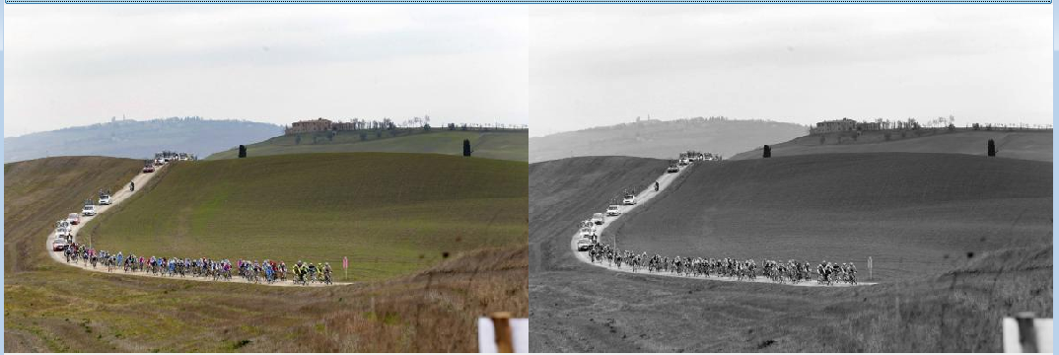
Grayscale
Typical Grayscale conversion
gray = Red * .3 + Green * .59 + Blue * .11
color = (gray, gray, gray)

Slide 72
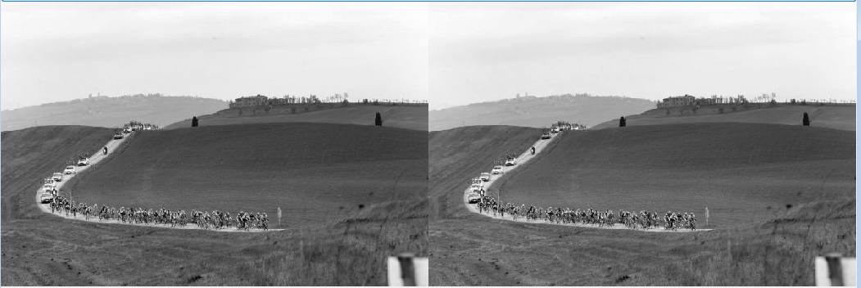
Grayscale Side by Side

Slide 73
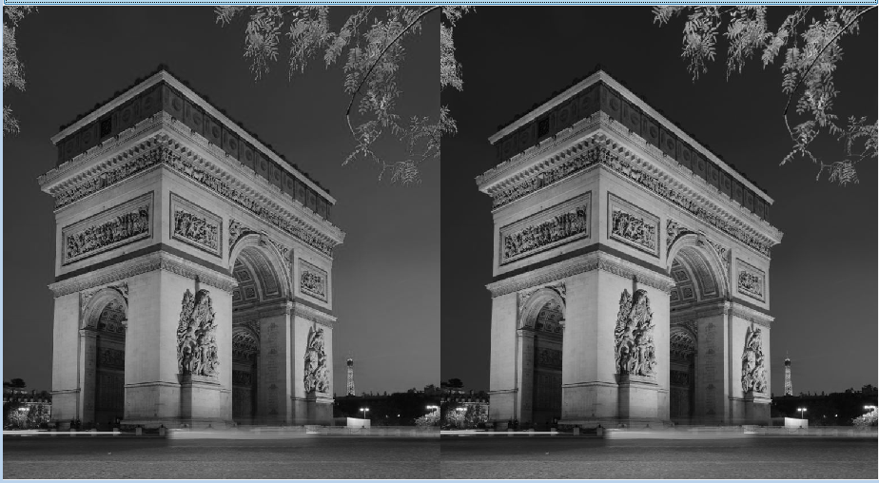
Grayscale Side by Side

Slide 74
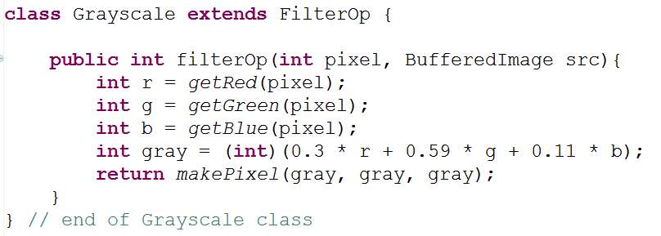
Grayscale Class
What BufferedImageOp could we have used instead?

Slide 75
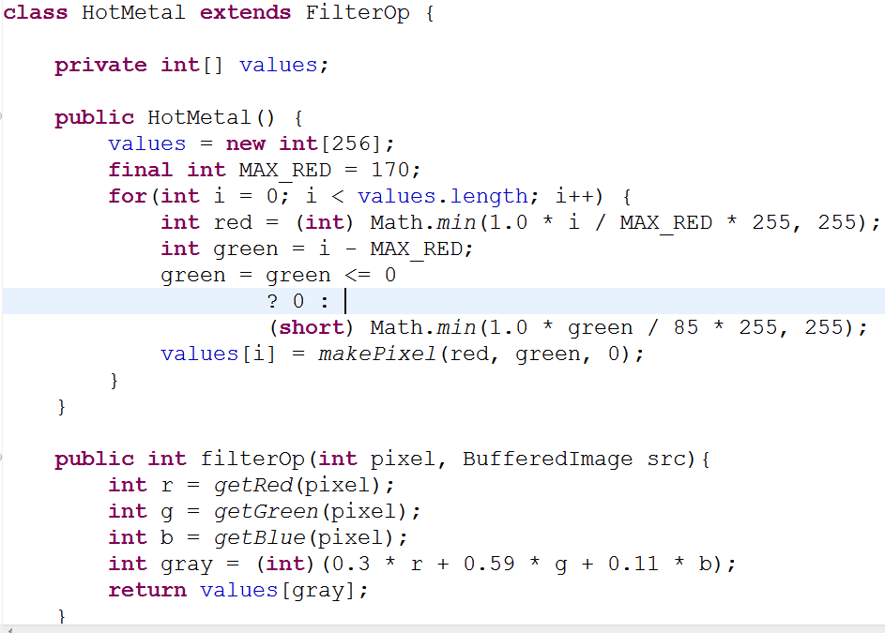
HotMetal FilterOp
Converts color at pixel to grayscale then uses a lookup table

Slide 76
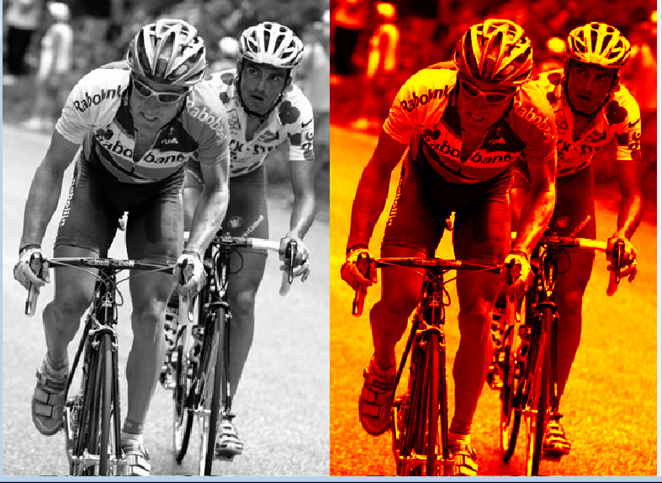
HotMetal

