Slide 1
CS324e - Elements of Graphics and Visualization
Intro to Animation

Slide 2
Animation
definition: time-based alteration of graphical objects through different states, locations, sizes, and orientations
FRC chapter 12
alteration: change the way we are drawing objects
all the stuff from graphics basics
time-based: define how objects change over time and render objects based on this as time goes by

Slide 3
Make the Ship Move

Slide 4
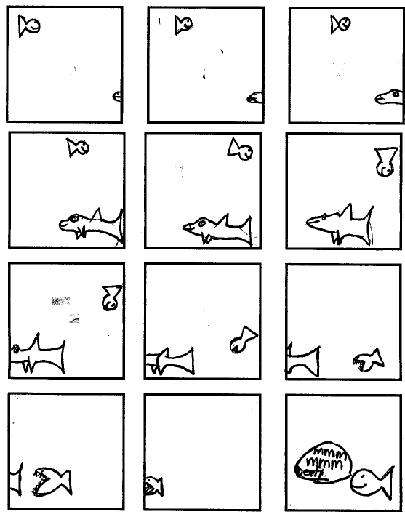
Frame
Frame: one still drawing
illusion of motion achieved by drawing multiple frames with slight differences in how graphical object is rendered
a series of still drawings shown quickly
like a flip book

Slide 5
Time-Based vs. Frame-Based
We will do time based animation
amount of movement or alteration based on how much time has passed
In framed based animation the amount of movement or alteration is defined per frame (instead of per unit time)
Frame rate: number of frames drawn per unit time, usually per second
Frame based relies on strictly controlling the frame rate

Slide 6
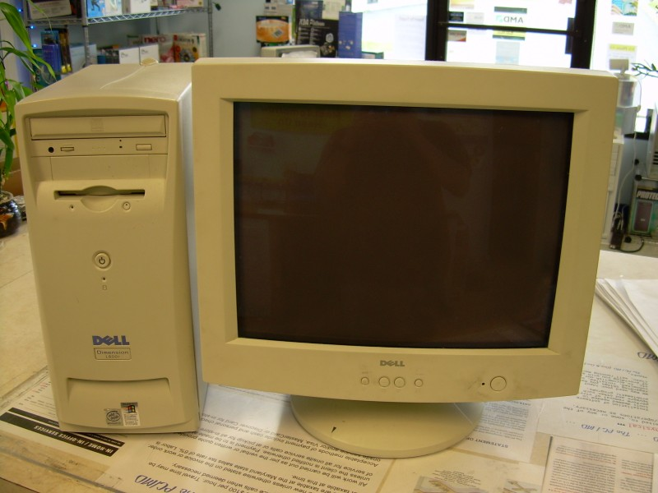
Controlling Frame Rate
Difficult based on
speed of system (which varies between systems your program will run on)
complexity of what is being rendered

Slide 7
Series of Attempts at Animation
Attempt 1:
What is result when run?
Why?

Slide 8
Problems
Teleportation != Animation
Too fast
Swing Buffering
Motion not time based

Slide 9
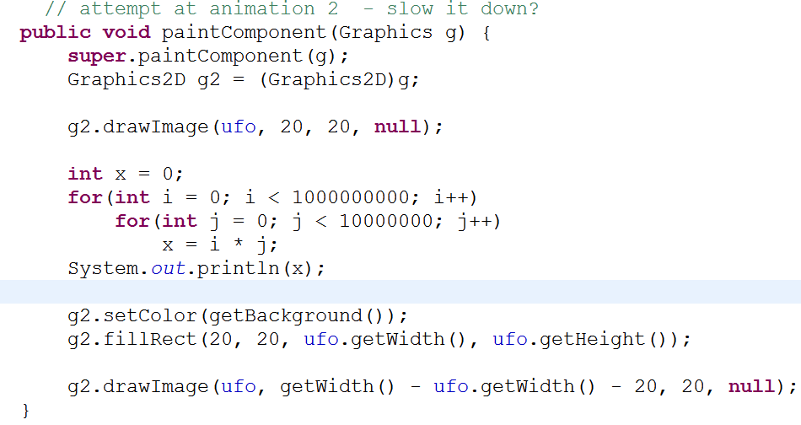
Second Attempt
What is wrong with this attempt?

Slide 10
Third Attempt
Remember, swing uses a back buffer
All the drawing done to the back buffer (essentially a buffered image) and when it is done the result is displayed
All drawing from paintComponent appears at once
recall the random art assignment
didn't see a few pixels at a time did we?

Slide 11
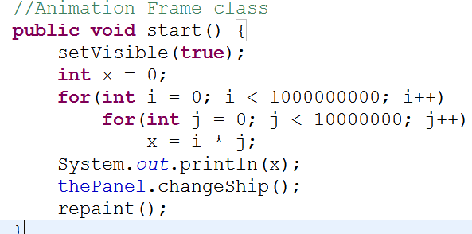
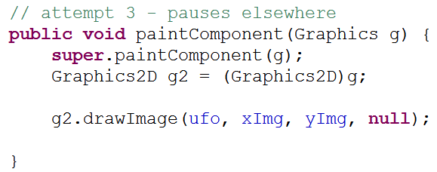
Third Attempt

Slide 12
Teleportation != Animation
Must change the position of the ship a little bit at a time
Change the x position of the ship a little bit at a time
Eventually alter y as well

Slide 13
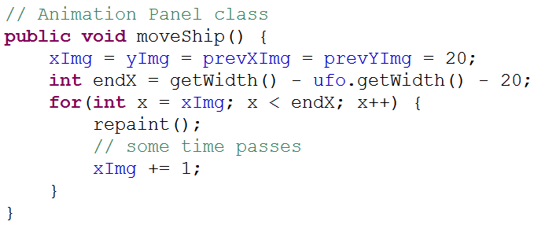
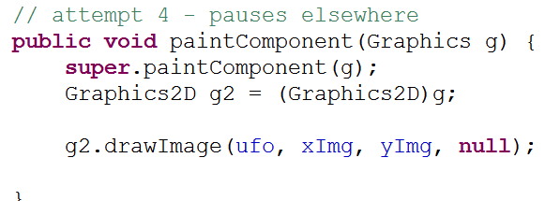
Fourth Attempt
What happens?

Slide 14
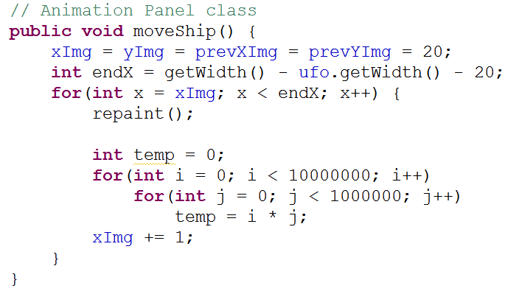
Too Fast
Need to allow time to pass between calls to repaint
Kludge:

Slide 15
Movement Achieved
The ship appears to move, but the approach couldn't be worse
Must not burn cycles to allow the passage of time
run on a different machine?
Also, motion is frame based not time based
moving one pixel at a time

Slide 16
Time Based Motion
define a speed for the object / motion and update x (and y) based on how much time has passed
x = x0 + t * (x1 - x0)
x current position of ship
x0 start position of ship
x1 ending value of ship
t = fraction of time elapsed, from 0 to 1

Slide 17
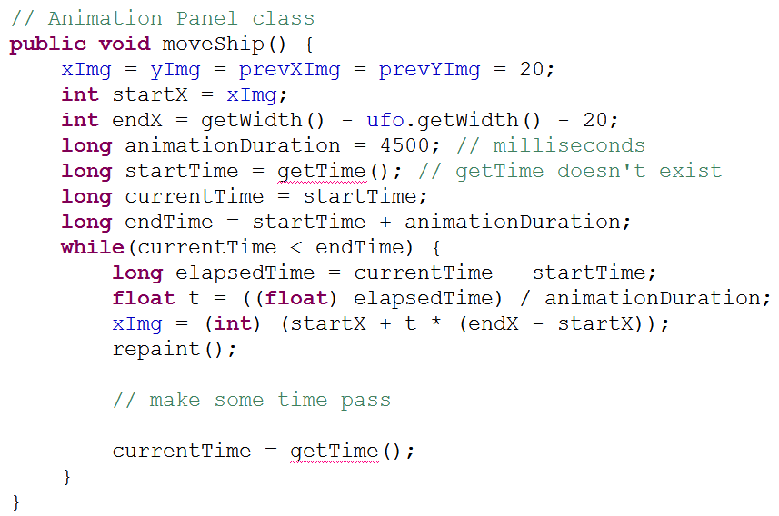
Time Based Motion

Slide 18
What's The Time
Two ways of getting system time in Java
the time the computer thinks it is
System.currentTimeMillis()
System.nanoTime()

Slide 19
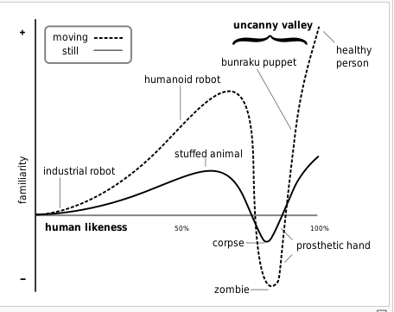
Aside - From Last Time
The uncanny valley
Masahiro Mori

Slide 20
System.currentTimeMillis()
the number of milliseconds (thousandths of a second) that have passed since January 1, 1970
arbitrary date and time know as the Unix Epoch
useful for determining how much time has passed between events in the program
measurements often limited to 10s of milliseconds

Slide 21
System.nanoTime()
based on an arbitrary point in time
don't assume Unix Epoch
may even be in future
only used for elapsed time
smaller granularity
billionths of a second
better resolution than System.currentTimeMillis()

Slide 22
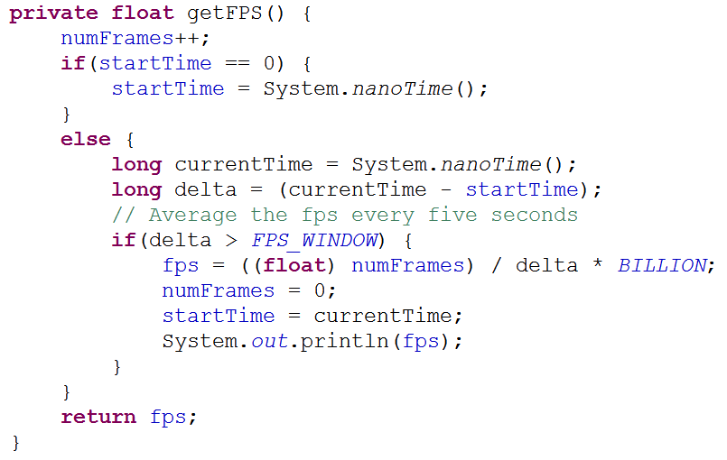
Measuring Frame Rate

Slide 23
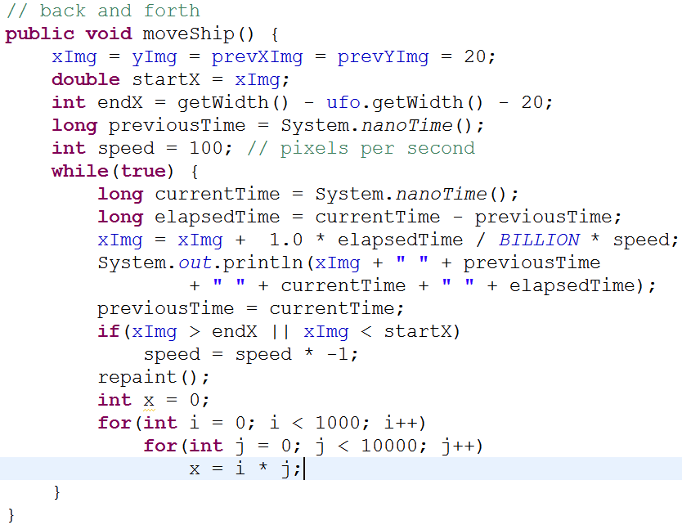
Move Ship Back and Forth
x coordinate (xImg) changed to double

Slide 24
Pausing
The delay loop is a horrible kludge
First option: pause the thread of execution using Thread.sleep() method
Thread making call is paused by system
Doesn't do any work, but doesn't burn CPU cycles either
argument is milliseconds to sleep

Slide 25
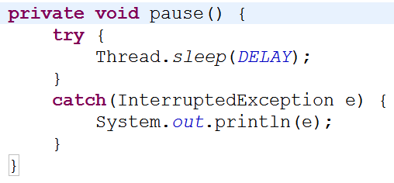
Thread.sleep(int millis)
call pause method from moveShip
DELAY set to 30 milliseconds
Compare two versions of pausing

Slide 26
Problems With Sleeping
Thread.sleep() causes the whole thread (program) to stop
What if we have a lot of computations to do?
Imagine the random art program
what if we wanted to "animate" the drawing of the art by showing a few hundred pixels at a time?
Does Thread.sleep help?

Slide 27
Timers
To get repeated notifications that some time has passed without putting the whole thread to sleep
"Timers allow the program to perform repetitive operations at regular time intervals in a way that allows other work to happen asynchronously."
FRC

Slide 28
Timer Classes
java.util.Timer
general purpose timer class
Creates a separate thread of execution (your program forks)
schedule TimerTasks with a run() method that is called by the Timer
fixed delay times (adjusts on fly) or fixed rate times (doesn't adjust

Slide 29
javax.swing.Timer
Create a time and it will make callbacks
much like our action listeners for buttons and mouse listeners
Create a time and then create listeners for when the timer goes off
javax.swing.Timer specifically for Swing applications / GUIs
the callbacks are to the Swing Event Dispatch Thread

Slide 30
Fixed Delay Timing
Timer will adjust delay times to meet desired wakeup call interval
Events are coalesced:
if it gets to far behind some timing events are simply discarded
repaint does the same thing

Slide 31
Comparison of Timers
SwingTimerDemo creates two swing timers
one using fixed delay (default)
one using fixed rate (events not coalesced)

Slide 32
Swing Fixed Delay
results:
Fixed Delay Times
Elapsed time = 134
Elapsed time = 270
Elapsed time = 100
Elapsed time = 100
Elapsed time = 100
Elapsed time = 100
Elapsed time = 100
Elapsed time = 100
Elapsed time = 100
Elapsed time = 100
Elapsed time = 100

Slide 33
Swing Fixed Rate
result
Fixed Rate Times
Elapsed time = 0
Elapsed time = 100
Elapsed time = 30
Elapsed time = 200
Elapsed time = 30
Elapsed time = 30
Elapsed time = 30
Elapsed time = 30
Elapsed time = 50
Elapsed time = 30

Slide 34
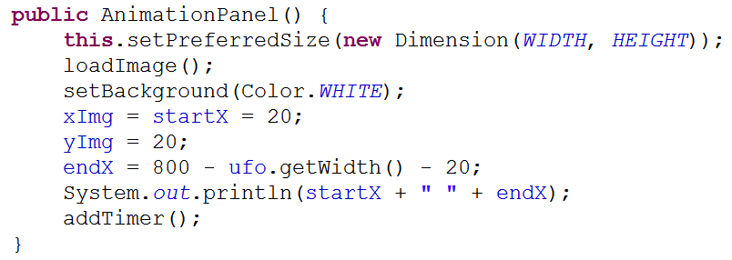
Using Timer in UFO Program
Loop no longer in moveShip
constructor for AnimationPanel

Slide 35
AnimationPanel With Timer
Create timer
ActionListener is an annoynomoyus inner class that calls update method on the panel

Slide 36
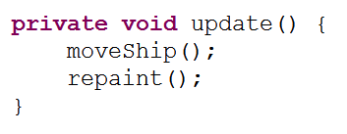
AnimationPanel With Timer
start method to begin animation
update method called when timer goes off

Slide 37
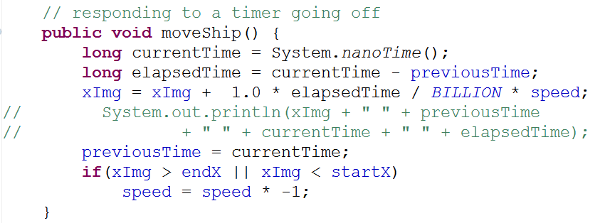
AnimationPanel With Timer
moveShip
no loop
must make many variables instance variables - (what happens if speed local?)

Slide 38
What's Next?
Clearly the logic for the ship does not belong in the AnimationPanel class
Create a Ship class that contains logic for moving ship
Move ship in something other than a straight line
animate ship in another way (shrink, fade out)

