Slide 1
CS324e - Elements of Graphics and Visualization
Timing Framework

Slide 2
Animating Swing Based Programs
From FRC
goal: provide framework and library to allow animation of components in a GUI
Set of utility classes that contain the code common to handling timing issues for animation
more functionality than the javax.swing.timer class

Slide 3
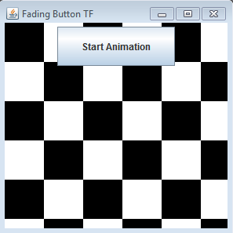
Example - Fading Button
When button clicked it fades out and then back in
fading cycle repeats until the button is pressed again

Slide 4
Fading Button Classes
JFrame to hold panel and button
checkerboard is a JPanel
Button is a FadingButtonTF
class extends the JButton class
implements ActionListener (instead of using an anonymous inner class) and TimingTarget interfaces

Slide 5
FRC Timing Framework
Handle common tasks such as determining what fraction of the animation has been completed
Provide a simple API (Application Programming Interface)
a way of using existing code in a simple way
We have been using the Java API

Slide 6
Core Concepts of FRC Timing Framework
handles timing, but alteration left to the programmer
Animator
class that contains most of the timing functionality
callbacks (listeners)
similar to timer callbacks but with more types of callbacks and more information

Slide 7
Core Concepts
Duration: length of time animation runs, or can be set to indefinite (a clock for a game)
Repetition: timer can run once and stop or repeat over and over
Resolution: frame rate or frames per second
how often does timer send out notifications
default is 20 fps

Slide 8
Core Concepts
Starting and Ending behaviors:
may add delay to start or begin in the middle of a repetition
Interpolation
default is linear interpolation
fractions based on elapsed time / total time
possible to have other kinds of interpolation
start and end slowly (ease in and out)

Slide 9
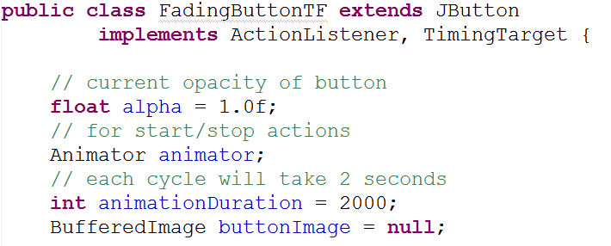
Example Program
Class declaration and instance variables

Slide 10
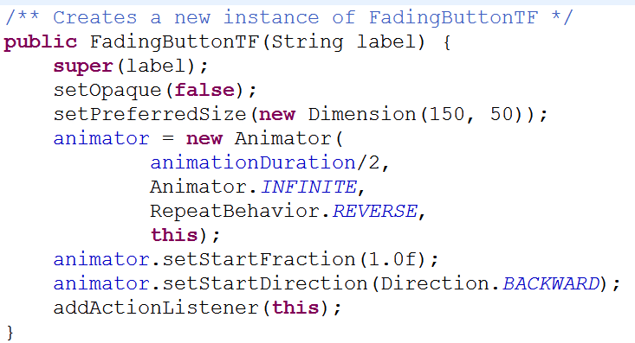
Example Program
Constructor with creation of Animator

Slide 11
Animator Properties
duration in milliseconds
can set to Animator.INFINITE to run continuously
repeatCount
number of times to run, can also be INFINITE
repeatBehavior: LOOP or REVERSE
target: listener for timer notifications

Slide 12
Loop vs. Reverse
LOOP
fraction from
Animator
time
REVERSE
fraction from
Animator
time

Slide 13
Animator Properties
REVERSE
fraction from
Animator
time

Slide 14
Controlling the Animator
methods for Animator Object
void start()
callbacks to start and timingEvent methods
void stop()
callback to end method
void cancel()
stops Animator, but no callbacks
void pause()
void resume()
boolean isRunning()

Slide 15
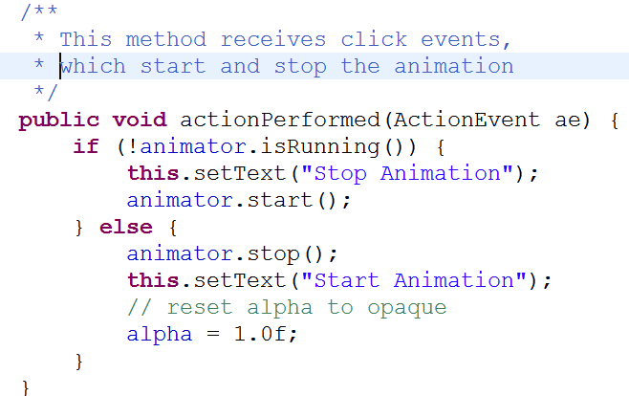
Fading Button Demo
Respond to button clicks
recall the FadingButtonTF class implements the ActionListener interface

Slide 16
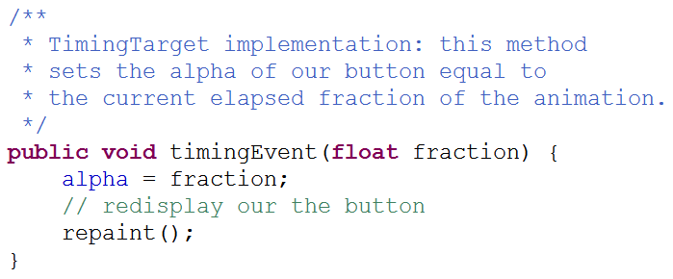
Responding to Notifications
To respond to notifications from the animator create a class that implements the timing

Slide 17
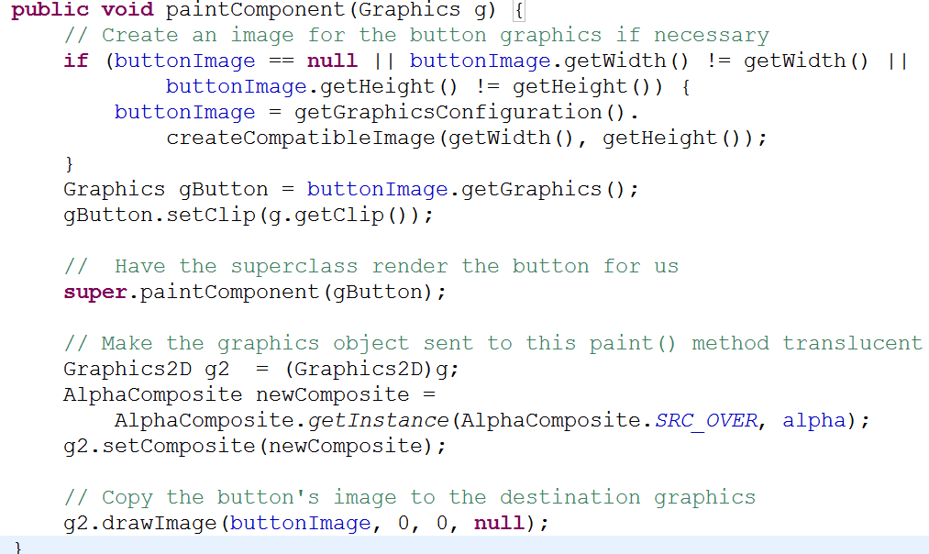
Alteration of Button

Slide 18
Non Linear Interpolation
Animator objects have acceleration and deceleration properties
by default these are not used
can set so animation eases in and / or out
instead of fraction of animation being linear with respect to time elapsed

Slide 19
Set Acceleration and Deceleration
represented as fraction of animation to accelerate to average speed and decelerate to stop
sum of fractions must be <= 1

Slide 20
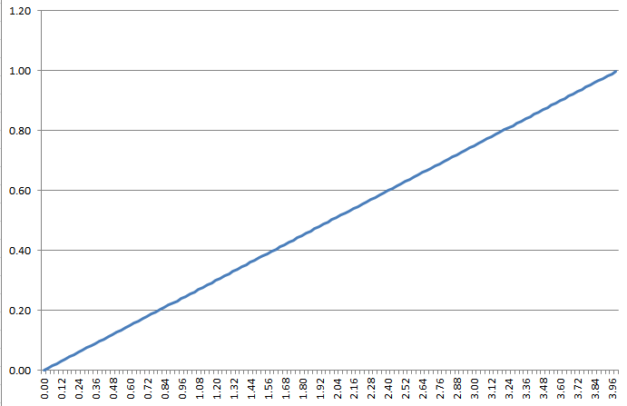
Linear
Horizontal axis is time
Vertical axis is fraction

Slide 21
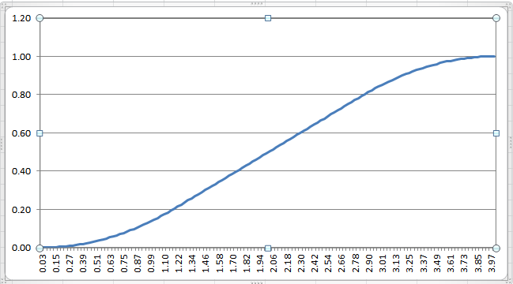
Acceleration and Deceleration
.3 of duration for acceleration
.3 of duration for Deceleration
note, at 1 second (1/4 of time) fraction is still below 0.2

Slide 22
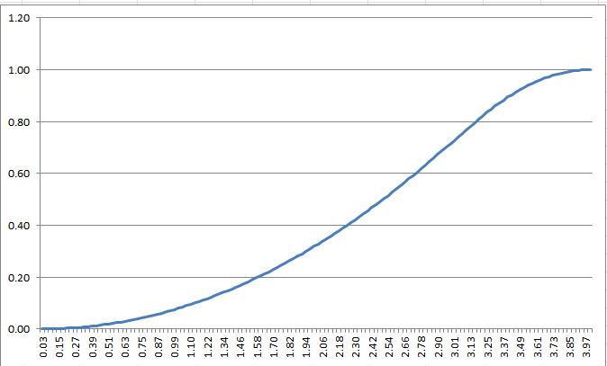
Acceleration and Deceleration
.7 of duration for acceleration
.2 of duration for Deceleration

Slide 23
Triggers
Part of FRC Timing Framework
Start animation based on a specified event
for example:
user presses a button
user clicks on a door in a game
car in a game goes off the track in a game

Slide 24
Triggers
Respond to
GUI events
time events
custom events created by the programmer
Use triggers by:
create trigger including information about the Animator the trigger will run
add listeners to respond to trigger when it goes off

Slide 25
Triggers in Action
Firing: when trigger event occurs the Animator objects start
Disarming: canceling a trigger
Auto-reverse: trigger has ability to run Animator forwards and then backwards
like the button fading in and out

Slide 26
Trigger Classes
Trigger: base case for more complicated triggers
TriggerEvent: part of framework to make it easy to add different kinds of Triggers
ActionTrigger: simplest kind of Trigger
responds to java.awt.event.ActionEvent (like button clicks)

Slide 27
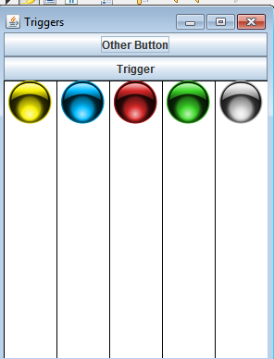
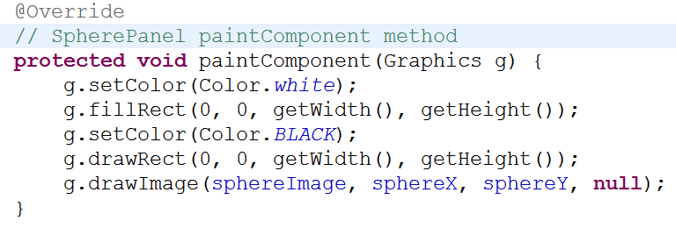
Trigger Demo
Spheres fall and bounce based on various triggers
The spheres are in their own panels, placed side by side

Slide 28
Trigger Types
Program demos 5 different kinds of triggers
Yellow Sphere - ActionTrigger
when the Trigger button is clicked the yellow ball's animation runs
restarts if button clicked again before animation complete
action is the SpherePanel for the Yellow sphere

Slide 29
Animator for SpherePanel
The FRC timing framework includes a class to automate alteration aspect of animations
PropertySetter
From SpherePanel
Creates animator

Slide 30
More on PropertySetter
Note the PropertySetter.createAnimator method
duration, object that has property animated, name of property (must have set… method), values property takes (y coordinate -> top, bottom, top)

Slide 31
Focus Trigger
Blue Sphere - A FocusTrigger
When the Trigger Button gains the focus (not pressed) the Blue Sphere bounces
demo: use tab to change focus between Trigger button and Other Button

Slide 32
MouseTriggers
Two MouseTriggers in the demo
Red Sphere - armed trigger
When the mouse is pressed on the button the red sphere bounces
press and hold button
change from triggerButton to action panel

Slide 33
MouseTrigger
Green Sphere - MouseTrigger
Activated when the mouse enters the Trigger button region
does not need to be pressed

Slide 34
Timing Trigger
Gray Sphere - TimingTrigger
When the action trigger (yellow sphere) stops then the timing trigger for the silver sphere starts
useful for chaining animations
Add triggers so when gray sphere stops, red, green, and blue bounce

