Slide 1
Wa-Tor World
Assignment 7 - CS324e

Slide 2
Overview
Visualization - Animal Populations
Description of Wa-Tor World
Demos

Slide 3
Predator – Prey Equations
a.k.a. Lotka–Volterra equations
x = number of animals that are prey
x = number of predatory animals
$α$ = prey population increase (birth rate - death rate)
$β$ = rate the predators eat the prey
$γ=$ predator mortality rate
$δ$ = reproduction rate of predators per 1 prey eaten

Slide 4
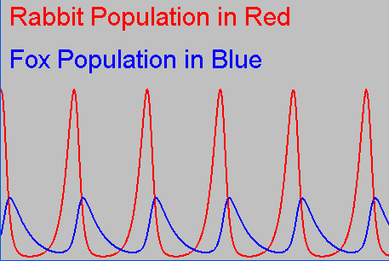
Lotka–Volterra equations
Graphed over time

Slide 5
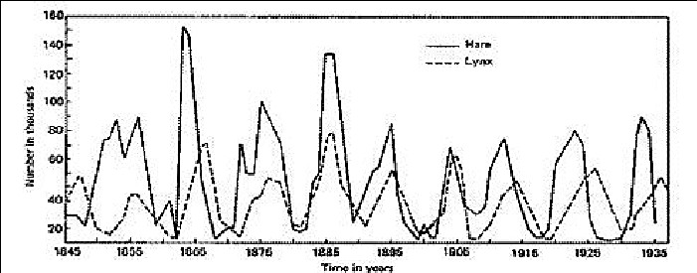
Hudson Bay Company - Pelts
Solid line - Rabbits, dashed line - Lynxes

Slide 6
Wa-tor World Population

Slide 7
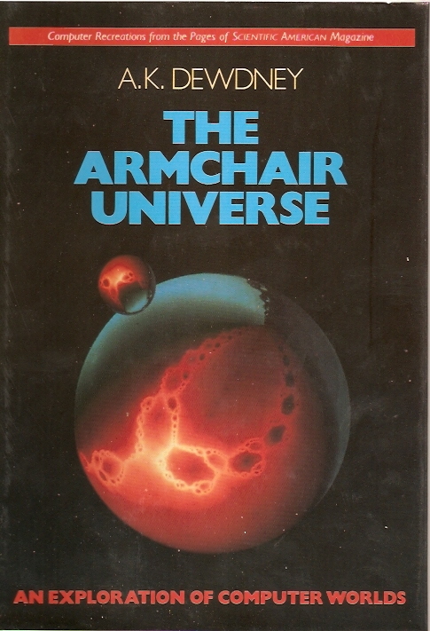
Description of Wa-Tor World
A.K. Dewdney
Computer Recreations column in Scientific America
Sharks and Fish Wage an Ecological War on the Toroidal Planet Wa-Tor

Slide 8
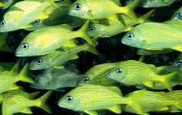
The World and its Inhabitants
Wa-Tor

Slide 9
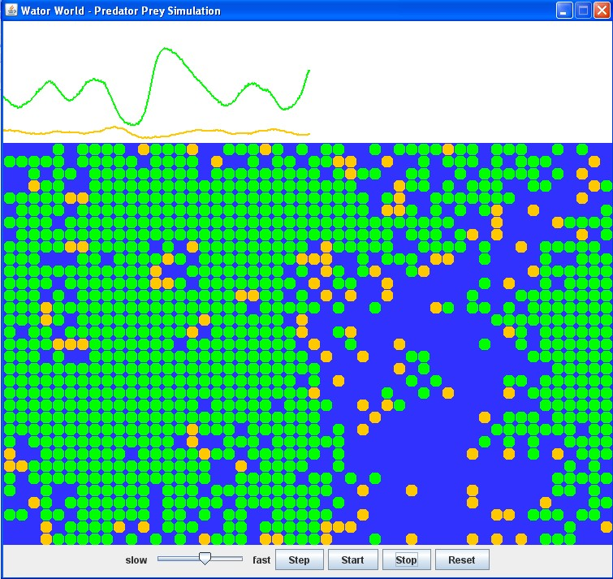
The Assignment
Given Simulator
Must implement GUI and controls
Population Graphs
The World
Controls

Slide 10
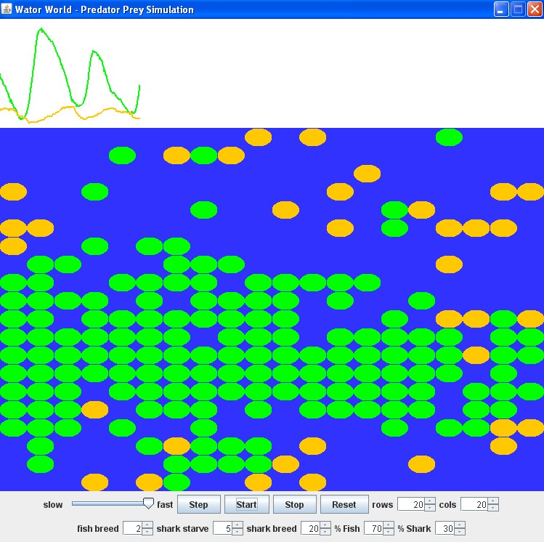
Demos
Basic Version
Advanced Controls
Simple Demo in CS324E/A4 folder

Slide 11
Large Worlds

