Slide 1
CS324e - Elements of Graphics and Visualization
Java 3D Intro

Slide 2
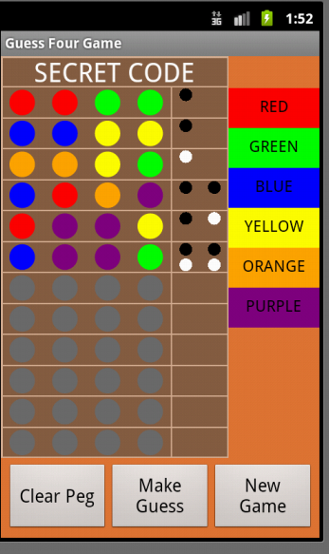
Java 2D
Java2D and Swing part of standard Java
Various attempts to make two d graphics appear more "lifelike" and 3 dimensional

Slide 3
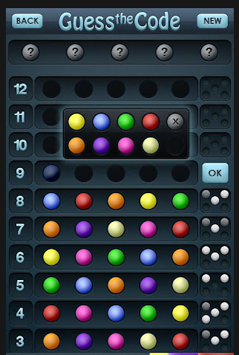
Gradients
Gradient Paints can add depth to 2d primitives
Notice the gradient paint on the pegs and shading on numbers

Slide 4
2D Graphics

Slide 5
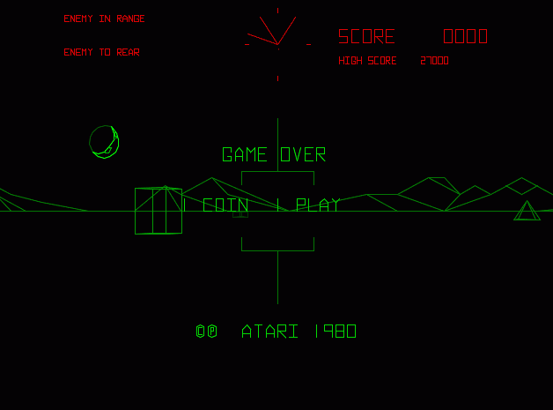
Wireframe Vector Graphics
BattleZone - 1980

Slide 6
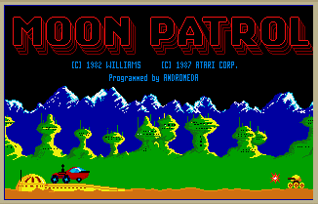
Parallax Scrolling
multiple backgrounds
backgrounds closer to view move at a faster speed than backgrounds farther away

Slide 7

Parallax Scrolling Example

Slide 8
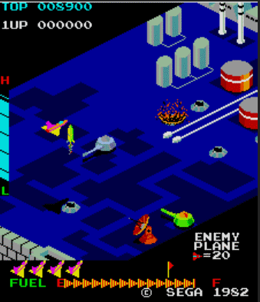
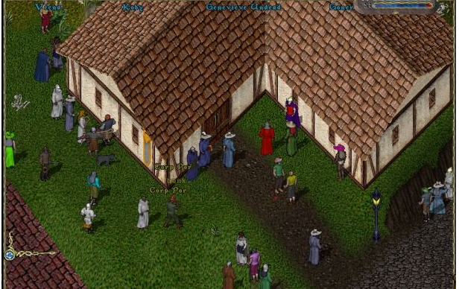
2.5D
Isometric Graphics
"rotate" object to reveal details on the side
Zaxxon
Ultima Online

Slide 9
3D Graphics
Create 3D model
  a small scene or a large world
Model rendered into a 2D projection
model includes
  objects (boxes, cones, cylinders, sphere, user defined models)
  lighting
  cameras
  textures
  dynamic behaviors

Slide 10
Java3D
Not standard Java
One of multiple non standard libraries to create 3d graphics in Java
  others include
  JOGL, jMonkey Engine, Ardor3D, JReality, LWJGL
Java3D websites:
http://java3d.java.net/
http://www.oracle.com/technetwork/java/javase/tech/index-jsp-138252.html

Slide 11
Java 3D Coordinate System
x and y as expected (positive y is up, not down as in 2d graphics
z axis - positive z is out of screen, negative z is into screen
y⁺
z⁻
z⁺
x⁺

Slide 12
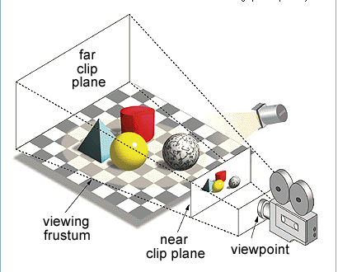
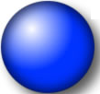
Visual Portion
Portion of 3D Scene that is rendered is contained in a frustum (pro: frəstəm)
  a pyramid or cone with its top cut off
objects in
scene, but not
visible

Slide 13
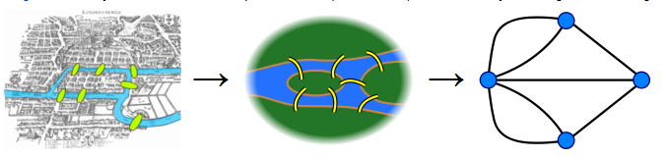
Scene Graphs
The elements of a Java3D scene are stored in a data structure known as a scene graph
Graph consist of nodes (aka vertices) that contain a piece of data and are connected to other nodes by links (aka edges)

Slide 14
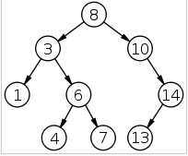

Trees - A Kind of Graph
Trees and Binary Trees are special instances of Graphs
root is node that contains 8
leaves on the
bottom

Slide 15
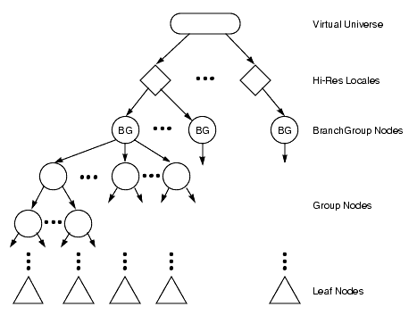
Java3D Scene Graphs
(shapes, lights)

Slide 16
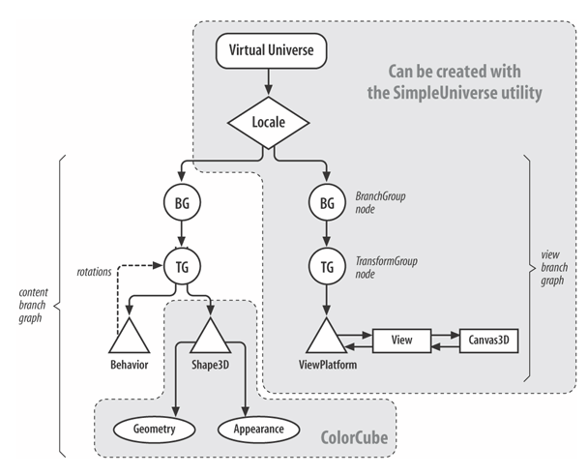
Java3D Scene Graphs

Slide 17
HelloUniverse
Program to test installation of Java3D libraries
Simple Scene Graph
http://www.java2s.com/Code/Java/3D/HelloUniverse1.htm
Simple Universe
Branch Group
Transform Group
Colored
Cube
Rotator

Slide 18
HelloUniverse Code
Root of Scene Graph is SimpleUniverse object
  convenience class to set up ViewingPlatform, Locale, Viewer
canvas3D
  like a BufferedImage
  once set up in graph we don't interact with in simple examples

Slide 19
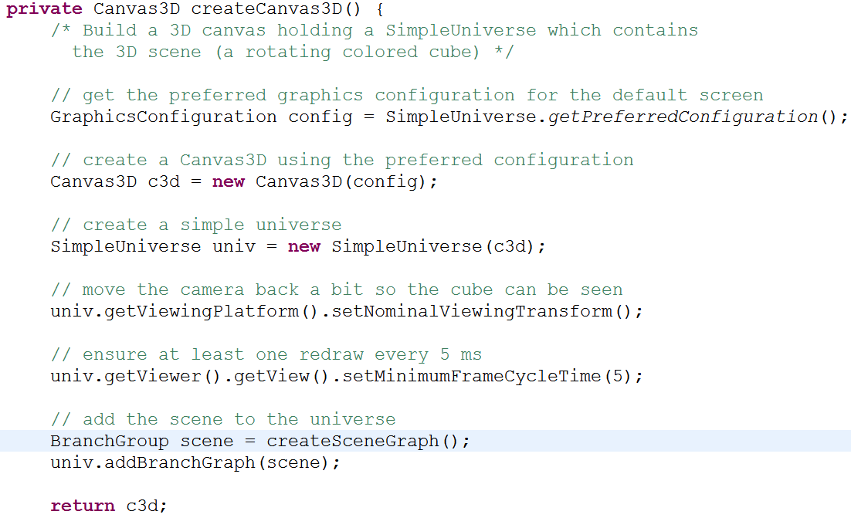
HelloUniverse Code

Slide 20
Create the Objects
Branch Groups used to group related objects together
Transform Groups used to perform transforms on all objects in the group (children)
ColoredCube a class to allow a simple shape to be displayed with out having to set up materials or color

Slide 21
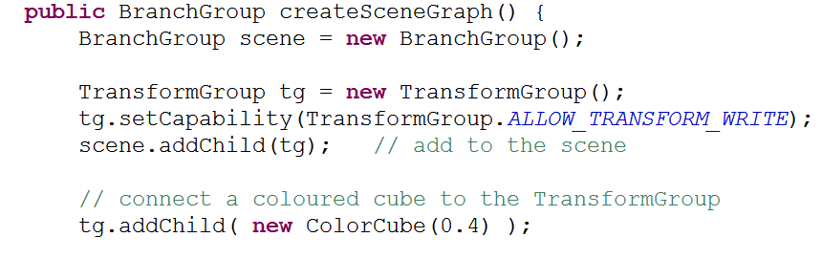
Adding ColoredCube
0.4 is size of cube
  try different sizes when demoing program

Slide 22
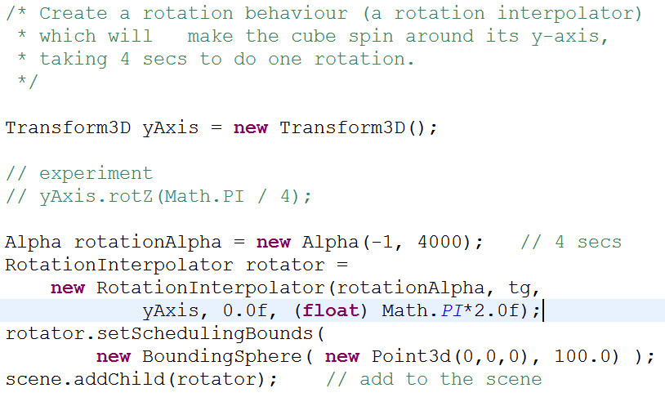
Adding Rotation Behavior

Slide 23

Rotation Behavior
Alpha like the FRC Timing Framework interpolators
  -1, loop continuously, 4000 milliseconds
alpha, transformGroup, transform3D (local coordinate system - rotation around y axis) , min angle, max angle

Slide 24
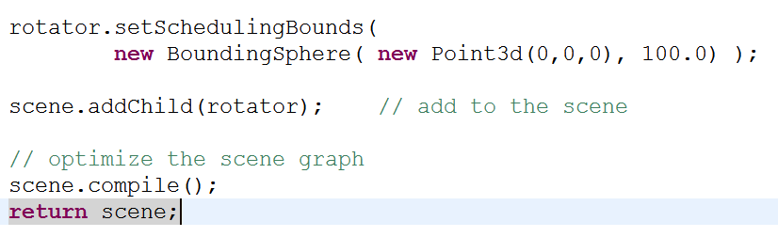
Finishing SceneGraph
Behaviors, such as rotation, have a bounds that must be set
recall scene is the Branch Group

Slide 25
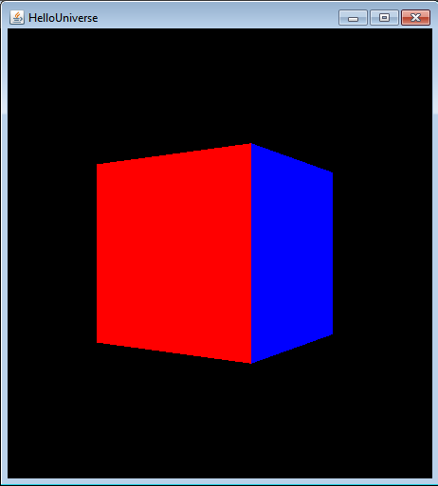
Demo
try making cube bigger
try changing axis of rotation
try adding another cube
try changing position of cube
why is background black?

