Slide 1
CS324e - Elements of Graphics and Visualization
Checkerboard World

Slide 2
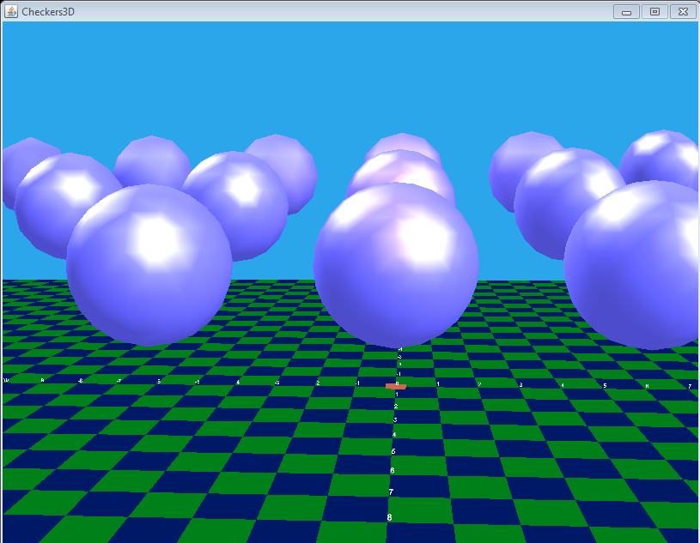
Larger Example - From KGPJ

Slide 3
Classes (Not All)
Checkers3D
extends JFrame
Sphere
WrapCheckers3D
extends JPanel
coloredTiles Extends Shape3D
CheckerFloor

Slide 4
Checkers3D
Extends JFrame
Similar to frame from HelloUniverse
Contains the panel that contains the canvas3D
Could add other GUI components
controls or menu items to affect the 3d scene

Slide 5
WrapCheckers3D
extends JPanel
Contains the Canvas3D
Canvas3D a GUI component
Canvas3D show up on top of other swing components if you try and mix them
doesn't play well
keep separate
don't try to put buttons or scroll bars in canvas
No animation loop
Canvas3D and Scene graph self monitor and if something changes redraw automatically

Slide 6
WrapCheckers3D
Most of the code to set up the 3D world
Instance variables and class constants
Where is USERPOSN located?

Slide 7
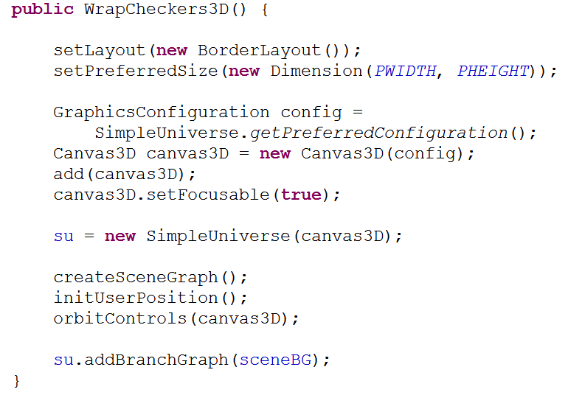
Creating the World

Slide 8
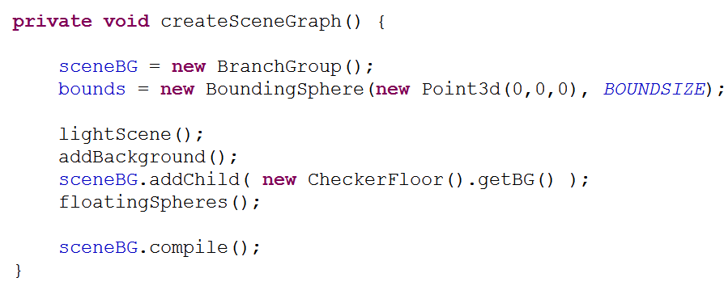
Creating the Scene Graph

Slide 9
Lighting the Scene
four kinds of lights can be placed in a Java3D world
ambient light
directional lights
point lights
spot lights
Scene can have multiple lights
Lights have color, position (possibly), direction (possibly), attenuation (possibly) attributes

Slide 10
Lights
Ambient lights
Uniform in all directions and locations
create AmbientLight object, give it a color, and add as a node to scene graph
Color3f each channel (red, green, blue defined with value between 0 and 1

Slide 11
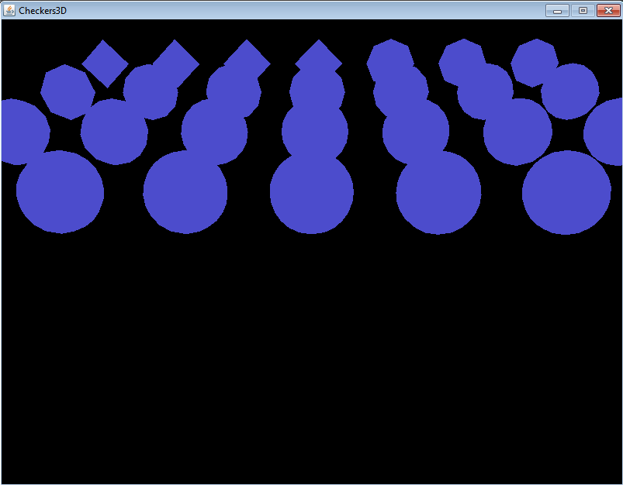
Spheres and Ambient Light

Slide 12
Directional Lights
fixed direction
no specific location (think of it as being at an infinite distance away from scene)
light rays are parallel

Slide 13
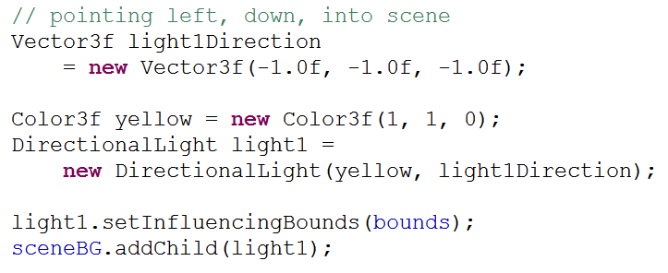
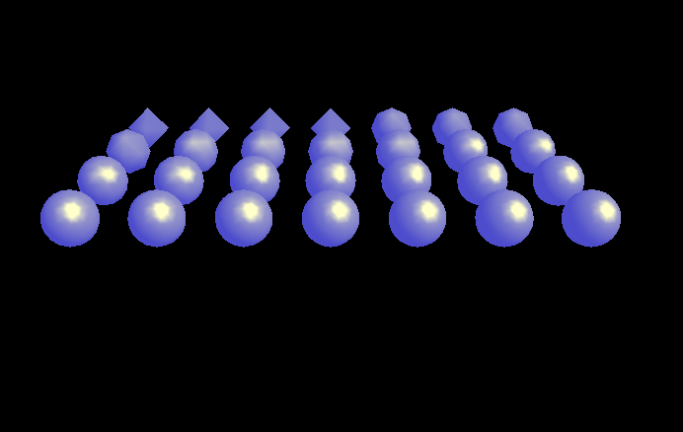
Directional Light

Slide 14
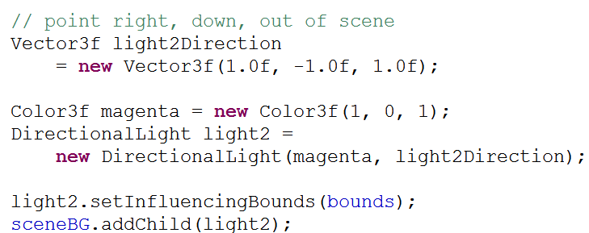
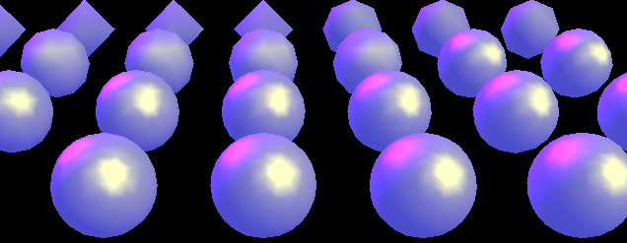
Directional Light

Slide 15
Point Light
Has a location in the scene
emits in all directions
has a color
has an attenuation, intensity decreases as distance from light increases

Slide 16
Point Light
Attenuation of Point Light has three factors:
constant attenuation, ac
linear attenuation, la
quadratic attenuation, qa
light intensity at a given point distance d away from the light = 1.0 / (ac + la * d + qa * d * d)

Slide 17
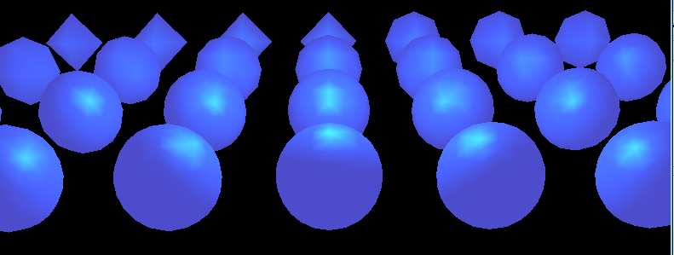
Point Light

Slide 18
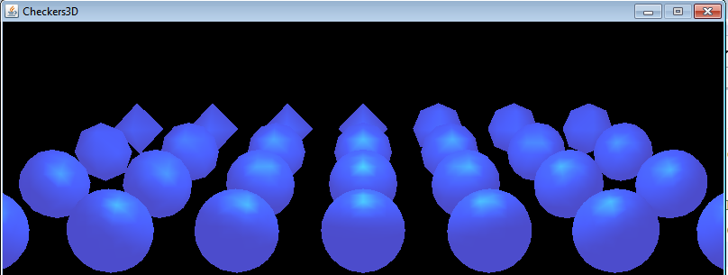
Point Light
Change y coordinate of location from 10 to 20
We see the things the light interacts with

Slide 19
Spotlight
Similar to Point Light
has location and direction, but does not emit light in all directions
emits light in a cone shape region
attenuation like Point Light, but add attenuation for light rays away from central direction

Slide 20
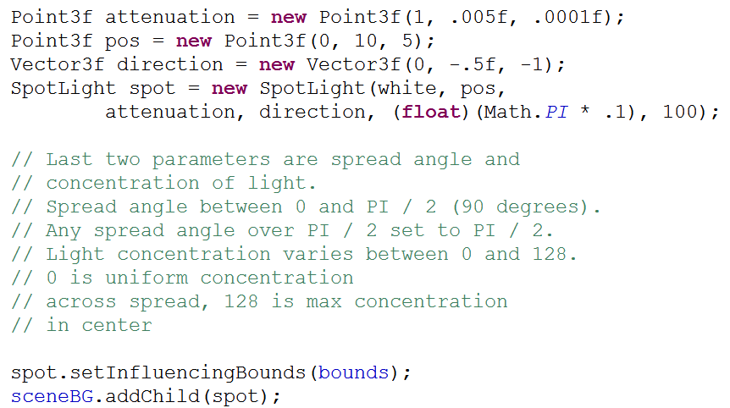
Spotlight

Slide 21
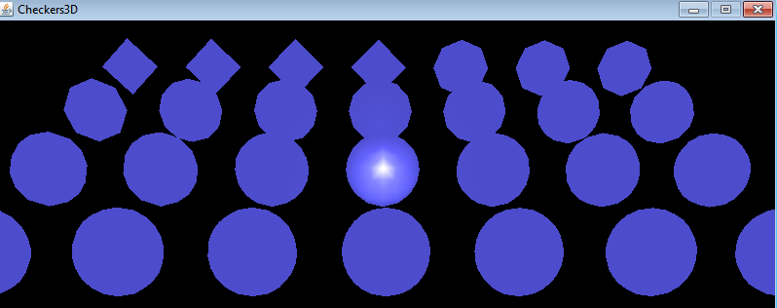
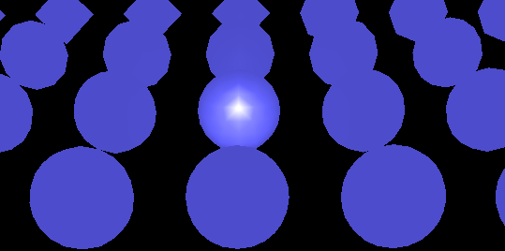
Spotlight Effects
attenuation changed to PI / 2

Slide 22
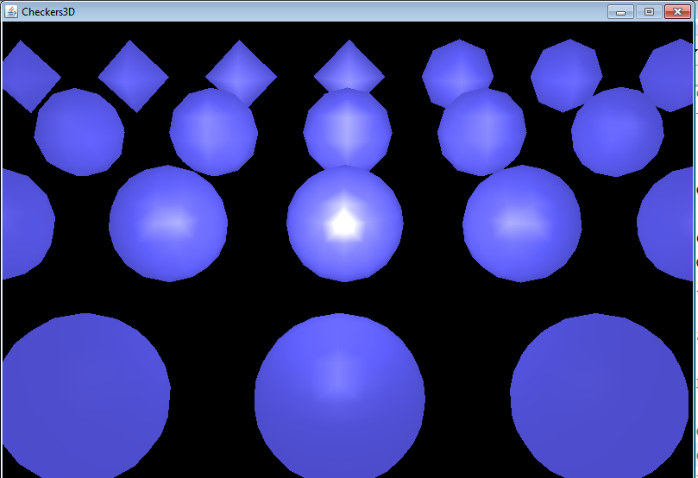
Spotlight Effects
Concentration changed from 100 to 10, spread angle still set at PI / 2

Slide 23
Background
can add a background image or color
draw at the back of a scene and is not altered by camera movement in the scene

Slide 24
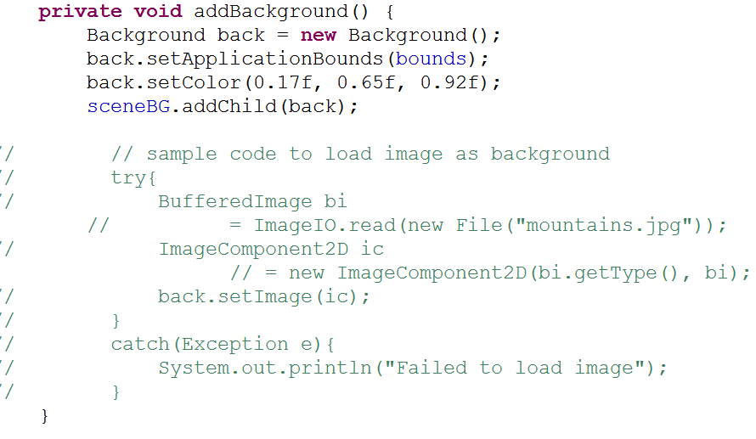
Background Code

Slide 25
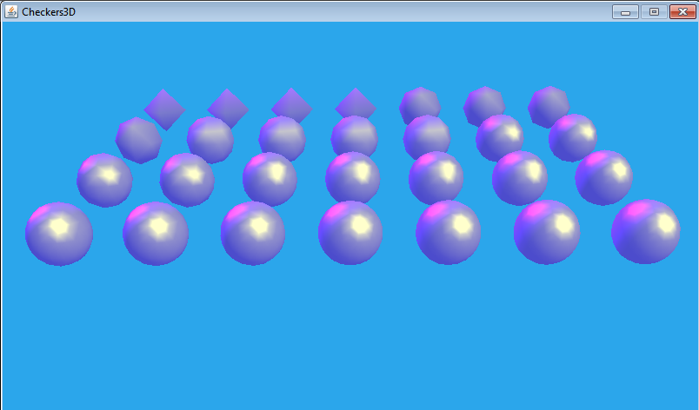
Background Effect - Color
ambient and directional lights

Slide 26
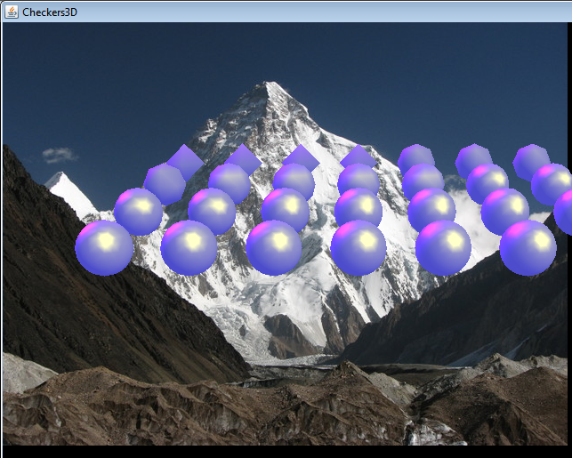
Background Effect - Image

Slide 27
Adding Shapes
Documentation for Java3D package at http://download.java.net/media/java3d/javadoc/1.5.1/index.html
Add visible objects to a scene requires adding Primitives or creating a class that extends Shape3D
built in subclasses of primitive include:
box, cone, cylinder, sphere

Slide 28
Adding Spheres
Multiple Sphere constructors but all have some variation of these parameters
radius, size of sphere
primFlags, A number of constants that affect how the sphere is created (for example should the appearance be allowed to be changed)
divisions, affects the number of polygons used to construct the sphere (divisions != total number)
appearance, how the sphere should look

Slide 29
Sphere Constructor
primflags - refer to Sphere class for options, GENERATE_NORMALS in our case
radius = 2.0f
vary divisions from 4 to 31
Appearance, show wireframe and blue materials

Slide 30
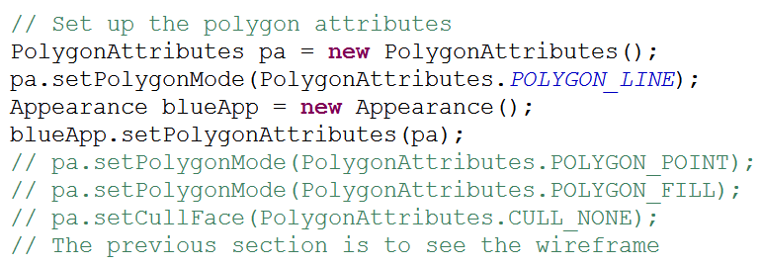
Appearances
Program includes two hard coded appearances for the spheres
First, just show the polygons

Slide 31
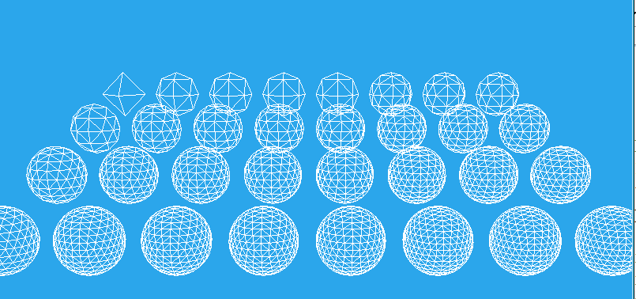
Wireframes
By default inside faces are culled, not visible
notice difference in divisions
why not just crank divisions up to 100s?

Slide 32
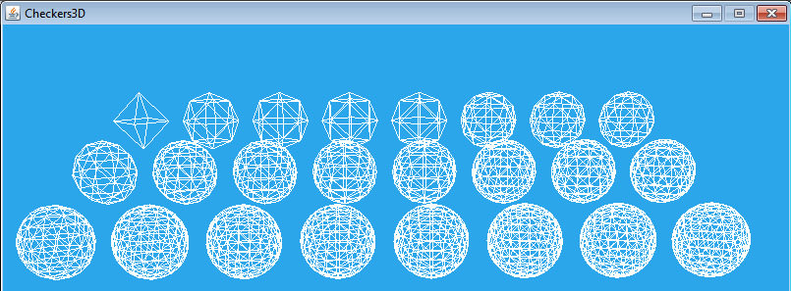
Wireframes
CULL_NONE
Notice difference in smaller divisions
we see lines the "backs" of lines

Slide 33
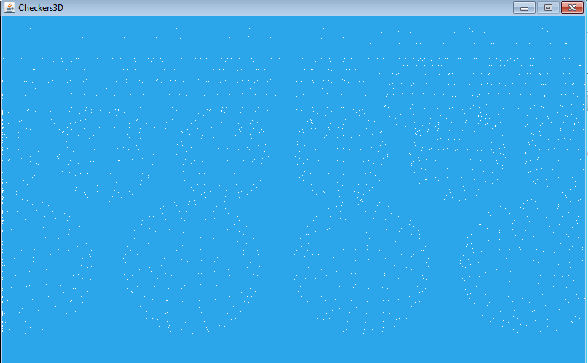
Wireframes
Using POLYGON_POINT instead of POLYGON_LINE

Slide 34
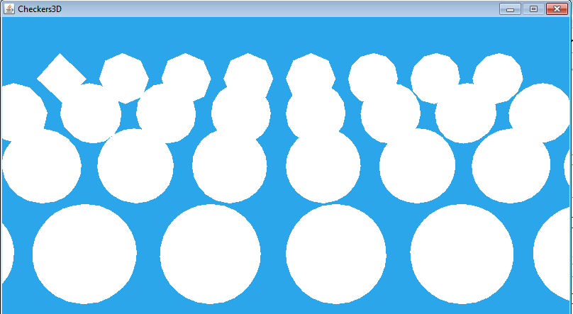
Polygon Attributes
Using POLYGON_FILL

Slide 35
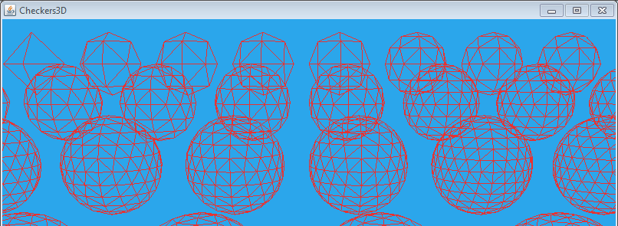
Changing Color
Color attribute of an appearance can be changed, default is white

Slide 36
Materials
More realistic appearances created using materials
Material class
specify four colors and a value for shininess (1 to 128)
four colors for ambient, emissive, diffuse, and specular properties of the material
Define how light interacts with the material and the light it gives off.

Slide 37
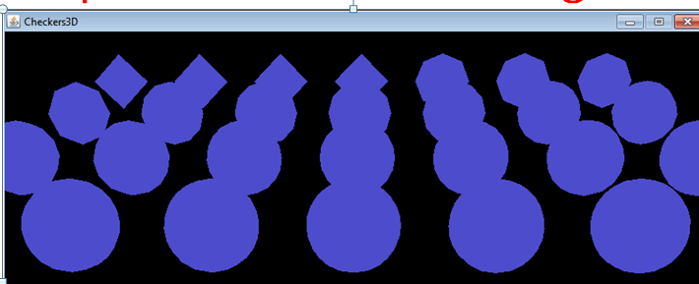
Material Properties
Ambient Color: how much (and what color) ambient light is reflected by the material
Recall when only ambient light in the world

Slide 38
Material Properties
Emissive Light
the color of light the material gives off itself
material glows, but does not illuminate other materials
to create a flashlight pair a spotlight and a shape with a material that gives off light
examples so far emissive light for spheres was black (none)
dim the lights and let the spheres give off a bright yellow light

Slide 39
Emissive Light
No other lights

Slide 40
Diffuse and Specular Properties
Ambient color is response to ambient light which appears to come from all directions
diffuse color reflects light coming from one direction (directional, point, and spot lights)
angle in != angle out
various angles of reflection
specular color, follows law of reflection
angle in = angle out

Slide 41
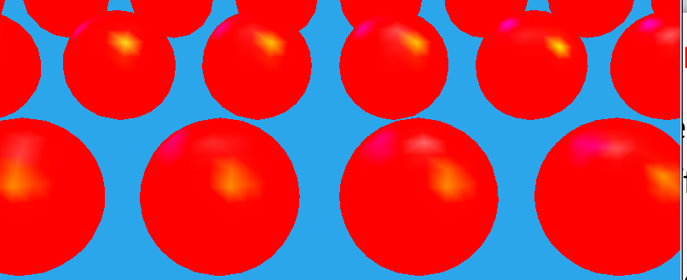
Materials
Billiard Ball like material
ambient emissive diffuse specular shininess
(red, black, red, white, 70)
notice glinting off edges

Slide 42
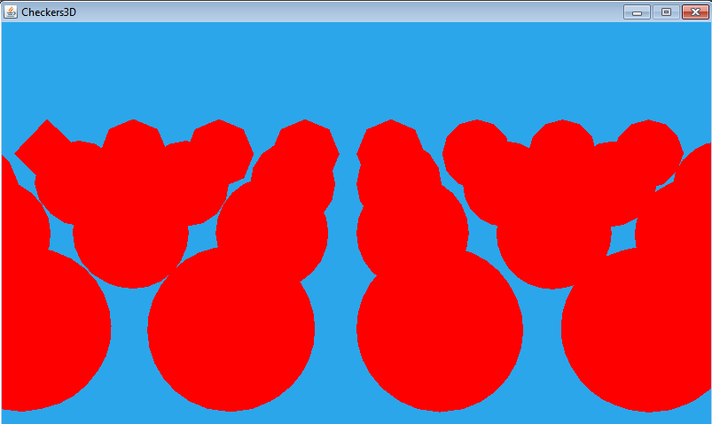
Materials
Specular set to black

Slide 43
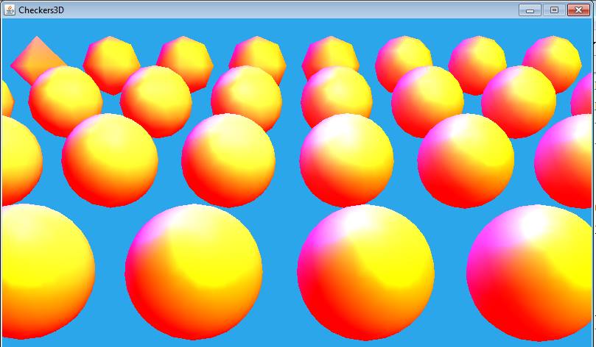
Materials
ambient emissive diffuse specular shininess
(red, black, white, white, 25)

Slide 44
Positioning Spheres
To position spheres each has its own Transform Group
change x, y, and z for each transform group
can't just update one TG, otherwise position changes
Simple Universe
Branch Group
Transform Group
Transform Group
Transform Group
Sphere
Sphere
Sphere

Slide 45
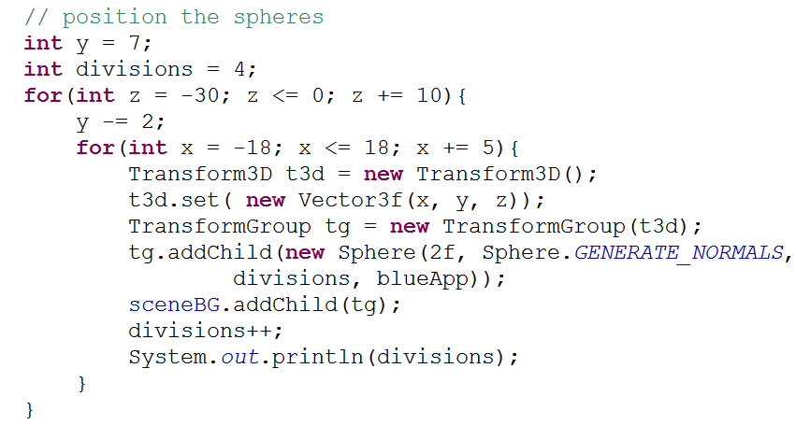
Positioning Spheres

Slide 46
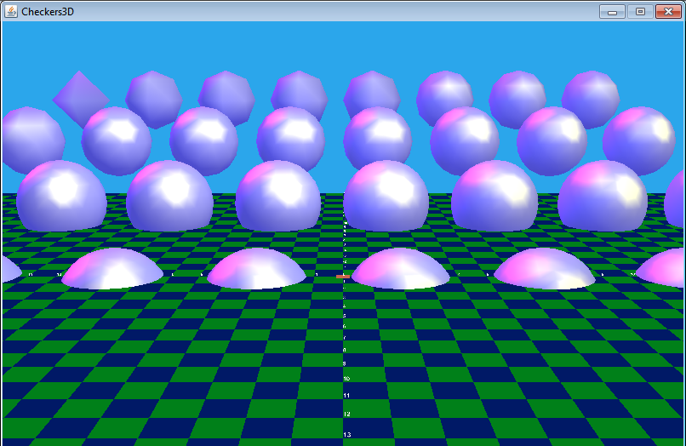
Adding the Checker Floor

Slide 47
CheckerFloor
Not a standard Java3D class
creates its own branch group
consists of
2 sets of colored tiles, blue and green
a red colored tile at the center
labels which are Text2D objects

Slide 48
Colored Tiles
ColoredTiles class extends built in Shjape3D class
Uses a QuadArray to represent the tiles
QuadArray a built in Java3D class
stores sets of 4 points that define individual quadrilaterals
In this case a flat surface, but quads do not have to be co-planar
quads don't have to be connected to each other

Slide 49
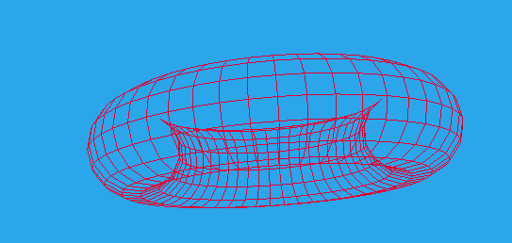
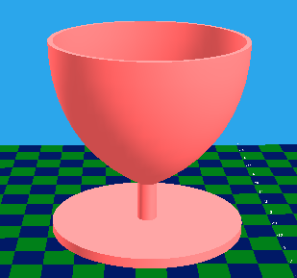
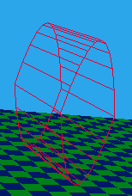
Morph and Lathe
Build shapes by defining an outline and rotating outline 360 degrees

Slide 50
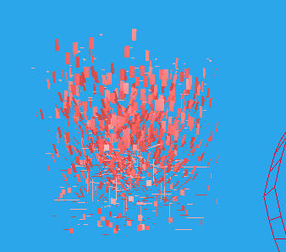
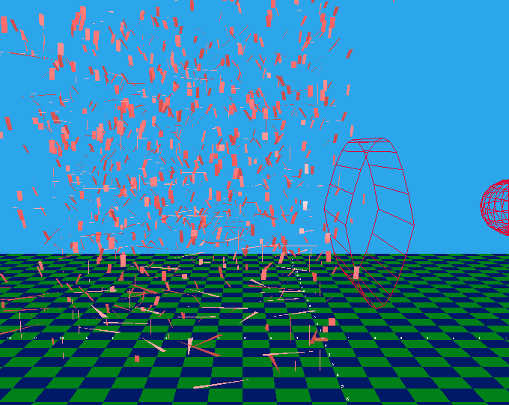
Exploding a Shape3D
can alter coordinates of quads to create an explosion affect

Slide 51
Colored Tiles
Quad specified with 4 Point3f objects
four corners of the quad
order significant
"front" of the shape is counterclockwise loop formed by the points
Individual quads do not have to be adjacent to other quads

Slide 52
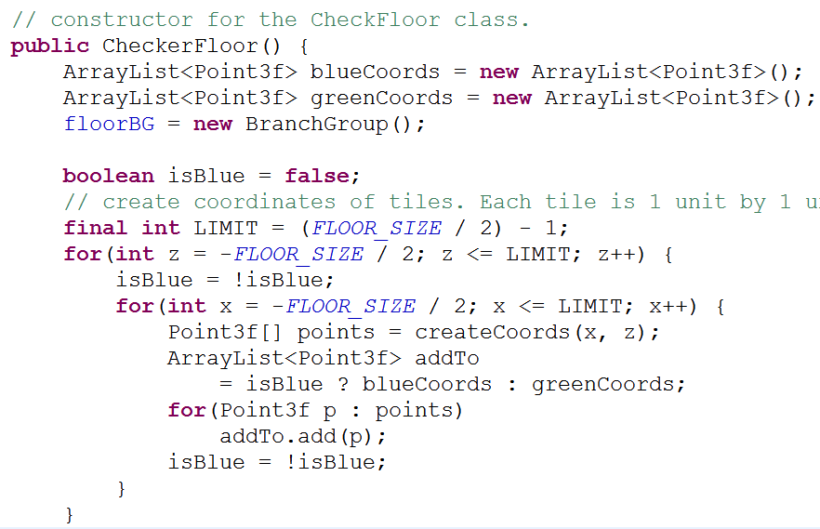
CheckerFloor Constructor

Slide 53
CheckerFloor Constructor
continued

Slide 54
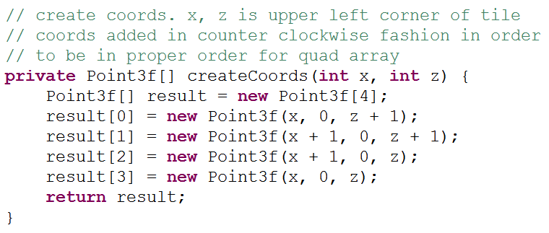
Creating Points
Called by constructor to create 4 points for one time based on anchor point

Slide 55
colored Tiles
ArrayList contains 4x Point3f to build QuadArray
Each tile given a color instead of a material
does not react with light
must calculate normals if wish to base Appearance on a material

Slide 56
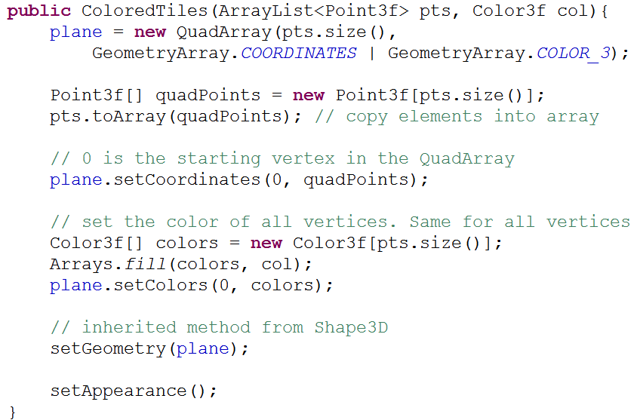
colored Tiles Constructor

Slide 57
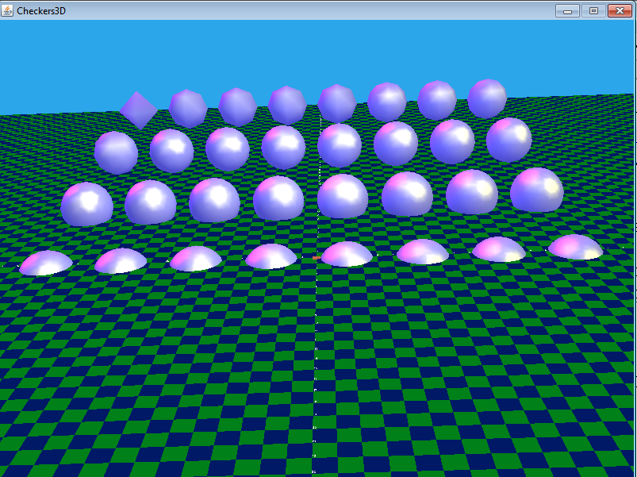
Checker Floor

Slide 58
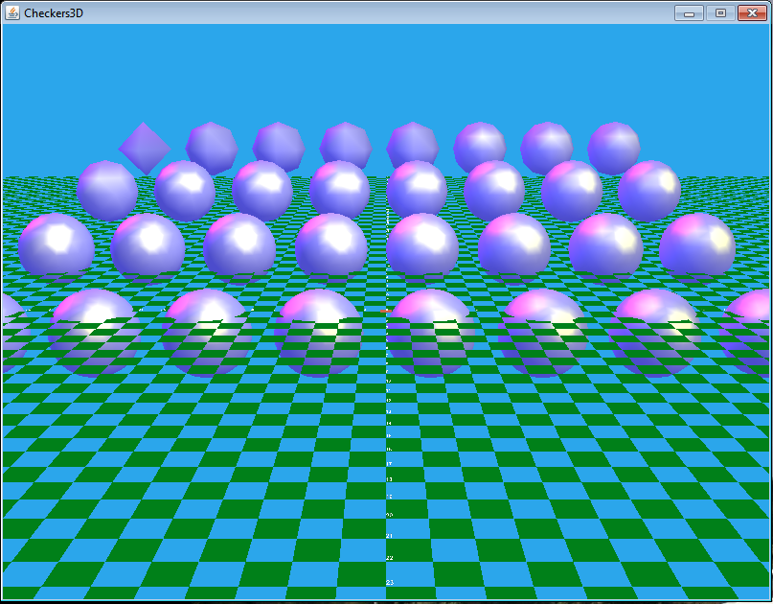
Checker floor - Only Green Tiles

Slide 59
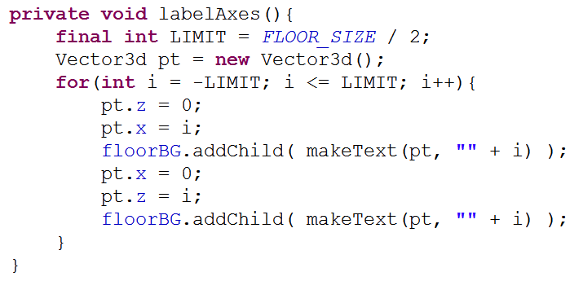
Adding Labels
Back in CheckerFloor class
two methods

Slide 60
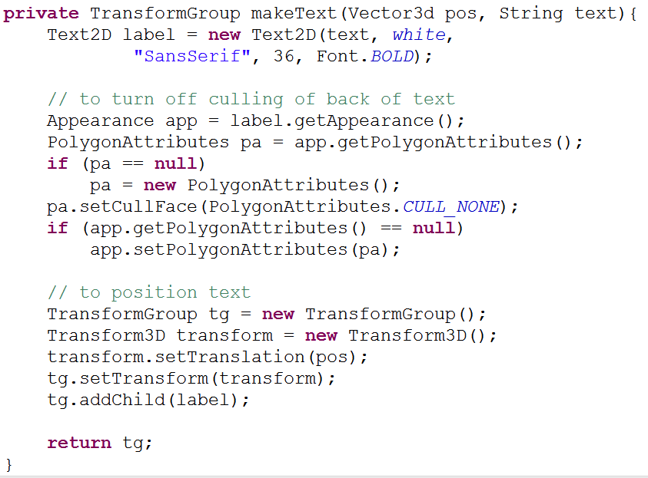
Adding Labels

Slide 61
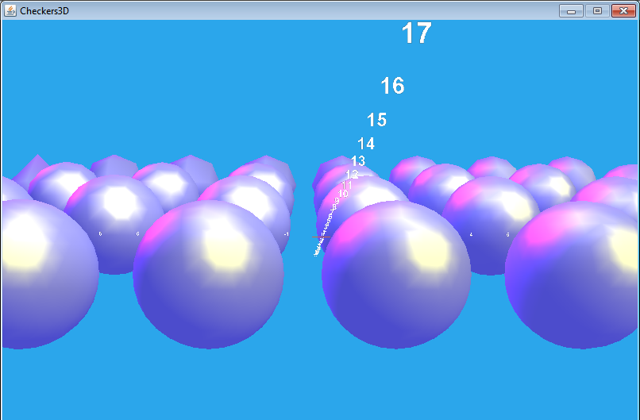
Effects of Culling
demo program when culling performed on colored Tiles and text

Slide 62
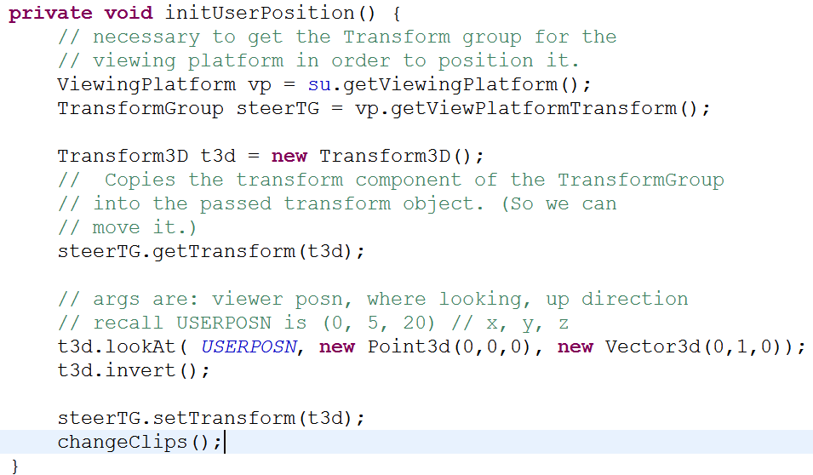
Creating and Positioning Camera
Back in WrapCheckers3D class

Slide 63
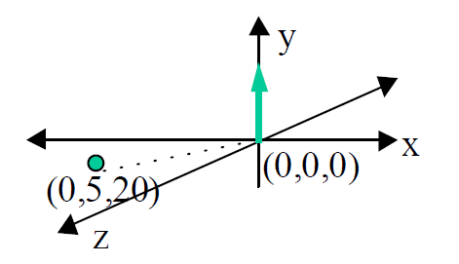
Initial Position
SimpleUniverse create viewing platform for us
lookAt method to set position

Slide 64
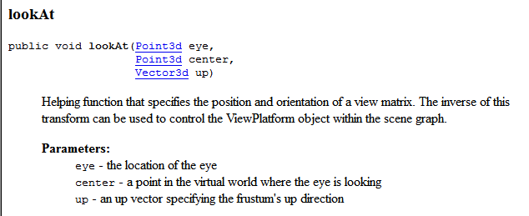
lookAt method
the lookAt method makes the object being translated face towards the ViewPlatform, which actually makes the ViewPlatform face exactly away from our scene, so we invert it at that point.

Slide 65
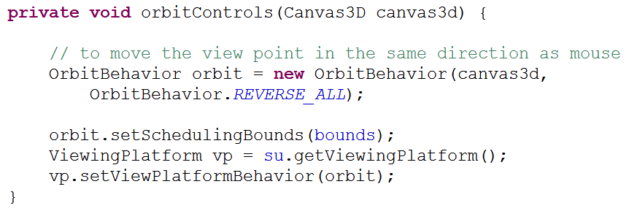
Orbit Controls
Simple way to allow mouse to move the viewing platform

