Slide 1
CS324e - Elements of Graphics and Visualization
Animation in Java3D

Slide 2
Adding Animation
Animation in Java2D achieved by changing the position (or some other attribute) of the graphic primitive over time
Animation framework from FRC simplified things, but still changing attributes of the primitives ourselves
Different in Java3D

Slide 3
Alphas
First step to create animation in Java3D is to create an Alpha, Java3D class
not to be confused with the alpha channel present in some color spaces
Similar to the Animator objects from FRC Timing framework
Generate a series of values over time

Slide 4
Sample Alpha Creation
parameters for
loop count (number of repetitions),
mode (increasing or decreasing or both)
trigger time, when to start
duration and ramp times (ramp = acceleration)
time pause at one and zero

Slide 5
Output of Alpha
Ignoring the ramp times:
1.0
value
0.0
1 2 3 4 5 6 7 8 9 10 11 12
time in seconds

Slide 6
Result
Notice delay at start and time paused at top

Slide 7
Interpolators
Alphas are not enough to create animation in the Java3D scene
results of Alpha must be fed to an Interpolator which in turn alters properties of a 3D primitive
Several kinds of interpolators
Color, Transform, Transparency, PositionPath, Rotation, Scale,

Slide 8
PositionPath Interpolator
Movement shown in clip achieved via a PositionPathInterpolator
a = alpha
tg = transform group interpolator acting on
Transform3D = local coordinate system
knots = how to split up alpha
points = positions to move between

Slide 9
Points and Knots
Points are 3d coordinates
start position same as start position of large colored cube
what will happen if it isn't?
Knots are proportions
must match number of points or error
first must be 0.0, last must be 1.0
must be strictly increasing, each value greater than the last
knots specify what fraction of alpha to move from one point to the next

Slide 10
SceneGraph for Simple Motion
scene
Branch
Group
Transform Group
(-5, 1, 0)
(-5, 1, 0)
Transform Group
large ColoredCube
PositionPath Interpolator
small ColoredCube

Slide 11
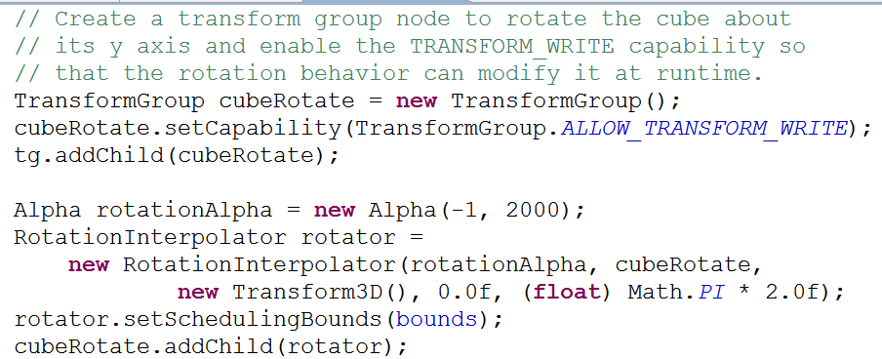
Add Rotation to the Large Cube
Another Interpolator
one approach requires adding another TG which will be rotated

Slide 12
New Scene Graph
scene
Branch
Group
Transform Group
(-5, 1, 0)
Transform Group
PositionPath Interpolator
(-5, 1, 0)
Transform Group
large ColoredCube
Rotation Interpolator
small ColoredCube

Slide 13
Steps to Add Object and Animation
The panel that holds our 3D scene has a BranchGroup object named sceneBG
All of the objects in the scene are children of the sceneBG or descendants

Slide 14
Adding a visible Object to Scene
Add one sphere
create Appearance for sphere based on ColoringAttributes, Material, or others (line, polygon, texture)
Create Sphere
size, primFlags (GENERATE_NORMALS usually), divisions, appearance

Slide 15
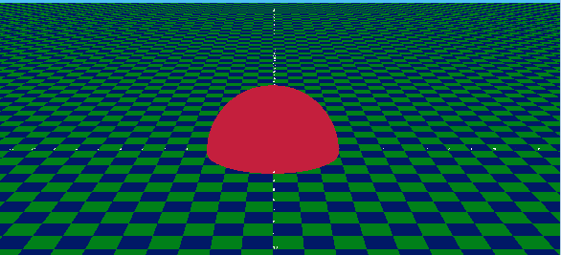
Adding Object to Scene
If add sphere to sceneBG placed at origin of the scene

Slide 16
Positioning Sphere
To position Sphere somewhere besides the origin we must create a Transform3D to specify the position
Then create a TransformGroup using that Transform3D
Then add the sphere as a child to that TransformGroup
Add the transform group as a child to the sceneBG

Slide 17
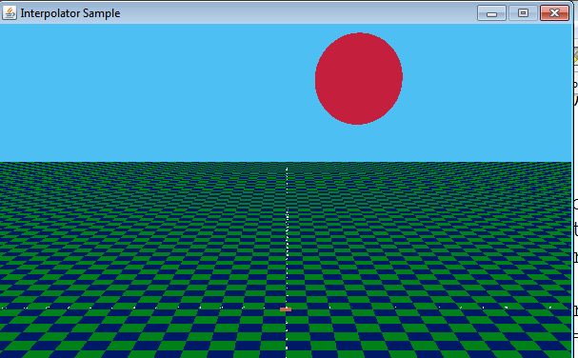
Positioning Sphere - Code

Slide 18
Animate Sphere
Create new transform group for interpolator
set READ and WRITE capabilities on Transform group
Create Alpha for Interpolator
Create Interpolator
Set scheduling bounds for interpolator
add interpolator to TransformGroup
add transform group to sceneBG or other transform group
to move sphere and have scale change new two transform groups

Slide 19
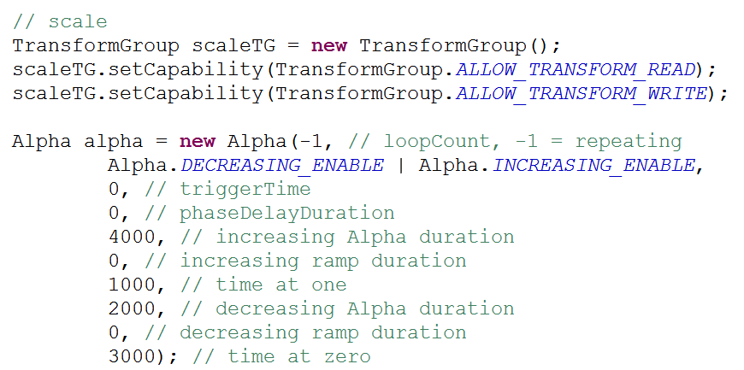
Create TG for Interpolator and Create Alpha

Slide 20
Create Interpolator, Set Scheduling Bounds

Slide 21
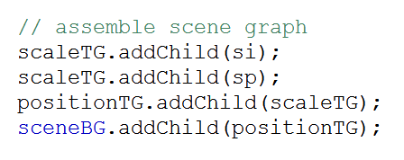
Assemble Scene Graph
scene
Branch
Group
Transform Group
positionTG (-5, 15, -20)
Transform Group
scaleTG
si Scale Interpolator
sp Sphere

Slide 22
Result

Slide 23
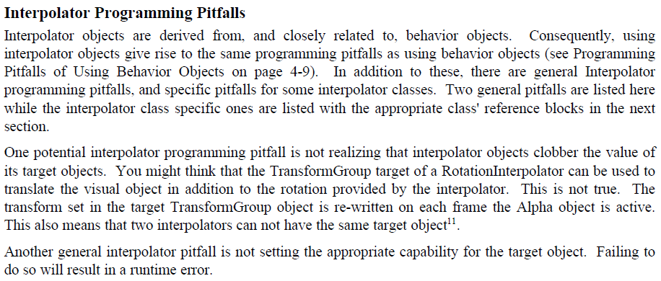
Java3D Tutorial
Animation in Java3D:
http://java.sun.com/developer/onlineTraining/java3d/j3d_tutorial_ch5.pdf
General Java3D tutorial:
http://java.sun.com/developer/onlineTraining/java3d/

Slide 24
Controlling Movement
In the examples so far animation was continuous
Animation can be controlled via Java3D classes such as Behaviors or Picking
Or via a Java2D GUI that causes interpolators to run
Example of second kind

Slide 25
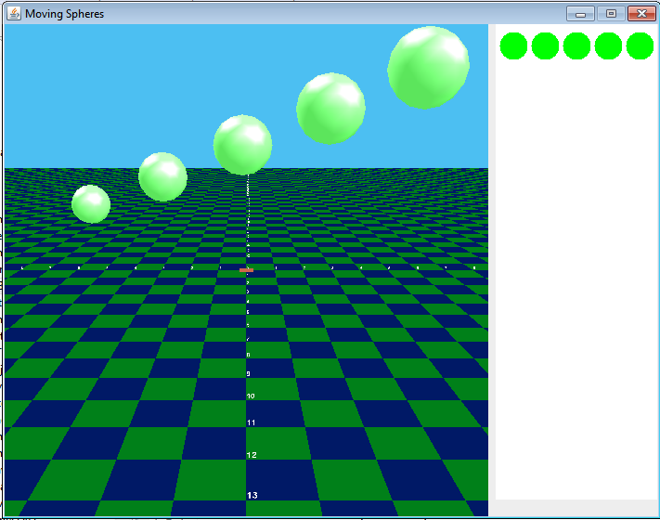
User Initiated Movement

Slide 26
User Activated Movement
Click on a green circle in panel on right
creates a new Alpha and starts it
move method in 3D world
Each Sphere part of a graph that has its own PositionPathInterpolator
Start movement by creating and starting a new Alpha

Slide 27
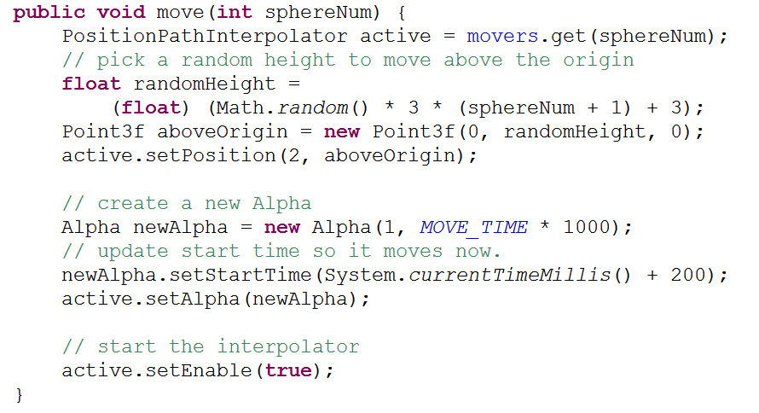
move Method

Slide 28
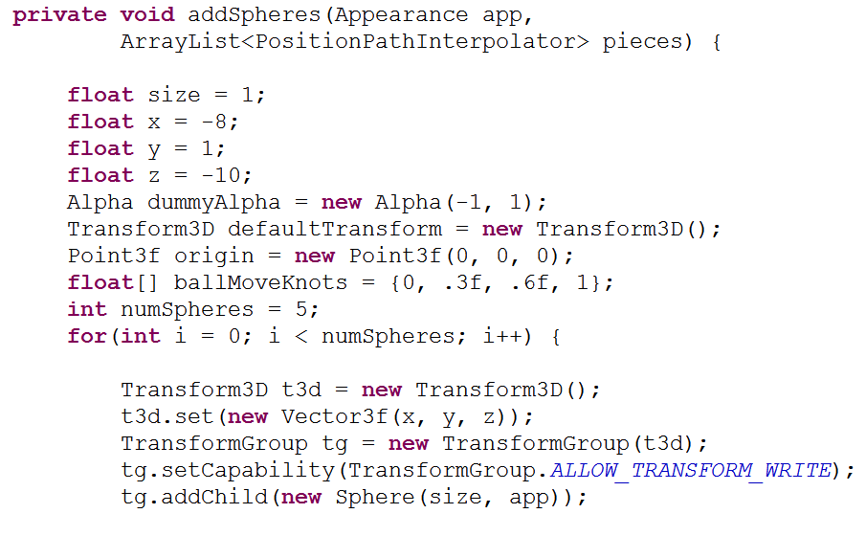
movers
movers is an ArrayList of PositionPathInterpolators

Slide 29
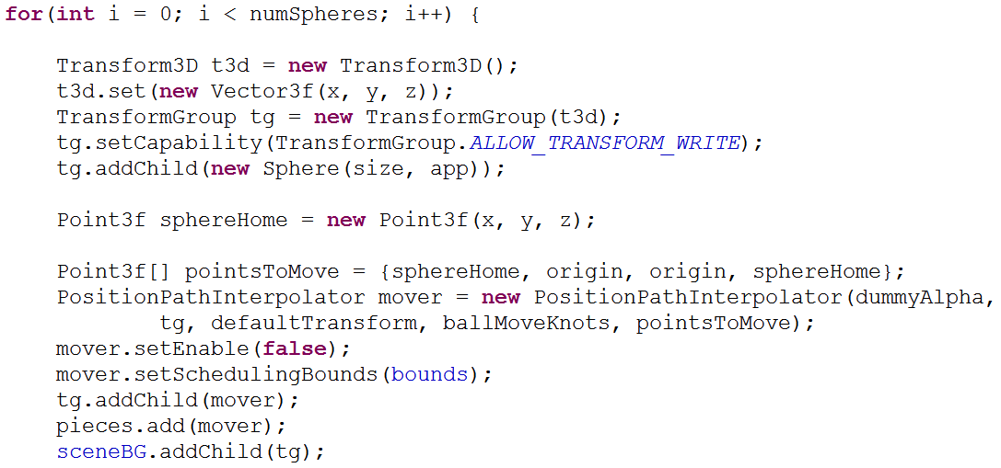
Creating and Positioning Spheres

