Slide 1
CS324e - Elements of Graphics and Visualization
Fractals and 3D Landscapes

Slide 2
Fractals
A geometric figure in which smaller parts share characteristics of the entire figure
a detailed pattern that repeats itself
contain self similar patterns
appearance of details matches the overall figure
often described mathematically

Slide 3
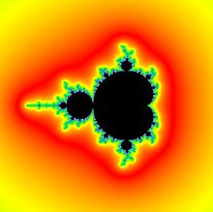
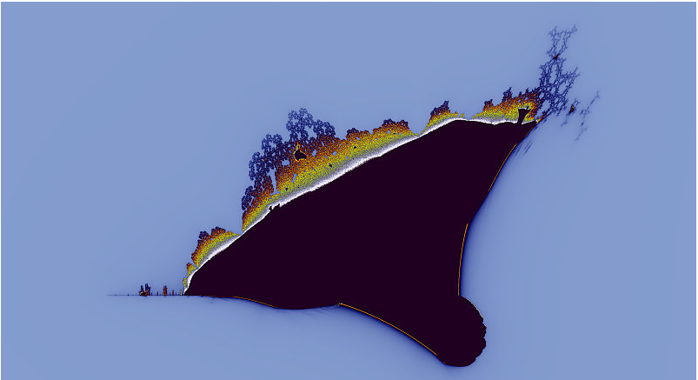
Fractals
Mandelbrot Set
Burning Ship Fractal

Slide 4
Sierpinski Triangle Fractal
Described by Polish mathematician Wacław Sierpiński in 1915
Algorithm
Pick a side length and the lower left vertex for an equilateral triangle
If the side length is less than some minimum draw the triangle
else draw three smaller Sierpinski Triangles

Slide 5
Sierpinski Triangle
x + .25 * side length, y + sqrt(3) / 4 * side length
side length
x, y
x + .5*side length, y

Slide 6
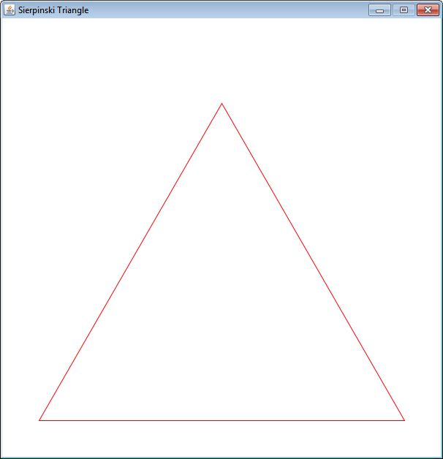
Sierpinski Triangle
min length = start length

Slide 7
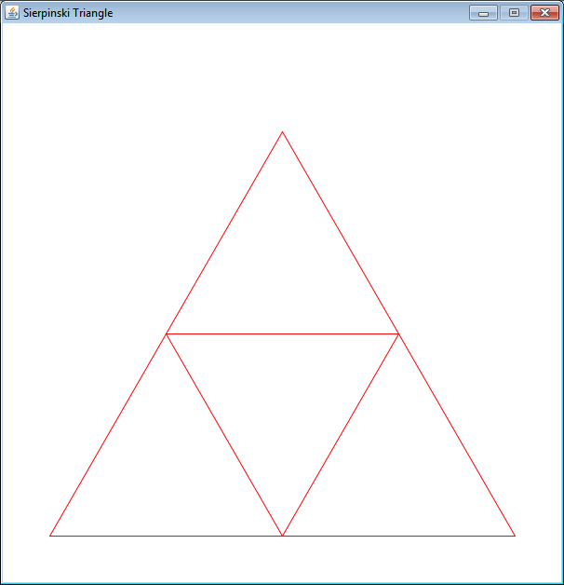
Sierpinski Triangle
min length = start length / 2

Slide 8
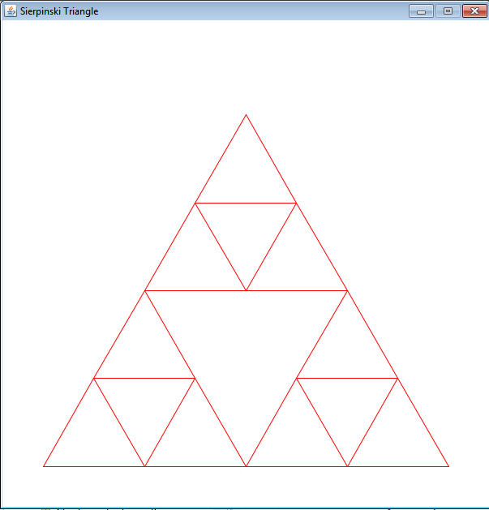
Sierpinski Triangle
min length = start length / 4

Slide 9
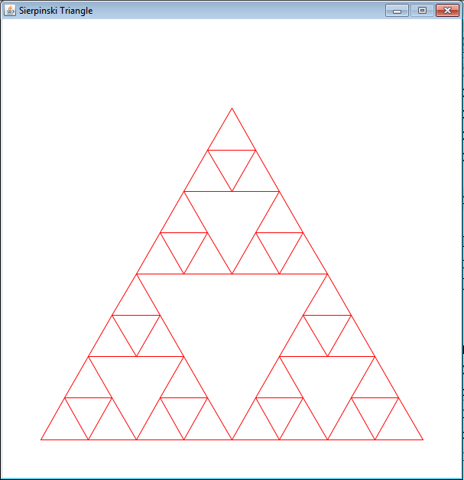
Sierpinski Triangle
min length = start length / 8

Slide 10
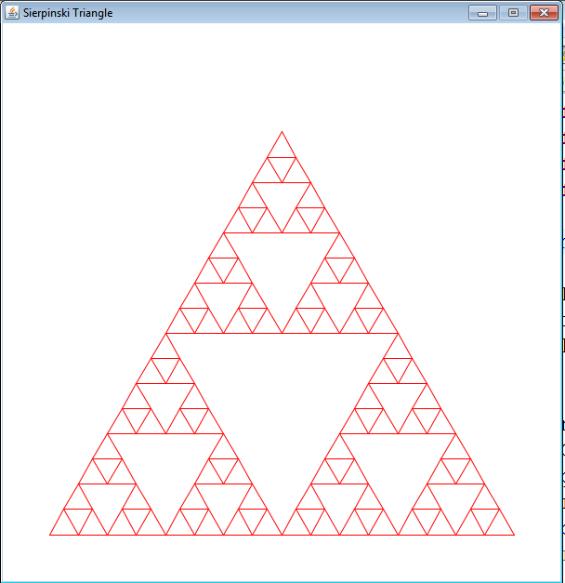
Sierpinski Triangle
min length = start length / 16

Slide 11
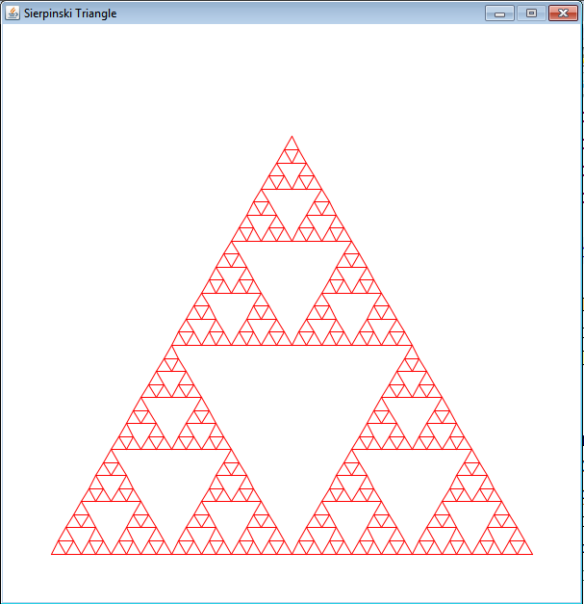
Sierpinski Triangle
min length = start length / 32

Slide 12
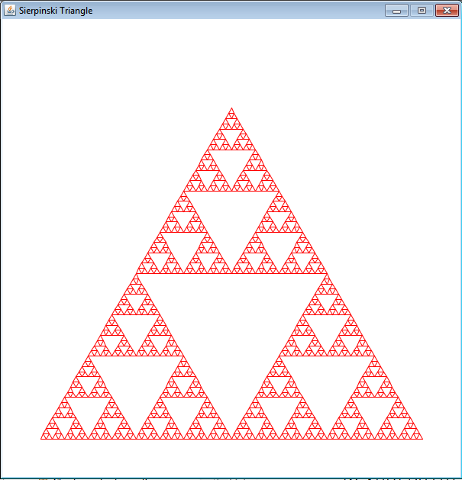
Sierpinski Triangle
min length = start length / 64

Slide 13
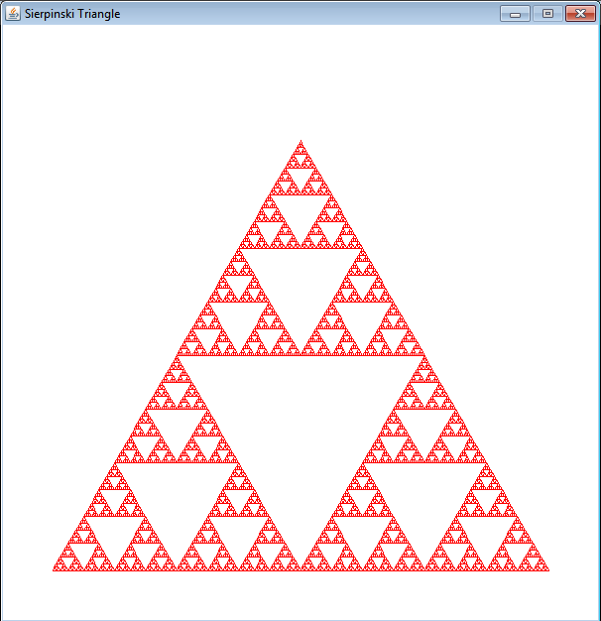
Sierpinski Triangle
min length = start length / 128

Slide 14
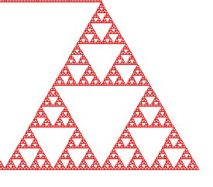
Close up - Self Similar
Close up of bottom, right triangle from minLength = startLength / 128

Slide 15
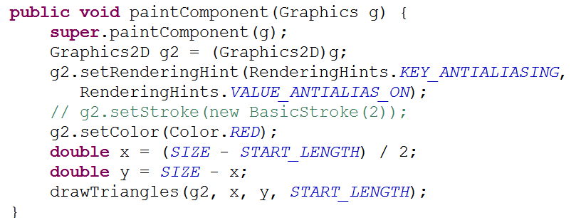
Implementation of Sierpinski

Slide 16
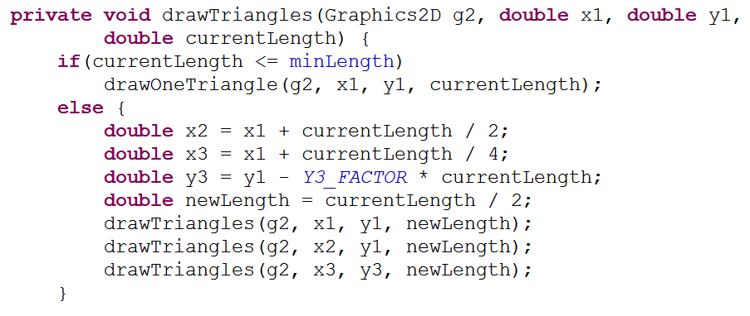
Implementation of Sierpinski
Base Case
Recursive Case

Slide 17
Implementation of Sierpinski
Base Case - Draw One Triangle

Slide 18
Fractal Land
Example from KGPJ chapter 26
Create a mesh of quads
example 256 x 256 tiles
allow the height of points in the quad to vary from one to the next
split quads into one of 5 categories based on height
water, sand, grass, dry earth, stone
appearance based on texture (image file)

Slide 19
Fractal Mesh
Generate varied height of quads using a "Diamond - Square" algorithm
looking down on mesh
heights of points A, B, C, D
A
B
C
D

Slide 20
Generate Fractal Mesh - Diamond Step
dHeight = max height
- min height
Height of Point E =
(Ah + Bh + Ch + Dh) / 4 + random(-dHeight/2, +dHeight/2)
average of 4 corner points plus some random value in range of max and min allowed height
A
B
E
C
D

Slide 21
Square Step
With height of E set generate height of 4 points around E
Gh = (Ah + Eh + Eh + Ch) / 4 + random( -dHeight/2, +dHeight/2 )
F
A
B
E
G
H
C
D
I

Slide 22
Repeat Diamond Step
F
A
B
J
K
E
G
H
L
M
C
D
I

Slide 23
Completing Mesh
Continuing alternating diamond and square step until the size of the quad is 1.
Each point of quad at a fixed x and z coordinate, but the y has been generated randomly
Problem: if the height is allowed to vary between the min and max height for every point how different can points on a quad be?

Slide 24
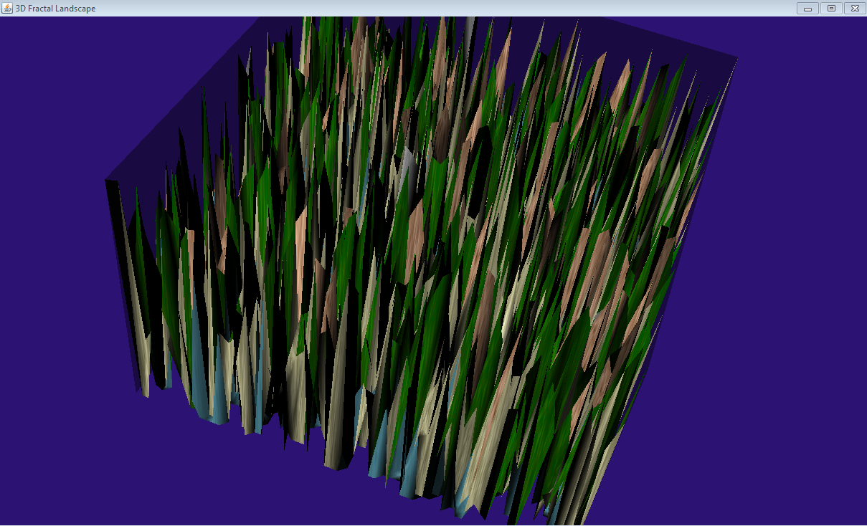
A Spear Trap

Slide 25
What is the Problem?
By allowing the points that form a single quad to vary anywhere in the range from min to max height we get vast differences
Solution: after a pair of diamond - square steps reduce the range of the random value
referred to as the flatness factor
range = range / flatness

Slide 26
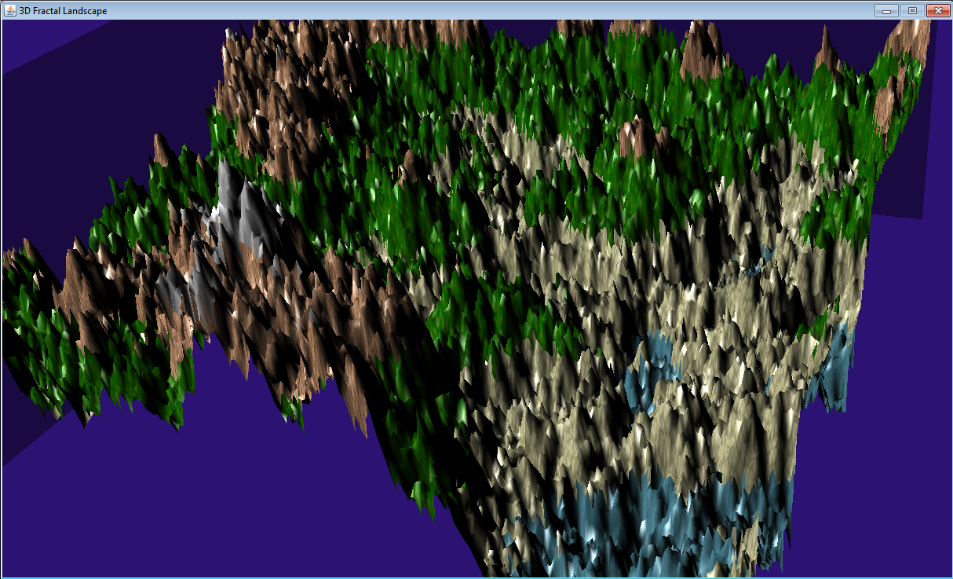
Flatness of 1.5

Slide 27
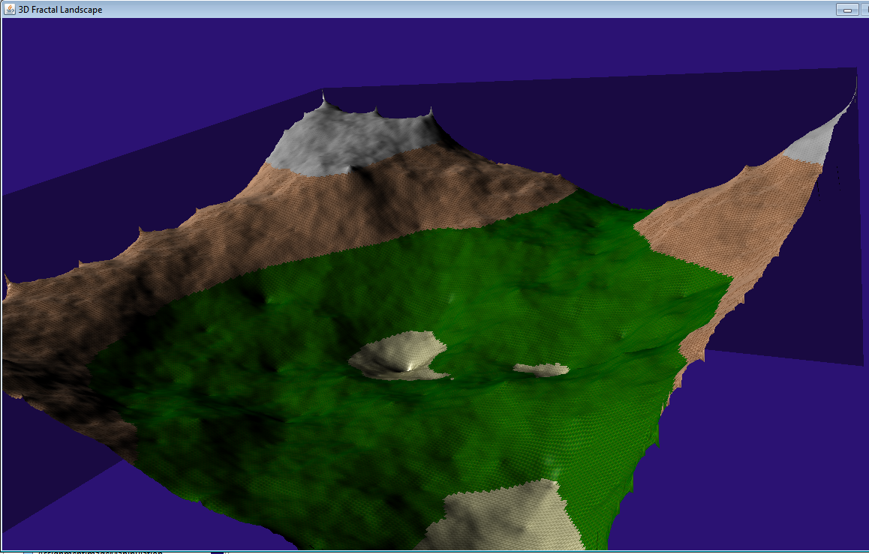
Flatness of 2.5

Slide 28
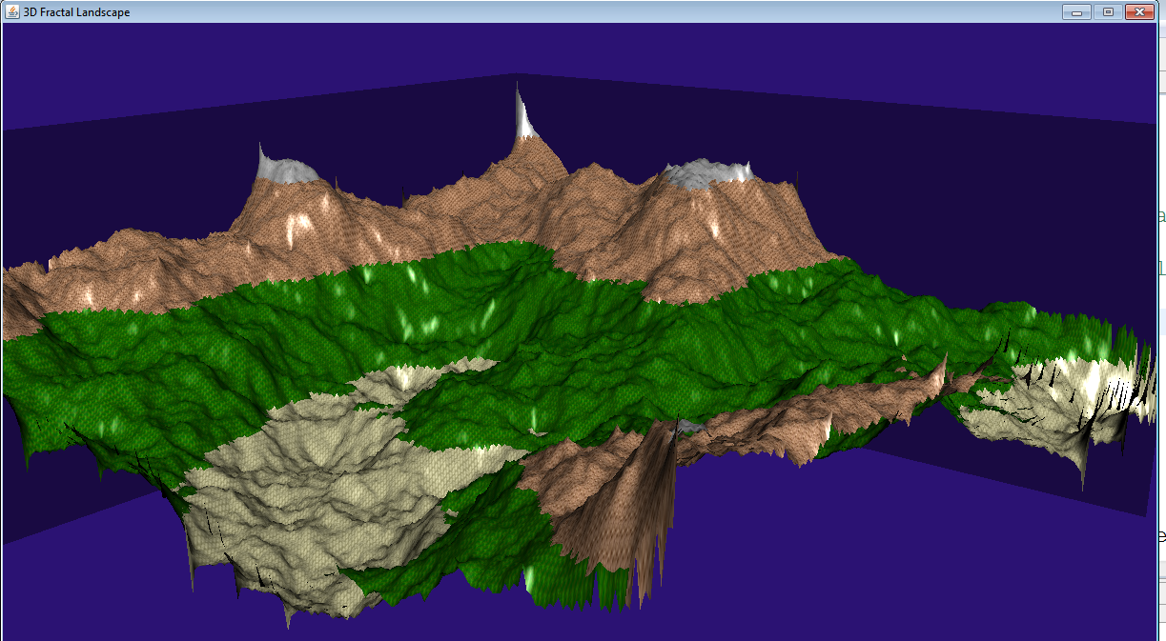
Flatness of 2.0

Slide 29
Textures
Shapes in Java3D may be wrapped in a texture
In FractalLand the mesh is simply a QuadArray
Each texture is an image file
Quad Array created and texture coordinates generated for each quad
how does image map to quad

Slide 30
Simple Textures
Texture can also be applied to the primitive shapes: box, cone, sphere, cylinder
From the interpolator example
When creating box must add primFlag to generate texture coordinates

Slide 31
Creating Appearance
Appearance for shape based on texture not material

Slide 32
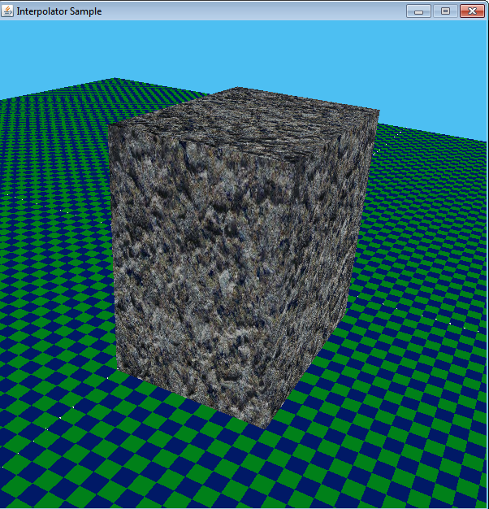
Result
texture wrapped and repeated as necessary
can lead to odd seams, creases, and stretching

Slide 33
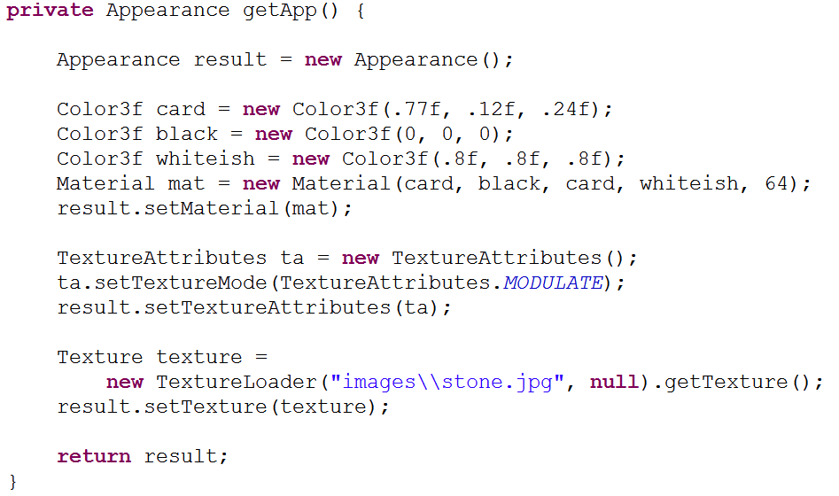
Combining Texture and Material
can combine material and texture to create modulated material

Slide 34
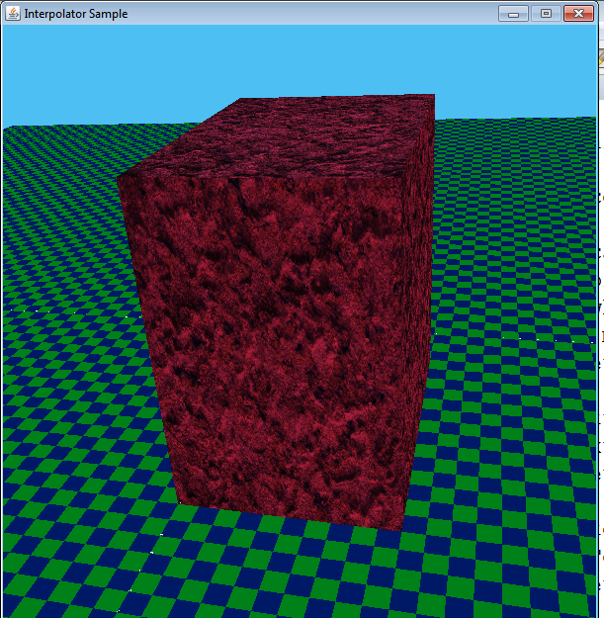
Result

Slide 35
Controls
Version of FractalLand shown had orbit controls to allow movement of camera anywhere in scene
program includes method to add key controls and keeps camera close to the ground
as if moving across the landscape

Slide 36
Result

Slide 37
Adding Fog
Java3D includes ability to add fog
LinearFog
ExponentialFog
density of fog as function of distance from the camera
fog has color and parameters to determine density of fog

Slide 38
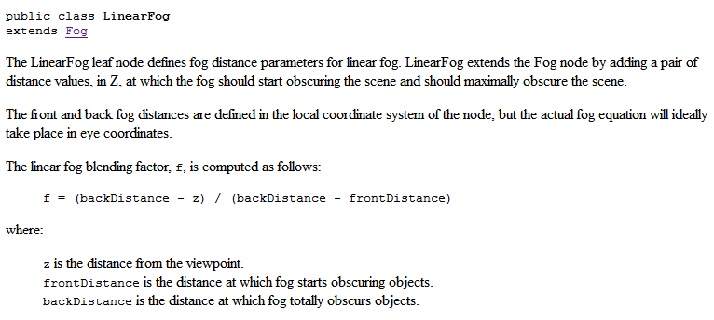
LinearFog

Slide 39
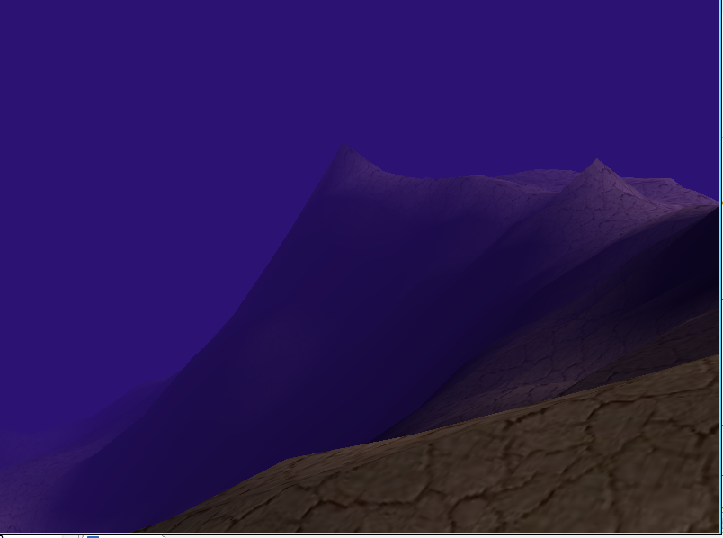
Result

