Slide 1
CS324e - Elements of Graphics and Visualization
A Little Java
A Little Python

Slide 2
From Python to Java
Most students have taken CS303e and CS313e which are taught using Python
CS324E uses Java
First couple of lectures and first two assignments an intro and review of Java
First - look at common techniques in Python and Java equivalent
Second - implement an interesting Java program

Slide 3
Learning Another Language
"The first programming language to learn is the second hardest programming language to learn.
The hardest programming language to learn is the second programming language."

Slide 4
Java
A general purpose programming language
so is Python
More geared towards object oriented programming
encapsulation, inheritance, polymorphism
strongly typed
braces used to distinguish blocks of code
all code is part of some class (programmer defined data type)

Slide 5
Identifiers
Identifiers composed of letters, digits, _, and $
must start with letter or _
by convention variable and method (function) names start with lower case and use camel case
typicalMethodName
by convention class names start with a capital letter and use camel case
ArrayList
constants use all upper case with _ between words
DAYS_PER_WEEK

Slide 6
Basic Program
public class Hello {
/**
* Where the program starts
*/
public static void main(String[] args) {
System.out.println("Hello World!!");
System.out.println("This is a Java program.");
}
}
{} for code blocks
main is called when program run
; at the end of statements
System.out.println is standard output
analogous to print statement in Python
comments, /* stuff */ or // stuff

Slide 7
Variables
Python
Java
i = 10
j = 20
k = i * j + i / j
x = 1.7526
name = "Olivia"
list = [1, 2, 3, 4]
blank = [0] * 10
int i = 10;
int j = 20;
int k = i * j + i / j;
double x = 1.7526;
String name = "Olivia";
int[] list = [1, 2, 3, 4];
int[] blank = new int[10];

Slide 8
Variables
Data Type of variable must be declared when variable declared
Type can not be changed
sort of
Can not assign an inappropriate (different data type) value to variable
Typical: int, double, boolean, String, ArrayList
Many more we will learn and use

Slide 9
Arrays vs. Lists
Java has built in arrays, not lists
Size is fixed and cannot be changed
indices from 0 to length - 1
no negative indices or wrap around
The Java ArrayList and LinkedList classes are more like the Python list data type
classes, programmer defined data types
call methods on variables of type ArrayList

Slide 10
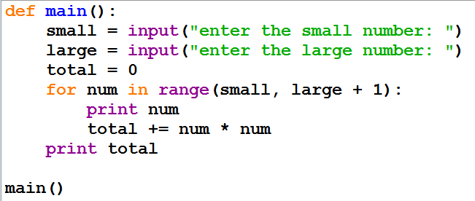
Example: get sum of squares

Slide 11
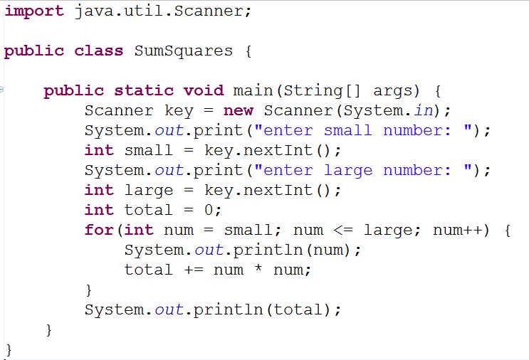
Example: get sum of squares

Slide 12
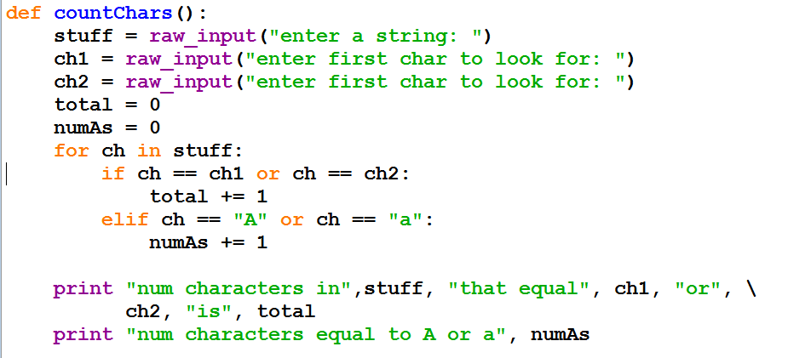
Example: Count number of chars

Slide 13
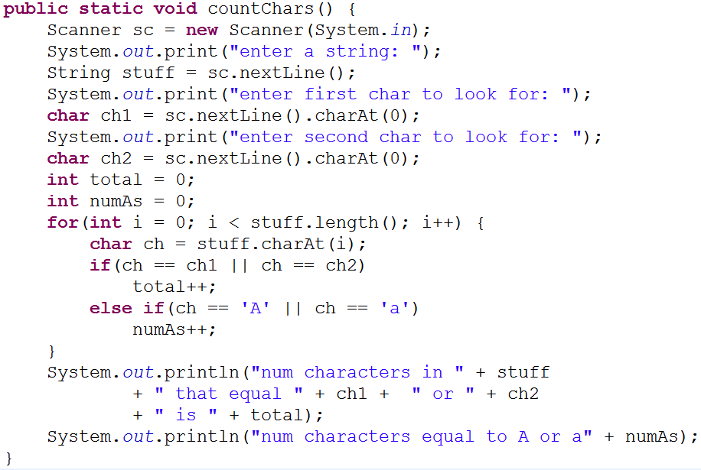
Example: Count number of chars

Slide 14
Example: Search list for values

Slide 15
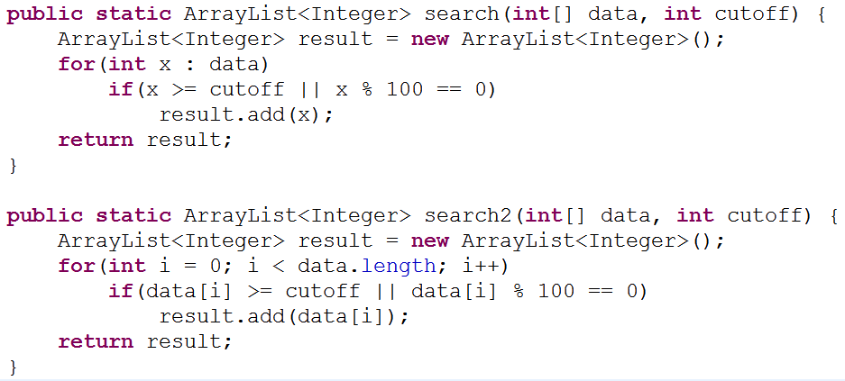
Example: Search list for values

