Slide 1
CS324e - Elements of Graphics and Visualization
Class Intro
www.cs.utexas.edu/~scottm/cs324e/index.htm

Slide 2
Teaching Staff
Mike Scott
Lecturer (not a professor, no PhD, so "Mike" please)
At UT since 2000
scottm@cs.utexas.edu
lab hours MW 3 - 4:30 5th floor PAI lab
also F 12 - 4 in PAI 5.68, but priority for CS378 students
and by appointment
TA: Sarah Abraham
lab hours TBD

Slide 3
Prereqs
CS307, CS314, CS313e, EE422c, or EE322c with C- or better
ability to design and implement medium sized program with some complexity in the algorithms required
work load is significant

Slide 4
Survey
Survey on Java and object-based programming experience

Slide 5
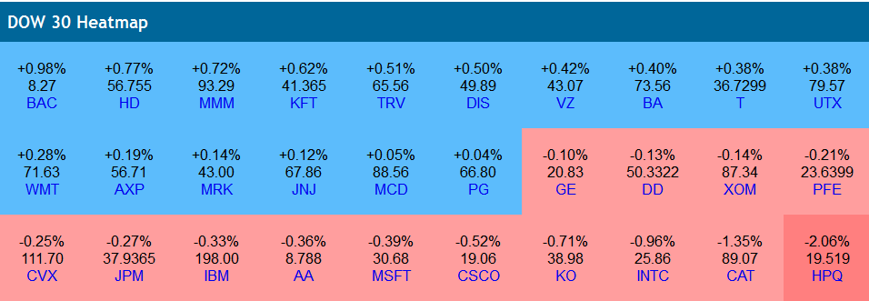
Course Content Graphics and Visualization Heat Map

Slide 6
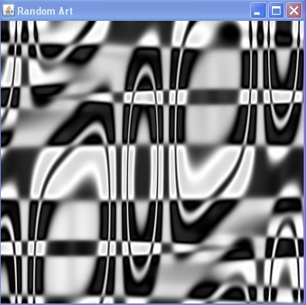
Random Art

Slide 7
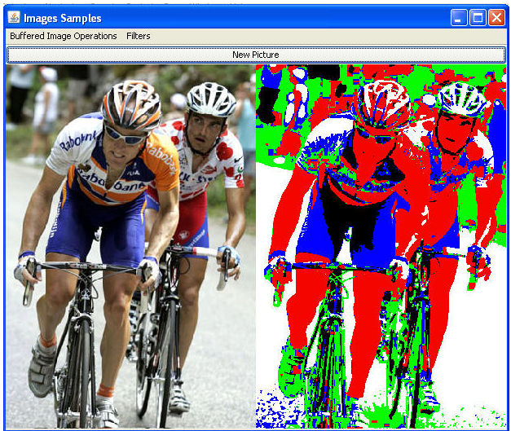
Image Manipulation

Slide 8
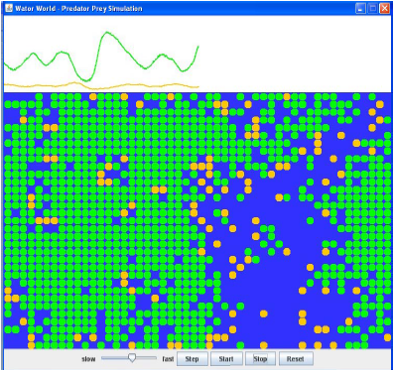
Simulation and Visualization WatorWorld

Slide 9
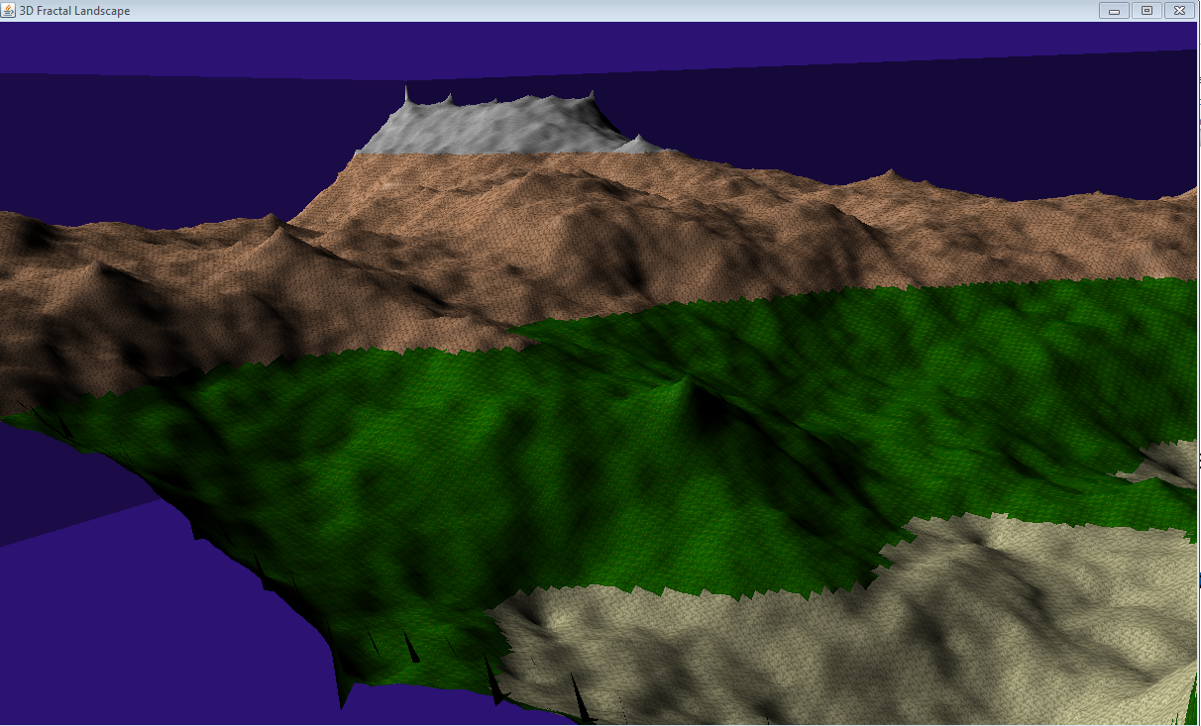
Fractal 3D Landscape

Slide 10
Course Content
Focus on using existing libraries to create programs that use Graphics.
not as much detail on graphics algorithms
call drawLine(int x1, int y1, int x2, int y2) instead of implementing Bresenham's line drawing algorithm
Java review / tutorial, GUIs, Color, 2D graphics, Image filtering, animation, 3D graphics

Slide 11
Other Courses
RTF 319 - Introduction to Digital Media using graphics tools such Illustrator, Photoshop, Flash, etc.
CS 354 - Computer Graphics, more in depth and theoretical
ART 304L - Digital Foundations
CS324e part of Bridging Disciplines Arts and Digital Media Program http://www.utexas.edu/ugs/bdp/programs/dam and Elements of CS Program

Slide 12
Programming Language
Programming language is Java
Survey today on familiarity with Java and object based programming
First 3 class periods will be Java intro / review
First major assignment (A1) just Java, no graphics
not trivial

Slide 13
Book
Filthy Rich Clients - Developing Animated and Graphical Effects for Desktop Java Applications by Chet Hause and Romain Guy, ISBN 978-0-13-241393-0
Readings supplemented with material from the web

Slide 14
Grading
Midterm 10/17 during class, 100 points
Final 12/12, 2 - 5 pm, 300 points
both exams open book, open note
Assignments: 9 programming assignments
point value varies 25 - 125
some individual, some pair
electronic turn in by 11 pm
"This is the first class I have had where I wish the tests were worth more and the homework / projects were worth less"
A: 925 - 1000, A- 900 - 924, B+ 875 - 899, B 825 - 874, B- 800 - 824 and so forth …

Slide 15
Assignments
In Java
6 slip days, no more than 2 on one assignment
CS department account required for turnin, even if you work on your own machine
If you had account last semester should renew
check turnin to see if active:
turnin.microlab.cs.utexas.edu/turnin/webturnin.dll/login

Slide 16
Class Resources
Web page (assignments, schedule, links to reading, code samples)
Class discussion group on Piazza
Grades on Canvas
Microlab (machines with required software and help from me and the TA)

Slide 17
Questions ?????

