Slide 1
CS324e - Elements of Graphics and Visualization
Java GUIs - Frames and Panels

Slide 2
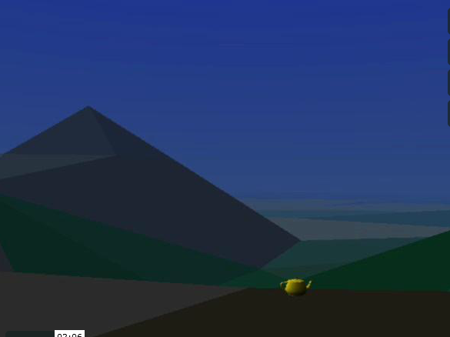
Intro to Java GUIs
First, a little history
Vol Libre. Made by Loren Carpenter in 1979 - 1980.
http://vimeo.com/5810737
Shown at SIGGRAPH

Slide 3
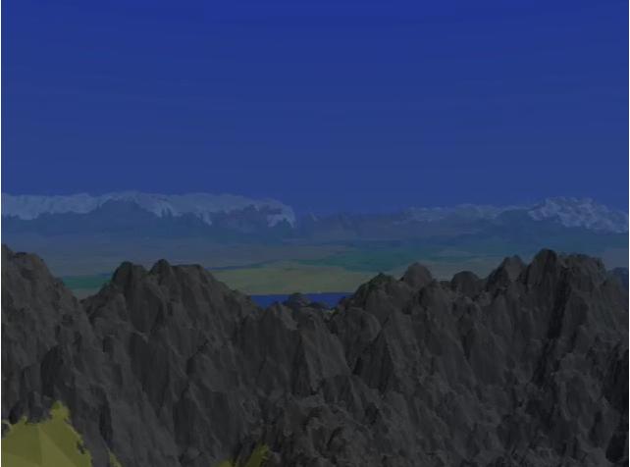
Vol Libre

Slide 4
Vol Libre
Use of fractal (take a shape, split it into subparts, each subpart is the same general shape as the original) to generate things such as mountains, snowflakes, lightning.
We will generate a 3d fractal landscape later in the term

Slide 5
Computer Power
Carpenter reported it took 20 - 40 minutes of computer time to generate each frame of movie
Machine was a VAX-11/780.
A mini computer with a speed of about 0.5 MIPS. (millions of instructions per second)
Ball parking: 2 minutes * 60 sec / minute * 30 frames / sec * 30 minutes / frame =
75 days? Seems high. if frame rate were less, say 5 / sec answer is 12.5 days.

Slide 6
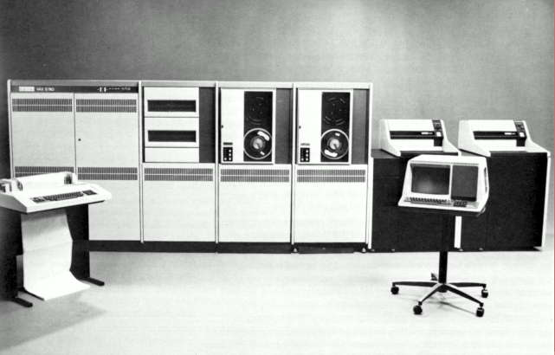
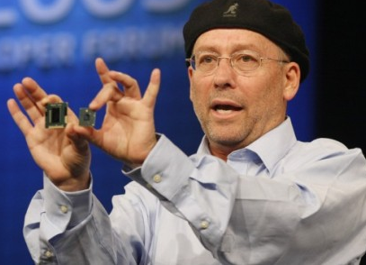
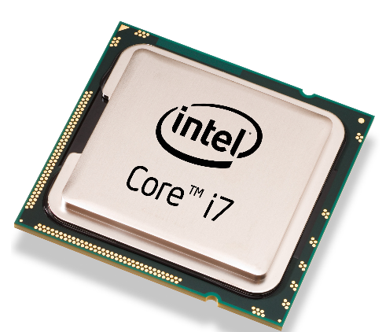
Computer Power
The Vax 0.5 MIPS
Intel Core 7 (high end) 177,730 MIPS
~350,000 times faster
12.5 days / 350,000 = about 3 seconds

Slide 7
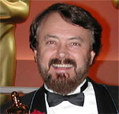
Loren Carpenter
Loren was an engineer at Boeing.
He went to work at the computer division at Lucas Films.
The computer division was eventually sold to Steve Jobs and evolved int Pixar
instrumental in writing the software used to render Pixar movies

Slide 8
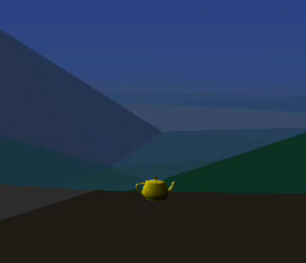
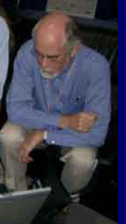
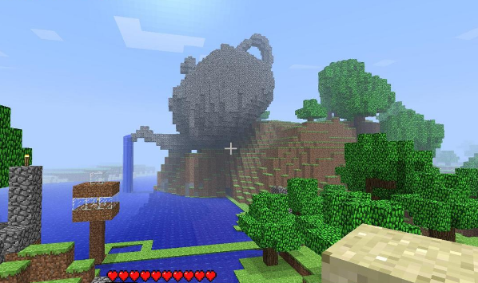
The Teapot
Homage to the "Utah Teapot"
A lot of early work in computer graphics was done at the University of Utah
Martin Newell, 1975
wanted a model of an ordinary object to test graphics engine / program

Slide 9
Java GUIs
Java has huge library of built in classes
The API
works with files, networking, databases, xml, cryptography, graphics, …
AWT (Abstract Windowing Toolkit) and Swing

Slide 10
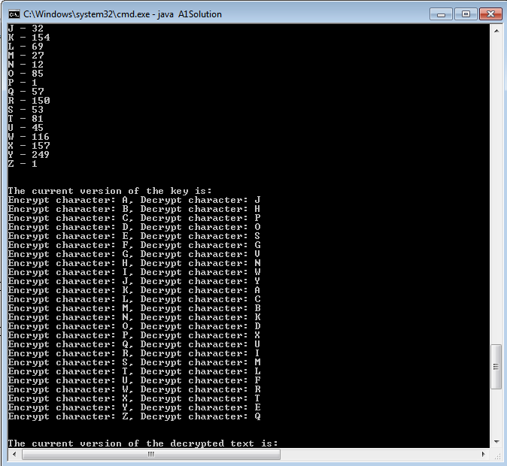
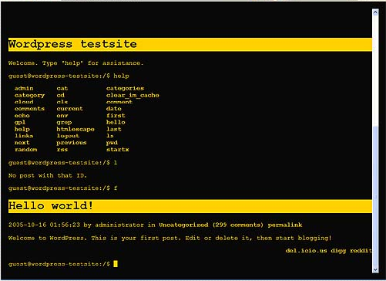
Sidetrack GUIs
In the beginning, was the command line

Slide 11
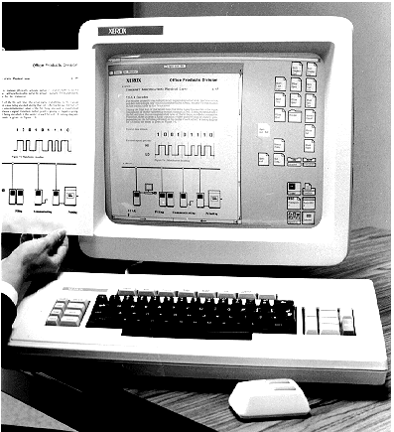
GUIs
As Computer use grew (rapidly) ease of use became an issue
HCI, Human Computer Interaction
GUIs
Xerox Alto from PARC and Xerox Star
Macintosh
Windows

Slide 12
Back to Java GUIs - AWT
early 90s, AWT was first attempt to provide ability to have graphics and GUIs in Java
Approach was to have very little code in Java and instead map to components provided by host machine
use a Max button or a Windows button
Java "Write Once, Run Everywhere"
"write once, debug everywhere"

Slide 13
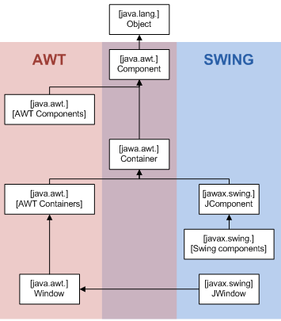
Swing
Sun and Java developers borrowed IFC (Internet Foundation Classes) from Netscape
Everything written in Java, so not as platform dependent as AWT
still use parts of AWT for GUI programming

Slide 14
First Component
use JFrame class
frames hold things
main class to do "other stuff"
creates a frame
Inheritance sidetrack
creating a new data type based on a preexisting data type
get all of the existing methods!
inheritance in Java

Slide 15
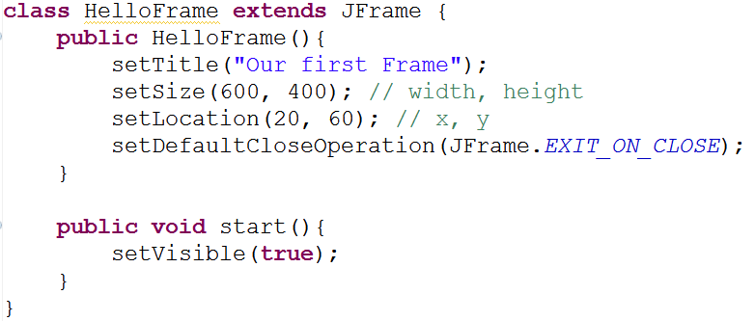
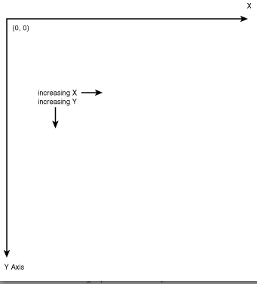
HelloFrame
Graphics Coordinate Systems

Slide 16
JPanel
Frames holds things
We will use panels as out canvas to draw (paint stuff)
painting metaphor very useful in Java graphics
panel is like a frame and a canvas
Panels can hold other things, but can we can also paint on them

Slide 17
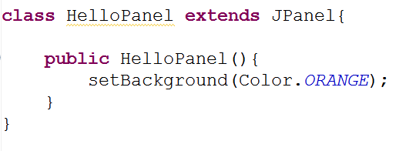
HelloPanel
Initial Version:

Slide 18
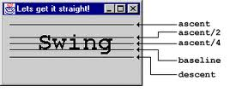
Try Drawing on Panel
Naïve attempt:
get graphics object for panel
drawString method
x, y are of baseline of String
in constructor?
in start()?
what happens when frame resized?

Slide 19
Swing Rendering
"Something" generates a paint request
such as resizing the frame
A component, such as the frame will eventually have its paintComponent method called
The component's children will also have their paintComponent method called
back to front painting

Slide 20
Override paintComponent
in HelloPanel
what happens if don't call super.paintComponent?
what happens when resized?

