Slide 1
CS324e - Elements of Graphics and Visualization
Java GUIs - Event Handling

Slide 2
Event Driven Programming
A "Programming Paradigm"
others: object-oriented, functional, data -flow, procedural, and more!
Most early programs we write:
get data
perform computations
output results
CRUD programming (Create, Read, Update, Delete)
That's not how most programs we use actually behave.

Slide 3
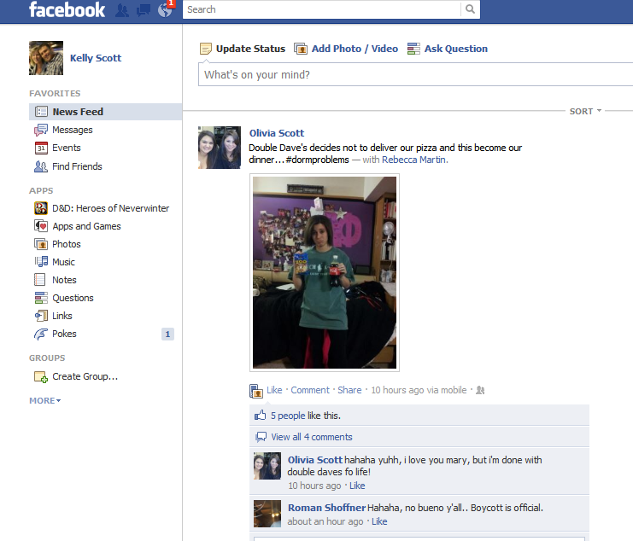
Event Driven Programming

Slide 4
GUIs and Events
Most programs sit there and wait for the user to respond
Flow of control is based on user actions
User action is an event that the program responds to
Different languages have different levels of support for doing event driven programming

Slide 5
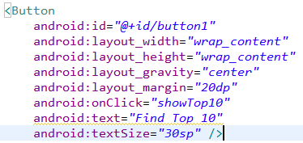
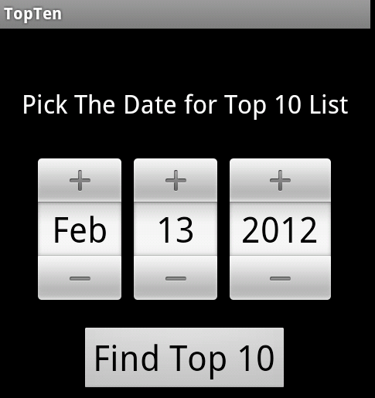
Events Handling
High level approach:
fixes set of events and can attach code to the event: android:onclick
Low level approach
must write code to check if events have occurred and deal with them in other code
Big old switch statement

Slide 6
Java Event Handling
Java is in between the high level and low level approaches
Built in GUI components in Swing:
buttons, check box, combo box, lists, menus, radio buttons, sliders, spinners, text fields, password text fields, labels, trees, color chooser, file chooser, separators, progress bars, trees, tables, and more
http://docs.oracle.com/javase/tutorial/ui/features/components.html

Slide 7
Java Event Handling
These built in components can be added to top level containers such as frames (menus) and panels
Position is handled via a layout manager
initially we will use default layout manager FlowLayout
components added one after another in a line
Components are drawn and generate events

Slide 8
New Sample Program
Program with buttons
background color changes when button pressed
Main program -> frame -> panel
Panel has an instance variable currentColor
When paint component called, background set to currentColor
demo

Slide 9
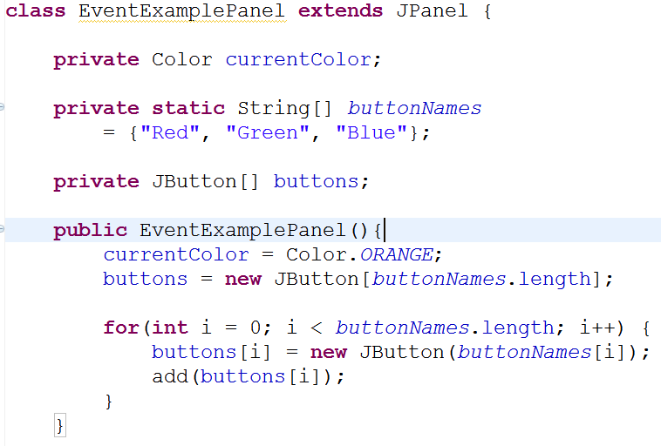
Add Buttons
Add Buttons to the panel

Slide 10
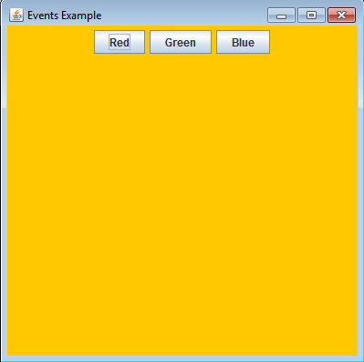
Result of Adding Buttons
Notice order of buttons
What happens if change order of names?
What happens if add more buttons?
What happens if resize Frame?
What happens if Button pressed?

Slide 11
Listeners
When the buttons are pressed events are being generated, but no one is listening
In other words we don't have any code that responds to the events
We need to create listeners for each button to listen for the event and respond by changing background color

Slide 12
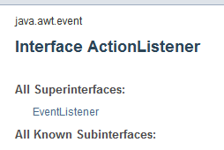
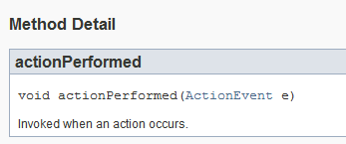
ActionListener
LOTS of kinds of listeners
All extend or implement the EventListener interface
http://docs.oracle.com/javase/7/docs/api/java/util/EventListener.html
We will create a class that implements the ActionListener interface

Slide 13
Try a Separate Class
Create a ColorAction class
instance vars
constructor
actionPerformed method
repaint -> request an entire component be repainted. Don't call paintComponent
array of colors
build ColorAction and attach to each button

Slide 14
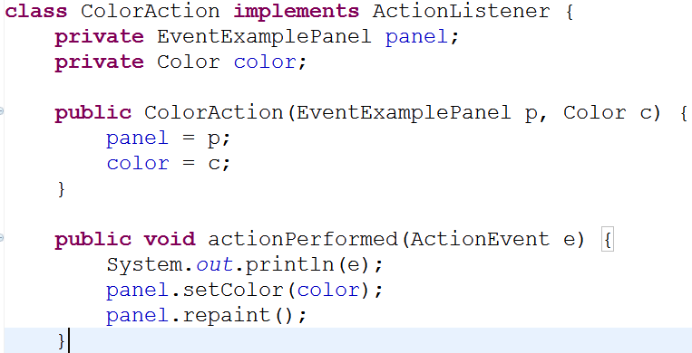
ColorAction class

Slide 15
Change Panel Class
create setColor method
add array of colors
change constructor
call addActionListener on each button and add an appropriate ColorAction

Slide 16
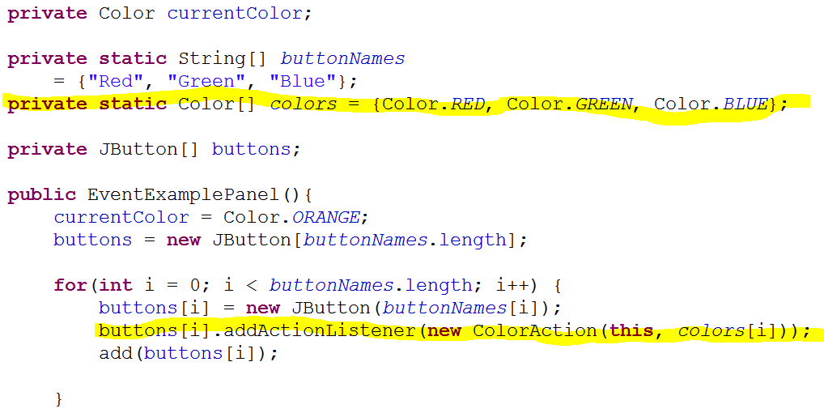
Changes to EventExamplePanel
Demo -> Examine output of ActionPerformed
Add more buttons and colors

