Slide 1
CS324e - Elements of Graphics and Visualization
Java2D Graphics

Slide 2
Java2D Graphics
Render
Heating animal remains to extract fat
generating an image from a (mathematical) model
Java2D can handle primitive shapes, text, images
The Graphics object is an abstraction used to perform the rendering

Slide 3
Graphics Object Properties
foreground color - setColor(Color c)
background color - setBackground(Color c)
font - setFont(Font f)
stroke - how wide is brush plus end joints - setStroke(Stroke s)
rendering hints - for example anti-aliasing (demo bugs)
clip - region to which drawing is constrained

Slide 4
Graphics Object Properties
Composite - what method to use to combine color data from a new object being drawn to the objects already on the screen
Paint - similar to color, allows the creation of gradients
Transform - size, position, and orientation of drawing primitives
translate, rotate, scale, shear

Slide 5
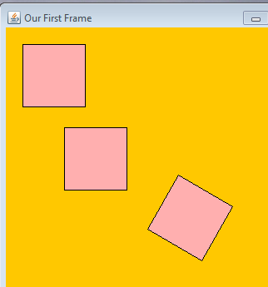
Transforms
Methods to apply an affine transformation
affine transformations alter the coordinates of an object but preserve straight lines and proportions between points on a straight line

Slide 6
Examples
Translate
Rotate
translate after a rotation
Scale
Shear
If you specify a non-zero x shear, then x values will be more and more shifted to the right the farther they are away from the y axis. For example, an x shear of 0.1 means that the x value will be shifted 10% of the distance the point is away from the y axis. Y shears are similar: points are shifted down in proportion to the distance they are away from the x axis.
http://www.apl.jhu.edu/~hall/java/Java2D-Tutorial.html#Java2D-Tutorial-Transforms-Shear

Slide 7
Graphics Primitives
the Graphics2D fill and draw methods accept parameters of type Shape
polymorphism
Built in Shapes
Arc2D
Ellipse2D
Line2d
Polygon
Rectangle2D
and more!

Slide 8
Ellipse2D
Specify x and y of upper corner of bounding box, width and height
abstract class
nested classes
Ellipse2D.Double
Ellipse2D.Float

Slide 9
Arc2D
Multiple constructors
ellipse bounds, start angle, extent angle, type
angles in degrees
types: CHORD, OPEN, PIE
"The angles are specified relative to the non-square framing rectangle such that 45 degrees always falls on the line from the center of the ellipse to the upper right corner of the framing rectangle."

Slide 10
Arc2D
CHORD PIE OPEN
start = 30, extent = 110

Slide 11
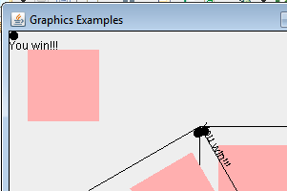
Fonts
Recall the drawString method from the Graphics class:
Property of the graphics object is the current font

Slide 12
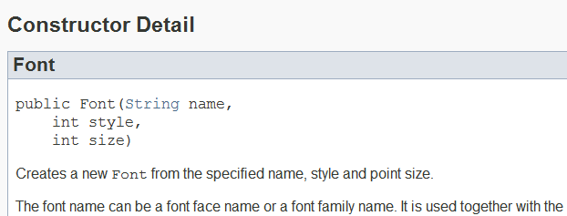
Fonts
Font can be changed
Font constructors

Slide 13
Font Properties
Font family names:
DIALOG, DIALOG_INPUT, MONOSPACED, SANS_SERIF, SERIF
Styles:
BOLD, ITALIC, PLAIN
Size: point size

Slide 14
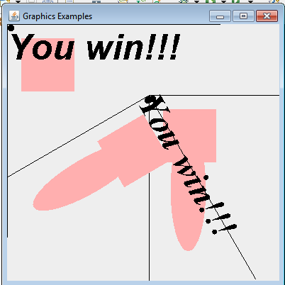
Font Example
| operator

Slide 15
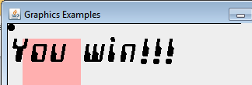
Checking Available Fonts
Last time I ran it, 302 fonts
Handles nonexistent fonts gracefully

Slide 16
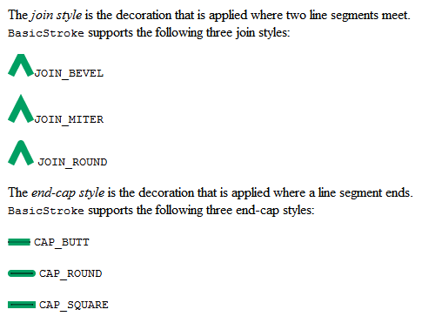
Stroke
line width
end caps of lines
join style for multi-segment lines

Slide 17
Stroke
parameters: width, cap, join, miterLimit, dash, dash_phase
Also constructor with just new line width

Slide 18
Sample Stroke
From previous slide,
dashed (10, 5), round caps

Slide 19
The Clip
Restrict area the graphics object will draw on
Can be any Shape
so far just primitives, ellipses, rectangles, arcs
More advanced possible

Slide 20
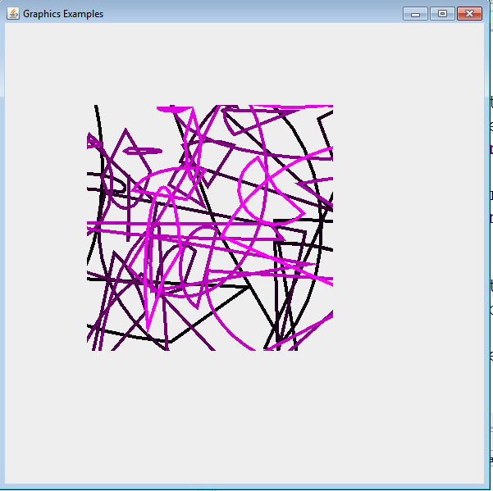
The Clip

Slide 21
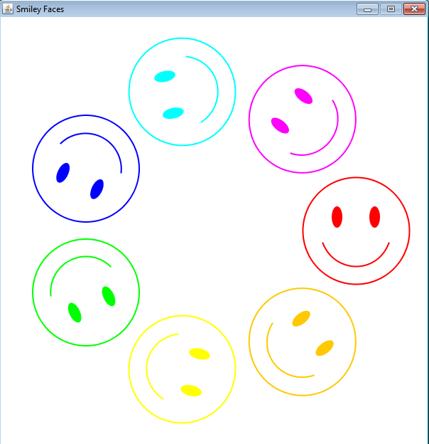
Write a program to draw a circle of Smiley Faces

Slide 22
One Smiley Face
frame for smile arc
Center face to center eye
face size
eye size

Slide 23
Calculate Eye Distance
center face to center eye distance
y distance = hyp * sin(angle)
x, y for center of face
x distance = hyp * cos(angle)

Slide 24
Use Constants!
Constants for various dimensions
Could even have constants for various ellipses and arcs
no need to recalculate each time if the graphics object is translated and rotated correctly
Complete code to draw one face at a given location and angle
generalize the solution!!

Slide 25
Drawing Many
To draw many smiley faces translate graphics to middle of panel
determine angle increment for each face
calculate center point for each face
trigonometry again
array of colors for faces

Slide 26
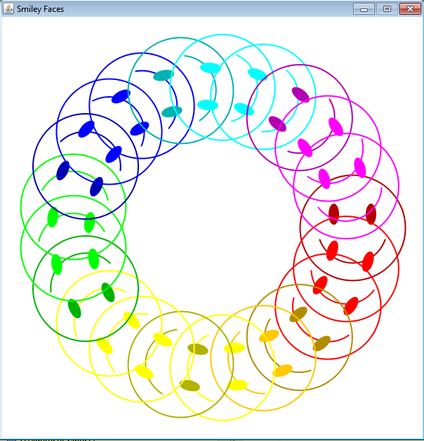
manyColor

