Slide 1
CS324e - Elements of Graphics and Visualization
More Java2D Graphics

Slide 2
More 2D Graphics "Primitives"
We have already seen:
  rectangles, ellipses, arcs, lines
Today:
  curves, polygons, areas, paths

Slide 3
Quad Curves
Quadratic curves
Defined with 2 end points and a control point
A type of Bézier curve
A way to model smooth curves
Given ends points and control points, points on the curve are calculated
  popularized by Pierre Bézier for designing automobile bodies, based on early work of Paul de Casteljau

Slide 4
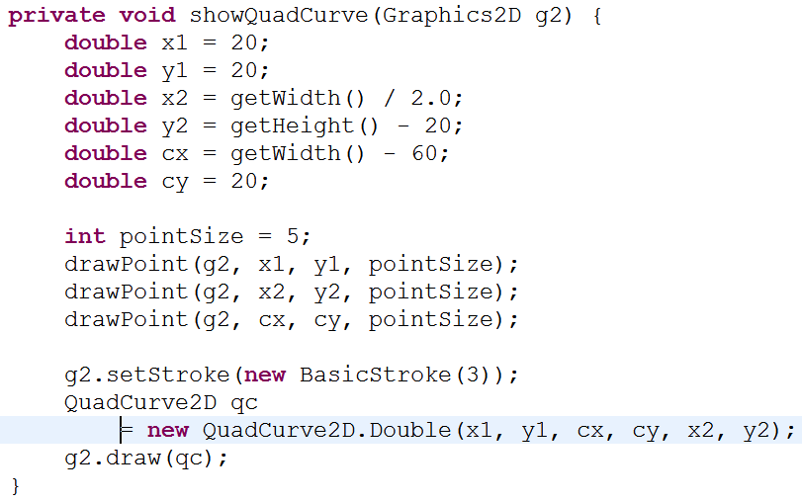
Code to Draw QuadCurve

Slide 5
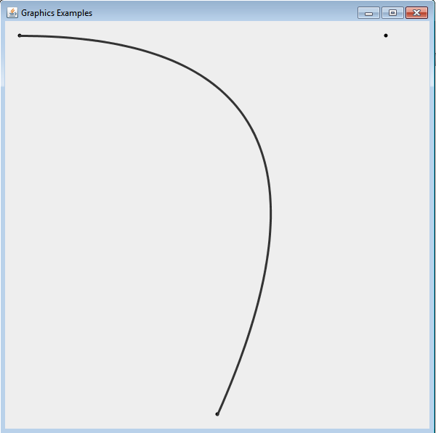
Result

Slide 6
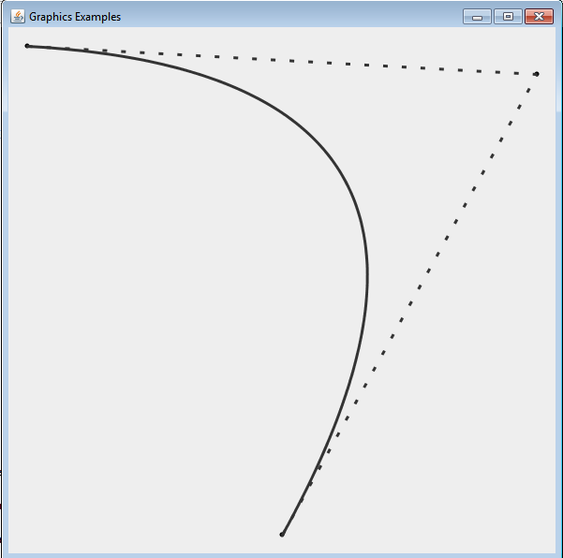
Lines from End Points to Control Point

Slide 7
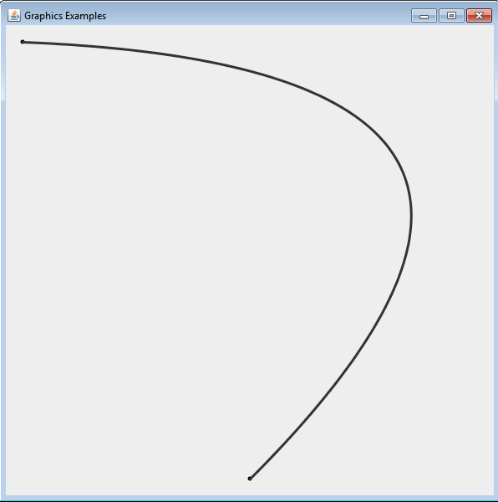
Another QuadCurve
Control point does not need to be on screen

Slide 8
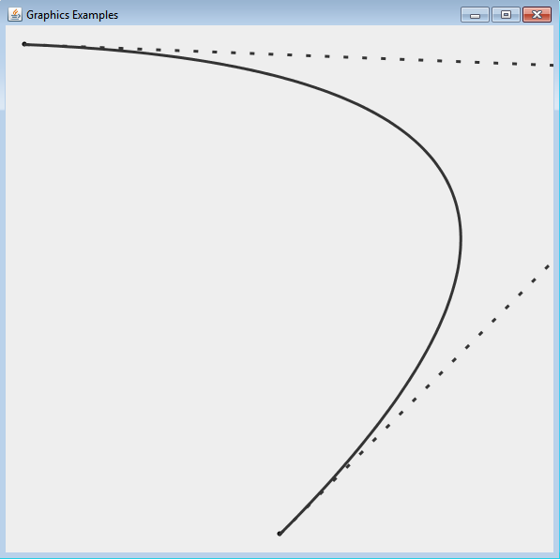
Showing Lines from End Points to Control Point

Slide 9
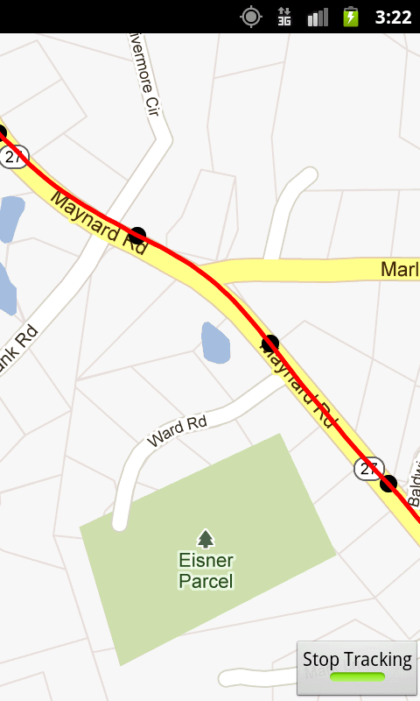
Use of QuadCurve
Mapping Application
Drawing lines (curves) between track points
Uses QuadCurves to connect points

Slide 10
Aside - Responding to MouseEvent
Alter program so a mouse click changes the control point for the curve
cx and cy become instance variables
Create a MouseListener to respond to mouse clicks
add listener to the panel

Slide 11
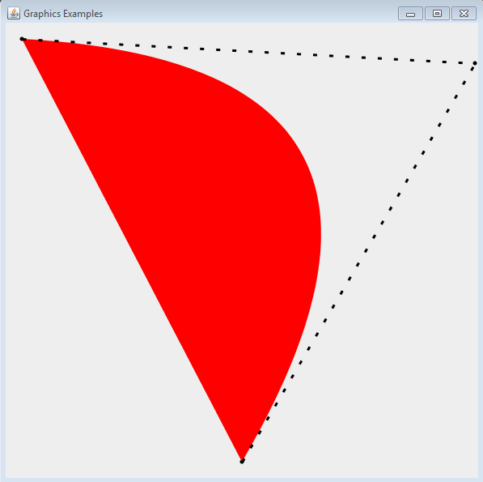
Graphics Fill
result of g2.fill(quadCurve)

Slide 12
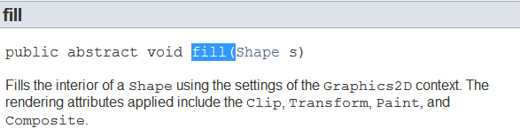
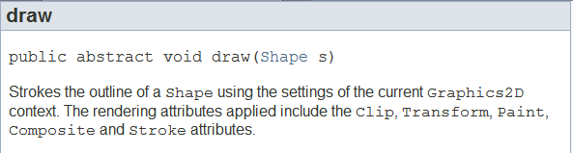
Aside fill and draw
Methods in the Graphics2D class

Slide 13
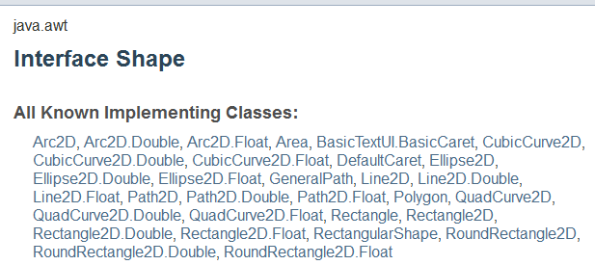
Polymorphism
Shape is an interface in Java
  the to do list
Any class that implements the Shape interface can be sent as an argument to draw and fill

Slide 14
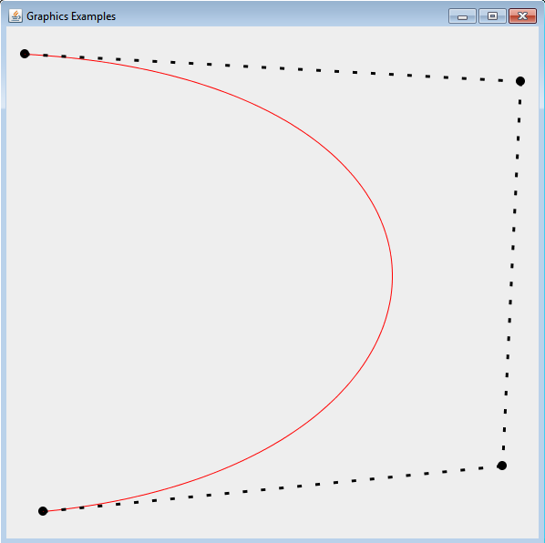
Cubic Curve
Another Bézier curve, but with 2 control points
draw or fill
s curve if control points on opposite sides of endpoints

Slide 15
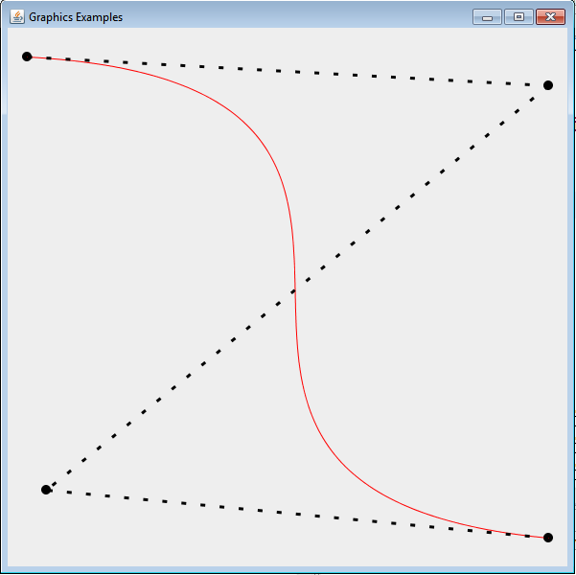
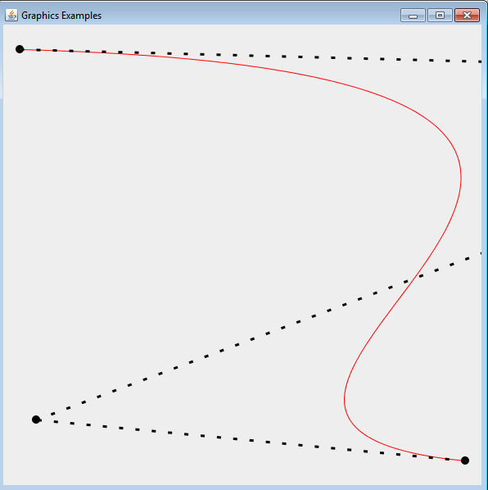
Cubic Curves

Slide 16
General Path
Combine lines, quad curves, and cubic curves into a general path
can create with a Shape or empty
methods to moveTo, lineTo, quadTo, curveTo
  similar to turtle graphics
can be drawn or filled

Slide 17
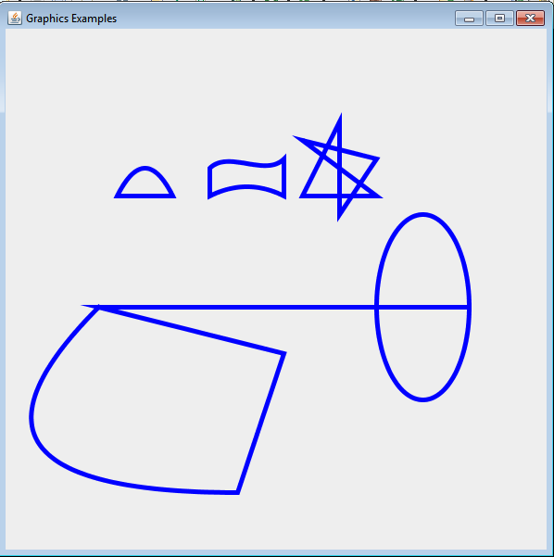
General Paths

Slide 18

Filling General Paths
Filling of a general path depends on the winding rule set for the path
Two winding rules:
  Path2D.WIND_EVEN_ODD
  Path2D.WIND_NON_ZERO

Slide 19
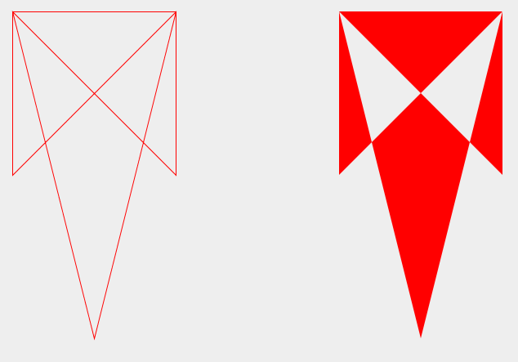
Sample Path
Path2D.WIND_EVEN_ODD

Slide 20
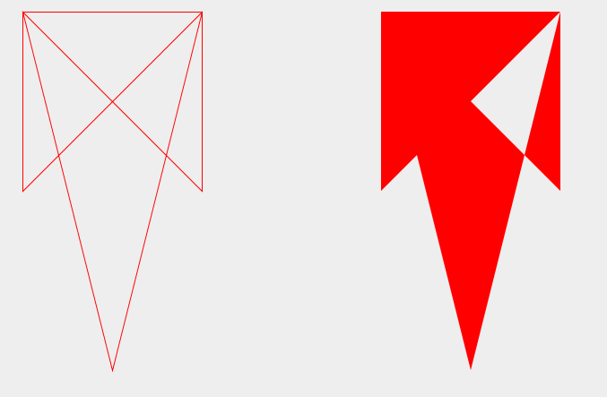
Sample Path
Path2D.WIND_NON_ZERO
(Must know direction path drawn)

Slide 21
WIND_EVEN_ODD
To determine if region is inside or outside the path draw a line from inside the region to outside the path (infinity)
If the number of crossings is odd then the region is inside the path.
If the number of crossings is even then the region is outside the path.

Slide 22
Even Odd Example
cross path 1 time
odd, inside
cross path 2 times
even, outside
cross path 1 time
odd, inside

Slide 23
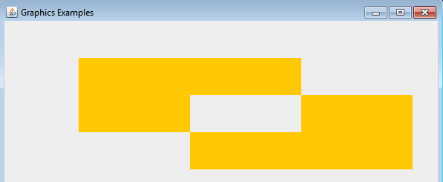
Even Odd Result

Slide 24
Non Zero Rule
The direction of the path crossed is considered
Draw line from region to infinity
Initialize counter to 0
Every time path crossed "left to right" add 1
Every time path crossed "right to left" subtract 1
Interior regions have a total not equal to 0

Slide 25
Non Zero Example
cross left to right
count = 1
cross left to right
count = 1
cross left to right
count = 2

Slide 26
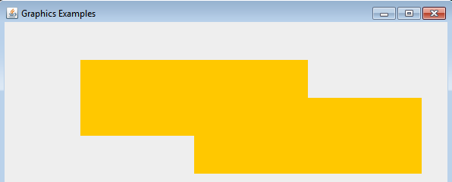
Non Zero Result

Slide 27
Change Direction of One Path
Result?

Slide 28
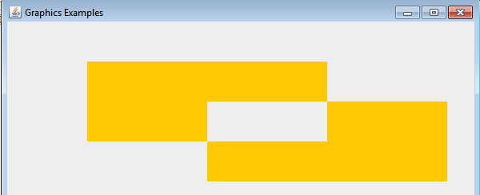
Result
Default of GeneralPath is NON_ZERO
Does direction of path affect interior regions for EVEN_ODD ruler?

Slide 29
Areas
Areas are to General Paths as Rectangles and Ellipses, are to Lines and Curves
Build an area out of multiple shapes
Constructive Area Geometry - CAG
Alter area by
  add (union)
  subtract
  intersection
  exclusive or (union minus intersection)

Slide 30
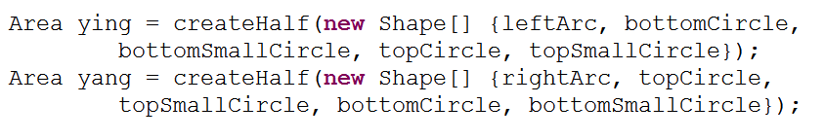
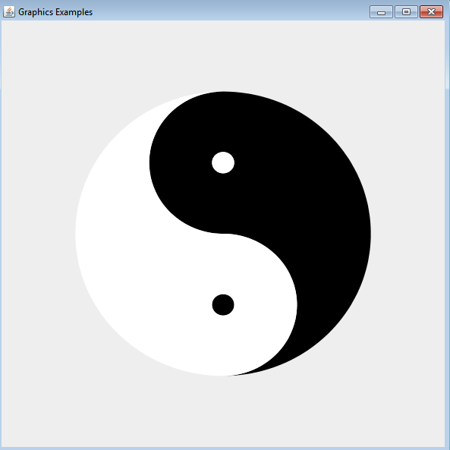
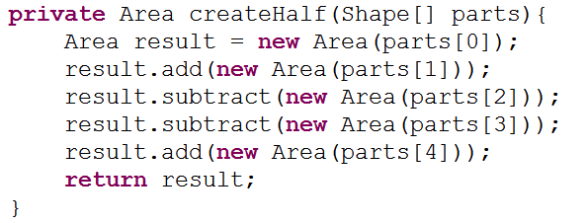
Sample CAG

Slide 31
Sample CAG
c2
r1
Area a1 = new Area(r1);
Area a2 = new Area(r2);
Area a3 = new Area(c1);
Area a4 = new Area(c2);
Area a5 = new Area(c3);
a1.subtract(a2);
a1.add(a3);
a1.exclusiveOr(a4);
a1.subtract(a5);
// result??
c1
r2
c2

