Slide 1
CS324e - Elements of Graphics and Visualization
Compositing

Slide 2
Compositing
How to store or combine colors in a drawable primitive (Shape, String, Image) with the colors already present in the destination
aka Blending
used extensively to combine CGI effects and live footage
Java 2D:
Composite interface
setComposite method on Graphics2D object

Slide 3
Alpha Compositing
Composite class implemented by one class in Java: AlphaComposite
rules affect the alpha value (transparency)
rules are mathematical and determine color and alpha for source (thing being drawn) and the destination (the graphics area and the things that have already been drawn)

Slide 4
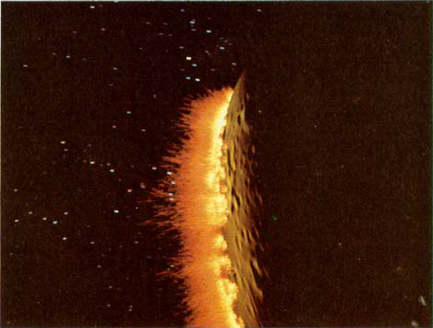
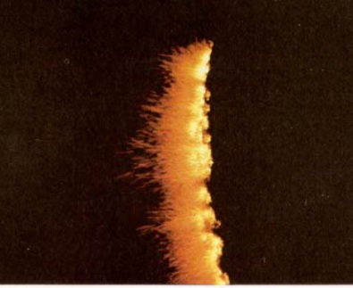
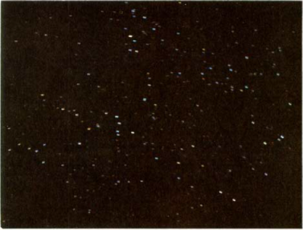
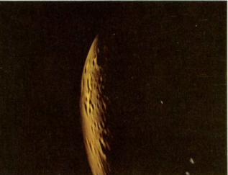
Porter Duff Rules
12 rules in AlphaComposite
Paper by Thomas Porter and Tom Duff
Clear, Dst, dstAtop, DstIn, DstOut, DstOver, Src, SrcAtop, ScrIn, SrcOut, SrcOver, Xor
http://graphics.pixar.com/library/Compositing/paper.pdf

Slide 5
Math Behind One Example
Source Over, SrcOver
"Composite the source over the destination as if the source were a translucent painting on a piece of glass held over the destination."
mixing of colors

Slide 6
Source Over
A_{r} = A_{s} + A_{d} * (1 - A_{s})
C_{r} = C_{s} + C_{d} * (1 - A_{s})
A is the alpha channel (value) of the pixel
C is the color component of the pixel
r = result
s = source
d = destination

Slide 7
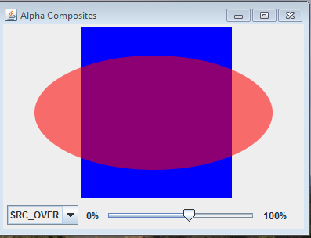
Src Over Result
red oval is source
alpha set to 50%
blue rectangle is destination drawn onto a transparent image (any non blue pixels are transparent)

Slide 8
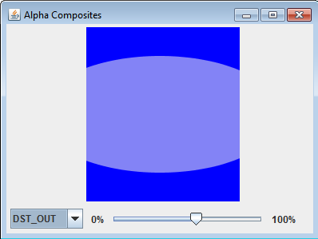
Example 2- DstOut
"The part of the destination lying outside of the source replaces the destination. Opposite of DstIn, but with an alpha value of 50 percent, both operations look the same"
A_{r} = A_{d} * (1 - A_{s})
C_{r} = C_{d} * (1 - A_{s})
notice, no red
only effect from alpha of source

Slide 9
Example Program
red oval is source
blue rectangle is destination drawn onto a transparent image (any non blue pixels are transparent)
Java adds parameter to Porter-Duff rules, alpha value of source prior to blending with destination
In examples alpha values 50% opacity

Slide 10
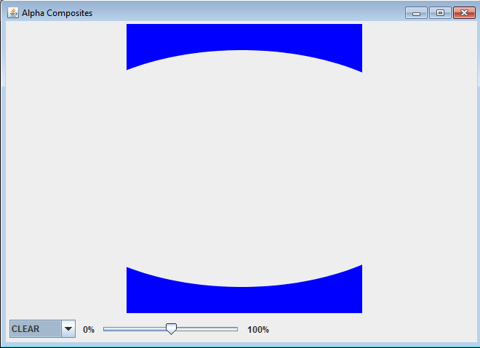
Clear
Color and alpha of destination cleared

Slide 11
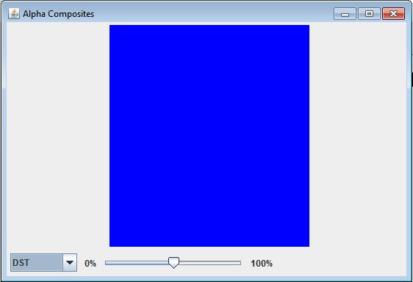
Dst
Destination untouched (not so useful)

Slide 12
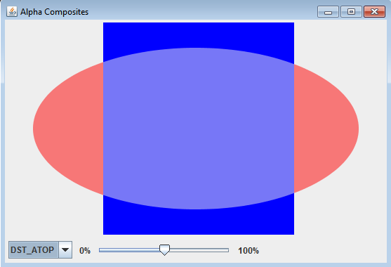
DstAtop
Part of destination inside of source is composited with source and replaces destination.
Destination appears to be drawn on top of source.

Slide 13
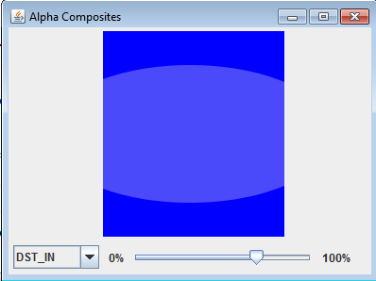
DstIn
The part of the destination inside the source replaces the destination

Slide 14
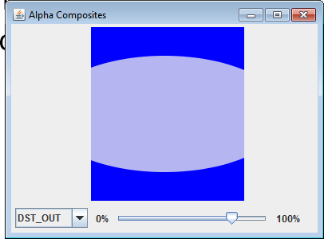
DstOut
The part of the destination outside the source replaces the destination

Slide 15
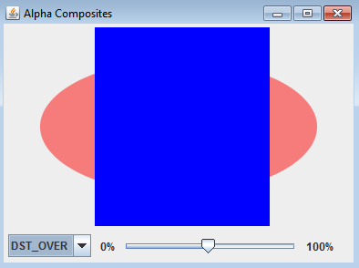
DstOver
The destination is composited with the source and the result replaces the destination.

Slide 16
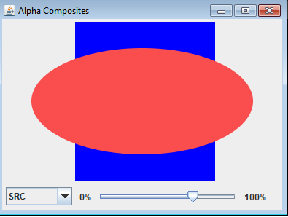
Src
Source copied into destination. (no blending due to alpha)

Slide 17
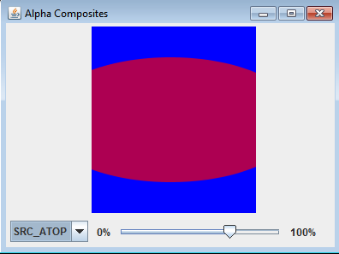
SrcAtop
Source inside the destination is composed with the destination. Source outside destination discarded.

Slide 18
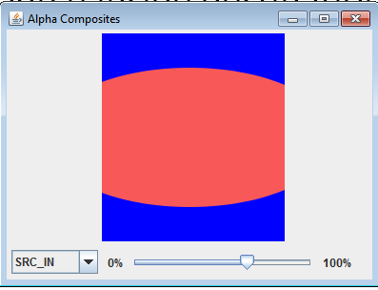
SrcIn
Source inside destination replaces destination. Source outside destination discarded.

Slide 19
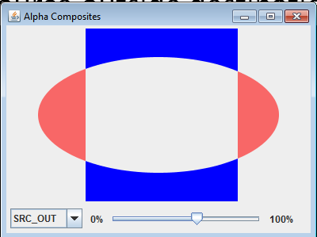
SrcOut
Source outside destination replaces destination. Part of source inside is discarded

Slide 20
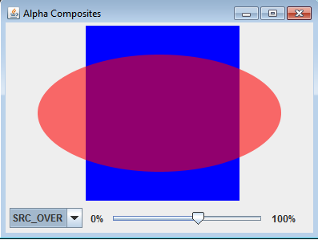
SrcOver
Source is composed / blended with destination. (Standard behaviors of graphics object)

Slide 21
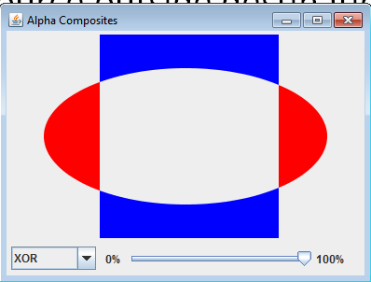
Xor
Source outside destination combined with part of destination that is outside source.
similar to CAG

Slide 22
Effects with AlphaComposites
Four most useful rules:
Clear, Src, SrcOver, SrcIn
Clear:
erase an arbitrary shape.

Slide 23
Programmer Defined Composites
Examples from Filthy Rich Clients
Recall, two images, a source and a destination
Composites similar to image filtering
Recall BufferedImageOp
FRC textbook: BlendComposites
Implements the Composite interface
Lots of support code

Slide 24
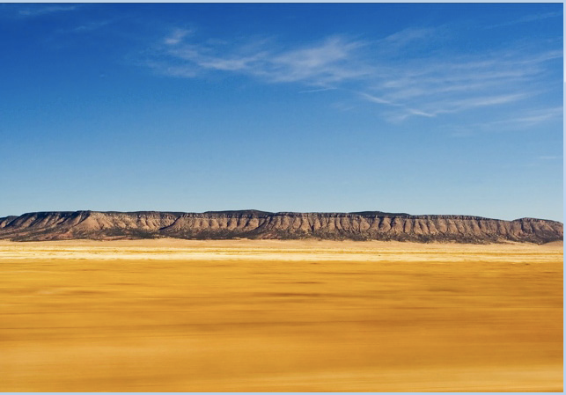
BlendComposites
Lots of support code, but different Composites from different rules (blending) for combining source and destination image
Example images
dest
src

Slide 25
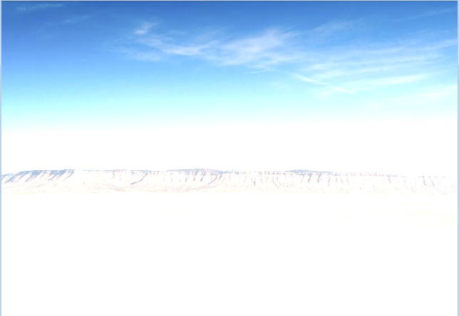
BlendComposites - ADD
Array values are RGBA

Slide 26
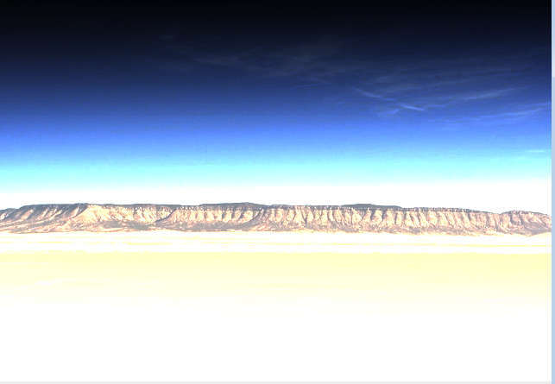
BlendComposites - GLOW

Slide 27
Putting AlphaComposites and Gradients to Use
Create a reflection of an image using gradients and alpha composite
Draw an image
Draw the same image below it, reflected
Create a paint that varies alpha from half to 0
Use Alpha Composite to combine alpha paint and upside down image

Slide 28
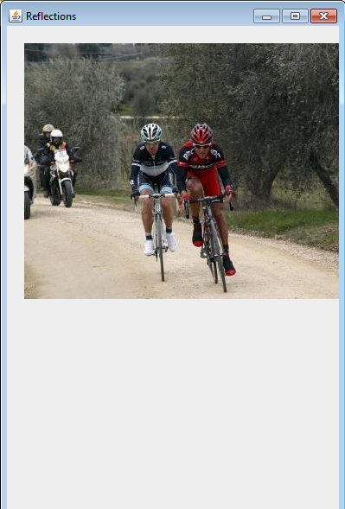
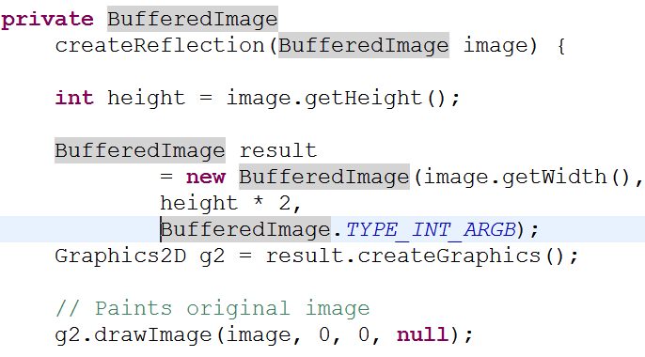
Image

Slide 29
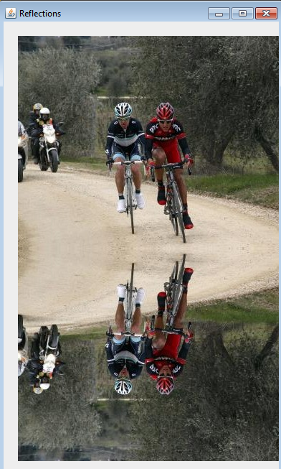
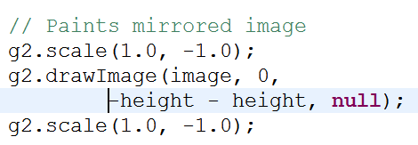
Reflection

Slide 30
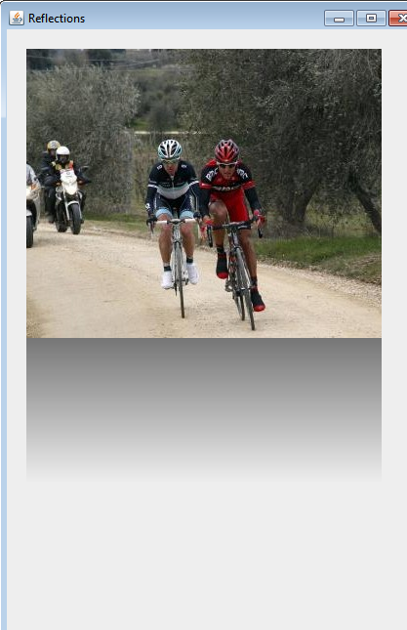
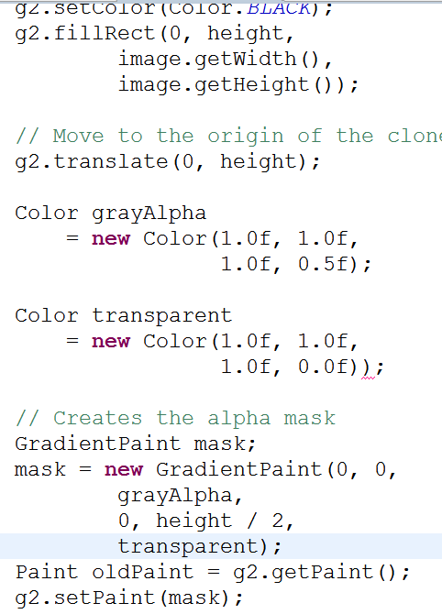
Gradient (alpha mask)

Slide 31
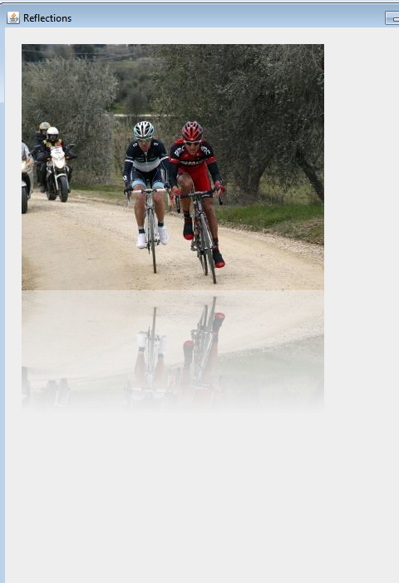
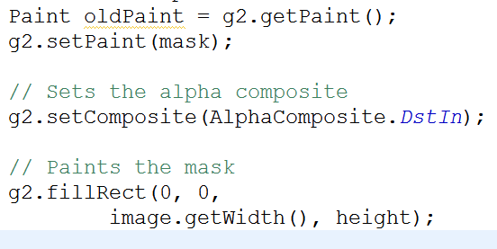
Final result using AlphaComposite DstIn

