Slide 1
CS324e - Elements of Graphics and Visualization
Gradients

Slide 2
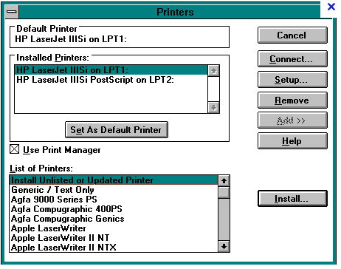
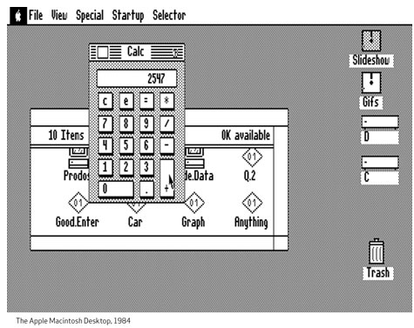
GUIs
Windows 3 1990
Mac 1984

Slide 3
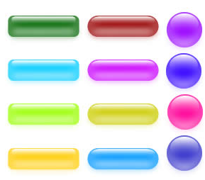
GUIs

Slide 4
Gradients
Gradient: vary color from one to another interpolating in between
Current trend (~2010) is to use gradients everywhere in interfaces and graphic design
Java provides some built in classes to create and apply gradients
GradientPaint
LinearGradientPaint
RadialGradientPaint

Slide 5
GradientPaint
Define two end points and two colors
color varies along a line drawn between two points
same colors along lines drawn perpendicular to line connecting points
Set Graphics2D object paint to the GradientPaint
Anything drawn or filled uses gradient

Slide 6
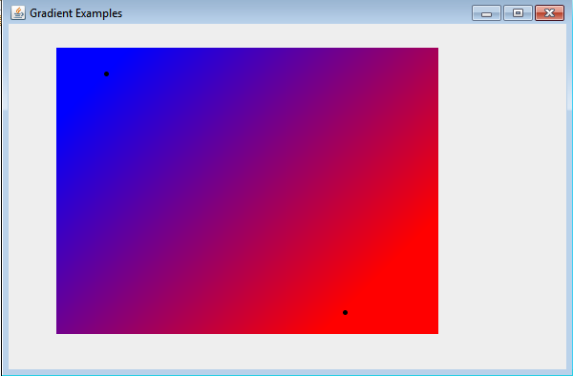
GradientPaint Example

Slide 7
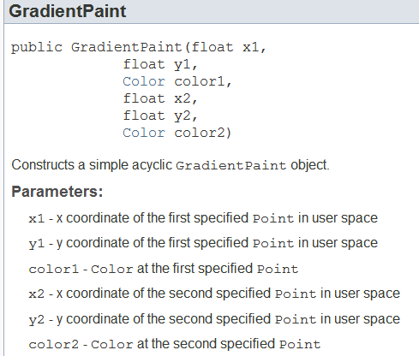
GradientPaint

Slide 8
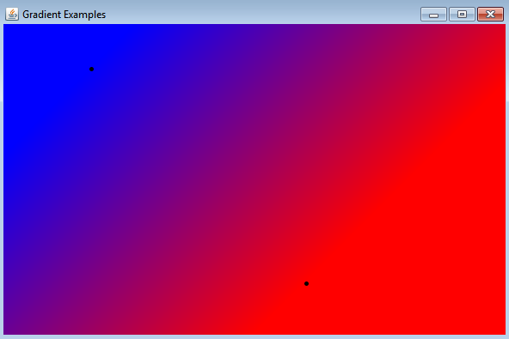
GradientPaint
By default gradient is acyclic
beyond endpoints color is same as color at endpoint

Slide 9
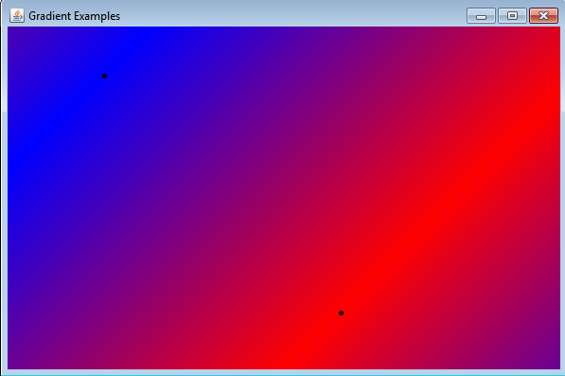
GradientPaint
Set GradientPaint to cyclical
another constructor

Slide 10
LinearGradientPaint
Until Java 6.0 in 2006 GradientPaint was only gradient
LinearGradientPaint added in version 6.0
GradientPaint only allowed 2 paints
LinearGradientPaint allows 2 or more colors
Can alter "distance" between two paints
More options

Slide 11
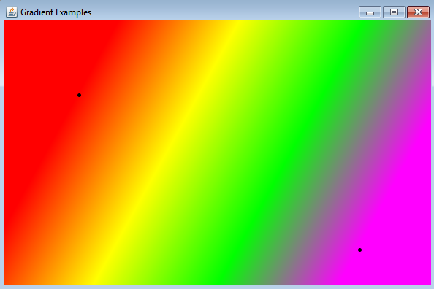
LinearGradientPaint
4 Colors

Slide 12
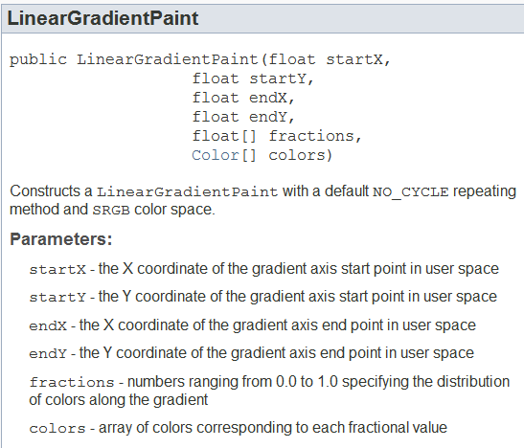
LinearGradientPaint
Define 2 endpoints
array of fractions and array of colors must be equal in length
fractions defines portion to use that color

Slide 13
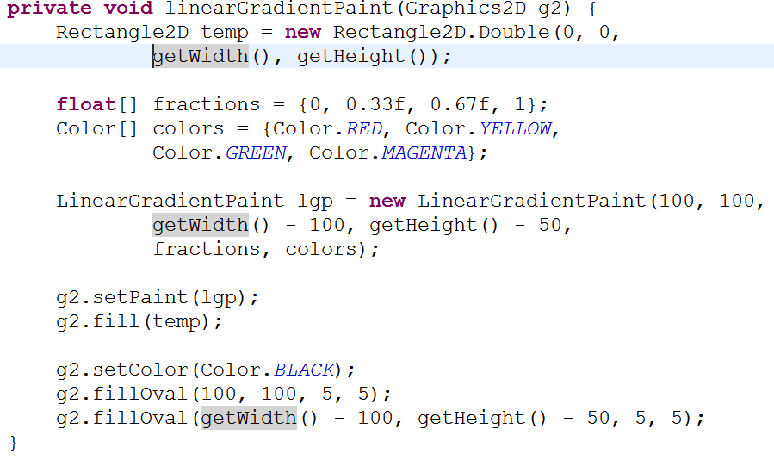
LinearGradientPaint

Slide 14
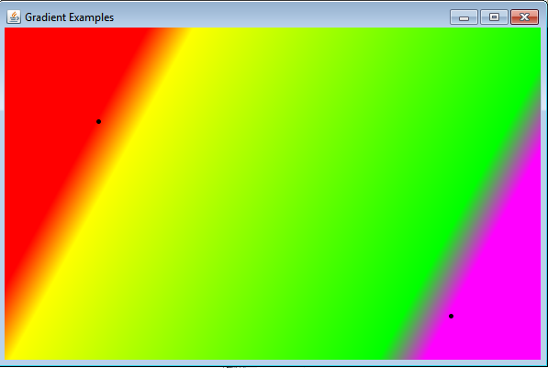
LinearGradientPaint
Change Fractions
{0, 0.1f, 0.9f, 1} // f for float
fractions must be in strictly increasing order

Slide 15
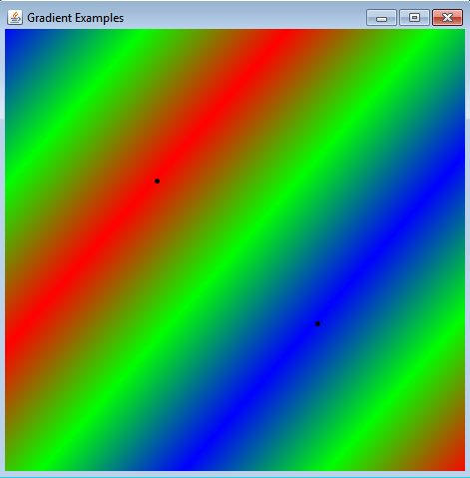
LinearGradientPaint - REFLECT
Previous examples were acyclic
Cycle can be set to reflect or repeat

Slide 16
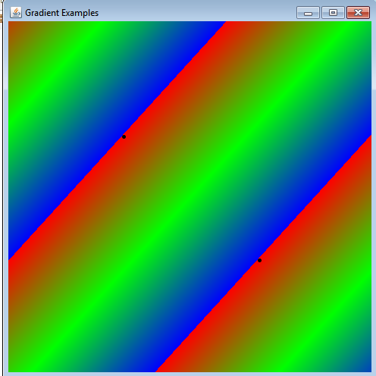
LinearGradientPaint - REPEAT

Slide 17
LinearGradientPaint
or REPEAT

Slide 18
RadialGradientPaint
Specify two or more colors, a center point, and a radius
can also set the focal point to a spot other than the center
May be acyclic (NO_CYCLE), REFLECT, or REPEAT similar to LinearGradientPaint

Slide 19
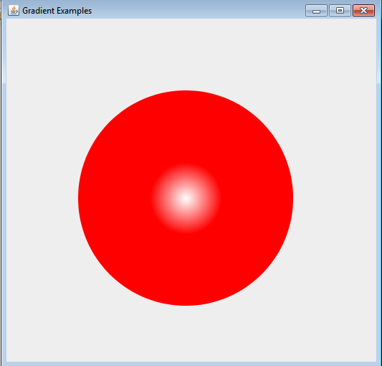
RadialGradientPaint

Slide 20
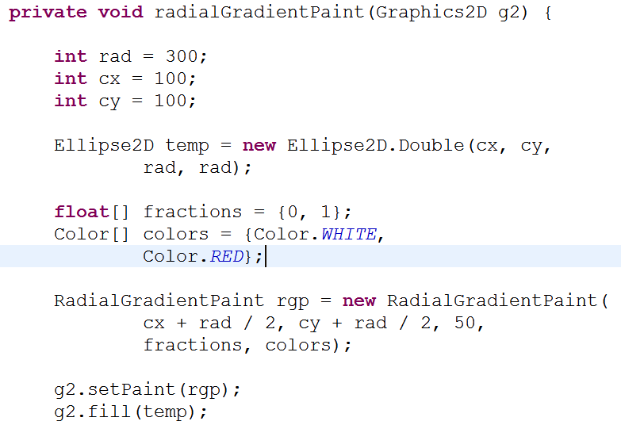
RadialGradientPaint

Slide 21
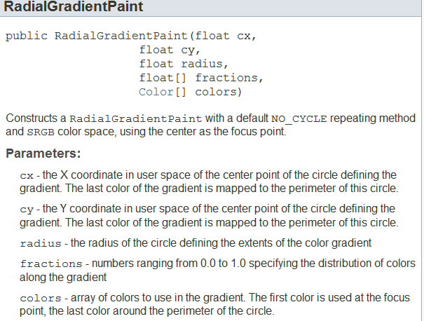
RadialGradientPaint Constructor
Not only one!

Slide 22
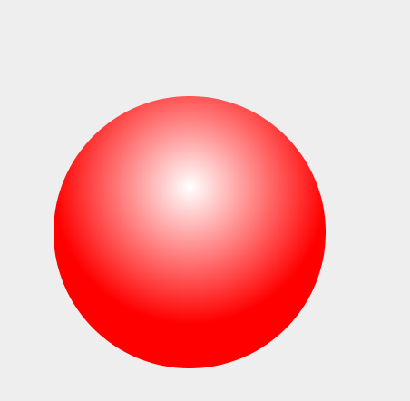
RadialGradientPaint
Example with ellipse not centered
Can either move ellipse or change focal point of gradient paint.
Slightly different effects

Slide 23
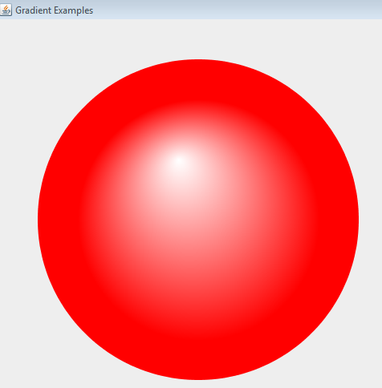
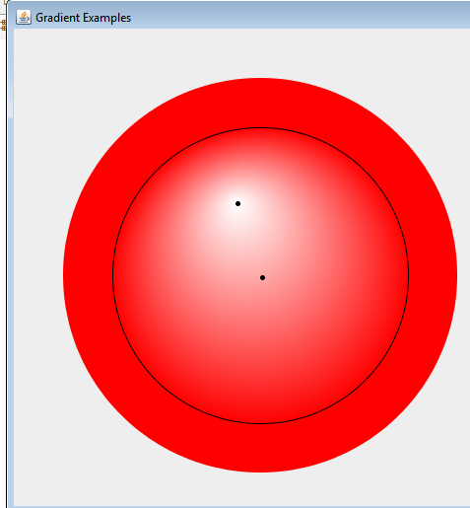
RadialGradientPaint - Altered Focal Point

Slide 24
Putting Gradients to Use
Create a reflection of an image using gradients and alpha composite
Draw an image
Draw the same image below it, reflected
Create a paint that varies alpha from half to 0
Use Alpha Composite to combine alpha paint and upside down image

Slide 25
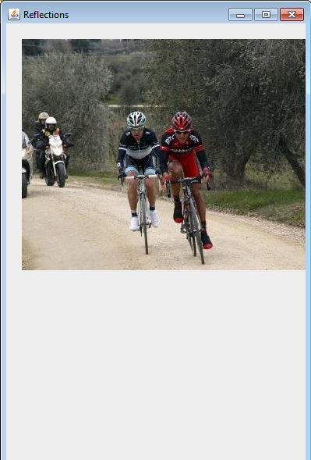
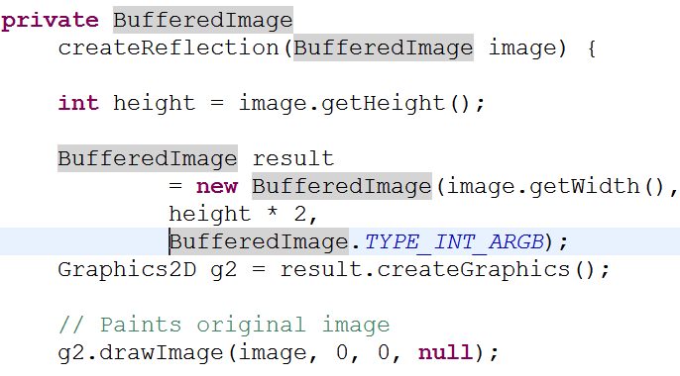
Image

Slide 26
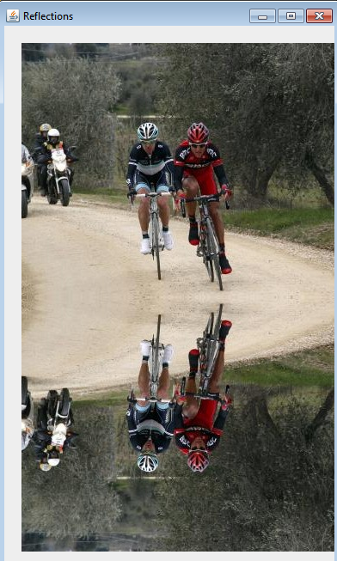
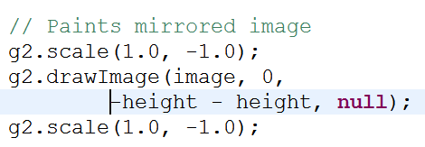
Reflection

Slide 27
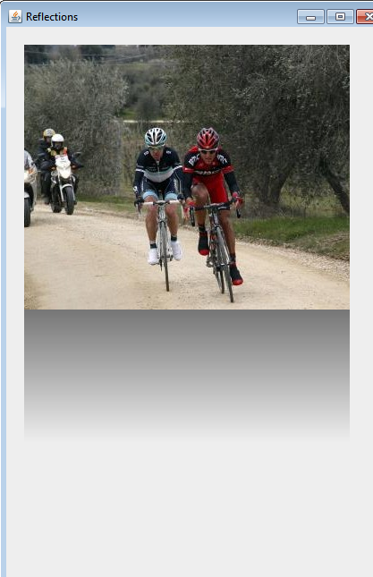
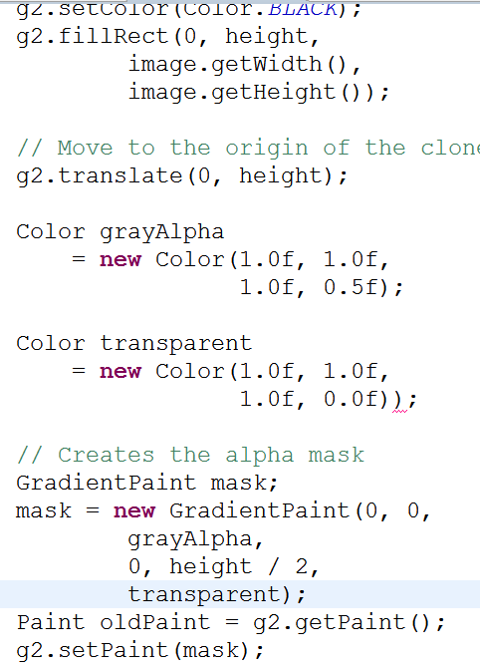
Gradient (alpha mask)

Slide 28
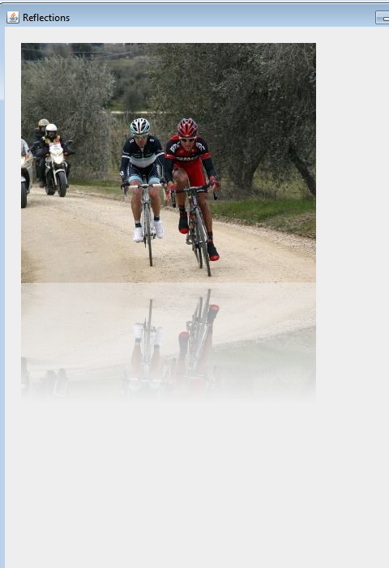
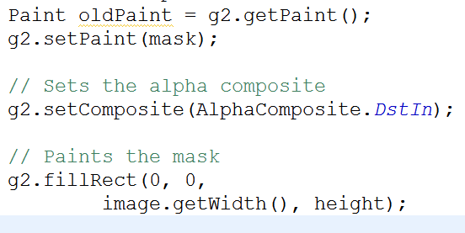
Final result using AlphaComposite DstIn

