Slide 1
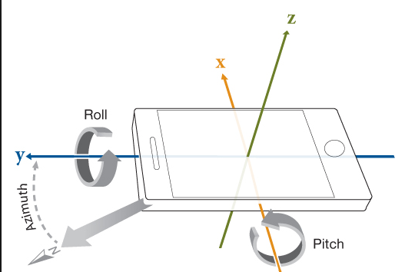

CS371m - Mobile Computing
Sensing and Sensors

Slide 2
Sensors
"I should have paid more attention in Physics 41"
Most devices have built in sensors to measure and monitor
  motion
  orientation (aka position of device)
  environmental conditions
sensors deliver raw data to applications

Slide 3
Sensor Framework
Determine which sensors are available on a device.
Determine an individual sensor's capabilities, such as its range, manufacturer, power requirements, and resolution.
Acquire raw sensor data and define the minimum rate at which you acquire sensor data.
Register and unregister sensor event listeners that monitor sensor changes.
http://developer.android.com/guide/topics/sensors/sensors_overview.html

Slide 4
Sensor Framework Classes
SensorManager
  conduit between your classes and Sensors
Sensors
  abstract representations of Sensors on device
SensorEventListener
  register with SensorManager to listen for events from a Sensor
SensorEvent
  data sent to listener

Slide 5
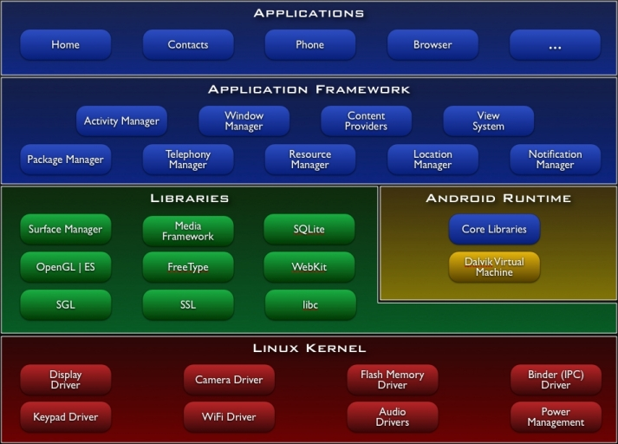
Recall: Android Software Stack
AND
SENSOR
MANAGER
AND
SENSOR
DRIVERS

Slide 6
Types of sensors

Slide 7
Types of Sensors
Three main classes of sensors:
motion (acceleration and rotational forces)
  accelerometers, gravity sensors, gyroscopes, rotational vector sensors, step detector
environmental (ambient air temperature and pressure, illumination, and humidity)
  barometers, photometers, and thermometers.
position (physical position of a device)
  orientation sensors and magnetometers

Slide 8
Types of Sensors
Hardware sensors
  built into the device
Software sensors
  takes data from hardware sensors and manipulates it
  from our perspective acts like a hardware sensor
  aka synthetic or virtual sensors

Slide 9
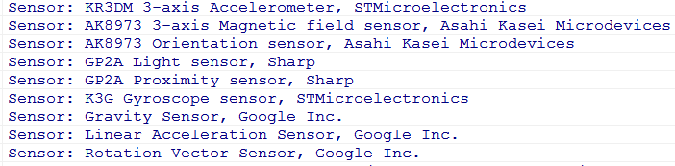
Types of Sensors - Dev Phone - Older
accelerometer, linear acceleration, magnetic field, orientation, light, proximity, gyroscope, gravity

Slide 10
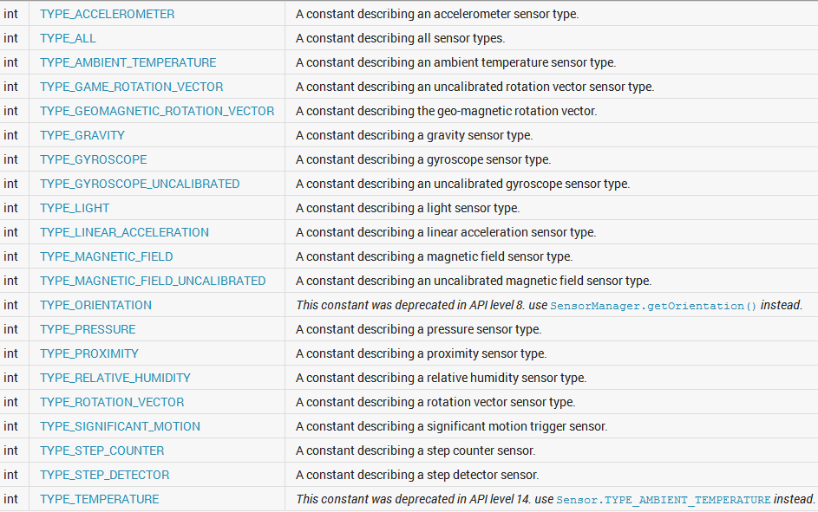
Sensor Types - (Sensor Class)

Slide 11
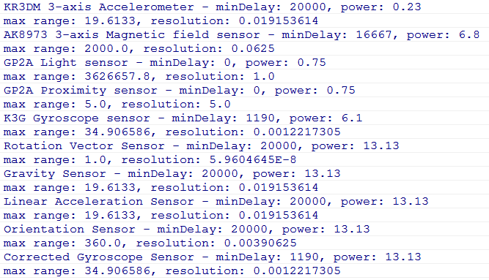
Sensor Capabilities - Dev Phones - Older

Slide 12
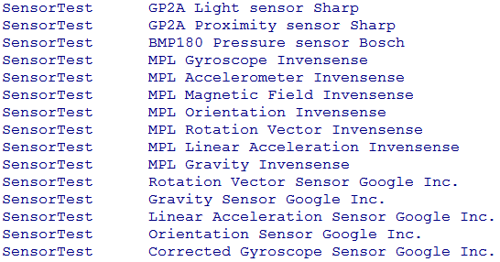
Types of Sensors - Dev Phone - Newer

Slide 13
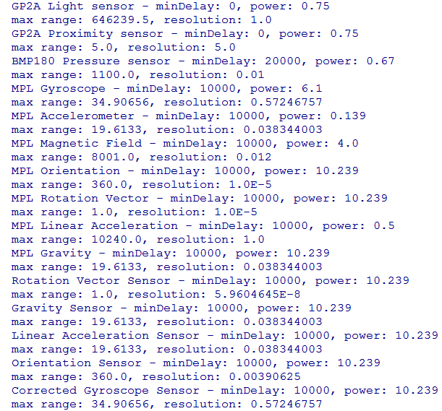
Sensor Capabilities - Dev Phone - Newer

Slide 14
Types of Sensors
TYPE_ACCELEROMETER
  hardware
  acceleration in m/s²
  x, y, z axis
  includes gravity

Slide 15
Types of Sensors
  TYPE_AMBIENT_TEMPERATURE [deprecated)]
  hardware
  "room" temperature in degrees Celsius
  no such sensor on dev phones TYPE_GRAVITY
  software or hardware
  just gravity
  if phone at rest same as TYPE_ACCELEROMETER

Slide 16
Types of Sensors
TYPE_GYROSCOPE
  hardware
  measure device's rate of rotation in
  radians / second around 3 axis
TYPE_LIGHT
  hardware
  light level in lx,
  lux is SI measure illuminance in luminous flux per unit area

Slide 17
Types of Sensors
TYPE_LINEAR_ACCELERATION
  software or hardware
  measure acceleration force applied to device in three axes excluding the force of gravity
TYPE_MAGNETC_FIELD
  hardware
  ambient geomagnetic field in all three axes
  uT micro Teslas

Slide 18
Types of Sensors
TYPE_ORIENTATION [deprecated]
  software
  measure of degrees of rotation a device makes around all three axes
TYPE_PRESSURE
  hardware
  ambient air pressure in hPa or mbar
  force per unit area
  1 Pascal = 1 Newton per square meter
  hecto Pascals (100 Pascals)
  milli bar - 1 mbar = 1hecto Pascal

Slide 19
Types of Sensors
TYPE_PROXIMITY
  hardware
  proximity of an object in cm relative to the view screen of a device
  usually binary (see range, resolution)
  typically used to determine if handset is being held to person's ear during a call
TYPE_RELATIVE_HUMIDITY
  ambient humidity in percent ( 0 to 100)

Slide 20
Types of Sensors
TYPE_ROTATION_VECTOR (ABSOLUTE)
  hardware or software
  orientation of device, three elements of the device's rotation vector
TYPE_ROTATION_VECTOR
  orientation sensor
  replacement for TYPE_ORIENTATION
  combination of angle of rotation and access
  uses geomagnetic field in calculations
  compare to TYPE_GAME_ROTATION_VECTOR

Slide 21
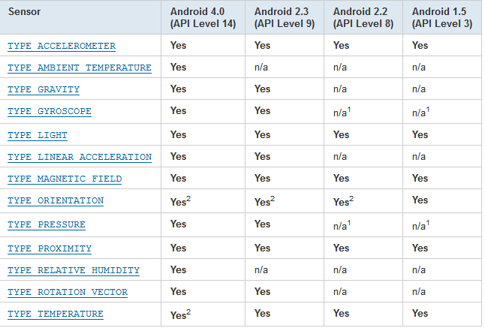
Availability of Sensors

Slide 22
Sensor Capabilities
Various methods in Sensor class to get capabilities of Sensor
minDelay (in microseconds)
power consumption in mA (microAmps)
maxRange
resolution

Slide 23
Triggered Sensors
Android 4.4, API level 19, Kit-Kat added trigger sensors
TYPE_SIGNIFICANT_MOTION
TYPE_STEP_COUNTER
TYPE_STEP_DETECTOR

Slide 24
Using sensors example

Slide 25
Using Sensors - Basics
Obtain the SensorManager object
create a SensorEventListener for SensorEvents
  logic that responds to sensor event
  varying amounts of data from sensor depending on type of sensor
Register the sensor listener with a Sensor via the SensorManager
Unregister when done
  a good thing to do in the onPause method

Slide 26
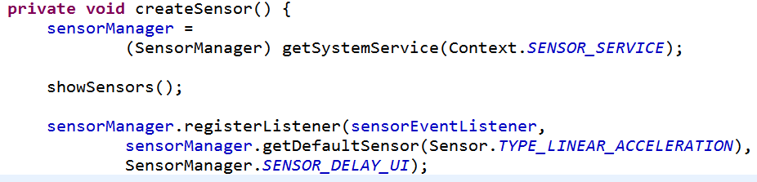
Using Sensors
registerListener(SensorEventListener, Sensor, int rate)
rate is just a hint
SENSOR_DELAY_NORMAL, SENSOR_DELAY_UI, SENSOR_DELAY_GAME, or SENSOR_DELAY_FASTEST, or time in microseconds (millionths of a second)

Slide 27
SensorEventListener
Interface with two methods:
  void onAccuracyChanged (Sensor sensor, int accuracy)
  void onSensorChanged (SensorEvent event)
    Sensor values have changed
    this is the key method to override
    don't do significant computations in this method
  don't hold onto the event
    part of pool of objects and the values may be altered soon

Slide 28
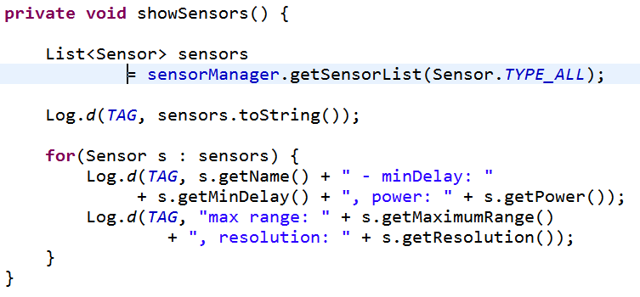
Listing Sensors on a Device to Log

Slide 29
Simple Sensor Example
App that shows acceleration
  TYPE_ACCELEROMETER
options to display current
… or maximum, ignoring direction
Linear Layout
TextViews for x, y, and z
Buttons to switch between max or current and to reset max

Slide 30
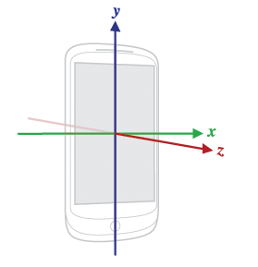
Sensor Coordinate System
For most motion sensors:
+x to the right
+y up
+z out of front face
relative to device
based on natural orientation of device
  tablet -> landscape

Slide 31
Clicker
With the device flat on a surface what, roughly, will be the magnitude of the largest acceleration?
0 m/s²
1 m/s²
5 m/s²
10 m/s²
32 m/s²

Slide 32
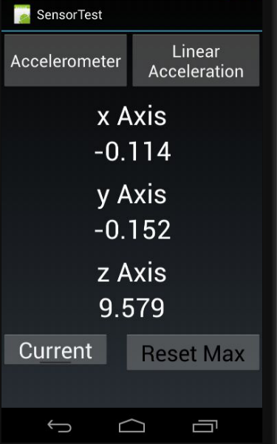

Accelerometer - Includes Gravity
Sensor.
TYPE_ACCELEROMETER
Device flat on table
g ~= 9.81 m/s²
Clearly some error

Slide 33
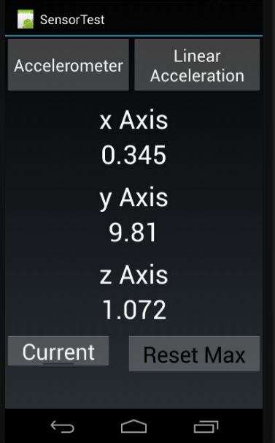
Sensor Coordinate System
Hold phone straight up and down:

Slide 34
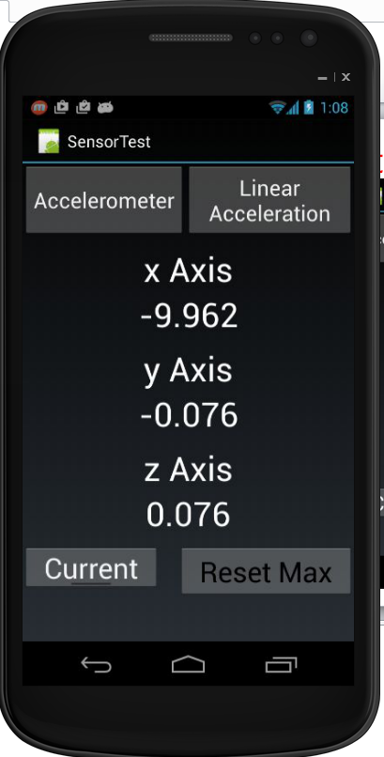
Sensor Coordinate System
Hold phone on edge

Slide 35
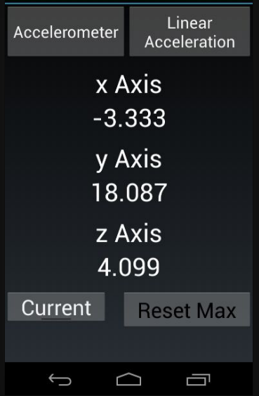
Sensor Coordinate System
Hold phone straight up and down and pull towards the floor:

Slide 36
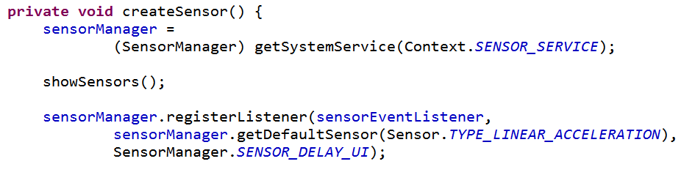
Getting Sensor Data
registerListener
  sensorEventListener
  Sensor -> obtain via SensorManager
  rate of updates, a hint only, or microseconds (not much effect)
returns true if successful

Slide 37
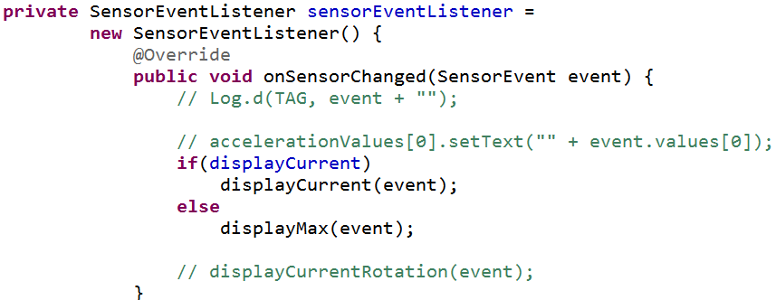
SensorEventListener

Slide 38
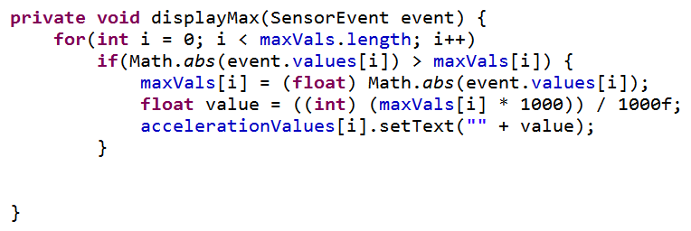
Display Max
Recall, max range of linear acceleration on dev phone is 19.613 + gravity = 29.423
- a baseball pitcher throwing a fastball reaches 350 m/s² or more (various "physics of baseball" articles)

Slide 39
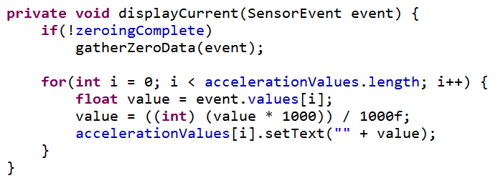
Display Current
Lots of jitter
Not a laboratory device
  simple sensors on a mobile device

Slide 40
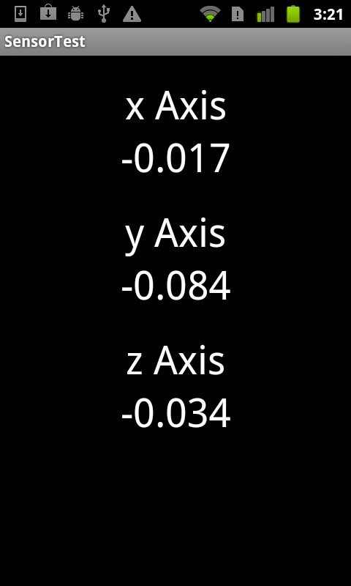
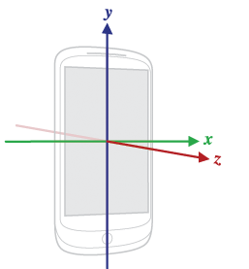
Linear Acceleration
At rest of table
Recall
units are m/s²

Slide 41


Zeroing out
Take average of first multiple (several hundred) events and average
  shorter time = more error
Potential error
  should be 0 at rest
Results:

Slide 42
Rate of Events
1000 events
SensorManager.SENSOR_DELAY_UI
  times in seconds: 21, 21, 21
  21 seconds / 1000 events
SensorManager.SENSOR_DELAY_FASTEST
  times in seconds: 21, 21, 21
Recall delay of 20,000 micro seconds
2x10⁴ x 1x10³ = 2x10⁷ = 20 seconds

Slide 43
USING SENSORS

Slide 44
Using Sensors
Recall basics for using a Sensor:
  Obtain the SensorManager object
  create a SensorEventListener for SensorEvents
    logic that responds to sensor event
  Register the sensor listener with a Sensor via the SensorManager

Slide 45
Sensor Best Practices
Unregister sensor listeners
  when done with Sensor or activity using sensor paused (onPause method)
  sensorManager. unregisterListener(sensorListener)
  otherwise data still sent and battery resources continue to be used

Slide 46
Sensors Best Practices
verify sensor available before using it
use getSensorList method and type
ensure list is not empty before trying to register a listener with a sensor

Slide 47
Sensors Best Practices
Avoid deprecated sensors and methods
TYPE_ORIENTATION and TYPE_TEMPERATURE are deprecated as of Ice Cream Sandwich / Android 4.0

Slide 48
Sensors Best Practices
Don't block the onSensorChanged() method
  recall the resolution on sensors
  50 updates a second for onSensorChange method not uncommon
  when registering listener update is only a hint and may be ignored
  if necessary save event and do work in another thread or asynch task

Slide 49
Sensor Best Practices
Testing on the emulator
Android SDK doesn't provide any simulated sensors
3rd party sensor emulator
http://code.google.com/p/openintents/wiki/SensorSimulator

Slide 50
SensorSimulator
Download the Sensor Simulator tool
Start Sensor Simulator program
Install SensorSimulator apk on the emulator
Start app, connect simulator to emulator, start app that requires sensor data
Must modify app so it uses Sensor Simulator library

Slide 51
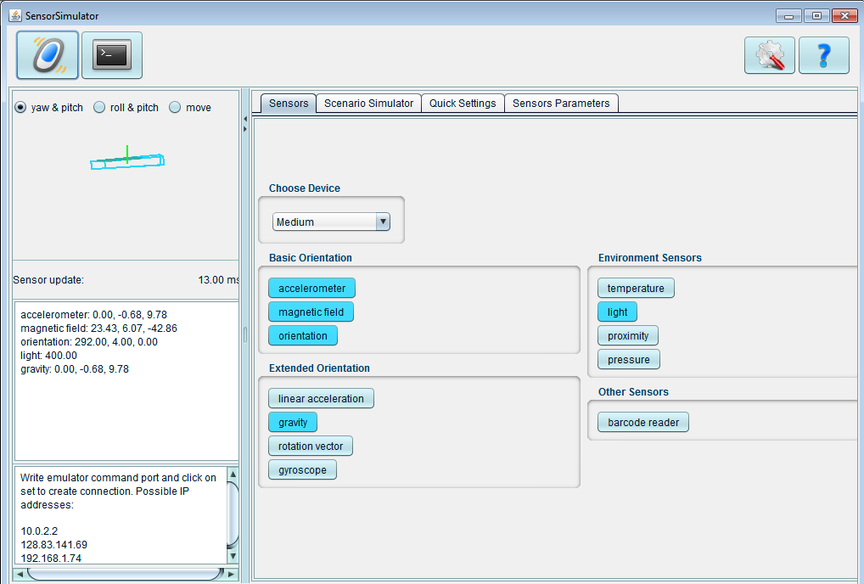
Sensor Simulator

Slide 52
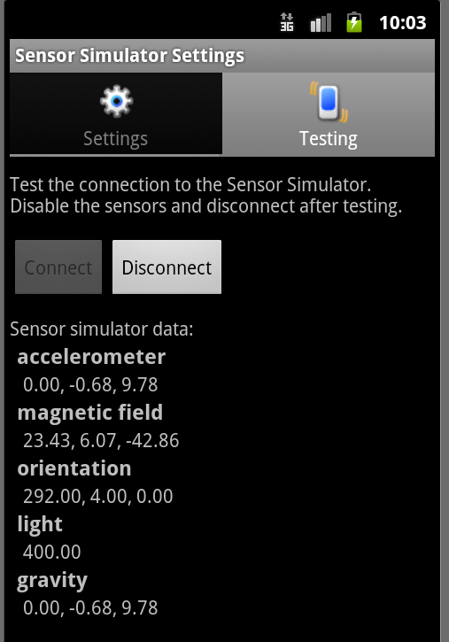
Sensor Simulator
Mouse in Sensor Simulator controls device, feeds sensor data to emulator
Can also record sensor data from real device and play back on emulator

Slide 53
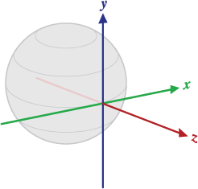
Sensing Orientation
Orientation of the device
x - tangential to ground and points roughly east
y - tangential to the ground and points towards magnetic north
z - perpendicular to the ground and points towards the sky
http://developer.android.com/reference/android/hardware/SensorEvent.html

Slide 54
Orientation Sensor
Deprecated
Instead use the Rotation vector sensor
int TYPE_ROTATION_VECTOR

Slide 55
Sensor Sample - Moving Balls

Slide 56
Sensor Sample - Moving Ball
Place ball in middle of screen
Ball has position, velocity, and acceleration
acceleration based on linear acceleration sensor
update over time, based on equations of motion, but fudged to suit application

Slide 57
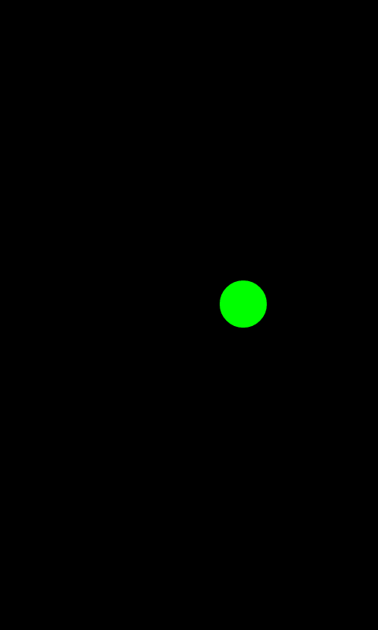
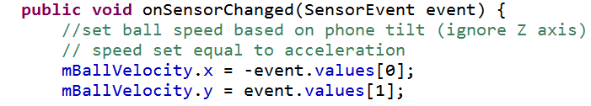
Sensor Sample - Moving Ball
Gross Simplification
velocity set equal to acceleration

Slide 58
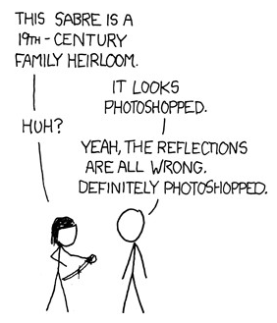
Reality is Unrealistic
"When exposed to an exaggeration or fabrication about certain real-life occurrences or facts, some people will perceive the fictional account as being more true than any factual account."

Slide 59

Reality is Unrealistic

Slide 60
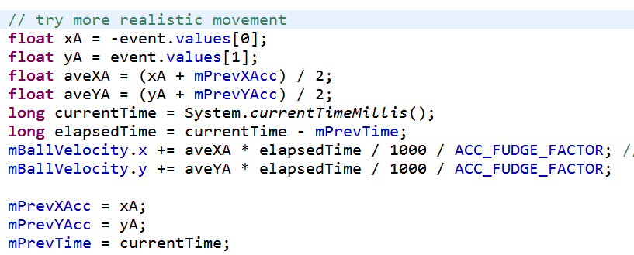
Sensor Sample - Moving Ball
Alternate Implementation
position updated in separate thread which redraws the view

Slide 61
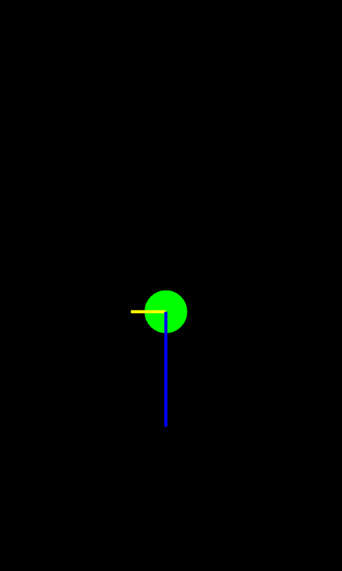
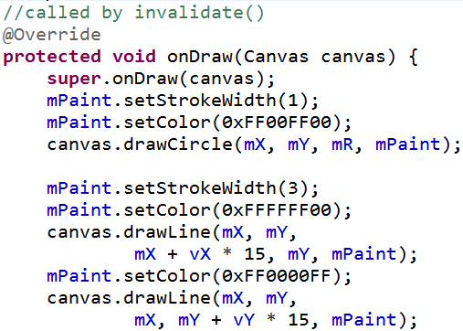
Sensor Sample
Draw lines for x and y velocities

Slide 62
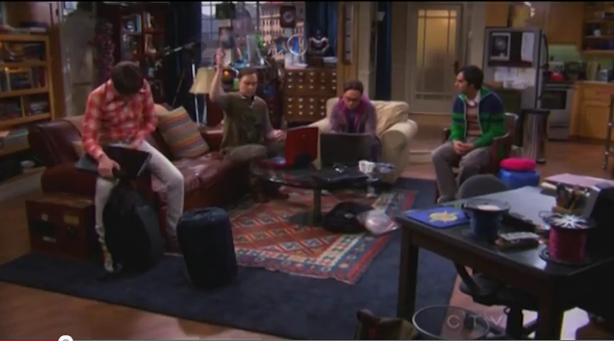
Sensor Sample - TBBT
Inspired by http://tinyurl.com/bxzaspy and http://tinyurl.com/6nhvnnv

Slide 63

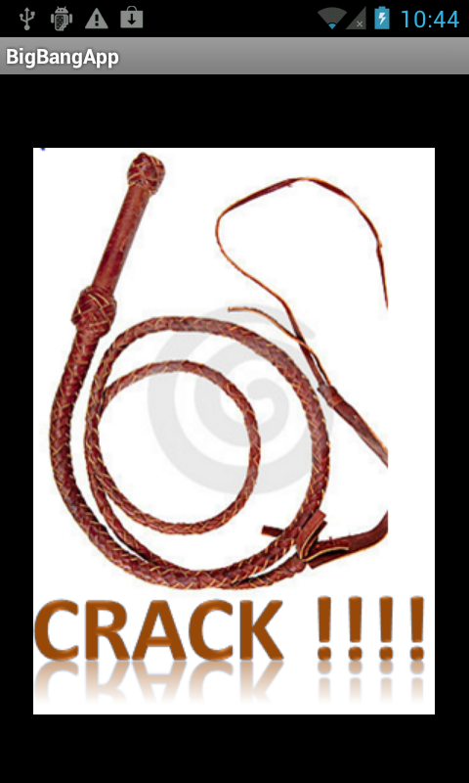

TBBT Sound Effect App

Slide 64
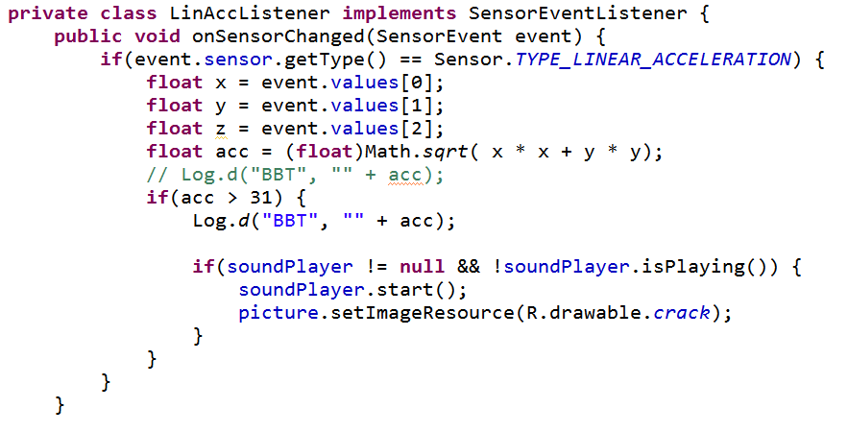
Responding to Events

Slide 65
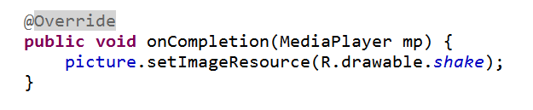
Changing Images
Use of an Image View
Initial Image set in onCreate
new image set in onSensorChange
register listener with MediaPlayer
on completion reset image

