Slide 1
CS371m - Mobile Computing
Persistence - SQLite

Slide 2
In case you have not taken
347: Data Management
or worked with databases
as part of a job, internship, or project:

Slide 3

Databases
RDBMS
  relational data base management system
Relational databases introduced by
E. F. Codd in the 1970s
Did Codd win the Turing Award?
A. Yes
B. No
Relational Database
  data stored in tables
  relationships among data stored in tables
  data can be accessed and viewed in
  different ways

Slide 4
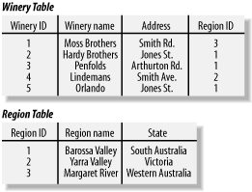
Example Database
Wines
Web Database Applications with PHP and MySQL, 2nd Edition ,
by Hugh E. Williams, David Lane

Slide 5
Relational Data
Data in different tables can be related
  hence, relational database

Slide 6
Keys
Each table has a key
Column used to uniquely identify each row
KEYS

Slide 7
SQL and SQLite
Structured Query Language
a programming language to manage data in a RDBMS
SQLite implements most,
but not all of SQL
  http://www.sqlite.org/

Slide 8


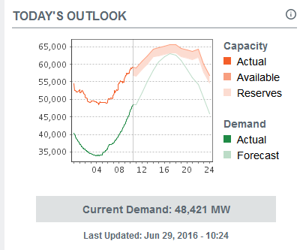
Aside - Database Admins
full time jobs
ERCOT = Electric Reliability Council of Texas

Slide 9
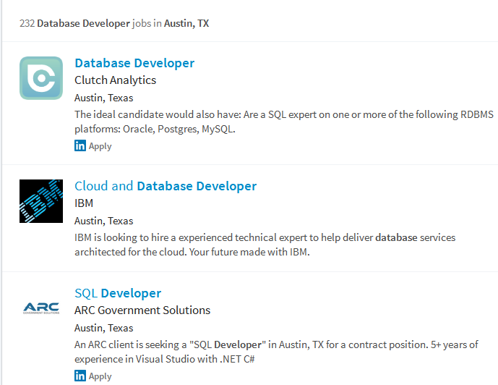

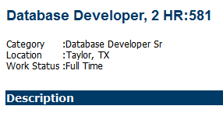
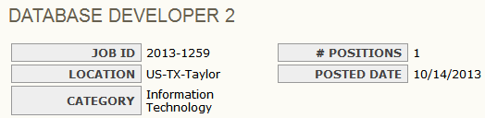
Database Admins

Slide 10
SQLite and Android
Databases created with applications are accessible by name to all classes in application, but no outside applications
Creating database:
  create subclass of SQLiteOpenHelper and override onCreate() method
  execute SQLite command to create tables in database
  onUpgrade() method for later versions of app and database already present

Slide 11
SQL and Databases
SQL is a language used to manipulate and manage information in a relational database management system (RDBMS)
SQL Commands:
CREATE TABLE - creates a new database table
ALTER TABLE - alters a database table
DROP TABLE - deletes a database table
CREATE INDEX - creates an index (search key)
DROP INDEX - deletes an index

Slide 12
SQL Commands
SELECT - get data from a database table
UPDATE - change data in a database table
DELETE - remove data from a database table
INSERT INTO - insert new data in a database table

Slide 13
android and sqlite

Slide 14
Android and SQLite
SQLite "baked into" Android.
Device will have SQLite and apps can create and use databases.
Not necessary to add third party library or jar to your app.
Many developers use a third party library to ease the syntax burden of using SQLite directly in their code.

Slide 15
Android and SQLite
SQLiteDatabase class
methods to programmatically interact with SQLite database
SQLiteDatabase has methods to create, delete, execute SQL commands, and perform other common database management tasks.
database restricted to application
  unless create content provider
http://developer.android.com/reference/android/database/sqlite/SQLiteDatabase.html

Slide 16
Android and SQLite
Build database on the fly in application
example (movie ratings) has no built in data to start with
possible to create database ahead of time and include in apk
move from apk to Android database on first use
http://stackoverflow.com/questions/5627037/how-can-i-embed-an-sqlite-database-into-an-application

Slide 17
Creating Database
Example: Movie Rating App
Stores user ratings
Not a complex example
Database only has one table
  overkill in this scenario
Adapted from Deitel Address Book Application

Slide 18
Classes
MovieRaterActivity
Starting Activity
Displays List of RatedMovies
click on Movie Title
menu - Add Rating
ViewRating
Show Rating
and Information
AddEditRating
Add or Edit Rating
menu - Edit Rating
menu - Delete Rating
DatabaseConnector
Interact With Database
Remove row from database

Slide 19
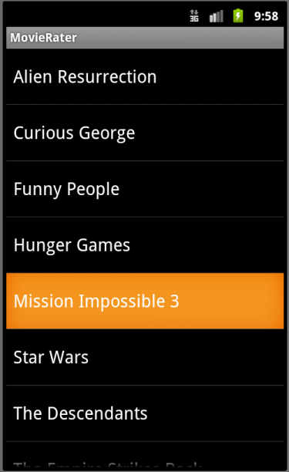
MovieRaterActivity
ListlView
Queries data base for all names / titles
Clicking on Title brings up that rating in ViewRating

Slide 20
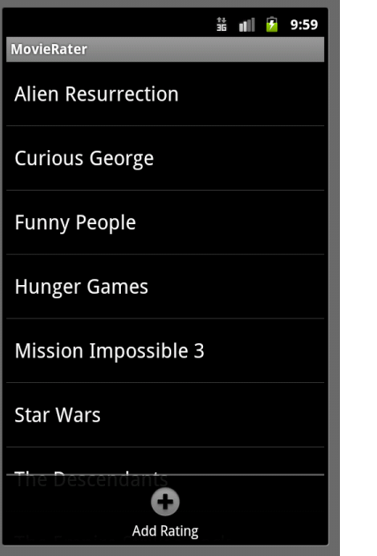
Menu for MovieRaterActivity
Only one app bar item
button to Add Rating
Brings up AddEditRating Activity

Slide 21
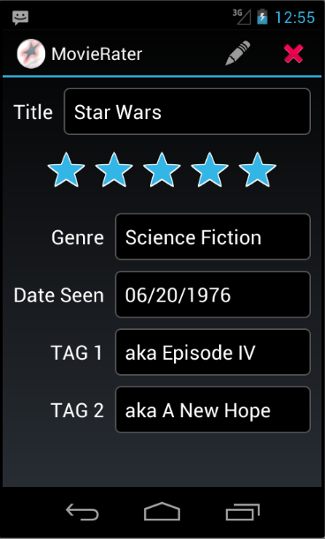
ViewRating
Pulls all data from database for row based on name / title
Use of a RatingBar
ViewRating has its own Action Bar items

Slide 22
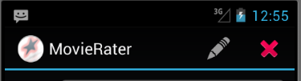
ViewRating Menu
Edit Rating starts AddEditRating activity and populates fields with these values (place in Extras)
Delete Rating brings up confirmation Dialog
Edit Rating
Delete Rating

Slide 23
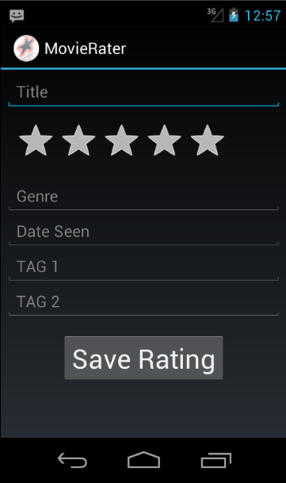
AddEditRating
Add Rating
  fields are blank
Consider adding a button for date picker instead of typing data
Must enter title / name
other fields can be blank

Slide 24
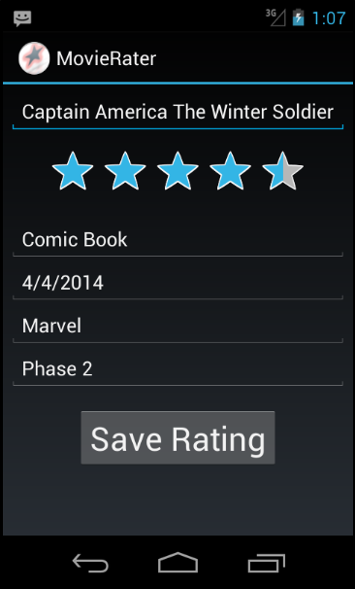
AddEditRating
When title clicked in main Activity, MovieRaterActivity
Make changes and click save

Slide 25
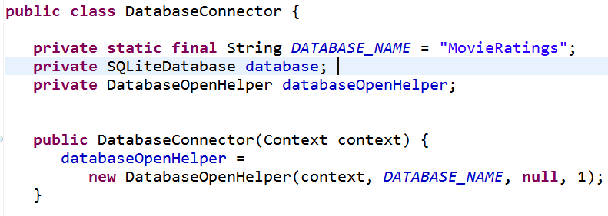
DatabaseConnector Class
Start of class

Slide 26
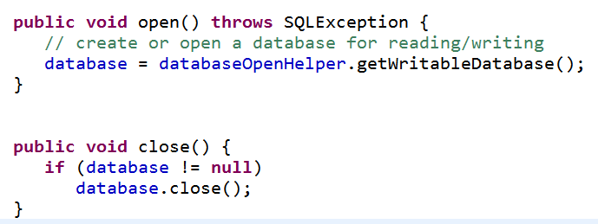
DatabaseConnector Class

Slide 27
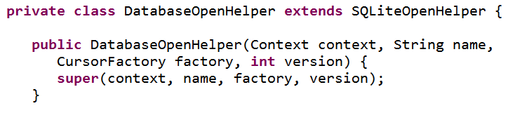
Creating Database
Via an inner class that extends SQLiteOpenHelper
Used to create database first time app run on a device
also used to update database if you update your app and alter the structure of the database

Slide 28
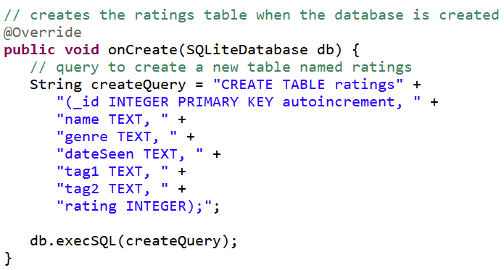
Creating Database
The key method in DatabaseOpenHelper

Slide 29
Creating Database
The String parameter is a SQLite command
ratings is name of table
table has seven columns
  _id, name, genre, dateSeen, tag1, tag2, rating
storage classes for columns:
  TEXT, INTEGER, REAL
  also NULL and BLOB (Binary Large OBject)
_id is used as primary key for rows

Slide 30
Updating Database
Quite likely you change the set up of you database over time
  add tables, add columns, remove tables or columns, reorganize
  referred to as the schema of the database
onUpgrade method for class that extends SQLiteOpenHelper
  for converting database on device (from previous version of your app) to scheme used by newer version of app
  not trivial!

Slide 31
Aside - Contract Class
If you plan to use the database in multiple activities and components of your app
  consider creating a Contract Class
A class with constants that define table names and columns
  instead of hard coding in multiple places
Android has built in ContactsContract and CalendarContract classes

Slide 32
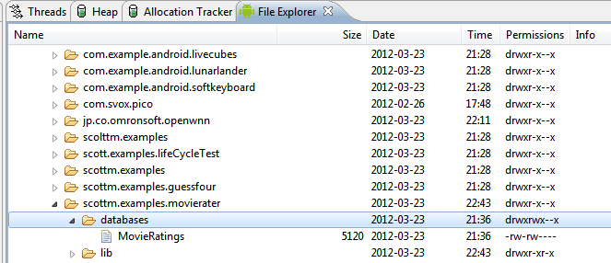
Databases on Device
can pull database and view
data/data/app package/database
sqlitebrowser is a decent tool

Slide 33
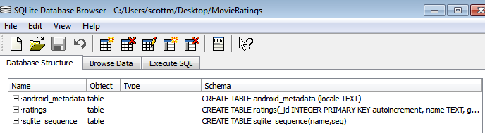
sqlite browser
Entire Database:
  Recall, we created a single table

Slide 34
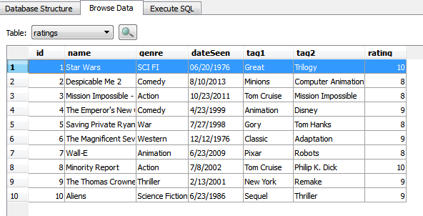
sqlite browser
ratings table

Slide 35
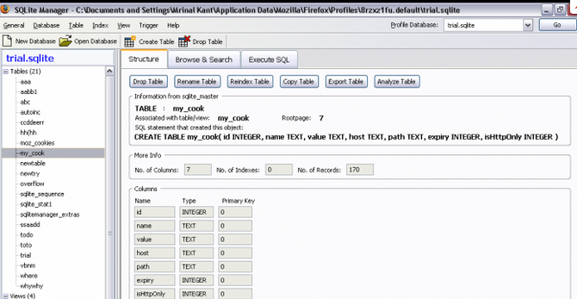
sqlite Manager for Firefox
Alternative to sqlite Viewer

Slide 36
Inserting Data
ContentValues: object with key/value pairs that are used when inserting/updating databases
Each ContentValue object corresponds to one row in a table
_id being added and incremented automatically

Slide 37
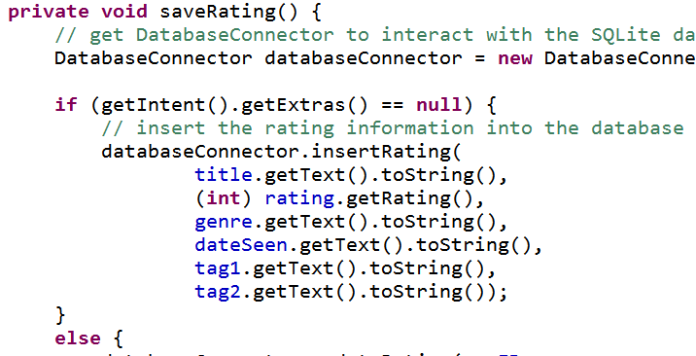
Inserting Data
In AddEditRating
When save button clicked

Slide 38
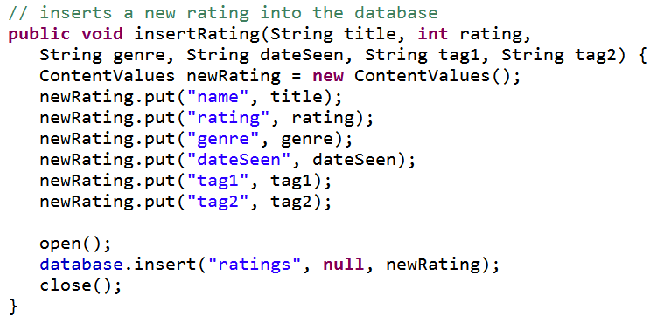
Inserting Data
Key method in DatabaseConnector
nullColumnHack, for inserting empty row

Slide 39
More on insert
The second parameter
nullColumnHack
  that's the parameter identifier
"optional; may be null. SQL doesn't allow inserting a completely empty row without naming at least one column name. If your provided values (second parameter) is empty, no column names are known and an empty row can't be inserted. If not set to null, the nullColumnHack parameter provides the name of nullable column name to explicitly insert a NULL into in the case where your values is empty."
http://tinyurl.com/kpl3ow7

Slide 40
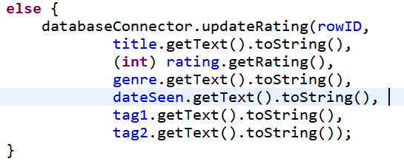
Updating Data
In AddEditRating
When save button clicked
notice id added

Slide 41
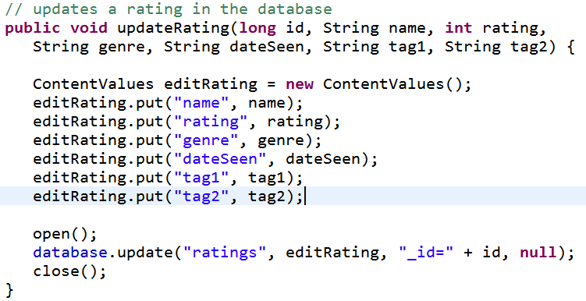
Updating Data
In DatabaseConnector

Slide 42
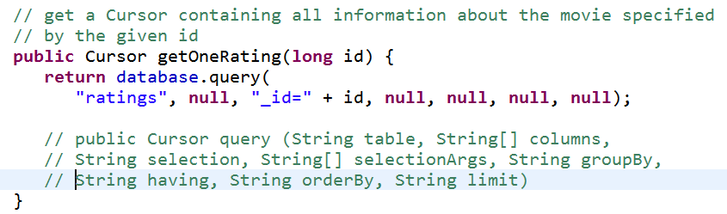
Query Data
Getting a single row by _id
  in order to populate ViewRating
  In DatabaseConnector

Slide 43
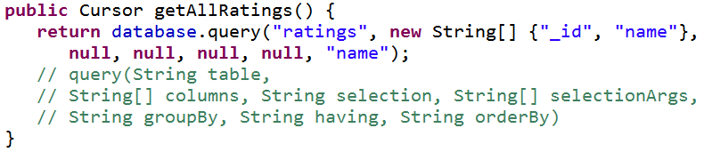
Query Data
Get all rows
  still In DatabaseConnector
To populate the ListView in the MovieRaterActivity
only getting _id and name columns

Slide 44
Cursors
When you execute a query on a database in Android …
you get a Cursor back
http://developer.android.com/reference/android/database/Cursor.html
"Cursor provided random [access] read-write access to the result of a query"
Commonly used in other database implementations / models

Slide 45
Cursor
find out number of rows in result with getCount()
iterate over rows
  moveToFirst(), moveToNext()
determine column names with getColumnNames()
get values for current row

Slide 46
Cursor
To use all the data …
wrap the Cursor in a SimpleCursorAdapter
pass the Adapter to a ListView or other view to handle lots of data
NOTE: result must contain an integer column named _ID that is unique for the result set
  used as id for row in ListView

Slide 47
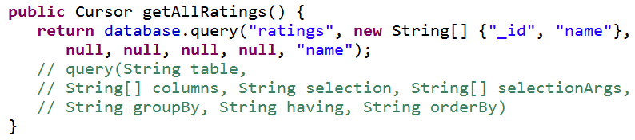
Database Connection
Recall:

Slide 48
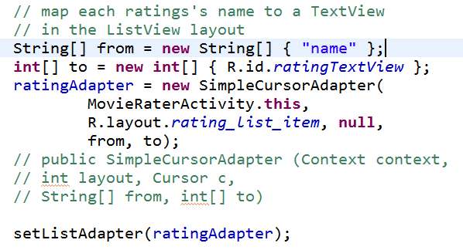
MovieRaterActivity
Rating Adapter is a SimpleCursorAdapter
  recall ArrayAdapter from CountryList
from onCreate method

Slide 49
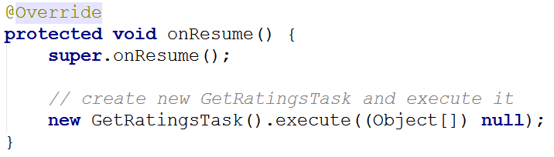
Populate List in MovieRater
Recall, accessing a database may block the UI thread

Slide 50
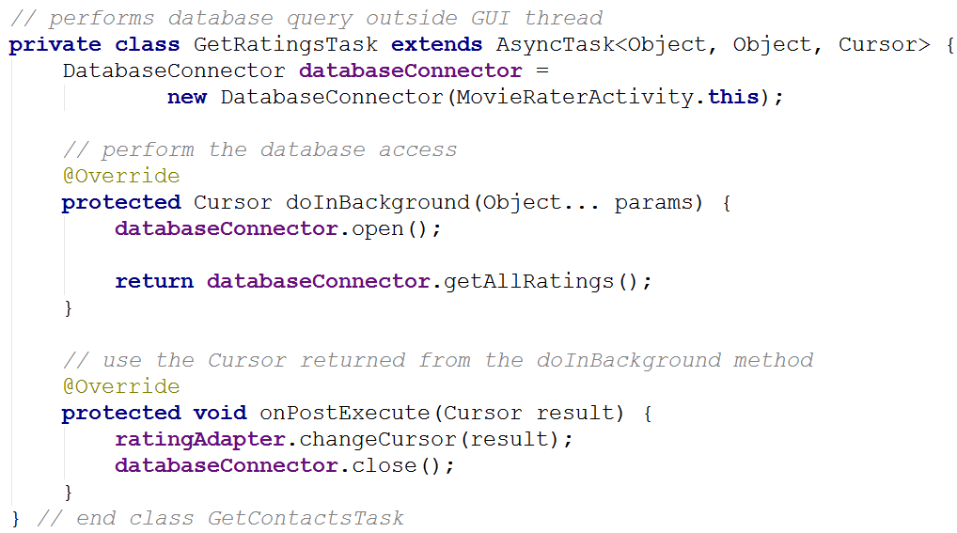
Obtaining Cursor in MovieRater

Slide 51
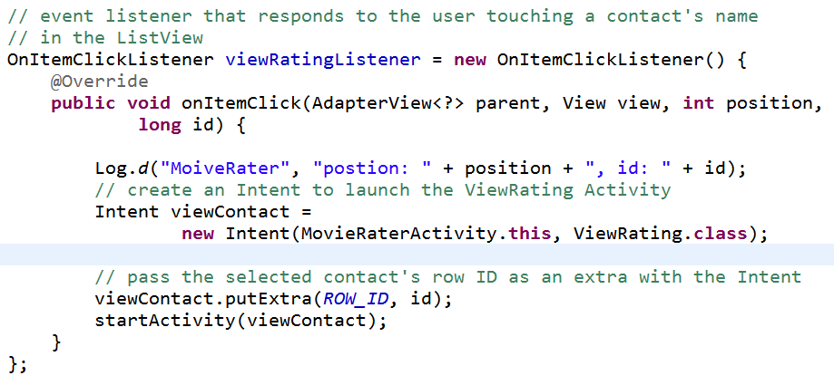
Clicking on Item in List
_id not displayed but still part of entry in list -> use _id to get back to database row

Slide 52
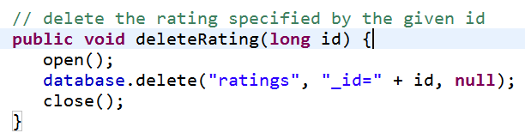
Deleting Data
Menu Option in ViewRating

Slide 53
Other Cursor Options
moveToPrevious
getCount
getColumnIndexOrThrow
getColumnName
getColumnNames
moveToPosition
getPosition

Slide 54
Possible Upgrades
Add functionality to
  show all movies that share a particular genre
  movies from a date range
  shared tags
  table for the genres (predefined)
Simply more complex data base queries

Slide 55
Alternatives to SQLITE
- Moving higher up the food chain

Slide 56
Alternatives to sqlite
When using SQLite you may feel like you are "Down in the weeds"
Various alternatives to work higher up the food chain
  in other words at a higher level of abstraction
Object Relational Mappers - ORM
Higher level wrappers for dealing with sql commands and sqlite databases
Many ORMs exist

Slide 57
ORM Example - Sugar ORM
Syntactic Sugar?
  what does that mean?
Install package
Add to manifest file
Classes you want stored in database must extend SugarRecord

Slide 58
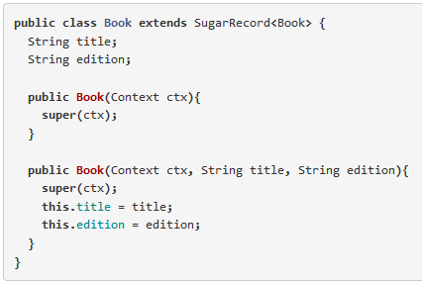
Example ORM - Sugar ORM

Slide 59
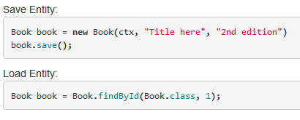
Example ORM - Sugar ORM
CRUD operations
  create, read, update, destroy
  working with the data
http://satyan.github.io/sugar/getting-started.html

Slide 60
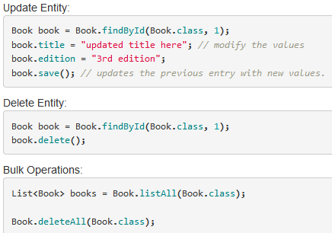
Example ORM - Sugar ORM

Slide 61
Implications for Movie Rater
Simple syntax and method calls to make queries on the database
In the demo app, Movie Rating should be its own class
Could use Sugar ORM to simplify dealing with the sqlite database

