Slide 1
CS371m - Mobile Computing
2D Graphics
A Crash Course in Using (Android) 2D Graphics Libraries

Slide 2
Using Graphics
Not an end in itself
Create a richer, easier to use User Interface
Display information in a easier to understand way
Entertainment
In Android picking the theme affects the appearance of your GUI widgets

Slide 3
Richer UI
The (OLD) Apple Effect?

Slide 4
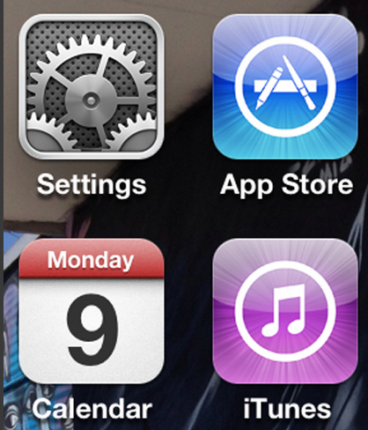
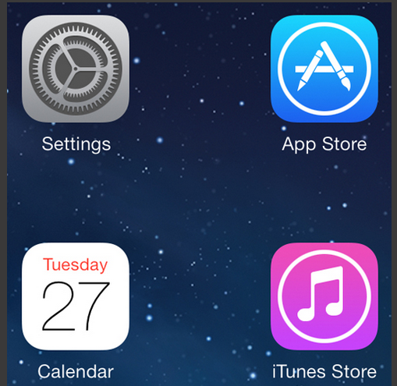
UI Design Changes
The (New) Apple Effect

Slide 5
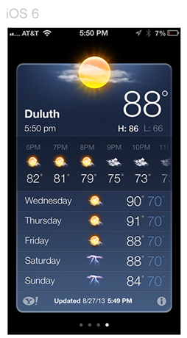
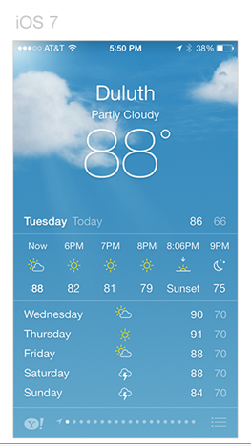
iOS 6 and iOS 7

Slide 6
Clicker
Which do you like more:
The graphics with 3d like effects
The flat graphics
I don’t have a preference

Slide 7
Clicker
How do you like your IDE’s set up?
Black text on white background
White text on black background
Something else
I don’t have a preference

Slide 8
Android Theme
Multiple Themes in Android’s History
Current Standard is the Material Theme
Set in Manifest
Able to alter aspects of theme
Creates a consistent look for app
Emphasis on Feedback via animation

Slide 9
sidetrack on the visual display of information

Slide 10
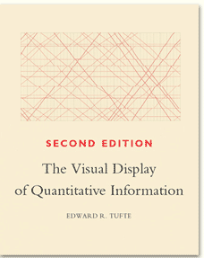
Visual Display of Information
Edward Tufte
Yale professor (poly sci, stats, and cs)
spark lines
small multiple
critical of PowerPoint

Slide 11
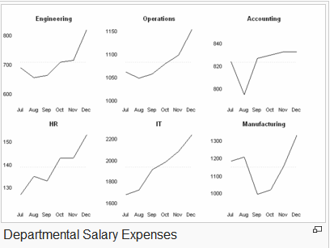
Visual Display
Spark Lines
Small Multiple

Slide 12
Examples of the visual display of information

Slide 13
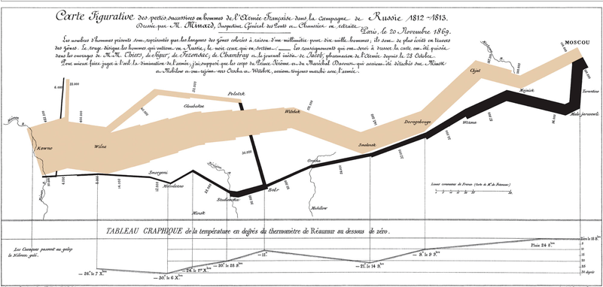
Joseph Minard Napoleon's Invasion of Russia
Location, size of army, data, temperature

Slide 14
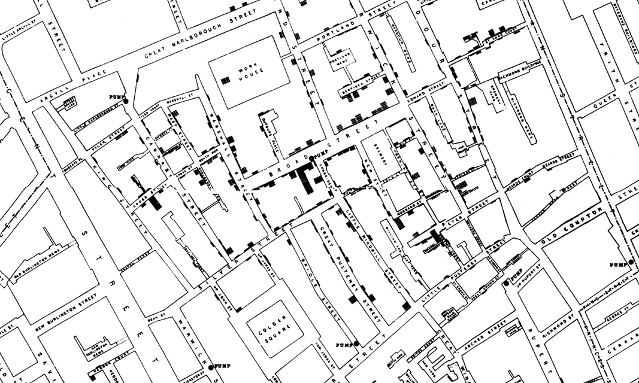
John Snow - Deaths from Cholera, 1854 Broad Street Outbreak (The Ghost Map)

Slide 15
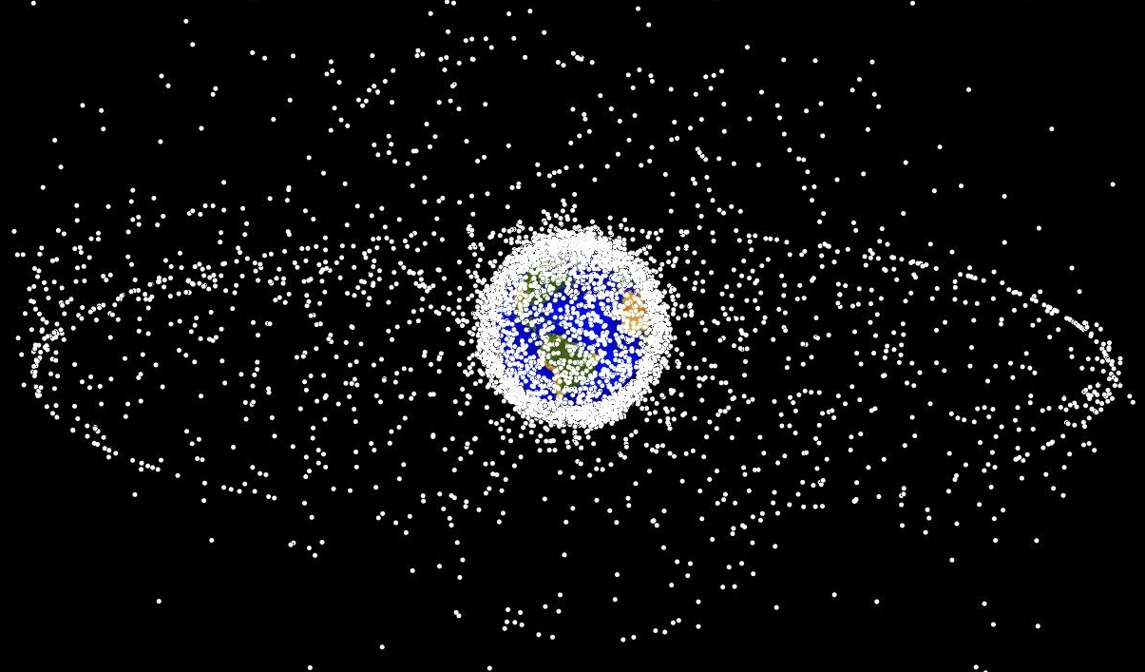
Space Debris Plot

Slide 16
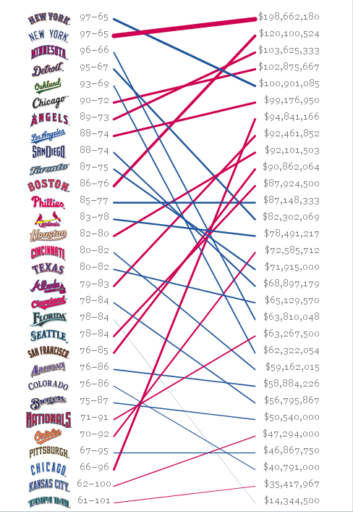
Visualizing Data
Ben Fry, one of the creators of Processing

Slide 17
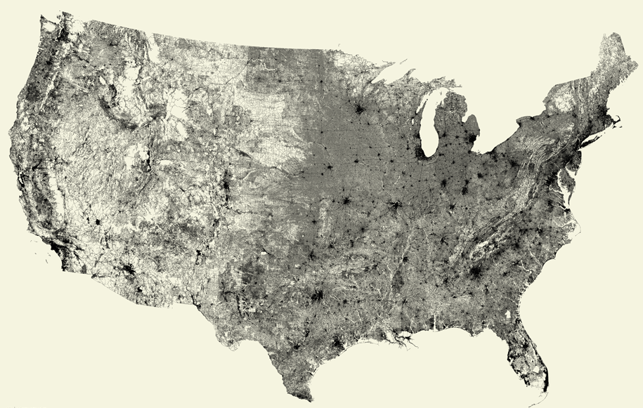
All Roads

Slide 18
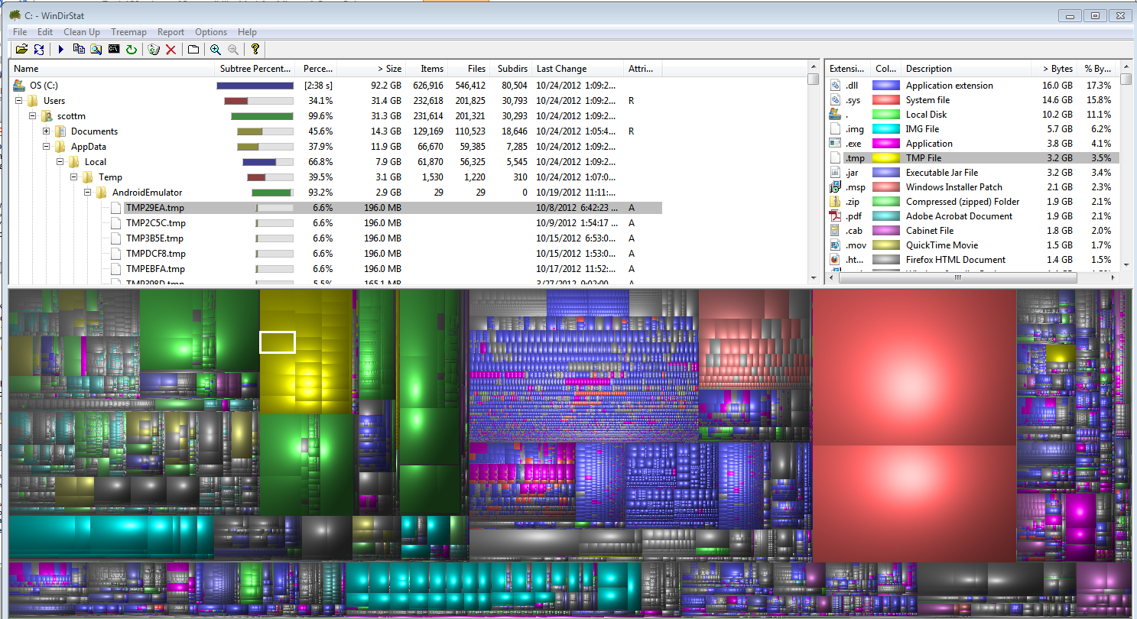
Files on Disk - WinDirStats

Slide 19
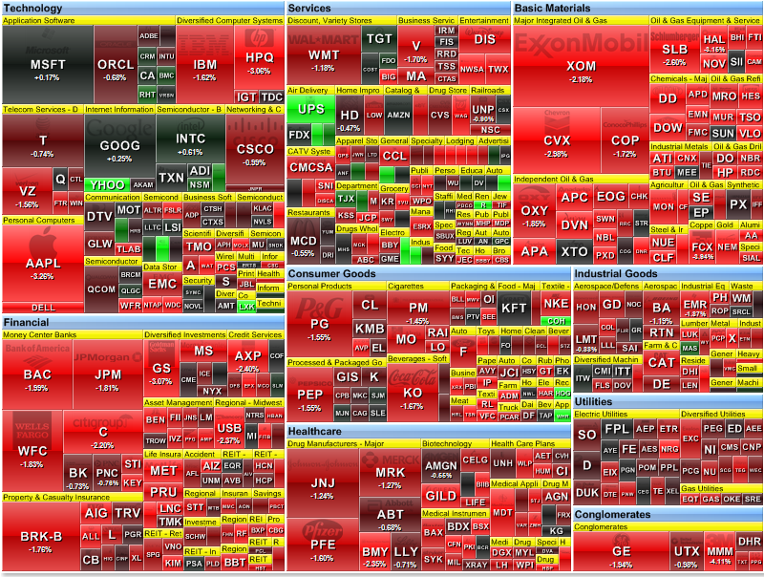
S&P 500 Heat Map

Slide 20
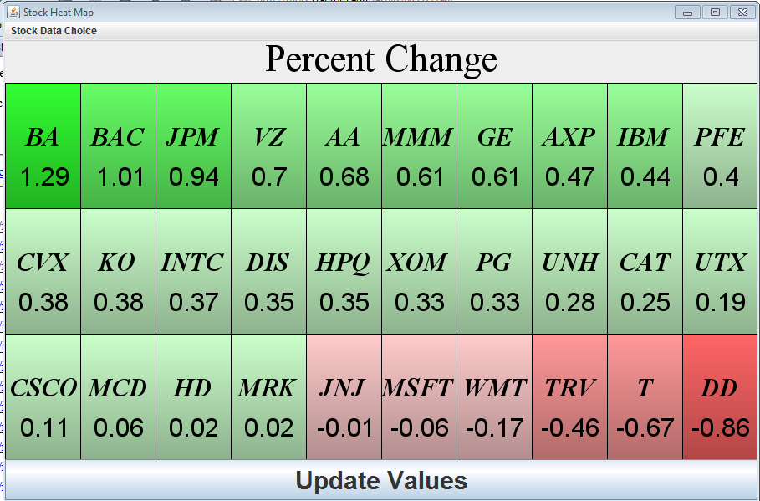
CS324E Heat Map
Notes:
Eclipse Projects / Workspace - A3_CS324E_HeatMap_

Slide 21
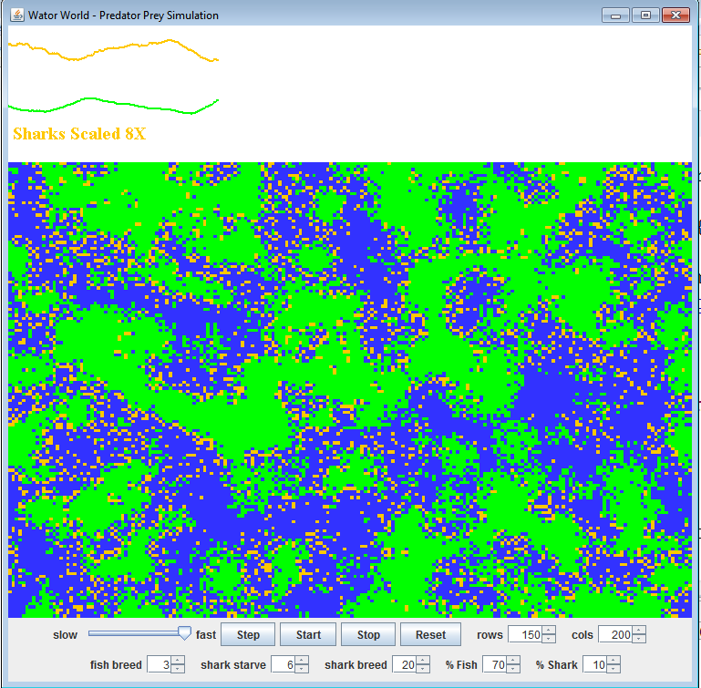
CS324E Wator World
Notes:
Program in Eclipse Workspace CS324e_old/A4/

Slide 22
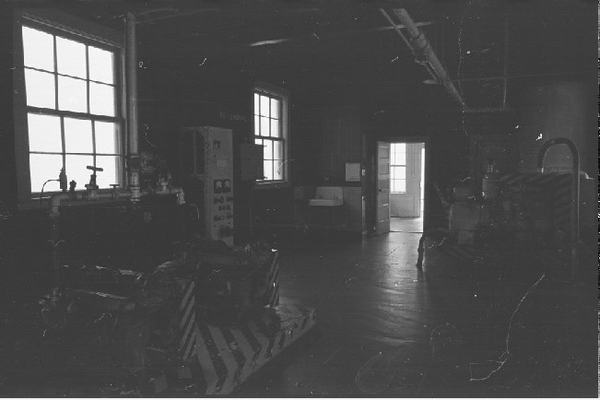
Image Processing

Slide 23
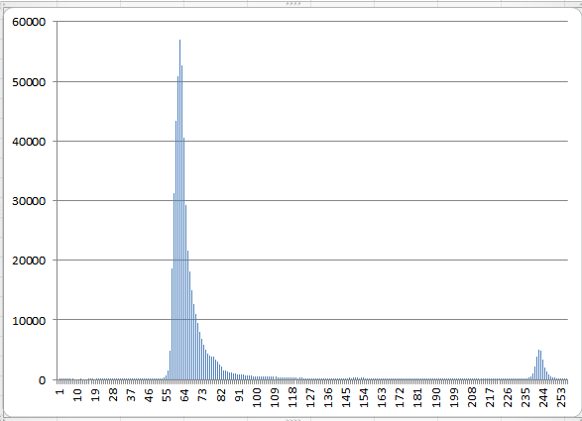
Color Histogram

Slide 24
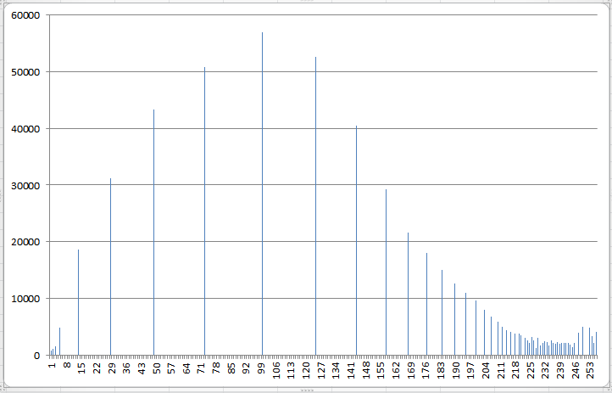
Histogram Equalization

Slide 25
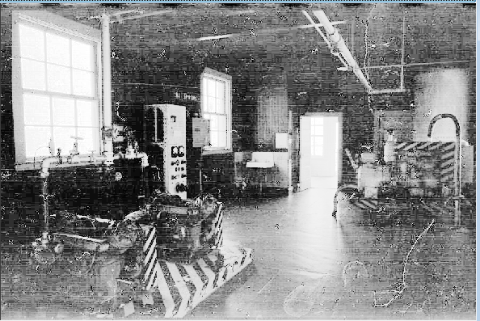
Revised Image

Slide 26
26

Slide 27
Using android NATIVE 2d graphics

Slide 28
Android Graphics
NOT the Java awt or swing packages
custom set of classes
Canvas: class that holds code for various "draw" methods
Similar to Java Graphics, Graphics2D objects
Paint: Controls the drawing. A whole host of properties.
Bitmap: the things drawn on
Drawable: the thing to draw. (rectangles, images, lines, etc.)
Typeface: for fonts

Slide 29
Using a Canvas
Simple way -> Create a custom View and override the onDraw method
The Canvas is a parameter to onDraw
Create a class that extends View
override the 2 parameter constructor
override the onDraw method
perform custom drawing in the onDraw method
add the View to the proper layout

Slide 30
Graphics Resources
Use Drawables in Views
Create a folder res/drawable
Add images
png (preferred)
jpg (acceptable)
gif (discouraged)
Images can be added as background for Views

Slide 31
Requesting Redraws of a View
call invalidate() on a View to redraw it
invalidate redraws the whole View
possible to redraw only a portion of the View, the part that changed
several overloaded versions of invalidate that accept a region of the View
only that portion redrawn
Override the onDraw method for the View to redraw
key we override onDraw but don't call it! call invalidate!
for really complex drawing and graphics move drawing off of the UI thread to a SurfaceView (more complex)

Slide 32
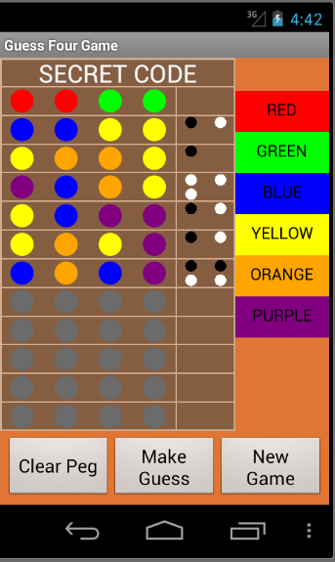
GuessFour
Board drawn in onDraw method of a View
Board will resize for different devices
lines, ovals, rectangles, and texts

Slide 33
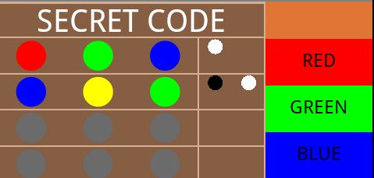
Paint
typically create Paint with anti aliasing enable
Paint p = new Paint(Paint.ANTI_ALIAS_FLAG);
Anti Aliasing on

Slide 34
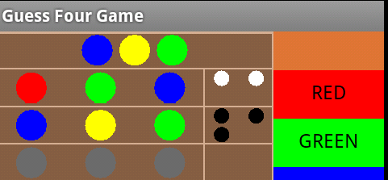
Anti Aliasing - The Jaggies
Anti Aliasing off
Anti Aliasing off
Anti Aliasing on

Slide 35
Using the Canvas Class
methods to draw:
rectangles
lines
arcs
paths
images
circles
ovals
points
text
and many more
Ability to set the "clip", portion of canvas where drawing takes place
commands to draw something that is outside clip are ignored
Ability to translate, rotate, and scale the canvas

Slide 36
Paint Object
many, many attributes and properties including:
current color to draw with
Color specified as aRGB
whether to fill or outline shapes
size of stroke when drawing
text attributes including size, style (e.g. underline, bold), alignment,
gradients

Slide 37
Gradients
3 kinds of gradients
LinearGradeint
RadialGradeint
SweepGradient
at least 2 color, but possibly more
flows from one color to another

Slide 38
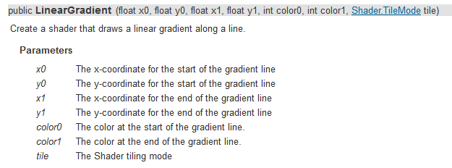
Linear Gradient

Slide 39
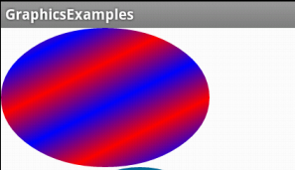
LinearGradient

Slide 40
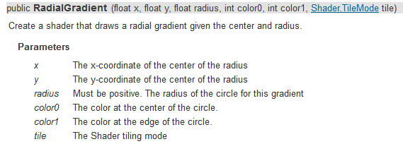
RadialGradient

Slide 41
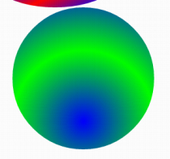
RadialGradient

Slide 42
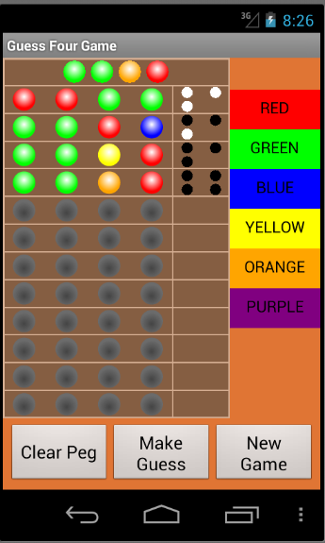
RadialGradeint
add depth to pegs and open spots in Guess Four game

Slide 43
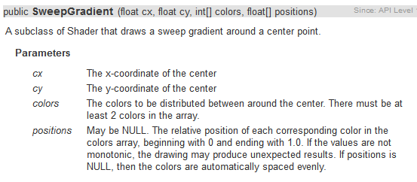
SweepGradient

Slide 44
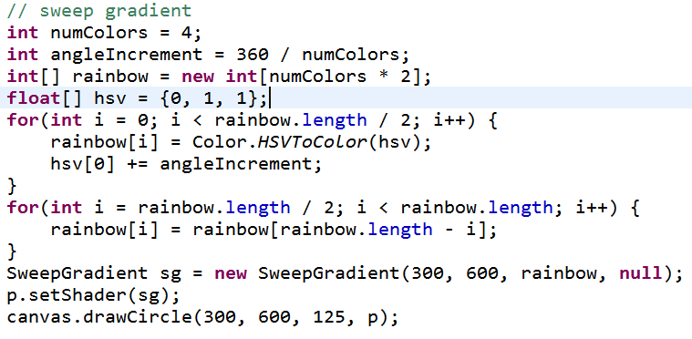
SweepGradient

Slide 45
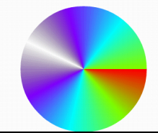
SweepGradient

Slide 46
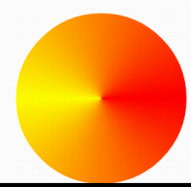
SweepGradient

Slide 47
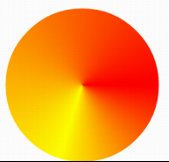
SweepGradient

Slide 48
Simple android animation loop

Slide 49
Simple Animation
Animation altering some property of a 2D primitive
position
size
color
alpha
Simplest animation loop, after onDraw, call invalidate
at the mercy of the UI frame rate

Slide 50
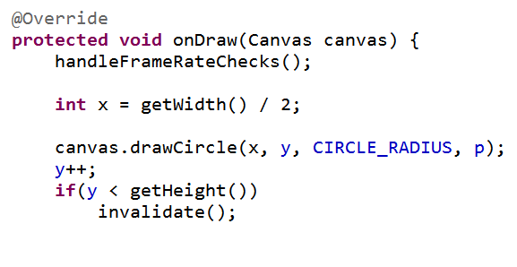
Simple (And Poor) Animation Approach
draw as fast as possible
emulator frame rate (on my machine) 12 fps
dev device frame rate, high 50s fps

Slide 51
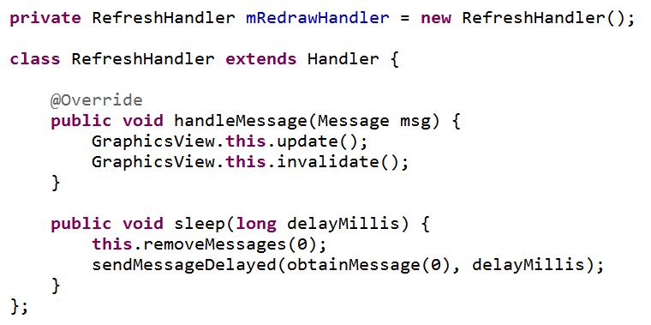
Better Animation Loop
Create a Handler to delay / sleep
update method will call sleep method on the Handler

Slide 52
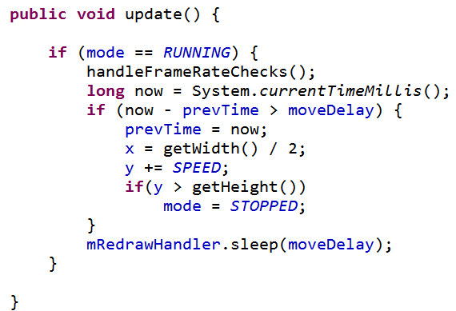
update method
animation loop
update tells handler to sleep
handler calls update when it wakes up …

Slide 53
Simple Animation Example Add Custom View to XML
in main.xml
add custom View as element in LinearLayout
Class Name
RGB Color, using hexadecimal

Slide 54
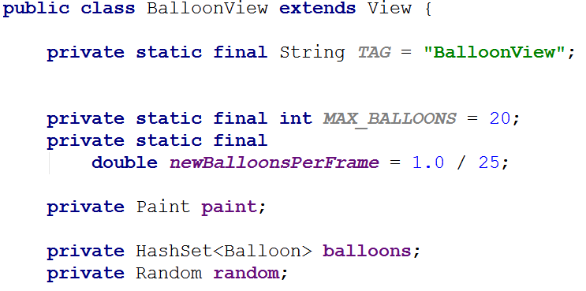
Simple Example - BalloonView

Slide 55
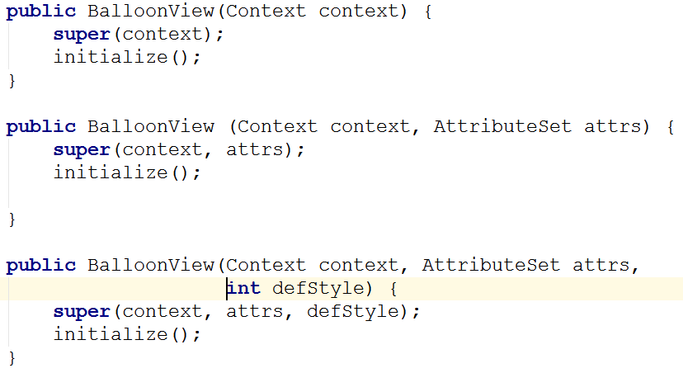
BalloonView Constructors

Slide 56
BalloonView
Tracks "balloons" on screen
Balloon class to track state of each balloon
Add balloons randomly
Update balloons when instructed
change position
remove if off screen

Slide 57
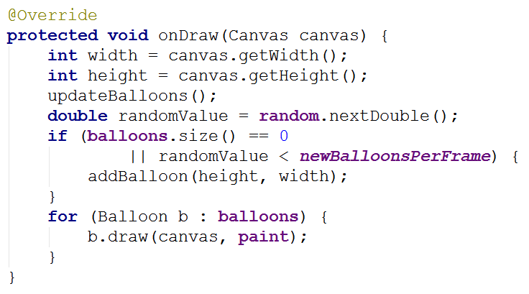
BalloonView onDraw Method

Slide 58
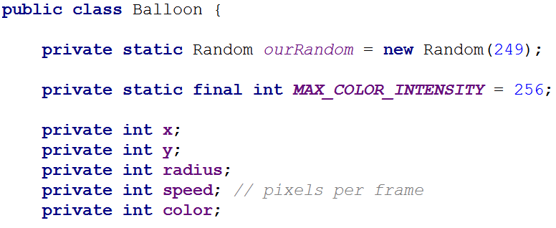
Balloon Class and draw Method

Slide 59
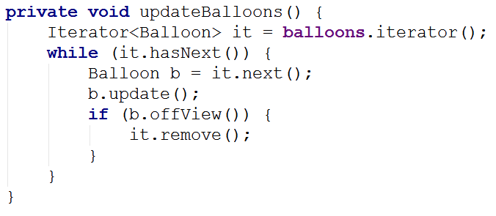
BalloonView update Method

Slide 60
Animation Loop
Activity has AnimationLoop object
non standard Android class to simplify animation loops
AnimationLoop given target frames per second and View to update

Slide 61
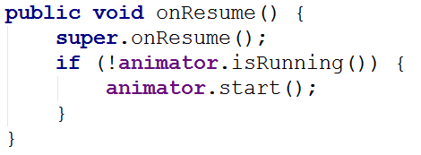
Animation Loop
When Activity resumes, animation loop started

Slide 62
Pausing
Animation Loop object paused when Activity paused
toggle animation when activity is clicked
create on click listener for activity

Slide 63
Animation Loop
Animation Loop has a Runnable and a Handler
Runnable: Any class whose instances are intended to be executed by a thread
standard Java class
Handler: Allows you to send and process Message and Runnable objects associated with a thread's Message queue.
schedule messages and runnables to be executed as some point in the future
Android specific class (there is a class named Handler in the Java standard library)

Slide 64
AnimationLoop
AnimationLoop start method
create new Runnable
and start (run method called)
Runnable run method
while (true)
sleep for appropriate time
on wakeup, tell View to update itself

Slide 65
tweened AnimationS

Slide 66
Simple Animations
Tweened Animations
also know as View Animations
provide a way to perform simple animations on Views, Bitmaps, TextViews, Drawables
provide start point, end point, size, rotation, transparency, other properties
Can set up tweened animation in XML or programmatically

Slide 67
Tweened Animations
Used to alter one of four properties of a single View affect
Alpha (transparency / opaqueness)
Rotation
Scale (size)
Location (movement, Translate)

Slide 68
Tweened Animations
define interpolator in XML (optional)
allow animation to be repeated, accelerate, decelerate, "bounce", and more
can use built in interpolators or create your own
define animation in XML
alpha, rotate, scale, translate
define from value and to value and duration
In program load and start animation in response to some event
Guess Four, invalid choice, solved puzzle

Slide 69
Guess Four res/anim
shake up down
shake left right

Slide 70
GuessFour res/anim
cycle_7.xml
spin.xml

Slide 71
GuessFour Example
On error board shakes back and forth
On win board spins
From BoardView in GuessFour

Slide 72
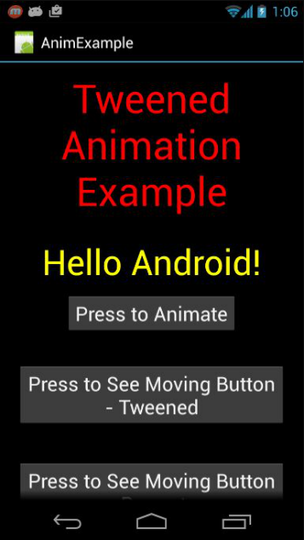
More Tweened Examples
hyperspace example from android dev site
rotate and change alpha
animation types:
alpha
scale
translate
rotate
http://developer.android.com/guide/topics/resources/animation-resource.html

Slide 73
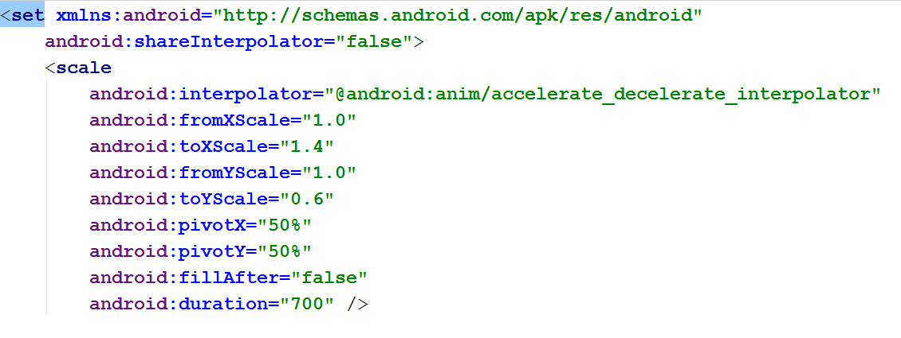
Hyperspace Part 1

Slide 74
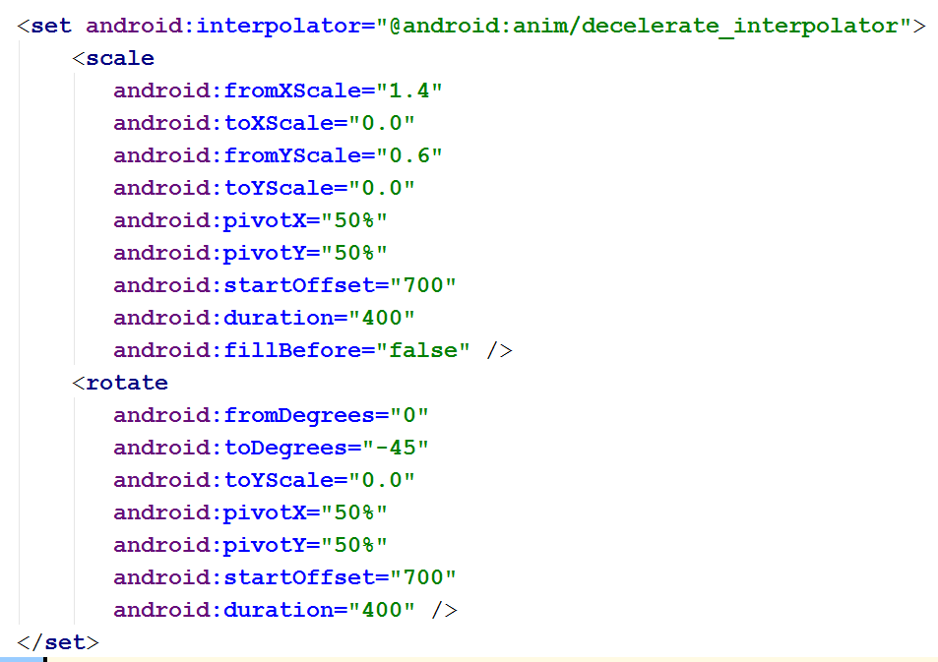
Hyperspace Part 2

Slide 75
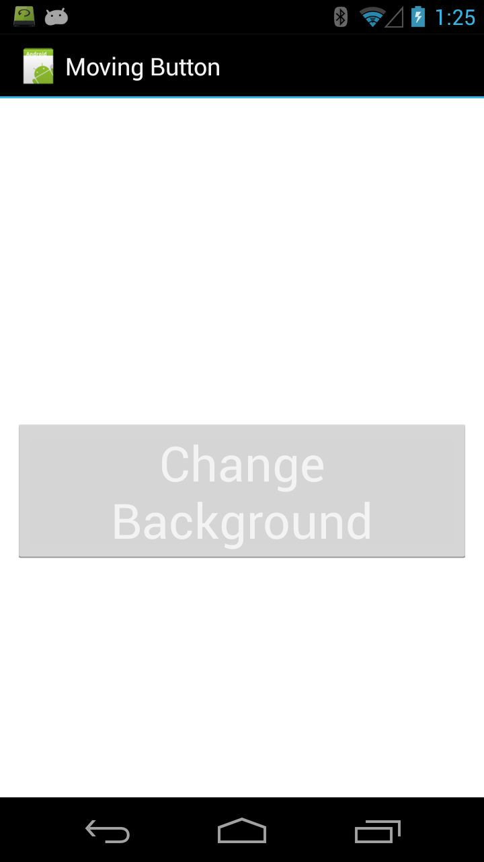
More Tweened Examples
Moving Button
Note, tweened animations draw the button in a different spot
But, the button's location does not actually change

Slide 76
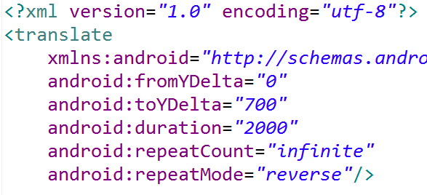
Up and Down Animation

Slide 77
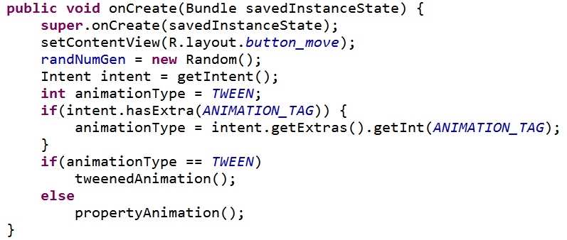
Moving Button Activity
Use extra from Intent to determine what type of animation to perform.

Slide 78
Tweened Animation

Slide 79
Change Background Color
Called when button clicked
onClick attribute
Result?

Slide 80
property animations -Available POST GINgerbread, Andoid 3.0, API Level 11

Slide 81
Developer of new animation framework for Android, Chet Haase and Romain Guy

Slide 82
Property Animations
A more general animation framework
Tweened Animations can only affect alpha, scale, rotation, and position
Property Animations can affect any property of an object
typically a View or Drawable
can be defined in sets, change multiple properties at a time
animation created separate from target object, reuse with different objects
http://developer.android.com/guide/topics/graphics/prop-animation.html

Slide 83
Property Animation - Classes
ValueAnimator
base class for property animations
Object Animator
convenience class for animating specific object and property
ViewPropertyAnimator
optimized, simple animation of View objects
evaluator classes such as ArgbEvaluator to animate property by defining how it changes over time

Slide 84
Some Animations Simple
API levels 11+
View objects have animate() method
ViewPropertyAnimator
methods for alpha, rotation, scale (size), translation (position)

Slide 85
ViewPropertyAnimator Example
onClick method for a button:
button will disappear and then reappear next time clicked

Slide 86
More Complex Property Animation
Object animation example
from moving button example
animated class must have a "set<Property>" method

Slide 87
Button Class

Slide 88
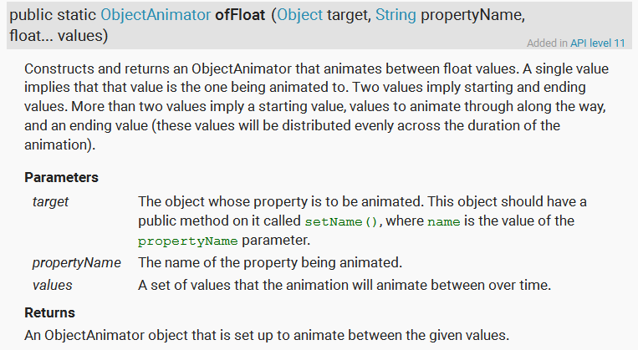
ObjectAnimator

Slide 89
HOW ??????
How can the ObjectAnimator call the right methods on the object passed?
reflection
open graphics library
static
xml
generics
Declared type is Object
must be calling setY method, right?

Slide 90
A Sidetrack on Reflection

Slide 91
Reflection
Advanced feature of Java.
Commonly used by programs that "examine or modify the runtime behavior of applications running in the Java virtual machine"
The Android Property Animation framework uses reflection

Slide 92
Why Reflection
Extensible features
like Android Property Animator framework
Class Browsers and Visual Development Environments
Debugger and Testing Tools
am I testing all the public methods?
coverage

Slide 93
Recall: Property Animation
ObjectAnimator class a subclass of ValueAnimator
Convenience class for property animation
When animator created set animation time, property to animate, and the starting and ending values
"The constructors of this class take parameters to define the target object that will be animated as well as the name of the property that will be animated. Appropriate set/get functions are then determined internally and the animation will call these functions as necessary to animate the property. "

Slide 94
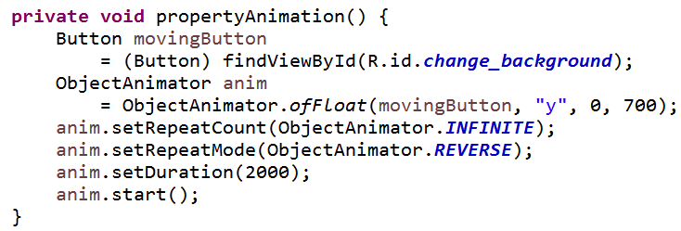
ObjectAnimator Example
Button class must have getY and setY methods that return and accept a float
ofFloat, ofInt, ofObject, ofMulti…

Slide 95
Object Animator
How does the Object animator affect the y value of the Button?
Recall Java, declared type, actual type
What methods does allow compiler allow?
Not a button

Slide 96
Class objects
Everything in Java is a primitive (byte, short, int, long, float, double, char, boolean) or an Object
arrays and Enums are Objects
The Java virtual machine instantiates an immutable instance of java.lang.Class for every type of Object necessary in a running program
Entry point for reflection

Slide 97
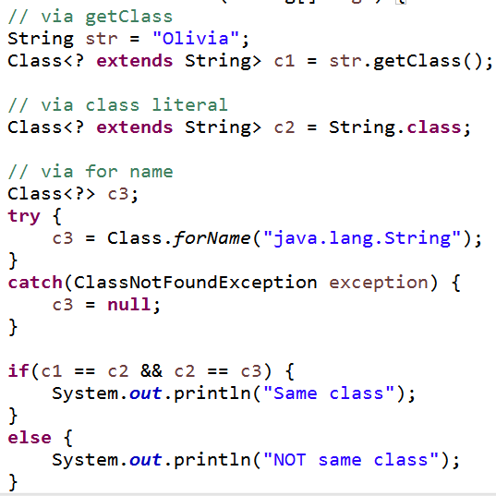
Getting the Class object

Slide 98
Accessing Internals
Class object may be used to access fields, methods, and constructors
… including private members
methods that enumerate members (instance variables) and methods that search for a member given a name
Like a spy

Slide 99
Security
This appears to be dangerous stuff
The ability to find out about private methods and fields
… and even change them
Thus many of the methods in the Class class and Reflection API throw SecurityExceptions
If a SecurityManager is present and permission for reflection is not granted, exceptions occur
"If you remove this sticker, the warranty is void"

Slide 100
Enumerating Fields

Slide 101
Enumerating Methods

Slide 102
Calling Methods

Slide 103
Calling Methods

Slide 104
Results of Method Calls - Animate!

Slide 105
Clicker Question
Can we alter the value stored in an object via reflection if there is not set method?
No
Yes
Maybe

Slide 106
And Then the Unthinkable Happened

Slide 107
Recall Button Class
x is private
no methods to access or alter x
YIKES

Slide 108
Clicker Question
Can we alter the value stored in an object via reflection if there is not set method and the value is declared to be final?
No
Yes
Maybe

Slide 109
But final is safe, right????
String fields in Java 8

Slide 110
Result of changeString
We are good right?

Slide 111
Oh the Humanity

Slide 112
Client Code

Slide 113
Result

Slide 114
rendering with complex calculations

Slide 115
More Complex Graphics
Don't want apps to become unresponsive
If complex graphics or animation use SurfaceView class
Main view not waiting on onDraw to finish
secondary thread with reference to SurfaceView
SrufaceView draws and when done display result

Slide 116
Using a SurfaceView
extend SurfaceView
implement SurfaceHolder.Callback
methods to notify main View when SurfaceView is created, changed or destroyed

Slide 117
Simple Example
Static Screen
continuously draw several hundred small rectangles (points, with stroke = 10)
slowly fill screen and then keep changing

Slide 118
Implement SurfaceHolder.Callback methods

Slide 119
Prevent Runaway Threads!

Slide 120
Inner Class for Thread

Slide 121
Run Method in StaticThread
Standard Approach for Drawing on SurfaceView

Slide 122
Demo run()
Pronounced flicker and jitter
Double buffer under the hood
We are drawing on two different Bitmaps
Canvas does drawing onto Bitmap

Slide 123
Remove Flicker / Jitter
If we draw background each "frame" then we don't redraw previous rectangles
How about "saving" all the data?
points, colors

Slide 124
Alternative
Recall two approaches:
draw on UI thread by overriding onDraw
create custom View (tutorial 4)
okay if not a lot of drawing
must keep UI thread responsive
complex drawing or animations using SurfaceView
Third approach, possible variation on the above two approaches
maintain a separate Bitmap

Slide 125
Separate Bitmap
StaticThread has a Bitmap instance var
Initialize in constructor

Slide 126
Updates to Bitmap
Create a
Canvas to draw on
the Bitmap
we are
saving
When done drawing to Bitmap use SurfaceView Canvas to draw

Slide 127
Demo Alt Version of run()
Flicker and jitter?
Also possible to save Bitmap to file for later use

Slide 128
Animations
Frame based vs. Time based
Frame based:
update every frame
simple, but difference in frame rates
Time based
update every frame but based on time elapsed since last frame
more work, more accurate
sdk example lunar lander

Slide 129
Checking Frame Rate
From StaticView
Emulator 6-7 fps, dev phone 40 -45 fps

Slide 130
Controlling Frame Rate
Sleep after completing work in loop of run
More complex than shown, use previous time and current time

Slide 131
Two Methods for Displaying 2D Graphics
Two approaches
draw graphics or animations into a View object that is part of layout
define graphics that go into View
simple approach for non dynamic graphics or simple "tweened" animations
This is what we did in Tic Tac Toe
Draw graphics directly to a Canvas
the complex way, but with more control

Slide 132
adding drawables to views

Slide 133
Adding Drawables to Views
Change background to an image
previously used background colors

Slide 134
Top Ten With Image Background

Slide 135
Add ImageView to Layout
In the main.xml for top ten

Slide 136
ImageView Attributes
scaleType: how image should be moved or resized in the ImageView
tint: affects color of image
more to position image in ImageView

Slide 137
Changing ImageView Programmatically
Randomly set the alpha (transparency of the image)
Or pick an image randomly
Or set image based on month (Season)

