Slide 1
CS371m - Mobile Computing
Services and Broadcast Receivers
ADD LIST TO SERVICE OF NUMBERS ALREADY CONTACTED SO DON’T RESPOND AGAIN
TRY SENDING THOSE BACK TO APP – SHARED PREFS? CONTACTS?

Slide 2
Clicker
Is it possible for your app to accomplish work when the forefront Activity is not one from your app?
Yes
No

Slide 3
Services
One of the four primary application components:
  activities
  content providers
  services
  broadcast receivers

Slide 4
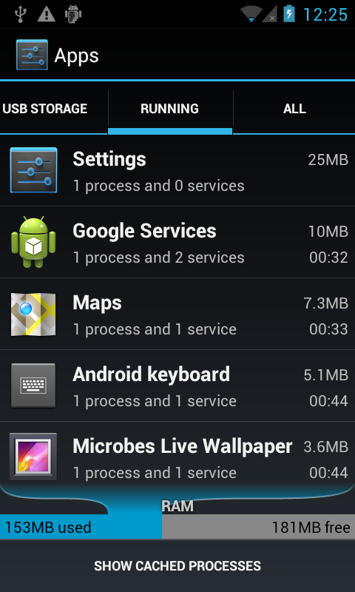
Services - Purpose
Application component that performs long-running operations in background with no UI
application starts service and service continues to run even if original application ended or user moves to another application
a way to run code when one of app's activity is not the forefront activity

Slide 5
Service - Examples
Download app from store
  leave store app, but download continues
  any kind of download of upload via network
Play music even when music player dismissed (if user desires)
maintain connection in chat app when phone call received
periodically poll website for updates / changes
  the grade checker
  may lead to notification

Slide 6
Clicker
Will a class in your app that extends the Service class have an xml layout file?
Yes
No

Slide 7
Clicker
Do services need to be declared in the app manifest file like activities?
Yes
No

Slide 8
Service Basics
No User Interface Components
Belongs to an app
  must be declared in the app manifest
May be running even if app is not at forefront, interacting with the user
May be private (usable only by the app they belong to) or public (usable by apps other than yours)

Slide 9
Starting Services
Two ways to start services:
Manually by an app using a call to the API
- recall the startActivity method for Activities
Another activity tries to connect (bind) to a service via inter process communication
- may be an app other than yours if your make your service public

Slide 10
Stopping Services
Services will run until shut down:
by themselves when task completed or possibly by owning app
stopSelf
By the owning app via a call to stopService
If Android needs the RAM the service is using
- just like it does for activities deep in the activity stack

Slide 11
Types Services - Started or Bound
Started:
  application component, such as an Activity, starts the service with the method call startService()
  once started service can run in background indefinitely
    clean up after yourself
  generally services do not return a result (see bound service)
    can send a local broadcast when done if necessary to notify Activity or other Service
  service should stop itself when done
Most services in our projects are started

Slide 12
Forms of Services - Started or Bound
Bound
  application component binds itself to existing service via the bindService() method
  bound service provides client-server interface that allows application component to interact with service
  interact with service, send requests, get result via IPC (inter process communication)
  service runs as long as one or more applications bound to it
  destroyed when no applications bound

Slide 13
Forms of Services
Service can be started and later bound to other applications
  so, both started and bound
private service (manifest) cannot be bound by other applications

Slide 14
Communicating with Services
Two ways:
Commands
  no lasting connection to service
  example: start service, end service
Binding
  creates communication channel between the service and other component
  other component typically an activity or perhaps another service

Slide 15
Service or Thread
Past examples, kept UI thread responsive with other threads of execution, especially AsyncTask
Should services be used for this?
Service for actions that need to take place even if user not interacting with UI or has closed application
Example, do complex rendering of image to display to user.
  Not a job for a service

Slide 16
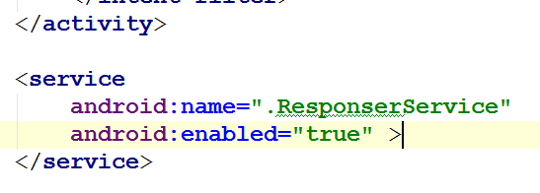
Service Setup
Must declare Services in manifest
  just like activities
  otherwise when Service started, app will crash
No intent filter
for Service
makes it private.

Slide 17
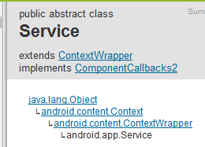
Creating a Service Class
create subclass of Android Service class or one of its existing subclasses
  commonly IntentService
override callback methods that handle important aspects of service lifecycle
most important of these are:
  onStartCommand
  onBind (bound services)
  onCreate
  onDestroy
  stopSelf

Slide 18
Service Lifecycle
If component starts service with startService method (leads to call to onStartCommand) service runs until it calls stopSelf or another activity calls stopService
if component calls bindService (onStartCommand not called) service runs as long as at least one component bound to it

Slide 19
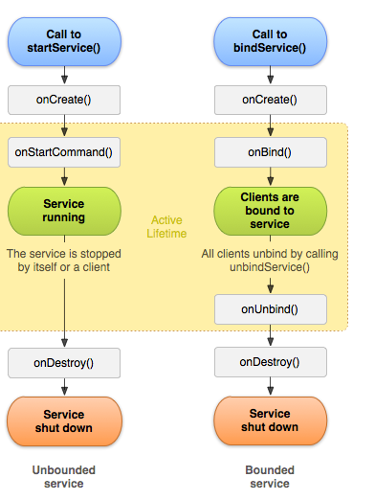
Service Lifecycle

Slide 20
Service Responsiveness
Services run on the main thread of hosting process
By default a Service does not create a separate thread of execution
If plan to do intensive CPU ops or blocking ops within Service, must still create a separate thread of execution to avoid ANRs
IntentService (subclass of Service) uses a worker thread to handle start requests

Slide 21
app example that uses a service

Slide 22

Service App Example
From Roger Wallace
  Spring 2011
  wanted an app that would
  respond to texts (SMS) received
  when driving and respond with
  a message ("Driving - Get
  back to you soon.")
  Initial version simply auto responds to all texts
  how to change it so it responds only when driving?

Slide 23
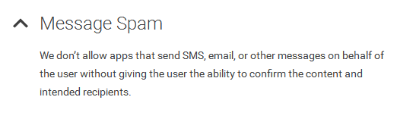

Interesting Sidetrack - Disallowed?
Google Play Developer Policy

Slide 24
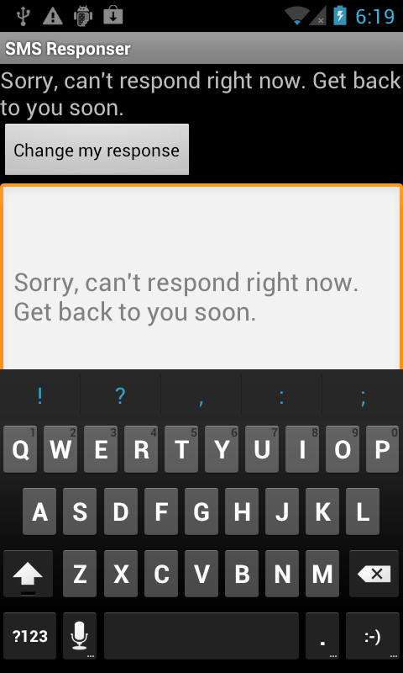
Example Service Application
From The Android Developer's Cookbook
SMSResponder Application
Response stored in shared preferences
App allows changes to message, start auto SMS responses and stop auto SMS respones

Slide 25

Using SMS
Permission in manifest file to send and / or receive SMS messages

Slide 26
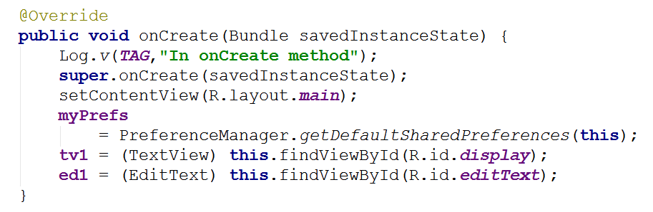
SMSResponder Basic App
onCreate
set up layout

Slide 27
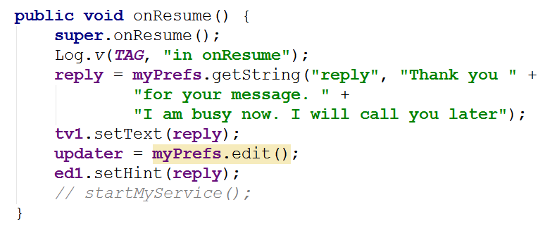
SMSResponder onResume

Slide 28
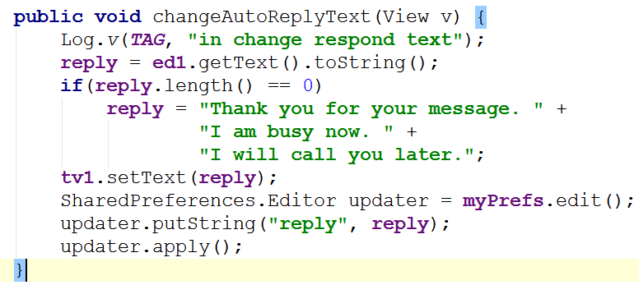
Change Auto Response Message

Slide 29
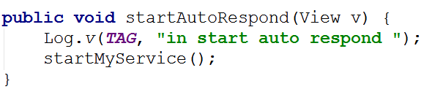
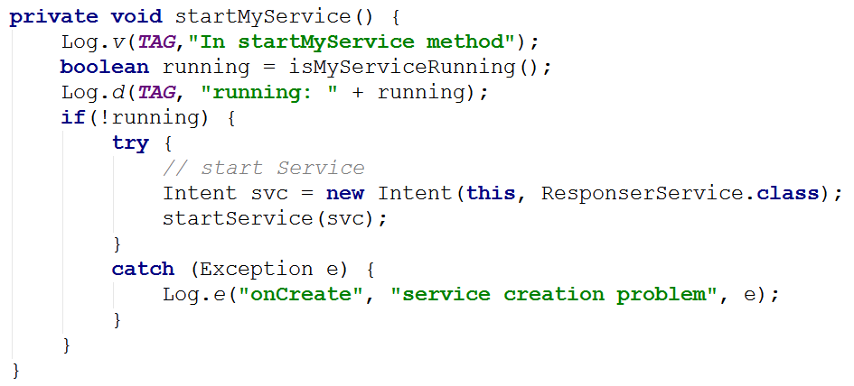
Starting Service

Slide 30
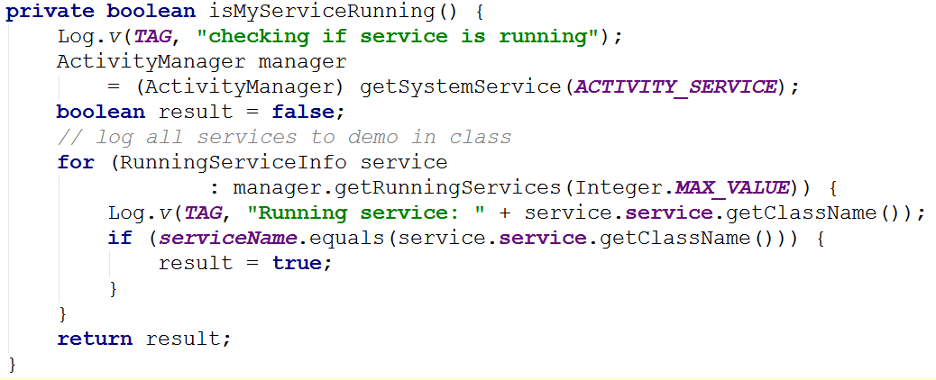
Check if Service Already Running
Alternative: Use public, static variable or method in Service class to indicate if running or not.

Slide 31
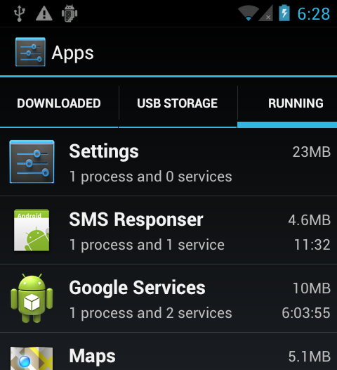
Service Running
Service is running

Slide 32
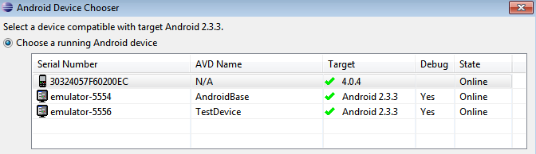
Simulating Texts
Calls and texts can be simulated between emulators
Start two emulators
Use messaging app to send text
Phone number is simply the emulator port number (visible at top of the emulator or in eclipse)

Slide 33
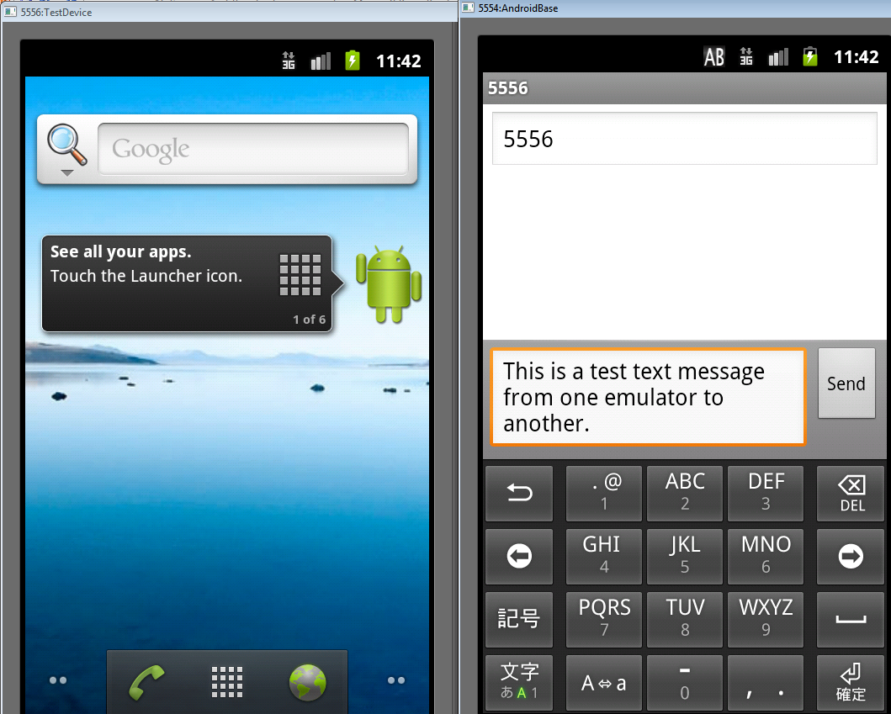
Dual Emulators

Slide 34
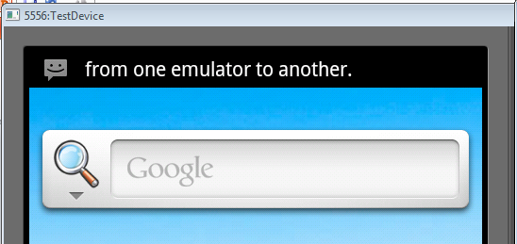
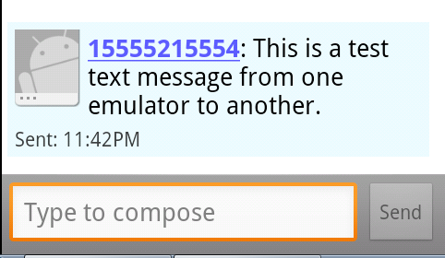
Emulator Texts

Slide 35
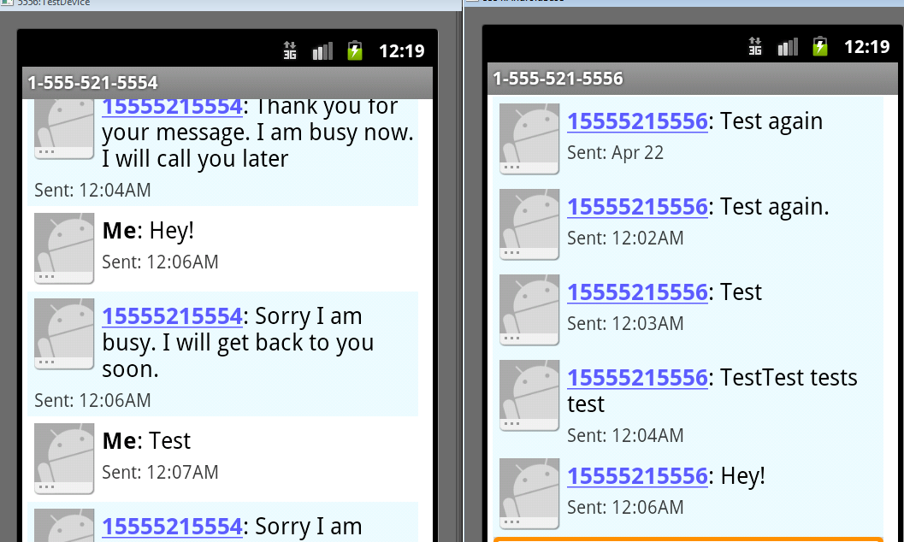
Testing Service

Slide 36
Creating a Service
Extend the Service class
  adapter class exists, IntentService handles a lot of the details
override onStartCommand
  return an int describing what system should do for starting service
  START_NOT_STICKY, if system kills service don't restart
  START_STICKY, if system kills service then recreate, but does not redeliver intent
  START_REDELIVER_INTENT, if system kills service then recreate and redeliver last intent

Slide 37
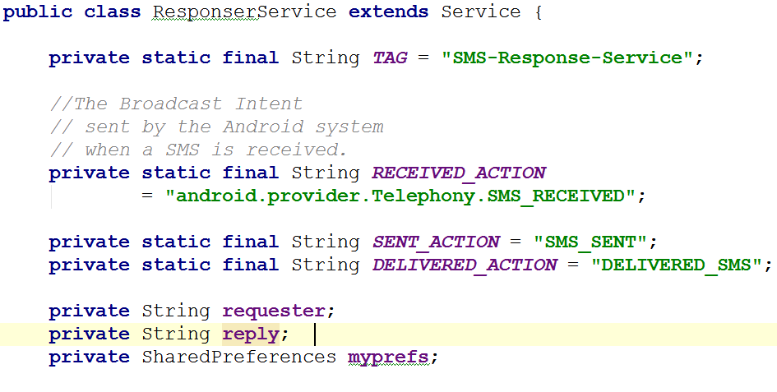
SMSResponser

Slide 38
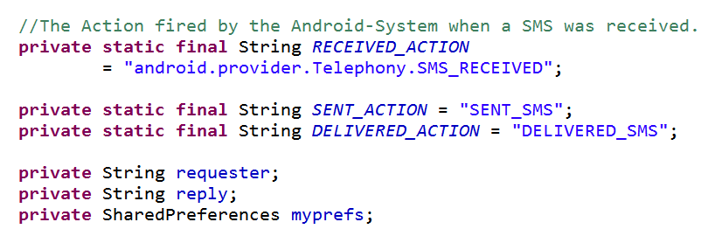
SMS Responder

Slide 39
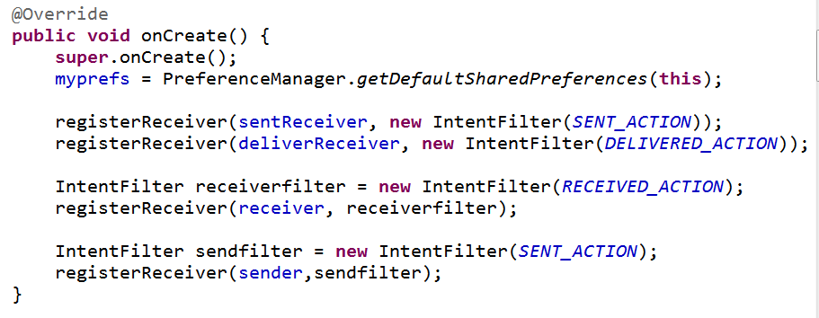
SMS Responder - onCreate

Slide 40
Broadcast receivers

Slide 41
Broadcast Receivers
The third of four application components
  activities, services, broadcast receivers, content providers / receivers
"A broadcast receiver is a component that responds to system-wide broadcast announcements."
Android system sends multiple kinds of broadcasts
  screen turned off, battery low, picture captured, SMS received, SMS sent, and more

Slide 42
Broadcasts
Another use of intents
Intents used to start activities and services
  startActivity()
  startActivityForResult()
  startService()
  bindService()
Also used to deliver information from system and applications to other applications
via Broadcast Intents

Slide 43
BroadcastReceivers
What broadcasts are available?
Check the Intent class
http://developer.android.com/reference/android/content/Intent.html
  search for "Broadcast Action"
Also look in android-sdk\platforms\<number>\data\
broadcast_actions.txt

Slide 44
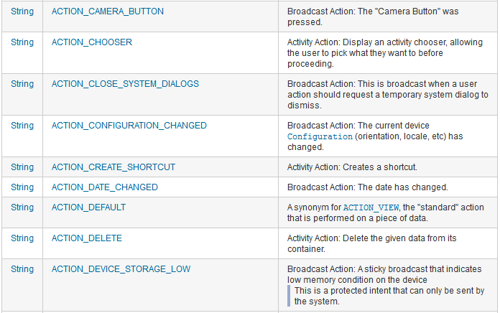
Broadcasts Listed in Intent class

Slide 45
Clicker
Can you app send out any Broadcasts it wants?
yes
no

Slide 46
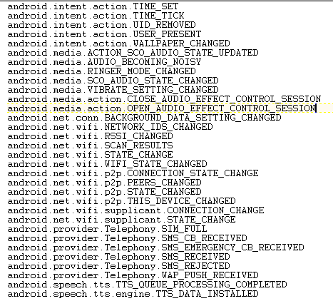
Broadcasts
from broadcast_
actions.txt in sdk files
platforms->
<api level>->
data\

Slide 47
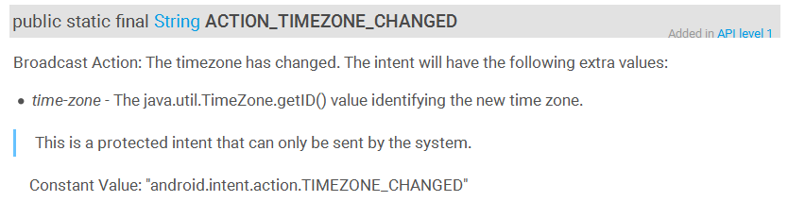
Broadcast Intents
You can create your own Broadcasts Intents
Many Intents listed in the Intent class are protected intents that may only be send by the system

Slide 48
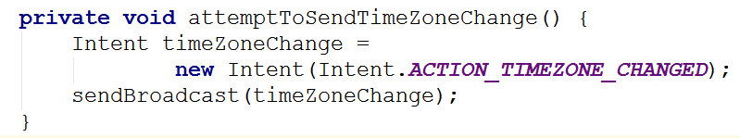
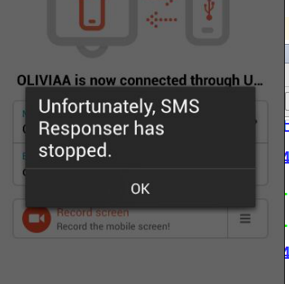
Protected Broadcasts
Try it anyway??
03-23 13:16:50.222 388-397/? W/ActivityManager: Permission Denial: not allowed to send broadcast android.intent.action.TIMEZONE_CHANGED from pid=3470, uid=10140

Slide 49
Permissions Again
Recall ...
Android 6.0, Marshmallow, API level 23 introduced changes to permissions
Dangerous vs. Normal permissions
Necessary to request Dangerous Permissions at runtime, not install time
Listening for SMS send and receive Broadcasts is a Dangerous Permission

Slide 50
Receiving Broadcasts
Activities and Services can listen for Broadcasts
4 steps
subclass BroadcastRecevier (
implement onReceive method)
create IntentFilter object to specify the kinds of Broadcasts you want
register receiver (onResume() of Activity)
unregister receiver (onPause() of Activity)
-- alternatively use manifest to register receiver

Slide 51
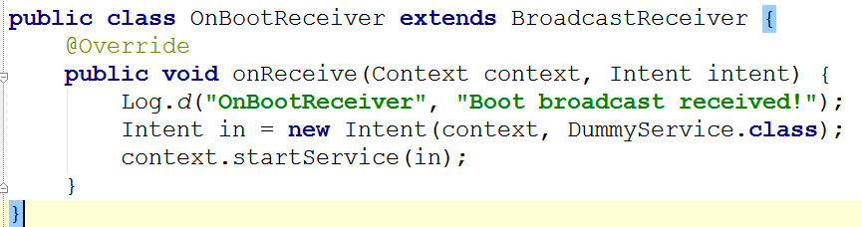
Example: Step 1
Start a service and print a toast at start up.
Step one: subclass BroadcastReceiver

Slide 52
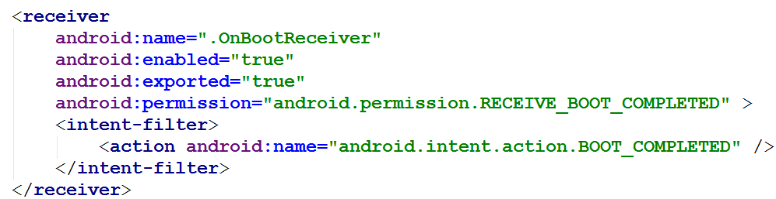
Example: Step 2
Step 2: Create intent filter to listen for broadcast
In manifest

Slide 53
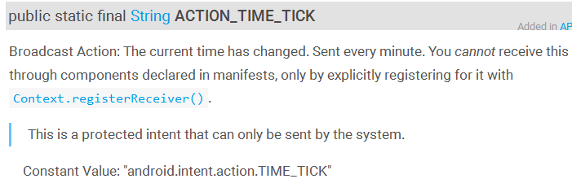
Step 2 - More on Intent Filters
For some Broadcasts you cannot use manifest to create IntentFilter
must be done programmatically

Slide 54
Example: Step 3
register receiver
normally done in onResume of activity
but no Activity on start up
so, BroadcastReceiver in manifest file
registers with System when app installed
app must be started once for this to work

Slide 55
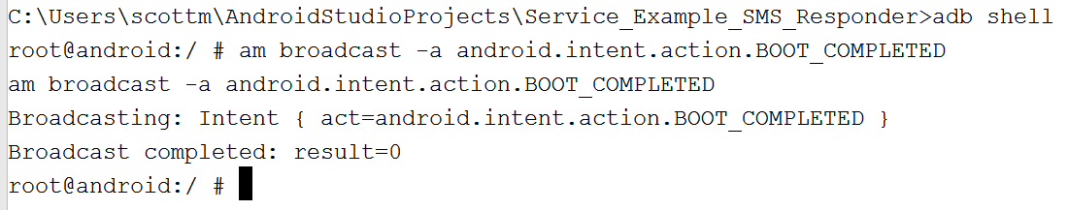
Spoofing Startup
Painful to shut down and start up device
Possible to spoof broadcasts
recommend using emulator
go to terminal
adb shell

Slide 56
Broadcast Receivers in Auto texting app

Slide 57
In SMS Responder
Service has inner classes for BroadcastReceiver that listens for Broadcast of SMS message received
create and register receivers when service stated
unregister when service destroyed
key point: override the onReceive method for BroadcastReceiver subclass

Slide 58
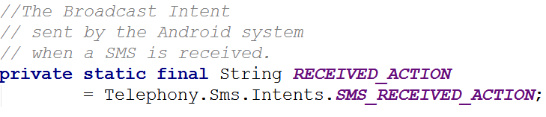
SMS Received Broadcast
from
developer.android.com/reference/android/provider/Telephony.Sms.Intents.html

Slide 59
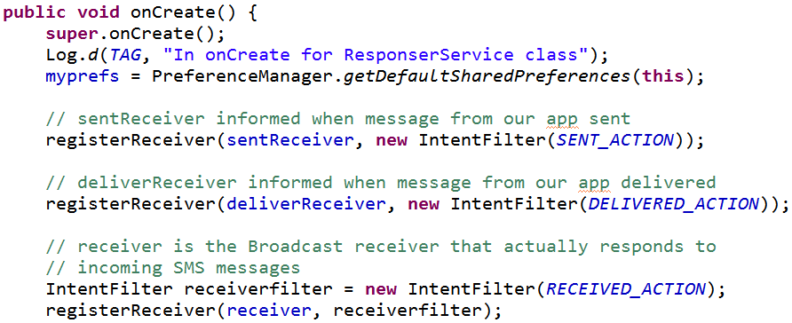
SMS Responder Service
Create and register receivers

Slide 60
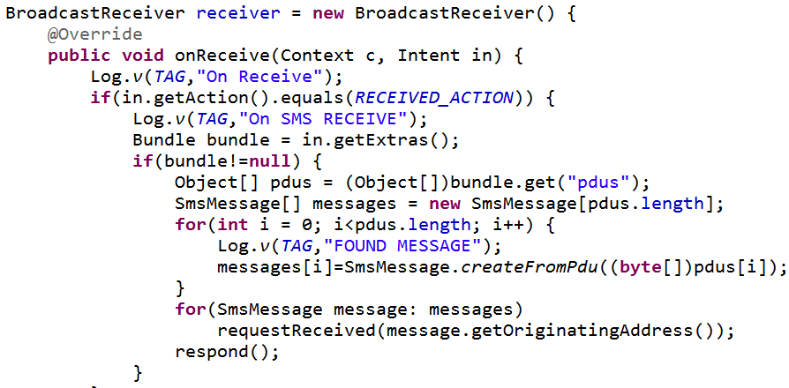
SMS Received - Broadcast Receiver

Slide 61
SMS Data
The SMS data in the Bundle (map) is under the key "pdus"
  pdu, protocol data unit (some sources indicate protocol description unit)

Slide 62
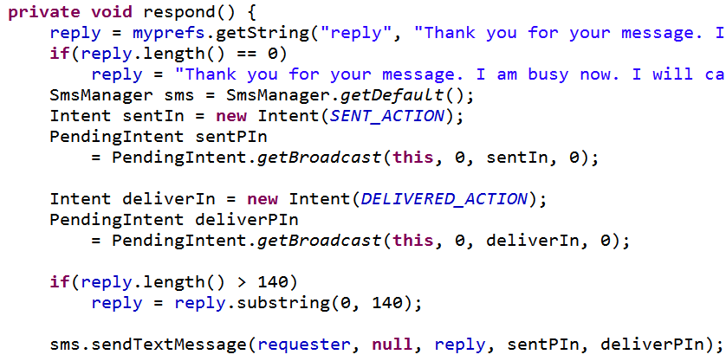
respond method

Slide 63
PendingIntent
Intent to deliver when some criteria met
Parameters:
this = context in which PendingIntent should sendBroadcast
0 = private request code for sender
sentIn = Intent to be Broadcast
0 = flags to modify send behavior

Slide 64
SMSManager.sendTextMessage
address to send text to (destination, recipient)
service center address (null = default)
text of message
pending intent to deliver when message sent
pending intent to deliver when message delivered

Slide 65
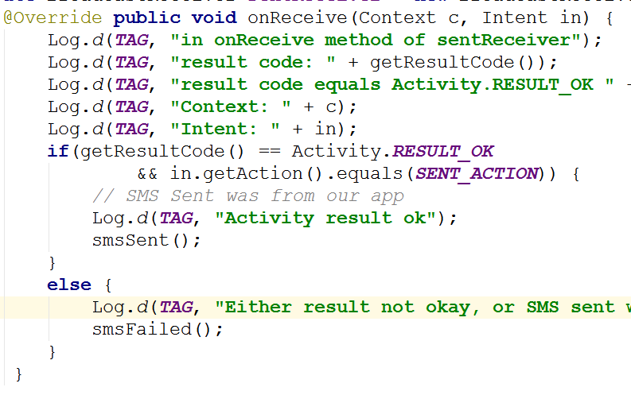
BroadcastReceiver for Sent

Slide 66
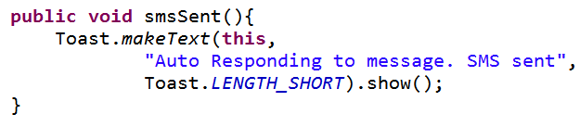
SMS Sent
Notify User with a Toast
  Probably better to use Notification
  Toast used so we see app in action during demonstration

Slide 67
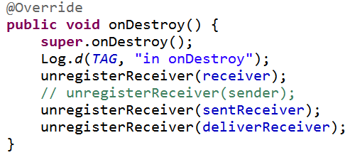
Unregistering Receivers
When no longer need unregister your receivers
In this case when the service is shut down

Slide 68
initiating broadcasts ourselves

Slide 69
Broadcast Receivers
Applications can initiate broadcasts to inform other applications of status or readiness
Don't display UI
  may create status bar notifications
Usually just a gateway to other components and does very minimal work
  initiate service based on some event
Broadcasts are delivered as Intents

Slide 70
Broadcast Receivers
intents sent by sendBroadcast() method
LocalBroadcastManager to send Broadcasts within your application only

Slide 71
More on Broadcast Receivers
can't initiate asynchronous actions in onReceive
  like creating and starting an AsyncTask
  because when method done BroadcastReceiver no longer active and system can and will kill the process
May need to use Notification Manager or start a service

Slide 72
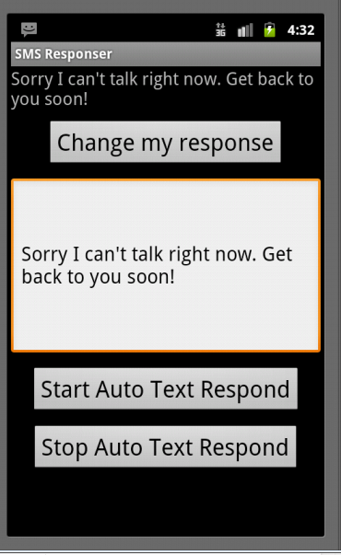
Stopping Service
Once started service runs until device shut down
Add option to start and shut down the service
Could add capability to start service on device start up

