Slide 1
CS371m - Mobile Computing
Content Providers And
Content Resolvers

Slide 2
Content Providers
One of the four primary application components:
  activities
  content providers / content resolvers
  services
  broadcast receivers

Slide 3
Android Applications
Recall…
Each application runs as a different user on the OS
private files, user id, separate process with its own instance of the Dalvik VM
Content Providers and Content Resolvers act as a bridge between applications to share data

Slide 4
Clciker
Which are you more likely to interact with directly in your apps?
A Content Resolver
A Content Provider

Slide 5
Content Providers
Standard mechanism / interface to allow code in one process (app, content resolver) to access data from another process (app, content provider)
  example, app to remind you to call certain people
  content resolver accesses call log to check last contact
manage access to a structured data
encapsulate the data and provide mechanisms for defining data security

Slide 6
Content Provider - Content Resolver
Calendar App Data
Content
Provider
Content
Resolver
data
Your App
Content
Resolver
Content
Provider
Call Log Data
data

Slide 7
Content Providers
Many of the built in applications on devices have content providers to allow other apps to access data
Examples of apps with content providers
  AlarmClock
  CalendarContract (API level 14)
  CallLog (sent and received calls)
  ContactsContract
  MediaStore (audio / visual data)
  UserDictionary
  VoicemailContract
  many, many more
http://developer.android.com/reference/android/provider/package-summary.html

Slide 8
Content Providers
Provide access to a central data repository
  ability to read and write to centralized data
data presented by Content Provider in the form of a table
  like table from relational database
Each row in data table one "piece" of data in repository

Slide 9
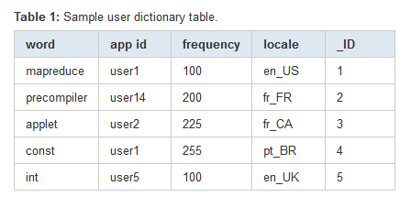
Example Table
Data from user dictionary
primary key optional
_ID column required to bind data from provider to a ListView

Slide 10
ConentProvider Theory
Abstraction facilitated by having URI for data from content provider
content://<more to follow> is the URI for the content
Don't know where data (content is actually stored)
  sqlite data base, flat file, server accessible via network
content://contacts/people

Slide 11
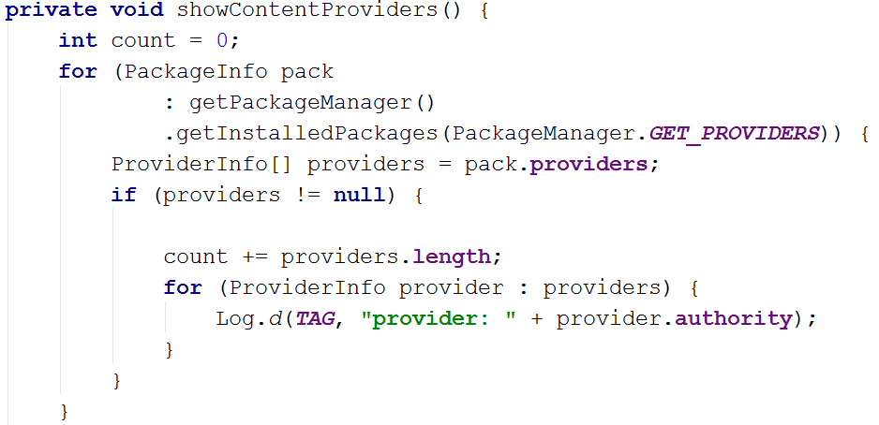
Listing Content Providers
Simple to list all ContentProviders available on Device / System
  Varies from device to device

Slide 12
using Content providers and content resolvers

Slide 13
Accessing Data
Use a ContentResolver client object in your app
ContentResolver communicates with ContentProvider
  provides "CRUD" functionality, Create, Retrieve, Update, Delete
matching methods in Content Resolver / Content Provider
example: query() method
Create a cursor via content resolver to move through rows of table

Slide 14
Using Content Providers
Unlike Activities, Services, and Broadcast Receivers we won't declare ContentResolvers in our AndroidManifest.xml file
In practice you may not even realize you are using a ContentProvider
we call the getContentResolver() method inherited from Context and then the query method on the returned ContentResolver

Slide 15
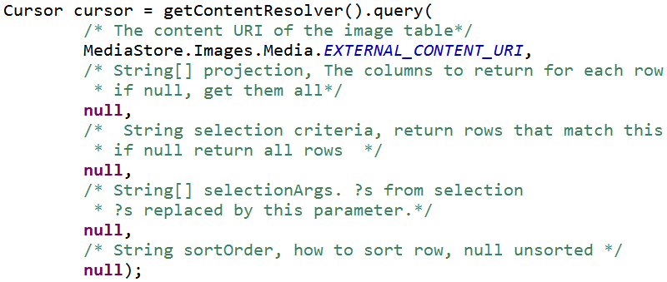
Accessing Content via Provider
Example: Exploring Images on a device
MediaStore.Images.Media class presents various Content Providers
get the cursor:

Slide 16
Query
5 parameters
uri for content, URI
  look at class documentation, generally a constant
projection, String[]
  what columns to get from the table, null = all,
  can be inefficient
selection clause, String
  filter, what rows to include, a SQL WHERE clause
selection args, String[]
  replace ?'s in selection with these
sortOrder, String
  how to order the rows

Slide 17
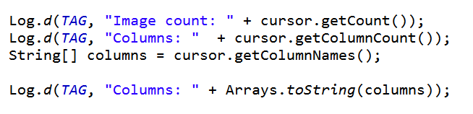
Accessing Content via Provider
After obtaining cursor:
result:

Slide 18
MediaStore.Images.Media
Columns from table:
According to Logcat:
[_id, _data, _size, _display_name, mime_type, title, date_added, date_modified, description, picasa_id, isprivate, latitude, longitude, datetaken, orientation, mini_thumb_magic, bucket_id, bucket_display_name, width, height]

Slide 19
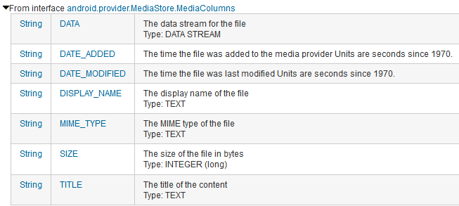
MediaStore.Images.Media
Columns documented in ContentProvider classes and interfaces

Slide 20
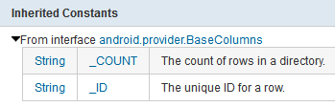
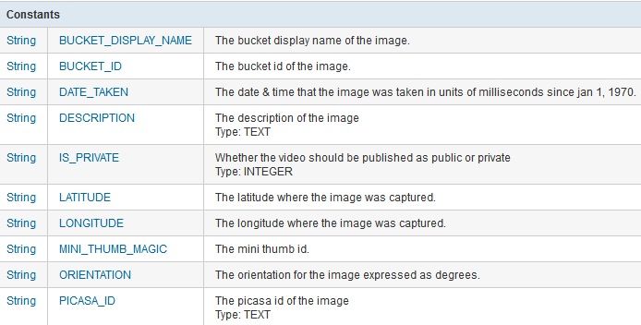
MediaStore.Images.Media Columns

Slide 21
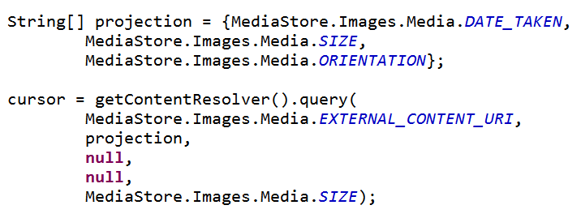
Selection Columns
Limit Columns returned with projection argument to query method that creates Cursor

Slide 22
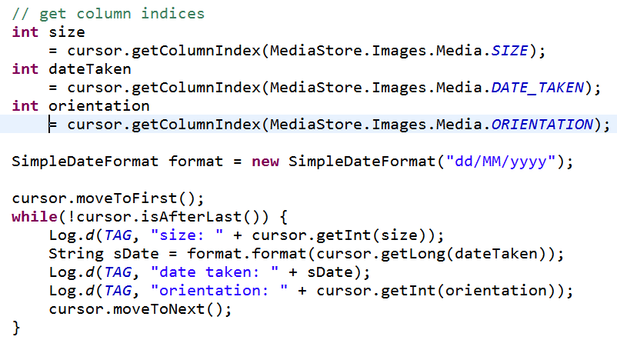
Showing Data in Logcat

Slide 23
Cursor
The ContentResolver query method creates and returns a Cursor
Similar to a Database Cursor
  similar to Scanner or Iterator
Move through the data (rows) one element at a time
Process data with loop or bind cursor to a ListView with an Adapter

Slide 24
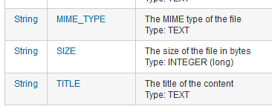
Getting Data from Row
Must determine what type column data is in, use getX method
refer to constants from ContentProvider class
careful - some INTEGERS longs

Slide 25
Using Selection Criteria
Example gets rows in table
the selection criteria and selection args allow picking only certain rows
essentially an SQL WHERE clause
  http://www.w3schools.com/sql/sql_where.asp
specify a criteria that must be met
? is value filled in with selectionArgs
  multiple criteria possible, AND, OR, NOT

Slide 26
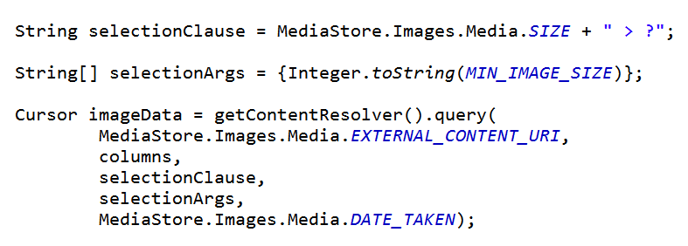
Using Selection Criteria
Instead of selecting all rows, only select rows with image size greater than some minimum value
  recall: null, null returns all rows

Slide 27
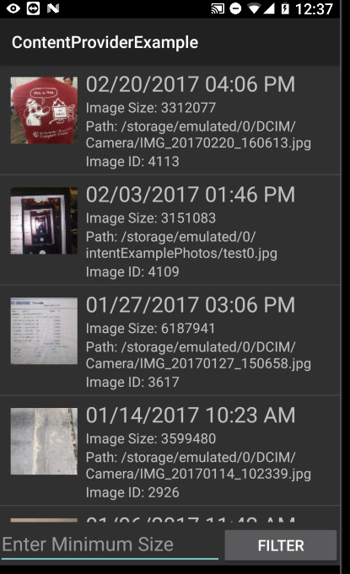
Result

Slide 28
Why selectionCriteria and selectionArgs??
Why not just say:
  selectionCriteria = "MediaStore.Images.Media.SIZE > 1750000"
SECURITY
If selection criteria is based on user input, user could insert malicious SQL statements to attempt to delete data base table
example:
" MediaStore.Images.Media.SIZE > " + "nothing; DROP TABLE *;"

Slide 29
Displaying Data in ListView
Specify columns to get from ContentProvider
Create view that will hold data
  one row
Obtain cursor from ContentProvider
Use ListAdapter to convert data from Cursor to Views
Sub class adapter to format text

Slide 30
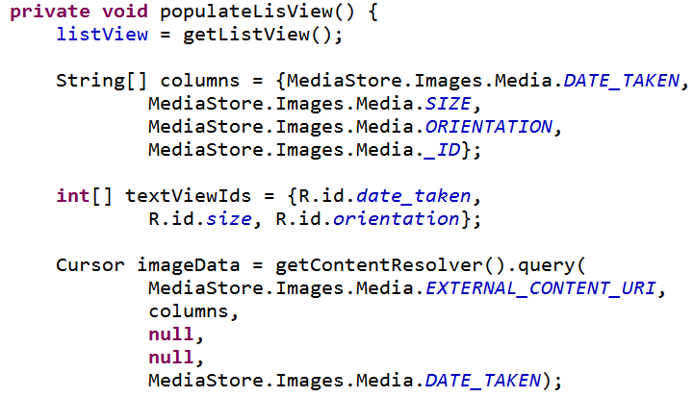
Display Data from ContentProvider

Slide 31
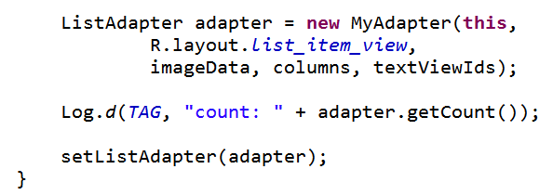
Display Data from ContentProvider
rest of populateListView from ListActivity

Slide 32
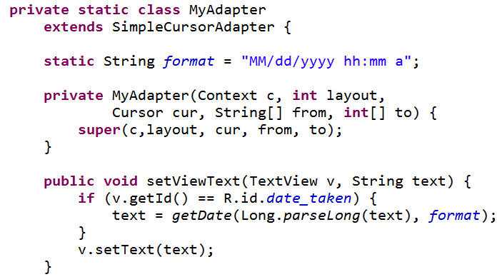
Subclass Adapter

Slide 33
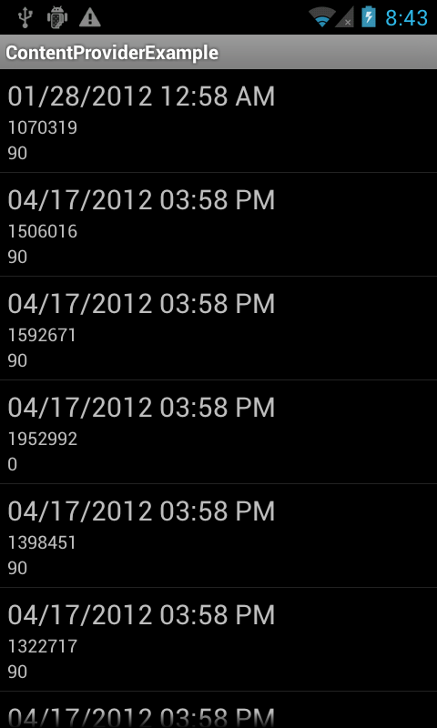
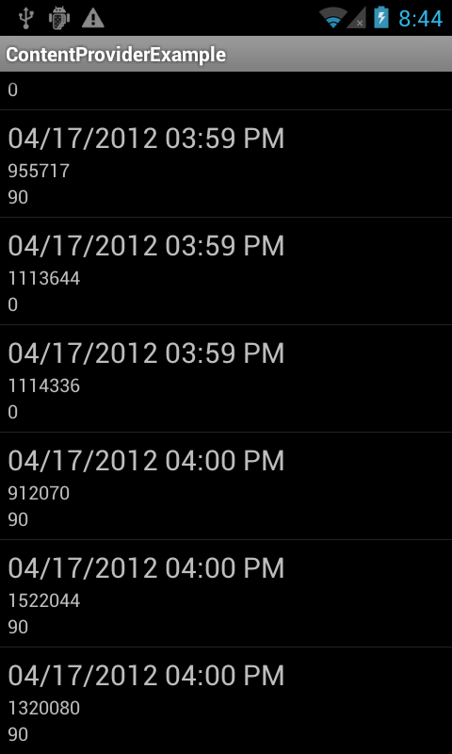
Results

Slide 34


Permissions
Using certain content providers require an application request permission
  Calendar and Contact permissions are catergorized as Dangerous Permissions
  Must request at runtime

Slide 35
Content Provider Capabilities
Possible to update, insert, and delete data via a ContentProvider
  CRUD
insert, update, and delete methods part of ContentResolver class
for example insert new calendar data or modify existing calendar data

Slide 36
ContentProviders and Intents
Some Content Providers have common activities
created Intent Filters to handle the operation
Example
  Calendar has Intent Filter so other applications can add events
  opens form with data filled in, finish creation, go back to original app, event added to calendar

Slide 37
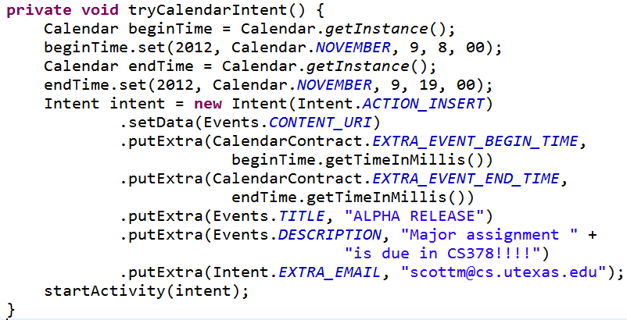
Calendar Event Add

Slide 38
Single Data Elements
Sometimes you don't want all the data from a Content Provider
  you want one piece of data, one row from the table
must have the ID value of the row and the Content Provider must support this functionality

Slide 39
Special providers and contracts

Slide 40
Calendar Provider and Contact Provider
Special providers
Calendar and Contact data considered central to user experience
Android has built in components to work with Calendar and Contact data

Slide 41
Contacts Provider
Built to accommodate a wide range of data and manage as much data as possible for each contact
flexible, powerful, … complicated
provides contract classes to access and modify Contacts data

Slide 42
Contracts
Some apps that have content providers provide Contract classes
"help work with Content provider Uris, column names, intent actions, and other features of the content provider"
Adds a layer of abstraction and encapsulation

Slide 43
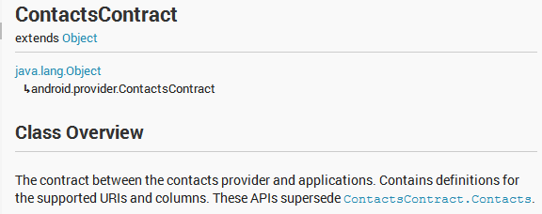
Contacts Contract
Many nested classes
Provide information on the tables in the content provider
… and some convenience methods for accessing that data

Slide 44
Contacts Contract
Example of abstraction
Possible to create cursor and pull out the last time a contact was contacted

Slide 45
Calendar and Contacts Providers
The Calendar and Contacts data used by many of the apps on the device
Each have their own APIs to perform CRUD operations
  create, read, update, delete
Calendar provider has tables for
  Calendars, Events, Instances, Attendees, Reminders
Contact provider manages as much data for each contact as possible leading to a complex organization
  multiple contract classes for retrieval and modification of contact data

Slide 46
creating content providers

Slide 47
Creating ContentProvider
You may need / want to provide a ContentProvider if:
  You want to offer complex data or files to other applications.
  You want to allow users to copy complex data from your app into other apps.
  You want to provide custom search suggestions using the search framework.
  Want the ability to change how you store data without changing how your own app accesses the data

Slide 48
LOADERS

Slide 49
Loaders
Alternative approach to getting Cursor from a ContentProvider
Accessing data from ContentProvider may be a lengthy operation
  doing this on the UI thread may lead to ANR, unresponsiveness
Loader interfaces and classes used to do this on a separate thread
  create their own AsynchTask

Slide 50
CursorLoader
create a loader
  API level 11 or greater
  ListView or ListFragment, but not ListActivity
implement a class with the proper callback methods for when the CursorLoader is finished and data is ready for access
  public Loader<Cursor> onCreateLoader(int id, Bundle args)
  public void onLoadFinished(Loader<Cursor> loader,
  Cursor data)
  public void onLoaderReset(Loader<Cursor> loader)

