Slide 1
CS371m - Mobile Computing
Android Overview and Android Development Environment

Slide 2
What is Android?
A software stack for mobile devices that includes
  An operating system
  Middleware
  Key Applications
Uses Linux to provide core system services
  Security
  Memory management
  Process management
  Power management
  Hardware drivers

Slide 3
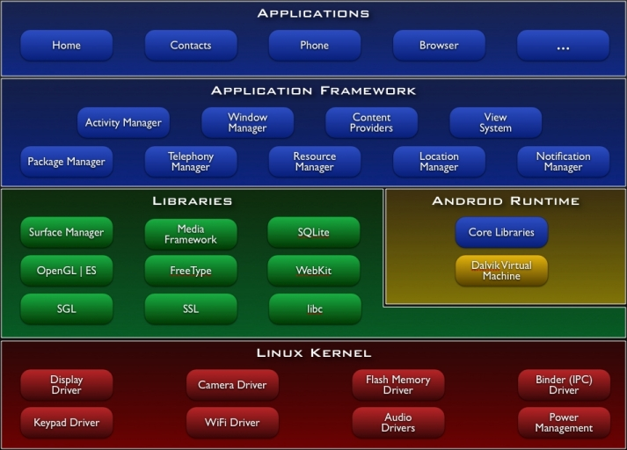
http://developer.android.com/guide/basics/what-is-android.html

Slide 4
Android Versioning
On the order of 27 versions in 9 years.
Slowing down, current pace is one large, major release a year
  will this slow down more?
Android releases have a code name, version number, and API level
Most recent:
  Oreo, Version 8.1, API level 27
https://en.wikipedia.org/wiki/Android_version_history

Slide 5
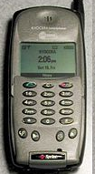
A Short History Of Android
2001 Palm Kyocera 6035, combing PDA and phone
  PDA = personal data assistant, PalmPilot
2003 - Blackberry smartphone released
2005
  Google acquires startup Android Inc. to start Android platform.
  Work on Dalvik VM begins
2007
  Open Handset Alliance announced
  Early look at SDK
  June, iPhone released
2008
  Google sponsors 1st Android Developer Challenge
  T-Mobile G1 announced, released fall
  SDK 1.0 released
  Android released open source (Apache License)
  Android Dev Phone 1 released
Pro Android by Hashimi & Komatineni (2009)

Slide 6

Short History cont.
2009
  SDK 1.5 (Cupcake) after Alpha and Beta
    New soft keyboard with “autocomplete” feature
  SDK 1.6 (Donut)
    Support Wide VGA
  SDK 2.0/2.0.1/2.1 (Eclair)
    Revamped UI, browser
2010
  Nexus One released to the public
  SDK 2.2 (Froyo)
    Flash support, tethering
  SDK 2.3 (Gingerbread)
    UI update, system-wide copy-paste
https://en.wikipedia.org/wiki/Android_version_history

Slide 7

Short History cont.
2011
  SDK 3.0 (Honeycomb) for tablets only
    New UI for tablets, support multi-core processors, fragments
  SDK 3.1 and 3.2
    Hardware support and UI improvements
  SDK 4.0 (Ice Cream Sandwich)
    For Q4, combination of Gingerbread and Honeycomb

Slide 8
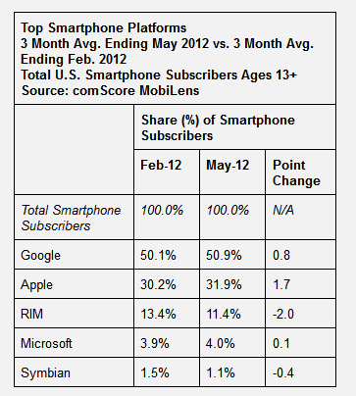

Short History cont.
2012
  Android 4.1, "Jelly Bean" released in July
2013
  Android 4.4, KitKat released October 31, 2013

Slide 9
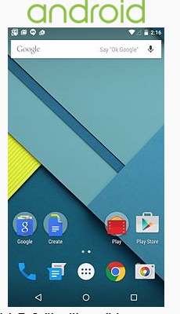


Short History (Getting Longer)
November, 2014
Android 5.0 Lollipop
released.
API level 21
"Material Design"
October, 2015
Android 6.0
Marshmallow
API level 23
  Runtime
  permissions

Slide 10


Still More
August 2016
  Nougat
  Daydream Virtual Reality Interface
  Doze functionality to improve battery life
August 2017
  Oreo
  Jetpack, tools for building apps, common libraries and frameworks

Slide 11
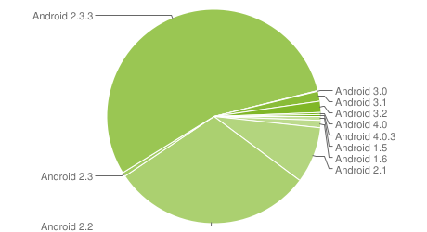
Device Distribution Jan 2012
Based on active devices
Forward compatible
Not necessarily
backward compatible
1.5 Cupcake: 0.6%
1.6 Donut: 1.1%
2.1 Ecliar 8.5%
2.2 Froyo 30.4%
2.3 Gingerbread: 56%
3.X Honeycomb 3.3%
4.x Ice Cream Sand. 0.6%
http://developer.android.com/resources/dashboard/platform-versions.html

Slide 12
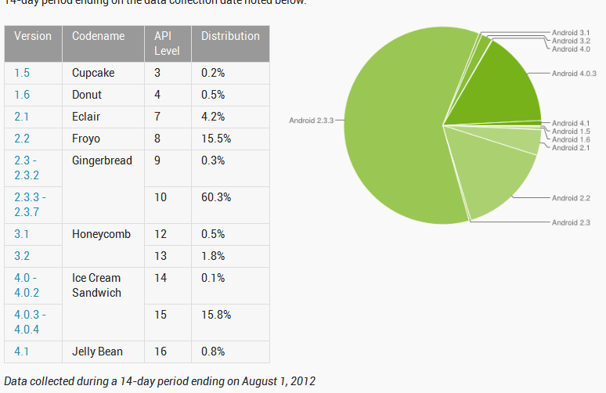
August 1, 2012
OS Version, API Level, Nickname
4.1, API Level 16, Jelly Bean

Slide 13
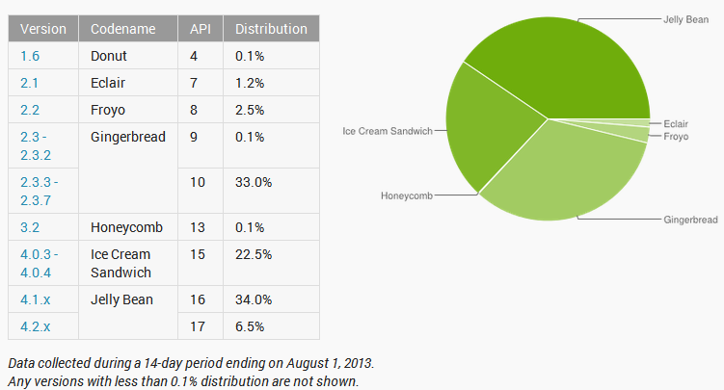
August 1, 2013
Based on device visits to Google Play

Slide 14
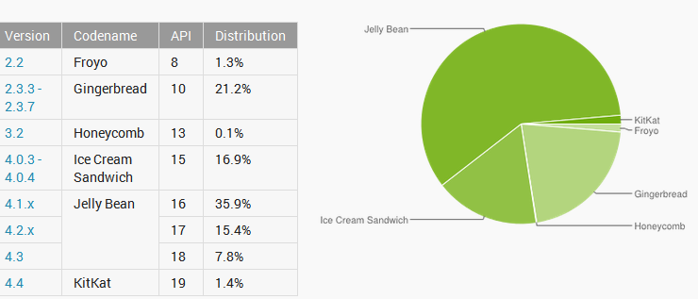
January 8, 2014
Based on device visits to Google Play

Slide 15
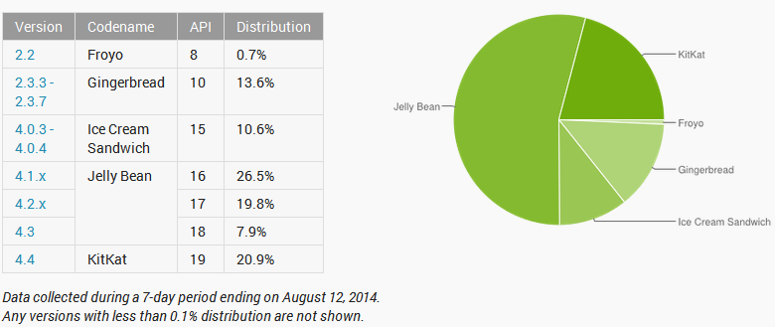
August, 2014
Based on unique devices that visit
the Google Play Store.

Slide 16
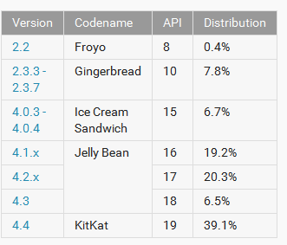
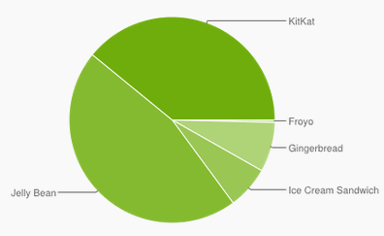
January 2015
Where is Lollipop?

Slide 17
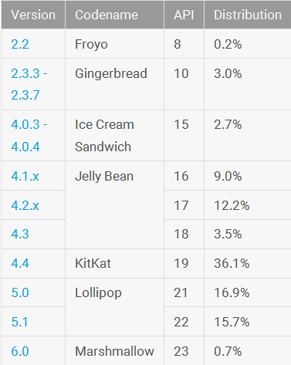
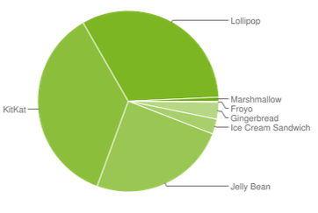
January 2016
Took a year for Lollipop to gain
roughly a third of device share.

Slide 18

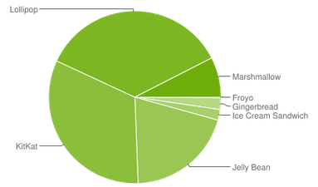
May 2016
Marshmallow not in the weeds
any more.

Slide 19
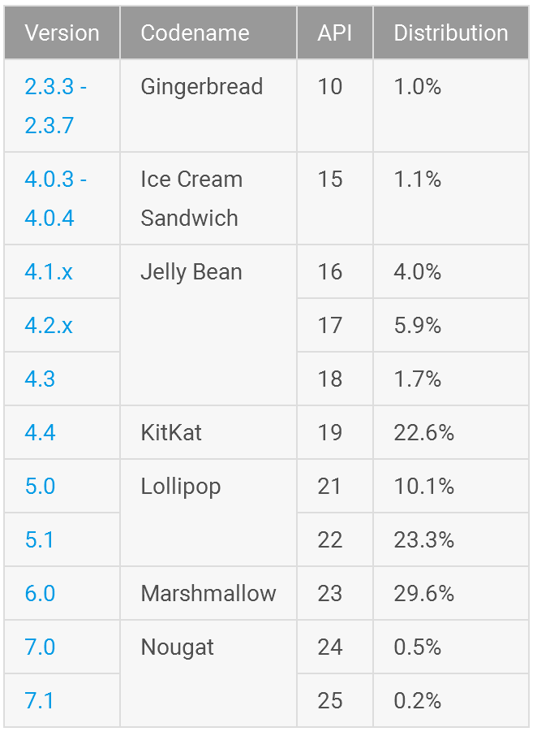
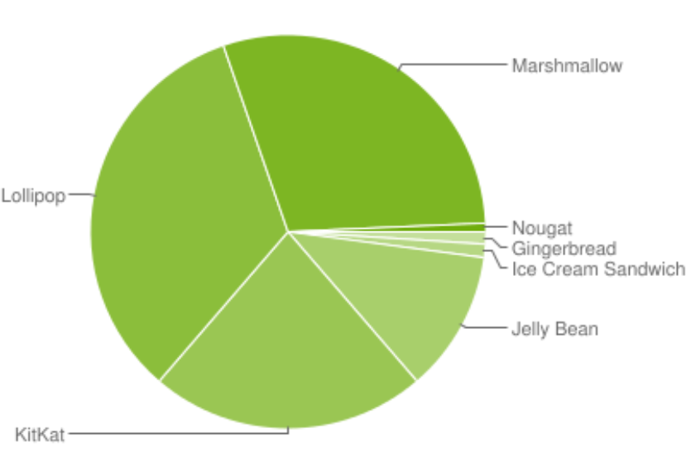
January 2017
Developer decision?

Slide 20
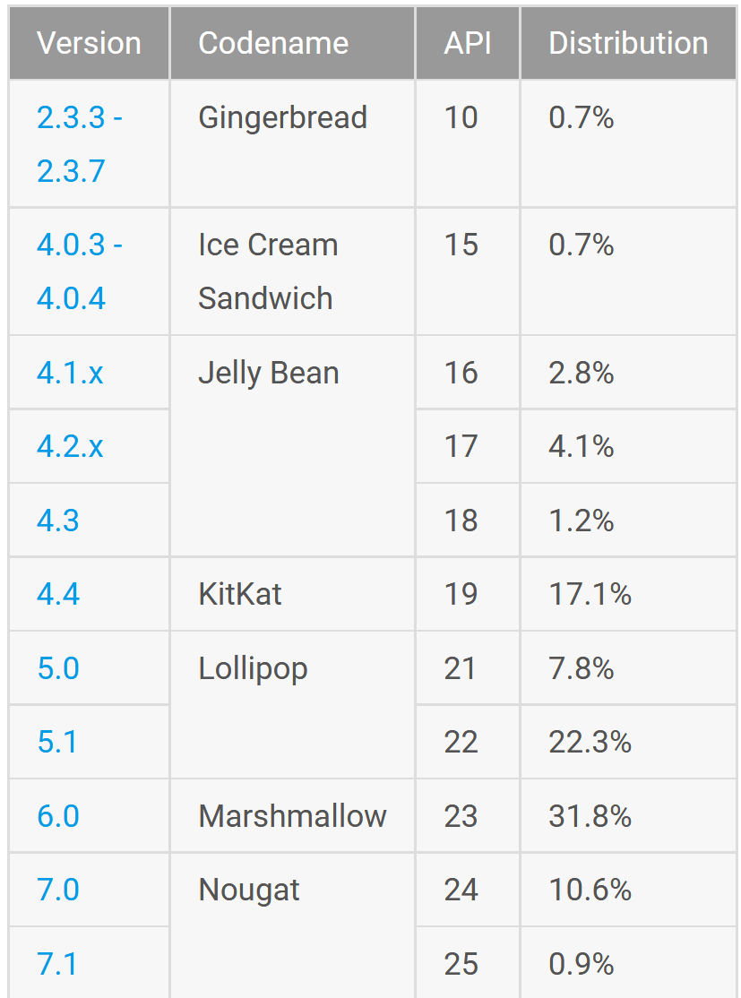
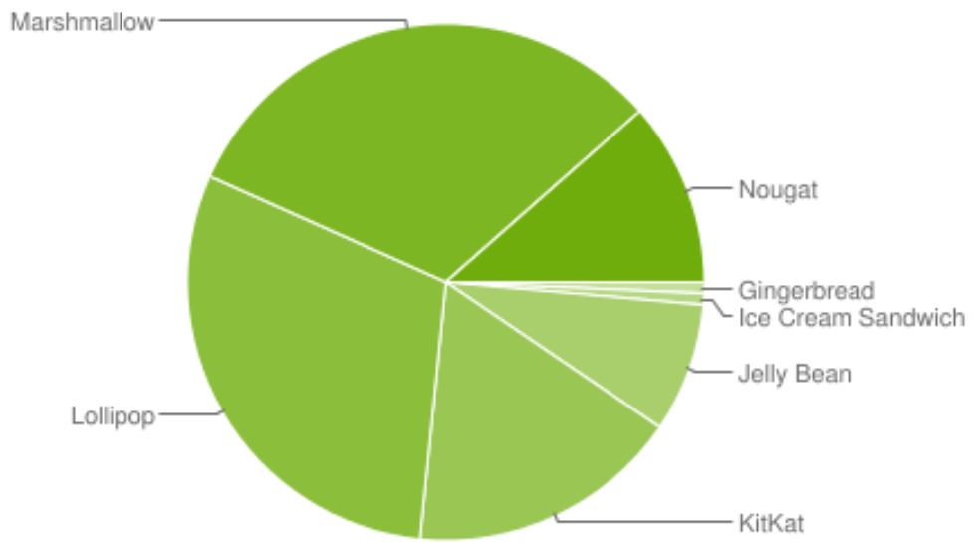
July 2017

Slide 21
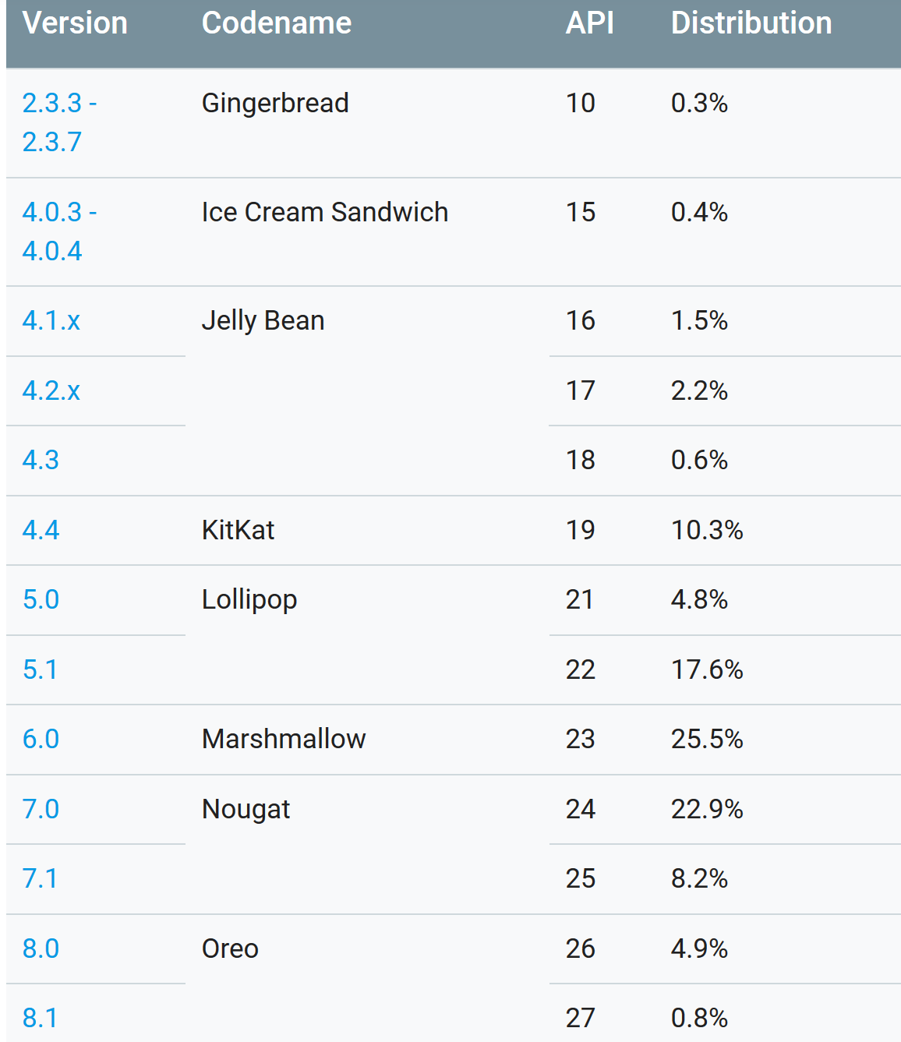
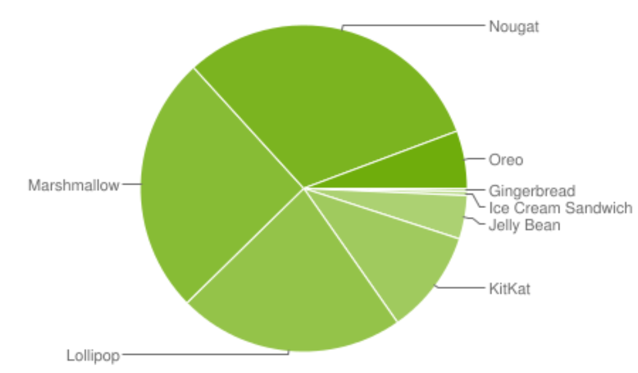
June 2018

Slide 22
Clicker Question
Do you own an Android device?
yes
no
What version of Android are you running?
Kit Kat
Lollipop
Marshmallow
Nougat
Other, don't know, or don't own Android device

Slide 23
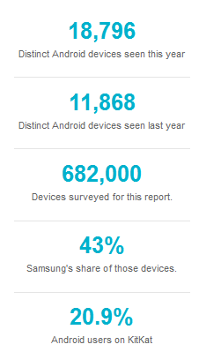
Android Fragmentation
August 2014
Report from
http://opensignal.com
/reports/2014/
android-fragmentation/
open signal app for
Android and iOS
5m - 10m Android
downloads

Slide 24
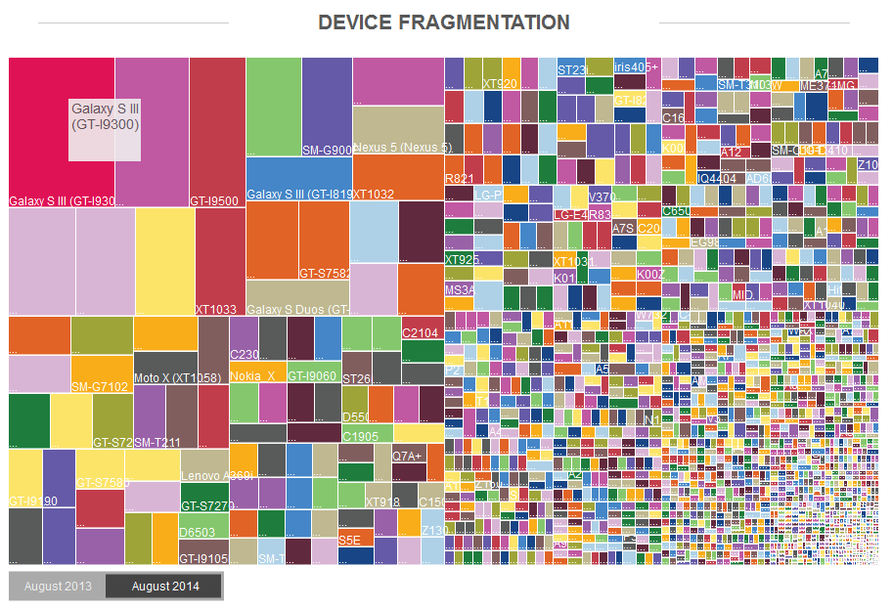
Device Fragmentation
sdd

Slide 25
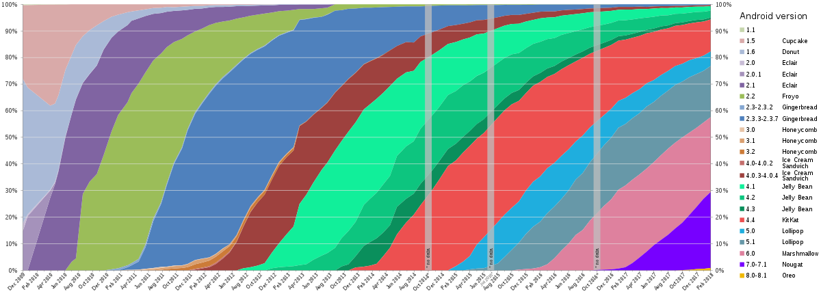
By Erikrespo - Android Developer Dashboard – Platform Distribution Data points

Slide 26
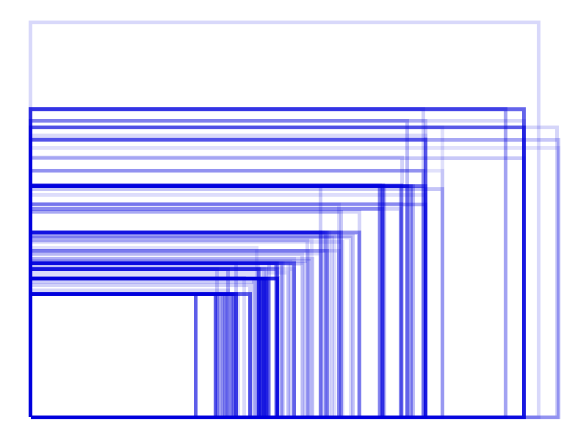
Android Screen Sizes - August 2014

Slide 27

iOS Screen Sizes - August 2014

Slide 28
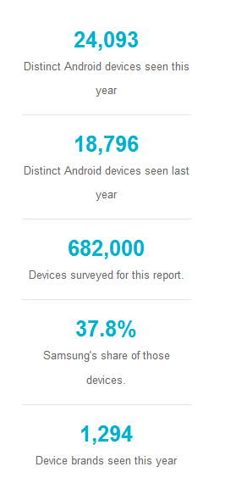
Android Fragmentation
August 2015
Report from
http://opensignal.com/reports/2015/08/android-fragmentation/open signal app for
10m - 50m Android
downloads

Slide 29
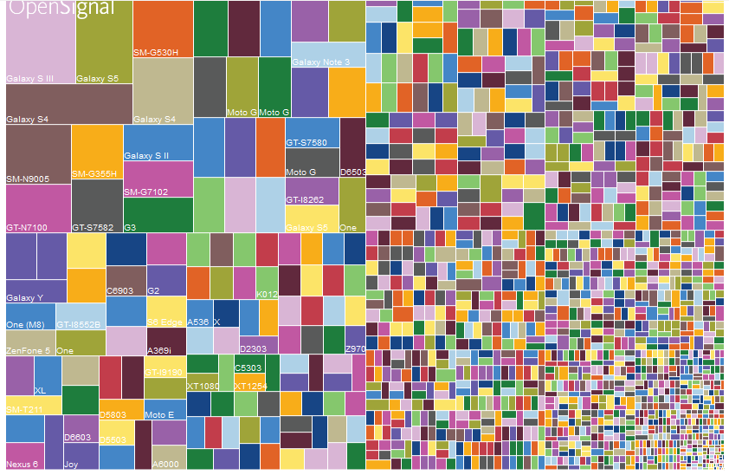
Device Fragmentation
http://opensignal.com/reports/2015/08/android-fragmentation/

Slide 30
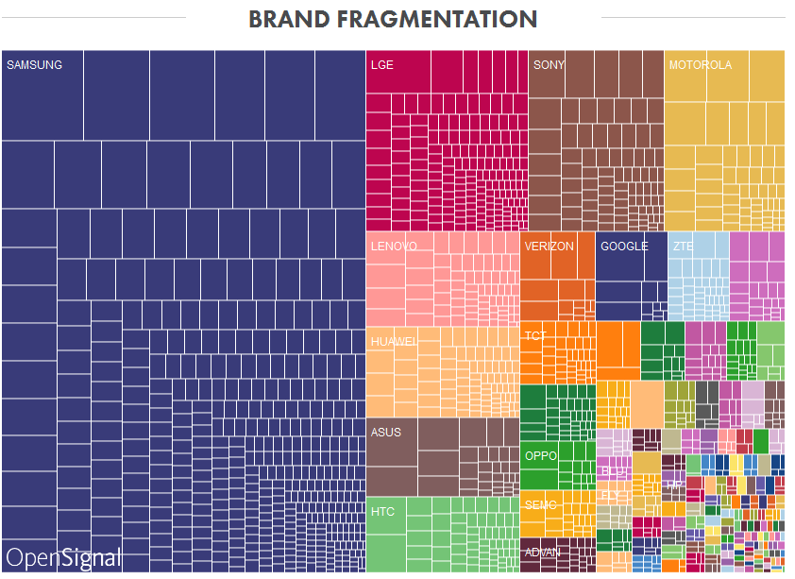
Brand Fragmentation
http://opensignal.com/reports/2015/08/android-fragmentation/

Slide 31
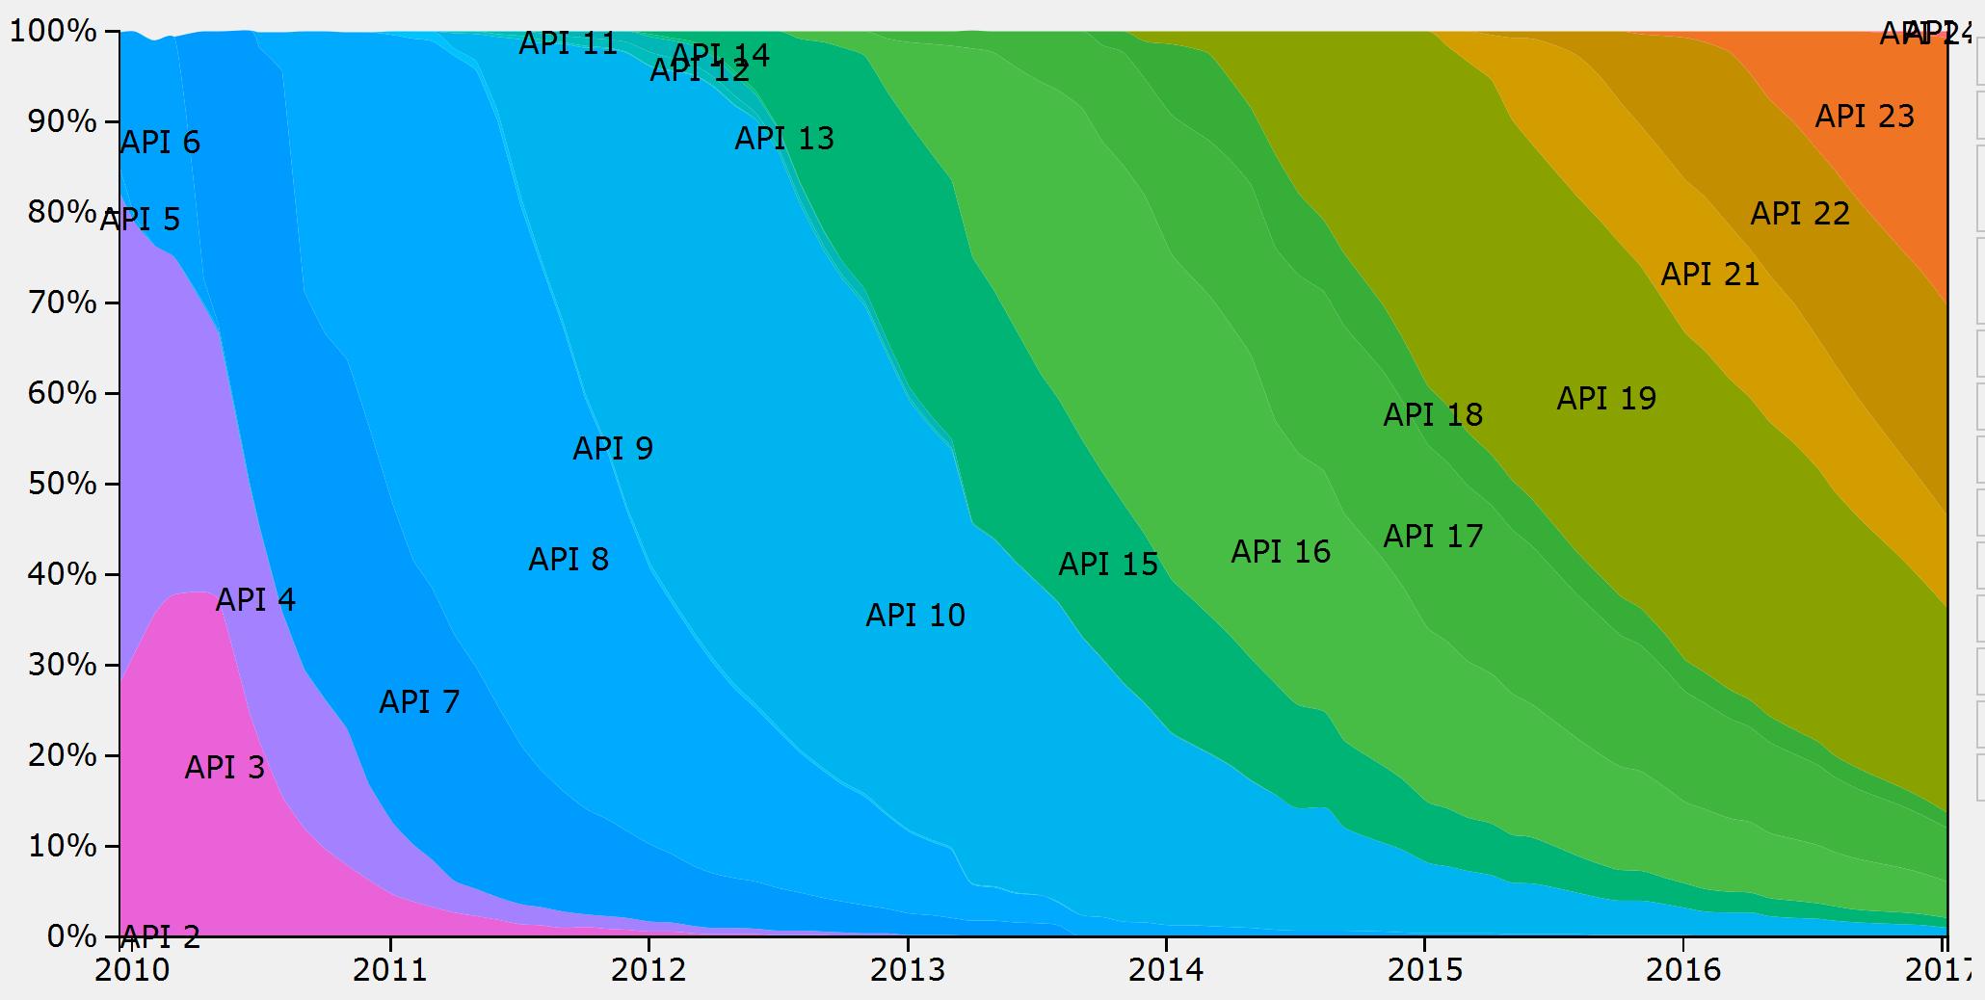
Marsh
mallow
lollipop
kit kat
jelly bean
ics
ginger
bread
January 2017

Slide 32
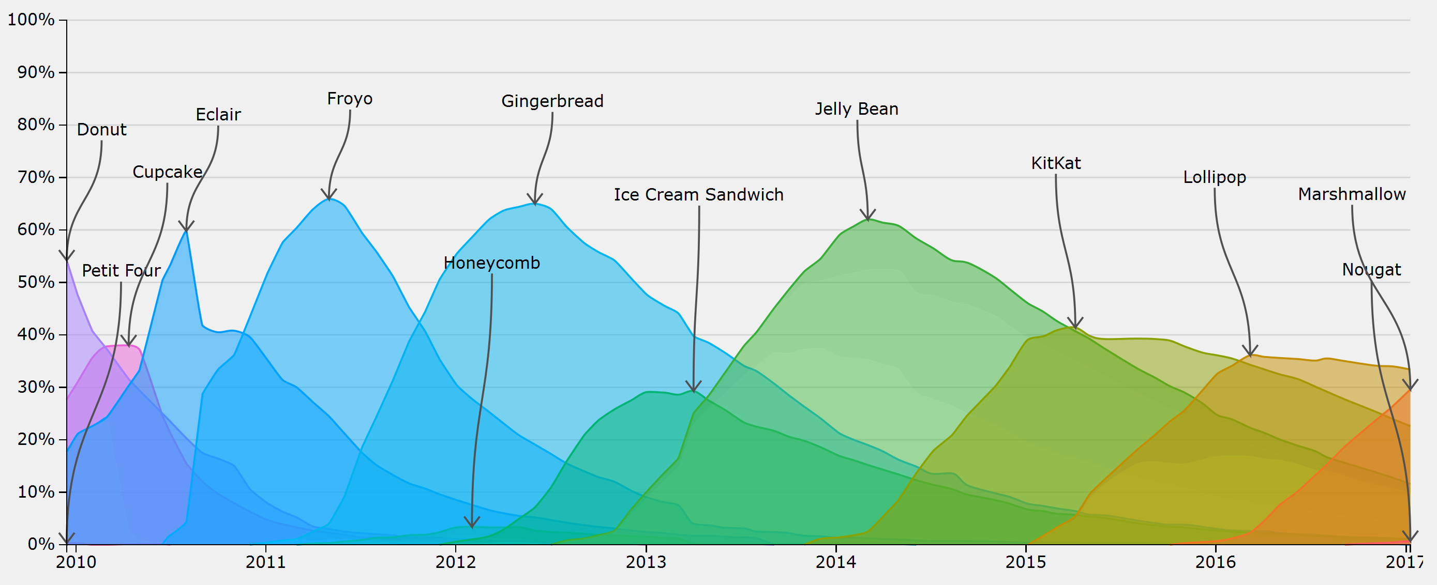
Dominant Version
http://www.bidouille.org/misc/androidcharts

Slide 33
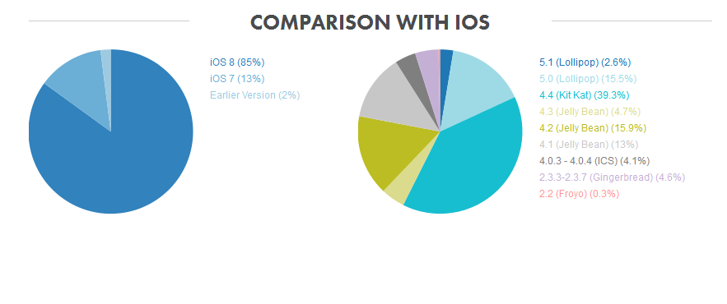
Android - iOS comparison
August 2015

Slide 34
Android Version Fragmentation
Why as a developer do you care about the fragmentation of
  Android versions, API level
    Each new release includes many new features and tools for developers.
    What is available to me?
    Some newer functionality available for older versions via the Support Library.
  screen sizes
  manufacturers

Slide 35
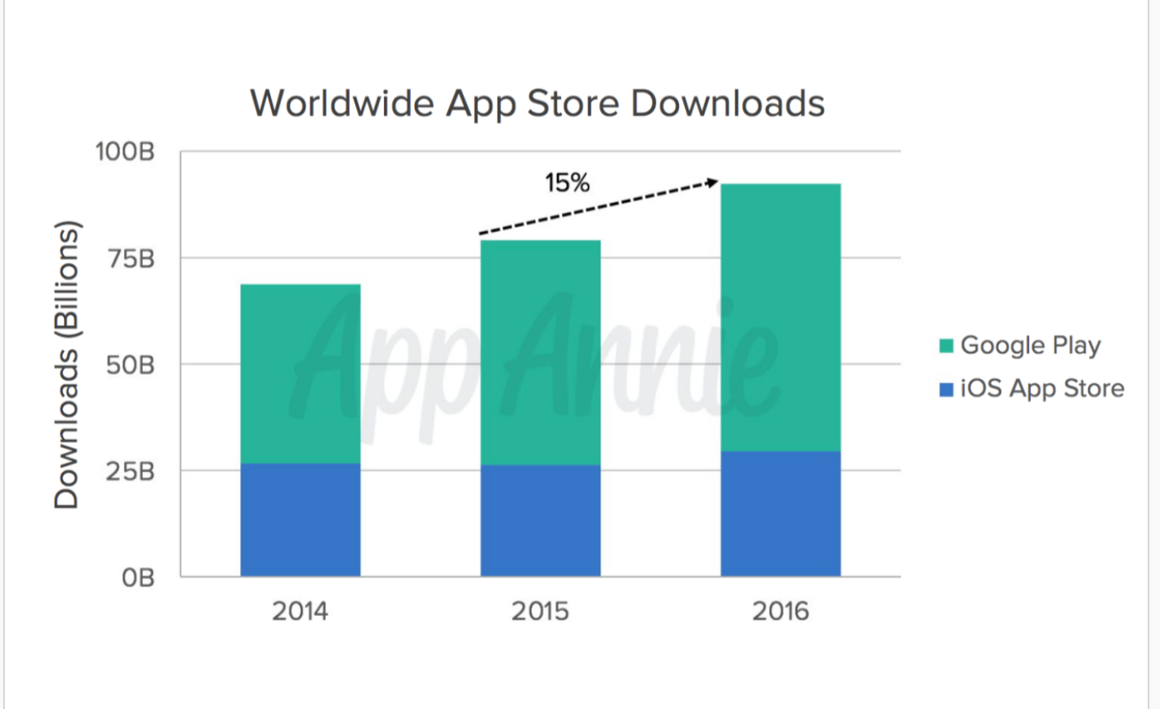
Android vs iOS

Slide 36
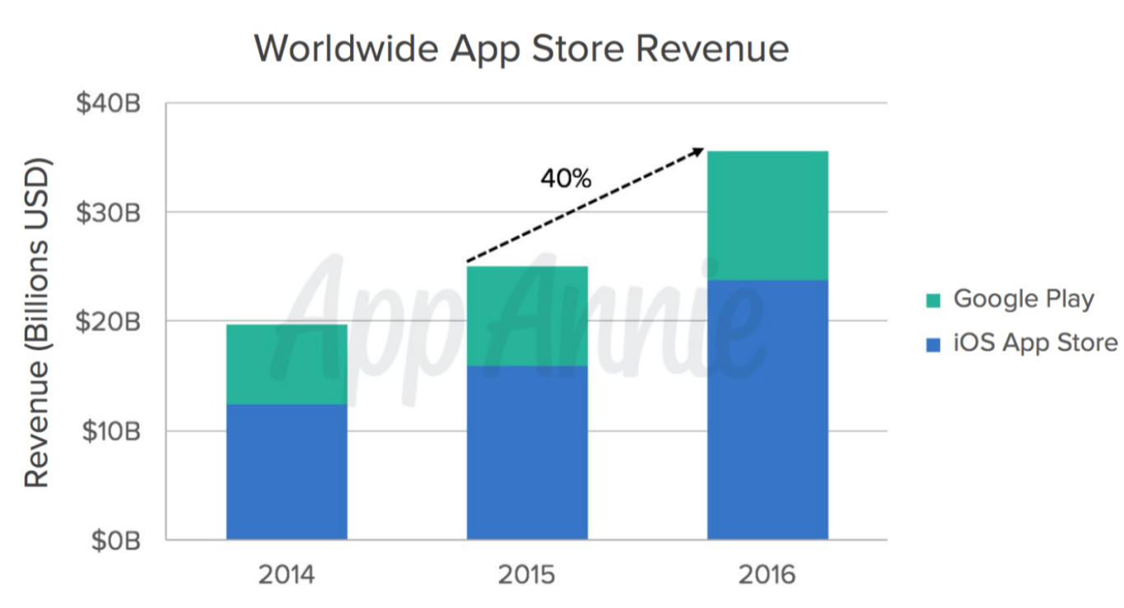
Revenue
Strategy: attract developers with comparison of revenue generated by applications, average revenue per user, etc.

Slide 37
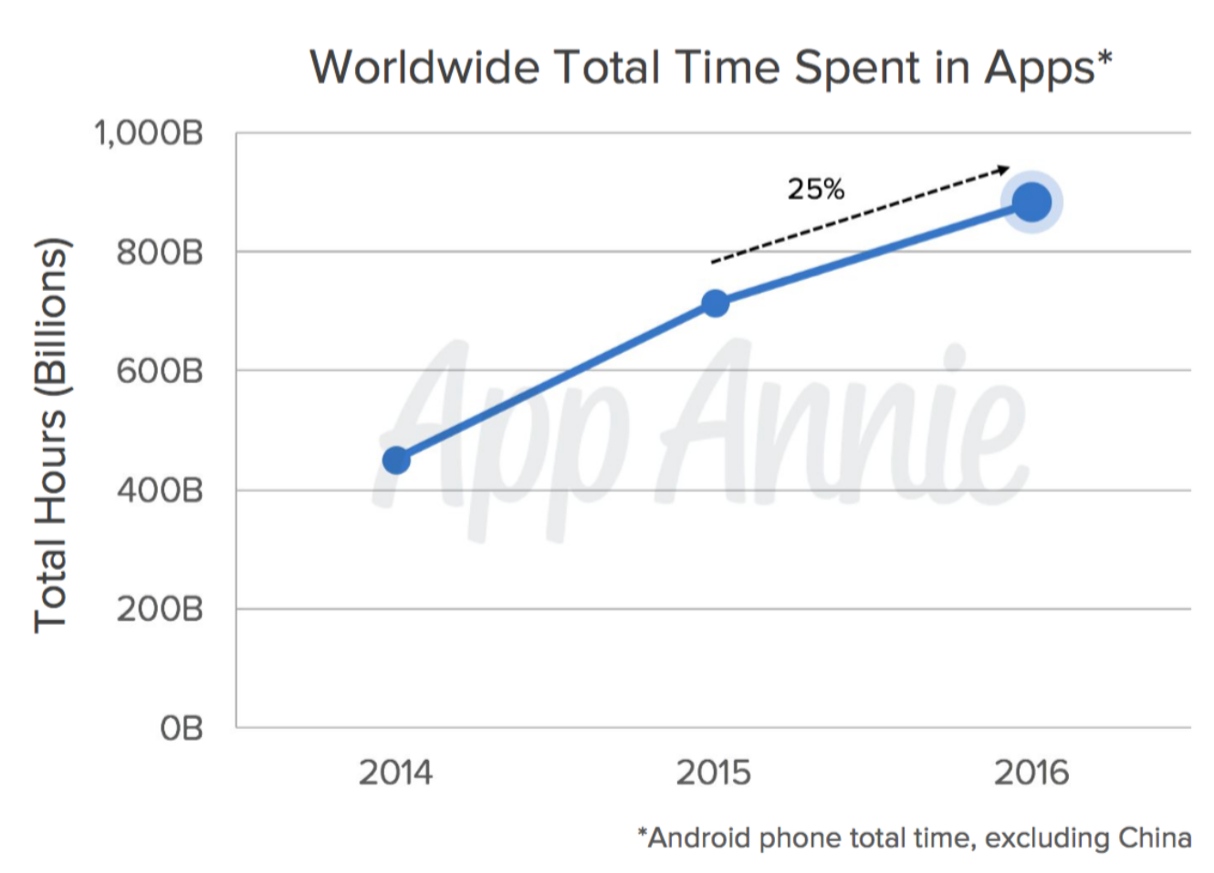
Shift to Mobile Still Underway

Slide 38
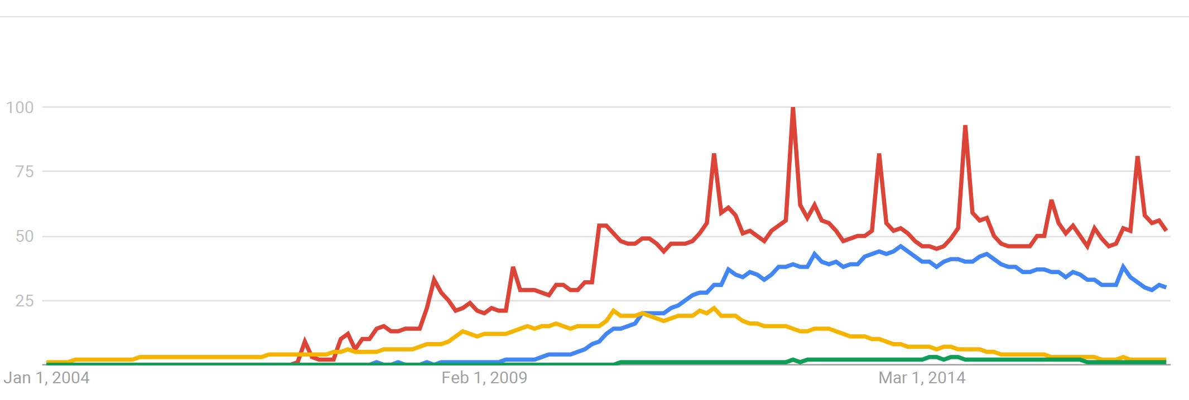
Search Trends January 2017
World wide (Add term galaxy?)

Slide 39
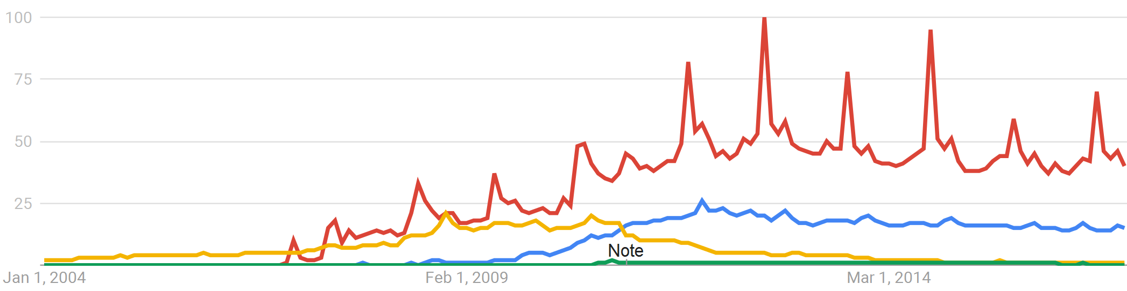
Search Trends January 2017
US only

Slide 40
Mobile Development
  Mobile "shops" (contract to develop mobile apps)
  Mutual Mobile, Chaotic Moon, Nerd Ranch
Companies tied to mobile
  Bee Cave Games, Waze, Snapchat, Instagram
Companies with major mobile apps
  Facebook, Ebay
Companies that want mobile apps for customers
  banks, everybody??
Companies that want mobile apps for internal use
  everybody?

Slide 41
Android development tools

Slide 42
Setup Development Environment
Install JDK 8 or 10
Install Android Studio
  includes API level 27
Use SDK manager to download lower API levels
  I suggest down to 21
Detailed install instructions available on Android site
http://developer.android.com/sdk/installing.html

Slide 43
Elements of Android Projects
Application Name
  seen by users on app chooser, app list, store
Project Name
  in IDE, can be different, often directory
Package Name
  Java package name, not using default package
Minimum SDK Level
  how far back do you support, ~21 as of June 2018
Target SDK Level
  device / api you had in mind for app, most recent?
Theme
  look and feel of app, color scheme, various built in themes such as Theme, Holo, Material (Design)

Slide 44
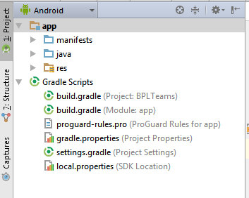
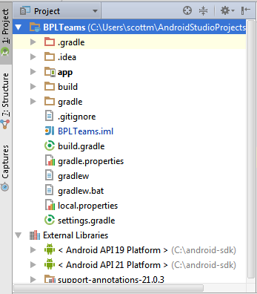
Android Projects
Creating a project results in multiple files and resources being created
Android Project View
Classic Project View

Slide 45
Android Project Components

Slide 46
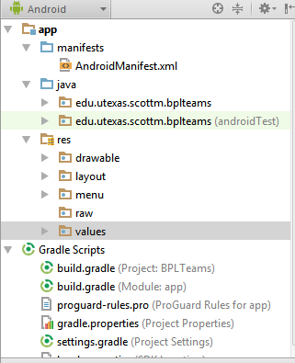
Android Projects - Components
Manifest
AndroidManifest.xml
Like a table of contents for your app
Main activity
Target and min SDK
Declare all the parts of your apps:
  activities, services
Request permissions
  network, location, ...

Slide 47
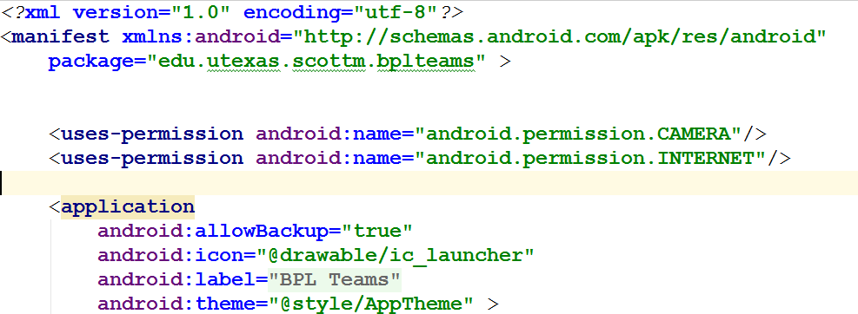
Android Manifest - Sample
defines Android namespace

Slide 48
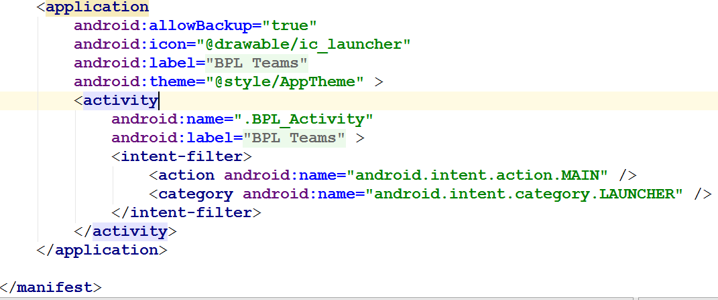
Android Manifest - Sample

Slide 49
Android Projects - Components
Java Source Code
Source Code:
In java directory in Android Project View
Actually in src directory on system

Slide 50
Android Projects - Components
Resources
Resources or the res directory
non source code resources for the app
packaged up with app
important role and use in development of app

Slide 51
Resource Directories
res/drawable for graphic images
such as png, jpeg
res/layout for xml files that define the layout of user interfaces inside the app
res/menu for xml based menu specifications
res/values for lists of strings, dimensions, colors, lists of data
res/raw for other kinds of files such as audio clips, video clips, csv files, raw text
res/xml for other general purpose xml files

Slide 52
Gradle
.apk files, Android Package Kit
  Android executables
Development environment takes, source code, manifest, libraries, resources, etc and packages them together in an APK
some things known and set
some things variable and configurable
Gradle

Slide 53
Gradle
Gradle is the build engine that Android Studio uses to convert your project into an APK
What needs to be created and how to do it
Like
  make for C/C++
  Ant/Maven for Java
build.gradle file

Slide 54
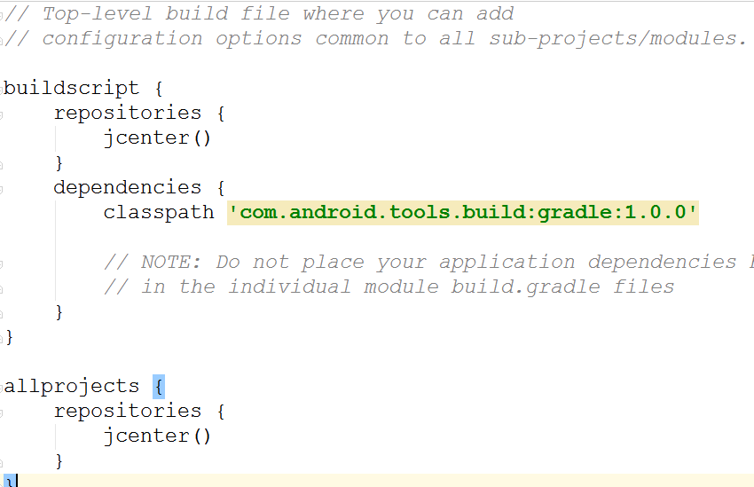
sample build.gradle file - PROJECT

Slide 55
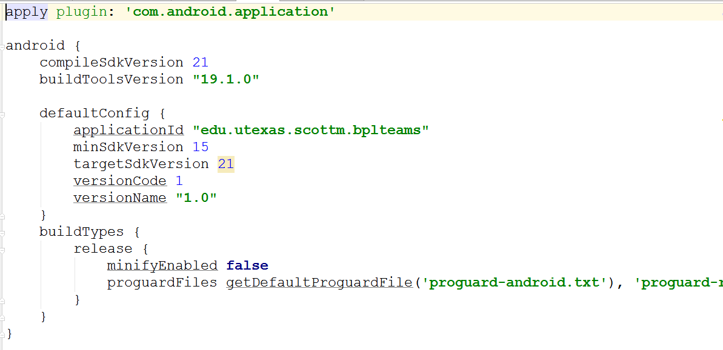
sample build.gradle file - MODULE / APP

Slide 56
emulators

Slide 57
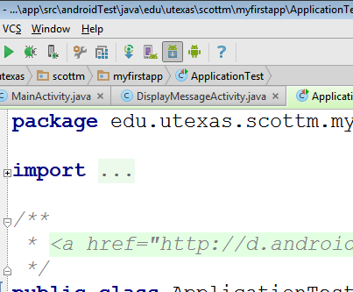
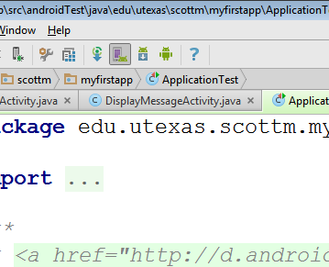
AVD Manager
SDK Manager

Slide 58
Android Emulator or AVD
Emulator is useful for testing apps but is not a substitute for a real device
Emulators are called Android Virtual Devices (AVDs)
Android SDK and AVD Manager allows you to create AVDs that target any Android API level
AVD have configurable resolutions, RAM, SD cards, skins, and other hardware

Slide 59
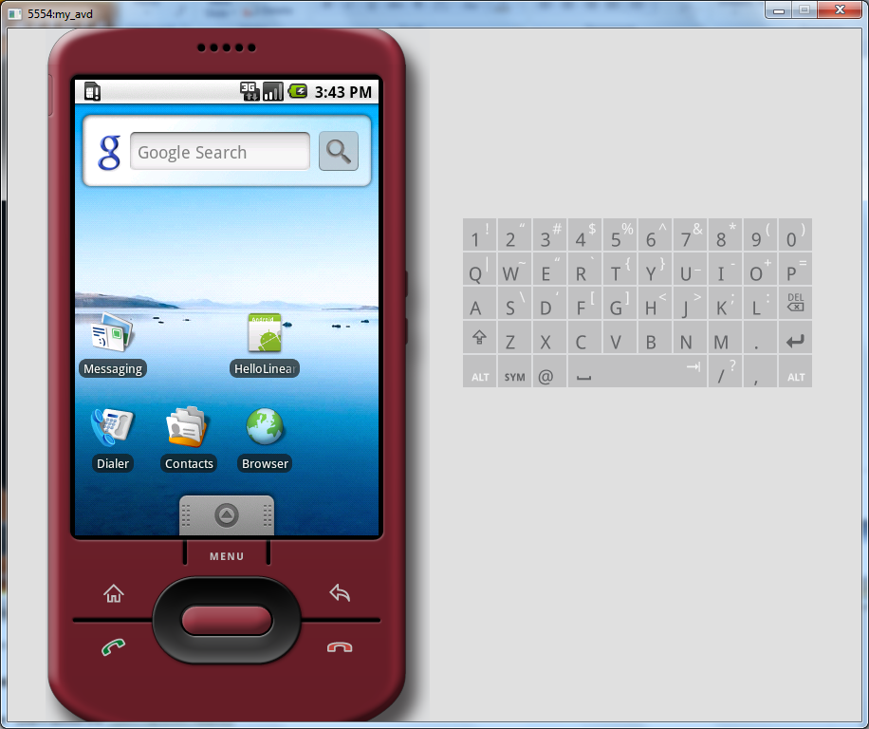
Android Emulator: 1.6

Slide 60
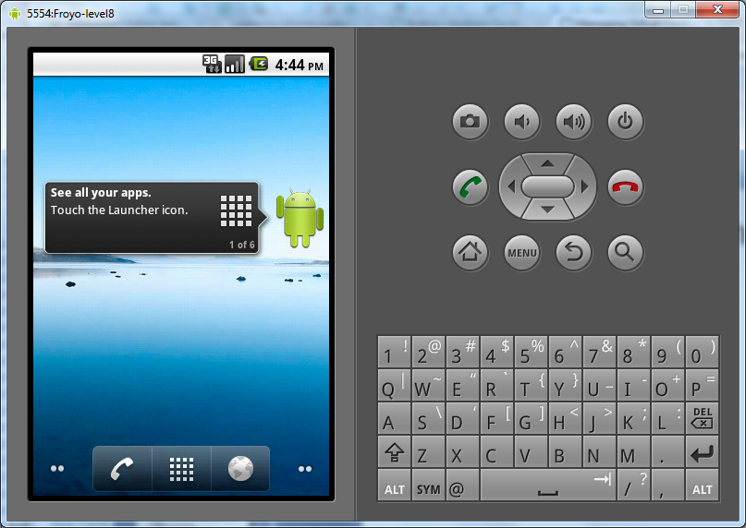
Android Emulator: 2.2

Slide 61
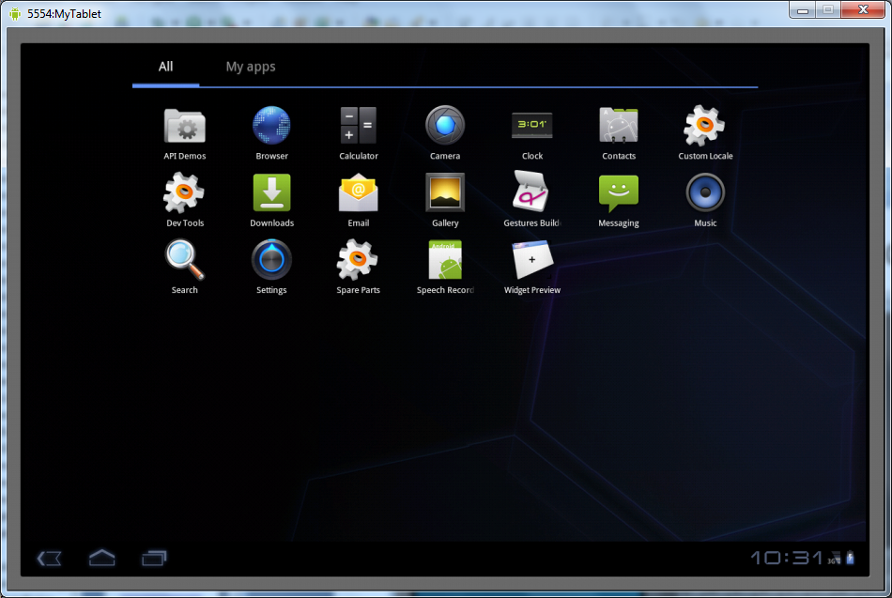
Android Emulator: 3.0

Slide 62
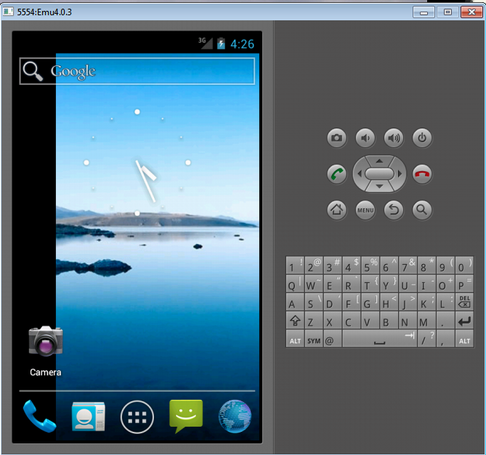
Android Emulator: 4.0

Slide 63
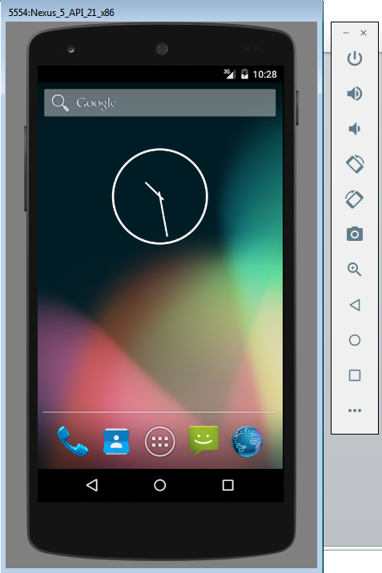
Android Emulator: 5.0
Controls

Slide 64
Emulator Basics
Host computer’s keyboard can be used
Host’s mouse acts as finger
Uses host’s Internet connection
Other buttons work: Home, Back, Search, volume up and down, etc.
More info at
https://developer.android.com/studio/run/managing-avds.html

Slide 65
Emulator Limitations
No support for placing or receiving actual phone calls
  Simulate phone calls (placed and received)
No support for USB connections
No support for camera/video capture (input)
No support for device-attached headphones
No support for determining connected state
No support for determining battery charge level and AC charging state
No support for determining SD card insert/eject
No support for Bluetooth
No support for simulating the accelerometer
  Use OpenIntents’s Sensor Simulator
That's why we need the dev phones and tablets!

Slide 66
Android Runtime: Dalvik VM
Subset of Java developed by Google
Optimized for mobile devices (better memory management, battery utilization, etc.)
Dalvik runs .dex files that are compiled from .class files
Introduces new libraries
Does not support some Java libraries like AWT, Swing
http://developer.android.com/reference/packages.html

Slide 67
Applications Are Boxed
By default, each app is run in its own Linux process
  Process started when app’s code needs to be executed
  Threads can be started to handle time-consuming operations
Each process has its own Dalvik VM
By default, each app is assigned unique Linux ID
  Permissions are set so app’s files are only visible to that app

Slide 68

Producing an Android App
Java code
javac
Byte code
Dalvik exe
dx
.java
.class
classes.dex
aapt
Byte code
<xml>
Other .class files
AndroidManifest.xml
.apk
<str>
Resources
Notes:
Every application must have an AndroidManifest.xml file (with precisely that name) in its root directory. The manifest presents essential information about the application to the Android system, information the system must have before it can run any of the application's code. Among other things, the manifest does the following:
It names the Java package for the application. The package name serves as a unique identifier for the application.
It describes the components of the application — the activities, services, broadcast receivers, and content providers that the application is composed of. It names the classes that implement each of the components and publishes their capabilities (for example, which Intent messages they can handle). These declarations let the Android system know what the components are and under what conditions they can be launched.
It determines which processes will host application components.
It declares which permissions the application must have in order to access protected parts of the API and interact with other applications.
It also declares the permissions that others are required to have in order to interact with the application's components.
It lists the Instrumentation classes that provide profiling and other information as the application is running. These declarations are present in the manifest only while the application is being developed and tested; they're removed before the application is published.
It declares the minimum level of the Android API that the application requires.
It lists the libraries that the application must be linked against.

Slide 69
Other Dev Tools
Android Debug Bridge
Part of SDK
command line tool to communicate with an emulator or connected Android device
  check devices attached / running
  install apk's, Android PacKage files, "executables", can find samples on places besides Google Play (security?)
  and more!
  https://developer.android.com/studio/command-line/adb.html

Slide 70
Dalvik Debug Monitor Server
DDMS
debugging tool
"provides, screen capture on the device, thread and heap information on the device, logcat, process, and radio state information, incoming call and SMS spoofing, location data spoofing, and more."
can interact with DDMS via Android Studio

Slide 71
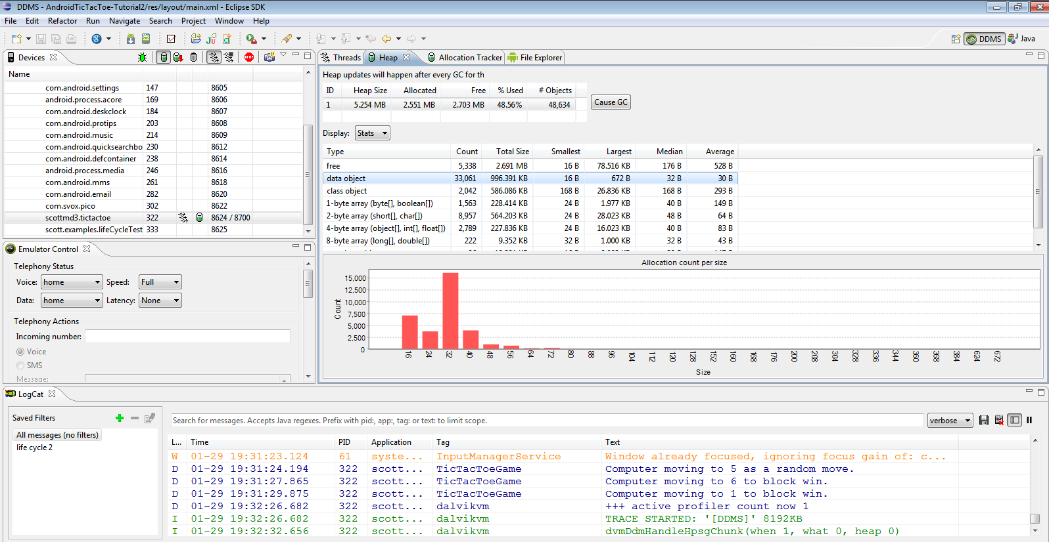
DDMS

Slide 72

iPhone vs. Android

