Slide 1
CS371m - Mobile Computing
App Project Overview

Slide 2
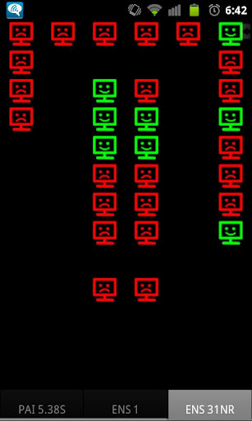
App Project
Teams of 3 students
Not pair or team programming
Okay to divide and conquer
Develop an Android application of your choosing subject to instructor approval
Application must run on class dev phones, API Level 19

Slide 3
App Milestones
App Proposals (Individual)
written 7/16, 11 pm via Canvas
posters 7/16, GDC 6.302, first half, second half
Design Document, Wireframe, Navigation and UI Plan: 7/26
How to, 8/9
In class DEMOS 8/15 and 8/16
App Project, 8/16 via Canvas

Slide 4
App Proposals
individual assignment
every student proposes two applications
Scope, use of mobile features
at least one service oriented
written due at 11 pm, Canvas on 7/16
posters in class 7/16
First half or second half presentation
Posters - polished, (obvious when thrown together the morning of class)

Slide 7
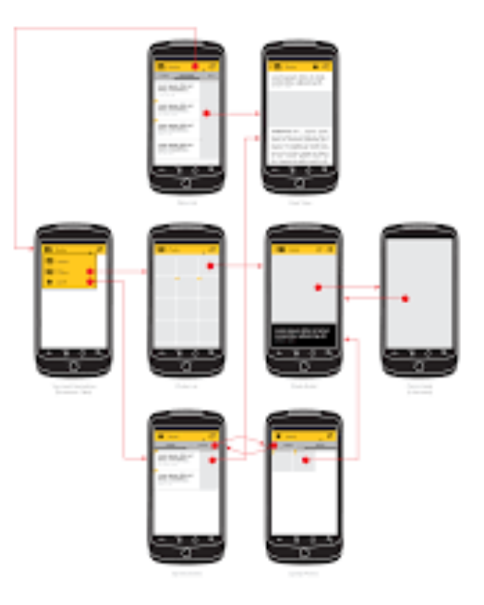
Design Document
7/26
What app will actually do
Use cases
Menus
Screens
Wireframe
Your Plan!!!

Slide 8
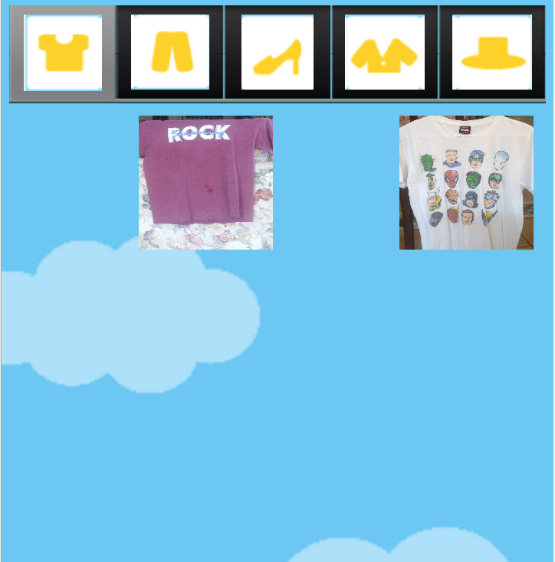
Finished App Project
8/16
Fully Functional
Polished
UI polished
icon
graphics if necessary
menu options / app bar
sound / feedback
persistence
responsiveness

Slide 9
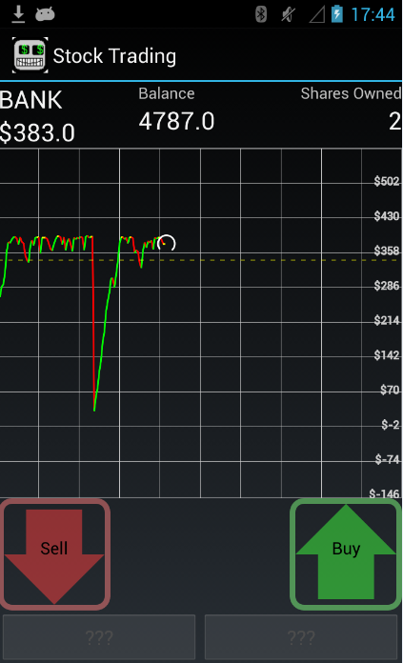
Beta Demos
8/15 and 8/16
Assigned randomly
roughly 10 minutes per presentation
describe and demo app to class

Slide 10
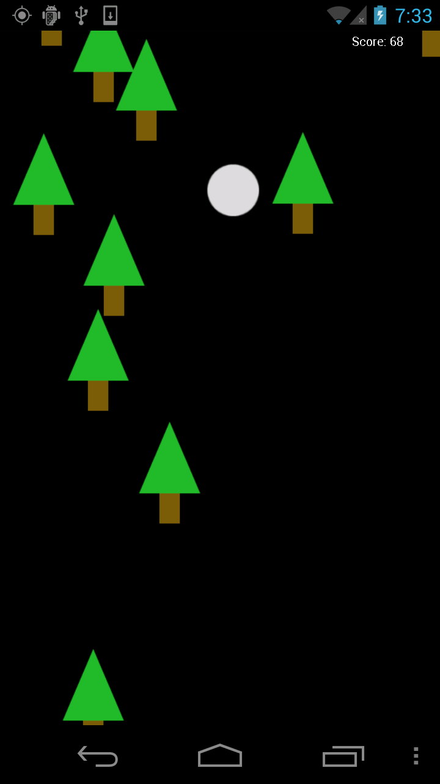
Recommendations
Based on my own experience (and bias)
Pick something you are interested in
… but that is reasonable!
Better to have simple idea / app that can be improved and extended
.. than a non-functioning pile of garbage

Slide 11
Recommendations
Okay to make a clone
Limit the scope!
Okay to use APIs / libraries
but no silver bullet
integration is hard and time consuming
Don't try to learn too many new technologies
if you need your own web server and to interact with a large data base, but don't know how to set one up, now is NOT the time to learn

Slide 12
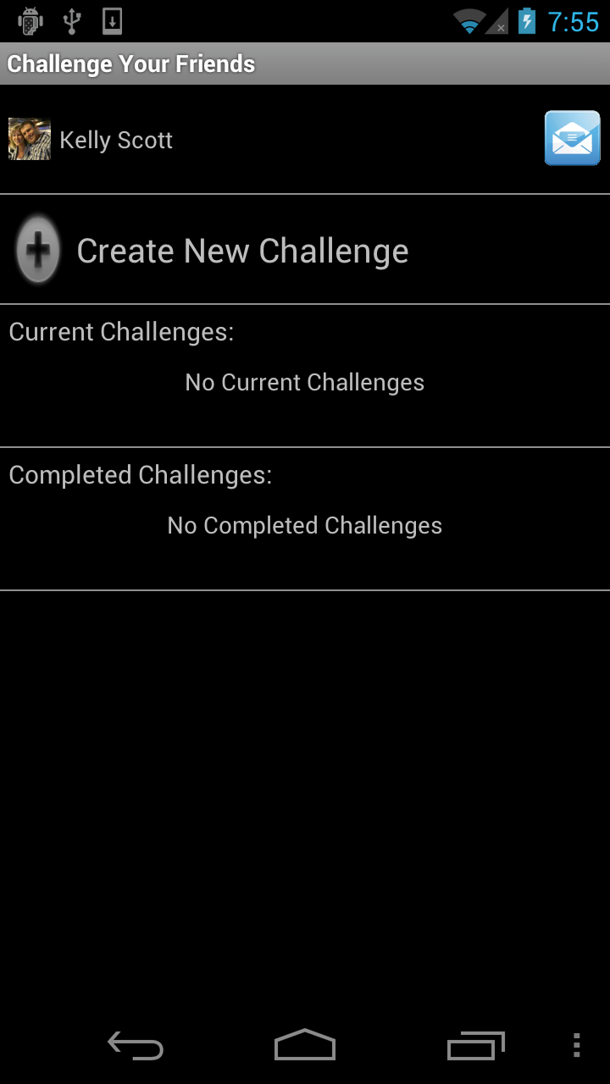
Recommendations
Avoid social media
probably my bias, but kind of boring and high barriers to entry, network effects needed to see power of app
Avoid apps with lots of initial data entry
Avoid apps that are essentially static web pages

Slide 13
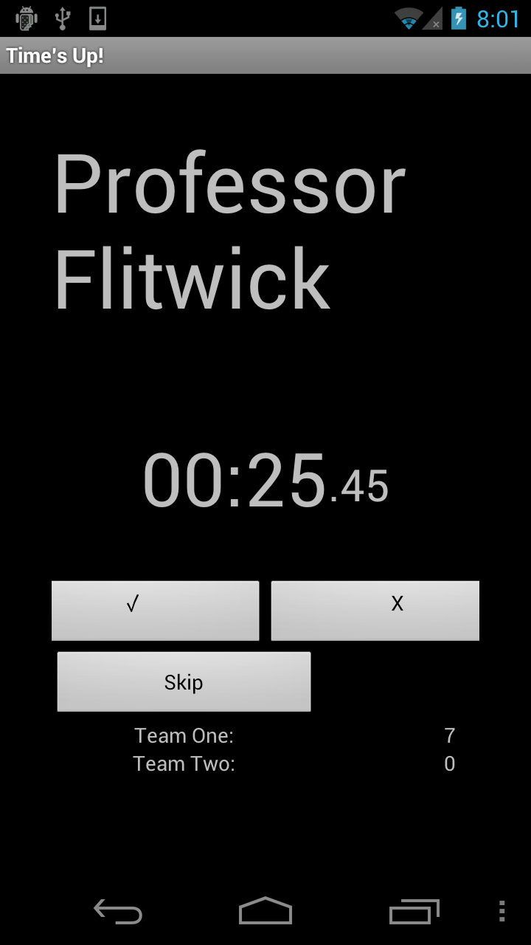
Requirement
Must use some features of the mobile device such as:
Location / Maps
Sensors
Gestures / Touch Screen
Contacts
Camera
Network
Available applications / services
Speech - to - text
microphone
audio output

Slide 14
Recommendations
Pick something you are interested in
Pick something that scales down well
Pick something you can do
the parking spot app

Slide 15
Backends
Many apps require a backend
storage off the device to share between apps
Easier now due to the rise in Mobile Backend as a Service
MBaaS
Old favorite Parse
Newer options
Firebase (Google)

Slide 16
Past projects

Slide 17
UTCS Lab Map
Spring 2012
What Linux machines are available (no one sitting there) in each CS lab?

Slide 18
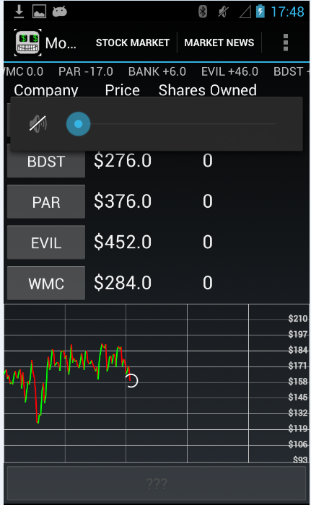
Past Projects
Moonstocks, Fall 2012
Stock market game
Stock price moves in response to music playing
buy low, sell high

Slide 19
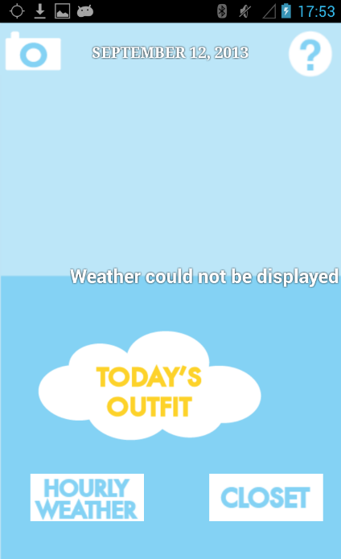
Dress for the Weather
Spring 2012
Take pictures of your clothes
Classify and tag for weather
Checks weather and recommends an outfit

Slide 20
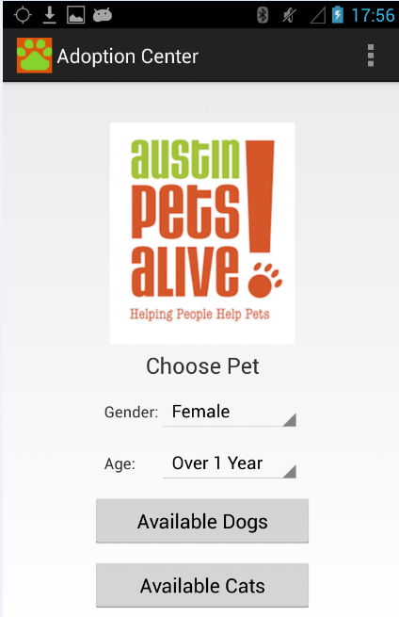
Austin Pets Alive
Fall 2012
Show dogs and cats available for adoption

Slide 21
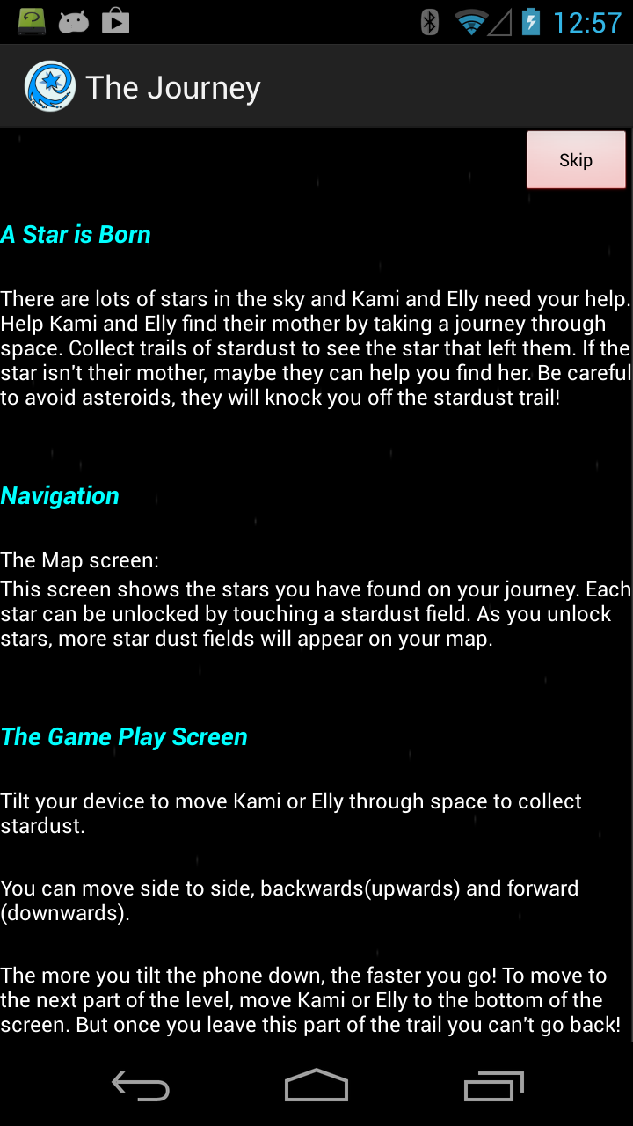
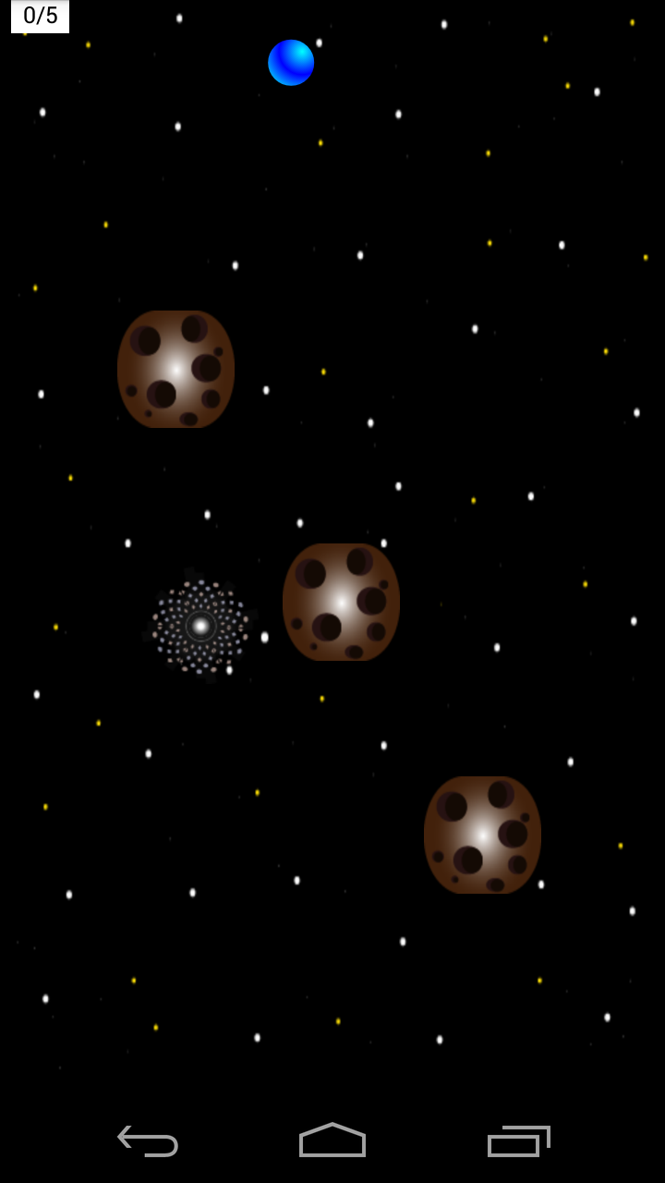
Shooting Stars Chronicles
Fall 2012
Tilt Game

Slide 22
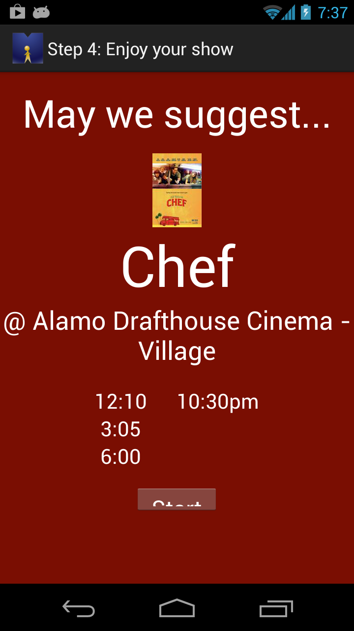
MovieGoer
Fall 2012
Suggests movie based on location and genre choice

Slide 23
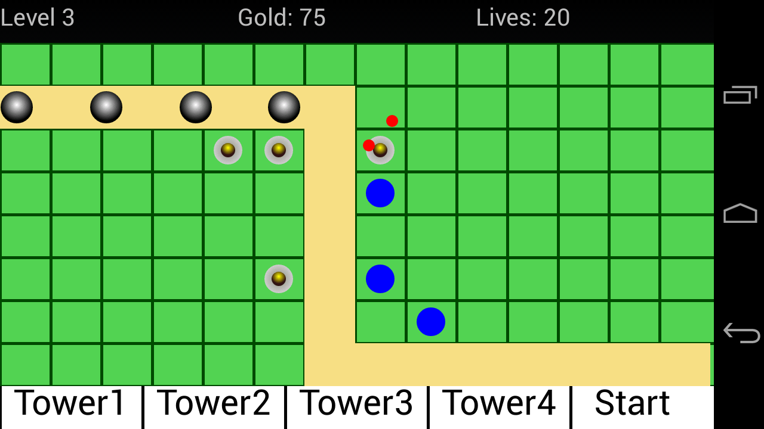
Tower Defense
Fall 2013, Simple Tower defense
All Android 2d Graphics

Slide 24
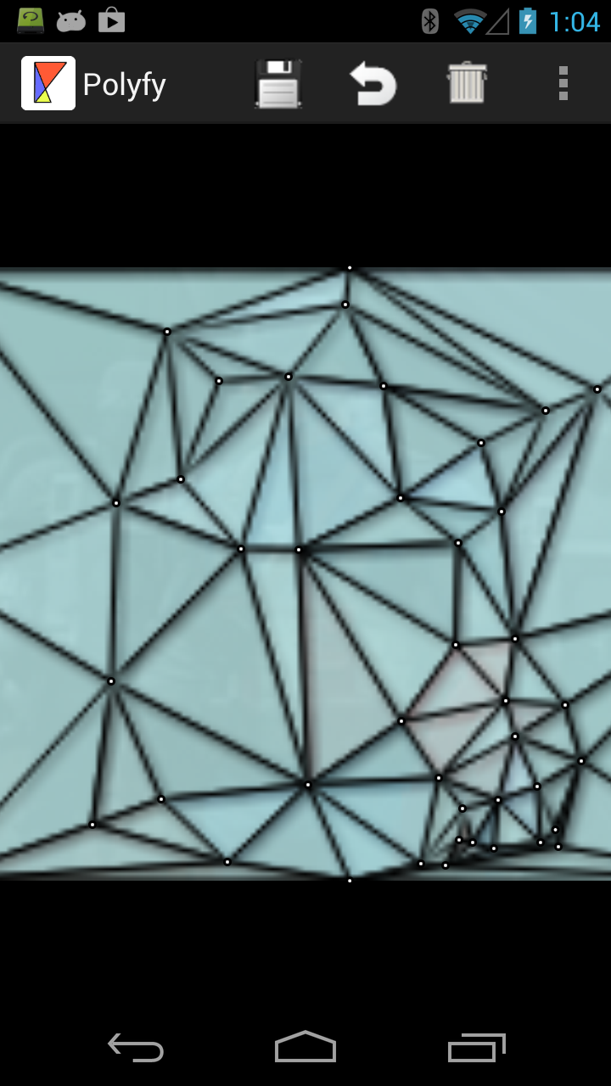
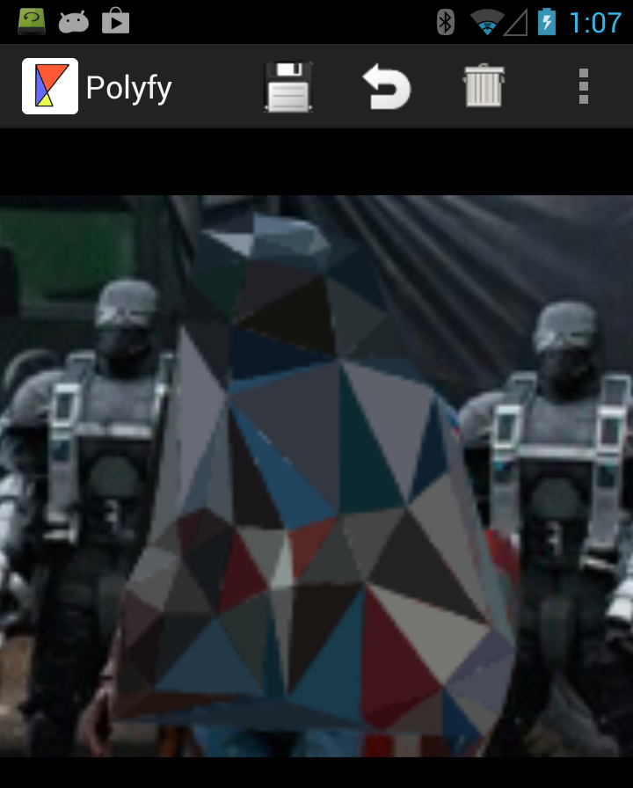
Polyfly - Fall 2013

Slide 25
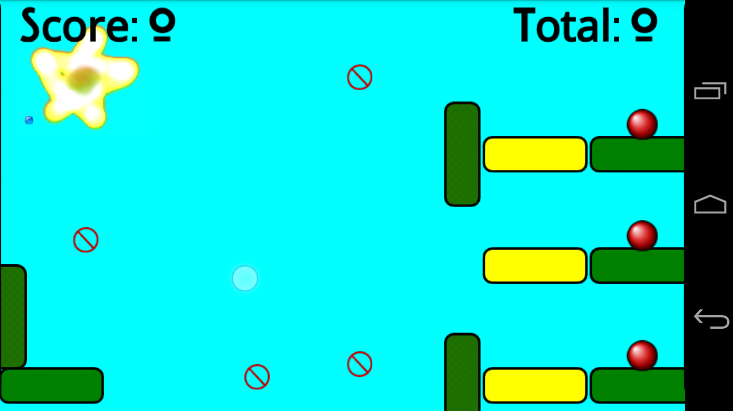
Deballisher
Fall 2013, Tap game
3rd party physics package

Slide 26
TraceMe
Spring 2014
Trace dotted pattern
Limited Ink
makes the game
Used Parse cloud storage service

Slide 27
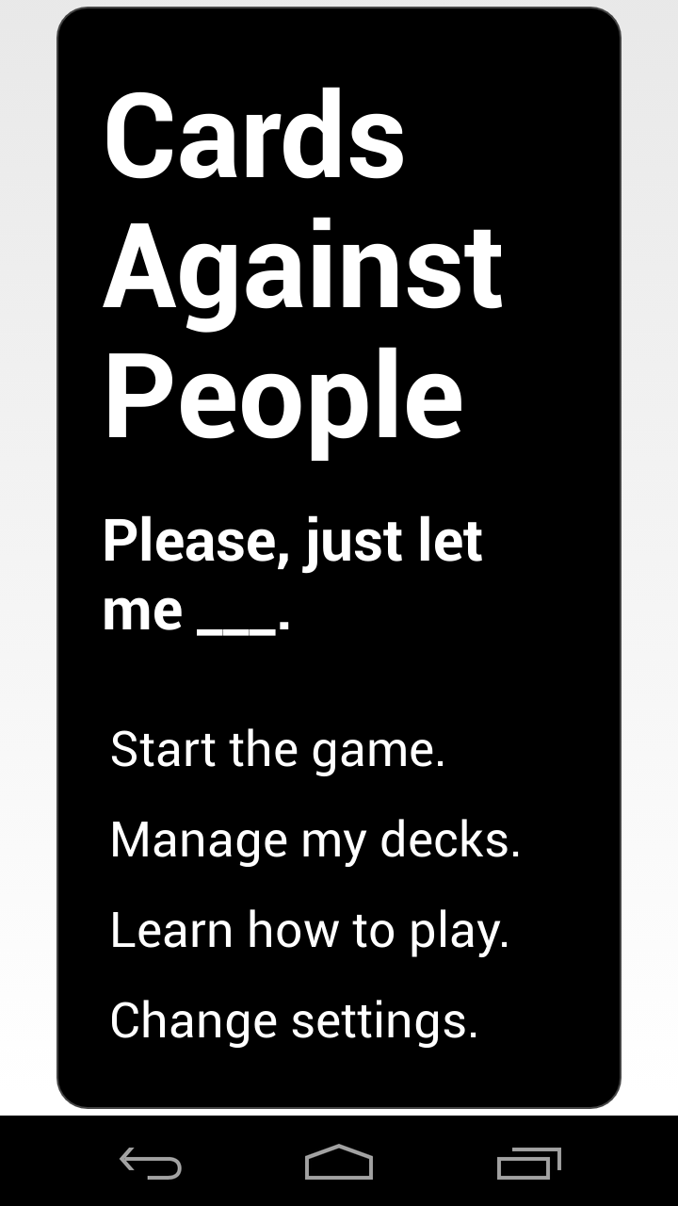
Cards Against People
Spring 2014
based on Cards Against Humanity
clean version for review
goal to use multiple devices but ran out of time

Slide 28
Android Design Guidelines
Create Vision!
Enchant Me!
Simplify My Life!
Make ME Amazing!
http://developer.android.com/design/index.html

Slide 29
Create Vision
Delight me in surprising ways
Real objects are more fun than buttons and menus
Let me make it mine
Get to know me

Slide 30
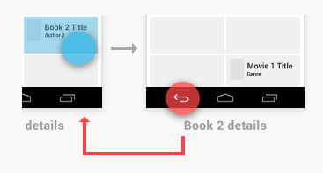
Simplify My Life
Keep it brief
Pictures are faster than words
Decide for me but let me have the final say
Only show what I need when I need it
I should always know where I am
Never lose my stuff
If it looks the same, it should act the same
Only interrupt me if it's important

Slide 31
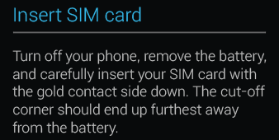
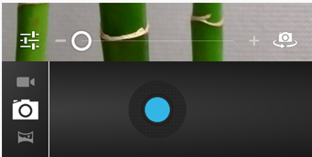
Make Me Amazing
Give me tricks that work everywhere
It's not my fault
Sprinkle encouragement
Do the heavy lifting for me
Make important things fast

Slide 32
Apple App Guidelines
The Display Is Paramount, Regardless of Its Size
Device Orientation Can Change
Apps Respond to Gestures, Not Clicks
People Interact with One App at a Time
Preferences Are Available in Settings
Onscreen User Help Is Minimal
Most iOS Apps Have a Single Window
http://tinyurl.com/3yj7b5y

Slide 33
Apple Human Interface Principles
Aesthetic Integrity
Consistency
Direct Manipulation
Feedback
Metaphors
User Control

Slide 34
User Experience Guidelines
Focus on the Primary Task
Elevate the Content that People Care About
Think Top Down
Give People a Logical Path to Follow
Make Usage Easy and Obvious
Use User-Centric Terminology
Minimize the Effort Required for User Input
Downplay File-Handling Operations
Enable Collaboration and Connectedness
De-emphasize Settings

Slide 35
User Experience Guidelines
Make Search Quick and Rewarding
Entice and Inform with a Well-Written Description
Be Succinct
Use UI Elements Consistently
Consider Adding Physicality and Realism
Delight People with Stunning Graphics

