Slide 1
CS371m - Mobile Computing
Location
(Location, Location, Location)

Slide 2
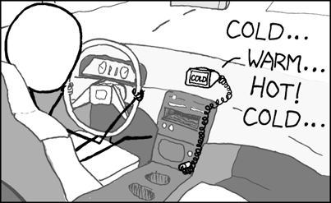
Cheap GPS
http://xkcd.com/407/

Slide 3

Android and Location
inputs to location for Android device include:
GPS
cell-ID (cell tower)
Wi-Fi networks
  Network Location Provider combines cell-ID and Wi-Fi data
Good reference for history of location:
You Are Here: From the Compass to GPS,
the History and Future of How We Find Ourselves

Slide 4
Location is Important
"On 8 January 2005 at 02:43 GMT, the USS San Francisco collided with an undersea mountain about 675 kilometers (364 nautical miles, 420 statute miles) southeast of Guam while operating at flank (maximum) speed at a depth of 525 feet."
- Wikipedia article on the USS San Francisco, SSN - 711
Dead reckoning
radar fix
visual fix
Loran
Omega
Navsat
GPS
Active Sonar
Inertial Navigation System

Slide 5


Location, Location, Location
Dead reckoning
radar fix
visual fix
Loran
Omega
Navsat
GPS
Active Sonar
Inertial Navigation System

Slide 6

USS San Francisco - http://tinyurl.com/l6vuucm

Slide 7

Global Positioning System
GPS
US System that provides position, navigation, and timing
Space Segment, Control Segment, User Segment
US Air Force develops, maintains, and operates the space segment and control segment

Slide 8
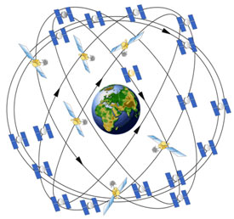
GPS Space Segment
24 core satellites
medium earth orbit, 20k km above the earth
6 orbital planes with 4
satellites each
generally 4 satellites in line
of sight at any spot on the
earth
recently upgraded to 27 sats

Slide 9
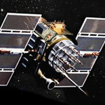
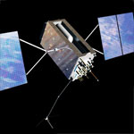
GPS Space Segment
satellites circle the earth twice a day
upgraded over time with different generations of satellites
Current generation of satellites being developed by Lockheed - Martin (FOCS)

Slide 10
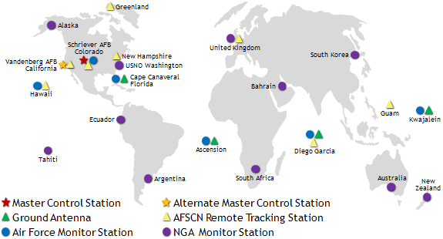
GPS Control Segment
Ground facilities that
  monitor transmissions, perform analysis, and send commands and data to satellites

Slide 11
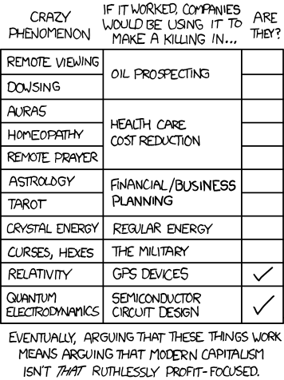
GPS User Segment
Onboard clocks with accuracy of 1 nanosecond (1 billionth of a second)
Satellites transmit
one-way
receiver calculates position and course by comparing time signals from multiple satellites with the known position of those satellites

Slide 12
GPS User Segment
accuracy normally within 5 - 10 meters
precision requires accuracy of clocks and timing signal on the order of 20 nanoseconds
the Special and General theories of Relativity must be taken into account to achieve the desired accuracy
Special relativity predicts clocks on satellites go slower, on the order of 10 microseconds per day
General relativity predicts the mass of the earth will have an effect

Slide 13
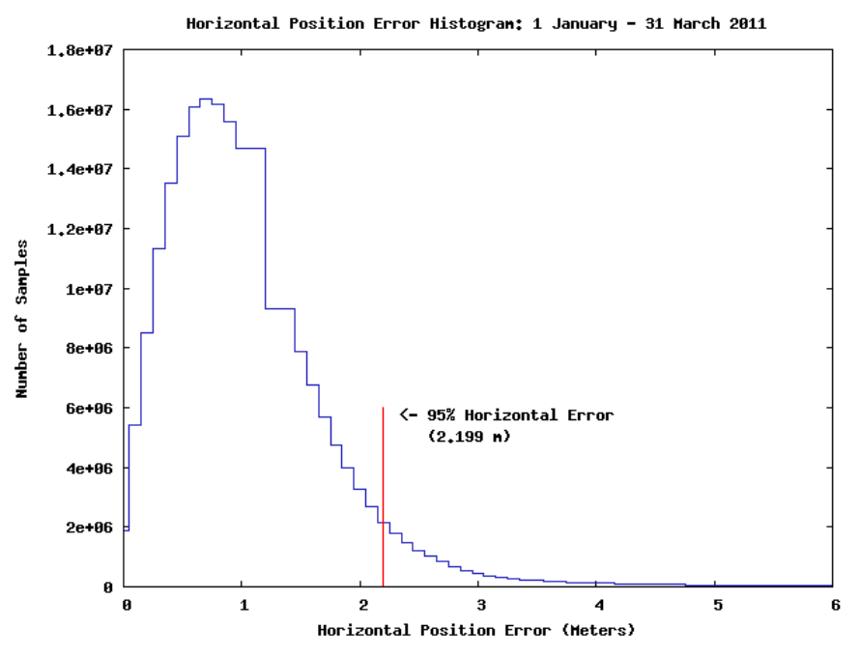
GPS Accuracy

Slide 14
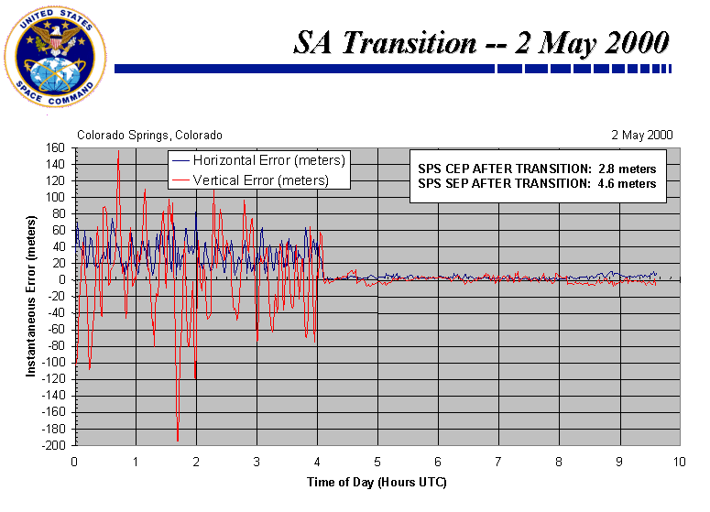
GPS Accuracy
Selective Availability: intentional degradation of signals for civilian use
  ended
  in 2000

Slide 15
GPS Accuracy
civilian GPS: aka SPS
military GPS: aka PPS
military broadcasts on two frequencies, civilian only one
"This means military users can perform ionospheric correction, a technique that reduces radio degradation caused by the Earth's atmosphere. With less degradation, PPS provides better accuracy than the basic SPS. "

Slide 16
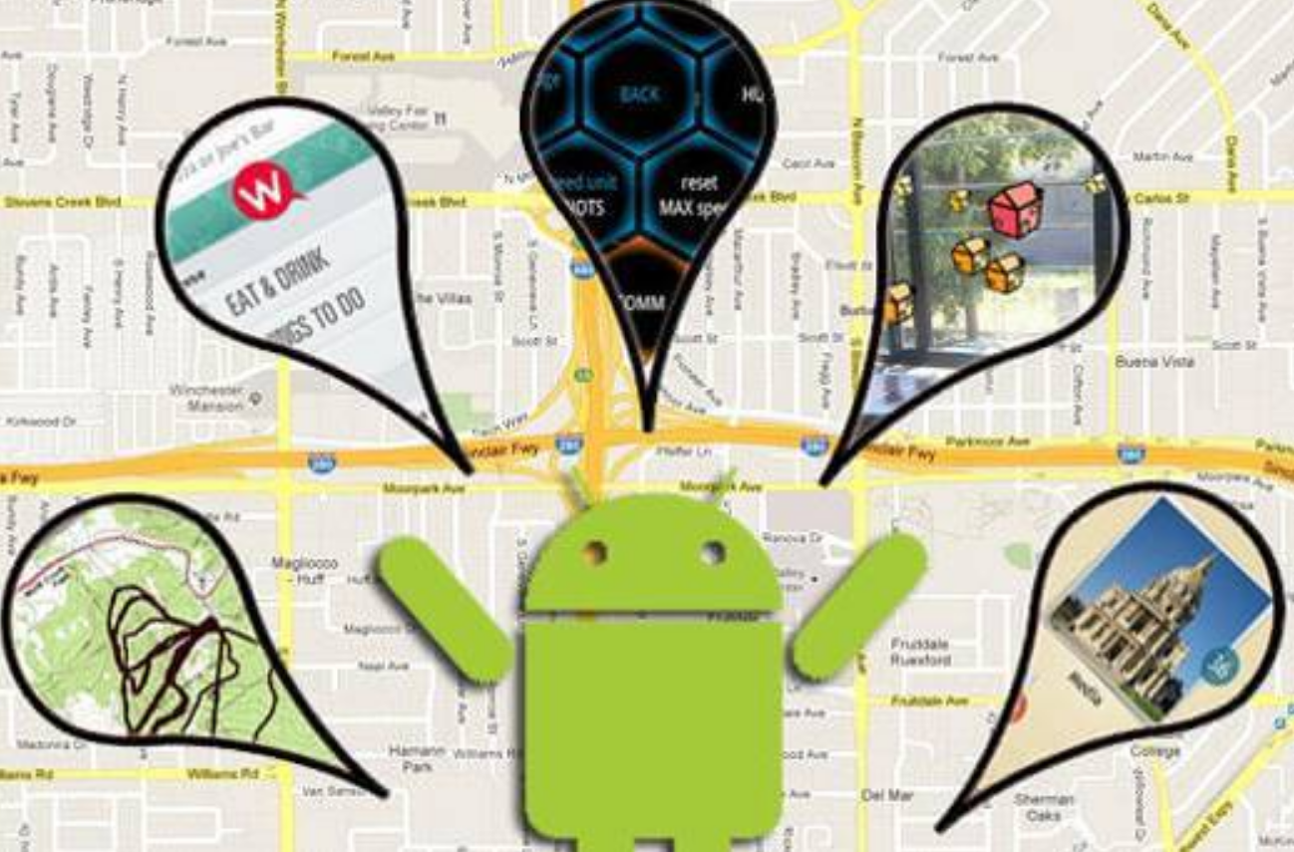
Android and Location

Slide 17
Android and Location
Currently 3 methods of obtaining location
GPS
NETWORK
  combines cell tower triangulation and wireless networks
PASSIVE
  not a real provider, just piggy back off other applications
  similar to software sensors

Slide 18
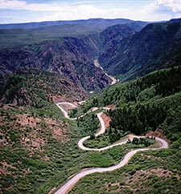
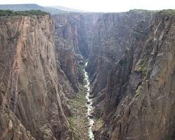
GPS
most accurate but,
only works OUTDOORS
quickly consumes battery power
delay in acquiring satellites or re- acquiring if lost

Slide 19
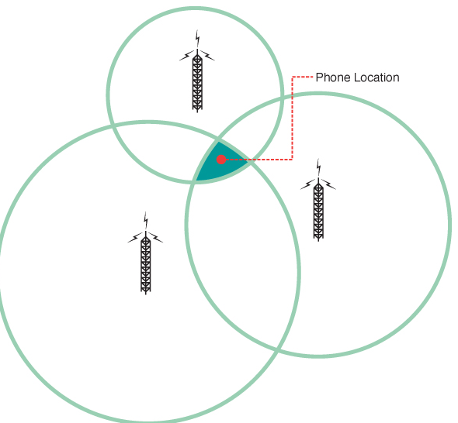
Network
Combines cell tower triangulation and in range wireless networks
If no cellular capability or plan on device (tablets?) then just wireless networks

Slide 20
Clicker Question
Do you think of Google as a “creepy” company?
No
Yes
Undecided

Slide 21
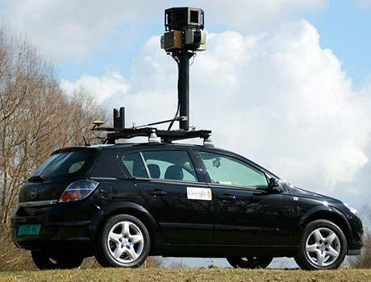
Wireless Network and Location
Formerly used StreetView cars
Now, use the devices themselves to map locations to wifi spots
Many other companies (Apple and Microsoft) do the same thing
default on dev phones was checked

Slide 22
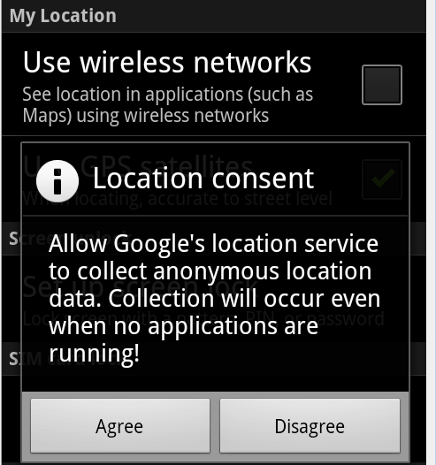
Google Location Services

Slide 23
Getting Location
Obtaining location:
Demo older, detailed approach
  Flexible, detailed, but developers typically make mistakes
  Consume lots of battery power, GPS receiver requires large amounts of power to amplify signal from satellites.
Newer, higher level, more abstract approach using Google Play Services

Slide 24
Finding Location Via the Location-Manager

Slide 25
Finding Location
Add appropriate permission to AndroidManifest.xml
Get instance of LocationManager using getSystemService method using LOCATION_SERVICE
Choose location provider (from all providers or using getBestProvider method)
Implement a LocationListener class
Call requestLocationUpdates method with chosen provider so LocationListener start receiving location information

Slide 26
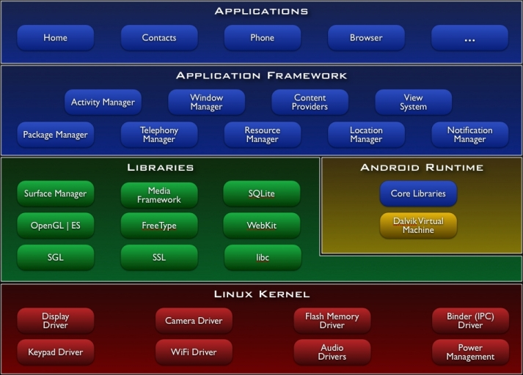
LocationManager

Slide 27
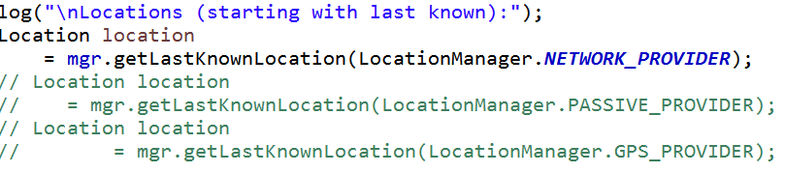
Quickly Finding Location
If you want a simple fix (location) get the LocationManager and ask for the last, best known position
Significant errors possible
  Why?

Slide 28

AndroidManifest.xml
User Permission in manifest
Options: ACCESS_FINE_LOCATION or ACCESS_COARSE_LOCATION
ACCESS_COARSE_LOCATION for use of NETWORK_PROVIDER using cell-ID and Wi-Fi
ACCESS_FINE_LOCATION: GPS or NETWORK_PROVIDER

Slide 29
Uses Features
In addition to request permissions the AndroidManifest.xml file can list features the app uses.
Google Play uses these tags to filter applications for users
examples of features: bluetooth, camera, location, network, microphone, nfc (near field communication), sensors, and more!

Slide 30
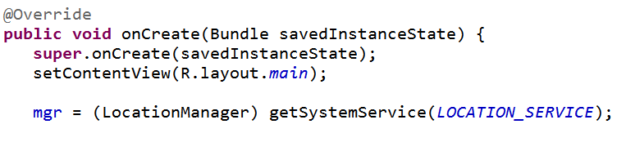
Location Manager
Obtain Location Manager

Slide 31
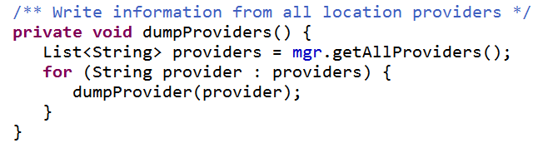
Simple Location Program
Just to demonstrate capabilities
After setting up listener show all providers
mgr is LocationManager

Slide 32
Properties of Location Providers
name
enabled
accuracy
power requirements
monetary cost
requires cell
requires network
requires satellite
supports altitude
supports bearing
supports speed

Slide 33
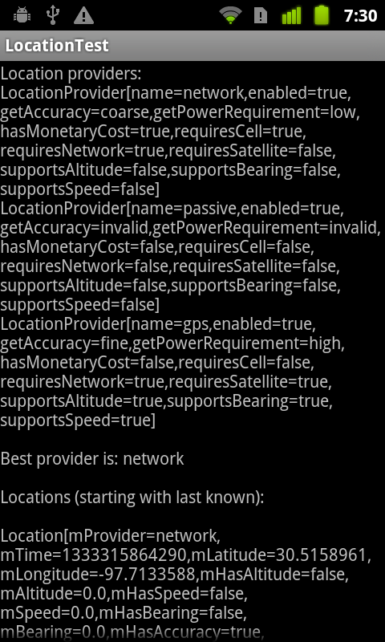
Program Output
network (wifi and cell tower id)
gps
passive
  use location updates requested by other applications or services

Slide 34
dev Phones (no cell service)
name | Network | Passive | GPS
enabled | true | true | true
accuracy | coarse | invalid | fine
power req. | low | invalid | high
monetary cost | true?? | false | false
request cell | true | false | false
requires network | true | false | true?
requires satellite | false | false | true
supports altitude | false | false | true
supports bearing | false | false | true
supports speed | false | false | true

Slide 35
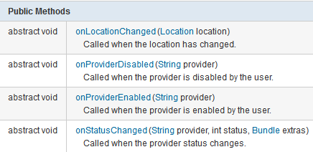
LocationListener
Implement class that implements LocationListener interface

Slide 36
Obtaining Locations
Register the LocationListener to receive location updates
locationManager.requestLocationUpdates(LocationManager.NETWORK_PROVIDER, 15000, 10, locationListener);
  provider: name of provider to register with
  minTime: the minimum time interval for notifications, in milliseconds. only a hint to conserve power, and actual time between location updates may be greater or lesser than this value.
  minDistance: min distance interval for notifications in meters
  the listener itself

Slide 37
requestLocationUpdates
More on arguments
0 for minTime AND minDistance indicate obtain updates as frequently as possible
for background services recommended minTime >= 300,000 ms to avoid consuming too much power with the GPS or Wi-Fi receivers
300,000 ms = 5 minutes
clearly less for apps in the foreground

Slide 38
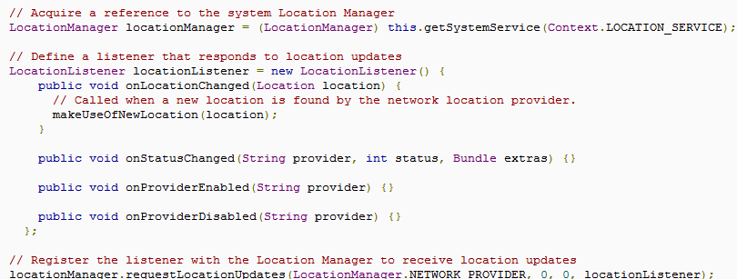
Location Listener

Slide 39
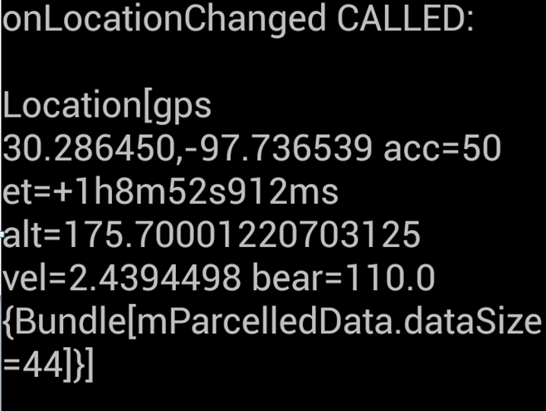
Location Data
onLocationChange method in the LocationListener receives Location objects
toString shown
latitude, longitude, estimated accuracy
in meters, bearing

Slide 40
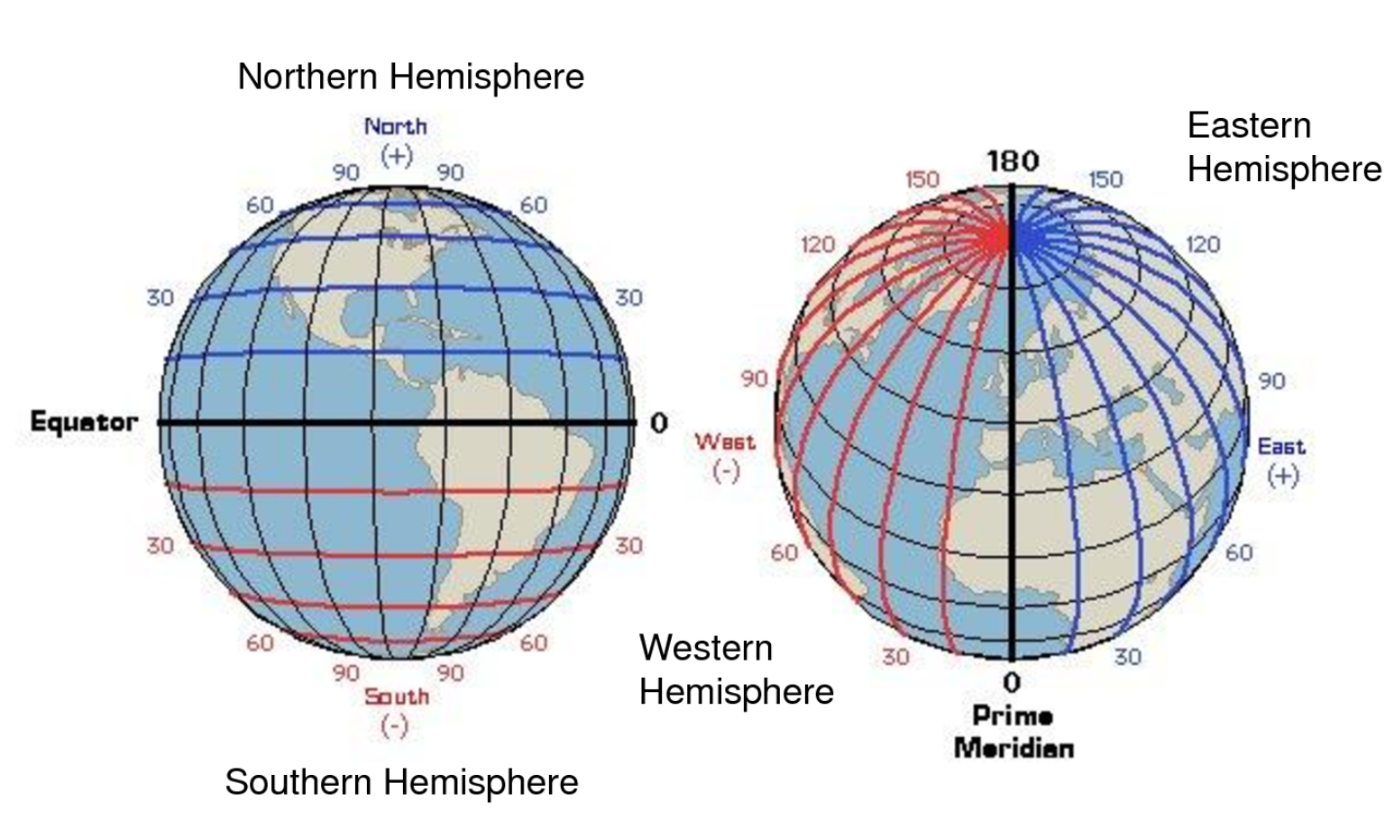
Latitude and Longitude

Slide 41
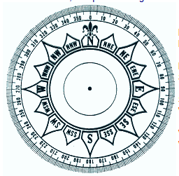
Bearing
direction
360 degrees
degrees east of north
0 = north
90 = east
180 = south
270 = west

Slide 42
Sample GPS Locations
ET = Elapsed time: Time passed since device start up
Altitude in meters
units for velocity: meters / sec
  1 m/s ~= 2.2 mph

Slide 43
toString for Location

Slide 44
Location Strategies
Location aware applications
  compelling? better information to user?
GPS -> slow, only works outdoors, consumes lots of power, very accurate
Network -> fast, works indoor and outdoor, uses less power, less accurate
Issues: multiple sources (cell id with call plan, wifi, gps), user movement, accuracy of locations

Slide 45
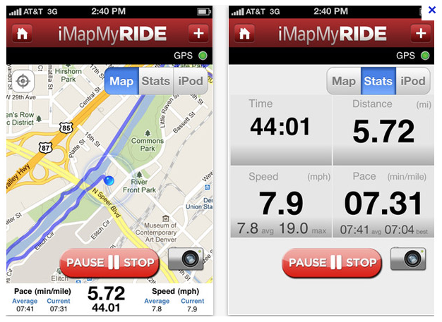
Getting a Fix
Some applications (driving directions, sport tracking) require constant location data
  using battery is expected

Slide 46
Periodic Location Updates
Many location aware applications do not need a constant stream of location updates
Obtaining location pattern:
Start application.
Sometime later, start listening for updates from desired location providers.
Maintain a "current best estimate" of location by filtering out new, but less accurate fixes.
Stop listening for location updates.
Take advantage of the last best location estimate.
http://developer.android.com/guide/topics/location/strategies.html

Slide 47
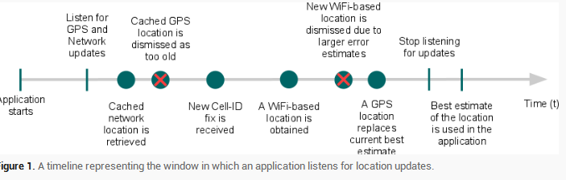
Getting Location
Timeline for getting location based on pattern described:

Slide 48
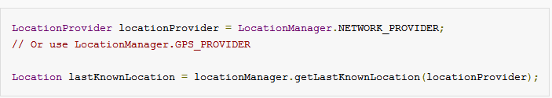
Last Known Location
Recall, application is part of a larger system
other applications may have asked for location and we can use those locations via the LocationManager

Slide 49
Current Best Estimate
The most recent location, may not be the most accurate
Evaluating a location
  how long has it been since the current best estimate?
  is the accuracy of the new location update better than the best estimate?
  what is the source of the location? which do you trust more?

Slide 50
LocationManager - Useful Methods
addProximityAlert(double latitude, double longitude, float radius, long expiration, PendingIntent intent)
  Sets a proximity alert for the location given by the position (latitude, longitude) and the given radius.
List<String> getAllProviders()
  Returns a list of the names of all known location providers.
Location getLastKnownLocation(String provider)
  Returns a Location indicating the data from the last known location fix obtained from the given provider.
Location class: float distanceTo(Location dest)
  Returns the approximate distance in meters between this location and the given location.

Slide 51
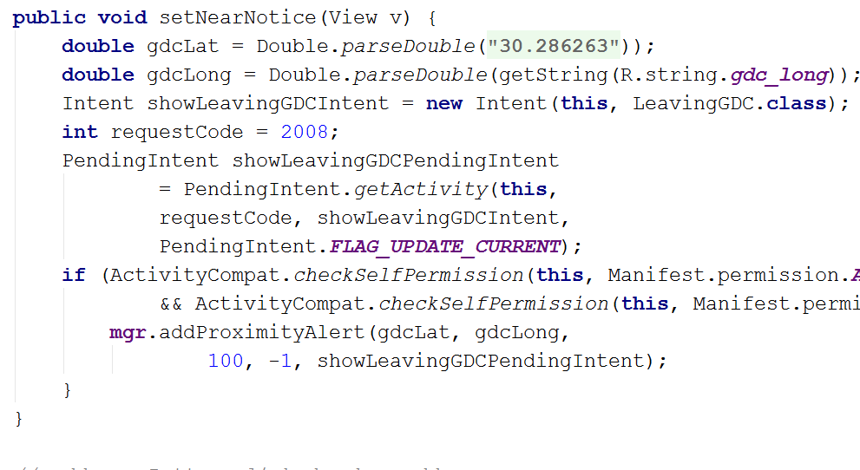
Sample Proximity Alert

Slide 52
geocoding

Slide 53
Geocoding
LocationManger and GooglePlayServices provide a Location object
Contains latitude and longitude
Latitude, degrees north of south of equator North Pole = 90N or +90, equator = 0, South Pole = 90S or -90
longitude, degrees east or west of prime meridian, 0 to -180 to west, 0 to +180 to west

Slide 54
Geocoding
Various databases exists to give address(es) at a given lat and long
Web Service?
GeoCoder class in Android provides:
  geocoding: convert physical address to lat / long
  reverse geocoding: convert lat / long to physical address

Slide 55
Geocoding
Accessing Google database of addresses
Making network calls may block the Activity
Key to not "BLOCK THE UI THREAD"
Meaning, don't do expensive computations or possibly slow operations in the code for an Activity
Another use of AsyncTask

Slide 56
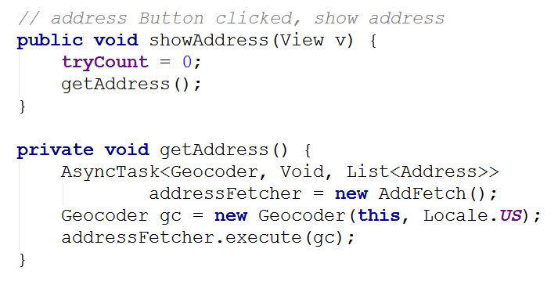
Geocoding
When address button clicked use a Geocode to try and get address

Slide 57
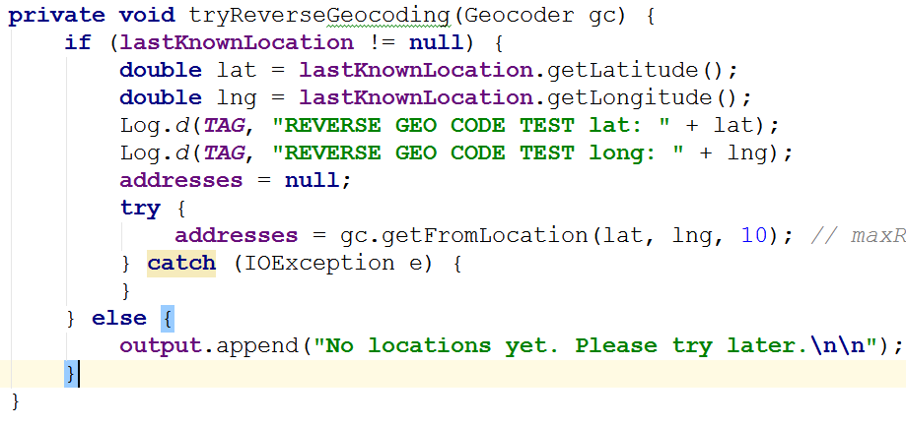
Reverse Geocoding
Get lat and long from last known location of LocationTest app
Use Geocoder to get addresses

Slide 58
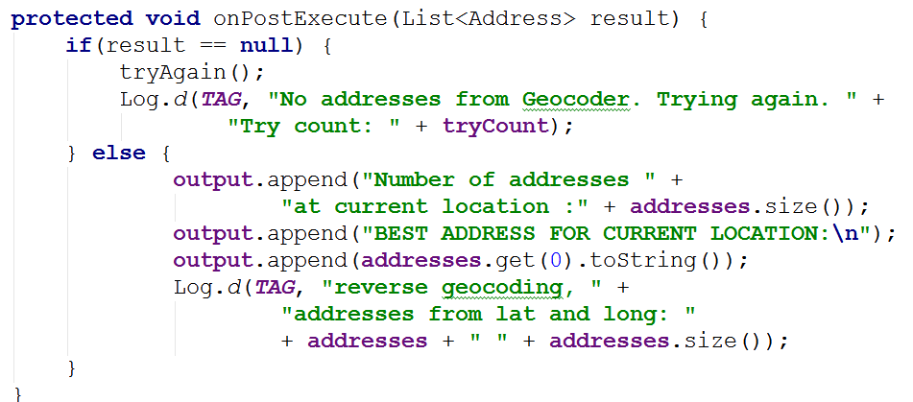
If Successful
Geocoder returns a list of possible addresses

Slide 59
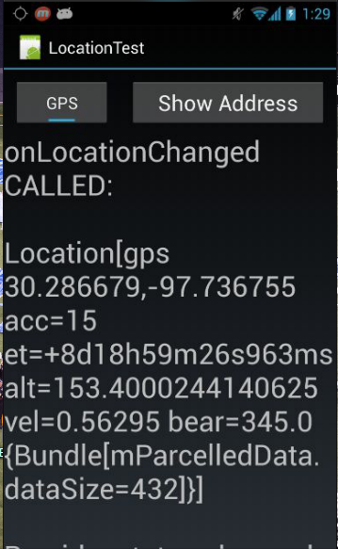
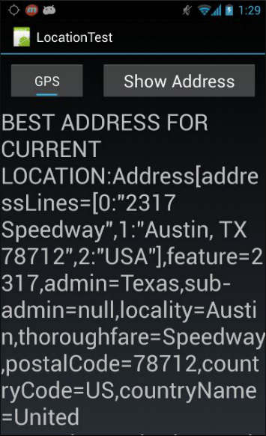
Demo

Slide 60
location Services via google play services

Slide 61
Alternative?
Google Location Services API
  "part of Google Play Services, provides a more powerful, high-level framework that automatically handles location providers, user movement, and location accuracy. It also handles location update scheduling based on power consumption parameters you provide. In most cases, you'll get better battery performance, as well as more appropriate accuracy, by using the Location Services API. "
http://developer.android.com/google/play-services/location.html

Slide 62
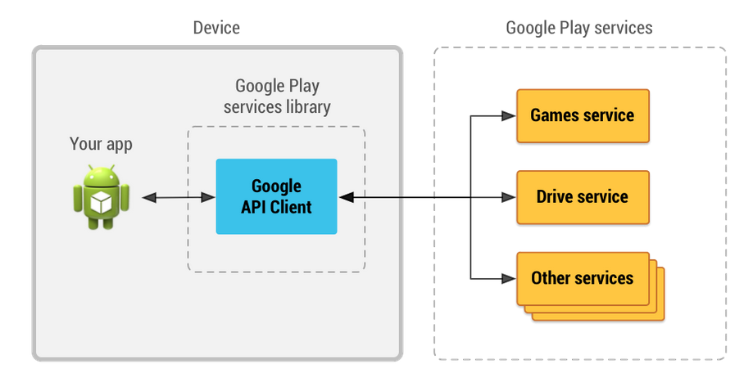
Google Play Services

Slide 63
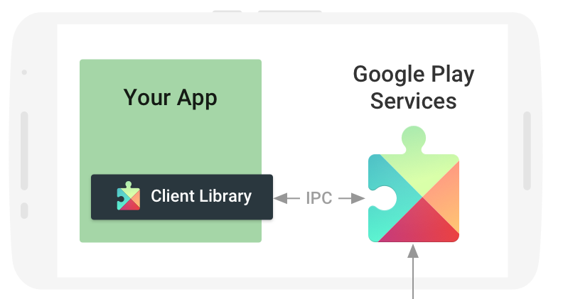
Google Play Services
Extra APIs provided by Google
Allows your app to access various Google services such as:
  maps
  game services
  location APIs
  ads
  Oauth
  many others
DEVICE

Slide 64
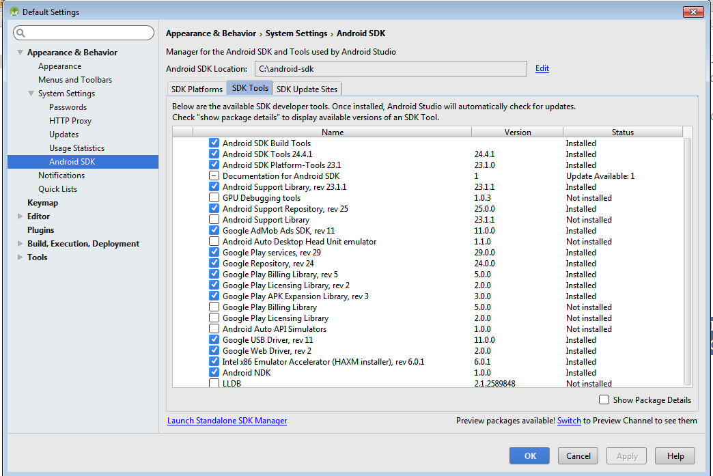
Using Google Play Services
Download Google Play Services for Android SDK via SDK Manager

Slide 65
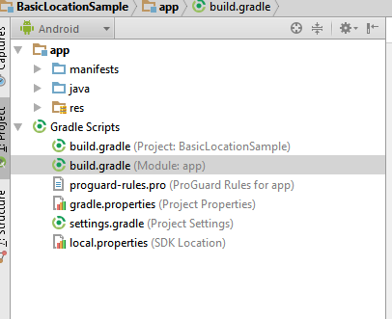
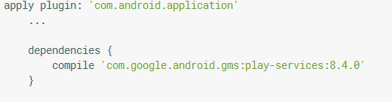
Setting up Google Play Services
In target app must add dependency in the Gradle build file for the app / module - not the project app

Slide 66
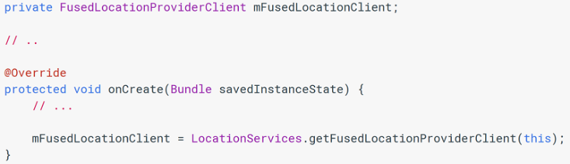
Getting Location
Must still request permission for location access in manifest file
Create FusedLocationProviderClient in onCreate method of Activity that wants location

Slide 67
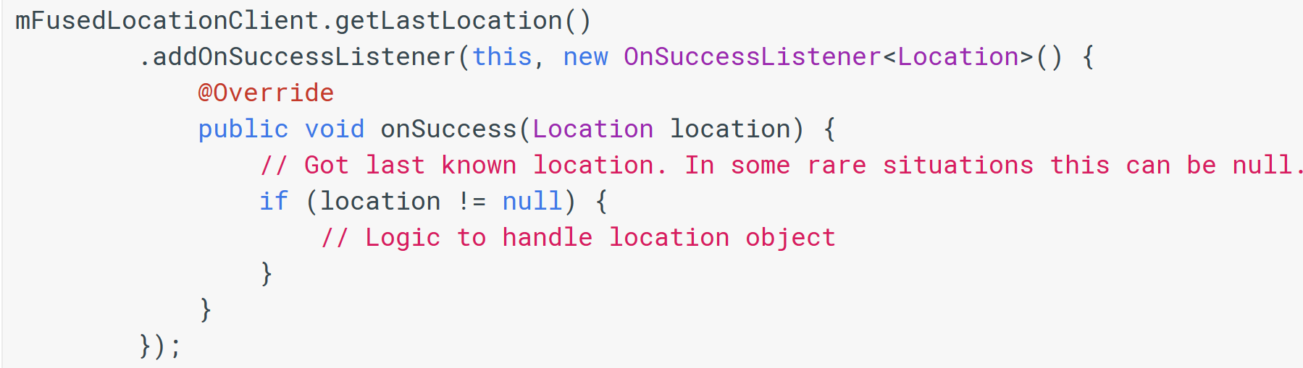
Getting Location
When Location desired:

Slide 68
Geofencing
Location Services also supports creating and monitoring geofences
App can create a geo fence
  latitude and longitude
  radius
Once a geofence is created app can ask Location Services for notifications
  when device enters geofence
  when device leaves geofence
  when device has been present (dwells) in geofence for a specified amount of time

Slide 69
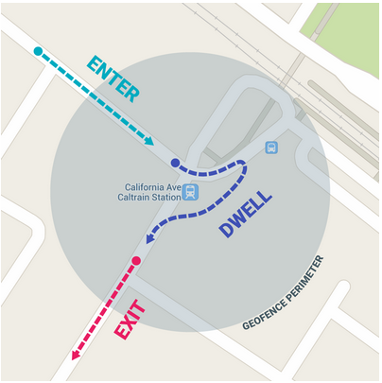
Geofencing

