Slide 1
CS371m - Mobile Computing
Runtime Permissions

Slide 2
Clicker
If your app wants to access the users contacts when do you request permission to do this?
Never, its not necessary
At compile time
At install time
At runtime
It depends

Slide 3

System Permissions
In an attempt to maintain security (system integrity, user privacy) on Android devices …
… run each app in a limited sandbox
If app wants to use resources (e.g. camera, storage, network) or information (e.g. contacts info) outside of sandbox, must request permission.
List of permissions:
https://developer.android.com/reference
/android/Manifest.permission.html

Slide 4
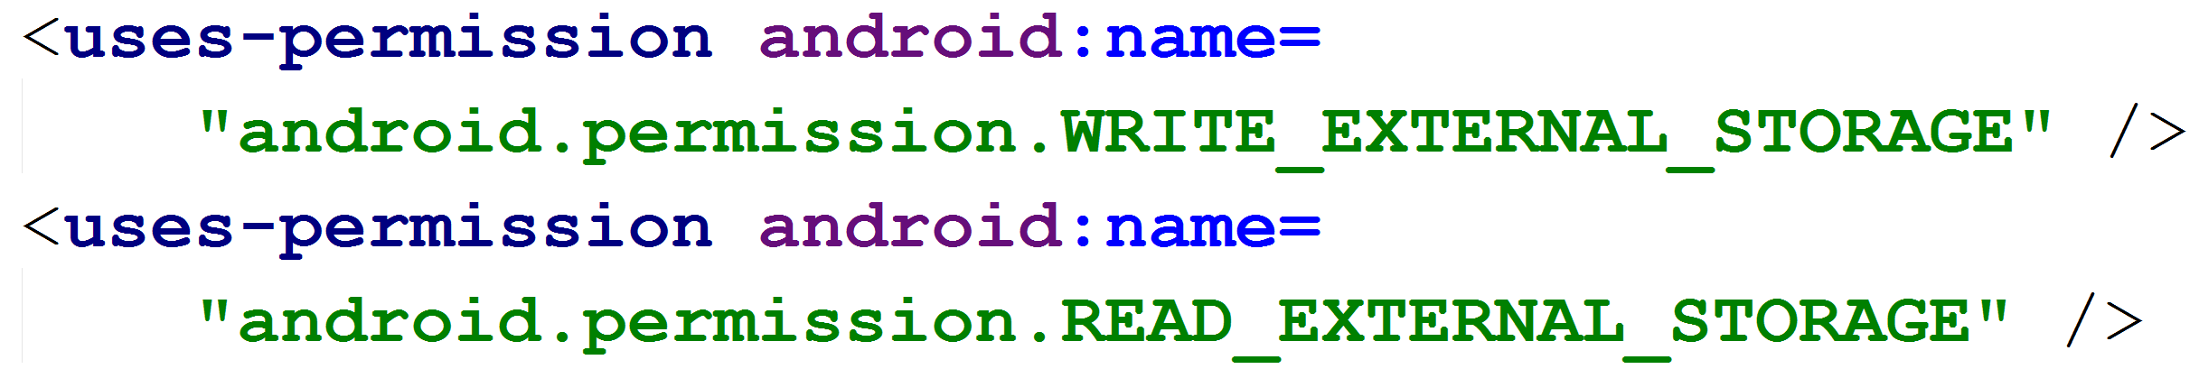
History of Permissions
Prior to Android version 6.0, Marshmallow…
Apps requested permission at install time
Permissions Listed in the AndroidManifest.xml File

Slide 5
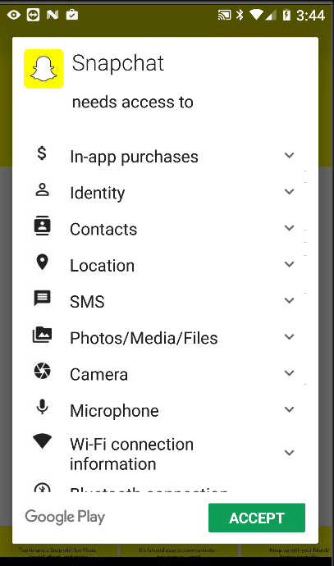
Install Time Permissions
Pre 6.0 / Marshmallow user granted permission at install time.
Google Play listed permissions for app when install selected
Based on permissions listed in manifest
Some apps … “we own you”

Slide 6
Clicker
What happens if an app tries to use a resource or access information it doesn’t have permission to use?
Compile error
Runtime error
Nothing, app allowed to access info or resource
Nothing, BUT app not allowed to access info or resource, a NO-OP

Slide 7
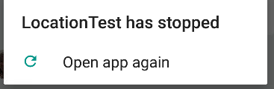
Lacks Permission
App stopped by system as soon as it tries to perform operation it doesn’t have permission for
02-09 16:03:39.857 26846-26846/org.example.locationtest
E/AndroidRuntime: FATAL EXCEPTION: main
Process: org.example.locationtest, PID: 26846
java.lang.RuntimeException: Unable to start activity
ComponentInfo
{org.example.locationtest/org.example.locationtest.LocationTest}:
java.lang.SecurityException: "passive" location provider requires
ACCESS_FINE_LOCATION permission.
at android.location.LocationManager.getProvider(LocationManager.java:383)
at org.example.locationtest.LocationTest.dumpProvider(LocationTest.java:372)
at org.example.locationtest.LocationTest.dumpProviders(LocationTest.java:364)
at org.example.locationtest.LocationTest.onCreate(LocationTest.java:80)

Slide 8
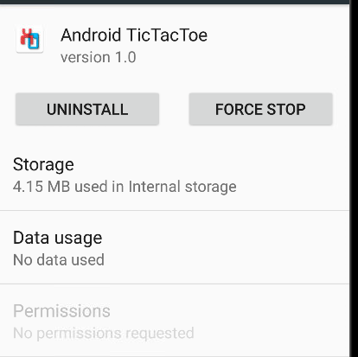
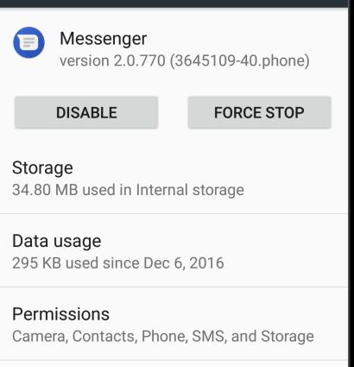
Viewing Permissions
A user can see what permissions an app has in Settings -> Apps
Developers can see device permissions via adb: $ adb shell pm list permissions -s

Slide 9
Changes to Permissions in M
Android 6.0 / Marshmallow introduced changes to permissions
Introduced Permission Groups
Introduced Normal and Dangerous Permissions
  “Dangerous Permissions cover areas where the app wants data or resources that involve the user's private information, or could potentially affect the user's stored data or the operation of other apps.”

Slide 10
Normal Permissions – API 23
ACCESS_LOCATION_EXTRA_COMMANDS
ACCESS_NETWORK_STATE
ACCESS_NOTIFICATION_POLICY
ACCESS_WIFI_STATE
BLUETOOTH
BLUETOOTH_ADMIN
BROADCAST_STICKY
CHANGE_NETWORK_STATE
CHANGE_WIFI_MULTICAST_STATE
CHANGE_WIFI_STATE
DISABLE_KEYGUARD
EXPAND_STATUS_BAR
GET_PACKAGE_SIZE
INSTALL_SHORTCUT
INTERNET
KILL_BACKGROUND_PROCESSES
MODIFY_AUDIO_SETTINGS
NFC
READ_SYNC_SETTINGS
READ_SYNC_STATS
RECEIVE_BOOT_COMPLETED
REORDER_TASKS
REQUEST_IGNORE_BATTERY_OPTIMIZATIONS
REQUEST_INSTALL_PACKAGES
SET_ALARM
SET_TIME_ZONE
SET_WALLPAPER
SET_WALLPAPER_HINTS
TRANSMIT_IR
UNINSTALL_SHORTCUT
USE_FINGERPRINT
VIBRATE
WAKE_LOCK
WRITE_SYNC_SETTINGS

Slide 11
Dangerous Permissions
Dangerous Permissions Organized into Permission Groups:
CALENDAR: READ_CALENDAR, WRITE_CALENDAR
CAMERA: CAMERA
CONTACTS: READ_CONTACTS, WRITE_CONTACTS, GET_ACCOUNTS
LOCATION: ACCESS_FINE_LOCATION, ACCESS_COARSE_LOCATION
MICROPHONE: RECORD_AUDIO
PHONE: READ_PHONE_STATE, CALL_PHONE, READ_CALL_LOG, WRITE_CALL_LOG, ADD_VOICEMAIL, USE_SIP, PROCESS_OUTGOING_CALLS
SENSORS: BODY_SENSORS
SMS: SEND_SMS, RECEIVE_SMS, READ_SMS, RECEIVE_WAP_PUSH, RECEIVE_MMS
STORAGE: READ_EXTERNAL_STORAGE, WRITE_EXTERNAL_STORAGE

Slide 12
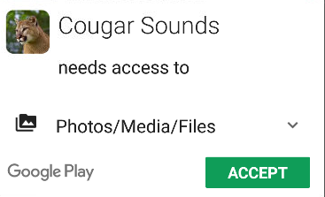
Runtime Permissions
Post Android 6.0 / Marhsmallow
All Normal and Dangerous Permissions still placed in app Manifest
If Device is Android 5.1 or lower OR app targets API level 22 or lower …
… then user must grant Dangerous Permissions at install time
Or app doesn’t install

Slide 13
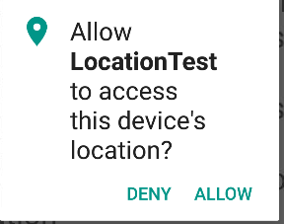
Runtime Permissions
If device is Android 6.0 or higher AND app targets API level 23 or higher
Must still list all permissions in manifest
Normal permissions granted at install time by system without informing the user
App must request each dangerous permission in needs
at runtime.
  Developers must write the
  code to do so.

Slide 14
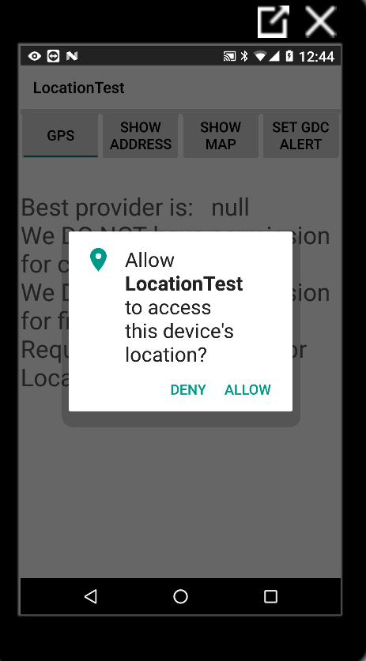
Requesting Permission at Runtime
When app needs dangerous permission:
Check to see if you already have permission
If not call one of the requestPermission methods with desired permissions and request code
requestPermission shows a standard, non modifiable dialog box to the user

Slide 15
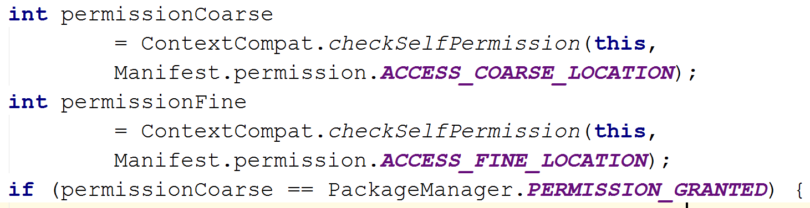
Checking Permissions
Before Requesting a Permission Check to see if you already have it.

Slide 16
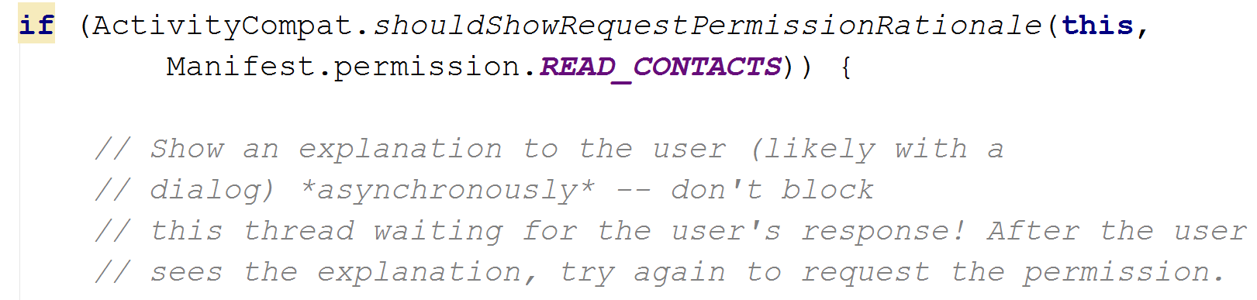
Requesting Permission
If you do not have a permission you need you must request it
shouldShowRequestPermissionRationale returns true if the app previously requested the permission and the user denied it

Slide 17
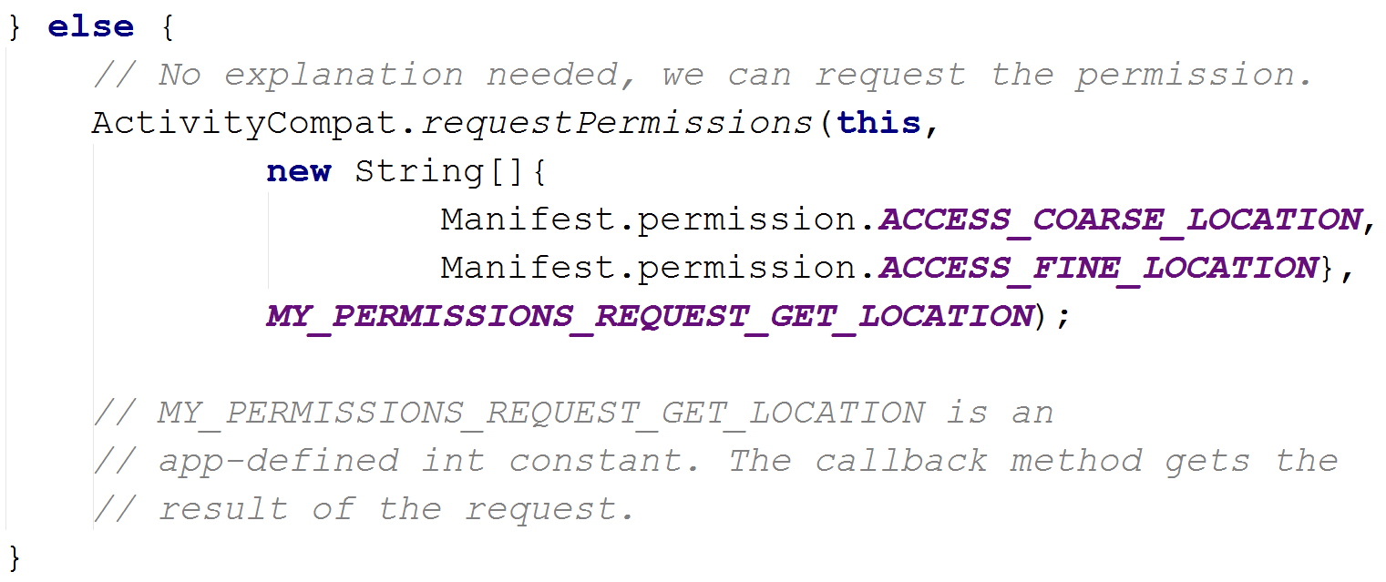
Requesting Permission
If user has not previously denied permission

Slide 18
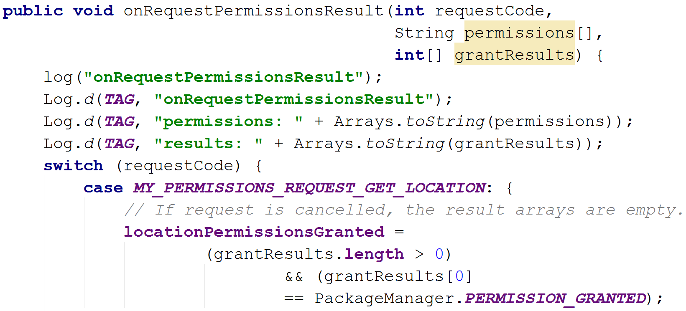
Dialog Result
Dialog displayed to user.
Lists permission group, not
individual permissions
Will lead to call back

Slide 19
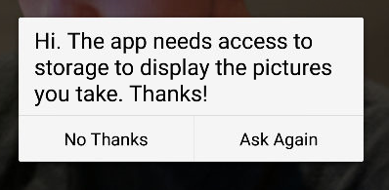
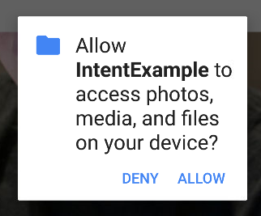
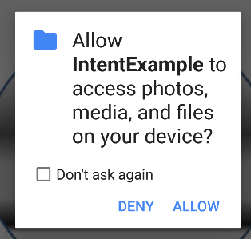
Denied Requests
If user denies first request for dangerous permission subsequent dialog boxes are a little different:
shouldShow
Request
Permission
Rationale
Was true.
This is a custom dialog.

Slide 20
Denied Permission
If user asked a gain and denies plus checks “Don’t ask again” system will never ask again
  Obviously may make a given app ‘unusable’

Slide 21
Permission Groups
Dialog shows Permission Group based on requested permission
If use grants permission for one permission in group …
… app now has all permission in that group.
If you check on different permission in group after one granted, it will be granted as well
Permissions retained when app rerun

Slide 22
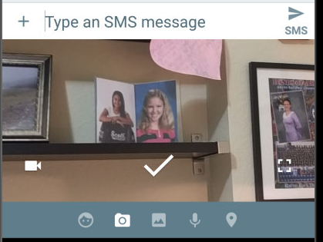
Permission Notes
If you use an intent to accomplish something via another app, then your app does not typically have to request permission.
For example, if you use an Intent to take a picture, you DO NOT need CAMERA permission.
Only if you want to access
camera directly in your app.
Example of app that uses
camera, messenger ->

Slide 23
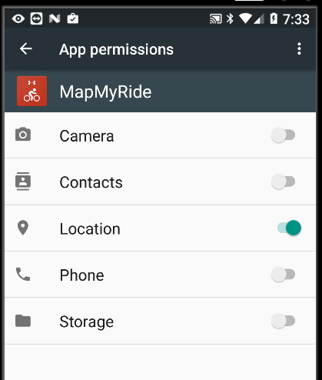
Permission Notes
A user can also
alter permissions
in the Settings app
Settings -> app
Toggle Switches
to grant and deny
permissions
Meaning, should
always check if we
have required
permission before
acting on it.

Slide 24
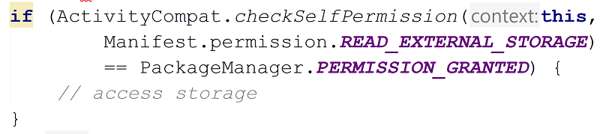
Checking if Permission Granted
Method to check if out app has a given permission:

Slide 25
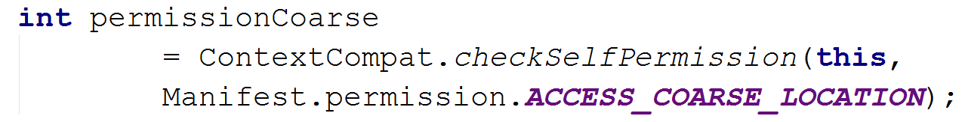
The Support Library
You may have noticed:
What are ContextCompat and ActivityCompat?

Slide 26
The Support Library
We want to use newest features, but also allow app to run on older versions of Android
Android provides libraries to provide newer functionality on older devices
Mimics newer features with code built on older versions
  Example: app bar using older widgets

Slide 27

The Support Library
Previously a single library
Now multiple libraries
Min API levels for most of the
official libraries (as fall 2016)
is API level 9, Gingerbread

Slide 28
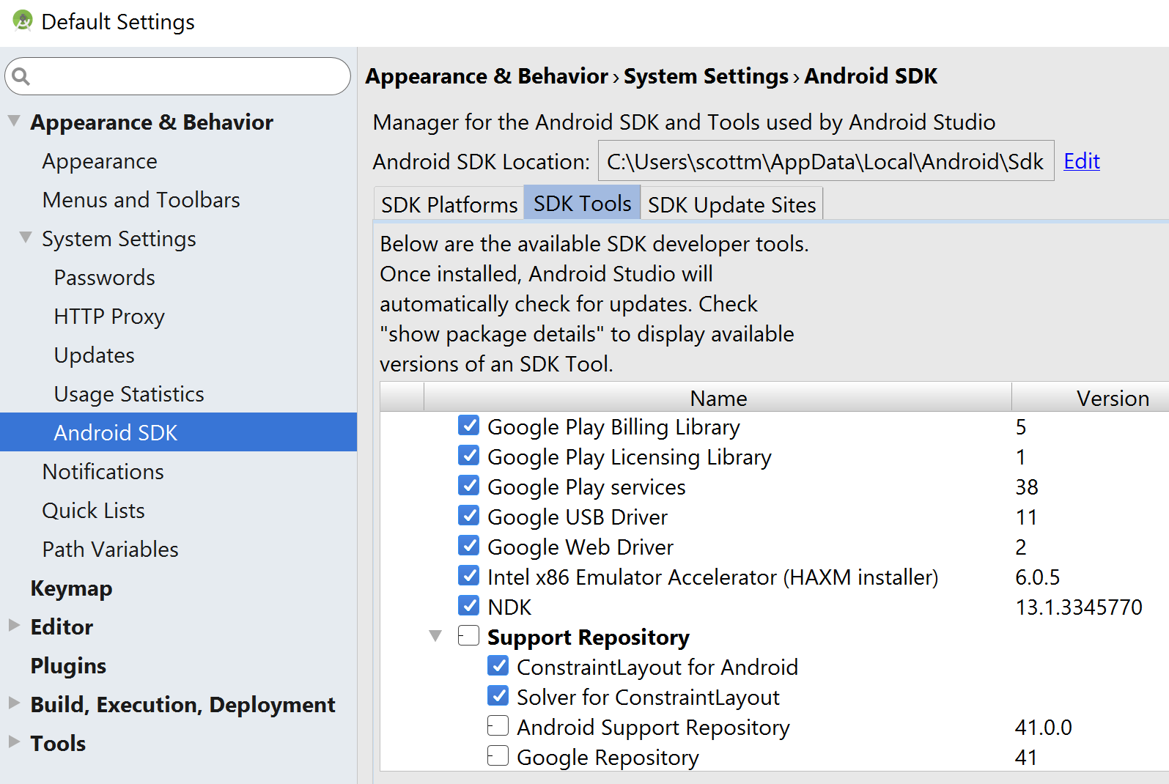
Support Library Setup
Must download via SDK Manager

Slide 29
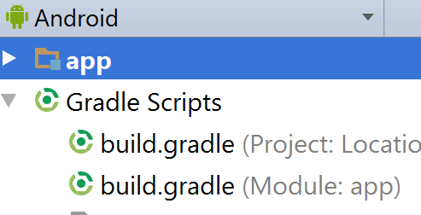
Support Library Setup
Must add dependency to gradle build file
build.gradle file for app
NOT project
Sample dependency:
Sample import:

Slide 30
Support Library References
Features:
https://developer.android.com/topic/libraries/support-library/features.html
Versions:
https://developer.android.com/topic/libraries/support-library/packages.html
Sample Documentation:
https://developer.android.com/reference/android/support/v4/app/package-summary.html
Release notes:
https://developer.android.com/topic/libraries/support-library/revisions.html
Design Patterns
https://material.io/guidelines/patterns/permissions.html#

