Slide 1
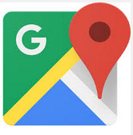
CS371m - Mobile Computing
Maps

Slide 2
Using Google Maps
This lecture focuses on using Google Maps inside an Android app
Alternatives Exist:
Open Street Maps
http://www.openstreetmap.org/
If you simply want to display a "standard Google map" from your app …

Slide 3
Clicker Question
What Android component we can use from our app to display a map of a location?
Activity
Broadcast Receiver
Content Resolver
Intent
Service

Slide 4
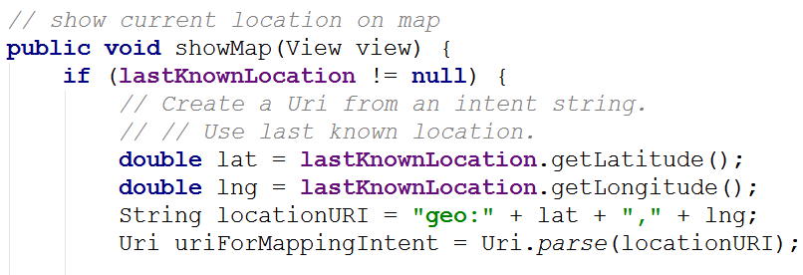
Displaying Standard Google Map
Create URI based on desired location.
From location sample:

Slide 5
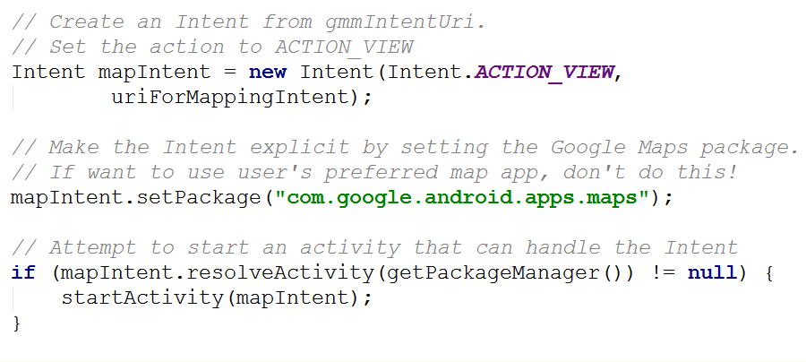
Create and Fire Intent

Slide 6
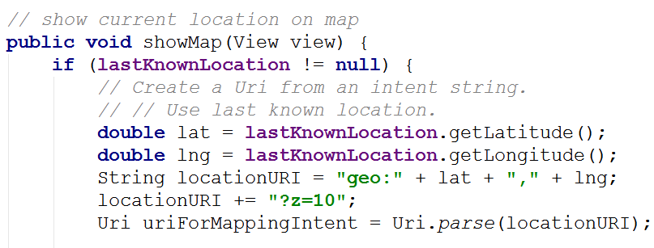
Adjusting Zoom Level
Specify Zoom Level for Google Map
Zoom Levels in Google Maps, 0 - 21
0 is the whole earth
21 individual buildings

Slide 7
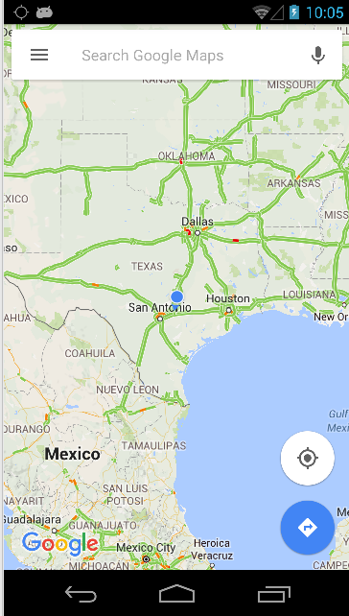
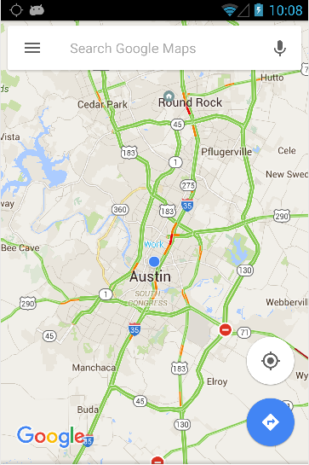
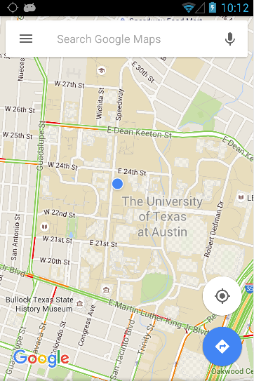
Zoom Comparisons
zoom = 5
zoom = 10
zoom = 15

Slide 8
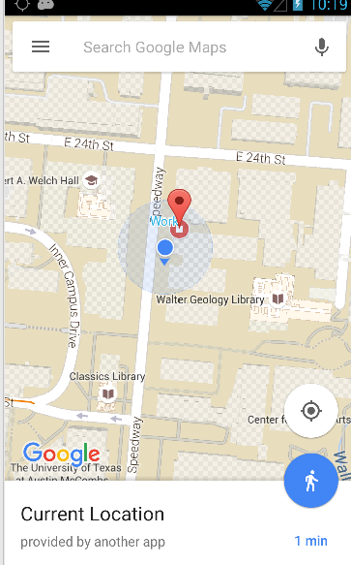
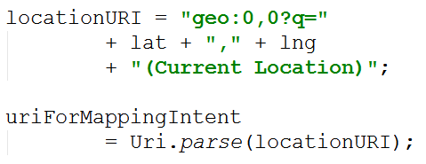
Searching for Locations and Label
Can create URIs that search for a location and provide a label

Slide 9
Incorporating Maps in your appS

Slide 10
Using Google Maps
Not standard Android
Requires an API key from Google
https://developers.google.com/maps/documentation/android/
required to use MapView class or MapFragments
Must add a reference to the Maps API Key in each MapView (xml or code)

Slide 11
Using Google Maps API v2
For Android, Google Maps API v2 part of the Google Play Services sdk
Download via SDK Manager

Slide 12
Include Google Play Services in Manifest
To make use of Google Play Services add data to manifest
Google Play Services has a host of non standard android tools
"simple location API"
"activity recognition"

Slide 13
Obtaining an API Key
Most web APIs require a key to use
a few do not such as the Yahoo finance API
Same with Google Maps API
New way of obtaining keys via Android Studio and Google Developers console is mostly painless
Old way of obtaining the key required some knowledge regarding how apps are published and was painful

Slide 14
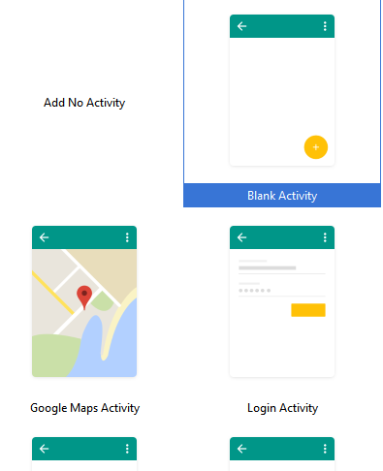
New Way to Get Maps API Key
Create a Google Maps Activity in Android Studio

Slide 15
New Way to Get Maps API Key
Look at google_maps_api.xml file in new project

Slide 16
Go to Developer Console

Slide 17
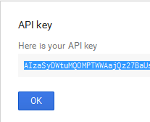
Create Key

Slide 18
Last Step
Copy API Key into google_maps_api.xml file

Slide 19
old painful way

Slide 20
Signing Apps
deploying apps on the Google Play requires signing the app with a certificate
development and debugging uses an automatic key creation process
invisible to us
In release mode you must create your own private key to sign apps
use of keytool program from Java SDK
http://developer.android.com/guide/publishing/app-signing.html

Slide 21
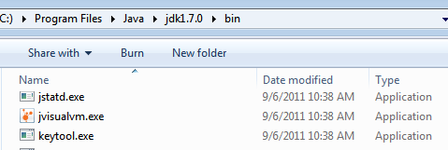
Signing Apps
A Java Keystore is a file (or files) that stores security certificates
Included in the JDK (Java Development Kit) is the keytool program
Used to create manipulate the keystore

Slide 22
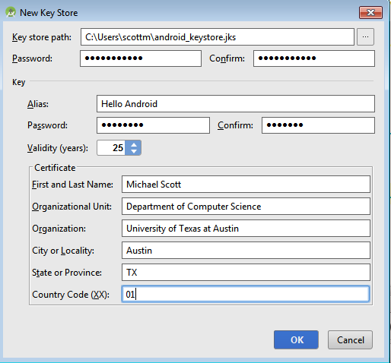
Signing Apps via Android Studio
Android Studio provides a GUI to run keytool for you
Build -> Generate Signed APK

Slide 23
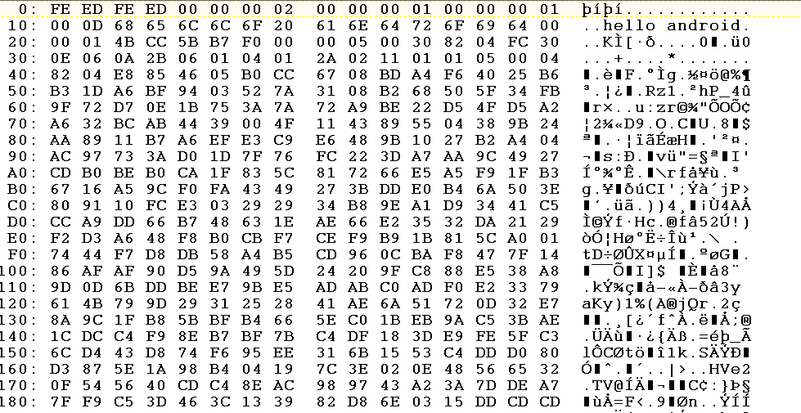
keystore file

Slide 24
Obtaining an API Key
For Google Maps API v2
One key tied to one signing certificate
Same key used for all instances of app
Normally sign apps with different certificates
If so different API keys required if two different apps use maps and signed with different certificates

Slide 25
Obtaining an API Key
To obtain a Google Maps API key we need the SHA-1 fingerprint of the signing certificate
A short form of the certificate based on the SHA-1 hashing algorithm
run keytool from the command line to pull out fingerprint of certificate

Slide 26
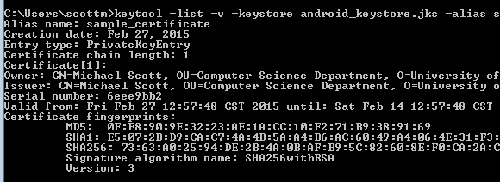
fingerprint via keytool
prompt>keytool -v -keystore <keystore_file_name> -alias <certificate_name> -storepass <keystore_password> -keypass <certificate_password>

Slide 27
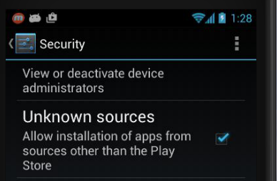
debug certificate
In development you are using a pre generated debug keystore to sign apps
Happens behind the scenes
Security settings on device

Slide 28
debug certificate
possible to obtain API key tied to your debug keystore
works in development
would need to change manifest with certificate used to sign the app

Slide 29
Obtaining the API key
The SHA-1 fingerprint is a 20 digit hexadecimal number
Use Google APIs console to obtain key for Maps
requires Google account
… and must agree to the terms of service.

Slide 30
Using Maps API Key in App
Must add key to manifest
KEY POINT: Replace API_KEY in the second line only (android:value) with the API key you obtained in previous steps

Slide 31
displaying a map inside your app

Slide 32
Google Maps Terms of Service
Some Highlights
may include ads in future
Google may limit number of transactions
You will not use the Service or Content for or in connection with (a) real-time navigation or route guidance; or (b) automatic or autonomous vehicle control.
Must include Google Play Services Attribution in your apps "legal notices"

Slide 33
Permissions
Recommended Permissions for manifest when using Google Maps inside your app

Slide 34
Display Simple Map in App
Hello Map
Like Hello World, but layout file becomes:
More on Fragments later, but they are a UI component between Activities and GUI Widgets

Slide 35
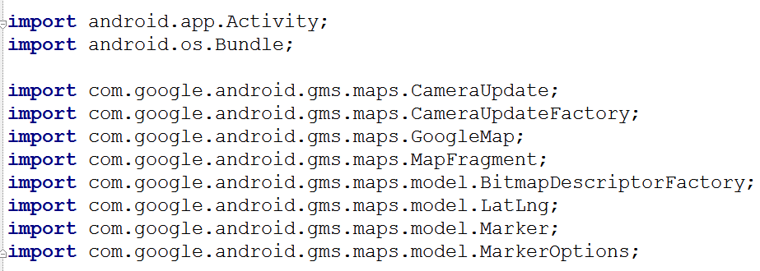
Hello Map Activity
Lots of new classes!!

Slide 36
Specifying Locations
Latitude and Longitude
GoogleMap object
Used for most interactions with map.

Slide 37
onCreate for Simple Map App
More on Fragments later …

Slide 38
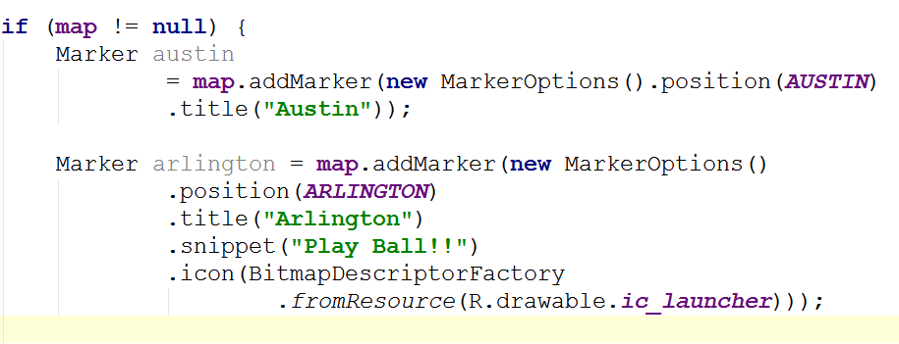
adding Markers in onCreate
first Marker uses default, pin and has a title, "Austin"
second Marker uses a different icon and adds text after the title

Slide 39
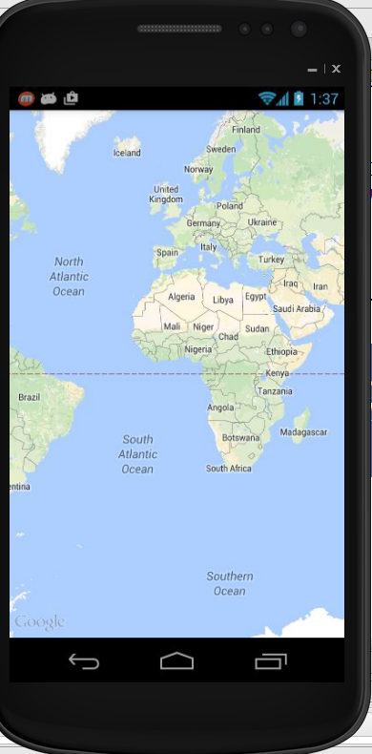
Center and Zoom
Running app as is produces this:
Centered where???
Zoomed out
Recall, zoom levels 0 to 21

Slide 40
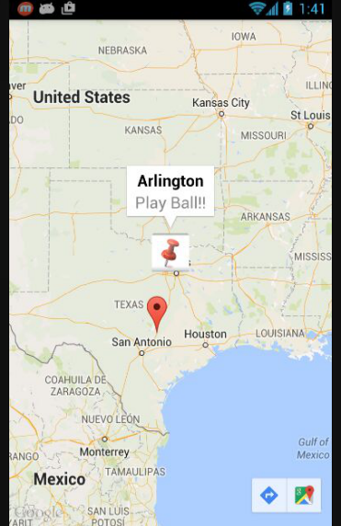
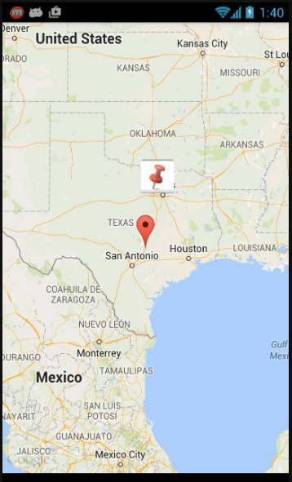

Slide 41
Resources for Working with Google Maps
https://developers.google.com/maps/ documentation/android-api/intro

Slide 42
Map Options
Adding UI controls
Handling user gestures
Handling user events
move and zoom camera
Draw on the map
markers, information windows, shapes, overlays
Heatmaps, Marker Clusters

Slide 43
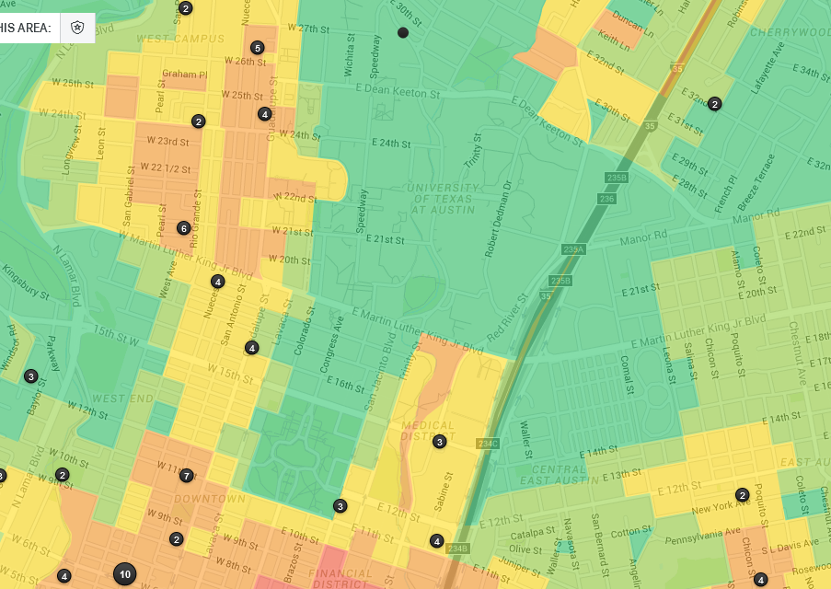
Heatmaps

Slide 44
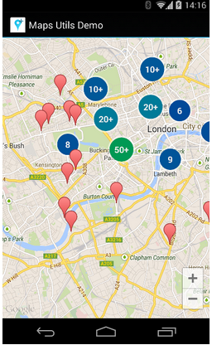
Marker Clusters
Too many markers can clutter the display
Especially on smaller displays
Marker clusters used to group together markers until user zooms in

Slide 45
The Map Object

Slide 46
OLD SLIDES PRE GOOGLE MAPS API 2

Slide 47
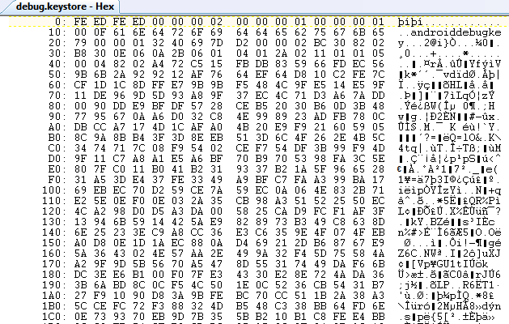
Debug Key
Portion of debug.keystore

Slide 48
Getting MD5 Fingerprint
use keytool program
keytool part of Java SDK
keytool -list -alias androiddebugkey -keystore <path_to_debug_keystore>.keystore -storepass android -keypass android
gives MD5 fingerprint of the debug certificate
keytool of Java 1.7 gives SHA1 by default
use -v after keytool, before -list

Slide 49
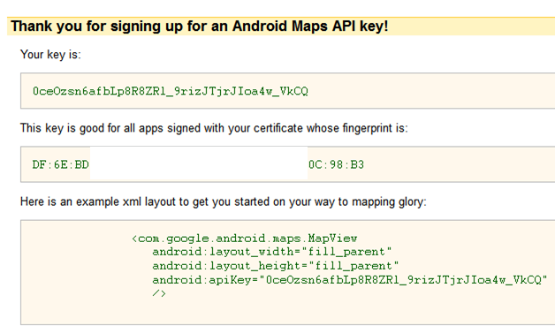
Debug API Key

Slide 50
Hello MapView
Build Target - Google, not Android
MapView not a standard Android class
part of Google Maps Library
add to manifest
must also include INTERNET permission and LOCATION permission

Slide 51
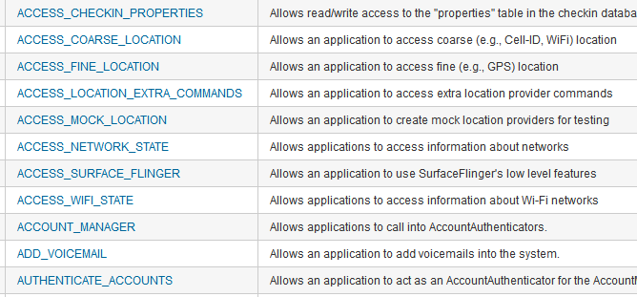
Aside - Permissions
http://developer.android.com/reference/android/Manifest.permission.html

Slide 52
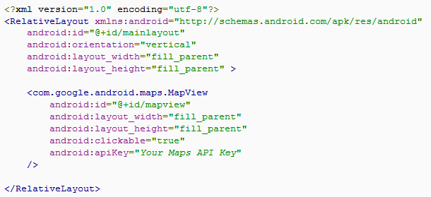
MapView
A type of view for layout file

Slide 53
MapActivity
Create class that extends MapActivity instead of Activity
import com.google.android.maps.MapActivity;
must implement isRouteDisplayed method
must return true if any kind of route (to be followed) is displayed, per terms of use

Slide 54
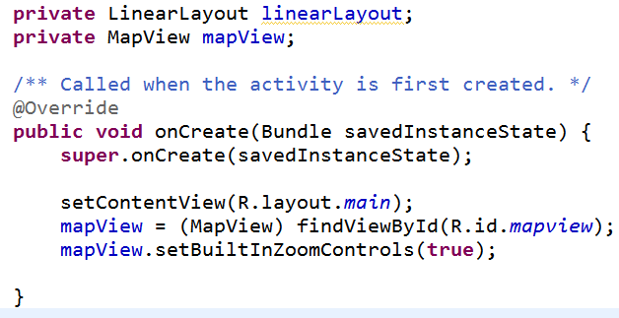
Instance Vars and onCreate
Add instance variables and initialize in onCreate method

Slide 55
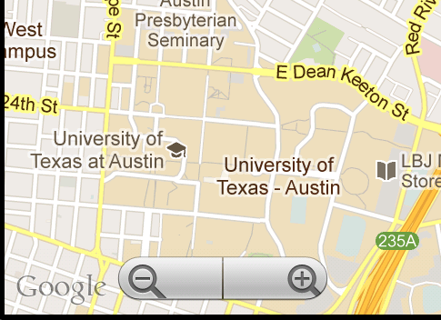
HelloMapView
Run app
Displays map and allows panning and zooming

Slide 56
Customizing Map
Easy to display map and allow interaction
Customize with markers and overlays
Overlays
used to display information on top of map
simple choice: ItemizedOverlay class

Slide 57
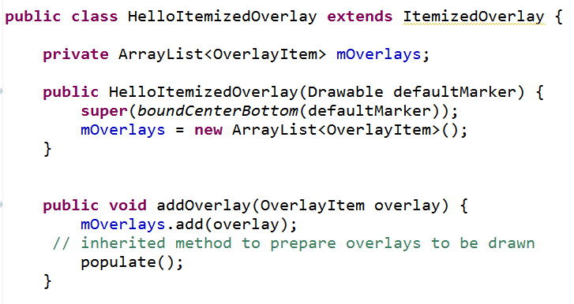
ItemizedOverlay

Slide 58
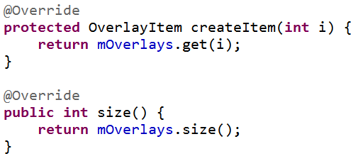
ItemizedOverlay
populate method will call createItem
define createItem and return value from the ArrayList instance var
define size method that returns number of overlay items

Slide 59
Adding Overlays
In MapActivity create OverlayItem
add to HelloItemizedOverlay
add to MapView
Need a drawable for the marker
res/drawable
issues display gif format images on some devices

Slide 60
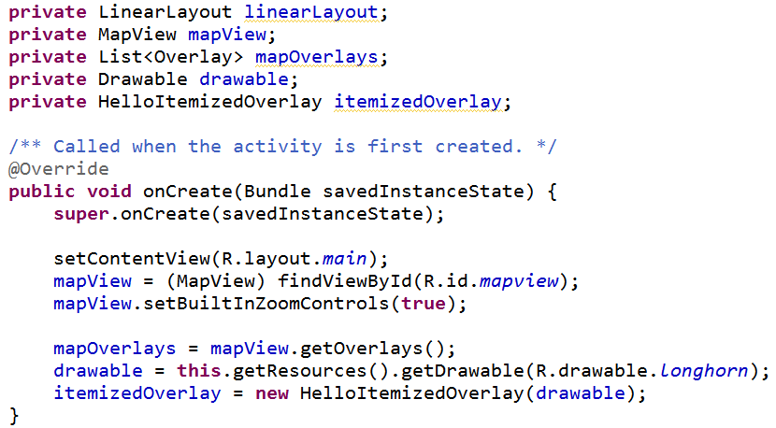
Changes to HelloMapView

Slide 61
Add Overlay Items
Create GeoPoint and use these to create OverlayItems
GeoPoint based on microdegrees
lat and long times 1,000,000
Build OverlayItems out of GeoPoints and include strings for title and snippet text to display when drawable clicked

Slide 62
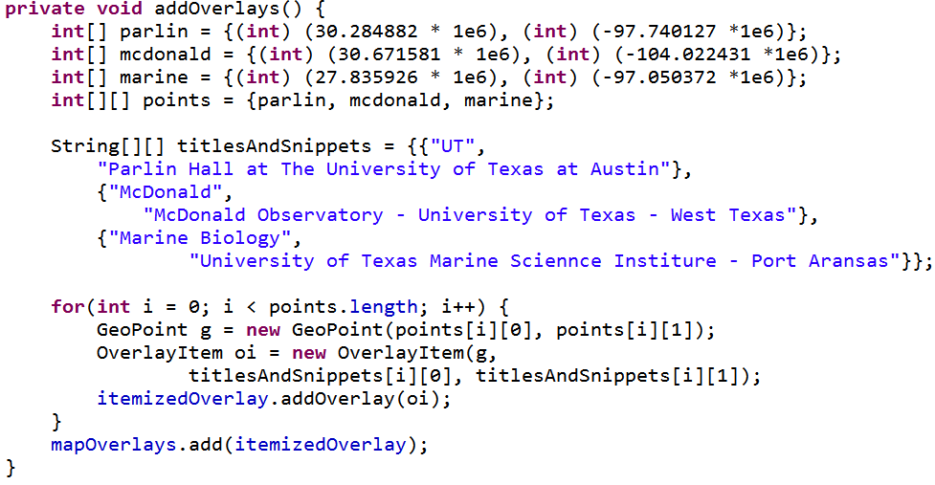
addOverlays method in HelloMapView

Slide 63
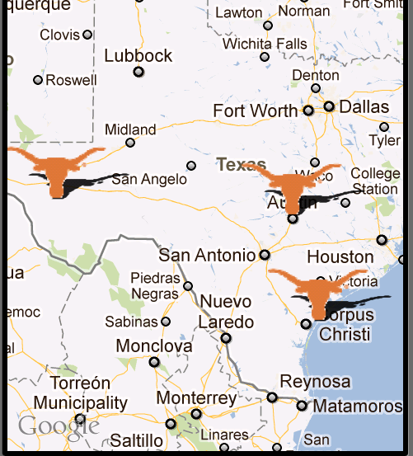
Result
one overlay with multiple items
based on locations we added

Slide 64
Display Information
To display information (title and snippet) of overlay override the onTap method in the ItemizedOverlay class

Slide 65
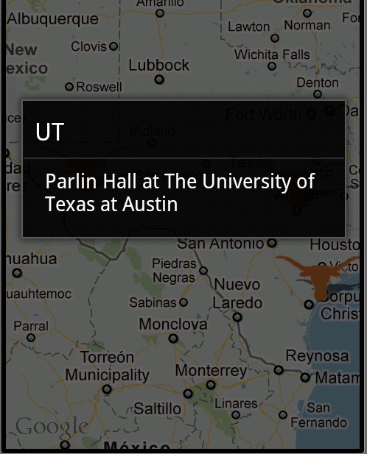
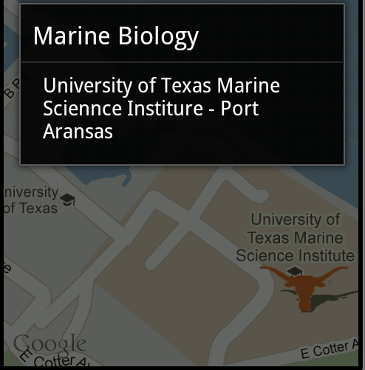
Results of Clicking Longhorn

Slide 66
Reverse Geocoding
Find addresses from longitude/latitude
Geocoder uses a backend that is NOT included in the core android framework
use isPresent method to check for service
location = locationManager.getLastKnownLocation(
LocationManager.GPS_PROVIDER);
double lat = location.getLatitude();
double lng = location.getLongitude();
Geocoder gc = new Geocoder(this, Locale.getDefault());
List<Address> addresses = null;
try {
addresses = gc.getFromLocation(lat, lng, 5); // maxResults
} catch (IOException e) {}

Slide 67
Forward Geocoding
Find longitude/latitude (and more) from address or airport code
Geocoder gc = new Geocoder(this, Locale.US);
List<Address> addresses = null;
try {
addresses = gc.getFromLocationName(
“713 N. Duchese, St. , Missouri”, 5);
} catch (IOException e) {}
double lat = addresses.get(0).getLatitude();
double lng = addresses.get(0). getLongitude (); String zip = addresses.get(0).getPostalCode();

Slide 68
Recent Changes
Google Maps API version 2
somewhat new, Released December 2012 as part of Google Play Services SDK
features:
indoor maps
simplified location services

Slide 69
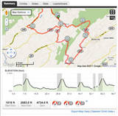
Maps Example
Route Tracker using Locations, MapActivity, MapView, and Google Maps
from Deitel AFP-AADA
Similar to Map My Ride
popular app among cyclists and runners

Slide 70
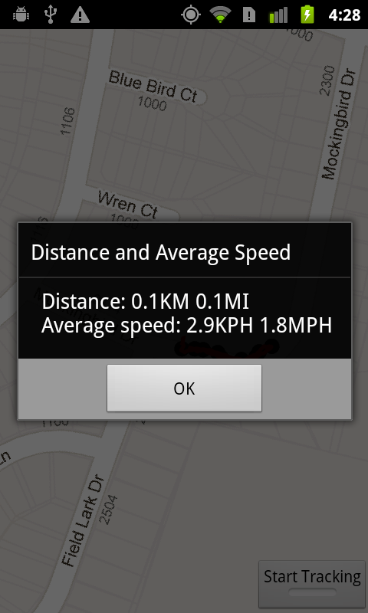
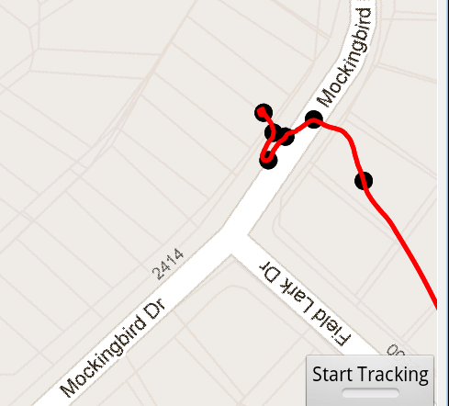
RouteTracker App

Slide 71
RouteTracker App
using FrameLayout to stack components with the most recently added component on top
ToggleButton at bottom to start and stop route tracking
MapView added to FrameLayout
route is an overlay to map with points and lines connecting points

Slide 72
RouteTracker Classes
RouteTracker Starting Activity
deals with LocationProvider
BearingFrameLayout Displays MapView
rotates based on bearing from location
RouteOverlay Overlay with location points
(every 10th)
and lines connecting.
Converts locations to GeoPoints.
Overloads draw

Slide 73
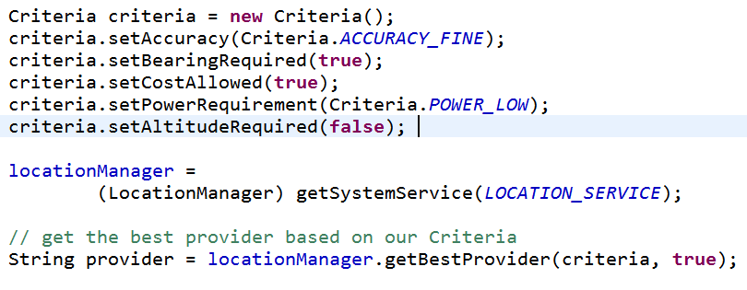
Criteria Class
Set criteria for selecting a LocationProvider

Slide 74
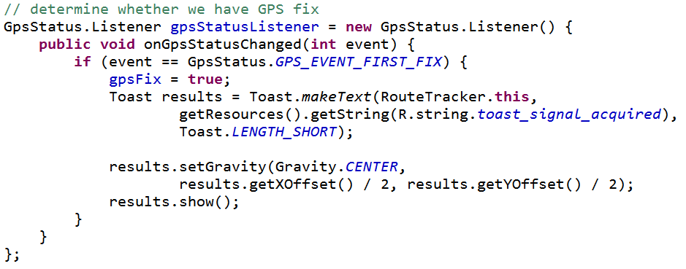
GpsStatus.Listener
Responds to changes in GPS status
Are we receiving GPS fixes?
App does not track unless this is true

Slide 75
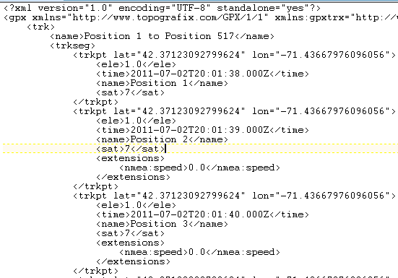
Simulating GPS Data
to simulate changes in location in emulator
GPS data in a file
GPS Exchange Format (GPX)

Slide 76
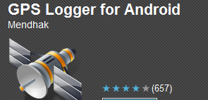
Creating GPX Files
Many apps and programs
One option for Android devices
GPSLogger
gpsbabel to convert between various GPS formats
gpx has different versions

Slide 77
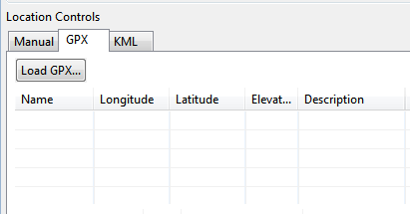
Running GPX files in App
DDMS
Emulator Control Tab
GPX Tab
Load

Slide 78
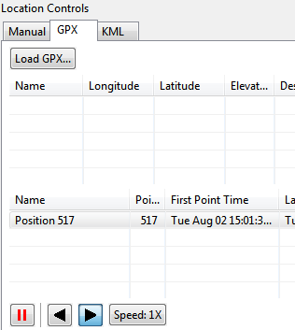
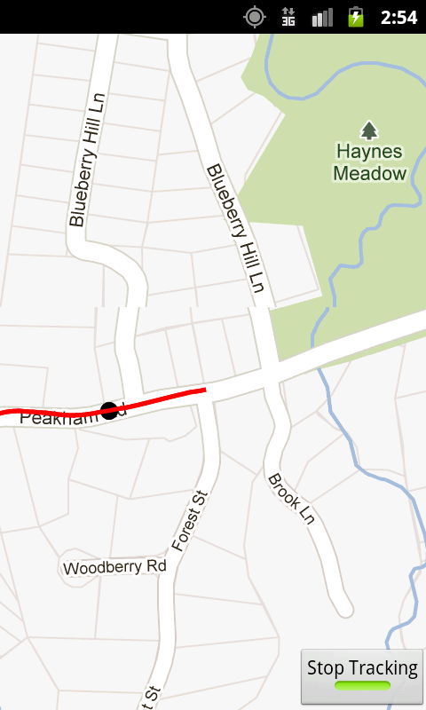
Running GPX

Slide 79
Geocoding
Finding addresses from lat / long and vice versa
Reverse geocoding: find address from lat and long
Forward geocoding: find lat and long from address

