Slide 1
CS378 - Mobile Computing
3D Graphics

Slide 2
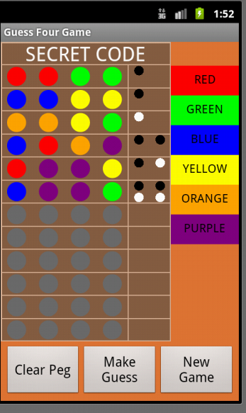
2D Graphics
android.graphics library for 2D graphics (not Java AWT and Swing)
classes such as Canvas, Drawable, Bitmap, and others to create 2D graphics
Various attempts to make two d graphics appear more "lifelike" and 3 dimensional

Slide 3
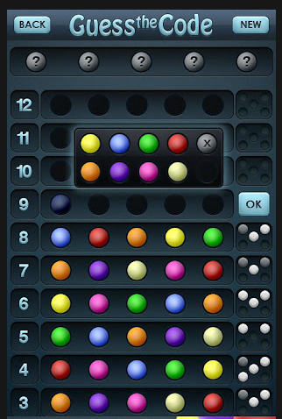
Gradients
Gradient Paints can add depth to 2d primitives
Notice the gradient paint on the pegs and shading on numbers

Slide 4
2D Graphics

Slide 5
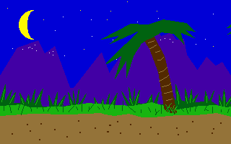
Parallax Scrolling Example

Slide 6
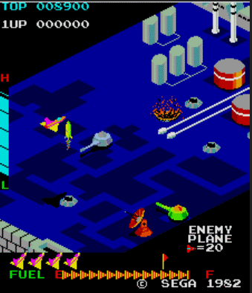
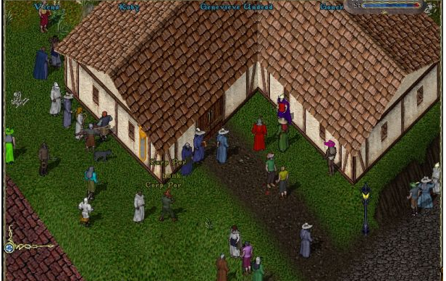
2.5D
Isometric Graphics
"rotate" object to reveal details on the side
Zaxxon
Ultima Online

Slide 7
3D Graphics
Create 3D model
a small scene or a large world
Model rendered into a 2D projection
model includes
objects (boxes, cones, cylinders, sphere, user defined models)
lighting
cameras
textures
dynamic behaviors

Slide 8
3D Coordinate System
x and y as expected (positive y is up, not down as in 2d graphics
z axis - positive z is out of screen, negative z is into screen
y⁺
z⁻
z⁺
x⁺

Slide 9
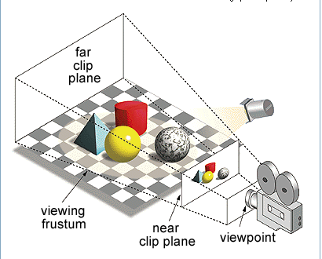
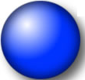
Visual Portion
Portion of 3D Scene that is rendered is contained in a frustum (pro: frəstəm)
a pyramid or cone with its top cut off
objects in scene, but not
visible

Slide 10
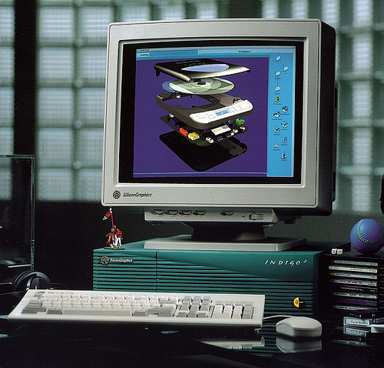
OpenGL
Developed by Silicon Graphics Inc.
developer of high end graphics systems and machines in 80s and 90s
Integrated Raster Imaging System Graphics Library
1992 OpenGL
maintained by non profit Khronos Group

Slide 11
OpenGL
low level, procedural API
programmer responsible for defining steps to create and render (show) a scene
alternatives use a scene graph where programmer describes scene and actions (behaviors) and library manages the details of rendering it
Example of Graphics libraries that use Scene Graphs: Java3D, Acrobat 3D, AutoCAD, CorelDRAW, RenderMan (Pixar)

Slide 12
OpenGL ES
ES = Embedded Systems
Used in a wide variety of devices, not just Android
iPad, iPhone, Blackberry, symbian, Nintendo3DS, Playstation 3, Web GL
OpenGL version ES 2.0 API supported in Android 2.2 and higher (API levels 8 and higher)
prior versions of Android support ES 1.1
emulator DOES NOT support ES 2.0

Slide 13
Android and OpenGL ES
two ways of working with GL:
through the framework APIandroid.opengl package
via the Android Native Development Kit (NDK)
companion tool to Android SDK to build portions of apps in native code in C or C++
Required Android classes for first approach:
GLSurfaceView and GLSurfaceView.Renderer

Slide 14
GLSurfaceView
Similar to SurfaceView
draw and manipulate objects using Open GL API calls
to respond to touch screen events subclass GLSurfaceView and implement touch listeners

Slide 15
GLSurfaceView.Renderer
An interface
Must implement these methods:
onSurfaceCreated for actions that only happen once such as initializing GL graphics objects
onDrawFrame() work horse method to create movement and animation
onSurfacechanged() called when size of view changes or orientation

Slide 16
Manifest Requirements
To use OpenGL ES 2.0 (Android 2.0 and later)
if app uses texture compression formats must declare which formats application supports
<support-gl-texture>

Slide 17
Steps to Use OpenGL
Create activity using GLSurfaceView and GLSurfaceView.Renderer
Create and draw graphics objects
define projection for screen geometry to correct for non square pixels
define a camera view
perform actions to animate objects
make view touch interactive if desired

Slide 18
Sample Program
Demonstrate set up of required elements
draw and rotate a 3d object (a cube)
Create Simple Activity that has a GLSurfaceView as its content view
To draw objects must implement GLSurfaceView.Renderer

Slide 19
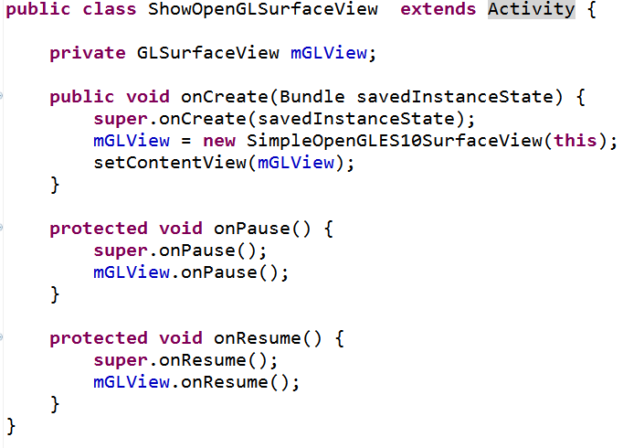
Activity

Slide 20
GLSurfaceView
Shell of class
Used to manage surface (special piece of memory), manage EGL display (embedded graphics library, renders on thread decoupled from I thread, and more

Slide 21
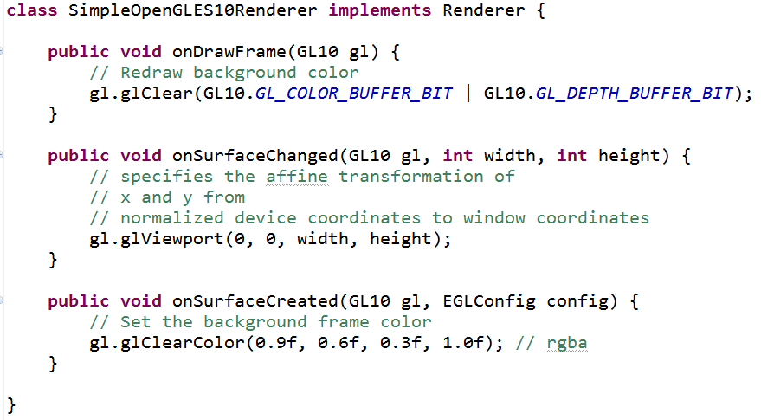
Skeleton Renderer

Slide 22
OpenGL Documentation
Android Documentation for GL10 list constants and methods but have no other useful information
Check the OpenGL ES documentation
http://www.khronos.org/opengles/sdk/1.1/docs/man/

Slide 23
Low Level Graphics Libraries
"What makes the situation worse is that the highest level CS course I've ever taken is cs4, and quotes from the graphics group startup readme like 'these paths are abstracted as being the result of a topological sort on the graph of ordering dependencies for the entries' make me lose consciousness in my chair and bleed from the nose." -mgrimes, Graphics problem report 134

Slide 24
Draw a Shape
Draw a simple, flat Triangle using OpenGL
(X,Y,Z) coordinate system
(0, 0, 0) center of frame
(1, 1, 0) is top right corner of frame
(-1, -1, 0) is bottom left corner of frame
must define vertices of our triangle

Slide 25
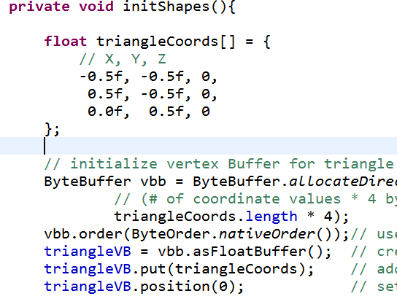
Define Triangle
-1 0 1
1 0 -1

Slide 26
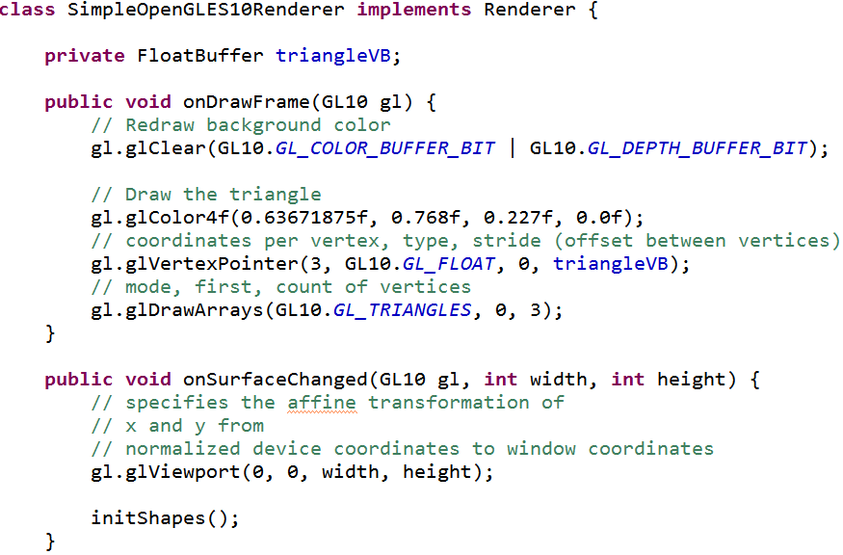
Draw Triangle
init OpenGL to use vertex arrays
call drawing API to draw triangle

Slide 27
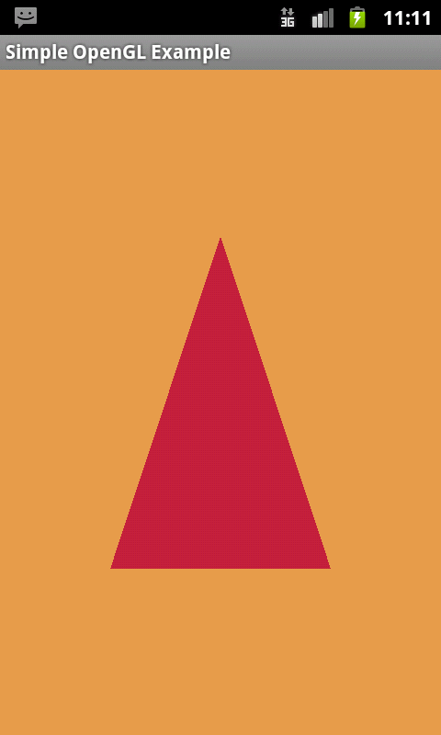
Result
oooo, ahhhh
Graphics coordinate system assumes a square but mapped to a rectangular frame

Slide 28
Correcting Projection
Apply an OpenGL projection view and camera (eye point) to transform coordinates of the triangle
"correct" the position onSurfaceChanged and onDrawframe()

Slide 29
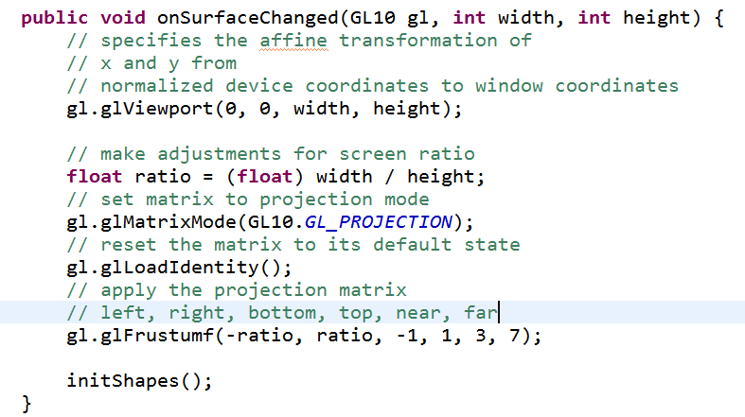
onSurfaceChanged

Slide 30
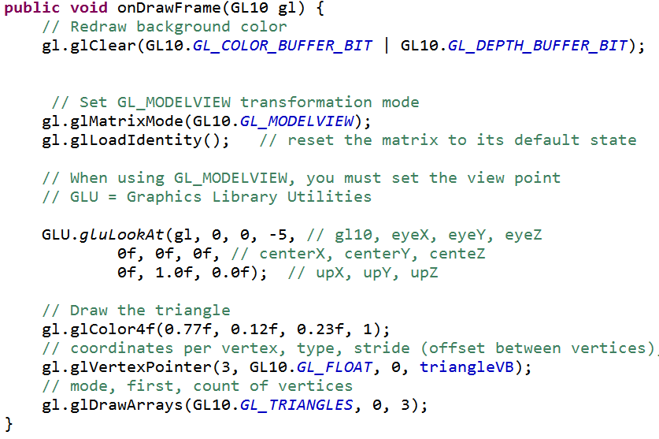
onDrawFrame

Slide 31
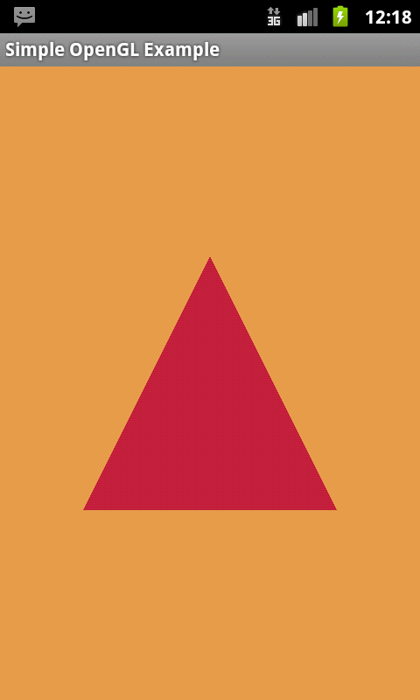
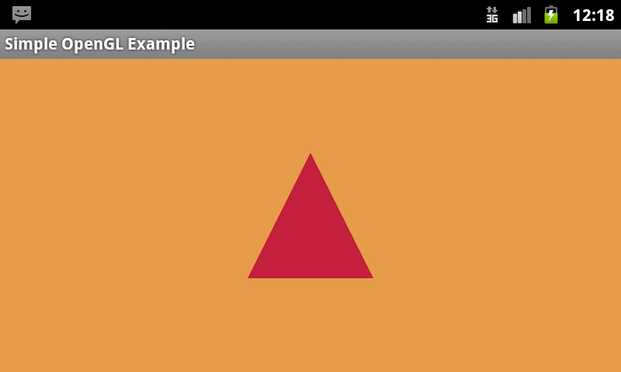
Result of Correcting Projection

Slide 32
Adding Motion
in onDrawFrame
define vector of rotation

Slide 33
Results
X Axis (angle, 1, 0, 0) Y Axis (angle, 0, 1, 0)

Slide 34
Results
Z Axis (angle, 0, 0, 1) Y Axis (angle, -1, 1, -1)

Slide 35
Another Example
Draw a pyramid that bounces around the screen
Same basic steps as previous apps
Activity with GLSurfaceView
Implementation of GLSurfaceView.Renderer
Pyramid class that defines the geometry and appearance of 3d pyramid object

Slide 36
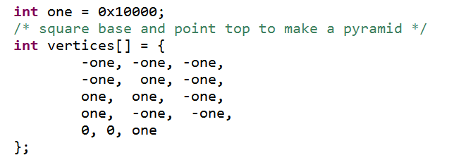
Constructing Pyramid
specify vertices for 6 triangles
4 sides, 2 triangles for the base
1 (-1, 1, -1)
2 (1, 1, -1)
4 (0, 0, 1) imagine it out of screen
0 (-1, -1, -1)
3 (1, -1, -1)

Slide 37
Constructing Pyramid
Indices refers to set or coordinate (x, y, z)

Slide 38
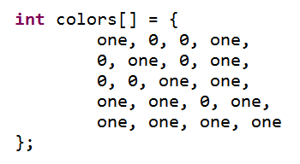
Coloring Pyramid
Define colors for each of the 5 vertices
Colors blend from one vertex to another
recall, rgba

Slide 39
Result

Slide 40
OpenGL Options
Renderscript
high performance, but low level
scripts written in C
OpenGLUT, OpenGL Utility Toolkit
not officially part of Android, Android GLUT Wrapper
include more geometric primitives

