Slide 1


Game Making with Alice Eat the Hay Game
Mike Scott
University of Texas at Austin

Slide 2
What is Alice?
Alice is a visual programming language.
Alice is designed to teach you how to program
The output of Alice programs are movies.
The movies can be interactive

Slide 3

Alice and Visual Programming
Programming is done by pointing and clicking, dragging and dropping, selecting from menus, and some typing
Download Alice for free:
www.alice.org

Slide 4
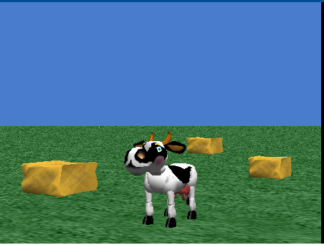
Alternate Game – Eat The Hay
Create a Game with a cow.
The arrow keys on the keyboard control the cow.
There are 3 bales of hay on the ground.
When the cow gets close to the bales they disappear.

Slide 5

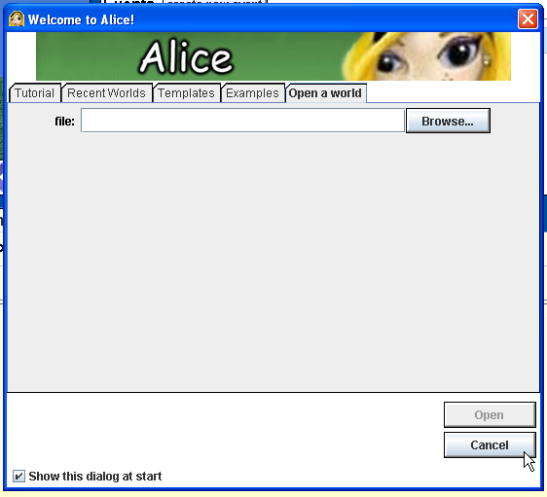
Start Alice
Double click on the Alice icon to start Alice
It may take a minute to start up
Cancel the opening dialog screen

Slide 6
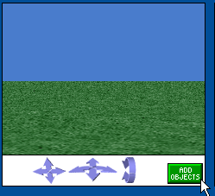
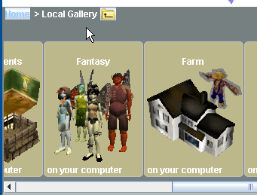
Build the Scene
Click on the add objects button at the bottom right of the scene
Scroll to the Farm category and clock on Farm

Slide 7
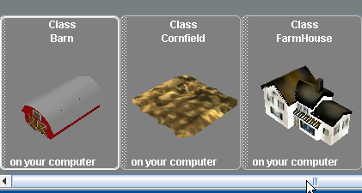
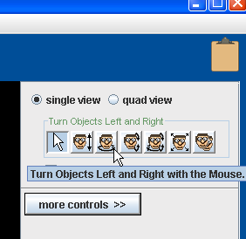
Add Hay to World
Click and drag 3 bales of hay into the scene
Once in the scene objects can be positioned with the mouse
Object can be rotated by selecting the proper option from the menu in the upper right
If you want to get rid of an object right click it and select delete

Slide 8
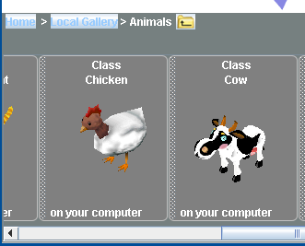
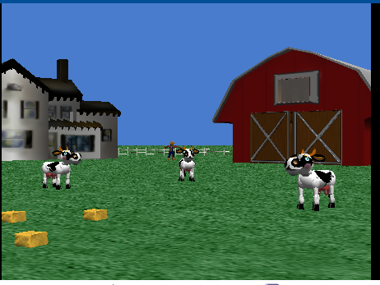
Add The Cow
Click on the Local Gallery to get back to the list of categories
Open the Animals Category
Scroll over to the Cow and add one to the world

Slide 9
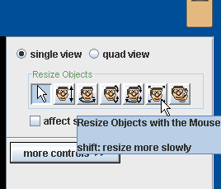
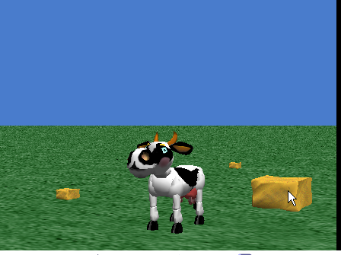
Make The Hay Bigger
Click on the resize objects button
Click on a bale of hay with the mouse.
Move the mouse up to make it bigger.
Make all 3 bigger

Slide 10
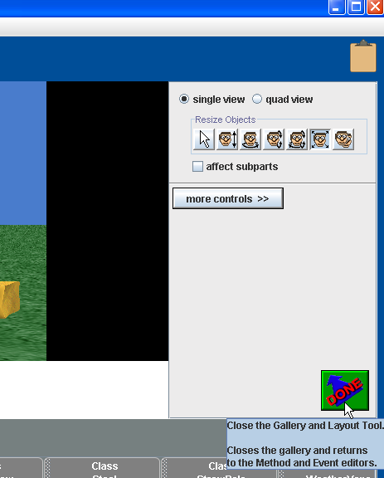
Exit Scene Editor
Click the Done Button

Slide 11
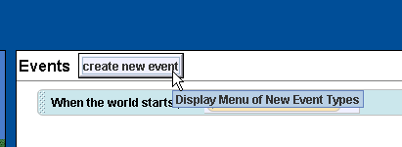
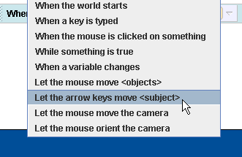
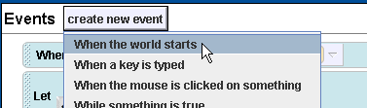
Add Events for Cow and Camera
Click the create new event button
Select the let the arrow keys move <subject> choice
Click the create new event button again.
Select the When the world starts choice.

Slide 12
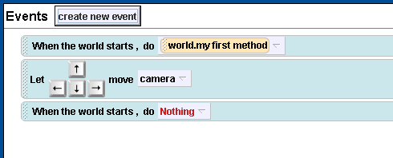
Events
Events should now look like this:

Slide 13

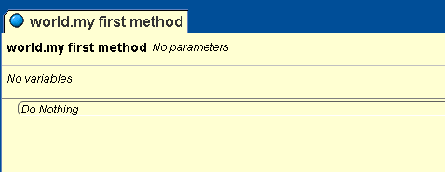
Write program for eating Hay
Drag a while icon from bottom of screen into the program.
While is on bottom of screen
Drag this to here pick true

Slide 14
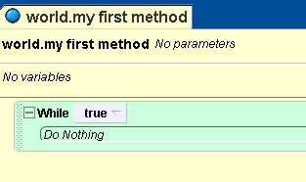
While Loop

Slide 15
Add 3 ifs
Drag 3 ifs from bottom into while loop.
Pick true

Slide 16
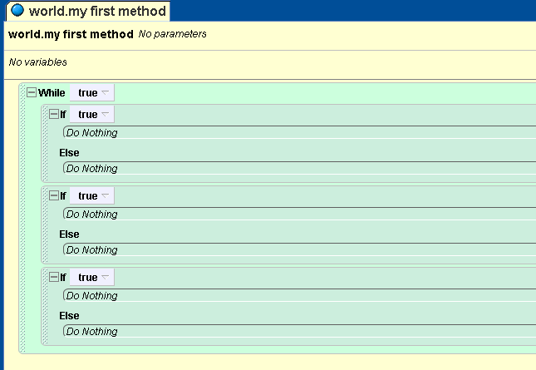
Program Looks Like This

Slide 17
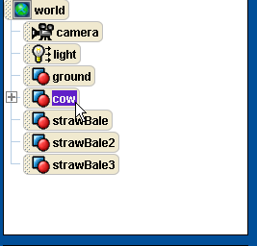
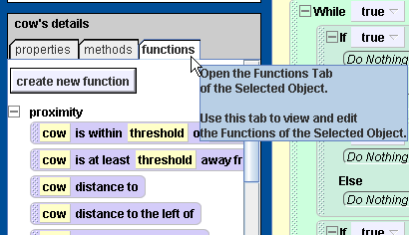
Pick the Cow
Click the cow in the object tree
Click the functions tab

Slide 18
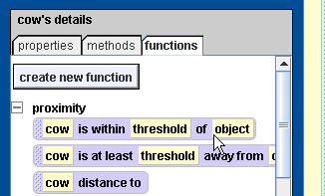
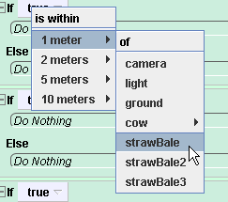
Drag into if
Click and drag the cow is within threshold of object icon to replace the true in the first if
When you drop icon select 1 meter and strawBale from list

Slide 19
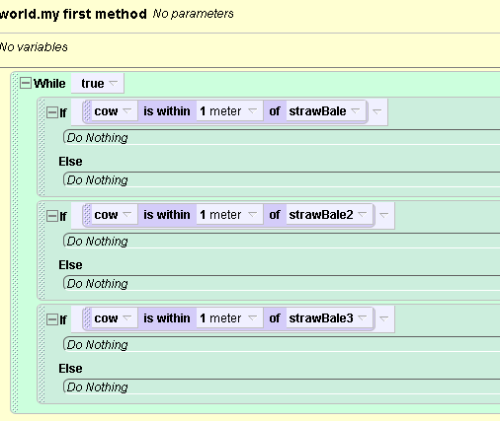
Complete ifs
Repeat for other 2 ifs but pick strawBale2 and strawBale3

Slide 20
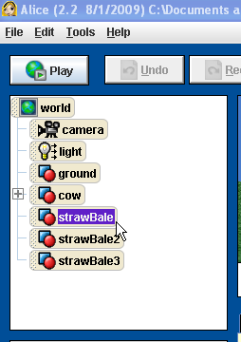
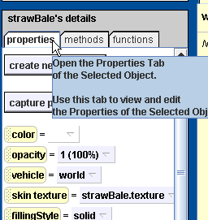
Make Hay Disappear
Click strawBale in object tree
Click the properties tab

Slide 21
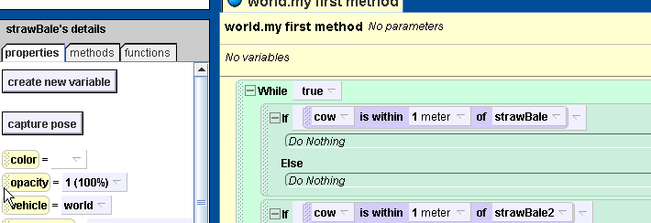
Make Hay Disappear
Click and Drag the opacity icon into the first if
Pick 0 (0%: invisible)

Slide 22
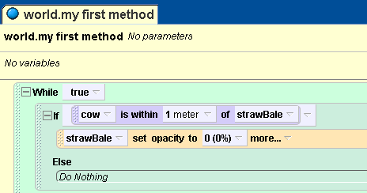
Result of Hay

Slide 23
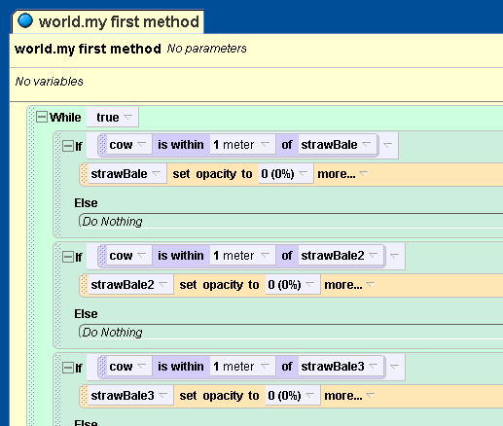
Repeat for other Hay
Do the same for the other 2 strawBales.
Select in Object tree, click and drag opacity icon, set to 0
Be sure to but strawBale2 into if for strawBale2

Slide 24
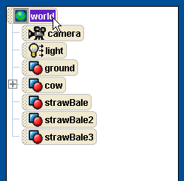
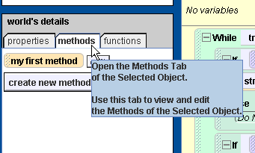
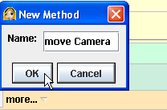
Create method for camera
Click on World in the object tree
Click on methods tab and then create new method button.
name method move camera

Slide 25
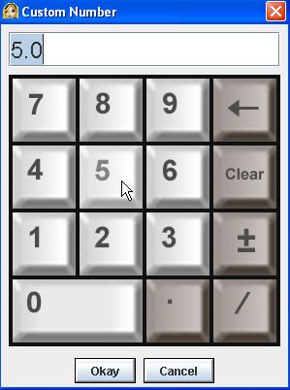
move Camera
click and drag while loop into move camera method
select true
click and drag wait icon from bottom into while loop
select other from the menu and enter 5 in the calculator and click okay

Slide 26
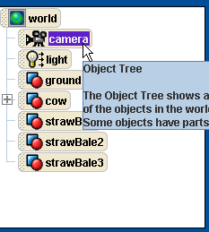
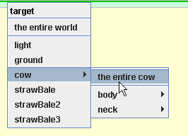
move camera
select camera in object tree
select the methods tab and scroll down
click and drag the camera turn to face command into the while loop after the wait
Select cow -> the entire cow from the menu

Slide 27
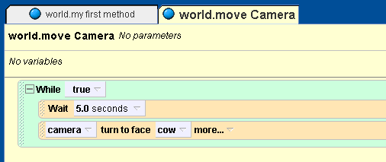
completed move camera

Slide 28
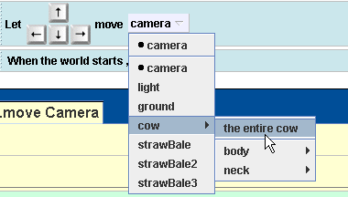
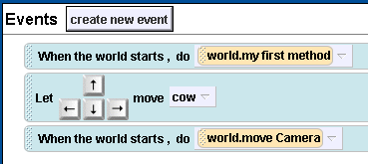
Set events
In the events click the camera in the let the arrow keys control event and change to the cow -> the entire cow
click the world in the object tree and then the methods tab
click and drag the move camera icon and replace the nothing event in the bottom when the world starts event

Slide 29
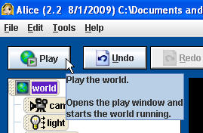
Final Events
Play!!!! Click the Play Button

Slide 30
Possible changes and additions
Make the hay bales move
Make the camera move towards the cow when it turns to face the cow
Change camera vehicle to cow
Add instructions
Add a message when player wins
Add more bales of hay or other objects
Play a sound when the bale is eaten

