Slide 1

Mechanisms for resource allocation
Shuchi Chawla
University of Wisconsin-Madison

Slide 2





Question: how to allocate scarce resources among multiple parties?
$$≡\$2$$
$$≡\$100$$
$$≡\$5$$
$$≡\$3$$
$$≡\$1000$$
What if participants can lie and subvert rules?
What if participants arrive over time and future demand is unknown?

Slide 3
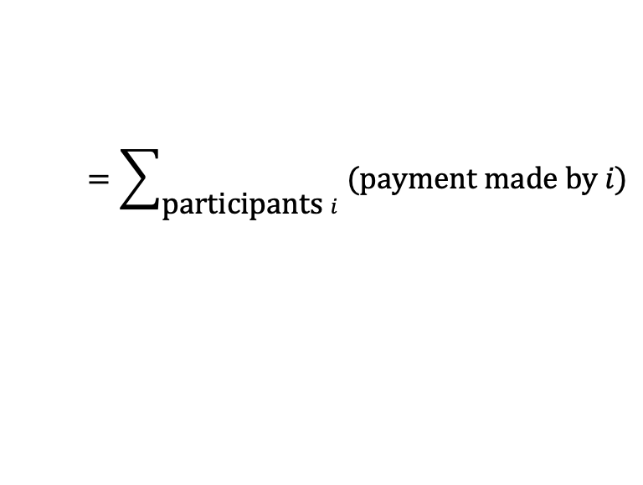

Objectives
Social welfare
Revenue
$$=\sum_{\text{p}\text{articipants} i}{\text{(}\text{value} i \text{gets} \text{from} \text{allocation}\text{)}}$$
$$=\sum_{\text{p}\text{articipants} i}{\text{(}\text{pay}\text{ment} \text{made} \text{by} i\text{)}}$$
Competitive analysis: compare against hindsight optimal allocation
Approximation: compare against revenue-optimal mechanism

Slide 4

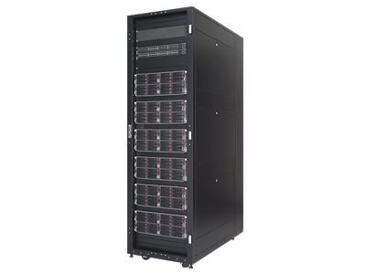

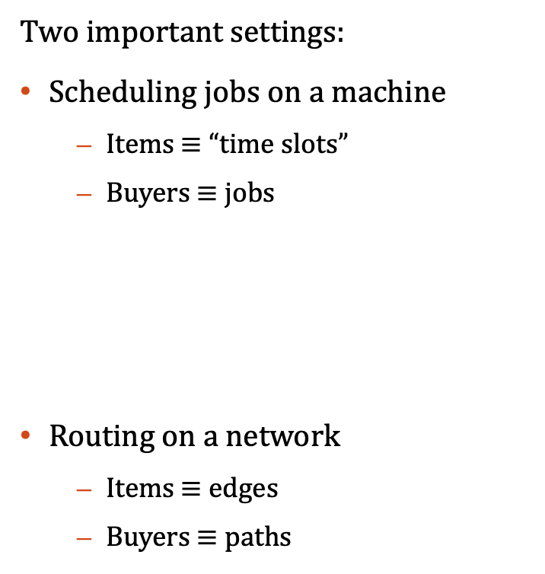
Some applications
Two important settings:
Scheduling jobs on a machine
  Items $≡$ “time slots”
  Buyers $≡$jobs
Routing on a network
  Items $≡$edges
  Buyers $≡$paths
Notes:
Resource allocation problems arise in many contexts, be it distributing computational resources between different processes, or Amazon EC2 instances among different customers’ jobs, or hotel rooms or taxi rides or plane tickets. These are classical problems, of course. What is different now is the scale and speed at which these transactions happen and the sophistication in allocation strategy that allows. A particularly revealing example of that scale and speed is the allocation of ad slots to advertisers on a search page or social network.

Slide 5


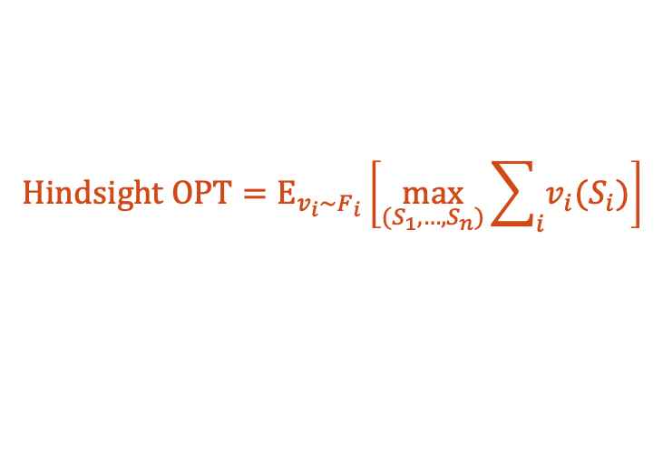
Assumptions
Buyers’ true values are unknown but their value distributions are known
Buyers arrive in an online fashion
Buyers can lie about their values and delay their arrival
Value function of buyer $i$: $v_{i}\sim F_{i}$.
$$Hind\text{sight} \text{OPT}={\text{E}}_{v_{i}\sim F_{i}}\left[\max_{(S_{1}, …, S_{n})}{\sum_{i}{v_{i}(S_{i})}}\right]$$
Adversarial order of arrival.
When buyer $i$ arrives, his identity and distribution are revealed.
Algorithm solicits values from buyers when they arrive.
Buyers are rational: maximize (value from alloc - payment)
We will think of truthful mechanisms as algorithms with structural constraints.

Slide 6
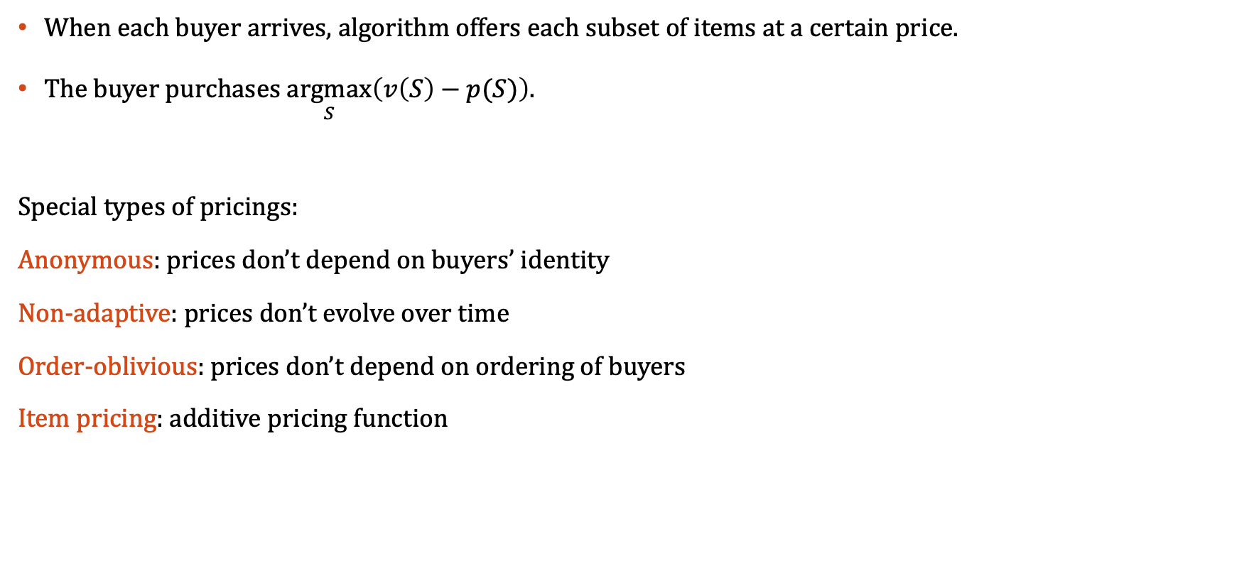
A simple class of algorithms: posted pricing
When each buyer arrives, algorithm offers each subset of items at a certain price.
The buyer purchases $\underset{S}{argmax}\left(v\left(S\right)−p(S)\right)$.
Special types of pricings:
Anonymous: prices don’t depend on buyers’ identity
Non-adaptive: prices don’t evolve over time
Order-oblivious: prices don’t depend on ordering of buyers
Item pricing: additive pricing function
Always truthful!
Static pricing

Slide 7
Some questions
How well does simple posted pricing approximate welfare/revenue?
Are there better (truthful) mechanisms?
Are there better (non-truthful) algorithms?
Can we optimize over the class of all pricings?

Slide 8
Maximizing social welfare
Key takeaway:
In many settings, static pricings are optimal-within-constant-factors across all online algorithms.

Slide 9
Outline
Why do prices perform well?
  A primal-dual view
  Issues with dual prices
Fix # 1: balanced prices
  Warm up: single item prophet inequality.
  Feldman-Gravin-Lucier generalization.
  Extension to scheduling & routing
Fix # 2: dual prices for large supply settings
  Warm up: single item with copies.
  Extension to scheduling
Summary of results; open questions

Slide 10
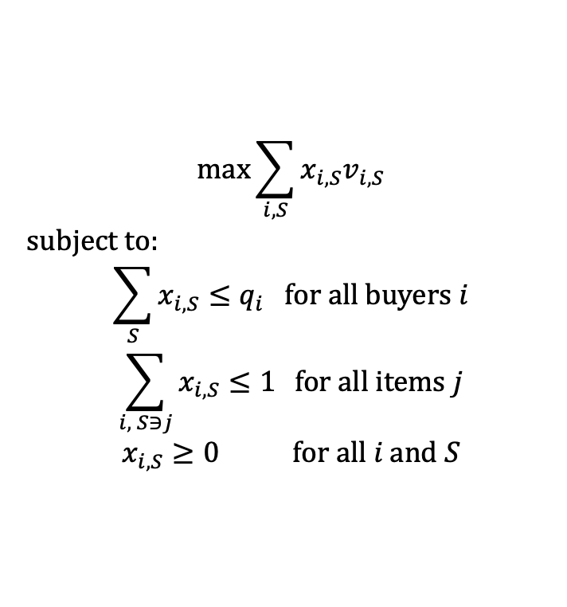

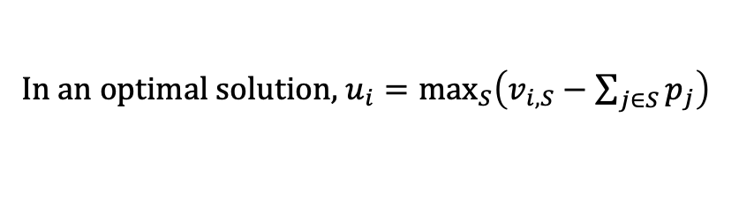
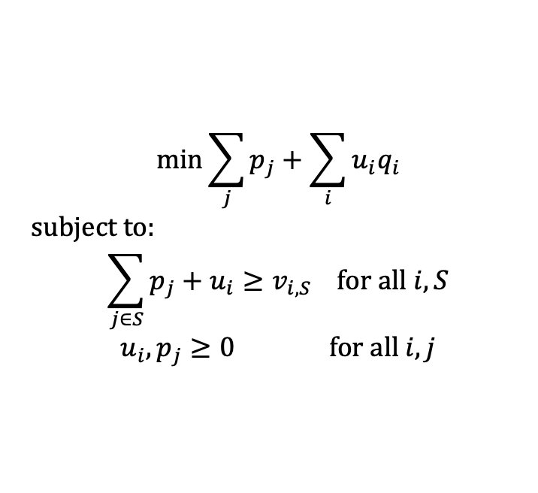
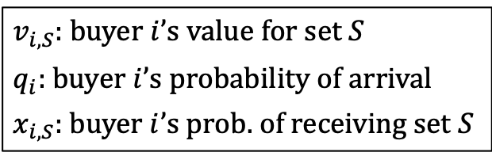
Approach # 1: Prices as dual variables
$v_{i,S}$: buyer $i$’s value for set $S$
$q_{i}$: buyer $i$’s probability of arrival
$x_{i,S}$: buyer $i$’s prob. of receiving set $S$
PRIMAL
DUAL
$$\max{\sum_{i,S}{x_{i,S}v_{i,S}}}$$
subject to:
$$\sum_{S}{x_{i,S}}≤q_{i} \text{for} \text{all} \text{buyers} i$$
$$\sum_{i, S∋j}{x_{i,S}≤1 } \text{for} \text{all} \text{items} j$$
$$x_{i,S}≥0 \text{for} \text{all} i \text{and} S$$
Seller’s revenue
Social Welfare
$$\min{\sum_{j}{p_{j}}+\sum_{i}{u_{i}q_{i}}}$$
subject to:
$$\sum_{j∈S}{p_{j}}+u_{i}≥v_{i,S} \text{for} \text{all} i,S$$
$$u_{i}, p_{j}≥0 \text{for} \text{all} i, j$$
Buyers’ utility
No overprovisioning
Demand $≤$ Supply
In an optimal solution, $u_{i}=\max_{S}\left(v_{i,S}−\sum_{j∈S}{p_{j}}\right)$
Complementary slackness implies $x_{i,S}>0$ iff $S$ is one of $i$’s favorite bundles under the pricing $p$.

Slide 11
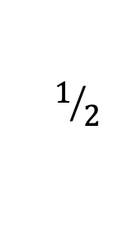





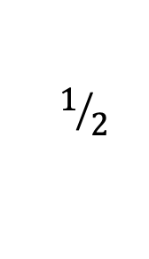

How good are dual prices?
Problem 1: dual prices are usually too low.
Problem 2: complementary slackness is not always useful due to the stochasticity of arrivals.
LP = $ϵ.\frac{1}{ε^{2}}+\left(1−ε\right).1≈1/ε$
Dual price = 1
OPT = $ϵ.\frac{1}{ε^{2}}+{\left(1−ε\right)}^{2}.1≈1/ε$
ALG $=\left(1−ε\right).1+ε^{2}.1/ε^{2} <2$
$$\text{value}=1$$
Prob. Arrival$=1−ε$
$$\text{value}=1/ε^{2}$$
Prob. Arrival$=ε$
$$1/2$$
$$1/2$$
Buyer shifts preferences based on availability
and has a new favorite set.
$$1$$

Slide 12


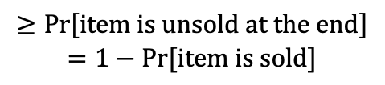

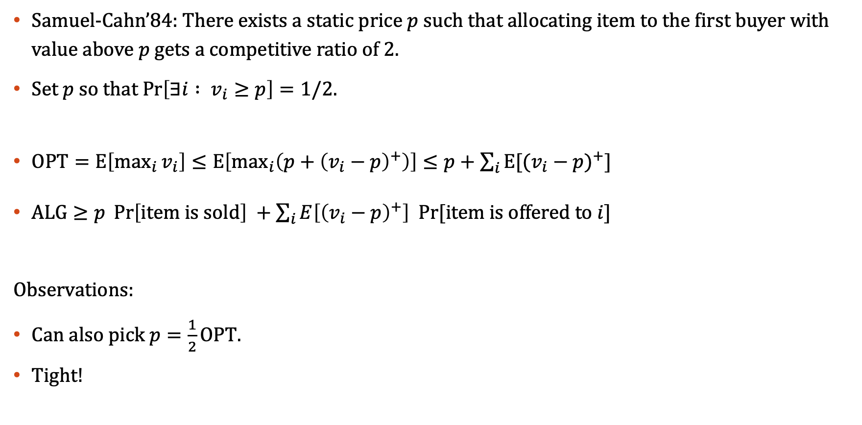

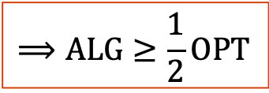


The single item prophet inequality
Samuel-Cahn’84: There exists a static price $p$ such that allocating item to the first buyer with value above $p$ gets a competitive ratio of 2.
Set $p$ so that $\operatorname{Pr}\left[∃i : v_{i}≥p\right]=1/2$.
$\text{OPT}=\text{E}\left[\max_{i}{v_{i}}\right]≤\text{E}\left[\max_{i}\left(p+{\left(v_{i}−p\right)}^{+}\right)\right]≤p+\sum_{i}{\text{E}[{(v_{i}−p)}^{+}]}$
$\text{ALG}≥p \operatorname{Pr}\left[\text{item} \text{is} \text{sold}\right] +\sum_{i}{E\left[{\left(v_{i}−p\right)}^{+}\right] Pr⁡[\text{item} \text{is} \text{offered} \text{to} i]}$
Observations:
Can also pick $p=\frac{1}{2}\text{OPT}$.
Tight!
$$⟹\text{ALG}≥\frac{1}{2}\text{OPT}$$
$$≥1/2$$
$$=1/2$$
$$≥\operatorname{Pr}\left[\text{item} \text{is} \text{unsold} \text{at} \text{the} \text{end}\right]$$
$$=1−Pr⁡[\text{item} \text{is} \text{sold}]$$
OPT = $ϵ.\frac{1}{ε}+\left(1−ε\right).1=2−ε$
$$\text{value}=1$$
Prob. Arrival$=1$
$$\text{value}=1/ε$$
Prob. Arrival$=ε$
ALG $=1$

Slide 13
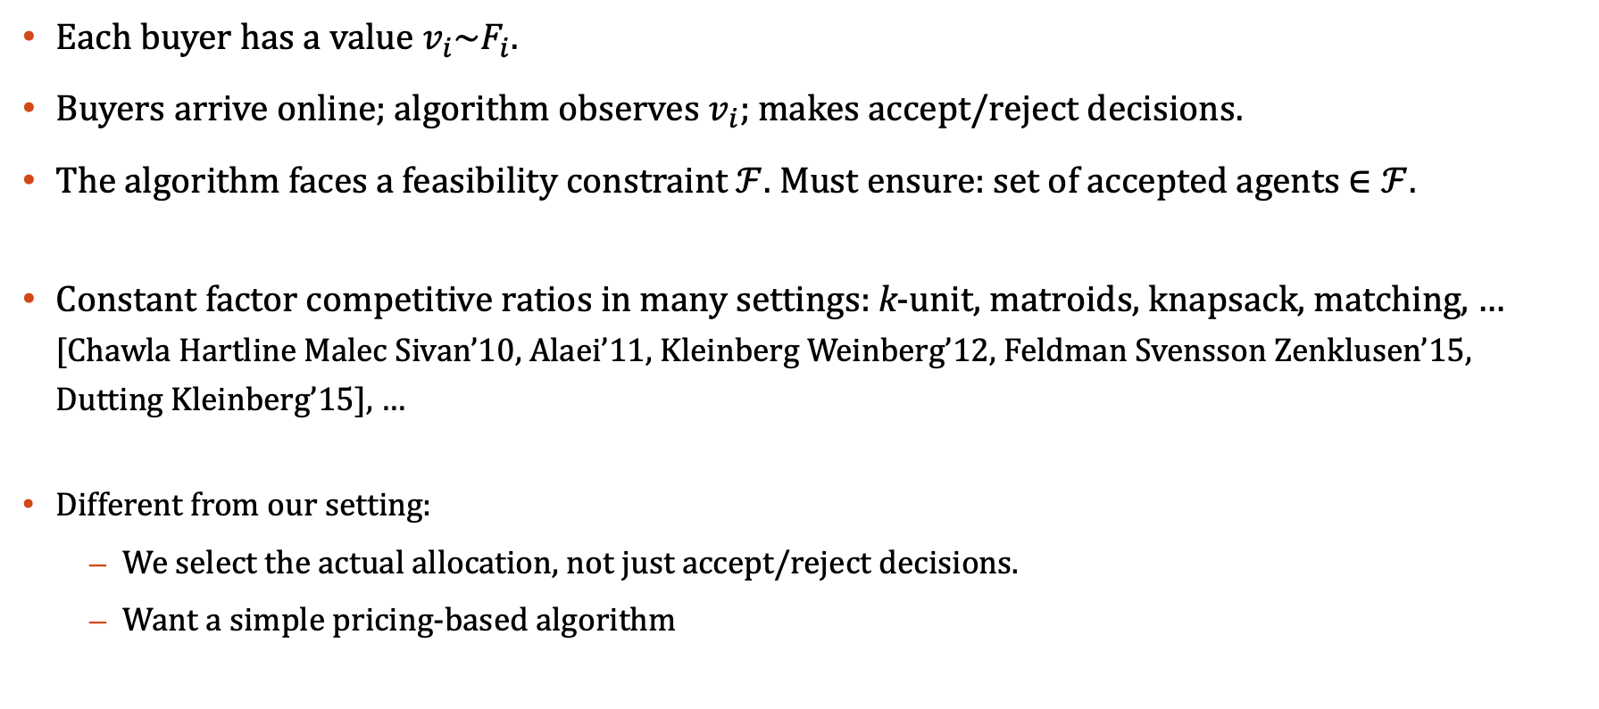
General (combinatorial) prophet inequalities
Each buyer has a value $v_{i}\sim F_{i}$.
Buyers arrive online; algorithm observes $v_{i}$; makes accept/reject decisions.
The algorithm faces a feasibility constraint $ℱ$. Must ensure: set of accepted agents $∈ℱ$.
Constant factor competitive ratios in many settings: k-unit, matroids, knapsack, matching, … [Chawla Hartline Malec Sivan’10, Alaei’11, Kleinberg Weinberg’12, Feldman Svensson Zenklusen’15, Dutting Kleinberg’15], …
Different from our setting:
  We select the actual allocation, not just accept/reject decisions.
  Want a simple pricing-based algorithm

Slide 14
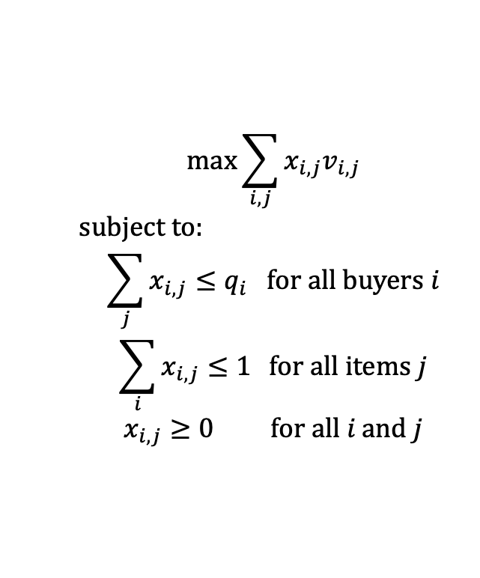
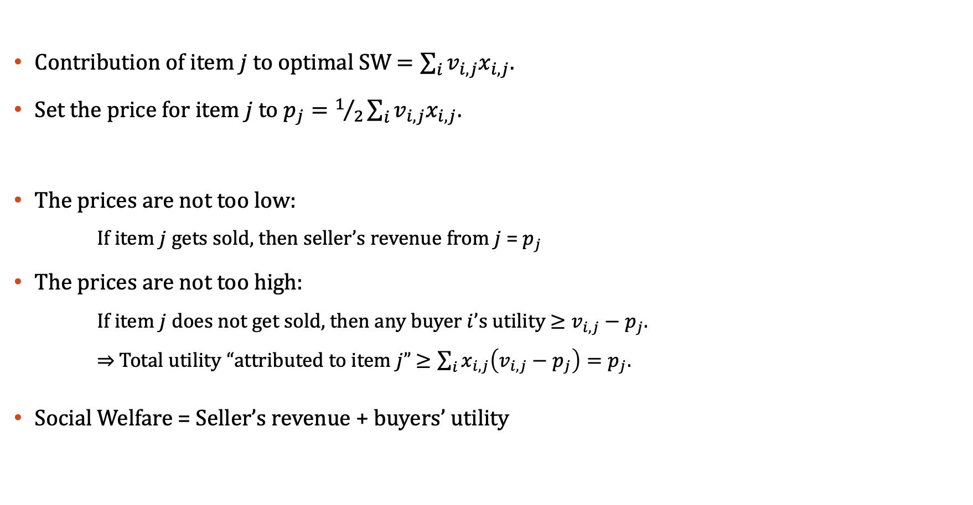
Approach # 2: balanced prices (for unit-demand buyers)
[Feldman Gravin Lucier’15]
[Kleinberg Weinberg’12]
Contribution of item $j$ to optimal SW $=\sum_{i}{v_{i,j}x_{i,j}}$.
Set the price for item $j$ to $p_{j}=1/2\sum_{i}{v_{i,j}x_{i,j}}$.
The prices are not too low:
If item $j$gets sold, then seller’s revenue from $j$ = $p_{j}$
The prices are not too high:
If item $j$ does not get sold, then any buyer $i$’s utility $≥v_{i,j}−p_{j}$.
$⇒$ Total utility “attributed to item $j$” $≥\sum_{i}{x_{i,j}\left(v_{i,j}−p_{j}\right)}=p_{j}$.
Social Welfare = Seller’s revenue + buyers’ utility
$$\max{\sum_{i,j}{x_{i,j}v_{i,j}}}$$
subject to:
$$\sum_{j}{x_{i,j}}≤q_{i} \text{for} \text{all} \text{buyers} i$$
$$\sum_{i}{x_{i,j}≤1 } \text{for} \text{all} \text{items} j$$
$$x_{i,j}≥0 \text{for} \text{all} i \text{and} j$$

Slide 15
Approach # 2: balanced prices
[Feldman Gravin Lucier’15]
[Dutting Feldman Kesselheim Lucier’17]
Type of value function | Competitive ratio | Lower bound
Unit-demand or additive | 2 | 2
XOS (max over additive functions) | 2 | 2
MPH-L | 4L-2 | L

Slide 16

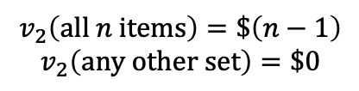

Limitations of balanced item prices
Poor approximation when values have complementarities
Any static item pricing must price every item at $>1$ to exclude buyer 1 but then also excludes buyer 2.
$$v_{1}\left(\text{any} \text{single} \text{item}\right)=\$1$$
$$v_{2}\left(\text{all} n \text{items}\right)=\$\left(n−1\right)$$
$$v_{2}\left(\text{any} \text{other} \text{set}\right)=\$0$$
OPT $=n−1$; ALG = 1

Slide 17
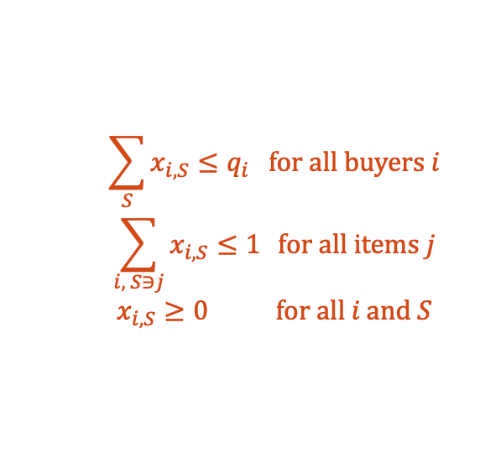
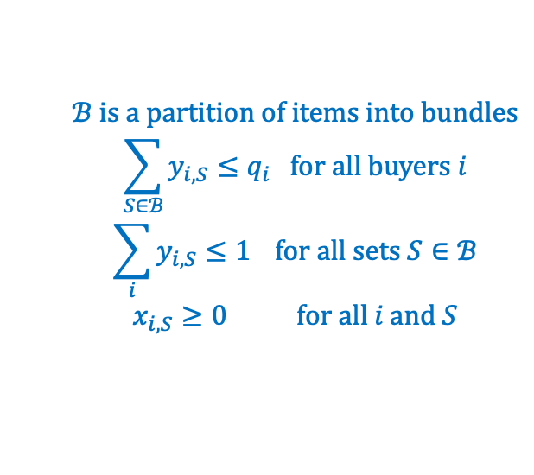
Approach # 3: Balanced bundle prices
[Chawla Miller Teng’19]
Key idea: partition items into bundles and pretend each buyer is unit-demand over the bundles. Then leverage FGL’s balanced pricing approach.
A fractional unit allocation is:
A partition of items into bundles
A fractional matching from buyers to bundles
Original fractional solution
$$\sum_{S}{x_{i,S}}≤q_{i} \text{for} \text{all} \text{buyers} i$$
$$\sum_{i, S∋j}{x_{i,S}≤1 } \text{for} \text{all} \text{items} j$$
$$x_{i,S}≥0 \text{for} \text{all} i \text{and} S$$
Fractional unit allocation
$$ℬ \text{is} \text{a} \text{partition} \text{of} \text{items} \text{into} \text{bundles}$$
$$\sum_{S∈ℬ}{y_{i,S}}≤q_{i} \text{for} \text{all} \text{buyers} i$$
$$\sum_{i}{y_{i,S}≤1 } \text{for} \text{all} \text{sets} S∈ℬ$$
$$x_{i,S}≥0 \text{for} \text{all} i \text{and} S$$

Slide 18
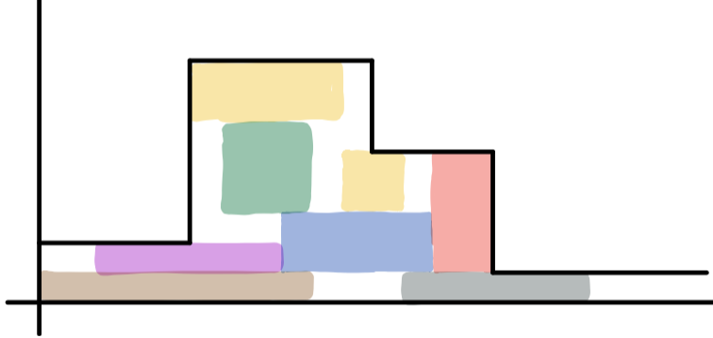
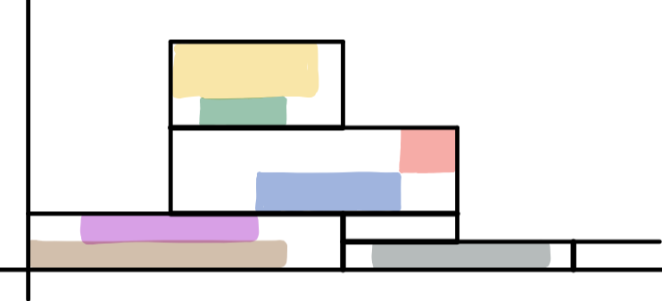
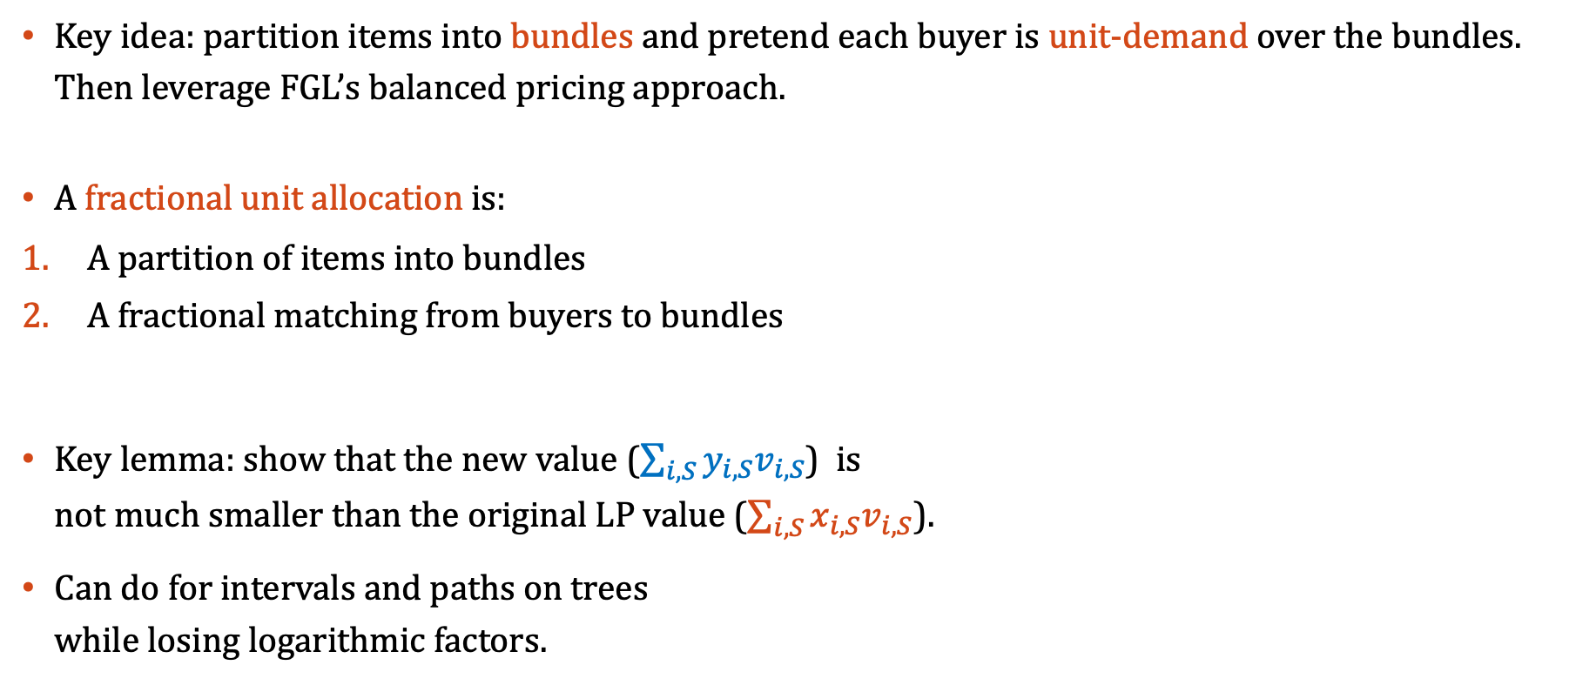
Approach # 3: Balanced bundle prices
[Chawla Miller Teng’19]
Key idea: partition items into bundles and pretend each buyer is unit-demand over the bundles. Then leverage FGL’s balanced pricing approach.
A fractional unit allocation is:
A partition of items into bundles
A fractional matching from buyers to bundles
Key lemma: show that the new value ($\sum_{i,S}{y_{i,S}v_{i,S}}$) is not much smaller than the original LP value ($\sum_{i,S}{x_{i,S}v_{i,S}}$).
Can do for intervals and paths on trees while losing logarithmic factors.
Original fractional solution
Fractional unit allocation

Slide 19
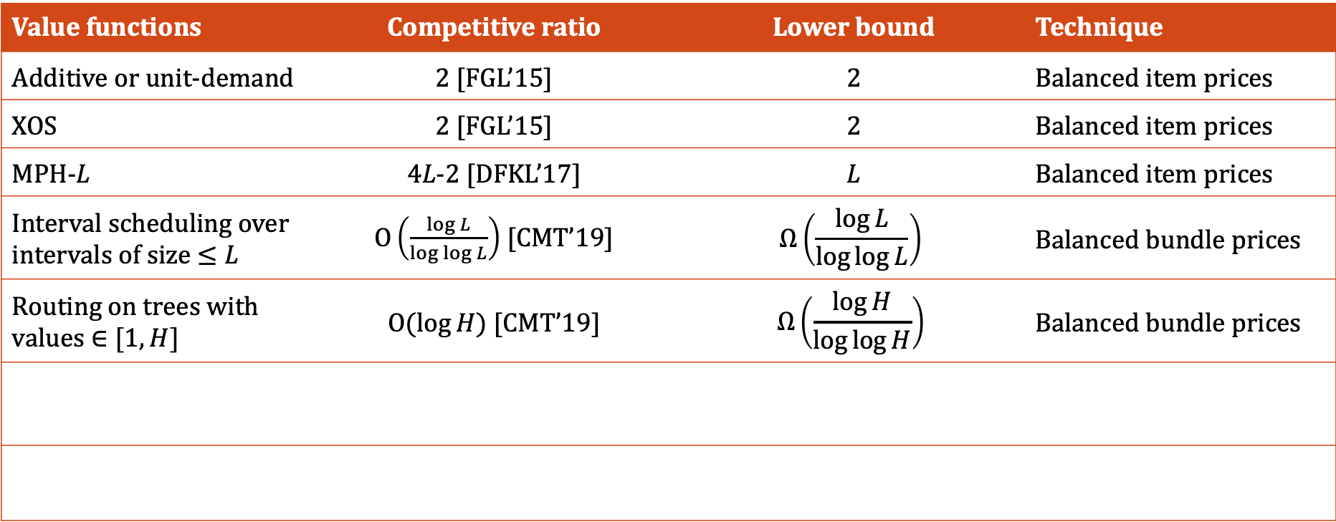
Approaches #2 & #3: Balanced item and bundle prices
Value functions | Competitive ratio | Lower bound | Technique
Additive or unit-demand | 2 [FGL’15] | 2 | Balanced item prices
XOS | 2 [FGL’15] | 2 | Balanced item prices
MPH-L | 4L-2 [DFKL’17] | L | Balanced item prices
Interval scheduling over intervals of size $≤L$ | $\text{O}\left(\frac{\log{L}}{\log{\log{L}}}\right)$ [CMT’19] | $$Ω\left(\frac{\log{L}}{\log{\log{L}}}\right)$$ | Balanced bundle prices
Routing on trees with values $∈[1,H]$ | $\text{O}(\log{H})$ [CMT’19] | $$Ω\left(\frac{\log{H}}{\log{\log{H}}}\right)$$ | Balanced bundle prices

Slide 20
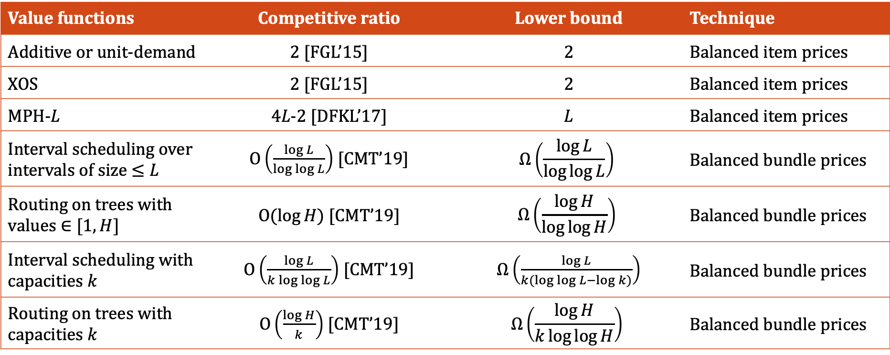
Approaches #2 & #3: Balanced item and bundle prices
Value functions | Competitive ratio | Lower bound | Technique
Additive or unit-demand | 2 [FGL’15] | 2 | Balanced item prices
XOS | 2 [FGL’15] | 2 | Balanced item prices
MPH-L | 4L-2 [DFKL’17] | L | Balanced item prices
Interval scheduling over intervals of size $≤L$ | $\text{O}\left(\frac{\log{L}}{\log{\log{L}}}\right)$ [CMT’19] | $$Ω\left(\frac{\log{L}}{\log{\log{L}}}\right)$$ | Balanced bundle prices
Routing on trees with values $∈[1,H]$ | $\text{O}(\log{H})$ [CMT’19] | $$Ω\left(\frac{\log{H}}{\log{\log{H}}}\right)$$ | Balanced bundle prices
Interval scheduling with capacities $k$ | $\text{O}\left(\frac{\log{L}}{k\log{\log{L}}}\right)$ [CMT’19] | $Ω\left(\frac{\log{L}}{k(\log{\log{L}−\log{k}})}\right)$ | Balanced bundle prices
Routing on trees with capacities $k$ | $\text{O}\left(\frac{\log{H}}{k}\right)$ [CMT’19] | $$Ω\left(\frac{\log{H}}{k\log{\log{H}}}\right)$$ | Balanced bundle prices

Slide 21
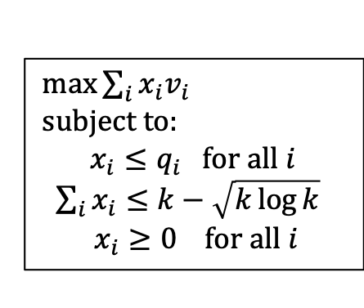
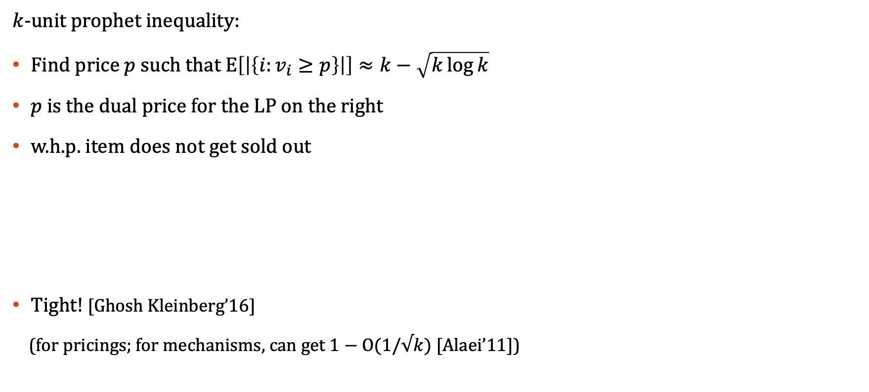
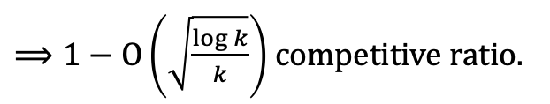
Can we beat the 2 in large supply settings?
$k$-unit prophet inequality:
Find price $p$ such that $E\left[\left|\left\{i:v_{i}≥p\right\}\right|\right]≈k−\sqrt{k\log{k}}$
$p$ is the dual price for the LP on the right
w.h.p. item does not get sold out
Tight! [Ghosh Kleinberg’16]
(for pricings; for mechanisms, can get $1−\text{O}(1/√k)$ [Alaei’11])
[Hajiaghayi Kleinberg Sandholm’07]
$\max{\sum_{i}{x_{i}v_{i}}}$
subject to:
$$x_{i}≤q_{i} \text{for} \text{all} i$$
$\sum_{i}{x_{i}}≤k−\sqrt{k\log{k}}$
$$x_{i}≥0 \text{for} \text{all} i$$
$⟹1−\text{O}\left(\sqrt{\frac{\log{k}}{k}}\right)$ competitive ratio.

Slide 22

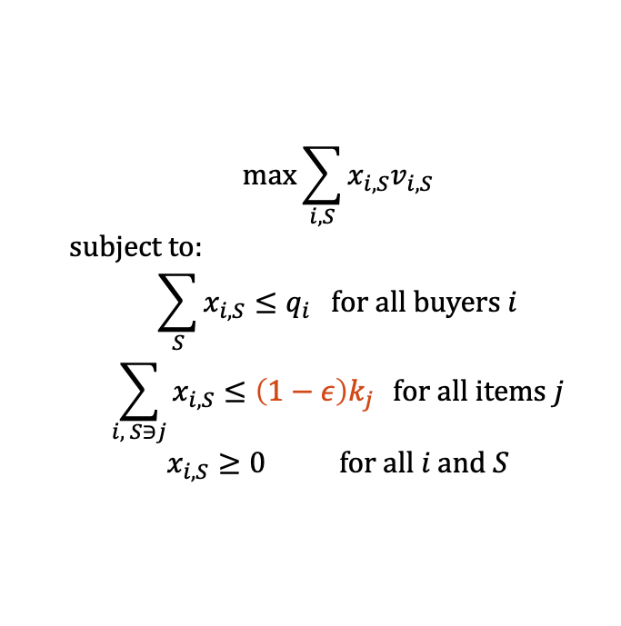
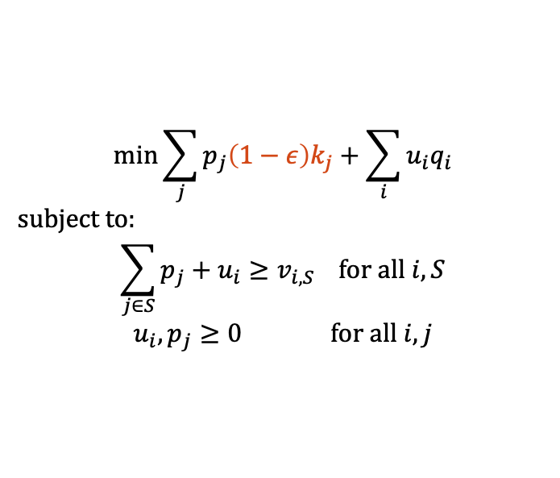
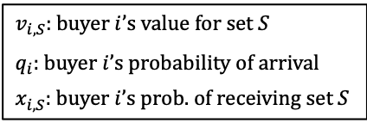
Approach # 4: Dual prices for large supply interval scheduling
Assumptions:
Each job has a fixed length; value.
Wants to get scheduled within a certain time window.
Supply at any time $t$ is at least $k$
$v_{i,S}$: buyer $i$’s value for set $S$
$q_{i}$: buyer $i$’s probability of arrival
$x_{i,S}$: buyer $i$’s prob. of receiving set $S$
PRIMAL
DUAL
$$\max{\sum_{i,S}{x_{i,S}v_{i,S}}}$$
subject to:
$$\sum_{S}{x_{i,S}}≤q_{i} \text{for} \text{all} \text{buyers} i$$
$$\sum_{i, S∋j}{x_{i,S}≤\left(1−ε\right)k_{j} } \text{for} \text{all} \text{items} j$$
$$x_{i,S}≥0 \text{for} \text{all} i \text{and} S$$
$$\min{\sum_{j}{p_{j}\left(1−ε\right)k_{j}}+\sum_{i}{u_{i}q_{i}}}$$
subject to:
$$\sum_{j∈S}{p_{j}}+u_{i}≥v_{i,S} \text{for} \text{all} i,S$$
$$u_{i}, p_{j}≥0 \text{for} \text{all} i, j$$

Slide 23




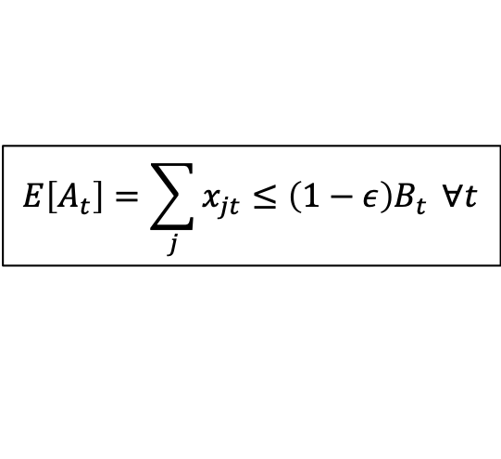


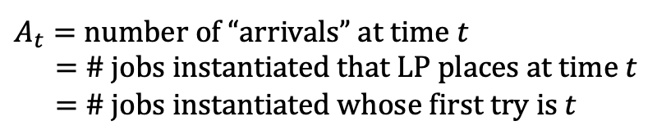
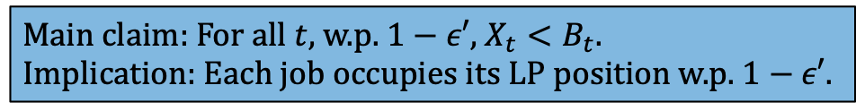

Approach # 4: Dual prices for large supply interval scheduling
$${ t}_{1}$$
Supply
$${ t}_{2}$$
$${ t}_{3}$$
Prices
5
2
8
5
1
5
$${ t}_{4}$$
$$v=6$$
$$v=9$$
$A_{t}=$ number of “arrivals” at time $t$
$=$ # jobs instantiated that LP places at time $t$
$=$ # jobs instantiated whose first try is $t$
$$E\left[A_{t}\right]=\sum_{j}{x_{jt}≤\left(1−ε\right)B_{t}} ∀t$$
Main claim: For all $t,$ w.p. $1−ε′$, $X_{t}<B_{t}$.
Implication: Each job occupies its LP position w.p. $1−ε′$.
$$⇒\text{w}\text{.}\text{p}\text{. }1−ε, A_{t}<B_{t}$$
$X_{t}=$ number of jobs that ever try $t$ $=$ arrivals + “forwards”
Want $X_{t}<B_{t} \text{w}\text{.}\text{h}\text{.}\text{p}\text{.}$; Problem: bad events are correlated across $t$.

Slide 24


Dual prices: bounding the failure probabilities on a forwarding graph
$$⟹$$
$$⟹$$
The forwarding graph
Instantiation of buyers;
forwarding paths
Consider all possible forwarding subtrees of G. The load in picture 2 can be bounded by the load in one of these subtrees.

Slide 25
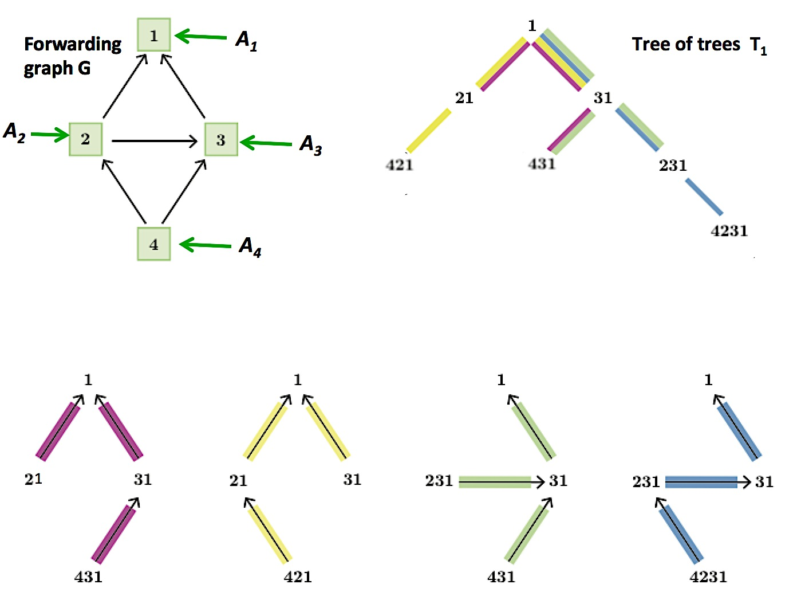
Dual prices: combining subtrees into one tree
( )
Worst case
Tree networks permit an inductive analysis. Failure probabilities depend on the in-degrees of nodes.

Slide 26

Approach # 4: Dual prices for large supply interval scheduling
[Chawla Devanur Holroyd Karlin Martin Sivan ’17]
There exist a price schedule such that if jobs are unit length^{(*)}, and,
$$k_{j}≥Ω\left(\frac{1}{ε^{2}}\log{\frac{1}{ε}}\right) \text{for} \text{all} j$$
Then the expected social welfare achieved is at least $\left(1−ε\right)$ times the Hindsight-OPT.
(*) Need $k_{j}≥Ω\left(\frac{L^{6}}{ε^{3}}\log{\frac{1}{ε}}\right)$ when jobs are of length up to $L$.

Slide 27
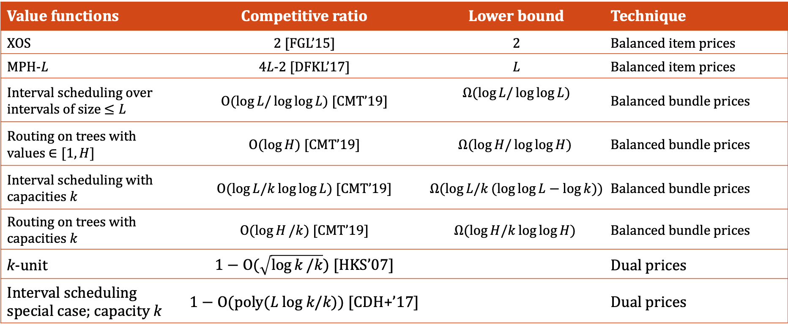
Approaches #2, #3, & #4: Balanced prices and dual prices
Value functions | Competitive ratio | Lower bound | Technique
XOS | 2 [FGL’15] | 2 | Balanced item prices
MPH-L | 4L-2 [DFKL’17] | L | Balanced item prices
Interval scheduling over intervals of size $≤L$ | $\text{O}(\log{L/\log{\log{L}}})$ [CMT’19] | $$Ω(\log{L/\log{\log{L}}})$$ | Balanced bundle prices
Routing on trees with values $∈[1,H]$ | $\text{O}(\log{H})$ [CMT’19] | $$Ω(\log{H/\log{\log{H}}})$$ | Balanced bundle prices
Interval scheduling with capacities $k$ | $\text{O}(\log{L/k\log{\log{L}}})$ [CMT’19] | $Ω(\log{L/k(log{\log{L−\log{k)}}}})$ | Balanced bundle prices
Routing on trees with capacities $k$ | $\text{O}(\log{H}/k)$ [CMT’19] | $$Ω(\log{H/k\log{\log{H}}})$$ | Balanced bundle prices
k-unit | $1−\text{O}\text{(}\sqrt{\log{k}/k}\text{)}$ [HKS’07] |  | Dual prices
Interval scheduling special case; capacity k | $1−\text{O}\text{(}\text{poly}\text{(}L \text{log} k\text{/}k\text{))}$ [CDH+’17] |  | Dual prices

Slide 28
Some open directions
Beat the factor of 2 for unit-demand with large supply?
Beat the factor of 2 for subadditive values with large supply?
Routing on general graphs?
General valuations on small sets?
  LP is too weak
Why do static prices perform so well?

Slide 29
Revenue maximization: a different story
Key takeaways:
Necessarily need non-anonymous mechanisms
Need to price random allocations
Even single-buyer setting is challenging

Slide 30





Revenue maximization: a different story
$$≡\$2$$
$$≡\$1$$
Simplest set-up: one buyer; two items
Optimal mechanism can be complicated:
Offers random allocations, a.k.a. lotteries [Thannasoulis’05]
Can have infinitely many options! [Hart Nisan’13]
Every near-optimal solution may be complicated
No finite menu can provide a finite approximation!
[Briest C. Kleinberg Weinberg’10, Hart Nisan’13]
$$v\sim F$$
$$⋯\$1$$
$⋯\$$3
$$⋯\$2$$

Slide 31


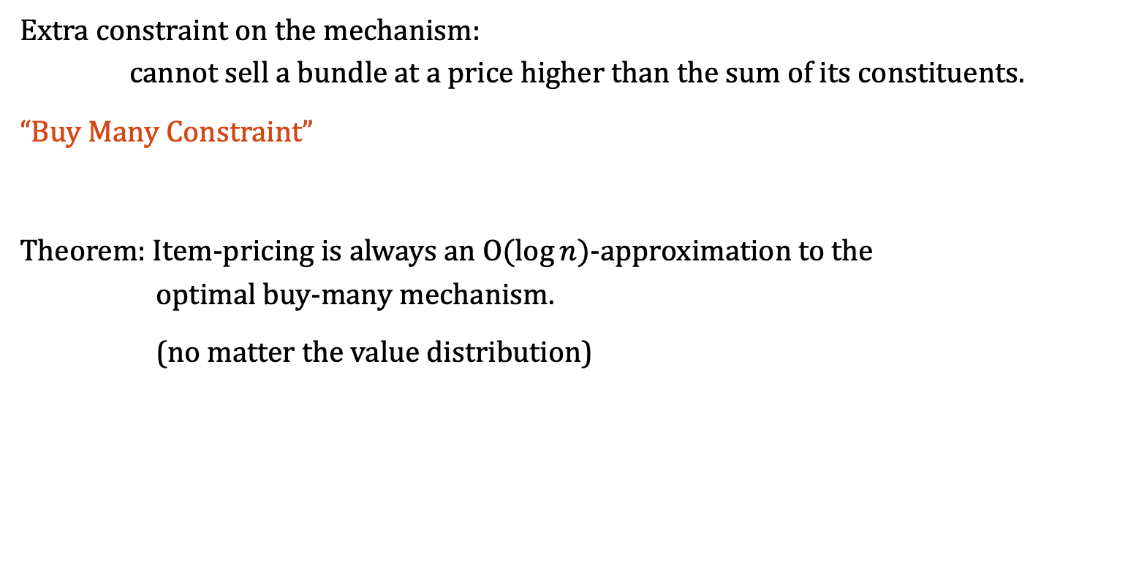


Revenue maximization: take two
[Chawla Teng Tzamos ’19]
Extra constraint on the mechanism: cannot sell a bundle at a price higher than the sum of its constituents.
“Buy Many Constraint”
Theorem: Item-pricing is always an $\text{O}(\log{n})$-approximation to the optimal buy-many mechanism.
(no matter the value distribution)
$$⋯\$1$$
$$⋯\$1$$
$$⋯\$3$$
$n=$ number of items

Slide 32
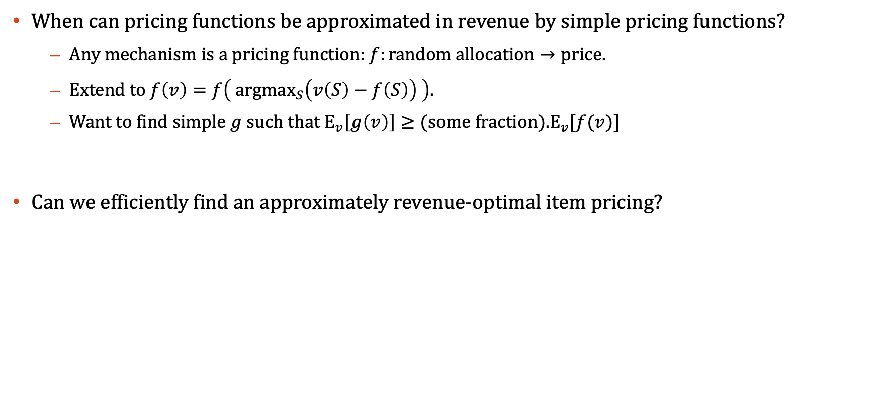
Some open directions
When can pricing functions be approximated in revenue by simple pricing functions?
  Any mechanism is a pricing function: $f:\text{random} \text{allocation}→\text{price}$.
  Extend to $f\left(v\right)=f\left( \text{argma}{\text{x}}_{S}\left(v\left(S\right)−f\left(S\right)\right) \right)$.
  Want to find simple $g$such that ${\text{E}}_{v}\left[g\left(v\right)\right]≥\text{(}\text{some} \text{fraction}\text{).} {\text{E}}_{v}[f(v)]$
Can we efficiently find an approximately revenue-optimal item pricing?

Slide 33
Pricing as a parameterized greedy algorithm
Can prices be used to simplify algorithm design in non-strategic settings?
Optimal prices depend on the instance – but can potentially be learned!

Slide 34
Acknowledgements
Buy-many mechanisms are not much better than item pricing.
C., Teng, and Tzamos. EC’19.
Posted pricing for online resource allocation: intervals and paths.
C., Miller, and Teng. SODA’19.
Stability of service under time-of-use pricing.
C., Devanur, Holroyd, Karlin, Martin, and Sivan. STOC’17.
Truth and regret in online scheduling.
C., Devanur, Kulkarni, and Niazadeh. EC’17.

Slide 35
Thanks for listening!

