Slide 1


Optimization with Costly Information: a survey
Shuchi Chawla

Slide 2

Shopping for a car…
Many possible choices…
A possible “solution”:
Pick top 5 cars based on ratings
Read reviews; shortlist 2 out of 5
Test drive the two
If you like one, negotiate with a dealer Else go back to step 1
Repeat until a choice is made
Many possible actions for each
Read reviews
Test drive
Negotiate with a dealer
…
Goal: to select the best option without expending too much time/effort
Many settings involve costly information acquisition before optimization …
Hiring: read resumes and letters, interview candidates before making offers
Procurement: evaluate suppliers before awarding contracts
Data-driven advertising: run experiments before allocating budget
…

Slide 3
Information can be expensive
Key Question: when should an algorithm pay to learn more?
How is this different from standard stochastic optimization?
Stochastic/online optimization: algorithm observes information for free in a fixed order; or makes decisions without observing it
This setting: whether to obtain information is itself a decision variable
Why is this challenging?
Task dependence: what is worth learning depends on the downstream objective
Adaptivity: what we learn changes what and how we should inspect next

Slide 4
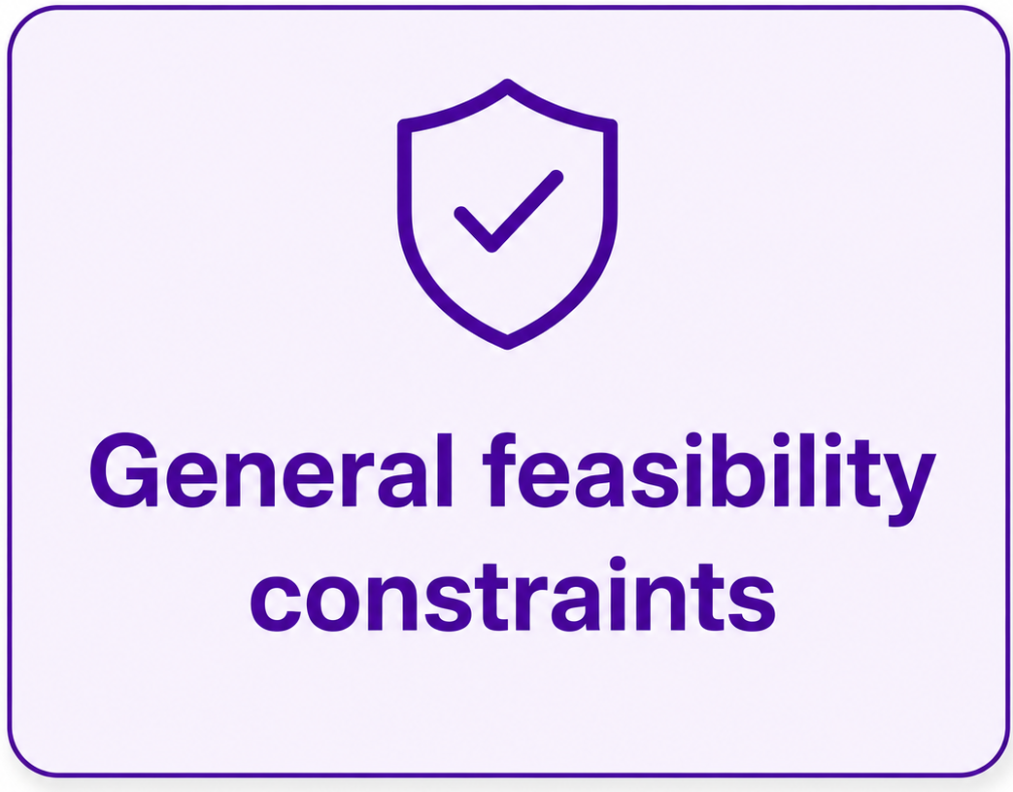
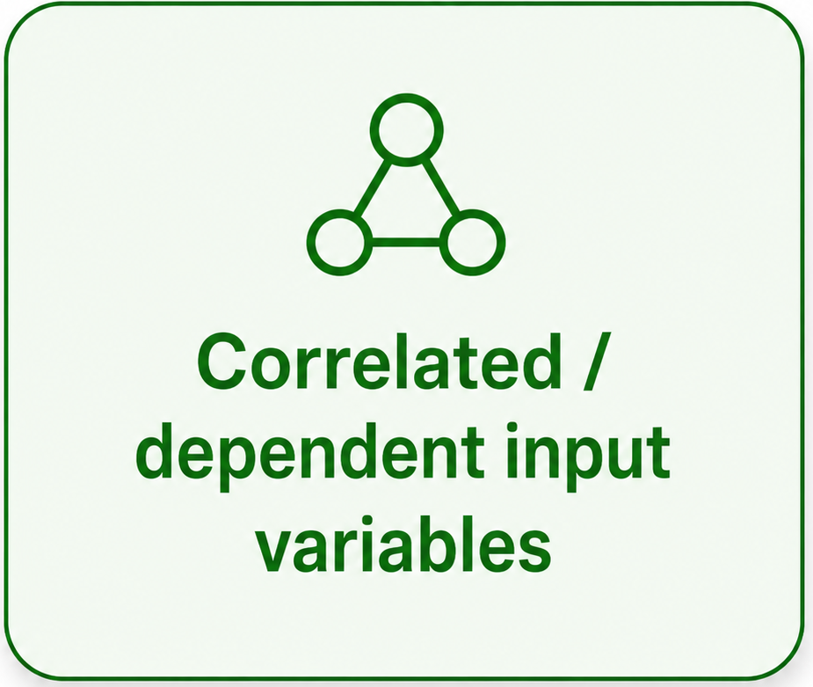
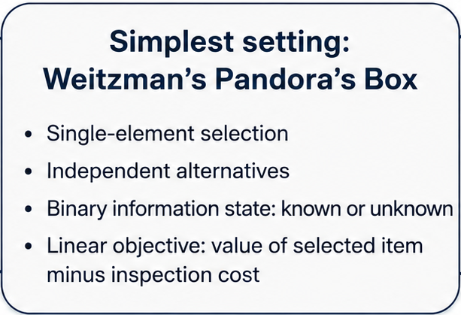
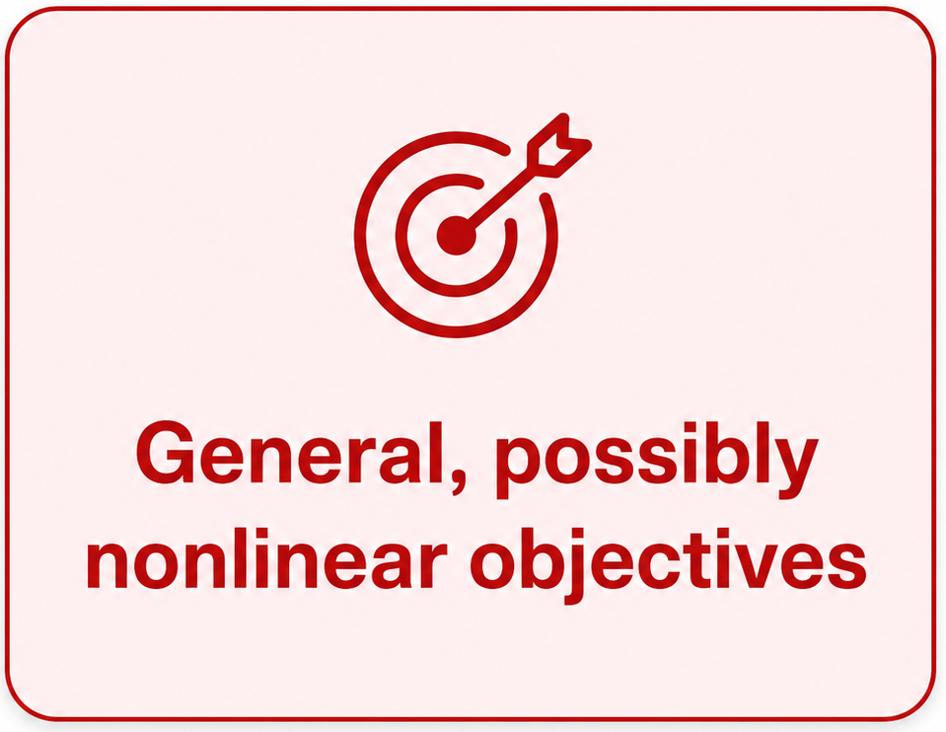
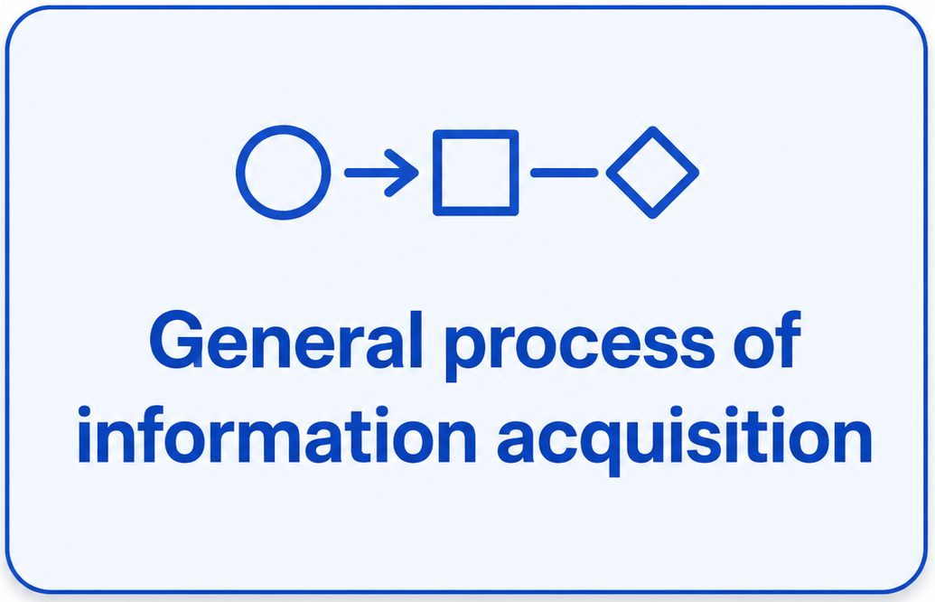
Three components of a costly information problem:
Downstream optimization task
Model of information revelation
Objective function:
value of solution – cost of info acquisition

Slide 5
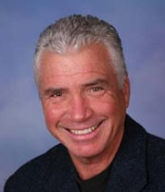




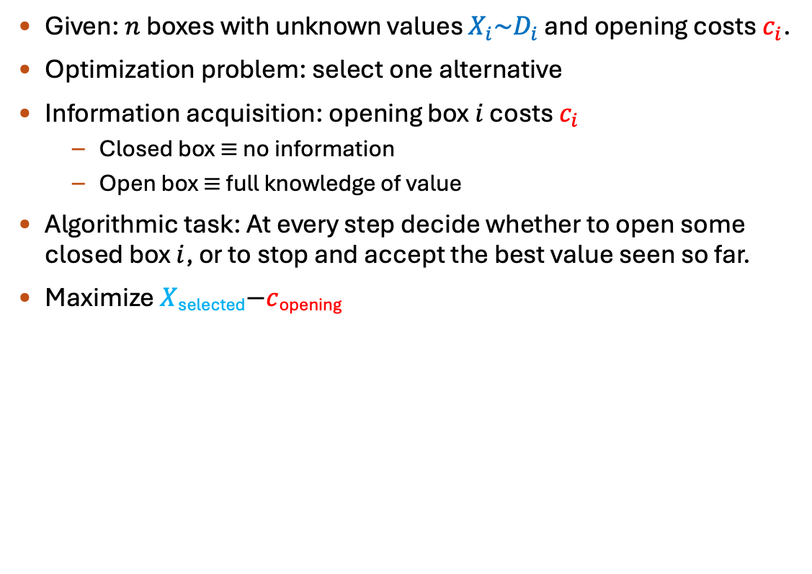




Classical special case: Weitzman’s Pandora’s Box [1979]
Given: $n$ boxes with unknown values $X_{i}\sim D_{i}$ and opening costs $c_{i}$.
Optimization problem: select one alternative
Information acquisition: opening box $i$ costs $c_{i}$
  Closed box $≡$ no information
  Open box $≡$ full knowledge of value
Algorithmic task: At every step decide whether to open some closed box $i$, or to stop and accept the best value seen so far.
Maximize $X$_{selected}$−c$_{opening}
Start
Open box
Cost $c_{i}$
…
Accept
value $x_{ij}$
$$X_{1}, c_{1}$$
$$X_{2}, c_{2}$$
$$X_{3}, c_{3}$$
…
$$X_{n}, c_{n}$$
$$x_{2}=4$$
$$x_{3}=1$$

Slide 6




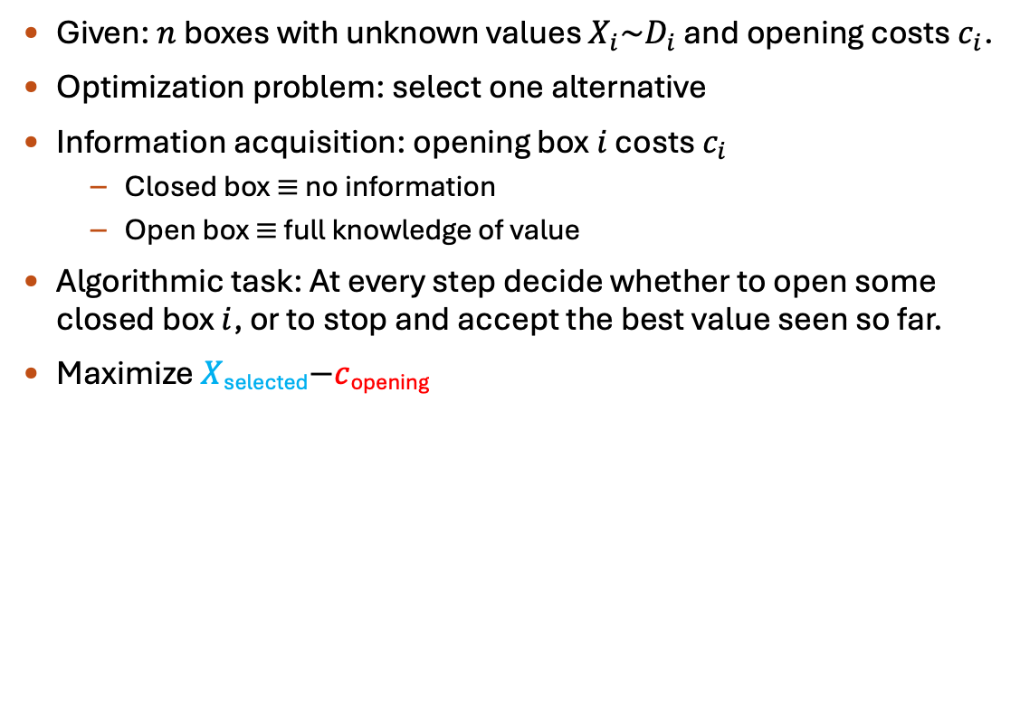






Classical special case: Weitzman’s Pandora’s Box [1979]
Given: $n$ boxes with unknown values $X_{i}\sim D_{i}$ and opening costs $c_{i}$.
Optimization problem: select one alternative
Information acquisition: opening box $i$ costs $c_{i}$
  Closed box $≡$ no information
  Open box $≡$ full knowledge of value
Algorithmic task: At every step decide whether to open some closed box $i$, or to stop and accept the best value seen so far.
Maximize $X$_{selected}$−c$_{opening}
$$g_{1}$$
Start
Open box
Cost $c_{i}$
$$x_{3}$$
$$g_{2}$$
$$g_{3}$$
…
$$x_{1}$$
Weitzman’s algorithm: index-based policy
Compute the “Gittins index” $g_{i}$ of every box
Open boxes in decreasing order of index
Until we find a value larger than all remaining indices
Stop and return the largest value
$$g_{4}$$
Accept
value $x_{ij}$
$$g_{5}$$
$$x_{2}$$
$$g_{6}$$
Weitzman’s algorithm is optimal for Pandora’s Box. – Let’s prove it!

Slide 7
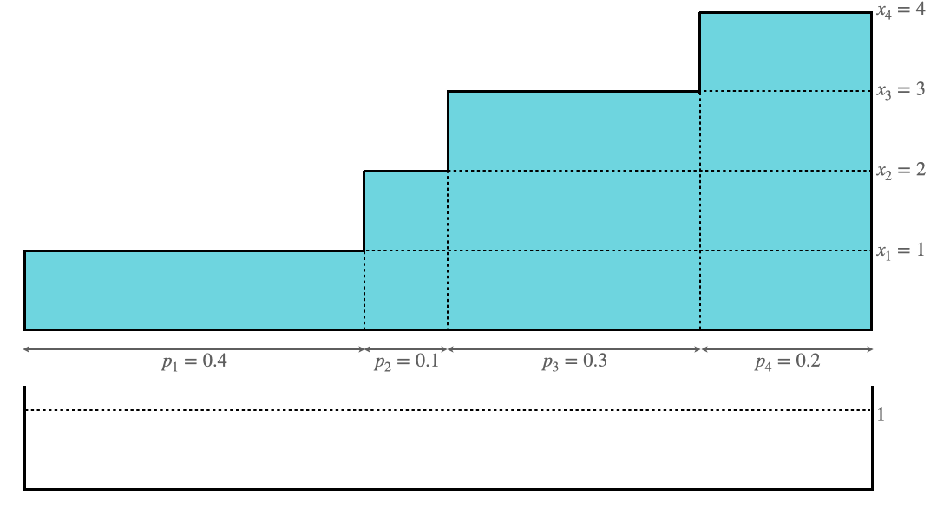
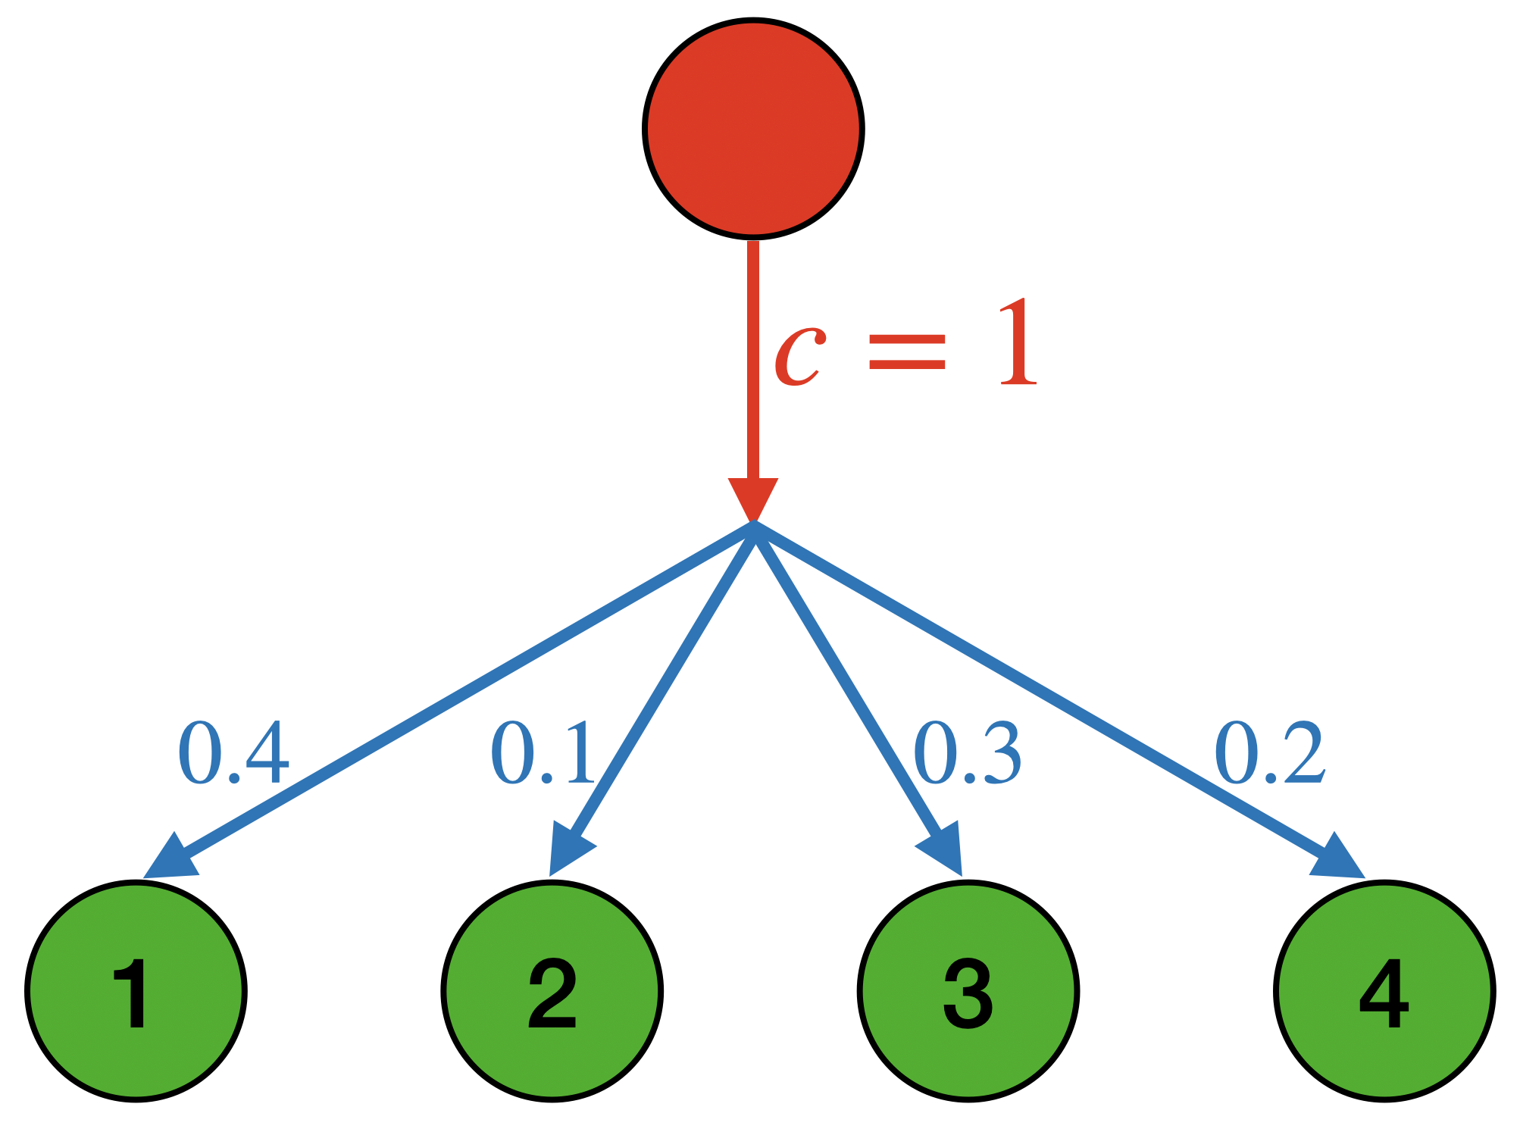
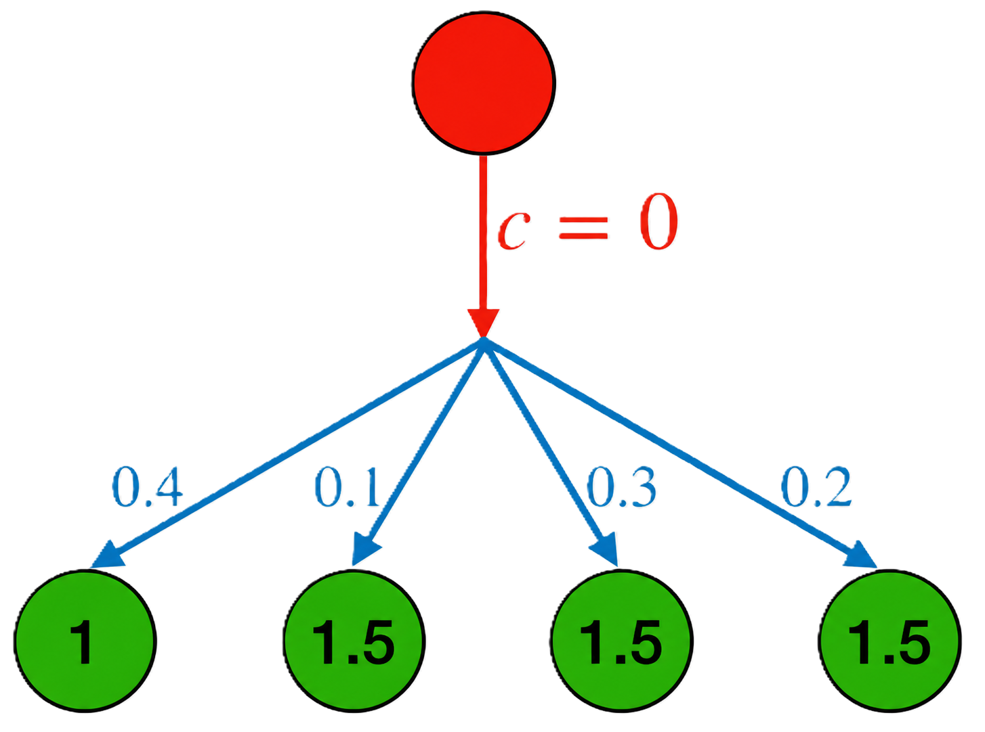


Technique: amortization and surrogate costs
Key idea: amortize the action costs down to the leaves.
Index = largest surrogate value = 1.5
Cost share
0.5
2
1
1.5
Surrogate value
0.5
0
2
2.5
Water draining amortization: cost shares are charged to the max value nodes
Surrogate value = value of node - amortized cost share
Weitzman’s algorithm: index-based policy
Open boxes in decreasing order of index
Until we find a value larger than all remaining indices
Stop and return the largest value
$$\text{E}\left[\text{cost} \text{share}\right]=\text{action} \text{cost} c$$
Promise of payment: if a node with cost share > 0 surrogate value = index is realized, the alg must accept at that node.
Promise of payment: if a node with cost share > 0 is realized, the alg must accept at that node.
Claim 1: For any alg and any amortization, surrogate value of selection $≥$ actual value.
Claim 2: For any alg satisfying promise of payment, surrogate value of selection = actual value.
$⟹$ optimality
Claim 3: Weitzman’s algorithm satisfies promise of payment and accepts the largest realized surrogate value.

Slide 8
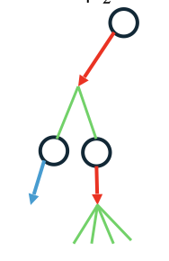
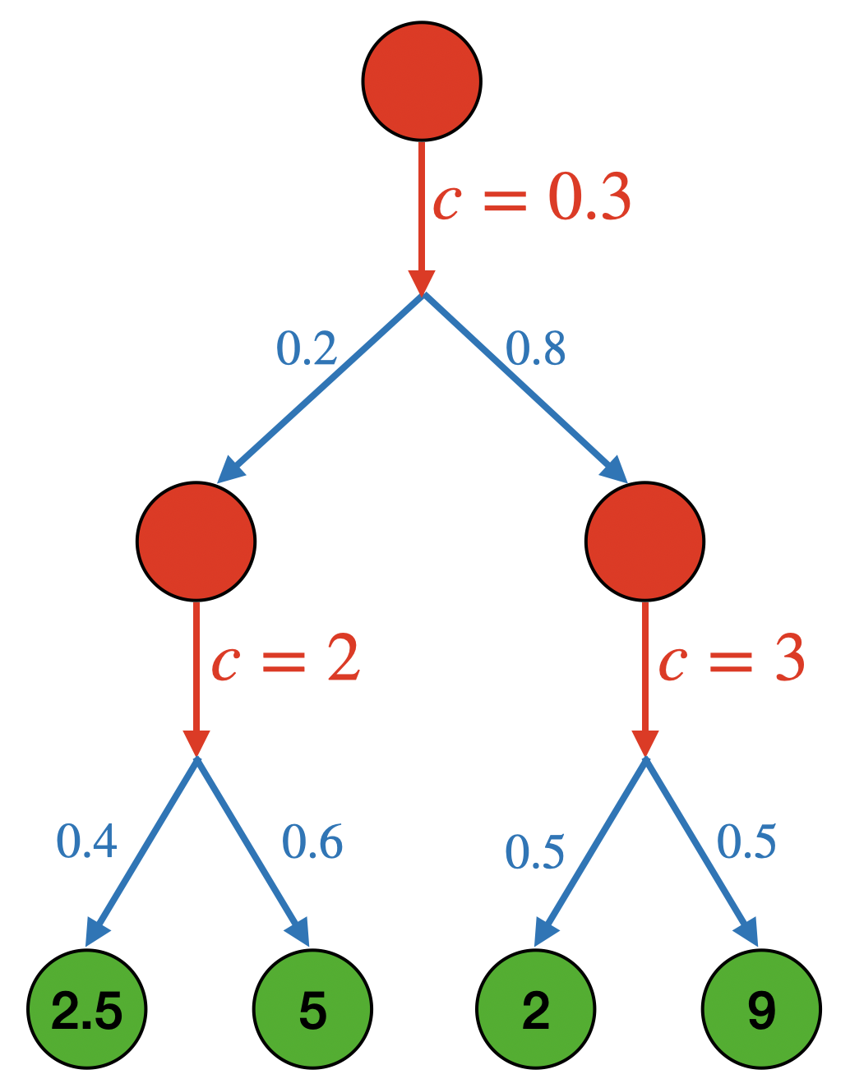
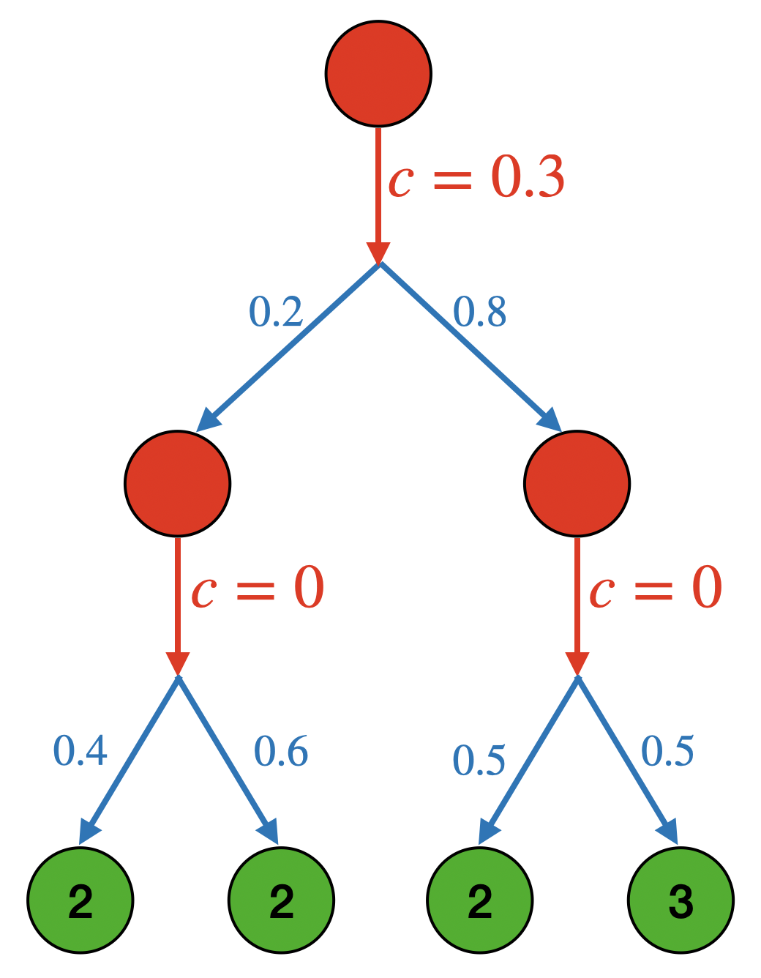
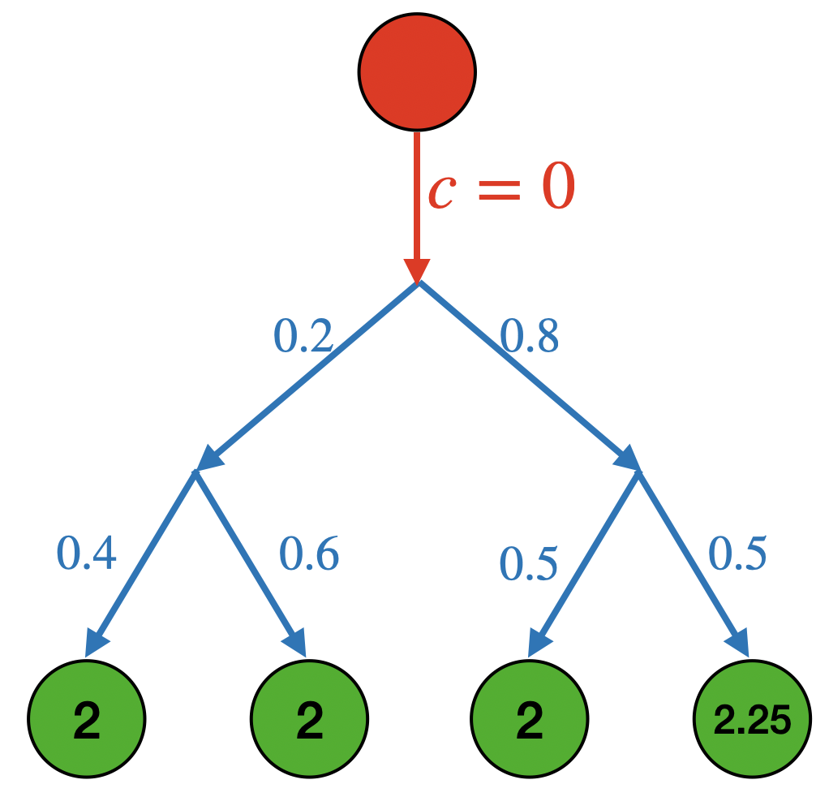


Extension to multi-stage information acquisition
Optimization problem: select one alternative
Information acquisition:
  Sequence of information revelation steps
  Each costly step further refines distribution
Algorithmic task: At every step decide whether to learn more about $i$, or to stop and accept the best value seen so far.
References:
Weitzman ’79 defines indices
Dumitrescu Tetali Winkler ’03 extend indices to Markov chains
Amortization idea is due to Kleinberg Waggoner Weyl ’16
Water draining proof is due to C. Christou Harlev Scully ’26
Optimal algorithm: index-based policy
Compute the “Gittins index” $g_{i}$ of every state
Advance the state with the largest index
If this leads to an “accept” action, stop
The same water draining amortization and analysis works!

Slide 9
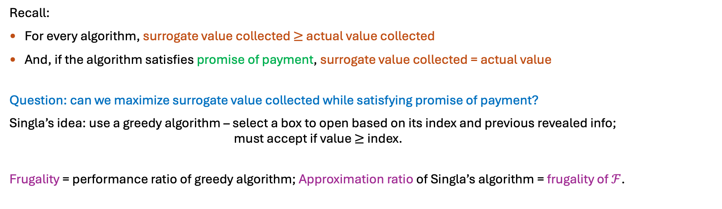
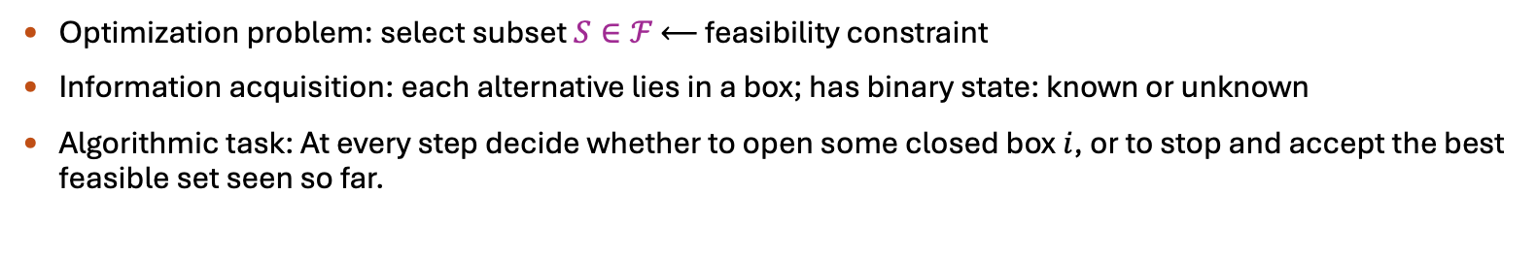
Extension to general feasibility constraints
Concept: Frugality
[Singla ’18, Gupta Jiang Scully Singla ’20]
Optimization problem: select subset $S∈ℱ$ $⟵$ feasibility constraint
Information acquisition: each alternative lies in a box; has binary state: known or unknown
Algorithmic task: At every step decide whether to open some closed box $i$, or to stop and accept the best feasible set seen so far.
Recall:
For every algorithm, surrogate value collected $≥$ actual value collected
And, if the algorithm satisfies promise of payment, surrogate value collected = actual value
Question: can we maximize surrogate value collected while satisfying promise of payment?
Singla’s idea: use a greedy algorithm – select a box to open based on its index and previous revealed info; must accept if value $≥$ index.
Frugality = performance ratio of greedy algorithm; Approximation ratio of Singla’s algorithm = frugality of $ℱ$.

Slide 10
Any constraints that admit good frugal algorithms
Next: Multi-modal info. acquisition
Any Markov chain type process of info. acquisition

Slide 11


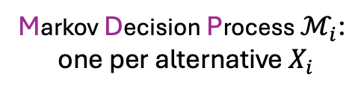





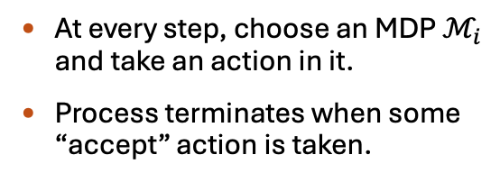


Extension to multi-modal information acquisition
Markov Decision Process $ℳ_{i}$:
one per alternative $X_{i}$
Start
Action 1
Action 2
Cost $c_{11}$
Cost $c_{12}$
At every step, choose an MDP $ℳ_{i}$ and take an action in it.
Process terminates when some “accept” action is taken.
Prob. $p_{1}$
$$p_{3}$$
$$p_{1}^{′}$$
$$p_{2}^{′}$$
$$p_{2}$$
Old problem: Bandit Super Process [Nash’73, Whittle’80, Glazebrook’82, …]
But much recent interest:
[Doval’18, Beyhaghi-Kleinberg’19, Ke-Villas-Boas’19, Aouad-Ji-Shaposhnik’20 Beyhaghi-Cai’22, Fu-Li-Liu’22, Scully-Doval’24, …]
See survey by Beyhaghi & Cai (2023)
Accept value $v_{1}$
Two components in the algorithm
  Which alternative to explore?
  How to explore it?

Slide 12
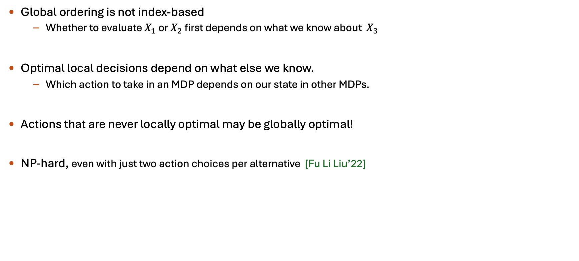


Extension to multi-modal information acquisition
Global ordering is not index-based
  Whether to evaluate $X_{1}$ or $X_{2}$ first depends on what we know about $X_{3}$
Optimal local decisions depend on what else we know.
  Which action to take in an MDP depends on our state in other MDPs.
Actions that are never locally optimal may be globally optimal!
NP-hard, even with just two action choices per alternative [Fu Li Liu’22]
$$ℳ_{1}$$
$$ℳ_{n}$$
…
…
…

Slide 13
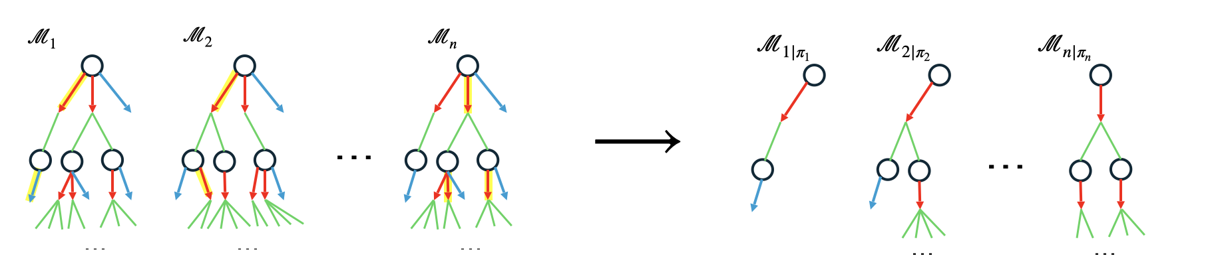
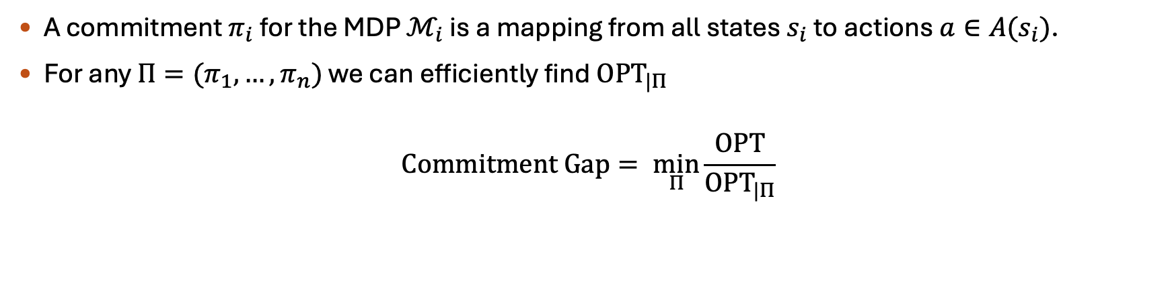
Concept: Commitment Policies and Commitment Gap
[Beyhaghi Kleinberg ’19]
A commitment $π_{i}$ for the MDP $ℳ_{i}$ is a mapping from all states $s_{i}$ to actions $a∈A(s_{i})$.
For any $Π=(π_{1}, …, π_{n})$ we can efficiently find ${\text{OPT}}_{|Π}$
$$\text{Commitment} \text{Gap}= \min_{Π}{\frac{\text{OPT}}{{\text{OPT}}_{|Π}}}$$

Slide 14

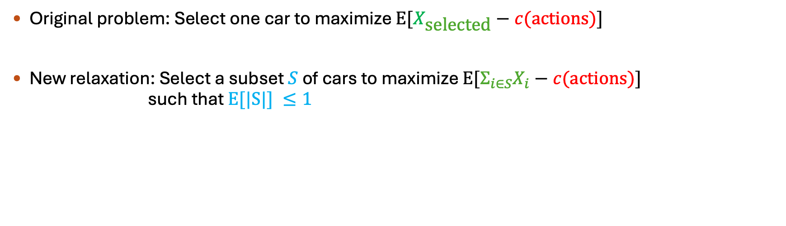



Technique: Ex Ante Relaxation
[Bowers Lindgren Waggoner ’26]
Original problem: Select one car to maximize $E[X_{\text{select}\text{ed}}−c(\text{actions})]$
New relaxation: Select a subset $S$ of cars to maximize $E[Σ_{i∈S}X_{i}−c(\text{actions})]$ such that $\text{E}\text{[|}\text{S}\text{|]} ≤1$
$$X_{1}\sim D_{1}$$
$$X_{2}\sim D_{2}$$
$$X_{3}\sim D_{3}$$
$$X_{4}\sim D_{4}$$
Prob. of acceptance:
0.1
0.3
0.5
0.1

Slide 15

An algorithm based on the ex ante relaxation
[C. Christou Dang ’25]
Solve the ex ante relaxation $⟹$ obtain acceptance probability $q_{i}$ for each alternative $i$
  Can solve optimally using a linear program of size $\sum_{i}{|ℳ_{i}|}$
For each alternative $i$, find the “optimal” local policy $π_{i}$ that accepts with probability $q_{i}$
Commit to the local actions $(π_{1}, …, π_{n})$ and run the index policy of Weitzman and DTW03
$$X_{1}\sim D_{1}$$
$$X_{2}\sim D_{2}$$
$$X_{3}\sim D_{3}$$
$$X_{4}\sim D_{4}$$
Prob. of acceptance:
0.1
0.3
0.5
0.1
Prescribed local actions:
Read reviews
Test drive if ★ ★ ★+
Read reviews
Buy if ★ ★ ★ ★ ★

Slide 16





Why does this work?
[C. Christou Dang ’25]
Solve the ex ante relaxation $⟹$ obtain acceptance probability $q_{i}$ for each alternative $i$
For each alternative $i$, find the “optimal” local policy $π_{i}$ that accepts with probability $q_{i}$
Commit to the local actions $(π_{1}, …, π_{n})$ and run the index policy of Weitzman and DTW03
Ex Post OPT$(ℳ_{1}^{π_{1}}, …, ℳ_{n}^{π_{n}})$
?
Ex Ante OPT$\left(ℳ_{1}^{π_{1}}, …,ℳ_{n}^{π_{n}}\right)=$
Ex Ante OPT$\left(ℳ_{1}, …,ℳ_{n}\right)≥$
Ex Post OPT$(ℳ_{1}, …,ℳ_{n})$
Our algorithm
Benchmark
What is this gap?
By construction
Relaxation

Slide 17
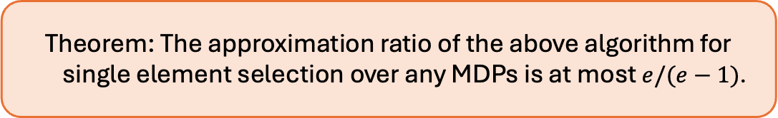
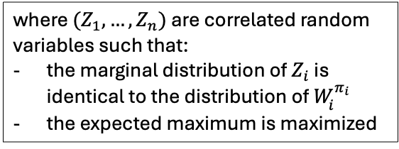
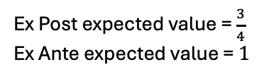





Correlation gap $⟹$ Approximation ratio
The correlation gap of the max function is $e/(e−1)$. [Agrawal-Ding-Saberi-Ye’10, Yan’11]
Theorem: The approximation ratio of the above algorithm for
single element selection over any MDPs is at most $e/(e−1)$.
$$W_{1}=0 \text{or} 1 \text{w}\text{.}\text{p}\text{.}½$$
Correlation gap of the max function
where $(Z_{1}, …,Z_{n})$ are correlated random variables such that:
the marginal distribution of $Z_{i}$ is identical to the distribution of $W_{i}^{π_{i}}$
the expected maximum is maximized
$$W_{2}=0 \text{or} 1 \text{w}\text{.}\text{p}\text{.}½$$
$\text{E}[\max_{i}{W_{i}^{π_{i}}]}$
$\text{E}[\max_{i}{Z_{i}]}$
Ex Post expected value = $\frac{3}{4}$
Ex Ante expected value = $1$
=
=
Ex Post OPT$(ℳ_{1}^{π_{1}}, …, ℳ_{n}^{π_{n}})$
?
Ex Ante OPT$\left(ℳ_{1}^{π_{1}}, …,ℳ_{n}^{π_{n}}\right)=$
Ex Ante OPT$\left(ℳ_{1}, …,ℳ_{n}\right)≥$
Ex Post OPT$(ℳ_{1}, …,ℳ_{n})$
Our algorithm
Benchmark
What is this gap?
By construction
Relaxation

Slide 18

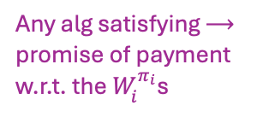


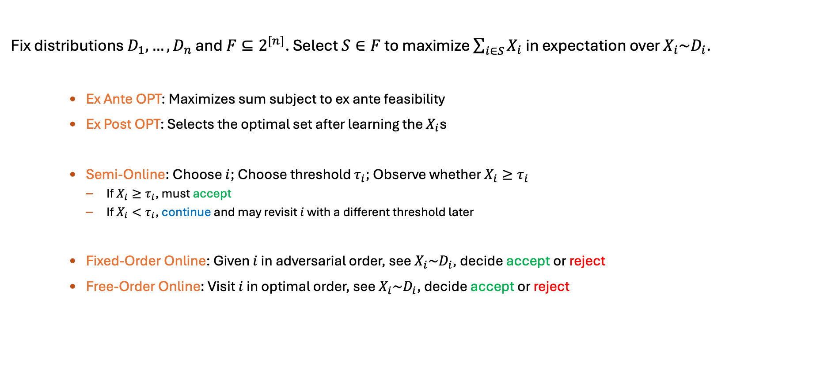






Technique: Reduction to Bayesian Selection
[C. Christou Dang ’25]
Fix distributions $D_{1},…, D_{n}$ and $F⊆2^{[n]}$. Select $S∈F$ to maximize $\sum_{i∈S}{X_{i}}$ in expectation over $X_{i}\sim D_{i}$.
Ex Ante OPT: Maximizes sum subject to ex ante feasibility
Ex Post OPT: Selects the optimal set after learning the $X_{i}$s
Semi-Online: Choose $i$; Choose threshold $τ_{i}$; Observe whether $X_{i}≥τ_{i}$
  If $X_{i}≥τ_{i}$, must accept
  If $X_{i}<τ_{i}$, continue and may revisit $i$ with a different threshold later
Fixed-Order Online: Given $i$ in adversarial order, see $X_{i}\sim D_{i}$, decide accept or reject
Free-Order Online: Visit $i$ in optimal order, see $X_{i}\sim D_{i}$, decide accept or reject
Benchmark $⟶$
$$X_{1}≥5$$
Yes
Accept $X_{1}$
No
$$X_{2}≥2$$
Yes
Accept $X_{2}$
Any alg satisfying $⟶$
promise of payment
w.r.t. the $W_{i}^{π_{i}}$s
No
$$X_{1}≥3$$
Yes
Accept $X_{1}$
No
$$X_{4}≥6$$
Yes
Accept $X_{4}$
No
…

Slide 19
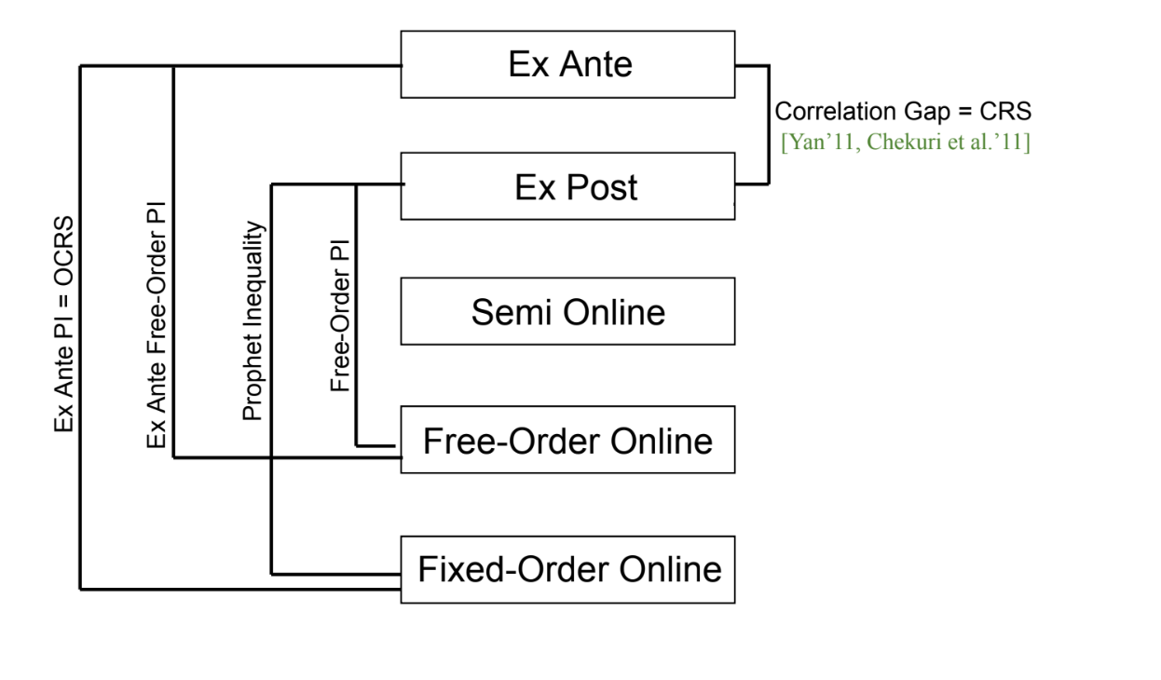
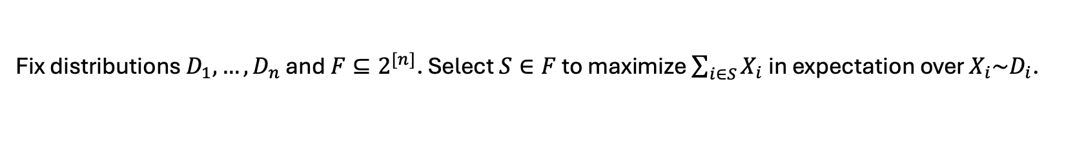
Technique: Reduction to Bayesian Selection
[C. Christou Dang ’25]
Fix distributions $D_{1},…, D_{n}$ and $F⊆2^{[n]}$. Select $S∈F$ to maximize $\sum_{i∈S}{X_{i}}$ in expectation over $X_{i}\sim D_{i}$.
Exactly captures the approx. factor of the CCD’25 algorithm
Bounded by “frugality”
[Singla’17]
These two gaps are exactly equal
Also equivalent to the query commit model for certain $F$
[Gamlath Kale Svensson’19]

Slide 20
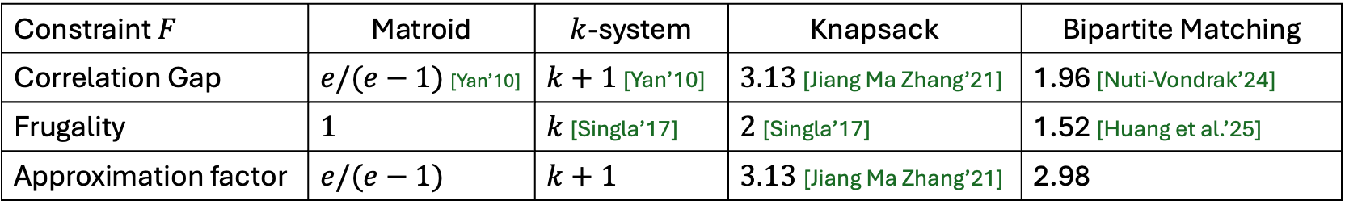
Technique: Reduction to Bayesian Selection
[C. Christou Dang ’25]
Exactly captures the approx. factor of the CCD’25 algorithm
Bounded by “frugality” [Singla’17]
These two gaps are exactly equal
Results for optimization with costly information under constraint $F$
Constraint $F$ | Matroid | $k$-system | Knapsack | Bipartite Matching
Correlation Gap | $e/(e−1)$ [Yan’10] | $k+1$ [Yan’10] | $3.13$ [Jiang Ma Zhang’21] | 1.96 [Nuti-Vondrak’24]
Frugality | $1$ | $k$ [Singla’17] | $2$ [Singla’17] | 1.52 [Huang et al.’25]
Approximation factor | $e/(e−1)$ | $k+1$ | $3.13$[Jiang Ma Zhang’21] | 2.98

Slide 21
Summary: extension to multi-modal information acquisition
Maximization problems can be solved by combining
  Ex Ante Relaxation
  Correlation Gap + Frugality
  Ex Ante Free Order Prophet Inequalities
What about minimization?
Objective: minimize value of selection + cost of info. acquisition
$$ℳ_{1}$$
$$ℳ_{n}$$
…
…
…

Slide 22
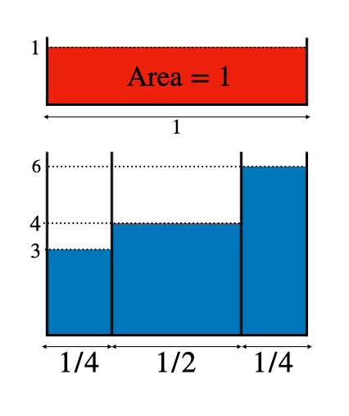














Concept: Amortization for MDPs
Surrogate cost = value of node + amortized cost share
[C. Christou Harlev Scully ’26]
Index of a node = smallest surrogate cost
in its subtree (best case scenario)
Start
Start
Index 5
$$1$$
$$0$$
~
$$\frac{1}{4}$$
$$\frac{1}{2}$$
$$\frac{1}{4}$$
$$\frac{1}{4}$$
$$\frac{1}{2}$$
$$\frac{1}{4}$$
$$3$$
$$4$$
$$6$$
$$3+2$$
$$4+1$$
$$6+0$$
5
5
6

Slide 23
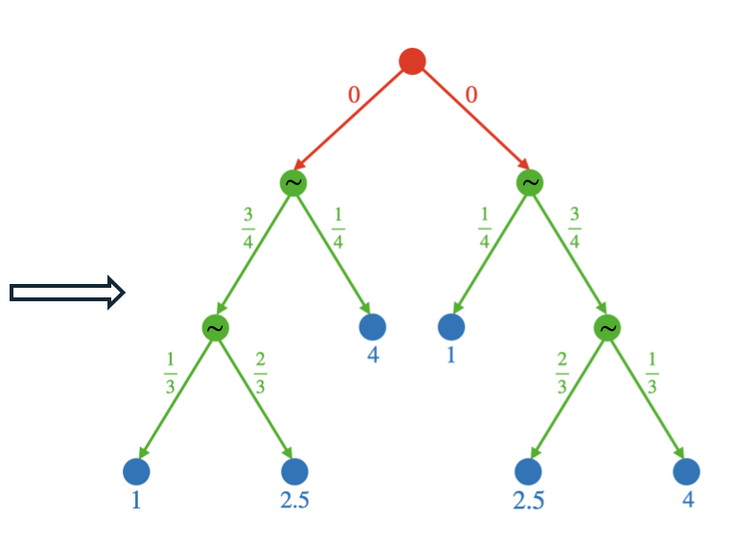
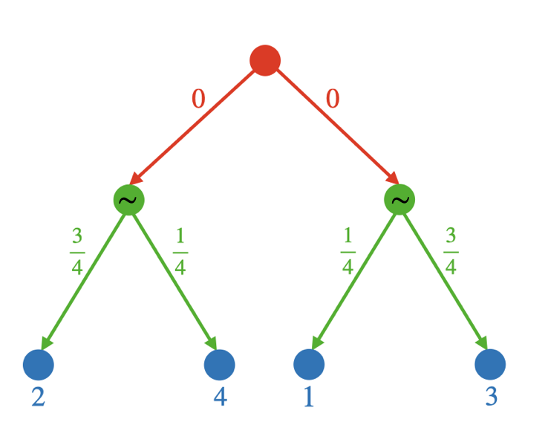
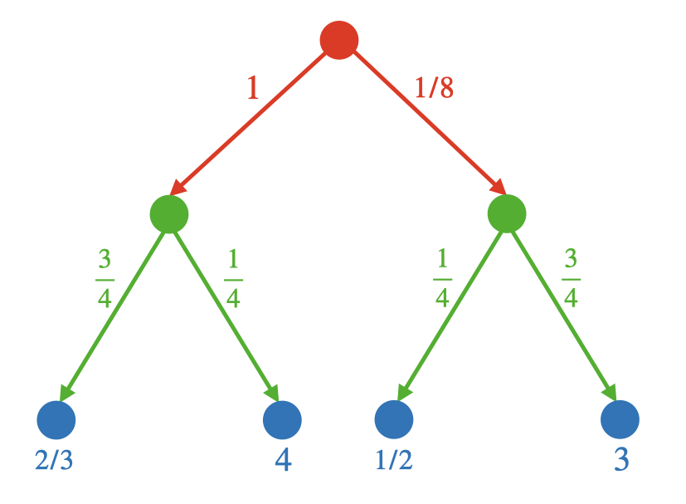
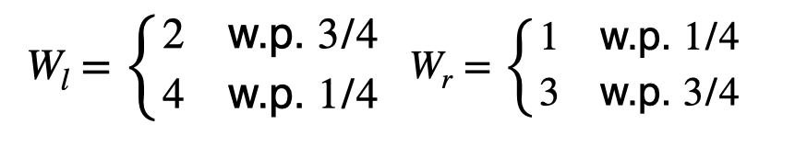
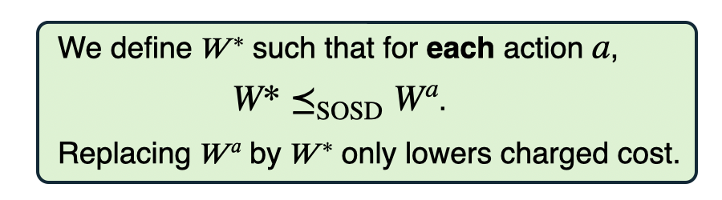
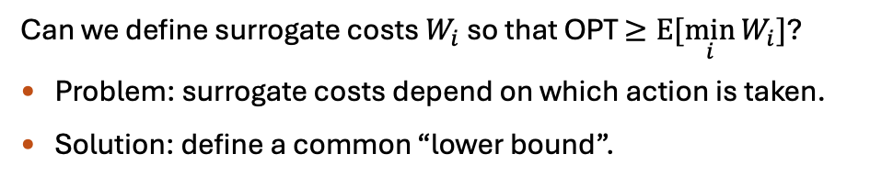
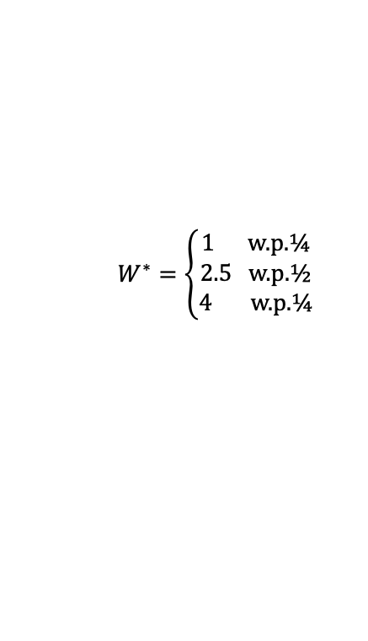
Concept: Amortization for MDPs
Surrogate cost = value of node + amortized cost share
[C. Christou Harlev Scully ’26]
Index of a node = smallest surrogate cost
in its subtree (best case scenario)
4
$$W^{∗}=\left\{\begin{aligned}1 \text{w}\text{.}\text{p}\text{.}¼ \\ 2.5 \text{w}\text{.}\text{p}\text{.}½ \\ 4 \text{w}\text{.}\text{p}\text{.}¼\end{aligned}\right.$$
2
3
1
3/4
1/4
1/4
3/4
Can we define surrogate costs $W_{i}$ so that OPT $≥\text{E}[\min_{i}{W_{i}}]$?
Problem: surrogate costs depend on which action is taken.
Solution: define a common “lower bound”.

Slide 24
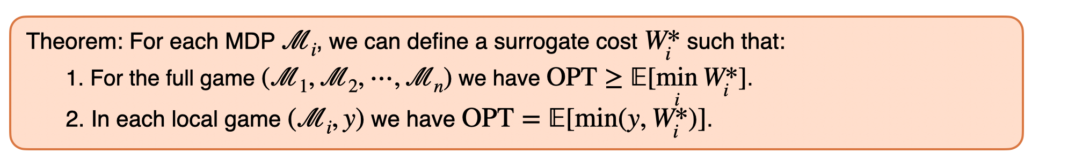


Concept: Amortization for MDPs
Surrogate cost = value of node + amortized cost share
[C. Christou Harlev Scully ’26]
Index of a node = smallest surrogate cost
in its subtree (best case scenario)
Local game $(ℳ_{i}, y)$
Value $y$
Can we define surrogate costs $W_{i}$ so that OPT $≥\text{E}[\min_{i}{W_{i}}]$?
Problem: surrogate costs depend on which action is taken.
Solution: define a common “lower bound”.

Slide 25






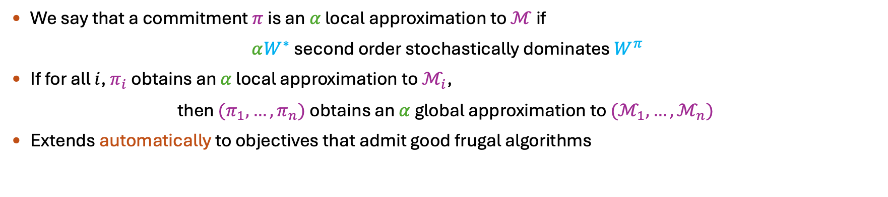





Technique: Commitment Gap via Local Approximation
[Doval Scully ’24]
Local game $(ℳ,y)$
Local game $(ℳ^{π},y)$
$$=$$
$$≤$$
$$=$$
$$.α≽$$
Value $y$
$$W^{∗}, 0$$
$$y, 0$$
$$W^{π}, 0$$
$$y, 0$$
Value $y$
We say that a commitment $π$ is an $α$ local approximation to $ℳ$ if
$αW^{∗}$ second order stochastically dominates $W^{π}$
If for all $i$, $π_{i}$ obtains an $α$ local approximation to $ℳ_{i}$,
then ${(π}_{1}, …,π_{n})$ obtains an $α$ global approximation to ${(ℳ}_{1}, …,ℳ_{n})$
Extends automatically to objectives that admit good frugal algorithms

Slide 26
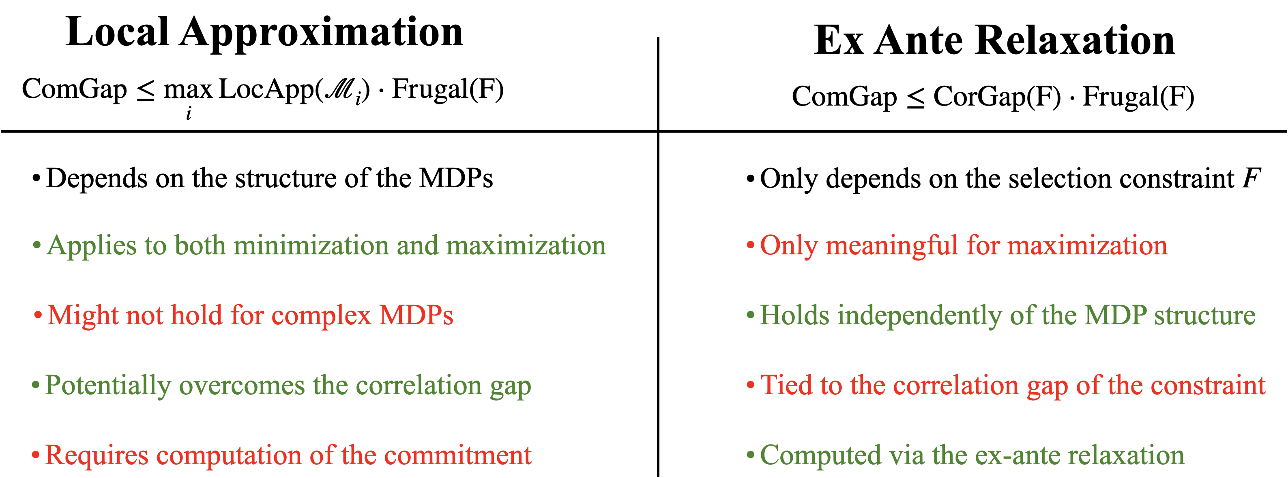

Slide 27
Any constraints that admit good frugal algorithms
Next: correlated values
Multi-modal info. acquisition
via ex ante relaxation or local approx
Any Markov chain type process of info. acquisition

Slide 28







Extension to correlated values
Optimization problem: select one alternative
Information acquisition: Pandora’s Box
Minimize value + opening cost
Joint distribution over box values: $\left(v_{1},…, v_{n}\right)\sim D$
$m$ “scenarios” representing the support of $D$
A special case: the Min Sum Set Cover problem
All costs are $0$ or $∞$. I.e. boxes are “acceptable” or “unacceptable”.
For simplicity: all probing penalties are $1$; Uniform distribution over $m$ scenarios.
Think of the scenarios as elements and boxes as sets. If an “acceptable” box is opened in a scenario, the scenario gets covered.
Objective: minimize total penalty a.k.a. covering time.
Example: may need to open “useless” boxes to find “useful” ones
  Let $f$ be a random mapping from $[n]$ to a large domain.
  $S^{(i)}=\left\{\begin{aligned} v_{1}=f\left(i\right) \\ v_{i}=0 \\ v_{i^{′}}=∞ \text{for} i′≠1,i \end{aligned}\right.$
  OPT = 2
4 boxes
acc | unacc | unacc | acc
unacc | unacc | acc | acc
unacc | acc | acc | unacc
unacc | unacc | acc | unacc
acc | acc | unacc | unacc
penalty = 3
penalty = 2
Probe $1$
5 scenarios
penalty = 1
penalty = 2
$$i≔f^{−1}(v_{1})$$
penalty = 1
Probe $i$
Stop & select $i$

Slide 29



Extension to correlated values
Optimization problem: select one alternative
Information acquisition: Pandora’s Box
Minimize value + opening cost
Joint distribution over box values: $\left(v_{1},…, v_{n}\right)\sim D$
$m$ “scenarios” representing the support of $D$
A special case: the Min Sum Set Cover problem
All costs are $0$ or $∞$. I.e. boxes are “acceptable” or “unacceptable”.
For simplicity: all probing penalties are $1$; Uniform distribution over $m$ scenarios.
Think of the scenarios as elements and boxes as sets. If an “acceptable” box is opened in a scenario, the scenario gets covered.
Objective: minimize total penalty a.k.a. covering time.
Example: may need to open “useless” boxes to find “useful” ones
  Let $f$ be a random mapping from $[n]$ to a large domain.
  $S^{(i)}=\left\{\begin{aligned} v_{1}=f\left(i\right) \\ v_{i}=0 \\ v_{i^{′}}=∞ \text{for} i′≠1,i \end{aligned}\right.$
  OPT = 2
Another special case: Optimal Decision Tree
Use “tests” to discover which of $m$ given hypotheses is true
Objective: minimize probing cost
$m$ states of the world $⟹O(\log{m)}$-approximation [Gupta Nagarajan Ravi’18, Li Liang Mussmann’20]
Tight in general [Chakravarthy et al.’07]
Probe $1$
$$i≔f^{−1}(v_{1})$$
Probe $i$
Stop & select $i$

Slide 30



Technique: Reduction to Optimal Decision Tree
[C. Gergatsouli McMahan Tzamos ’21]
Theorem: $\tilde{O}(\log{m})$-approximation where $m=$ number of scenarios.
[C. Gergatsouli McMahan Tzamos’22]
“Guess” an acceptable-cost threshold that covers a constant fraction of scenarios; Iterate.
Open: Can we obtain an $O(1)$ approximation?
Pandora’s Box
with outside option
Min Sum Set Cover
with “feedback”
Pandora’s Box
Optimal Decision Tree
$O(\log{\log{m)}}$ loss
a.k.a. stopping threshold
Known gap!
$O(\log{\log{m)}}$ loss
[Li Liang Mussmann’20]
Uniform
Pandora’s Box
with outside option
Uniform
Min Sum Set Cover
with “feedback”
Uniform Decision Tree
Can we say anything interesting when $m$ is very large?

Slide 31














Extension to large support correlated distributions
Concept: Approximating the Partially Adaptive Optimum
Inspired by Weitzman’s solution
Fully Adaptive Opt (FA-OPT)
Probing order and stopping rule depend adaptively on obtained info.
Hard to approximate better than $Ω(\log{m})$
Partially Adaptive Opt. (PA-OPT)
Probing order is non-adaptive
Stopping rule depends adaptively on obtained info.
Can approximate and learn from data! [C. Gergatsouli Teng Tzamos Zhang ’20]
Non Adaptive Optimum (NA-OPT)
Selects a subset of boxes
Opens all simultaneously
Chooses the best box
Hard to approximate better than $Ω(\log{m})$ (captures set cover)
Probe $1$
Probe $1$
Probe $S=\{1, 3, 4\}$
$$c_{1}∈[1,2]$$
$$c_{1}=4$$
$$c_{1}=0$$
$$\text{Else}$$
$$c_{1}<1$$
Stop & select 1
Stop & select 1
Probe 2
Probe 5
Probe 5
$$c_{2}=1$$
$$c_{5}<4$$
$$c_{5}≥4$$
$$\text{Else}$$
$$c_{1}+{2c}_{5}<4$$
Stop & select 2
$${c_{1}+c}_{2}>5$$
Stop & select 1
Stop & select argmin($c_{1},c_{5}$)
Stop & select ${\text{argmin}}_{i∈S} \{c_{i}\}$
Probe 2
Probe 2
Probe 3
$$c_{2}c_{5}<7.2$$
Theorem: Weitzman’s algorithm, suitably adapted, is a 4.4-approximation to the PA-OPT.
Stop & select 3
- - -
- - -
[Gergatsouli Tzamos’24]

Slide 32
Maximization?
Hard to approximate NA-OPT within any constant factor via fully adaptive algos
Any constraints that admit good frugal algorithms
Log approx. for small support
Const approx. to PA-OPT
Multi-modal info. acquisition
via ex ante relaxation or local approx
Any Markov chain type process of info. acquisition
Preliminary investigations by
[Olszewski Weber’15, Berger Ezra Feldman Fusco’23]

Slide 33
Some open directions
Minimization in the MDP setting
  Few and weak results
Maximization in the correlated setting
  Can we make suitable assumptions to simplify the problem?
Short range correlations?
General objectives
  Going beyond frugality?
  Non-linear objectives, e.g. Submodular over selected variables? Two-dimensional coverage?

Slide 34
Thanks for your attention!
Questions?

