Slide 1

Approximately Optimal Auction Design and Item Pricing
Shuchi Chawla

Slide 2

Optimization + Strategic participants
Mechanism Design
Allocation problem + Strategic agents
Auction Design
+ computational considerations
+ robustness
+ learnability
+ simplicity
+ …
Pricing
TCS contributions

Slide 3
This talk: some examples of pricing as a solution to an auction design problem
Part 1: Social Welfare Maximization
Part 2: Revenue Maximization

Slide 4








A generic stochastic resource allocation setting
Known population
of buyers
Buyers assign values to subsets of items
Many heterogenous items in limited supply
$$≡\$4$$
$$≡\$20$$
$$≡\$5$$
$4
$5
Auction:
(all reported prefs, market info) → (allocation, payments)
Buyers drawn randomly from population
Buyers’ goal: obtain an allocation that maximizes their value – the price they pay.

Slide 5
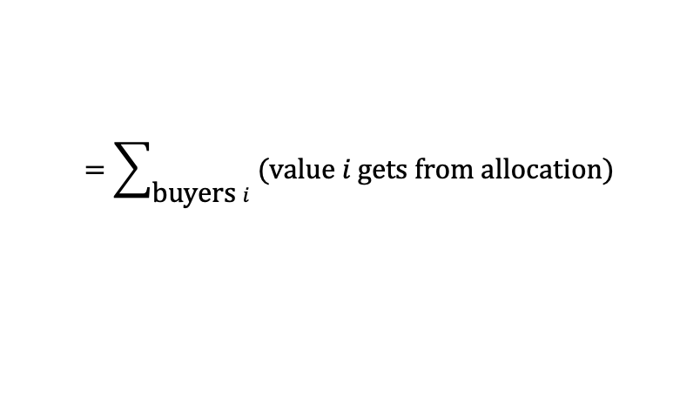
Part I: Social Welfare Maximization
$$≡\$4$$
$$≡\$20$$
$$≡\$5$$
Social welfare,
a.k.a., Economic Efficiency
$4
$5
$$=\sum_{\text{b}\text{uyer}\text{s} i}{\text{(}\text{value} i \text{gets} \text{from} \text{allocation}\text{)}}$$
Vickrey Auction: assigns the optimal allocation and charges “supporting” prices. Always truthful.

Slide 6
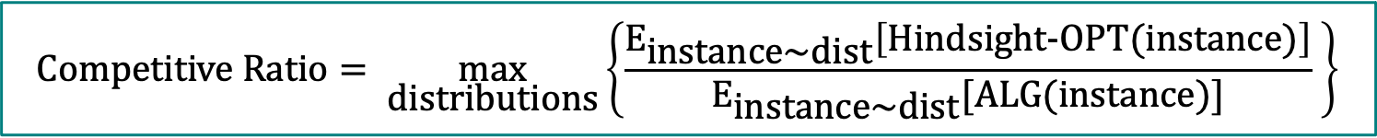
Part I: Online Stochastic Social Welfare Maximization
Challenge: determine the allocation and payment for each person before observing values of future arrivals.
$$≡\$4$$
$$≡\$20$$
$$≡\$5$$
Social welfare,
a.k.a., Economic Efficiency
$4
$5
$$=\sum_{\text{b}\text{uyer}\text{s} i}{\text{(}\text{value} i \text{gets} \text{from} \text{allocation}\text{)}}$$
Vickrey Auction: assigns the optimal allocation and charges “supporting” prices. Always truthful.
$$\text{Competitive} \text{Ratio}= \max_{\text{distributions}}\left\{\frac{{\text{E}}_{\text{instance}\text{\sim }\text{dist}}\left[\text{Hindsight}\text{−}\text{OPT}(\text{instance})\right]}{{\text{E}}_{\text{instance}\text{\sim }\text{dist}}[\text{ALG}(\text{instance})]} \right\}$$

Slide 7
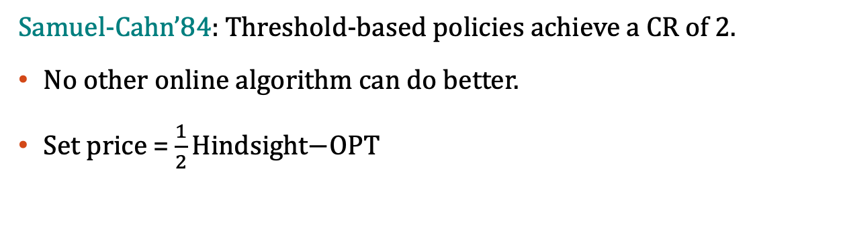
The single item case: prophet inequality
$1
10 w.p. 0.1
2 w.p. 1/3
1 w.p. 2/3
U[0,1]
Customers arrive in sequence and reveal their values
At every step, the algorithm decides whether to allocate and stop; or to reject and move forward.
Hindsight-OPT picks the maximum value
$t
A threshold-based policy: allocate to the first value that crosses pre-determined threshold, a.k.a. price, t.
Samuel-Cahn’84: Threshold-based policies achieve a CR of 2.
No other online algorithm can do better.
Set price = $\frac{1}{2}\text{Hindsight}\text{−}\text{OPT}$
Robust to different arrival orders!

Slide 8
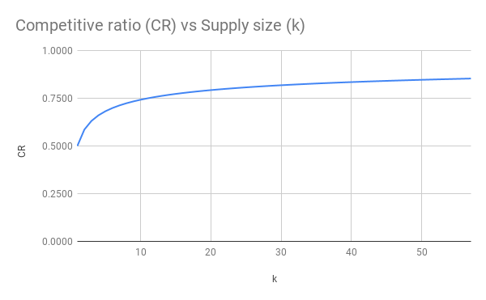

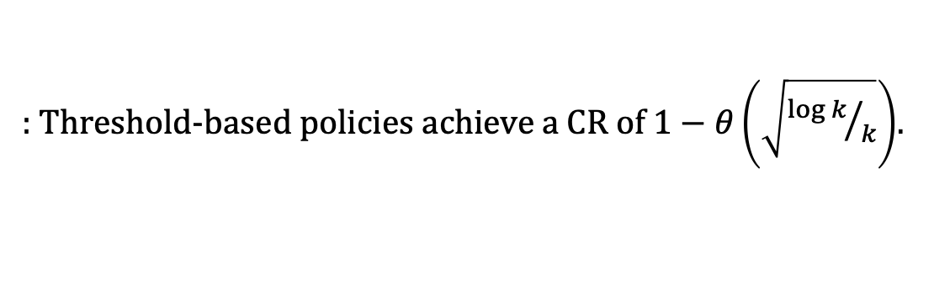
The single item case: prophet inequality
$1
10 w.p. 0.1
2 w.p. 1/3
1 w.p. 2/3
U[0,1]
Customers arrive in sequence and reveal their values
At every step, the algorithm decides whether to allocate and stop; or to reject and move forward.
Hindsight-OPT picks the maximum k values
$t
k copies
[C.-Devanur-Lykouris’21]
A threshold-based policy: allocate to the first k values that cross pre-determined threshold, a.k.a. price.
: Threshold-based policies achieve a CR of $1−θ\left(\sqrt{{\log{k}}/k}\right)$.
Samuel-Cahn’84: Threshold-based policies achieve a CR of 2.
No other online algorithm can do better.
Set price = $\frac{1}{2}\text{Hindsight}\text{−}\text{OPT}$
Hajiaghayi-Kleinberg-Sandholm’07 C.-Devanur-Lykouris’21
Ghosh-Kleinberg’16: No other online algorithm can do better asymptotically.
Robust to different arrival orders!

Slide 9





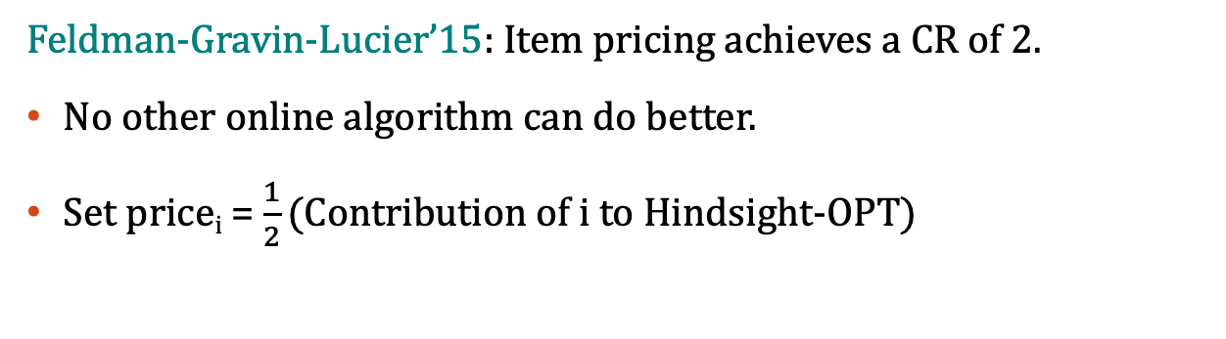

The “unit demand” case: balanced prices
$$≡\$2$$
$$≡U[0,5]$$
$$≡\$1$$
$$≡\$2 w.p. 0.1$$
Customers arrive in sequence and reveal their values
At every step, the algorithm decides what to allocate and at what price; or to reject and move forward.
Hindsight-OPT picks the SW maximizing allocation.
$$⋯\$1$$
$$⋯\$1$$
Item pricing: fix prices in advance; allow buyers to purchase their favorite item while supplies last.
Feldman-Gravin-Lucier’15: Item pricing achieves a CR of 2.
No other online algorithm can do better.
Set price_{i} = $\frac{1}{2}\text{(}\text{Contribution} \text{of} \text{i} \text{to} \text{Hindsight}\text{−}\text{OPT}\text{)}$
Robust to different arrival orders!

Slide 10


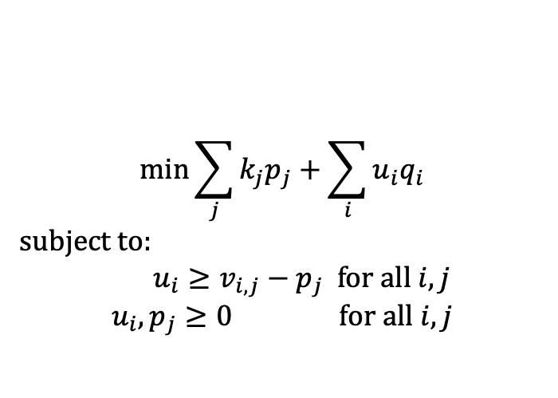
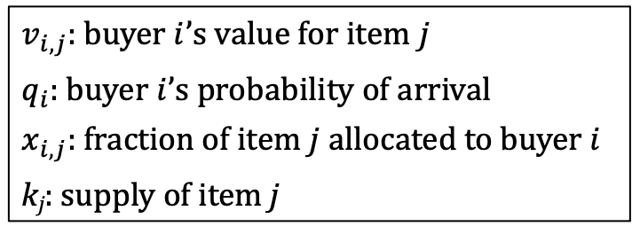

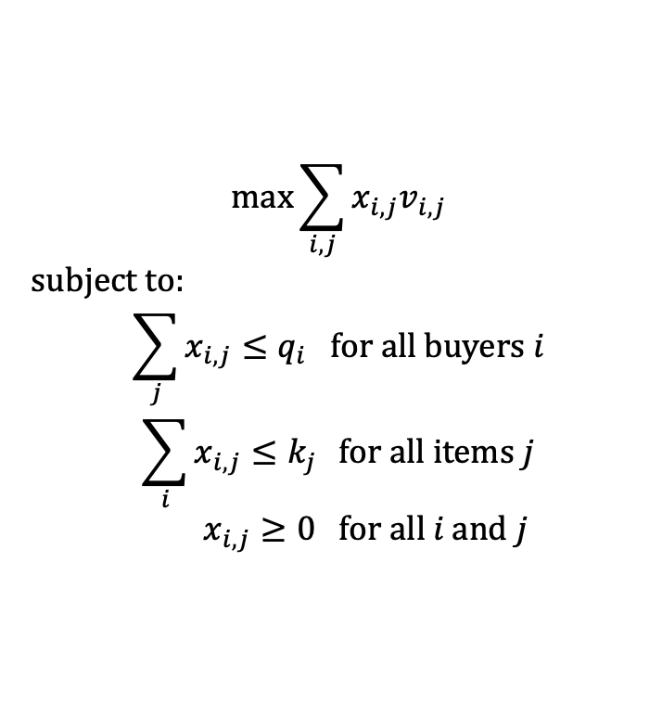

Item prices arise as dual variables
$v_{i,j}$: buyer $i$’s value for item $j$
$q_{i}$: buyer $i$’s probability of arrival
$x_{i,j}$: fraction of item $j$allocated to buyer $i$
k_{j}: supply of item j
PRIMAL a.k.a. expected case LP
DUAL
$$\max{\sum_{i,j}{x_{i,j}v_{i,j}}}$$
subject to:
$$\sum_{j}{x_{i,j}}≤q_{i} \text{for} \text{all} \text{buyers} i$$
$$\sum_{i}{x_{i,j}≤k_{j} } \text{for} \text{all} \text{items} j$$
$$x_{i,j}≥0 \text{for} \text{all} i \text{and} j$$
Social Welfare
$$\min{\sum_{j}{{k_{j}p}_{j}}+\sum_{i}{u_{i}q_{i}}}$$
subject to:
$$u_{i}≥v_{i,j}−p_{j} \text{for} \text{all} i,j$$
$$u_{i}, p_{j}≥0 \text{for} \text{all} i, j$$
No overprovisioning
One of these is “tight”
Demand $≤$ Supply
In an optimal solution, $u_{i}=\max_{j}\left(v_{i,j}−p_{j}\right)$
Optimal value of PRIMAL $≥$ Hindsight-OPT
If $p_{j}$’s denote prices, then $u_{i}$’s are utilities!
Complementary slackness $⟹$ LP allocates $j$ to $i$ iff $j$ is one of $i$’s favorite items under the pricing $p$.

Slide 11
The “unit demand” case: balanced prices
$$≡\$2$$
$$≡U[0,5]$$
$$≡\$1$$
$$≡\$2 w.p. 0.1$$
Customers arrive in sequence and reveal their values
At every step, the algorithm decides what to allocate and at what price; or to reject and move forward.
Hindsight-OPT picks the SW maximizing allocation.
$$⋯\$1$$
$$⋯\$1$$
Item pricing: fix prices in advance; allow buyers to purchase their favorite item while supplies last.
Feldman-Gravin-Lucier’15: Item pricing achieves a CR of 2.
No other online algorithm can do better.
Set price_{i} = $\frac{1}{2}\text{(}\text{Contribution} \text{of} \text{i} \text{to} \text{Hindsight}\text{−}\text{OPT}\text{)}$
Use dual prices??

Slide 12


But dual prices don’t work well in stochastic settings
Problem 1: dual prices are too low.
Problem 2: as supply diminishes, the correspondence between LP-allocation and buyer preferences breaks down.
Every buyer purchases her favorite of the remaining items
Dual price = 1; Alg allocates to the second buyer w.p. 0.01.
$$\text{V}\text{alue}=1$$
Arrival prob. =0.9
$$\text{V}\text{alue}=100$$
Arrival prob.=0.1
Coming up: two approaches to get around these problems…

Slide 13
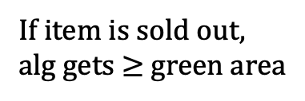

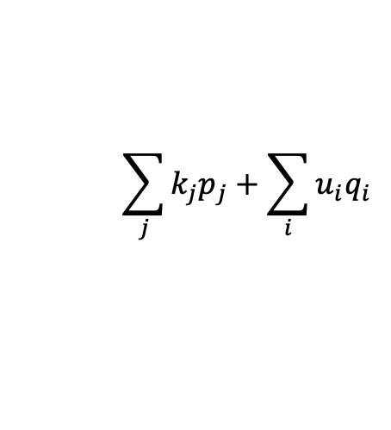

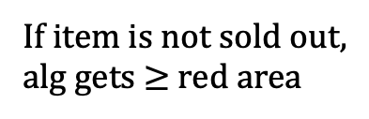
Approach 1: balanced prices
[Feldman-Gravin-Lucier’15]
A buyer assigned item i by the LP
$$\sum_{j}{{k_{j}p}_{j}}+\sum_{i}{u_{i}q_{i}}$$
If item is sold out,
alg gets $≥$ green area
buyer’s fractional allocation
buyer’s value for item i
If item is not sold out,
alg gets $≥$ red area
LP-Value = shaded area
Total alloc. of item i < supply of item i
Supply of item i
At “balanced” price p*:
Seller’s revenue = green area
Buyers’ utility = red area
$⟹$ 2-approximation
Dual price
Value for item i
FGL’s “balanced” price p*
Green area = red area $≥$ ½ LP-Value

Slide 14


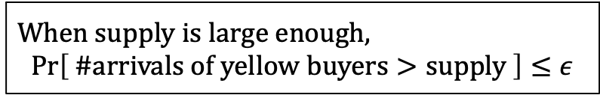
Approach 2: tracking buyer preferences
[C. Devanur Holroyd Karlin Martin Sivan’17]
Dual price with $\left(1−ε\right)$ supply
When supply is large enough,
$$Pr\left[ \text{\#}\text{arrivals} \text{of} \text{yellow} \text{buyers}>\text{supply} \right]≤ε$$
Failure event
$\left(1−ε\right)∙$ supply of item i
Challenge: a failure event at one item can cause a failure event at another item.
Total alloc. of item i < supply of item i
Supply of item i
Question: how do failure events cascade?
Dual price
FGL’s “balanced” price p*
Value for item i

Slide 15
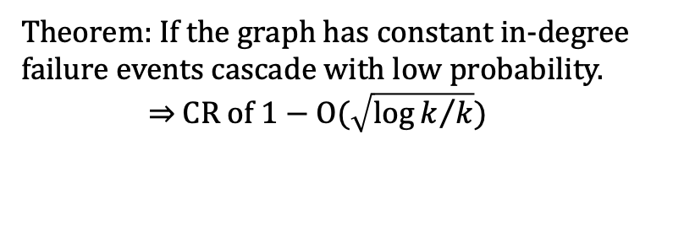

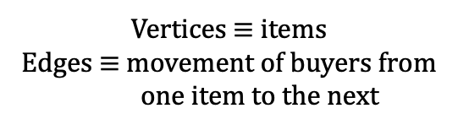



Approach 2: tracking buyer preferences
[C. Devanur Holroyd Karlin Martin Sivan’17]
Forwarding graph
When supply is large enough,
$$Pr\left[ \text{\#}\text{arrivals} \text{of} \text{yellow} \text{buyers}>\text{supply} \right]≤ε$$
$${ i}_{1}$$
Failure event
Challenge: a failure event at one item can cause a failure event at another item.
Failure events move along edges in the forwarding graph
$${ i}_{2}$$
$${ i}_{3}$$
Question: how do failure events cascade?
$${ i}_{4}$$
Theorem: If the graph has constant in-degree failure events cascade with low probability.
$⇒$CR of $1−\text{O}(\sqrt{{\log{k}}/k})$
Vertices $≡$ items
Edges $≡$ movement of buyers from
one item to the next

Slide 16

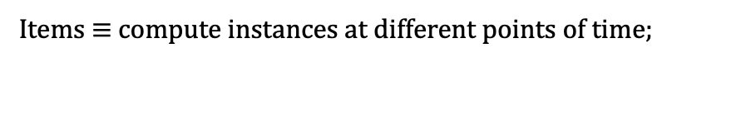
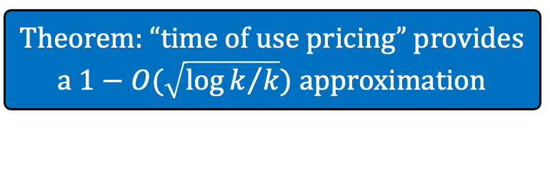

Approach 2: tracking buyer preferences; application to interval scheduling
Item 1
Item 2
Item 3
…
Theorem: “time of use pricing” provides a $1−O(\sqrt{{\log{k}}/k})$ approximation
Supply
[C. Devanur Holroyd Karlin Martin Sivan’17]
# instances available
Prices
$5
$2
$8
$5
$1
$5
Time
$$q_{j},v_{j}$$
job’s value
job’s time window
job’s probability of arrival
Items $≡$ compute instances at different points of time;
Buyers $≡$ jobs with requirements

Slide 17
Part I: Online Stochastic Social Welfare Maximization – Summary
Posted (static) pricing is the best online truthful SW-maximizing algorithm known for many settings:
Single item [Samuel-Cahn’84]
Unit demand [Feldman Gravin Lucier’15]
Job scheduling [C. Devanur Holroyd Karlin Martin Sivan’17, C. Miller Teng’19]
Fractionally subadditive values [FGL’15]
Subadditive values [Dutting Kesselheim Lucier’20]
MPH hierarchy of values [FGL’15, Dutting Feldman Kesselheim Lucier’17]
Bandwidth allocation [C. Miller Teng’19]
Item pricing; or Bundle pricing

Slide 18
A generic stochastic resource allocation setting
Known population
of buyers
Buyer assigns values to subsets of items
Many heterogenous items in limited supply
$$≡\$4$$
$$≡\$5$$
Auction:
(all reported prefs, market info) → (allocation, payment)
Buyer drawn randomly from population
Simplifying assumption:
single buyer
Buyers’ goal: obtain an allocation that maximizes their value – the price they pay.

Slide 19



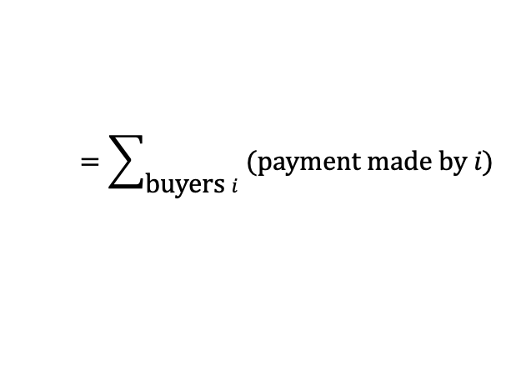


Part II: Revenue Maximization
Revenue*
$$=\sum_{\text{b}\text{uyer}\text{s} i}{\text{(}\text{pay}\text{ment} \text{made} \text{by} i\text{)}}$$
$$≡\$4$$
(*) Assumption: seller has a monopoly.
$$≡\$5$$
The optimal mechanism can be quite complicated:
Offers items packaged into bundles
Offers random allocations, a.k.a. lotteries [Thannasoulis’05]
Can have infinitely many options! [Hart Nisan’13]
Can be computationally hard to find. [Chen et al.’15]
$⋯$ $1
$⋯$ $1.5
$⋯$ $3
½ ( )
$⋯$ $1.25
+ ½
$⋯$ $1.5
Prob. of allocation

Slide 20
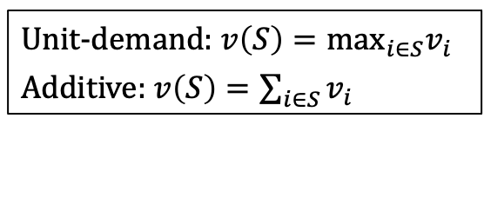
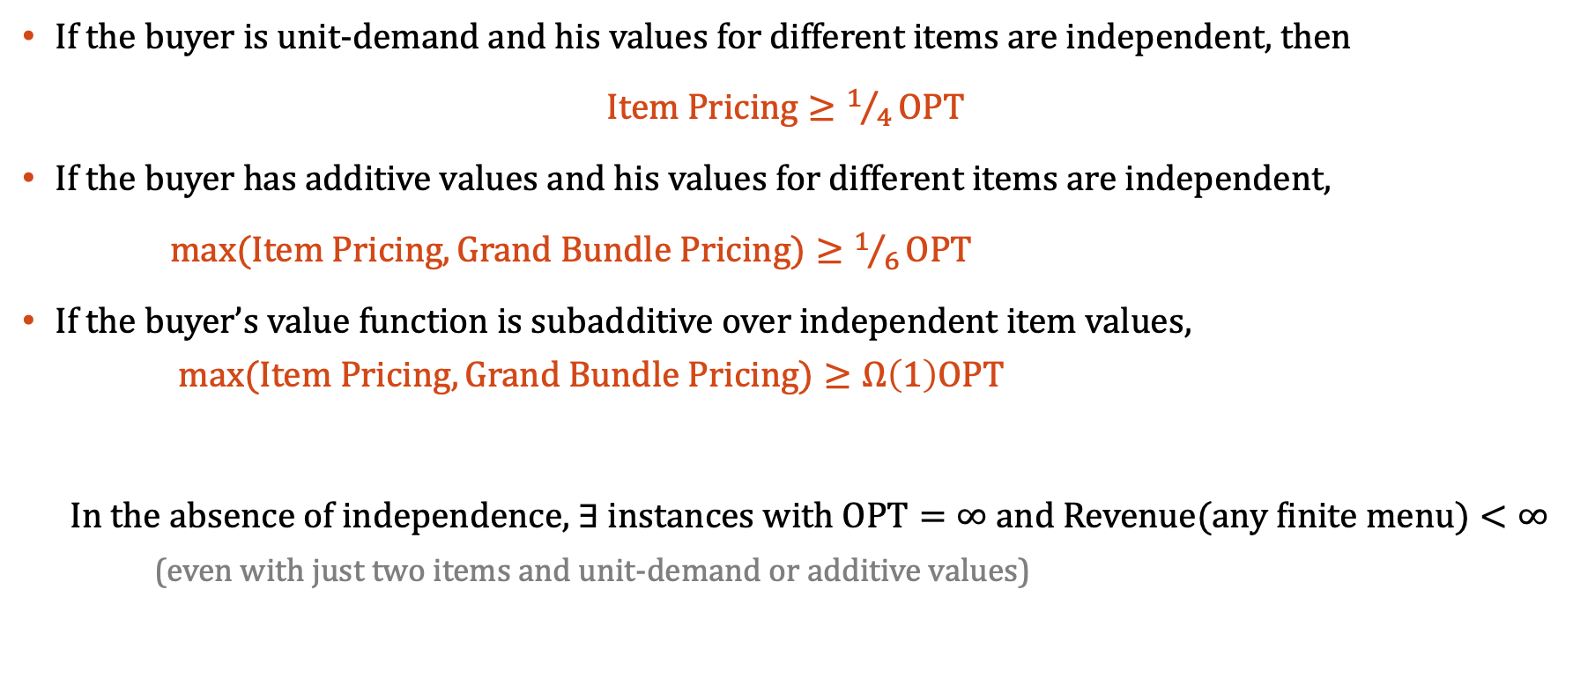
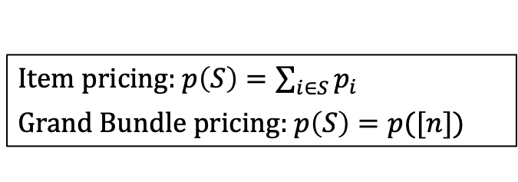
Part II: Revenue Maximization – Approximation
If the buyer is unit-demand and his values for different items are independent, then
$Item Pricing≥1/4\text{OPT}$
If the buyer has additive values and his values for different items are independent,
$max(Item Pricing, Grand Bundle Pricing)≥1/6\text{OPT}$
If the buyer’s value function is subadditive over independent item values, $max(Item Pricing,Grand Bundle Pricing)≥Ω\left(1\right)\text{OPT}$
In the absence of independence, $∃$ instances with $\text{OPT}=∞$ and $\text{Rev}\text{enue}\text{(}\text{any} \text{finite} \text{menu}\text{)}<∞$ (even with just two items and unit-demand or additive values)
[C.-Hartline-Kleinberg’07] [C.-Malec-Sivan’10]
[Li-Yao’13]
[Babaioff-Immorlica-Lucier-Weinberg ’14]
[Rubinstein-Weinberg’15]
Best known approximations using any “simple” mechanisms
[Briest-C.-Kleinberg-Weinberg’10]
[Hart-Nisan’13]
Unit-demand: $v\left(S\right)={\text{max}}_{i∈S}v_{i}$
Additive: $v\left(S\right)=\sum_{i∈S}{v_{i}}$
Item pricing: $p\left(S\right)=\sum_{i∈S}{p_{i}}$
Grand Bundle pricing: $p\left(S\right)=p([n])$

Slide 21
Part II: Revenue Maximization with a buy-many constraint
[C.-Tzamos-Teng’19]
$$≡\$4$$
Buy-many constraint: cannot sell a bundle at a price higher than the sum of its constituents.
$$≡\$5$$
The optimal buy-many mechanism can be quite complicated:
Offers random allocations, a.k.a. lotteries
Can have infinitely many options!
Can be computationally hard to find.
$⋯$ $1
$⋯$ $1.5
$⋯$ $3
½ ( )
$⋯$ $1.25
+ ½
$⋯$ $1.5

Slide 22
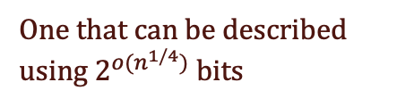
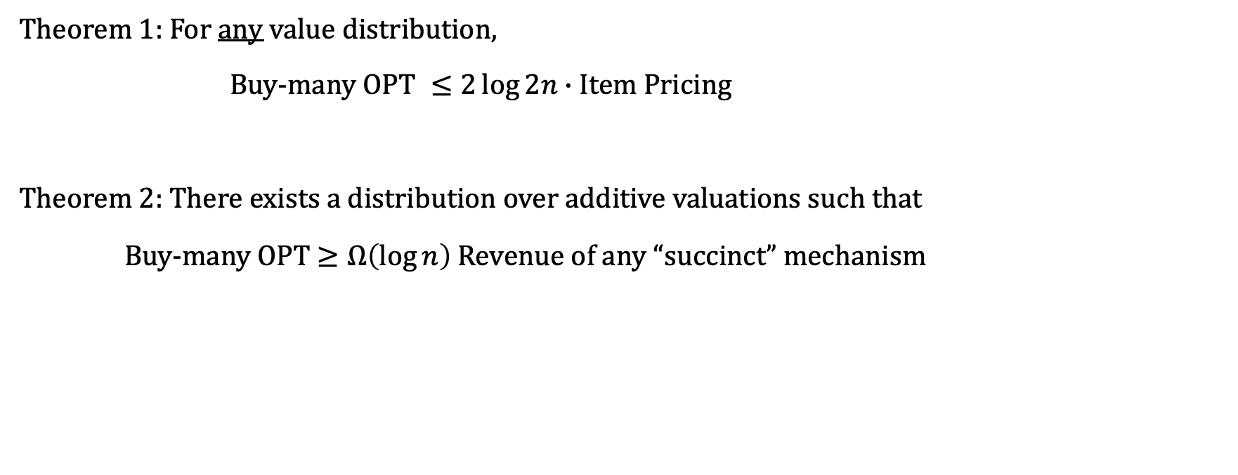
Part II: Revenue Maximization with a buy-many constraint – Approximation
[C.-Tzamos-Teng’19]
Theorem 1: For any value distribution,
Buy-many O$PT ≤2\log{2n}∙$ Item Pricing
Theorem 2: There exists a distribution over additive valuations such that
Buy-many OPT $≥Ω\left(\log{n}\right)$ Revenue of any “succinct” mechanism
n: #items
One that can be described using $2^{o(n^{1/4})}$ bits

Slide 23




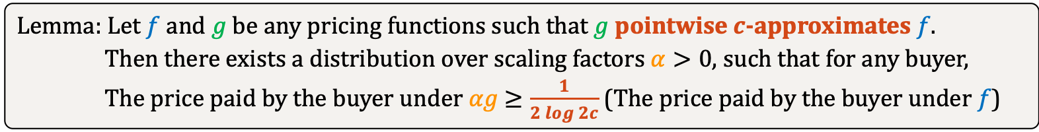

Theorem: Item Pricing is always a $2\log{2n}$-approximation to the optimal buy-many mechanism.
$$g$$
Buy-many menus $≡$ subadditive pricing function
Item pricing $≡$additive pricing function
Additive fns (g) pointwise $n$-approximate subadditive fns (f)
$$f$$
Pointwise approximation $⟹$ Approximation in revenue
$$αg$$
Additive functions are the succinct functions that best approximate an arbitrary subadditive function.
$g$/c
Lemma: Let $f$ and $g$ be any pricing functions such that $g$ pointwise $c$-approximates $f$.
Then there exists a distribution over scaling factors $α>0$, such that for any buyer,
The price paid by the buyer under $αg$ $≥\frac{1}{2 log{2c}}$ (The price paid by the buyer under $f$)

Slide 24









$\frac{1}{2}f(S)≤$ scaled-$g(S)≤f(S)$
$$g$$
$$f$$
$$f({\text{argmax}}_{S}\left\{v\left(S\right)−f\left(S\right)\right\})$$
$g s$caled by some power of 2
Big gap!
$g$/c
$$αg({\text{argmax}}_{S}\left\{v\left(S\right)−αg\left(S\right)\right\})$$
$$S$$
$$S′$$
Lemma: Let $f$ and $g$ be any pricing functions such that $g$ pointwise $c$-approximates $f$.
Then there exists a distribution over scaling factors $α>0$, such that for any buyer,
The price paid by the buyer under $αg$ $≥\frac{1}{2 log{2c}}$ (The price paid by the buyer under $f$)

Slide 25









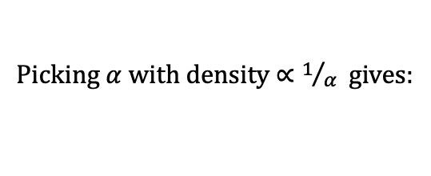

$${\text{util}}_{\text{max}}≈\text{rev}(f)$$
$$\text{u}\text{til}\left(αg\right)=\max_{S}{\{v\left(S\right)−αg\left(S\right)\}}$$
$$\text{r}\text{ev}\left(αg\right)=αg(S)$$
Buyer’s utility/payment
Picking $α$ with density $∝1/α$ gives:
$$E_{α}\left[\text{r}\text{ev}\left(αg\right)\right]$$
$$=\frac{{\text{util}}_{\text{max}}−{\text{util}}_{\text{min}}}{\log{(2c)}}$$
$${\text{util}}_{\text{m}\text{in}}≪\text{rev}(f)$$
$$\frac{1}{2c}$$
Scaling factor $α$
$$1$$
$$α$$
Lemma: Let $f$ and $g$ be any pricing functions such that $g$ pointwise $c$-approximates $f$.
Then there exists a distribution over scaling factors $α>0$, such that for any buyer,
The price paid by the buyer under $αg$ $≥\frac{1}{2 log{2c}}$ (The price paid by the buyer under $f$)

Slide 26
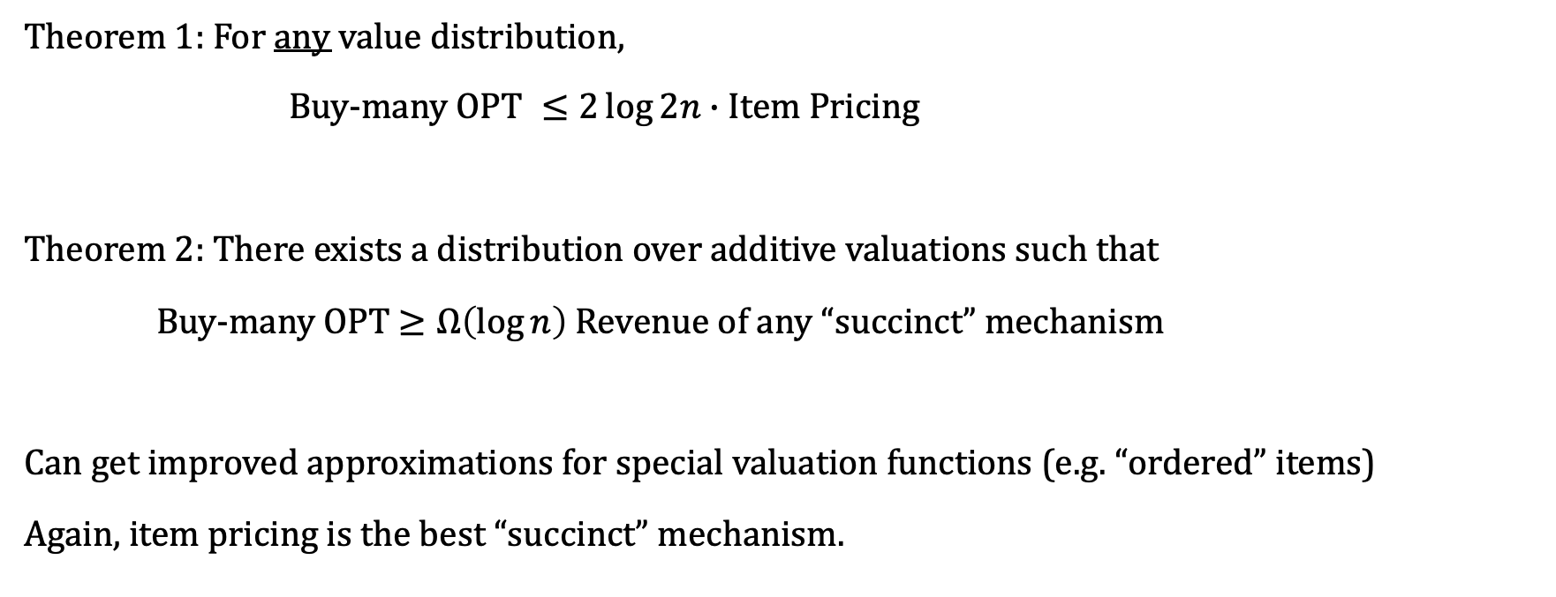
Part II: Revenue Maximization with a buy-many constraint – Approximation
[C.-Tzamos-Teng’19]
Theorem 1: For any value distribution,
Buy-many O$PT ≤2\log{2n}∙$ Item Pricing
Theorem 2: There exists a distribution over additive valuations such that
Buy-many OPT $≥Ω\left(\log{n}\right)$ Revenue of any “succinct” mechanism
Can get improved approximations for special valuation functions (e.g. “ordered” items)
Again, item pricing is the best “succinct” mechanism.
n: #items
[C. Rezvan Tzamos Teng’21]

Slide 27
Part II: Revenue Maximization – Summary
For single buyer settings, item pricing or grand bundle pricing is the best “simple” mechanism.
For multiple buyer settings:
Sequential posted price mechanisms
Price individual items as well as charge an “entry fee”
Generally not anonymous
For multiple buyer settings with buy-many constraint: nothing known yet!
[C. Hartline Malec Sivan’10, Yao’15,
C. Miller’16,
Cai-Zhao’17]

Slide 28
What else can posted prices do?
Often the best simple/succinct mechanisms
Suitable for online arrivals
Robust – max-min optimal in some settings [Carrol’17]
Learnable – polynomial pseudo-dimension [Morgenstern-Roughgarden’16]
Open direction: computing (approximately) optimal prices

Slide 29
Thanks for your attention!
Questions?

