Slide 1
394C, October 2, 2013
Topics:
Multiple Sequence Alignment
Estimating Species Trees from Gene Trees

Slide 2
Multiple Sequence Alignment
Multiple Sequence Alignments and Evolutionary Histories (the meaning of “homologous”)
How to define error rates in multiple sequence alignments
Minimum edit transformations and pairwise alignments
Dynamic Programming for calculating a pairwise alignment (or minimum edit transformation)
Co-estimating alignments and trees

Slide 3
DNA Sequence Evolution
AAGACTT
AAGACTT
AAGGCCT
AAGGCCT
TGGACTT
AAGGCCT
TGGACTT
AAGGCCT
TGGACTT
TGGACTT
AGGGCAT
AGGGCAT
TAGCCCT
TAGCCCT
AGCACTT
AGGGCAT
TAGCCCT
AGCACTT
AGCACTT
AGGGCAT
AGGGCAT
TAGCCCA
TAGCCCA
TAGACTT
TAGACTT
AGCACAA
AGCACAA
AGCGCTT
AGCGCTT

Slide 4
U
V
W
X
Y
AGGGCAT
TAGCCCA
TAGACTT
TGCACAA
TGCGCTT
X
U
Y
V
W
Notes:
4
Unrooted trees are equivalent to a rooted tree with branch lengths and the root node omitted.
Rooting is a separate problem which is not discussed in this talk.

Slide 5
Deletion
Mutation
…ACGGTGCAGTTACCA…
…ACCAGTCACCA…
Notes:
5

Slide 6
Deletion
Mutation
…ACGGTGCAGTTACCA…
…ACGGTGCAGTTACCA…
…AC----CAGTCACCA…
…ACCAGTCACCA…
The true multiple alignment
  Reflects historical substitution, insertion, and deletion events in the true phylogeny
Notes:
6
Homology = nucleotides lined up since they come from a common ancestor.
Indel = dash.

Slide 7
Input: unaligned sequences
S1 = AGGCTATCACCTGACCTCCA
S2 = TAGCTATCACGACCGC
S3 = TAGCTGACCGC
S4 = TCACGACCGACA

Slide 8
Phase 1: Multiple Sequence Alignment
S1 = AGGCTATCACCTGACCTCCA
S2 = TAGCTATCACGACCGC
S3 = TAGCTGACCGC
S4 = TCACGACCGACA
S1 = -AGGCTATCACCTGACCTCCA
S2 = TAG-CTATCAC--GACCGC--
S3 = TAG-CT-------GACCGC--
S4 = -------TCAC--GACCGACA

Slide 9
Phase 2: Construct tree
S1 = AGGCTATCACCTGACCTCCA
S2 = TAGCTATCACGACCGC
S3 = TAGCTGACCGC
S4 = TCACGACCGACA
S1 = -AGGCTATCACCTGACCTCCA
S2 = TAG-CTATCAC--GACCGC--
S3 = TAG-CT-------GACCGC--
S4 = -------TCAC--GACCGACA
S1
S2
S4
S3

Slide 10
Many methods
Alignment methods
Clustal
POY (and POY*)
Probcons (and Probtree)
MAFFT
Prank
Muscle
Di-align
T-Coffee
Opal
Etc.
Phylogeny methods
Bayesian MCMC
Maximum parsimony
Maximum likelihood
Neighbor joining
FastME
UPGMA
Quartet puzzling
Etc.
Notes:
10

Slide 11
Deletion
Mutation
…ACGGTGCAGTTACCA…
…ACGGTGCAGTTACCA…
…AC----CAGTCACCA…
…ACCAGTCACCA…
The true multiple alignment
  Reflects historical substitution, insertion, and deletion events in the true phylogeny
  But how do we try to estimate this?
Notes:
11
Homology = nucleotides lined up since they come from a common ancestor.
Indel = dash.

Slide 12
Pairwise alignments and edit transformations
Each pairwise alignment implies one or more edit transformations
Each edit transformation implies one or more pairwise alignments
So calculating the edit distance (and hence minimum cost edit transformation) is the same as calculating the optimal pairwise alignment

Slide 13
Edit distances
Substitution costs may depend upon which nucleotides are involved (e.g, transition/transversion differences)
Gap costs
  Linear (aka “simple”): gapcost(L) = cL
  Affine: gapcost(L) = c+c’L
  Other: gapcost(L) = c+c’log(L)

Slide 14
Computing optimal pairwise alignments
The cost of a pairwise alignment (under a simple gap model) is just the sum of the costs of the columns
Under affine gap models, it’s a bit more complicated (but not much)

Slide 15
Computing edit distance
Given two sequences and the edit distance function F(.,.), how do we compute the edit distance between two sequences?
Simple algorithm for standard gap cost functions (e.g., affine) based upon dynamic programming

Slide 16
DP alg for simple gap costs
Given two sequences A[1…n] and B[1…m], and an edit distance function F(.,.) with unit substitution costs and gap cost C,
Let
  A = A₁,A₂,…,A_{n}
  B = B₁,B₂,…,B_{m}
Let M(i,j)=F(A[1…i],B[1…j]) (i.e., the edit distance between these two prefixes )

Slide 17
Dynamic programming algorithm
Let M(i,j)=F(A[1…i],B[1…j])
M(0,0)=0
M(n,m) stores our answer
How do we compute M(i,j) from other entries of the matrix?

Slide 18
Calculating M(i,j)
Examine final column in some optimal pairwise alignment of A[1…i] to B[1…j]
Possibilities:
  Nucleotide over nucleotide: previous columns align A[1…i-1] to B[1…j-1]: M(i,j)=M(i-1,j-1)+subcost(A_{i},B_{j})
  Indel (-) over nucleotide: previous columns align A[1…i] to B[1…j-1]: M(i,j)=M(i,j-1)+indelcost
  Nucleotide over indel: previous columns align A[1…i-1] to B[1…j]: M(i,j)=M(i-1,j)+indelcost

Slide 19
Calculating M(i,j)
Examine final column in some optimal pairwise alignment of A[1…i] to B[1…j]
Possibilities:
  Nucleotide over nucleotide: previous columns align A[1…i-1] to B[1…j-1]: M(i,j)=M(i-1,j-1)+subcost(A_{i},B_{j})
  Indel (-) over nucleotide: previous columns align A[1…i] to B[1…j-1]: M(i,j)=M(i,j-1)+indelcost
  Nucleotide over indel: previous columns align A[1…i-1] to B[1…j]: M(i,j)=M(i-1,j)+indelcost

Slide 20
Calculating M(i,j)
M(i,j) = min { M(i-1,j-1)+subcost(A_{i},B_{j}), M(i,j-1)+indelcost, M(i-1,j)+indelcost }

Slide 21
O(nm) DP algorithm for pairwise alignment using simple gap costs
Initialize M(0,j) = M(j,0) = j∗indelcost
For i=1…n
  For j = 1…m
    M(i,j) = min {
    M(i-1,j-1)+subcost(A_{i},B_{j}),
    M(i,j-1)+indelcost,
    M(i-1,j)+indelcost
    }
Return M(n,m)
Add arrows for backtracking (to construct an optimal alignment and edit transformation rather than just the cost)
Modification for other gap cost functions is straightforward but leads to an increase in running time

Slide 22
Sum-of-pairs optimal multiple alignment
Given set S of sequences and edit cost function F(.,.),
Find multiple alignment that minimizes the sum of the implied pairwise alignments (Sum-of-Pairs criterion)
NP-hard, but can be approximated
Is this useful?

Slide 23
Other approaches to MSA
Many of the methods used in practice do not try to optimize the sum-of-pairs
Instead they use probabilistic models (HMMs)
Often they do a progressive alignment on an estimated tree (aligning alignments)
Performance of these methods can be assessed using real and simulated data

Slide 24
Many methods
Alignment methods
Clustal
POY (and POY*)
Probcons (and Probtree)
MAFFT
Prank
Muscle
Di-align
T-Coffee
Opal
Etc.
Phylogeny methods
Bayesian MCMC
Maximum parsimony
Maximum likelihood
Neighbor joining
FastME
UPGMA
Quartet puzzling
Etc.
Notes:
24

Slide 25
Simulation study
ROSE simulation:
  1000, 500, and 100 sequences
  Evolution with substitutions and indels
  Varied gap lengths, rates of evolution
Computed alignments
Used RAxML to compute trees
Recorded tree error (missing branch rate)
Recorded alignment error (SP-FN)

Slide 26
Alignment Error
Given a multiple sequence alignment, we represent it as a set of pairwise homologies.
To compare two alignments, we compare their sets of pairwise homologies.
The SP-FN (sum-of-pairs false negative rate) is the percentage of the true homologies (those present in the true alignment) that are missing in the estimated alignment.
The SP-FP (sum-of-pairs false positive rate) is the percentage of the homologies in the estimated alignment that are not in the true alignment.

Slide 27
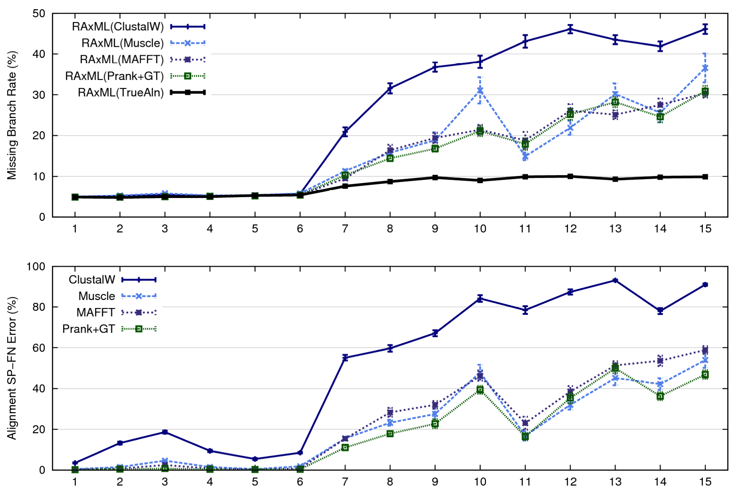
1000 taxon models ranked by difficulty
Notes:
27
1. 2 classes of MC: easy, moderate-to-difficult
2. true alignment
3. 2 classes: ClustalW, everything else
Alignment error, measured this way, isn't a perfect predictor of tree error, measured this way.

Slide 28
Problems with the two phase approach
Manual alignment can have a high level of subjectivity (and can take a long time).
Current alignment methods fail to return reasonable alignments on markers that evolve with high rates of indels and substitutions, especially if these are large datasets.
We discard potentially useful markers if they are difficult to align.

Slide 29
S1
S2
S4
S3
S1 = AGGCTATCACCTGACCTCCA
S2 = TAGCTATCACGACCGC
S3 = TAGCTGACCGC
S4 = TCACGACCGACA
and
S1 = -AGGCTATCACCTGACCTCCA
S2 = TAG-CTATCAC--GACCGC--
S3 = TAG-CT-------GACCGC--
S4 = -------TCAC--GACCGACA
Simultaneous estimation of trees and alignments
Notes:
29

Slide 30
Simultaneous Estimation Methods
Likelihood-based (under model of evolution including insertion/deletion events)‏
  ALIFRITZ, BAli-Phy, BEAST, StatAlign, others
  Computationally intensive
  Most are limited to small datasets (< 30 sequences)
Notes:
Define parsimony: instead of seeking the most probably explanation under a model, you want the most parsimonious explanation with the smallest number of evolutionary events.

Slide 31
Treelength-based
Input: Set S of unaligned sequences over an alphabet ∑, and an edit distance function F(.,.) (must account for gaps and substitutions)
Output: Tree T with sequences S at the leaves and other sequences at the internal nodes so as to minimize
  ∑_{e}F(s_{v},s_{w}),
  where the sum is taken over all edges e=(s_{v},s_{w}) in the tree

Slide 32
Minimizing treelength
Given set S of sequences and edit distance function F(.,.),
Find tree T with S at the leaves and sequences at the internal nodes so as to minimize the treelength (sum of edit distances)
NP-hard but can be approximated
NP-hard even if the tree is known!

Slide 33
Minimizing treelength
The problem of finding sequences at the internal nodes of a fixed tree was introduced by Sankoff.
Several algorithmic results related to this problem, with pretty theory
Most popular software is POY, which tries to optimize tree length.
The accuracy of any tree or alignment depends upon the edit distance function F(.,.), but so far even good affine distances don’t produce very good trees or alignments.

Slide 34
More
SATé: a heuristic method for simultaneous estimation and tree alignment
POY, POY*, and BeeTLe: results of how changing the gap penalty from simple to affine impacts the alignment and tree
Impact of guide tree on MSA
Statistical co-estimation using models that include indel events (Statalign, Alifritz, BAliPhy)
UPP (ultra-large alignments using SEPP)
Alignment estimation in the presence of duplications and rearrangements
Visualizing large alignments
The differences between amino-acid alignments and nucleotide alignments (especially for non-coding data)

Slide 35
Research Projects
How to use indel information in an alignment?
Do the statistical estimation methods (Bali-Phy, StatAlign, etc.) produce more accurate alignments than standard methods (e.g., MAFFT)? Do they result in better trees?
What benefit do we get from an improved alignment? (What biological problem does the alignment method help us solve, besides tree estimation?)

Slide 36
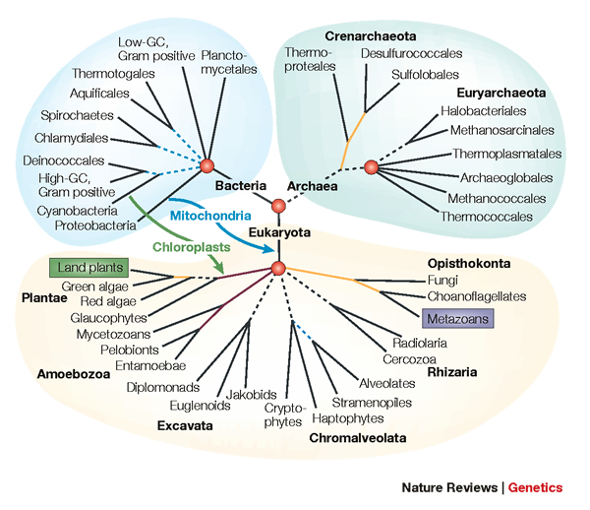
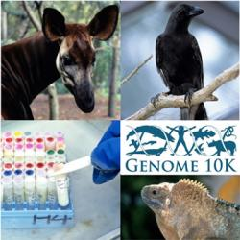
Phylogenomics
(Phylogenetic estimation from whole genomes)

Slide 37
Gene Trees to Species Trees
Gene trees are “inside” species trees
Causes of gene tree discord
Incomplete lineage sorting
Methods for estimating species trees from gene trees

Slide 38

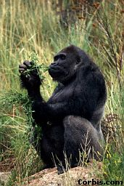


Sampling multiple genes from multiple species
Orangutan
Gorilla
Chimpanzee
Human
From the Tree of the Life Website,
University of Arizona

Slide 39
Using multiple genes
gene 1
gene 3
S₁
TCTAATGGAA
S₂
GCTAAGGGAA
gene 2
S₁
TATTGATACA
S₃
TCTAAGGGAA
S₃
TCTTGATACC
S₄
TCTAACGGAA
S₄
GGTAACCCTC
S₄
TAGTGATGCA
S₇
TCTAATGGAC
S₅
GCTAAACCTC
S₇
TAGTGATGCA
S₈
TATAACGGAA
S₆
GGTGACCATC
S₈
CATTCATACC
S₇
GCTAAACCTC

Slide 40
Two competing approaches
gene 1 gene 2 . . . gene k
Species
. . .
Concatenation
Analyze
separately
. . .
Summary Method
Notes:
point out that supertree methods take overlaping trees and produce a tree, and that the whole process of first generating small trees and then applying a supertree method is often referred to as the “supertree approach”.

Slide 41








1kp: Thousand Transcriptome Project
G. Ka-Shu Wong
U Alberta
J. Leebens-Mack
U Georgia
N. Wickett
Northwestern
N. Matasci
iPlant
T. Warnow, S. Mirarab, N. Nguyen, Md. S.Bayzid
UT-Austin UT-Austin UT-Austin UT-Austin
Plus many many other people…
Plant Tree of Life based on transcriptomes of ~1200 species
More than 13,000 gene families (most not single copy)
Gene sequence alignments and trees computed using SATé (Liu et al., Science 2009 and Systematic Biology 2012)
Gene Tree Incongruence
Challenges:
Multiple sequence alignments of > 100,000 sequences
Gene tree incongruence

Slide 42



Avian Phylogenomics Project
Erich Jarvis,
HHMI
MTP Gilbert,
Copenhagen
G Zhang,
BGI
T. Warnow
UT-Austin
S. Mirarab Md. S. Bayzid, UT-Austin UT-Austin
Plus many many other people…
Approx. 50 species, whole genomes
8000+ genes, UCEs
Gene sequence alignments and trees computed using SATé (Liu et al., Science 2009 and Systematic Biology 2012)
Challenges:
Maximum likelihood on multi-million-site sequence alignments
Massive gene tree incongruence

Slide 43
Questions
Is the model tree identifiable?
Which estimation methods are statistically consistent under this model?
What is the computational complexity of an estimation problem?

Slide 44
Statistical Consistency
error
Data

Slide 45
Statistical Consistency
error
Data
Data are sites in an alignment

Slide 46
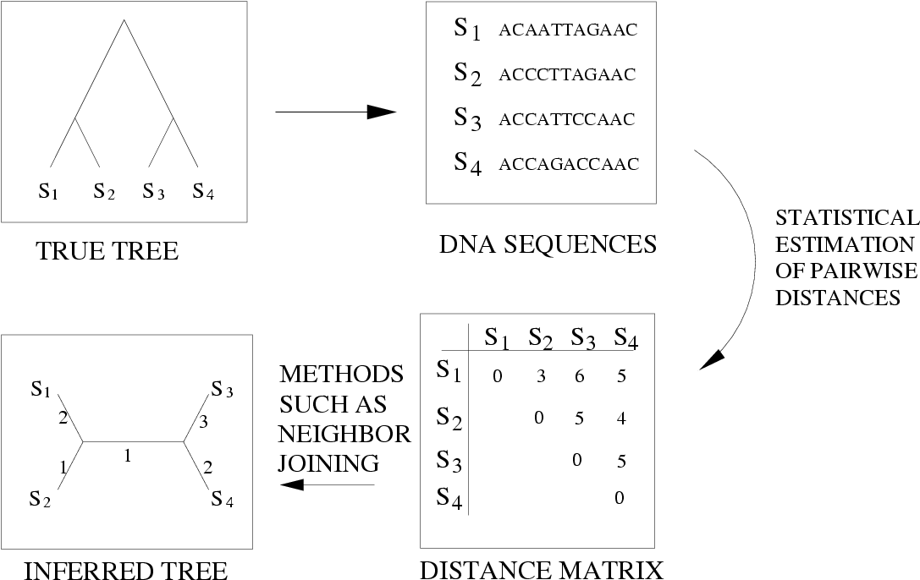
Neighbor Joining (and many other distance-based methods) are statistically consistent under Jukes-Cantor

Slide 47
Questions
Is the model tree identifiable?
Which estimation methods are statistically consistent under this model?
What is the computational complexity of an estimation problem?

Slide 48
Answers?
We know a lot about which site evolution models are identifiable, and which methods are statistically consistent.
Some polynomial time afc methods have been developed, and we know a little bit about the sequence length requirements for standard methods.
Just about everything is NP-hard, and the datasets are big.
Extensive studies show that even the best methods produce gene trees with some error.

Slide 49
Answers?
We know a lot about which site evolution models are identifiable, and which methods are statistically consistent.
Just about everything is NP-hard, and the datasets are big.
Extensive studies show that even the best methods produce gene trees with some error.

Slide 50
Answers?
We know a lot about which site evolution models are identifiable, and which methods are statistically consistent.
Just about everything is NP-hard, and the datasets are big.
Extensive studies show that even the best methods produce gene trees with some error.

Slide 51
In other words…
error
Data
Statistical consistency doesn’t guarantee accuracy w.h.p. unless the sequences are long enough.

Slide 52
Species Tree Estimation from Gene Trees
error
Data
Data are gene trees, presumed to be randomly sampled true gene trees.

Slide 53
Phylogenomics
(Phylogenetic estimation from whole genomes)
Why do we need whole genomes?
Will whole genomes make phylogeny estimation easy?
How hard are the computational problems?
Do we have sufficient methods for this?

Slide 54
Using multiple genes
gene 1
gene 3
S₁
TCTAATGGAA
S₂
GCTAAGGGAA
gene 2
S₁
TATTGATACA
S₃
TCTAAGGGAA
S₃
TCTTGATACC
S₄
TCTAACGGAA
S₄
GGTAACCCTC
S₄
TAGTGATGCA
S₇
TCTAATGGAC
S₅
GCTAAACCTC
S₇
TAGTGATGCA
S₈
TATAACGGAA
S₆
GGTGACCATC
S₈
CATTCATACC
S₇
GCTAAACCTC

Slide 55
Concatenation
gene 1
gene 2
gene 3
S₁
TCTAATGGAA
? ? ? ? ? ? ? ? ? ?
TATTGATACA
S₂
GCTAAGGGAA
? ? ? ? ? ? ? ? ? ?
? ? ? ? ? ? ? ? ? ?
S₃
TCTAAGGGAA
TCTTGATACC
? ? ? ? ? ? ? ? ? ?
S₄
TCTAACGGAA
GGTAACCCTC
TAGTGATGCA
S₅
? ? ? ? ? ? ? ? ? ?
GCTAAACCTC
? ? ? ? ? ? ? ? ? ?
S₆
? ? ? ? ? ? ? ? ? ?
GGTGACCATC
? ? ? ? ? ? ? ? ? ?
S₇
TCTAATGGAC
GCTAAACCTC
TAGTGATGCA
S₈
TATAACGGAA
? ? ? ? ? ? ? ? ? ?
CATTCATACC

Slide 56
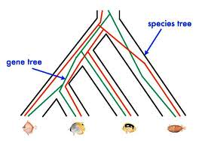
Red gene tree ≠ species tree
(green gene tree okay)

Slide 57
1KP: Thousand Transcriptome Project
Gene Tree Incongruence
G. Ka-Shu Wong
U Alberta
J. Leebens-Mack
U Georgia
N. Wickett
Northwestern
N. Matasci
iPlant
T. Warnow, S. Mirarab, N. Nguyen, Md. S.Bayzid
UT-Austin UT-Austin UT-Austin UT-Austin
1200 plant transcriptomes
More than 13,000 gene families (most not single copy)
Multi-institutional project (10+ universities)
iPLANT (NSF-funded cooperative)
Gene sequence alignments and trees computed using SATe (Liu et al., Science 2009 and Systematic Biology 2012)

Slide 58
Avian Phylogenomics Project
E Jarvis,
HHMI
MTP Gilbert,
Copenhagen
G Zhang,
BGI
T. Warnow
UT-Austin
S. Mirarab Md. S. Bayzid, UT-Austin UT-Austin
Gene Tree Incongruence
Plus many many other people…
Approx. 50 species, whole genomes
8000+ genes, UCEs
Gene sequence alignments computed using SATé (Liu et al., Science 2009 and Systematic Biology 2012)

Slide 59
Gene Tree Incongruence
Gene trees can differ from the species tree due to:
  Duplication and loss
  Horizontal gene transfer
  Incomplete lineage sorting (ILS)

Slide 60
Species Tree Estimation in the presence of ILS
Mathematical model: Kingman’s coalescent
“Coalescent-based” species tree estimation methods
Simulation studies evaluating methods
New techniques to improve methods
Application to the Avian Tree of Life

Slide 61
Species tree estimation: difficult, even for small datasets!
Orangutan
Gorilla
Chimpanzee
Human
From the Tree of the Life Website,
University of Arizona

Slide 62
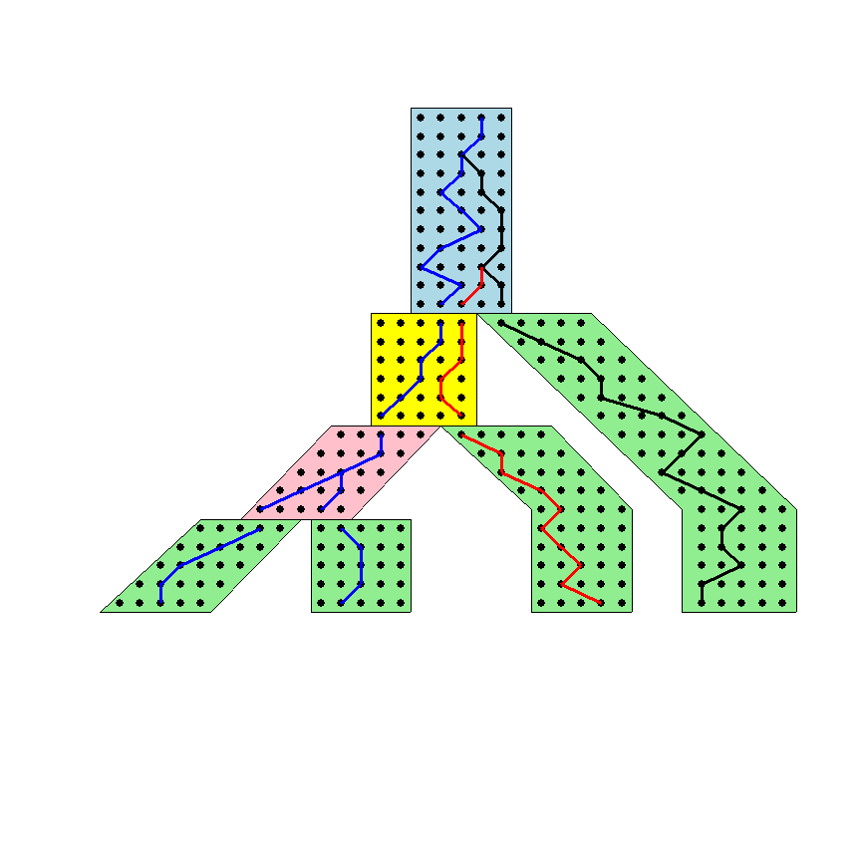




The Coalescent
Past
Gorilla and Orangutan
are not siblings in the
species tree, but they
are in the gene tree.
Present
Courtesy James Degnan

Slide 63
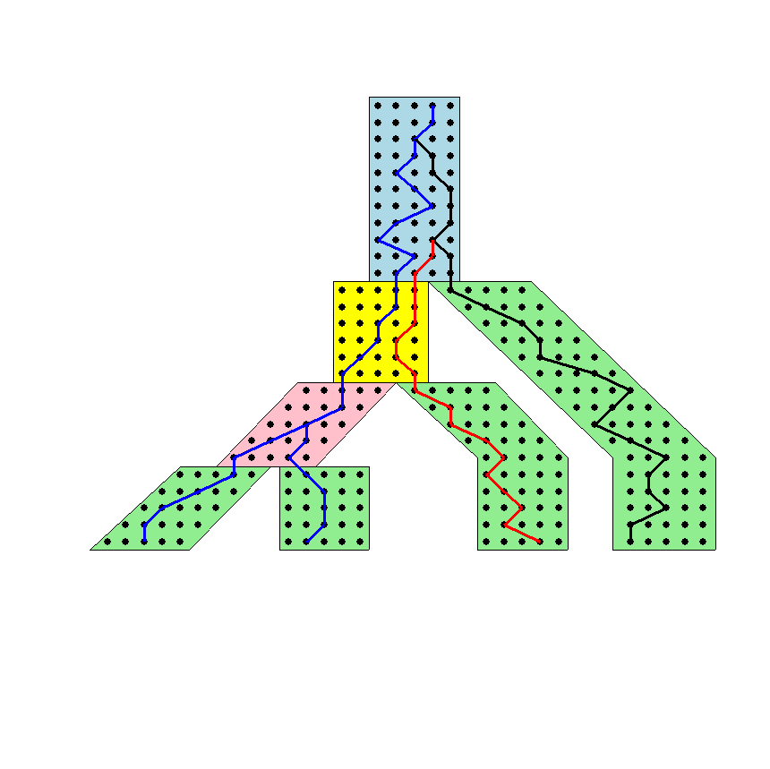
Gene tree in a species tree
Courtesy James Degnan

Slide 64
Lineage Sorting
Lineage sorting is a Population-level process, also called the “Multi-species coalescent” (Kingman, 1982).
The probability that a gene tree will differ from species trees increases for short times between speciation events or large population size.
When a gene tree differs from the species tree, this is called “Incomplete Lineage Sorting” or “Deep Coalescence”.

Slide 65
Key observation:
Under the multi-species coalescent model, the species tree defines a probability distribution on the gene trees
Courtesy James Degnan

Slide 66
Incomplete Lineage Sorting (ILS)
2000+ papers in 2013 alone
Confounds phylogenetic analysis for many groups:
  Hominids
  Birds
  Yeast
  Animals
  Toads
  Fish
  Fungi
There is substantial debate about how to analyze phylogenomic datasets in the presence of ILS.

Slide 67
Two competing approaches
gene 1 gene 2 . . . gene k
Species
. . .
Concatenation
Analyze
separately
. . .
Summary Method
Notes:
point out that supertree methods take overlaping trees and produce a tree, and that the whole process of first generating small trees and then applying a supertree method is often referred to as the “supertree approach”.

Slide 68
How to compute a species tree?
. . .
Notes:
point out that supertree methods take overlaping trees and produce a tree, and that the whole process of first generating small trees and then applying a supertree method is often referred to as the “supertree approach”.

Slide 69
MDC Problem (Maddison 1997)
Courtesy James Degnan
XL(T,t) = the number of extra lineages on the species tree T with respect to the gene tree t. In this example, XL(T,t) = 1.
MDC (minimize deep coalescence) problem:
  Given set X = {t₁,t₂,…,t_{k}} of gene trees find the species tree T
  that implies the fewest extra lineages (deep coalescences)
  with respect to X, i.e.,
  minimize MDC(T, X) = Σ_{i} XL(T,t_{i})

Slide 70
MDC Problem
MDC is NP-hard
Exact solution to MDC that runs in exponential time (Than and Nakhleh, PLoS Comp Biol 2009).
Popular technique, often gives good accuracy.
However, not statistically consistent under ILS, even if solved exactly!

Slide 71
Statistically consistent under ILS?
MDC – NO
Greedy – NO
Most frequent gene tree - NO
Concatenation under maximum likelihood – open
MRP (supertree method) – open
MP-EST (Liu et al. 2010): maximum likelihood estimation of rooted species tree – YES
BUCKy-pop (Ané and Larget 2010): quartet-based Bayesian species tree estimation –YES

Slide 72
Under the multi-species coalescent model, the species tree defines a probability distribution on the gene trees
Courtesy James Degnan
Theorem (Degnan et al., 2006, 2009): Under the multi-species coalescent model, for any three taxa A, B, and C, the most probable rooted gene tree on {A,B,C} is identical to the rooted species tree induced on {A,B,C}.

Slide 73
How to compute a species tree?
. . .
Techniques:
MDC?
Most frequent gene tree?
Consensus of gene trees?
Other?
Notes:
point out that supertree methods take overlaping trees and produce a tree, and that the whole process of first generating small trees and then applying a supertree method is often referred to as the “supertree approach”.

Slide 74
How to compute a species tree?
. . .
Theorem (Degnan et al., 2006, 2009): Under the multi-species coalescent model, for any three taxa A, B, and C, the most probable rooted gene tree on {A,B,C} is identical to the rooted species tree induced on {A,B,C}.
Notes:
point out that supertree methods take overlaping trees and produce a tree, and that the whole process of first generating small trees and then applying a supertree method is often referred to as the “supertree approach”.

Slide 75
How to compute a species tree?
. . .
. . .
Estimate species
tree for every
3 species
Theorem (Degnan et al., 2006, 2009): Under the multi-species coalescent model, for any three taxa A, B, and C, the most probable rooted gene tree on {A,B,C} is identical to the rooted species tree induced on {A,B,C}.
Notes:
point out that supertree methods take overlaping trees and produce a tree, and that the whole process of first generating small trees and then applying a supertree method is often referred to as the “supertree approach”.

Slide 76
How to compute a species tree?
. . .
. . .
Estimate species
tree for every
3 species
Theorem (Aho et al.): The rooted tree on n species can be computed from its set of 3-taxon rooted subtrees in polynomial time.
Notes:
point out that supertree methods take overlaping trees and produce a tree, and that the whole process of first generating small trees and then applying a supertree method is often referred to as the “supertree approach”.

Slide 77
How to compute a species tree?
. . .
. . .
Estimate species
tree for every
3 species
Combine
rooted
3-taxon
trees
Theorem (Aho et al.): The rooted tree on n species can be computed from its set of 3-taxon rooted subtrees in polynomial time.
Notes:
point out that supertree methods take overlaping trees and produce a tree, and that the whole process of first generating small trees and then applying a supertree method is often referred to as the “supertree approach”.

Slide 78
How to compute a species tree?
. . .
. . .
Estimate species
tree for every
3 species
Combine
rooted
3-taxon
trees
Theorem (Degnan et al., 2009): Under the multi-species coalescent, the rooted species tree can be estimated correctly (with high probability) given a large enough number of true rooted gene trees.
Theorem (Allman et al., 2011): the unrooted species tree can be estimated from a large enough number of true unrooted gene trees.
Notes:
point out that supertree methods take overlaping trees and produce a tree, and that the whole process of first generating small trees and then applying a supertree method is often referred to as the “supertree approach”.

Slide 79
How to compute a species tree?
. . .
. . .
Estimate species
tree for every
3 species
Combine
rooted
3-taxon
trees
Theorem (Degnan et al., 2009): Under the multi-species coalescent, the rooted species tree can be estimated correctly (with high probability) given a large enough number of true rooted gene trees.
Theorem (Allman et al., 2011): the unrooted species tree can be estimated from a large enough number of true unrooted gene trees.
Notes:
point out that supertree methods take overlaping trees and produce a tree, and that the whole process of first generating small trees and then applying a supertree method is often referred to as the “supertree approach”.

Slide 80
How to compute a species tree?
. . .
. . .
Estimate species
tree for every
3 species
Combine
rooted
3-taxon
trees
Theorem (Degnan et al., 2009): Under the multi-species coalescent, the rooted species tree can be estimated correctly (with high probability) given a large enough number of true rooted gene trees.
Theorem (Allman et al., 2011): the unrooted species tree can be estimated from a large enough number of true unrooted gene trees.
Notes:
point out that supertree methods take overlaping trees and produce a tree, and that the whole process of first generating small trees and then applying a supertree method is often referred to as the “supertree approach”.

Slide 81
Statistical Consistency
error
Data
Data are gene trees, presumed to be randomly sampled true gene trees.

Slide 82
Statistically consistent methods under ILS
Quartet-based methods (e.g., BUCKy-pop (Ané and Larget 2010)) for unrooted species trees
MP-EST (Liu et al. 2010): maximum likelihood estimation of rooted species tree for rooted species trees
*BEAST (Heled and Drummond, 2011), co-estimates gene trees and species trees
(and some others)

Slide 83
Questions
Is the model tree identifiable?
Which estimation methods are statistically consistent under this model?
What is the computational complexity of an estimation problem?
What is the performance in practice?

Slide 84
Results on 11-taxon weakILS
20 replicates studied, due to computational challenge of running *BEAST and BUCKy

Slide 85
Results on 11-taxon strongILS
20 replicates studied, due to computational challenge of running *BEAST and BUCKy

Slide 86
*BEAST is better than ML at estimating gene trees
11-taxon weakILS datasets
17-taxon (very high ILS) datasets
FastTree-2 and RAxML very close in accuracy
*BEAST much more accurate than both ML methods
*BEAST gives biggest improvement under low-ILS conditions

Slide 87
Impact of Gene Tree Estimation Error on MP-EST
MP-EST has no error on true gene trees, but
MP-EST has 9% error on estimated gene trees
Similar results for other summary methods (e.g., MDC)
Datasets: 11-taxon 50-gene datasets with high ILS (Chung and Ané 2010).

Slide 88
Problem: poor phylogenetic signal
Summary methods combine estimated gene trees, not true gene trees.
The individual genes in the 11-taxon datasets have poor phylogenetic signal.
Species trees obtained by combining poorly estimated gene trees have poor accuracy.

Slide 89
Controversies/Open Problems
Concatenation may (or may not be) statistically consistent under ILS – but some simulation studies suggest it can be positively misleading.
Coalescent-based methods have not in general given strong results on biological data – can give poor bootstrap support, or produce strange trees, compared to concatenation.

Slide 90
Problem: poor gene trees
Summary methods combine estimated gene trees, not true gene trees.
The individual gene sequence alignments in the 11-taxon datasets have poor phylogenetic signal, and result in poorly estimated gene trees.
Species trees obtained by combining poorly estimated gene trees have poor accuracy.

Slide 91
Problem: poor gene trees
Summary methods combine estimated gene trees, not true gene trees.
The individual gene sequence alignments in the 11-taxon datasets have poor phylogenetic signal, and result in poorly estimated gene trees.
Species trees obtained by combining poorly estimated gene trees have poor accuracy.

Slide 92
Problem: poor gene trees
Summary methods combine estimated gene trees, not true gene trees.
The individual gene sequence alignments in the 11-taxon datasets have poor phylogenetic signal, and result in poorly estimated gene trees.
Species trees obtained by combining poorly estimated gene trees have poor accuracy.

Slide 93
TYPICAL PHYLOGENOMICS PROBLEM:
many poor gene trees
Summary methods combine estimated gene trees, not true gene trees.
The individual gene sequence alignments in the 11-taxon datasets have poor phylogenetic signal, and result in poorly estimated gene trees.
Species trees obtained by combining poorly estimated gene trees have poor accuracy.

Slide 94
Research Projects
Coalescent-based methods: analyze a biological dataset using different coalescent-based methods and compare to concatenation
Evaluation impact of choice of gene trees (e.g., removing gene trees with low support)
Evaluate impact of missing taxa in gene trees
Develop new coalescent-based method (e.g., combine quartet trees)
Evaluate scalability of coalescent-based methods

