Slide 1
Software for Scientists
Tandy Warnow
Department of Computer Science
University of Texas at Austin

Slide 2




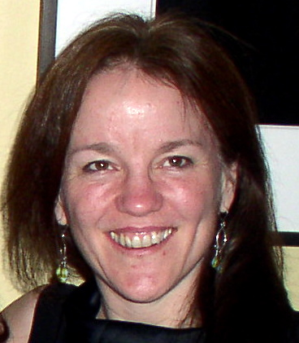
Warnow Laboratory
PhD students: Siavash Mirarab¹, Nam Nguyen, and Md. S. Bayzid²
Undergrad: Keerthana Kumar
Lab Website: http://www.cs.utexas.edu/users/phylo
Funding: Guggenheim Foundation, Packard Foundation, NSF, Microsoft Research New England, David Bruton Jr. Centennial Professorship, and TACC (Texas Advanced Computing Center)
¹HHMI International Predoctoral Fellow, ²Fulbright Predoctoral Fellow

Slide 3
Main Points
Computer scientists develop algorithms and software to make it possible for scientists to get improved accuracy in their analyses.
These algorithms involve creative strategies, including divide-and-conquer, iteration, and randomization.
Extensive simulations and data analyses are part of the evaluation process!

Slide 4




Slide 5

BigData for Biology: Genomics

Slide 6
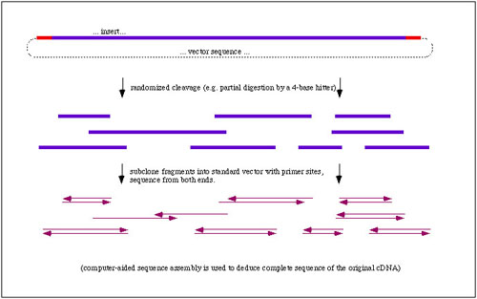
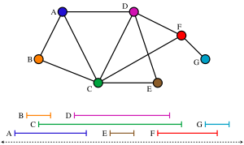
Whole Genome Sequencing:
Graph Algorithms and Combinatorial Optimization!

Slide 7
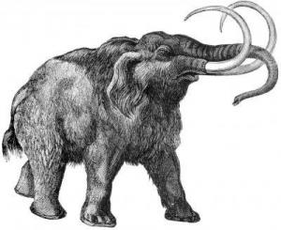
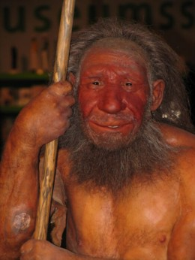


Other Genome Projects! (Neandertals, Wooly Mammoths, and more ordinary creatures…)

Slide 8
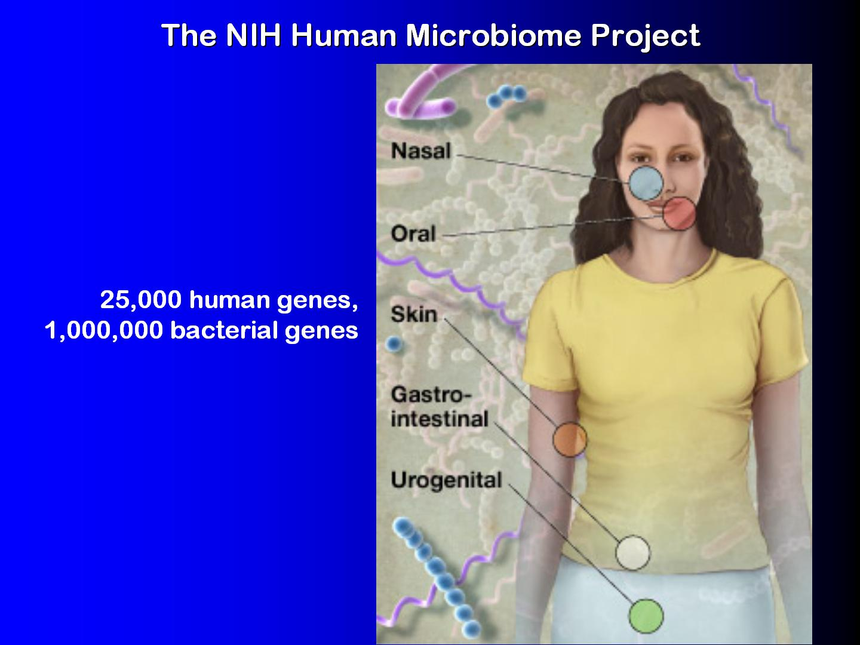

Slide 9

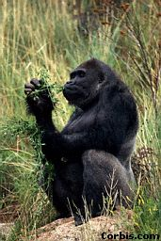
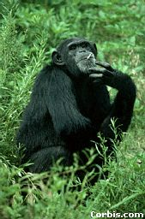

Phylogeny (evolutionary tree)
Orangutan
Gorilla
Chimpanzee
Human
From the Tree of the Life Website,
University of Arizona

Slide 10
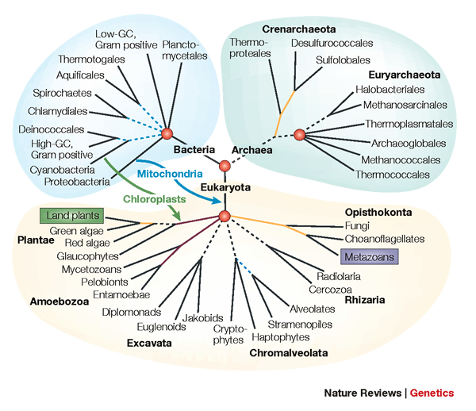
Assembling the Tree of Life

Slide 11
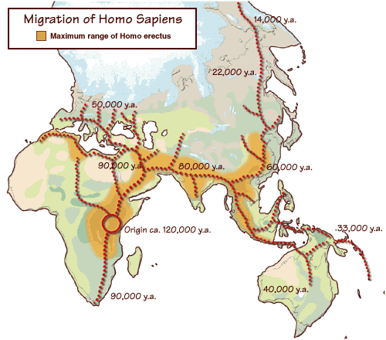
Where did humans come from, and how did they move throughout the globe?
The 1000 Genome Project: using human genetic variation to better treat diseases

Slide 12
Goal: Constructing a Tree of Life
Why do we want to do this?
What are the computer science challenges?
What kinds of techniques help us do this well?

Slide 13
Why? Because!
Evolutionary history relates all organisms and genes, and helps us understand and predict
  interactions between genes (genetic networks)
  drug design
  predicting functions of genes
  influenza vaccine development
  origins and spread of disease
  origins and migrations of humans
“Nothing in biology makes sense except in the light of evolution” Dobzhansky

Slide 14
DNA Sequence Evolution
AAGACTT
-3 mil yrs
AAGACTT
-2 mil yrs
AAGGCCT
AAGGCCT
AAGGCCT
AAGGCCT
TGGACTT
TGGACTT
TGGACTT
TGGACTT
-1 mil yrs
AGGGCAT
AGGGCAT
AGGGCAT
TAGCCCT
TAGCCCT
TAGCCCT
AGCACTT
AGCACTT
AGCACTT
AGGGCAT
TAGCCCA
TAGACTT
AGCACAA
AGCGCTT
today
AGGGCAT
TAGCCCA
TAGACTT
AGCACAA
AGCGCTT

Slide 15
Phylogeny Problem
U
V
W
X
Y
AGGGCAT
TAGCCCA
TAGACTT
TGCACAA
TGCGCTT
X
U
Y
V
W

Slide 16
Performance criteria
Running time.
Space.
“Topological accuracy” with respect to the underlying true tree or true alignment. Typically studied in simulation or using mathematical theory.
Accuracy with respect to a particular criterion (e.g. maximum likelihood score), on real data.

Slide 17
Tree Estimation Methods
Bayesian MCMC -- very very slow to converge
NP-hard problems:
  Maximum parsimony
  Maximum likelihood
Polynomial time methods:
  Neighbor joining
  FastME
  UPGMA
  Quartet puzzling
Notes:
17

Slide 18
Tree Estimation Methods
Bayesian MCMC -- very very slow to converge
NP-hard problems:
  Maximum parsimony
  Maximum likelihood
Polynomial time methods:
  Neighbor joining
  FastME
  UPGMA
  Quartet puzzling
Notes:
18

Slide 19
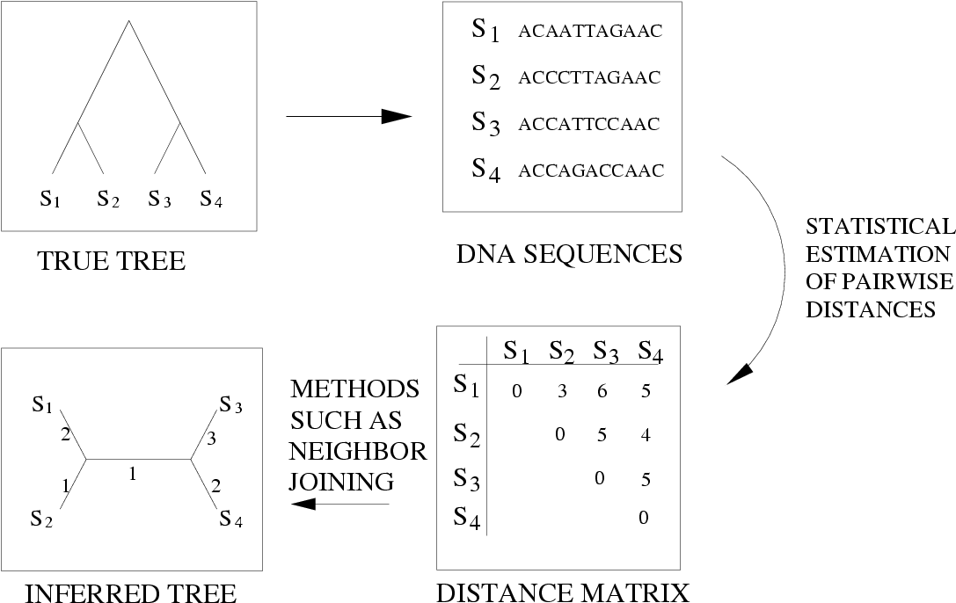
Distance-based estimation

Slide 20
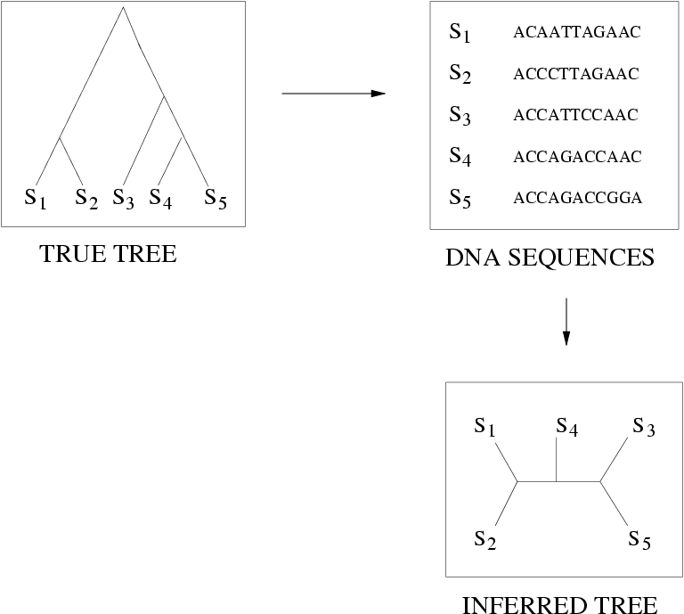
Quantifying Error
FN
FN: false negative
(missing edge)
FP: false positive
(incorrect edge)
50% error rate
FP

Slide 21
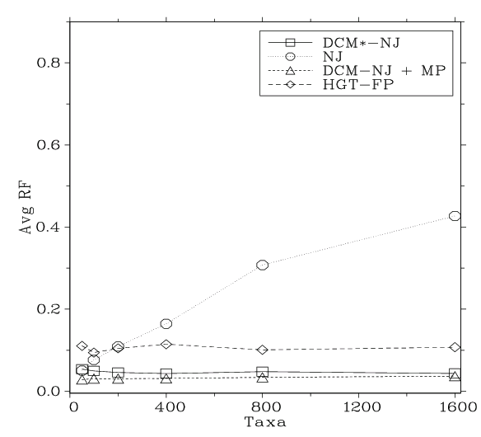
Polynomial time methods typically have high error rates on large trees
Simulation study based upon fixed edge lengths, K2P model of evolution, sequence lengths fixed to 1000 nucleotides.
Neighbor joining method for tree estimation.
Error rates reflect proportion of incorrect edges in inferred trees.
[Nakhleh et al. ISMB 2001]
0.8
NJ
0.6
Error Rate
0.4
0.2
0
0
400
800
1200
1600
No. Taxa

Slide 22
Tree Estimation Methods
Bayesian MCMC -- very very slow to converge
NP-hard problems:
  Maximum parsimony
  Maximum likelihood
Polynomial time methods:
  Neighbor joining
  FastME
  UPGMA
  Quartet puzzling
Notes:
22

Slide 23
A polynomial-time problem
2-colorability: Given graph G = (V,E), determine if we can assign colors red and blue to the vertices of G so that no edge connects vertices of the same color.
Greedy Algorithm. Start with one vertex and make it red, and then make all its neighbors blue, and keep going. If you succeed in coloring the graph without making two nodes of the same color adjacent, the graph can be 2-colored.
Running time: O(n+m) time, where n is the number of vertices and m is the number of edges.

Slide 24
A polynomial-time problem
2-colorability: Given graph G = (V,E), determine if we can assign colors red and blue to the vertices of G so that no edge connects vertices of the same color.
Greedy Algorithm. Start with one vertex and make it red, and then make all its neighbors blue, and keep going. If you succeed in coloring the graph without making two nodes of the same color adjacent, the graph can be 2-colored.
Running time: O(n+m) time, where n is the number of vertices and m is the number of edges.

Slide 25
What about this?
3-colorability: Given graph G, determine if we can assign red, blue, and green to the vertices in G so that no edge connects vertices of the same color.

Slide 26
Some decision problems can be solved in polynomial time:
  Can graph G be 2-colored?
  Does graph G have a Eulerian tour?
Some decision problems seem to not be solvable in polynomial time:
  Can graph G be 3-colored?
  Does graph G have a Hamiltonian cycle?

Slide 27
What about this?
3-colorability: Given graph G, determine if we can assign red, blue, and green to the vertices in G so that no edge connects vertices of the same color.
This problem is provably NP-hard. What does this mean?

Slide 28
P vs. NP, continued
The “big” question in theoretical computer science is:
  Is it possible to solve an NP-hard problem in polynomial time?
If the answer is “yes”, then all NP-hard problems can be solved in polynomial time, so P=NP. This is generally not believed.

Slide 29
Coping with NP-hard problems
Since NP-hard problems may not be solvable in polynomial time, the options are:
  Solve the problem exactly (but use lots of time on some inputs)
  Use heuristics which may not solve the problem exactly (and which might be computationally expensive, anyway)

Slide 30
Solving NP-hard problems exactly is … unlikely
#leaves | #trees
4 | 3
5 | 15
6 | 105
7 | 945
8 | 10395
9 | 135135
10 | 2027025
20 | 2.2 x 10²⁰
100 | 4.5 x 10¹⁹⁰
1000 | 2.7 x 10²⁹⁰⁰
Number of (unrooted) binary trees on n leaves is (2n-5)!!
If each tree on 1000 taxa could be analyzed in 0.001 seconds, we would find the best tree in
2890 millennia

Slide 31
Tree Estimation Methods
Bayesian MCMC -- very very slow to converge
NP-hard problems:
  Maximum parsimony
  Maximum likelihood
Polynomial time methods:
  Neighbor joining
  FastME
  UPGMA
  Quartet puzzling
Notes:
31

Slide 32
NP-hard optimization problems: better accuracy, but slow to find good solutions
Current best techniques
DCM boosted version of best techniques
Comparison of TNT to Rec-I-DCM3(TNT) on one large dataset

Slide 33
NP-hard problems in Biology
Optimization problems in biology are almost all NP-hard, and heuristics may run for months (or years!!) before finding local optima.
The challenge here is to find better heuristics, since exact solutions are very unlikely to ever be achievable on large datasets.

Slide 34
Challenges
Tree estimation:
The most accurate methods are heuristics for NP-hard problems, but these may not run efficiently (or find good solutions) on big datasets.
Polynomial time methods have poor accuracy on large datasets

Slide 35
DNA Sequence Evolution
AAGACTT
-3 mil yrs
AAGACTT
-2 mil yrs
AAGGCCT
AAGGCCT
AAGGCCT
AAGGCCT
TGGACTT
TGGACTT
TGGACTT
TGGACTT
-1 mil yrs
AGGGCAT
AGGGCAT
AGGGCAT
TAGCCCT
TAGCCCT
TAGCCCT
AGCACTT
AGCACTT
AGCACTT
AGGGCAT
TAGCCCA
TAGACTT
AGCACAA
AGCGCTT
today
AGGGCAT
TAGCCCA
TAGACTT
AGCACAA
AGCGCTT

Slide 36
Phylogeny Problem
U
V
W
X
Y
AGGGCAT
TAGCCCA
TAGACTT
TGCACAA
TGCGCTT
X
U
Y
V
W

Slide 37
The “real” problem!
U
V
W
X
Y
AGGGCATGA
AGAT
TAGACTT
TGCACAA
TGCGCTT
X
U
Y
V
W

Slide 38
Deletion
Substitution
…ACGGTGCAGTTACCA…
Insertion
…ACGGTGCAGTTACC-A…
…AC----CAGTCACCTA…
…ACCAGTCACCTA…
The true multiple alignment
  Reflects historical substitution, insertion, and deletion events
  Defined using transitive closure of pairwise alignments computed on edges of the true tree
Notes:
38
Homology = nucleotides lined up since they come from a common ancestor.
Indel = dash.

Slide 39
Input: unaligned sequences
S1 = AGGCTATCACCTGACCTCCA
S2 = TAGCTATCACGACCGC
S3 = TAGCTGACCGC
S4 = TCACGACCGACA

Slide 40
Phase 1: Multiple Sequence Alignment
S1 = AGGCTATCACCTGACCTCCA
S2 = TAGCTATCACGACCGC
S3 = TAGCTGACCGC
S4 = TCACGACCGACA
S1 = -AGGCTATCACCTGACCTCCA
S2 = TAG-CTATCAC--GACCGC--
S3 = TAG-CT-------GACCGC--
S4 = -------TCAC--GACCGACA

Slide 41
Phase 2: Construct tree
S1 = AGGCTATCACCTGACCTCCA
S2 = TAGCTATCACGACCGC
S3 = TAGCTGACCGC
S4 = TCACGACCGACA
S1 = -AGGCTATCACCTGACCTCCA
S2 = TAG-CTATCAC--GACCGC--
S3 = TAG-CT-------GACCGC--
S4 = -------TCAC--GACCGACA
S1
S2
S4
S3

Slide 42
Two-phase estimation
Alignment methods
Clustal
POY (and POY*)
Probcons (and Probtree)
Probalign
MAFFT
Muscle
Di-align
T-Coffee
Prank (PNAS 2005, Science 2008)
Opal (ISMB and Bioinf. 2007)
FSA (PLoS Comp. Bio. 2009)
Infernal (Bioinf. 2009)
Etc.
Phylogeny methods
Bayesian MCMC
Maximum parsimony
Maximum likelihood
Neighbor joining
FastME
UPGMA
Quartet puzzling
Etc.
RAxML: heuristic for large-scale ML optimization
Notes:
42

Slide 43
Simulation Studies
S1 = AGGCTATCACCTGACCTCCA
S2 = TAGCTATCACGACCGC
S3 = TAGCTGACCGC
S4 = TCACGACCGACA
Unaligned Sequences
S1 = -AGGCTATCACCTGACCTCCA
S2 = TAG-CTATCAC--GACCGC--
S3 = TAG-CT-------GACCGC--
S4 = -------TCAC--GACCGACA
S1 = -AGGCTATCACCTGACCTCCA
S2 = TAG-CTATCAC--GACCGC--
S3 = TAG-C--T-----GACCGC--
S4 = T---C-A-CGACCGA----CA
S1
S2
S1
S4
Compare
S4
S3
S2
S3
True tree and alignment
Estimated tree and alignment

Slide 44
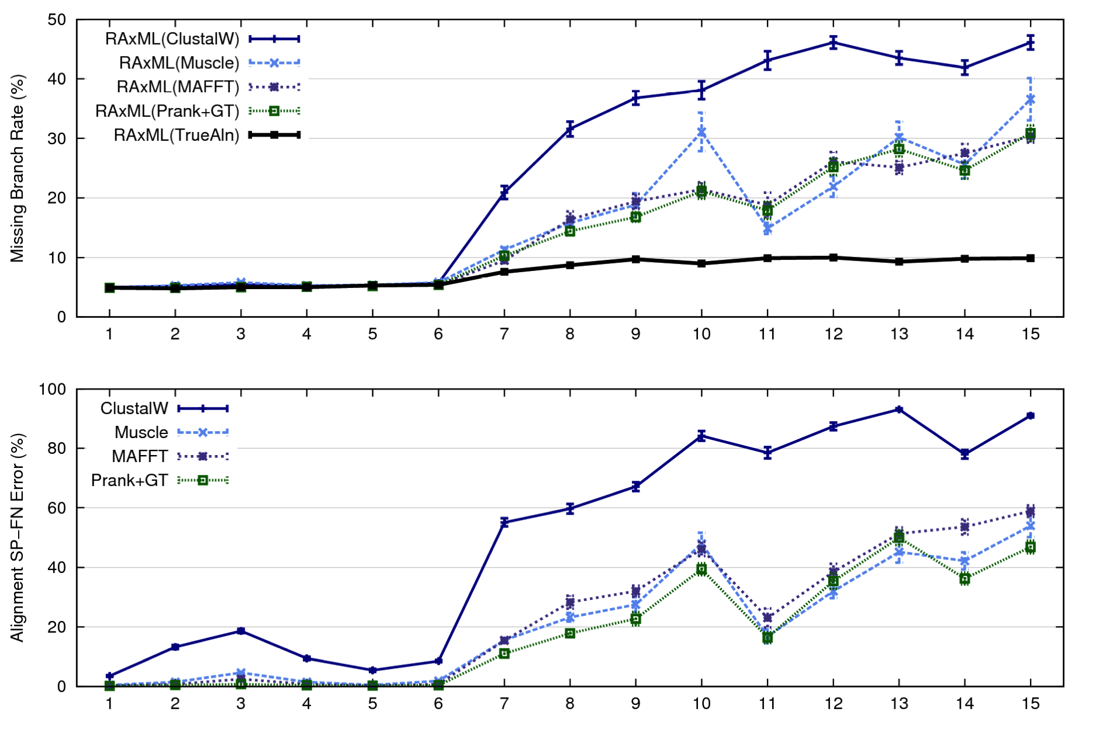
1000 taxon models, ordered by difficulty (Liu et al., 2009)
Notes:
44
1. 2 classes of MC: easy, moderate-to-difficult
2. true alignment
3. 2 classes: ClustalW, everything else
Alignment error, measured this way, isn't a perfect predictor of tree error, measured this way.

Slide 45
Problems
Large datasets with high rates of evolution are hard to align accurately, and phylogeny estimation methods produce poor trees when alignments are poor.
Many phylogeny estimation methods have poor accuracy on large datasets (even if given correct alignments)
Potentially useful genes are often discarded if they are difficult to align.
These issues seriously impact large-scale phylogeny estimation (and Tree of Life projects)

Slide 46
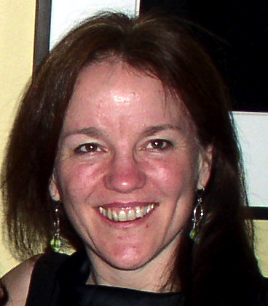
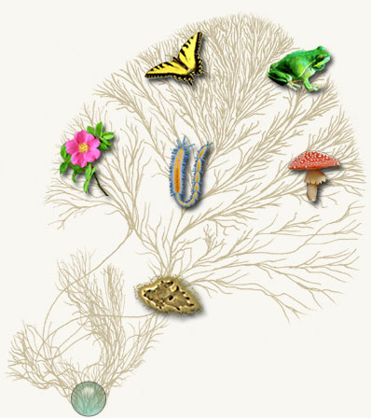
Computational Phylogenetics
Current methods can use months to
estimate trees on 1000 DNA sequences
Our objective:
More accurate trees and alignments
on 500,000 sequences in under a week
We prove theorems using graph theory
and probability theory, and our
algorithms are studied on real and
simulated data.
Courtesy of the Tree of Life project

Slide 47
(Some of) our Methods
SATé, PASTA, and UPP: large, very large, and ultra-large multiple sequence alignment
DACTAL and DCM: ultra-large tree estimation
Techniques:
  Divide-and-conquer
  Iteration
  Hidden Markov Models
  Graph Theory

Slide 48
Divide-and-Conquer
Divide-and-conquer is a basic algorithmic trick for solving problems!
Basic idea: divide a dataset into two or more sets, solve the problem on each set, and then combine solutions.
Example: MergeSort to sort a list of k integers!

Slide 49
Divide-and-Conquer
MergeSort solves the “Sorting Problem”: given a list of integers, put them into increasing order (smallest to largest).
This can be done by recursively dividing the unsorted list in half, applying MergeSort to each side, and then merging the right and left back together.

Slide 50
Merge Sort Algorithm
Given a list L with a length k:
If k == 1 → the list is sorted
Else:
  Merge Sort the left side (0 through k/2)
  Merge Sort the right side (k/2+1 thru k)
  Merge the right side with the left side

Slide 51
Merging two sorted lists
X:
3 | 10 | 23 | 54
Y:
1 | 5 | 25 | 75
Result:

Slide 52
Merging (cont.)
X:
3 | 10 | 23 | 54
Y:
 | 5 | 25 | 75
Result:
1

Slide 53
Merging (cont.)
X:
 | 10 | 23 | 54
Y:
 | 5 | 25 | 75
Result:
1 | 3

Slide 54
Merging (cont.)
X:
 | 10 | 23 | 54
Y:
 |  | 25 | 75
Result:
1 | 3 | 5

Slide 55
Merging (cont.)
X:
 |  | 23 | 54
Y:
 |  | 25 | 75
Result:
1 | 3 | 5 | 10

Slide 56
Merging (cont.)
X:
 |  |  | 54
Y:
 |  | 25 | 75
Result:
1 | 3 | 5 | 10 | 23

Slide 57
Merging (cont.)
X:
 |  |  | 54
Y:
 |  |  | 75
Result:
1 | 3 | 5 | 10 | 23 | 25

Slide 58
Merging (cont.)
X:
Y:
 |  |  | 75
Result:
1 | 3 | 5 | 10 | 23 | 25 | 54

Slide 59
Merging (cont.)
X:
Y:
Result:
1 | 3 | 5 | 10 | 23 | 25 | 54 | 75

Slide 60
Divide-and-Conquer for
Tree Estimation
Basic idea: divide a dataset into two or more overlapping subsets, construct trees on each set, and then combine trees!
Somewhat easy to figure out how to do this on rooted trees, but a bit harder on unrooted trees.

Slide 61
Constructing trees from smaller trees
Rooted trees: If they agree, it’s easy! (Not so easy if they disagree)
Unrooted trees: NP-hard, even if they agree!
+
=
a
b
c
a
d
b
a
d
b
c

Slide 62
DCMs: Divide-and-conquer for improving phylogeny reconstruction

Slide 63
Four Boosters
DCM1: improves accuracy of distance-based methods using divide-and-conquer and chordal graph theory
DACTAL: uses divide-and-conquer plus iteration to get a very large tree without needing a multiple sequence alignment
SATé: uses divide-and-conquer plus iteration to co-estimate the multiple sequence alignment and a tree
UPP: uses divide-and-conquer, randomization, and Hidden Markov Models to obtain ultra-large alignments

Slide 64
First example: DCM1
DCM = “Disk Covering Method”
Theory: Warnow, St. John, and Moret, SODA 2001,
Practice:Nakhleh et al., ISMB 2001

Slide 65
Performance on large diameter trees
Simulation study based upon fixed edge lengths, K2P model of evolution, sequence lengths fixed to 1000 nucleotides.
Error rates reflect proportion of incorrect edges in inferred trees.
[Nakhleh et al. ISMB 2001]
0.8
NJ
0.6
Error Rate
0.4
0.2
0
0
400
800
1200
1600
No. Taxa

Slide 66
DCM1 Decompositions
Input: Distance matrix (distances between species) and threshold q.
Output: Division of the set of species into overlapping subsets.
Technique: Compute maximal cliques in a “Triangulated Threshold Graph”.
Looks like moving a disk across a tree!

Slide 67
DCM1-boosting distance-based methods
[Nakhleh et al. ISMB 2001]
Theorem (Warnow et al., SODA 2001): DCM1-NJ converges to the true tree from polynomial length sequences
0.8
NJ
DCM1-NJ
0.6
Error Rate
0.4
0.2
0
0
400
800
1200
1600
No. Taxa

Slide 68
Second Example: DACTAL
(Divide-And-Conquer Trees (Almost) without alignments)
Input: set S of unaligned sequences
Output: tree on S (but no alignment)
Nelesen, Liu, Wang, Linder, and Warnow, ISMB and Bioinformatics 2012

Slide 69
DACTAL
BLAST-based
Existing Method:
RAxML(MAFFT)
Unaligned Sequences
Overlapping
subsets
pRecDCM3
A tree for each subset
New supertree method: SuperFine
A tree for the entire dataset

Slide 70
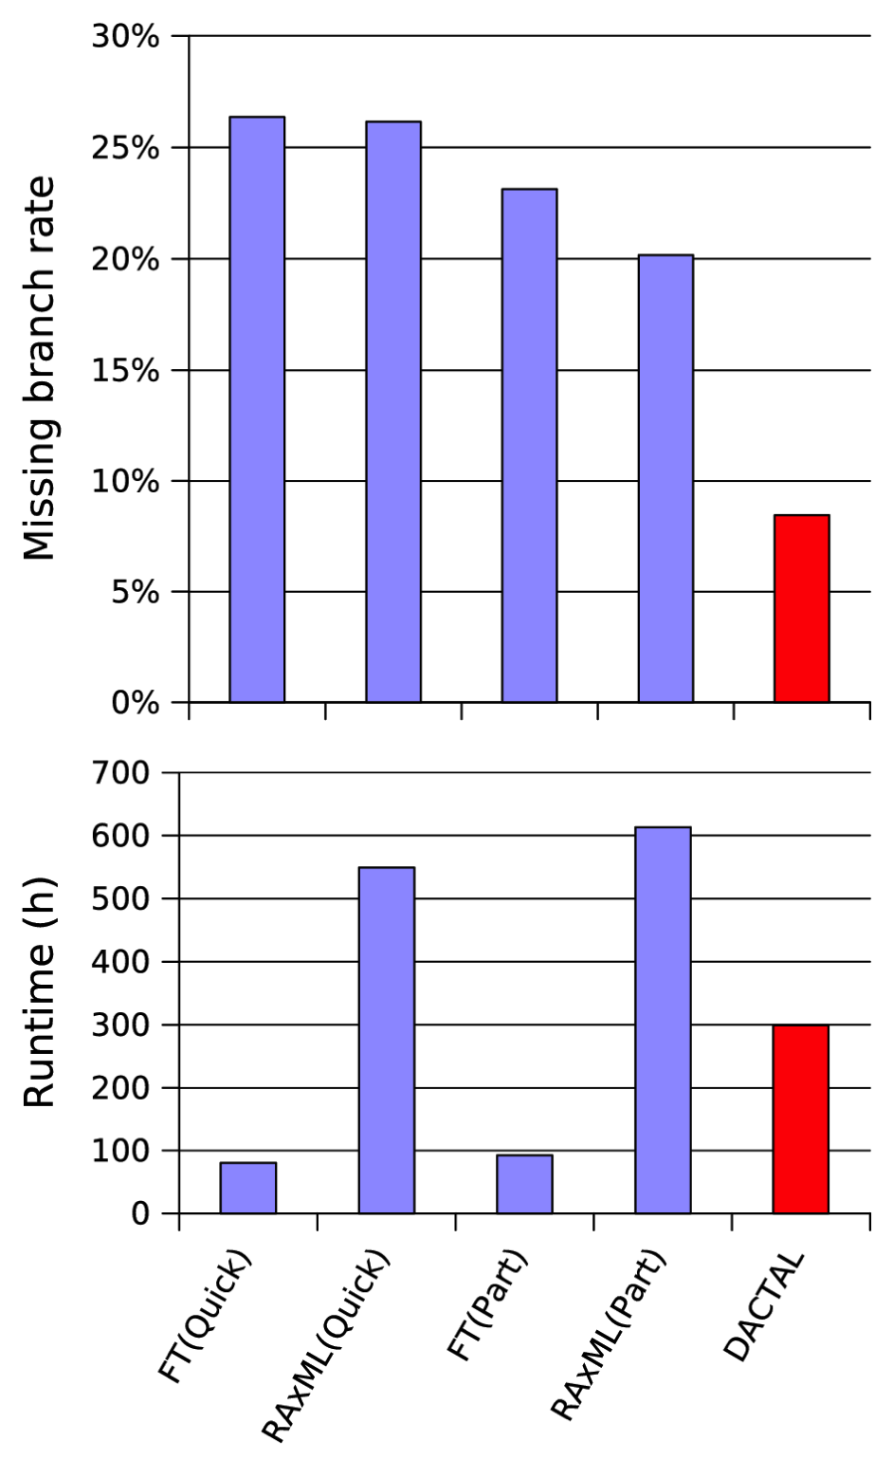
Average of 3 Largest CRW Datasets
CRW: Comparative RNA database,
Three 16S datasets with 6,323 to 27,643 sequences
Reference alignments based on secondary structure
Reference trees are 75% RAxML bootstrap trees
DACTAL (shown in red) run for 5 iterations starting from FT(Part)
FastTree (FT) and RAxML are ML methods

Slide 71
Divide-and-Conquer for Alignment
SATé: uses divide-and-conquer plus iteration to co-estimate the multiple sequence alignment and a tree
UPP: uses divide-and-conquer, randomization, and Hidden Markov Models to obtain ultra-large alignments

Slide 72
Example 3: SATé
SATé: Simultaneous Alignment and Tree Estimation
Liu, Nelesen, Raghavan, Linder, and Warnow, Science, 19 June 2009, pp. 1561-1564.
Liu et al., Systematic Biology 2012
Public software distribution (open source) through Mark Holder’s group at the University of Kansas

Slide 73
U
V
W
X
Y
AGGGCATGA
AGAT
TAGACTT
TGCACAA
TGCGCTT
X
U
Y
V
W

Slide 74
1000 taxon models, ordered by difficulty (Liu et al., 2009)
Notes:
74
1. 2 classes of MC: easy, moderate-to-difficult
2. true alignment
3. 2 classes: ClustalW, everything else
Alignment error, measured this way, isn't a perfect predictor of tree error, measured this way.

Slide 75
Re-aligning on a tree
A
C
Decompose dataset
A
B
C
D
B
D
Align subproblems
A
B
C
D
Estimate ML tree on merged alignment
ABCD
Merge sub-alignments

Slide 76
SATé Algorithm
Obtain initial alignment and estimated ML tree
Tree

Slide 77
SATé Algorithm
Obtain initial alignment and estimated ML tree
Tree
Use tree to compute new alignment
Alignment

Slide 78
SATé Algorithm
Obtain initial alignment and estimated ML tree
Tree
Use tree to compute new alignment
Estimate ML tree on new alignment
Alignment

Slide 79
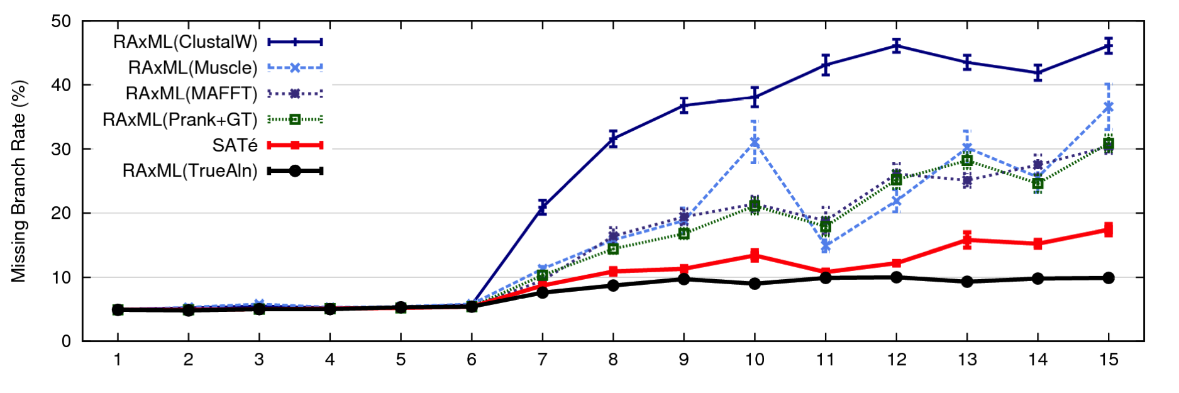
1000 taxon models, ordered by difficulty
24 hour SATé analysis, on desktop machines
(Similar improvements for biological datasets)
Notes:
For moderate-to-difficult datasets, SATe gets better trees and alignments than all other estimated methods. Close to what you might get if you had access to true alignment.
Opens up a new realm of possibility: Datasets currently considered “unalignable” can in fact be aligned reasonably well. This opens up the feasibility of accurate estimations of deep evolutionary histories using a wider range of markers.
TRANSITION: can we do better? What about smaller simulated datasets? And what about biological datasets?

Slide 80
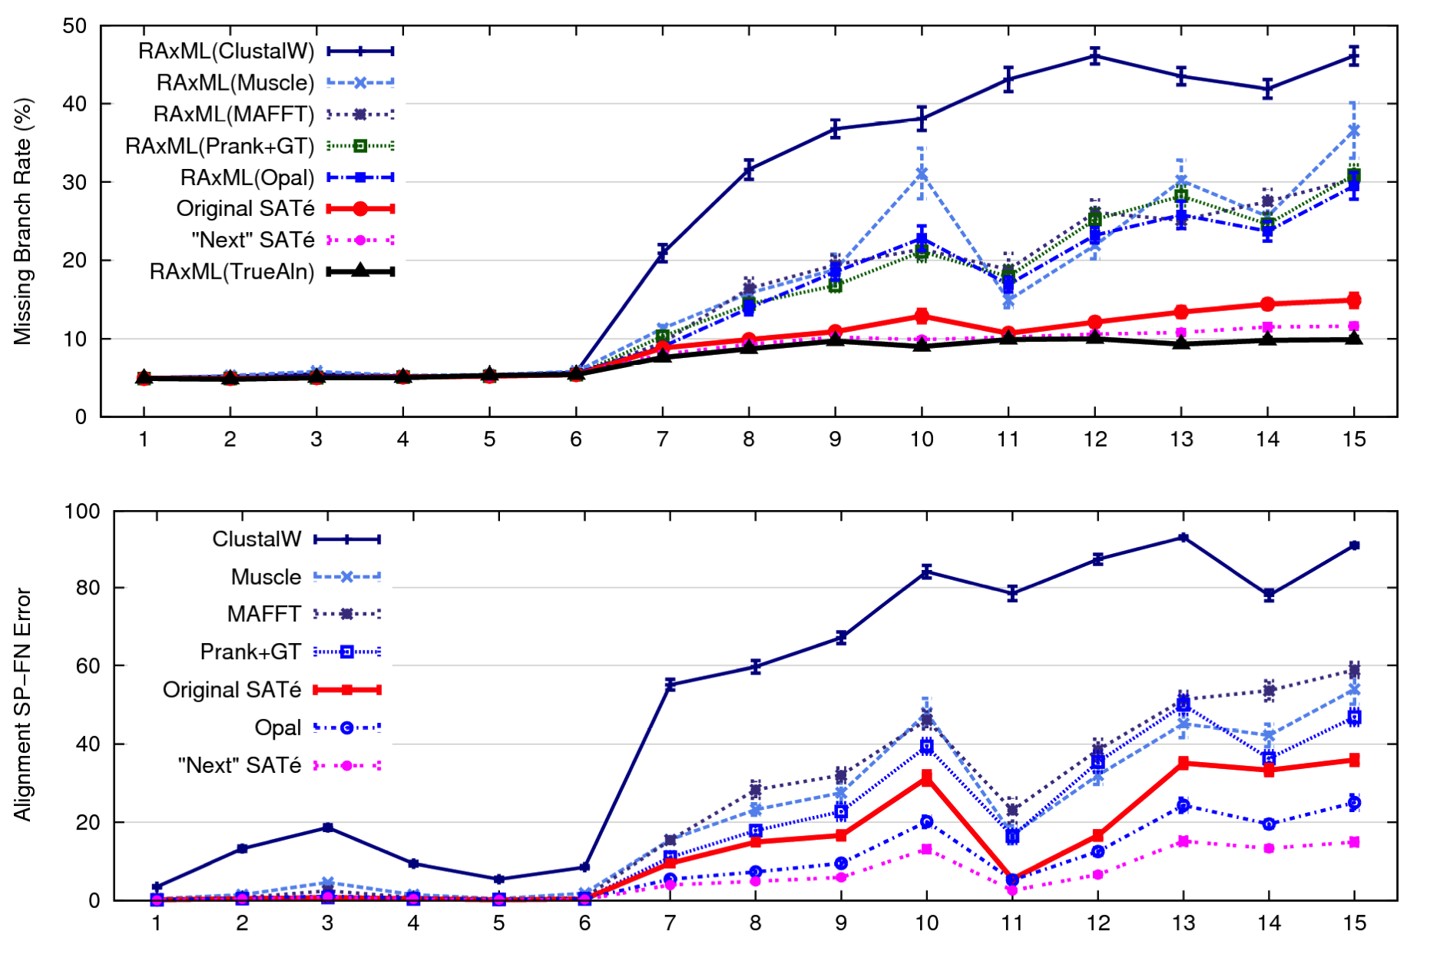
1000 taxon models ranked by difficulty

Slide 81
Example 4: UPP
UPP: Ultra-large alignments using SEPP
Authors: Nam Nguyen, Siavash Mirarab, and Tandy Warnow
Basic idea:
estimate an alignment on a small random subset of the sequence dataset
add all the remaining sequences into the small alignment (one by one, independently), using multiple Hidden Markov Models

Slide 82
UPP vs. HMMER vs. MAFFT (alignment error)
MAFFT-profile alignment strategy not as accurate as
UPP(100,10) or UPP(100,100).

Slide 83
UPP vs. HMMER vs. MAFFT (tree error)
ML on UPP(100,10) and UPP(100,100) alignments both produce
produce better trees than MAFFT.
Decomposition into a family of HMMs improves resultant trees.

Slide 84
Four Boosters
DCM1: improves accuracy of distance-based methods using divide-and-conquer and chordal graph theory
DACTAL: uses divide-and-conquer plus iteration to get a very large tree without needing a multiple sequence alignment
SATé: uses divide-and-conquer plus iteration to co-estimate the multiple sequence alignment and a tree
UPP: uses divide-and-conquer, randomization, and Hidden Markov Models to obtain ultra-large alignments

Slide 85
“Boosters”, or “Meta-Methods”
Meta-methods use divide-and-conquer and iteration (or other techniques) to “boost” the performance of base methods (phylogeny reconstruction, alignment estimation, etc)
Meta-method
Base method M
M*

Slide 86
Summary
Standard alignment and phylogeny estimation methods do not provide adequate accuracy on large datasets.
When markers tend to yield poor alignments and trees, don’t throw out the data – get a better method!

Slide 87
Summary
Computer scientists develop algorithms and software to make it possible for scientists to get improved accuracy in their analyses.
These algorithms involve creative strategies, including divide-and-conquer, iteration, and randomization.
Extensive simulations and data analyses are part of the evaluation process!

Slide 88
Warnow Laboratory
PhD students: Siavash Mirarab¹, Nam Nguyen, and Md. S. Bayzid²
Undergrad: Keerthana Kumar
Lab Website: http://www.cs.utexas.edu/users/phylo
Funding: Guggenheim Foundation, Packard Foundation, NSF, Microsoft Research New England, David Bruton Jr. Centennial Professorship, and TACC (Texas Advanced Computing Center)
¹HHMI International Predoctoral Fellow, ²Fulbright Predoctoral Fellow

Slide 89
DCM1 Decompositions
Input: Set S of sequences, distance matrix d, threshold value
1. Compute threshold graph
2. Perform minimum weight triangulation (note: if d is an additive matrix, then
the threshold graph is provably triangulated).
DCM1 decomposition :
Compute maximal cliques

