Slide 1
IPAM Workshop on Multiple Sequence Alignment
Tandy Warnow
The University of Illinois
at Urbana-Champaign

Slide 2
Multiple Sequence Alignment (MSA): a major grand challenge¹
S1 = AGGCTATCACCTGACCTCCA
S2 = TAGCTATCACGACCGC
S3 = TAGCTGACCGC
…
Sn = TCACGACCGACA
S1 = -AGGCTATCACCTGACCTCCA
S2 = TAG-CTATCAC--GACCGC--
S3 = TAG-CT-------GACCGC--
…
Sn = -------TCAC--GACCGACA
Novel techniques needed for scalability and accuracy
NP-hard problems and large datasets
Current methods do not provide good accuracy
Few methods can analyze even moderately large datasets
Many important applications besides phylogenetic estimation
¹ Frontiers in Massive Data Analysis, National Academies Press, 2013

Slide 3
Multiple Sequence Alignment
Multiple purposes (e.g., phylogeny estimation and molecular function/structure prediction)
Multiple techniques, drawing from disparate communities (biophysics, statistical inference, computer science, discrete mathematics, etc.)
Multi-disciplinary effort and communication needed

Slide 4
Multiple Sequence Alignment
Multiple purposes (e.g., phylogeny estimation and molecular function/structure prediction)
Multiple techniques, drawing from disparate communities (biophysics, statistical inference, computer science, discrete mathematics, etc.)
Multi-disciplinary effort and communication needed

Slide 5

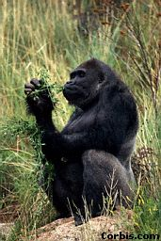


Phylogeny (evolutionary tree)
Orangutan
Gorilla
Chimpanzee
Human
From the Tree of the Life Website,
University of Arizona

Slide 6
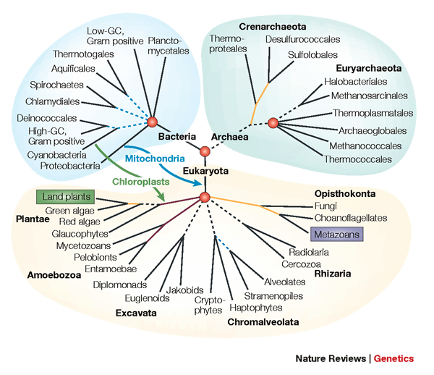
Constructing the Tree of Life:
Hard Computational Problems
NP-hard problems
Large datasets
100,000+ sequences
thousands of genes
“Big data” complexity:
model misspecification
fragmentary sequences
errors in input data
streaming data

Slide 7
Phylogenomic pipeline
Select taxon set and markers
Gather and screen sequence data, possibly identify orthologs
Compute multiple sequence alignments for each locus
Compute species tree or network:
  Compute gene trees on the alignments and combine the estimated gene trees, OR
  Estimate a tree from a concatenation of the multiple sequence alignments
Get statistical support on each branch (e.g., bootstrapping)
Estimate dates on the nodes of the phylogeny
Use species tree with branch support and dates to understand biology

Slide 8
Phylogenomic pipeline
Select taxon set and markers
Gather and screen sequence data, possibly identify orthologs
Compute multiple sequence alignments for each locus
Compute species tree or network:
  Compute gene trees on the alignments and combine the estimated gene trees, OR
  Estimate a tree from a concatenation of the multiple sequence alignments
Get statistical support on each branch (e.g., bootstrapping)
Estimate dates on the nodes of the phylogeny
Use species tree with branch support and dates to understand biology

Slide 9
DNA Sequence Evolution
AAGACTT
-3 mil yrs
AAGACTT
-2 mil yrs
AAGGCCT
AAGGCCT
AAGGCCT
AAGGCCT
TGGACTT
TGGACTT
TGGACTT
TGGACTT
-1 mil yrs
AGGGCAT
AGGGCAT
AGGGCAT
TAGCCCT
TAGCCCT
TAGCCCT
AGCACTT
AGCACTT
AGCACTT
AGGGCAT
TAGCCCA
TAGACTT
AGCACAA
AGCGCTT
today
AGGGCAT
TAGCCCA
TAGACTT
AGCACAA
AGCGCTT

Slide 10
Phylogeny Problem
U
V
W
X
Y
AGGGCAT
TAGCCCA
TAGACTT
TGCACAA
TGCGCTT
X
U
Y
V
W

Slide 11
Performance criteria
Running time
Space
Statistical performance issues (e.g., statistical consistency) with respect to a Markov model of evolution
“Topological accuracy” with respect to the underlying true tree or true alignment, typically studied in simulation
Accuracy with respect to a particular criterion (e.g. maximum likelihood score), on real data

Slide 12
Markov models of site evolution
Simplest (Jukes-Cantor):
The model tree is a pair (T,{e,p(e)}), where T is a rooted binary tree, and p(e) is the probability of a substitution on the edge e
The state at the root is random
If a site changes on an edge, it changes with equal probability to each of the remaining states
The evolutionary process is Markovian
More complex models (such as the General Markov model) are also considered, with little change to the theory.

Slide 13
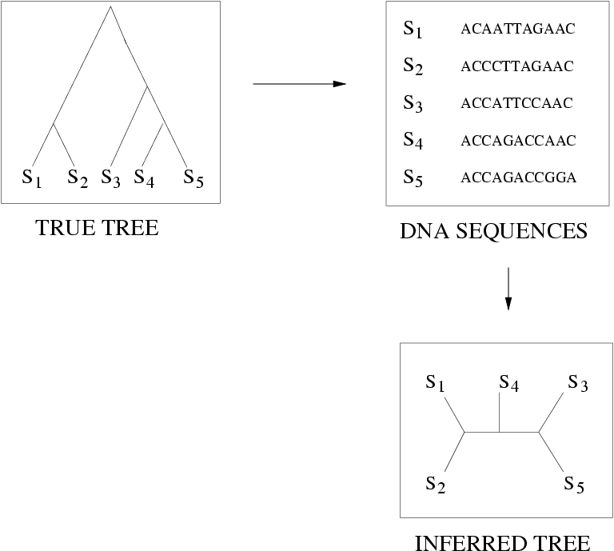
Quantifying Error
FN
FN: false negative
(missing edge)
FP: false positive
(incorrect edge)
50% error rate
FP

Slide 14
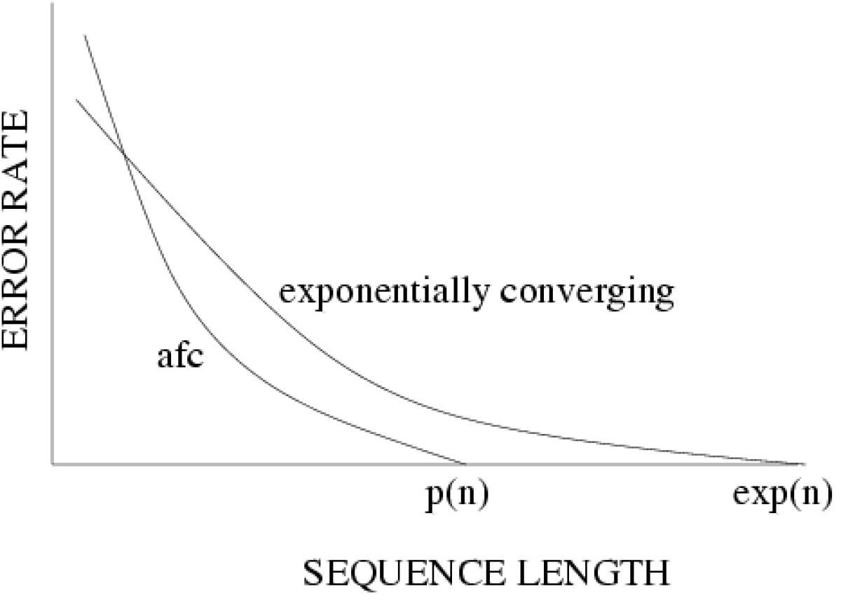
Statistical consistency, exponential convergence, and absolute fast convergence (afc)

Slide 15
Phylogenetic reconstruction methods
Hill-climbing heuristics for hard optimization criteria (Maximum Parsimony and Maximum Likelihood)
Local optimum
Cost
Global optimum
Phylogenetic trees
Polynomial time distance-based methods: Neighbor Joining, FastME, Weighbor, etc.
3. Bayesian methods

Slide 16
Phylogeny Problem
U
V
W
X
Y
AGGGCAT
TAGCCCA
TAGACTT
TGCACAA
TGCGCTT
X
U
Y
V
W

Slide 17
The “real” problem
U
V
W
X
Y
AGGGCATGA
AGAT
TAGACTT
TGCACAA
TGCGCTT
X
U
Y
V
W

Slide 18
Indels (insertions and deletions)
Deletion
Mutation
…ACGGTGCAGTTACCA…
…ACCAGTCACCA…
Notes:
18

Slide 19
Deletion
Substitution
…ACGGTGCAGTTACCA…
Insertion
…ACGGTGCAGTTACC-A…
…AC----CAGTCACCTA…
…ACCAGTCACCTA…
The true multiple alignment
  Reflects historical substitution, insertion, and deletion events
  Defined using transitive closure of pairwise alignments computed on edges of the true tree
Notes:
19
Homology = nucleotides lined up since they come from a common ancestor.
Indel = dash.

Slide 20
Input: unaligned sequences
S1 = AGGCTATCACCTGACCTCCA
S2 = TAGCTATCACGACCGC
S3 = TAGCTGACCGC
S4 = TCACGACCGACA

Slide 21
Phase 1: Alignment
S1 = AGGCTATCACCTGACCTCCA
S2 = TAGCTATCACGACCGC
S3 = TAGCTGACCGC
S4 = TCACGACCGACA
S1 = -AGGCTATCACCTGACCTCCA
S2 = TAG-CTATCAC--GACCGC--
S3 = TAG-CT-------GACCGC--
S4 = -------TCAC--GACCGACA

Slide 22
Phase 2: Construct tree
S1 = AGGCTATCACCTGACCTCCA
S2 = TAGCTATCACGACCGC
S3 = TAGCTGACCGC
S4 = TCACGACCGACA
S1 = -AGGCTATCACCTGACCTCCA
S2 = TAG-CTATCAC--GACCGC--
S3 = TAG-CT-------GACCGC--
S4 = -------TCAC--GACCGACA
S1
S2
S4
S3

Slide 23
Simulation Studies
S1 = AGGCTATCACCTGACCTCCA
S2 = TAGCTATCACGACCGC
S3 = TAGCTGACCGC
S4 = TCACGACCGACA
Unaligned Sequences
S1 = -AGGCTATCACCTGACCTCCA
S2 = TAG-CTATCAC--GACCGC--
S3 = TAG-CT-------GACCGC--
S4 = -------TCAC--GACCGACA
S1 = -AGGCTATCACCTGACCTCCA
S2 = TAG-CTATCAC--GACCGC--
S3 = TAG-C--T-----GACCGC--
S4 = T---C-A-CGACCGA----CA
S1
S2
S1
S4
Compare
S4
S3
S2
S3
True tree and alignment
Estimated tree and alignment

Slide 24
Quantifying Error
FN
FN: false negative
(missing edge)
FP: false positive
(incorrect edge)
50% error rate
FP

Slide 25
Two-phase estimation
Alignment methods
Clustal
POY (and POY*)
Probcons (and Probtree)
Probalign
MAFFT
Muscle
Di-align
T-Coffee
Prank (PNAS 2005, Science 2008)
Opal (ISMB and Bioinf. 2007)
FSA (PLoS Comp. Bio. 2009)
Infernal (Bioinf. 2009)
Etc.
Phylogeny methods
Bayesian MCMC
Maximum parsimony
Maximum likelihood
Neighbor joining
FastME
UPGMA
Quartet puzzling
Etc.
RAxML: heuristic for large-scale ML optimization
Notes:
25

Slide 26
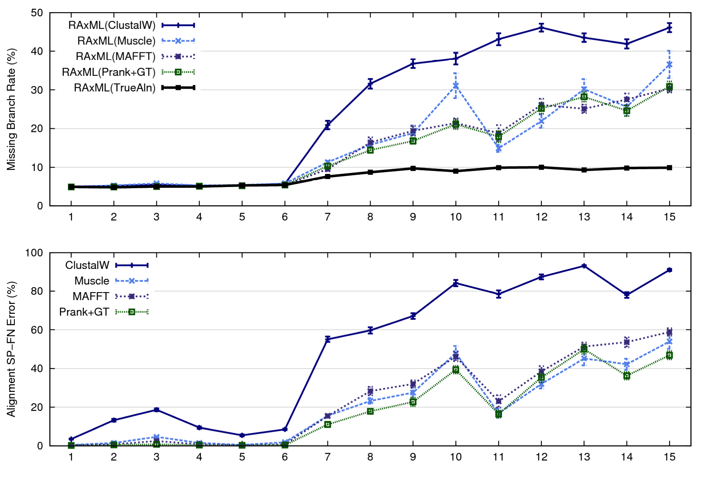
1000-taxon models, ordered by difficulty (Liu et al., 2009)
Notes:
26
1. 2 classes of MC: easy, moderate-to-difficult
2. true alignment
3. 2 classes: ClustalW, everything else
Alignment error, measured this way, isn't a perfect predictor of tree error, measured this way.

Slide 27
Large-scale Alignment Estimation
Alignments of large datasets with high rates of evolution typically have high error, and trees estimated on these alignments also have high error
Only a few methods can analyze large datasets

Slide 28







1kp: Thousand Transcriptome Project
G. Ka-Shu Wong
U Alberta
J. Leebens-Mack
U Georgia
N. Wickett
Northwestern
N. Matasci
iPlant
T. Warnow, S. Mirarab, N. Nguyen,
UIUC UT-Austin UT-Austin
Plus many many other people…
First study (Wickett, Mirarab, et al., PNAS 2014) had ~100 species and ~800 genes, gene trees and alignments estimated using SATe, and a coalescent-based species tree estimated using ASTRAL
Second study: Plant Tree of Life based on transcriptomes of ~1200 species, and more than 13,000 gene families (most not single copy)
Gene Tree Incongruence
Upcoming Challenges:
Species tree estimation from conflicting gene trees
Alignment of datasets with > 100,000 sequences

Slide 29
1KP dataset: more than
100,000 p450 amino-acid
sequences, many fragmentary
All standard multiple
sequence alignment
methods we tested
performed poorly on
datasets with fragments.

Slide 30
1kp: Thousand Transcriptome Project
G. Ka-Shu Wong
U Alberta
J. Leebens-Mack
U Georgia
N. Wickett
Northwestern
N. Matasci
iPlant
T. Warnow, S. Mirarab, N. Nguyen,
UIUC UT-Austin UT-Austin
Plus many many other people…
First study (Wickett, Mirarab, et al., PNAS 2014) had ~100 species and ~800 genes, gene trees and alignments estimated using SATe, and a coalescent-based species tree estimated using ASTRAL
Second study: Plant Tree of Life based on transcriptomes of ~1200 species, and more than 13,000 gene families (most not single copy)
Gene Tree Incongruence
Upcoming Challenges:
Species tree estimation from conflicting gene trees
Alignment of datasets with > 100,000 sequences,
and many fragmentary sequences!

Slide 31
Multiple Sequence Alignment (MSA): another grand challenge¹
S1 = AGGCTATCACCTGACCTCCA
S2 = TAGCTATCACGACCGC
S3 = TAGCTGACCGC
…
Sn = TCACGACCGACA
S1 = -AGGCTATCACCTGACCTCCA
S2 = TAG-CTATCAC--GACCGC--
S3 = TAG-CT-------GACCGC--
…
Sn = -------TCAC--GACCGACA
Novel techniques needed for scalability and accuracy
NP-hard problems and large datasets
Current methods do not provide good accuracy
Few methods can analyze even moderately large datasets
Many important applications besides phylogenetic estimation
¹ Frontiers in Massive Data Analysis, National Academies Press, 2013

Slide 32
Phylogenomic pipeline
Select taxon set and markers
Gather and screen sequence data, possibly identify orthologs
Compute multiple sequence alignments for each locus
Compute species tree or network:
  Compute gene trees on the alignments and combine the estimated gene trees, OR
  Estimate a tree from a concatenation of the multiple sequence alignments
Get statistical support on each branch (e.g., bootstrapping)
Estimate dates on the nodes of the phylogeny
Use species tree with branch support and dates to understand biology

Slide 33
Research Questions
What are good statistical models of sequence evolution that include insertions, deletions, and other events (rearrangements, duplications, etc.)? Are the model trees identifiable under these models?
Can we co-estimate sequence alignments and trees with high accuracy?
Can we improve alignments?
Can we do large-scale alignment estimation with high accuracy?
Can we do alignment-free phylogeny estimation?
How should we measure alignment accuracy? Are common ways of measuring alignment accuracy predictive of tree accuracy?
Are alignments for the purpose of structure/function prediction the same as alignments for phylogeny estimation?
What is the impact of alignment error on downstream biological analyses?

Slide 34
Research Questions
What are good statistical models of sequence evolution that include insertions, deletions, and other events (rearrangements, duplications, etc.)? Are the model trees identifiable under these models?
Can we co-estimate sequence alignments and trees with high accuracy?
Can we improve alignments?
Can we do large-scale alignment estimation with high accuracy?
Can we do alignment-free phylogeny estimation?
How should we measure alignment accuracy? Are common ways of measuring alignment accuracy predictive of tree accuracy?
Are alignments for the purpose of structure/function prediction the same as alignments for phylogeny estimation?
What is the impact of alignment error on downstream biological analyses?

Slide 35
Patsy Babbit
Back to the Beginning: Which sequences to align?
While much attention has been directed at mathematical and statistical issues for creating accurate multiple alignments, consideration of which sequences (or parts of sequences) and structures to align is less well explored. This issue is especially important for investigation of structure-function relationships in large sets of highly diverse homologs for which the proteins of unknown function are far greater than those that have been biochemically or structurally characterized.
We discuss what we have learned about choosing representative sequences for creating MSAs from studies of several large and functionally diverse enzyme superfamilies and provide examples for how biologically informed questions can be framed using this context.
Sequence similarity networks built to summarize on a large scale relationships among members of several of these superfamilies are used to illustrate new challenges for creating MSAs as the volume of sequence data continues to increase.

Slide 36
Alexandre Bouchard-Cote
MSA using Divide-and-Conquer Sequential Monte Carlo
Divide-and-Conquer Sequential Monte Carlo (D&C SMC), a method for performing inference on a collection of auxiliary distributions organized into a tree.
D&C SMC provides a simple method for approximating the posterior distribution of Bayesian MSA models

Slide 37
Noah Daniels
Structure-based multiple sequence alignments

Slide 38
Steve Evans
Recovering a tree from the lengths of random subtrees
Suppose that we sample the leaves of edge-weighted tree with n leaves in a uniform random order and record the lengths of the subtrees spanned by the first k leaves (that is, in biological terms, the phylogenetic diversity of the first k taxa) for k between 2 and n.
``Can we reconstruct the tree (up to isomorphism) from the joint probability distribution of this random increasing sequence of lengths?"
The answer is affirmative if we know a priori that the tree belongs to one of a number of families, but the general question is still open.

Slide 39
Adam Godzik
Analysis and multiple alignments of periodic proteins
Periodic proteins, characterized by the presence of multiple repeats of short sequence motifs, present unique challenges in their analysis and alignments. Especially interesting class of periodic proteins are irregular periodic proteins, where individual repeats can vary in length, sometimes considerably.
We have developed a series of tools to classify regularity (or irregularity) of periodic proteins and to use such irregularity patterns to guide the multiple alignments.
We present application of these tools to a group of Leucine Rich Repeat (LRR) proteins.

Slide 40
Nick Grishin
Pushing the limits of sequence profile similarity search and alignment
Traditionally, sequence similarity search has been riding on negatives and deriving power from random models to be rejected for positive hits.
Exploring the other side, we show that the search can be significantly improved by considering the positives, i.e., known homology relationships in a database of sequence profiles.
Similar strategies have been widely used by most successful search engines, such as Google. This algorithm results in re-ranking of hits, but does not correct faulty alignments.
The main focus in the sequence alignment field has been on alignment construction. However, many alignments are reasonably accurate with the exception of several mildly misaligned regions.
We propose new approaches to refinement of existing alignments and show that successful a posteriori detection and correction of misaligned regions results in alignment improvement.

Slide 41
Jim Leebens-Mack
Plant gene family circumscription, multiple sequence alignment, and phylogenomic analysis

Slide 42
Olivier Lichtarge
Evolution versus disease: the calculus of life
The relationship between genotype mutations and phenotype variations determines health in the short term and evolution over the long term, and it hinges on the action of mutations on fitness. A fundamental difficulty in determining this action, however, is that it depends on the unique context of each mutation, which is complex and often cryptic. As a result, the effect of most genome variations on molecular function and overall fitness remains unknown, and stands apart from population genetics theories linking fitness effect to polymorphism frequency.
Here, we hypothesize that evolution is a continuous and differentiable physical process coupling genotype to phenotype.
Thus elementary calculus and phylogenetics can be integrated into a perturbation analysis of the evolutionary relationship between genotype and phenotype that quantitatively links point mutations to function and fitness and that opens a new analytic framework for equations of biology. In practice, it explicitly bridges molecular evolution with population genetics with applications from protein redesign to the clinical assessment of human genetic variations.

Slide 43
Ari Loytyjoja
Phylogeny-aware alignment with sequence graphs
PAGAN is a new program for phylogeny-aware multiple sequence alignment using partial-order sequence graphs, and Wasabi is a graphical front-end for phylogeny-aware alignment.
In PAGAN, we use sequence graphs to model uncertainties in character presence/absence and thus make the phylogeny-aware algorithm less sensitive to errors in guide phylogeny or noisy input data.
PAGAN can also extend existing alignments with new data: we have built applications of this for phylogenetic placement of marker gene data and for reference-based scaffolding of NGS data.

Slide 44
Cedric Notredame
Grabbing High Hanging Fruits From the Tree Of Life
Results on simulated data suggest that some disagreements may exist between evolutionarily and structurally correct multiple sequence alignments
I will introduce a recently developed confidence index for multiple sequence alignments, the TCS (Transitive consistency score) and show how this index can be used to both identify structurally correct positions in an alignment and evolutionary informative sites, thus suggesting more unity than initially thought between these two parameters.
I will then introduce the structure based clustering method we recently developed to further test these hypothesis.

Slide 45
Jian Peng
Distances between protein sequence alignments
We consider the problem on how to measure the similarity between sequence alignments.
With good similarity metrics, we are able to use machine learning methods to learn more accurate alignment models than traditional ones, for structure prediction and/or homology search.

Slide 46
Mark Ragan
Phylogenetics without multiple sequence alignment
Multiple alignment is computationally hard, and does not extend naturally to instances in which the sequences under consideration have been rearranged relative to each other, misassembled (or not assembled in the first place), or contain regions of lateral origin.
I explore alternative approaches that begin with the extraction of short perfectly or near-perfectly matching character strings variously known as words, k-mers or n-grams.
Using synthetic and empirical data I will survey the major alignment-free approaches in phylogenetics, consider their performance and robustness under various scenarios of sequence evolution, and comment on their computational scalability.

Slide 47
Benjamin Redelings
Erasing Errors Due to Alignment Ambiguity When Estimating Positive Selection
Current estimates of diversifying positive selection rely on first having an accurate multiple sequence alignment. Simulation studies have shown that under biologically plausible conditions, relying on a single estimate of the alignment from commonly used alignment software can lead to unacceptably high false positive rates in detecting diversifying positive selection.
We present a novel statistical method that eliminates excess false positives resulting from alignment error by jointly estimating the degree of positive selection and the alignment under an evolutionary model.
We also show that samples taken from the posterior alignment distribution using the software BAli-Phy have substantially lower alignment error compared to MUSCLE, MAFFT, PRANK, and FSA alignments.

Slide 48
Sebastien Roch
Survey of theoretical results/questions on phylogeny reconstruction/alignment under TKF-type models.

Slide 49
Scott Schmidler
The Cutoff Phenomenon in Evolutionary Models for Sequence Alignment
We examine limits on inferring evolutionary divergence times using sequence evolution models arising as a consequence of the probabilistic “cutoff phenomenon”, in which a Markov chain remains far equilibrium for an extended period, followed by a rapid transition into equilibrium.
We show that evolutionary sequence models exhibit a cutoff, which relates directly to increased uncertainty in evolutionary distance inferences.
We derive the cutoff explicitly for symmetric models, and demonstrate empirically the behavior in models routinely used in the literature. We also show how to locate cutoffs for specific models and sequences.
Finally, we show that the cutoff explains several previously reported problems with common default priors for Bayesian phylogenetic analysis, and we suggest a new class of priors to address these problems.

Slide 50
Martin Weigt
Coevolutionary modeling of protein sequences: Inference of 3D structure and mutational landscapes
Direct-Coupling Analysis (DCA): a statistical-inference approach for detecting direct residue coevolution in large multiple-sequence alignments of homologous proteins.
predict tertiary and quaternary protein structures, reconstruct protein-protein interaction networks, and infer quantitative mutational landscapes.

Slide 51
Jinbo Xu
Graphical models of multiple protein sequence alignment
This talk will present the modeling of multiple protein sequence alignment (MSA) by Markov Random Fields (MRF) and its applications to homology detection, evolutionary coupling analysis and protein folding.
This talk will cover
  modeling a set of related protein families (each represented as an MSA) by group graphical lasso and its application to joint evolutionary coupling analysis and protein contact prediction; and
  aligning two MSAs by aligning their respective MRFs and its application to homology detection and fold recognition.

Slide 52
Opportunities for presentations
Today: 4-5 PM: Brief (3-5 minute) presentations by participants. (No need to request a slot…)
Today: 5-6 PM: Poster session
Tuesday and Thursday: 4-5 PM: short talks (approx. 15 minutes each) – please see one of the organizers today to request to speak.

