Slide 1
Computer Science and Reconstructing Evolutionary Trees
Tandy Warnow
Department of Computer Science
University of Illinois at Urbana-Champaign

Slide 2




Slide 3

BigData for Biology: Genomics

Slide 4
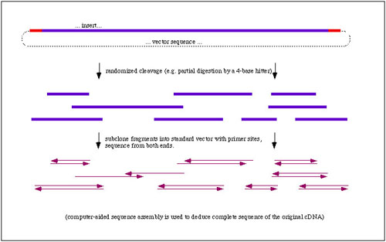
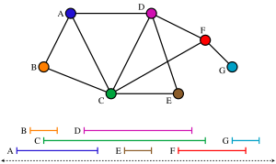
Whole Genome Sequencing:
Graph Algorithms and Combinatorial Optimization!

Slide 5
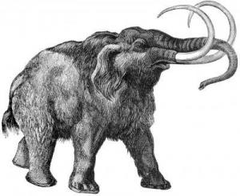
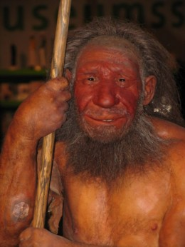


Other Genome Projects! (Neandertals, Wooly Mammoths, and more ordinary creatures…)

Slide 6
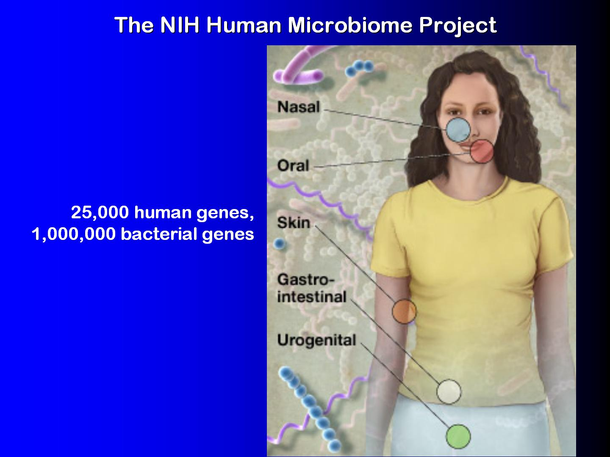

Slide 7
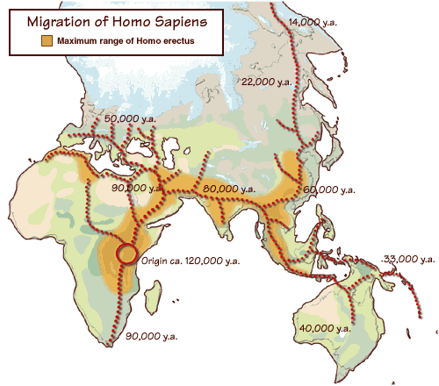
Where did humans come from, and how did they move throughout the globe?
The 1000 Genome Project: using human genetic variation to better treat diseases

Slide 8

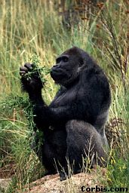
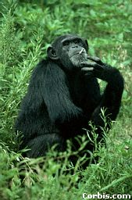

Phylogeny (evolutionary tree)
Orangutan
Gorilla
Chimpanzee
Human
From the Tree of the Life Website,
University of Arizona

Slide 9
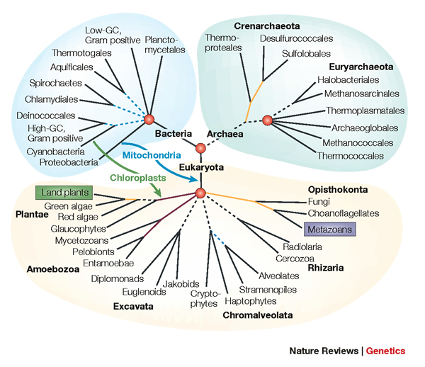
Assembling the Tree of Life

Slide 10
Goal: Constructing a Tree of Life
Why do we want to do this?
What are the computer science challenges?
What kinds of techniques help us do this well?

Slide 11
Why? Because!
Evolutionary history relates all organisms and genes, and helps us understand and predict
  interactions between genes (genetic networks)
  drug design
  predicting functions of genes
  influenza vaccine development
  origins and spread of disease
  origins and migrations of humans
“Nothing in biology makes sense except in the light of evolution” Dobzhansky

Slide 12
Indo-European Language Evolution
(Nakhleh et al.)

Slide 13
Main Points
Computer scientists develop algorithms and software to make it possible for scientists to get improved accuracy in their analyses.
These algorithms involve creative strategies, including divide-and-conquer, iteration, and randomization.
Extensive simulations and data analyses are part of the evaluation process!

Slide 14
DNA Sequence Evolution
AAGACTT
-3 mil yrs
AAGACTT
-2 mil yrs
AAGGCCT
AAGGCCT
AAGGCCT
AAGGCCT
TGGACTT
TGGACTT
TGGACTT
TGGACTT
-1 mil yrs
AGGGCAT
AGGGCAT
AGGGCAT
TAGCCCT
TAGCCCT
TAGCCCT
AGCACTT
AGCACTT
AGCACTT
AGGGCAT
TAGCCCA
TAGACTT
AGCACAA
AGCGCTT
today
AGGGCAT
TAGCCCA
TAGACTT
AGCACAA
AGCGCTT

Slide 15
Phylogeny Problem
U
V
W
X
Y
AGGGCAT
TAGCCCA
TAGACTT
TGCACAA
TGCGCTT
X
U
Y
V
W

Slide 16
Tree Construction
Input: Four sequences
  ACT
  ACA
  GTT
  GTA
Question: what is the best tree for this dataset?

Slide 17
Maximum Parsimony
Maximum parsimony:
  Input: set S of sequences (all of the same length),
  Output: a tree T with the sequences at the leaves that minimizes the total number of changes
This is an optimization problem.
How hard is it to solve this problem exactly?
Notes:
17

Slide 18
Maximum parsimony (example)
Input: Four sequences
  ACT
  ACA
  GTT
  GTA
Question: which of the three trees has the best MP scores?

Slide 19
Maximum Parsimony
ACT
GTA
ACA
ACT
GTT
ACA
GTT
GTA
ACA
GTA
ACT
GTT

Slide 20
Maximum Parsimony
ACT
GTA
ACA
ACT
2
GTT
GTA
ACA
ACT
1
3
1
3
GTT
2
ACA
GTT
GTA
MP score = 5
MP score = 7
ACA
GTA
ACA
GTA
1
2
1
ACT
GTT
MP score = 4
Optimal MP tree

Slide 21
Maximum Parsimony: computational complexity
Optimal labeling can be
computed in linear time O(nk)
ACA
GTA
ACA
GTA
1
2
1
ACT
GTT
MP score = 4
Finding the optimal MP tree is NP-hard

Slide 22
Exhaustive search is… exhausting
#leaves | #trees
4 | 3
5 | 15
6 | 105
7 | 945
8 | 10395
9 | 135135
10 | 2027025
20 | 2.2 x 10²⁰
100 | 4.5 x 10¹⁹⁰
1000 | 2.7 x 10²⁹⁰⁰
Number of (unrooted) binary trees on n leaves is (2n-5)!!
If each tree on 1000 taxa could be analyzed in 0.001 seconds, we would find the best tree in
2890 millennia

Slide 23
NP-hard problems in Biology
Optimization problems in biology are almost all NP-hard, and heuristics may run for months (or years!!) before finding local optima.
The challenge here is to find better heuristics, since exact solutions are very unlikely to ever be achievable on large datasets.

Slide 24
Polynomial time problems
A problem is polynomial time if it can be solved in time that runs (at worst) using a polynomial number of operations, in terms of the input size.
Examples:
  Are there ten people in this room with the same birthday?
  Are there five people in this room who all like each other?
  Find someone in the room who is friends with the most number of people in the room.
  Can we divide the people in the room into two sets, so that no two people in the same set dislike each other?

Slide 25
A polynomial-time graph problem
2-colorability: Given graph G = (V,E), determine if we can assign colors red and blue to the vertices of G so that no edge connects vertices of the same color.
Greedy Algorithm. Start with one vertex and make it red, and then make all its neighbors blue, and keep going. If you succeed in coloring the graph without making two nodes of the same color adjacent, the graph can be 2-colored.
Running time: O(n+m) time, where n is the number of vertices and m is the number of edges.

Slide 26
A polynomial-time graph problem
2-colorability: Given graph G = (V,E), determine if we can assign colors red and blue to the vertices of G so that no edge connects vertices of the same color.
Greedy Algorithm. Start with one vertex and make it red, and then make all its neighbors blue, and keep going. If you succeed in coloring the graph without making two nodes of the same color adjacent, the graph can be 2-colored.
Running time: O(n+m) time, where n is the number of vertices and m is the number of edges.

Slide 27
What about this?
3-colorability: Given graph G, determine if we can assign red, blue, and green to the vertices in G so that no edge connects vertices of the same color.

Slide 28
Some decision problems can be solved in polynomial time:
  Can graph G be 2-colored?
  Does graph G have a Eulerian tour?
Some decision problems seem to not be solvable in polynomial time:
  Can graph G be 3-colored?
  Does graph G have a Hamiltonian cycle?

Slide 29
What about this?
3-colorability: Given graph G, determine if we can assign red, blue, and green to the vertices in G so that no edge connects vertices of the same color.
This problem is provably NP-hard. What does this mean?

Slide 30
P vs. NP, continued
The “big” question in theoretical computer science is:
  Is it possible to solve an NP-hard problem in polynomial time?
If the answer is “yes”, then all NP-hard problems can be solved in polynomial time, so P=NP. This is generally not believed.

Slide 31
Coping with NP-hard problems
Since NP-hard problems may not be solvable in polynomial time, the options are:
  Solve the problem exactly (but use lots of time on some inputs)
  Use heuristics which may not solve the problem exactly (and which might be computationally expensive, anyway)

Slide 32
DNA Sequence Evolution
AAGACTT
-3 mil yrs
AAGACTT
-2 mil yrs
AAGGCCT
AAGGCCT
AAGGCCT
AAGGCCT
TGGACTT
TGGACTT
TGGACTT
TGGACTT
-1 mil yrs
AGGGCAT
AGGGCAT
AGGGCAT
TAGCCCT
TAGCCCT
TAGCCCT
AGCACTT
AGCACTT
AGCACTT
AGGGCAT
TAGCCCA
TAGACTT
AGCACAA
AGCGCTT
today
AGGGCAT
TAGCCCA
TAGACTT
AGCACAA
AGCGCTT

Slide 33
Phylogeny Problem
U
V
W
X
Y
AGGGCAT
TAGCCCA
TAGACTT
TGCACAA
TGCGCTT
X
U
Y
V
W

Slide 34
Maximum Parsimony is NP-hard
Maximum parsimony:
  Given sequences (all of the same length),
  Find a tree with the sequences at the leaves that minimizes the total number of changes
Notes:
34

Slide 35
NP-hard problems in Biology
Optimization problems in biology are almost all NP-hard, and heuristics may run for months (or years!!) before finding local optima.
The challenge here is to find better heuristics, since exact solutions are very unlikely to ever be achievable on large datasets.

Slide 36
Divide-and-Conquer
Divide-and-conquer is a basic algorithmic trick for solving problems!
Basic idea: divide a dataset into two or more sets, solve the problem on each set, and then combine solutions.
Example: MergeSort to sort a list of k integers!

Slide 37
Divide-and-Conquer
MergeSort solves the “Sorting Problem”: given a list of integers, put them into increasing order (smallest to largest).
This can be done by recursively dividing the unsorted list in half, applying MergeSort to each side, and then merging the right and left back together.

Slide 38
Merge Sort Algorithm
Given a list L with a length k:
If k == 1 → the list is sorted
Else:
  Merge Sort the left side (0 through k/2)
  Merge Sort the right side (k/2+1 thru k)
  Merge the right side with the left side

Slide 39
Merging two sorted lists
X:
3 | 10 | 23 | 54
Y:
1 | 5 | 25 | 75
Result:

Slide 40
Merging (cont.)
X:
3 | 10 | 23 | 54
Y:
 | 5 | 25 | 75
Result:
1

Slide 41
Merging (cont.)
X:
 | 10 | 23 | 54
Y:
 | 5 | 25 | 75
Result:
1 | 3

Slide 42
Merging (cont.)
X:
 | 10 | 23 | 54
Y:
 |  | 25 | 75
Result:
1 | 3 | 5

Slide 43
Merging (cont.)
X:
 |  | 23 | 54
Y:
 |  | 25 | 75
Result:
1 | 3 | 5 | 10

Slide 44
Merging (cont.)
X:
 |  |  | 54
Y:
 |  | 25 | 75
Result:
1 | 3 | 5 | 10 | 23

Slide 45
Merging (cont.)
X:
 |  |  | 54
Y:
 |  |  | 75
Result:
1 | 3 | 5 | 10 | 23 | 25

Slide 46
Merging (cont.)
X:
Y:
 |  |  | 75
Result:
1 | 3 | 5 | 10 | 23 | 25 | 54

Slide 47
Merging (cont.)
X:
Y:
Result:
1 | 3 | 5 | 10 | 23 | 25 | 54 | 75

Slide 48
Divide-and-Conquer for
Tree Estimation
Basic idea: divide a dataset into two or more overlapping subsets, construct trees on each set, and then combine trees!
Somewhat easy to figure out how to do this on rooted trees, but a bit harder on unrooted trees.

Slide 49
DCMs: Divide-and-conquer for improving phylogeny reconstruction

Slide 50
Iteration plus divide-and-conquer
Overlapping
subsets
A tree for each subset
A tree for the entire dataset

Slide 51
NP-hard optimization problems: better accuracy, but slow to find good solutions
Current best techniques
DCM boosted version of best techniques
Comparison of TNT to Rec-I-DCM3(TNT) on one large dataset

Slide 52
Computer Science Solving Problems in Biology and Linguistics
Algorithm design using
  Divide-and-conquer
  Iteration
  Heuristic search
  Graph theory
Algorithm analysis using
  Probability Theory
  Graph Theory
Simulations and modelling
Collaborations with biologists and linguists and data analysis
Discoveries about how life evolved on earth (and how languages evolved, too)

Slide 53
Main Points
Computer scientists develop algorithms and software to make it possible for scientists to get improved accuracy in their analyses.
These algorithms involve creative strategies, including divide-and-conquer, iteration, and randomization.
Extensive simulations and data analyses are part of the evaluation process!

Slide 54

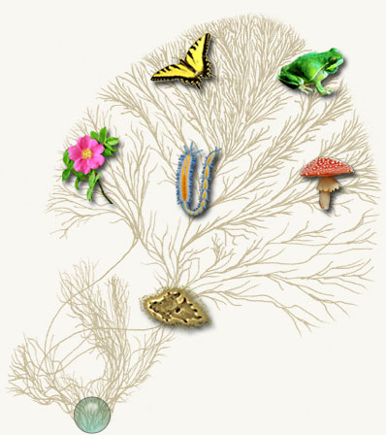
Computational Phylogenetics
Current methods can use months to
estimate trees on 1000 DNA sequences
Our objective:
More accurate trees and alignments
on 500,000 sequences in under a week
We prove theorems using graph theory
and probability theory, and our
algorithms are studied on real and
simulated data.
Courtesy of the Tree of Life project

Slide 55
Deletion
Substitution
…ACGGTGCAGTTACCA…
Insertion
…ACGGTGCAGTTACC-A…
…AC----CAGTCACCTA…
…ACCAGTCACCTA…
The true multiple alignment
  Reflects historical substitution, insertion, and deletion events
  Defined using transitive closure of pairwise alignments computed on edges of the true tree
Notes:
55
Homology = nucleotides lined up since they come from a common ancestor.
Indel = dash.

Slide 56
(Some of) our Methods
SATé, PASTA, and UPP: large, very large, and ultra-large multiple sequence alignment
DACTAL and DCM: ultra-large tree estimation
Techniques:
  Divide-and-conquer
  Iteration
  Hidden Markov Models
  Graph Theory

Slide 57
Constructing trees from smaller trees
Rooted trees: If they agree, it’s easy! (Not so easy if they disagree)
Unrooted trees: NP-hard, even if they agree!
+
=
a
b
c
a
d
b
a
d
b
c

Slide 58
Four Boosters
DCM1: improves accuracy of distance-based methods using divide-and-conquer and chordal graph theory
DACTAL: uses divide-and-conquer plus iteration to get a very large tree without needing a multiple sequence alignment
SATé: uses divide-and-conquer plus iteration to co-estimate the multiple sequence alignment and a tree
UPP: uses divide-and-conquer, randomization, and Hidden Markov Models to obtain ultra-large alignments

Slide 59
First example: DCM1
DCM = “Disk Covering Method”
Theory: Warnow, St. John, and Moret, SODA 2001,
Practice:Nakhleh et al., ISMB 2001

Slide 60
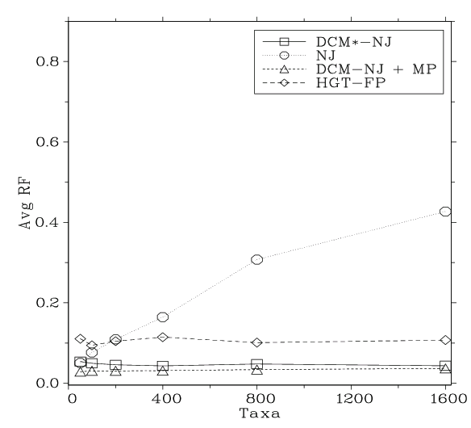
Performance on large diameter trees
Simulation study based upon fixed edge lengths, K2P model of evolution, sequence lengths fixed to 1000 nucleotides.
Error rates reflect proportion of incorrect edges in inferred trees.
[Nakhleh et al. ISMB 2001]
0.8
NJ
0.6
Error Rate
0.4
0.2
0
0
400
800
1200
1600
No. Taxa

Slide 61
DCM1 Decompositions
Input: Distance matrix (distances between species) and threshold q.
Output: Division of the set of species into overlapping subsets.
Technique: Compute maximal cliques in a “Triangulated Threshold Graph”.
Looks like moving a disk across a tree!

Slide 62
DCM1-boosting distance-based methods
[Nakhleh et al. ISMB 2001]
Theorem (Warnow et al., SODA 2001): DCM1-NJ converges to the true tree from polynomial length sequences
0.8
NJ
DCM1-NJ
0.6
Error Rate
0.4
0.2
0
0
400
800
1200
1600
No. Taxa

Slide 63
Second Example: DACTAL
(Divide-And-Conquer Trees (Almost) without alignments)
Input: set S of unaligned sequences
Output: tree on S (but no alignment)
Nelesen, Liu, Wang, Linder, and Warnow, ISMB and Bioinformatics 2012

Slide 64
Divide-and-Conquer for Alignment
SATé: uses divide-and-conquer plus iteration to co-estimate the multiple sequence alignment and a tree
UPP: uses divide-and-conquer, randomization, and Hidden Markov Models to obtain ultra-large alignments

Slide 65
Example 3: SATé
SATé: Simultaneous Alignment and Tree Estimation
Liu, Nelesen, Raghavan, Linder, and Warnow, Science, 19 June 2009, pp. 1561-1564.
Liu et al., Systematic Biology 2012
Public software distribution (open source) through Mark Holder’s group at the University of Kansas

Slide 66
U
V
W
X
Y
AGGGCATGA
AGAT
TAGACTT
TGCACAA
TGCGCTT
X
U
Y
V
W

Slide 67
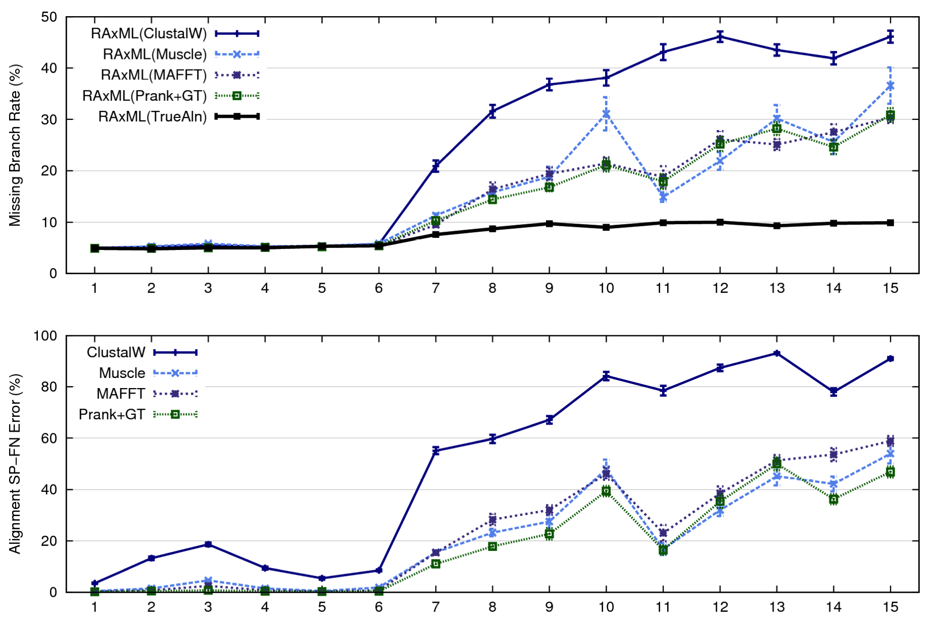
1000 taxon models, ordered by difficulty (Liu et al., 2009)
Notes:
67
1. 2 classes of MC: easy, moderate-to-difficult
2. true alignment
3. 2 classes: ClustalW, everything else
Alignment error, measured this way, isn't a perfect predictor of tree error, measured this way.

Slide 68
Re-aligning on a tree
A
C
Decompose dataset
A
B
C
D
B
D
Align subproblems
A
B
C
D
Estimate ML tree on merged alignment
ABCD
Merge sub-alignments

Slide 69
SATé Algorithm
Obtain initial alignment and estimated ML tree
Tree

Slide 70
SATé Algorithm
Obtain initial alignment and estimated ML tree
Tree
Use tree to compute new alignment
Alignment

Slide 71
SATé Algorithm
Obtain initial alignment and estimated ML tree
Tree
Use tree to compute new alignment
Estimate ML tree on new alignment
Alignment

Slide 72
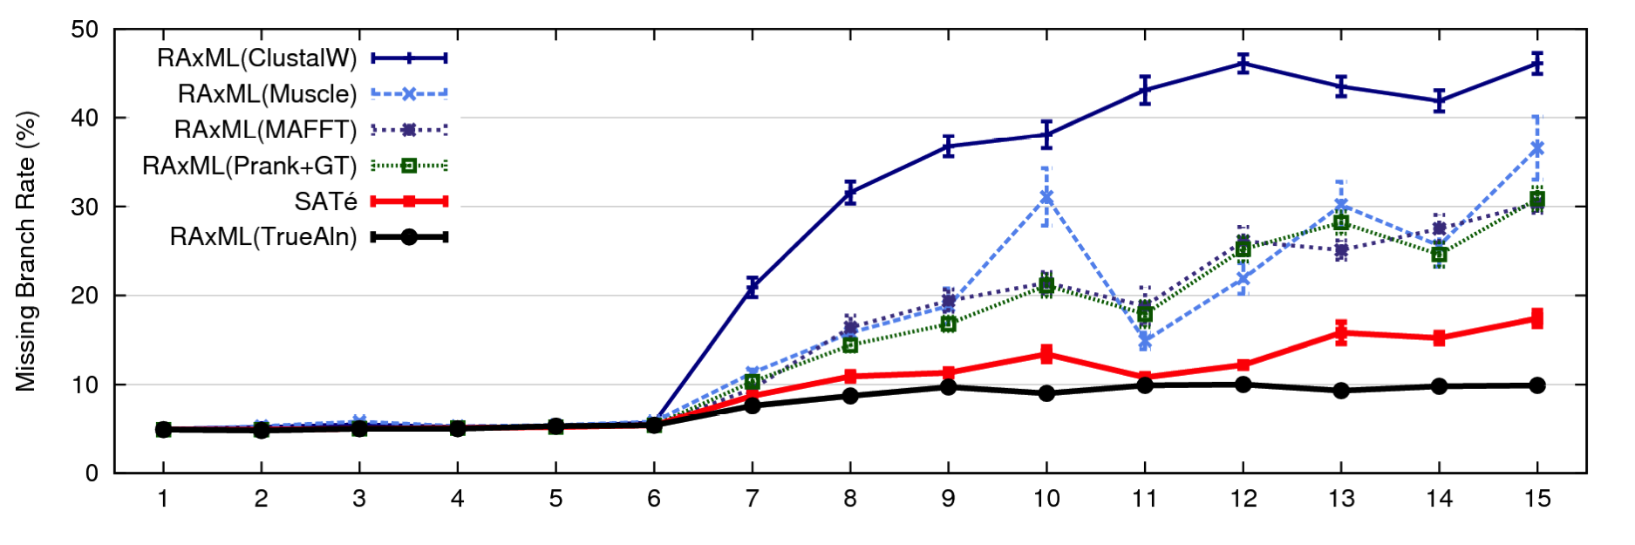
1000 taxon models, ordered by difficulty
24 hour SATé analysis, on desktop machines
(Similar improvements for biological datasets)
Notes:
For moderate-to-difficult datasets, SATe gets better trees and alignments than all other estimated methods. Close to what you might get if you had access to true alignment.
Opens up a new realm of possibility: Datasets currently considered “unalignable” can in fact be aligned reasonably well. This opens up the feasibility of accurate estimations of deep evolutionary histories using a wider range of markers.
TRANSITION: can we do better? What about smaller simulated datasets? And what about biological datasets?

Slide 73
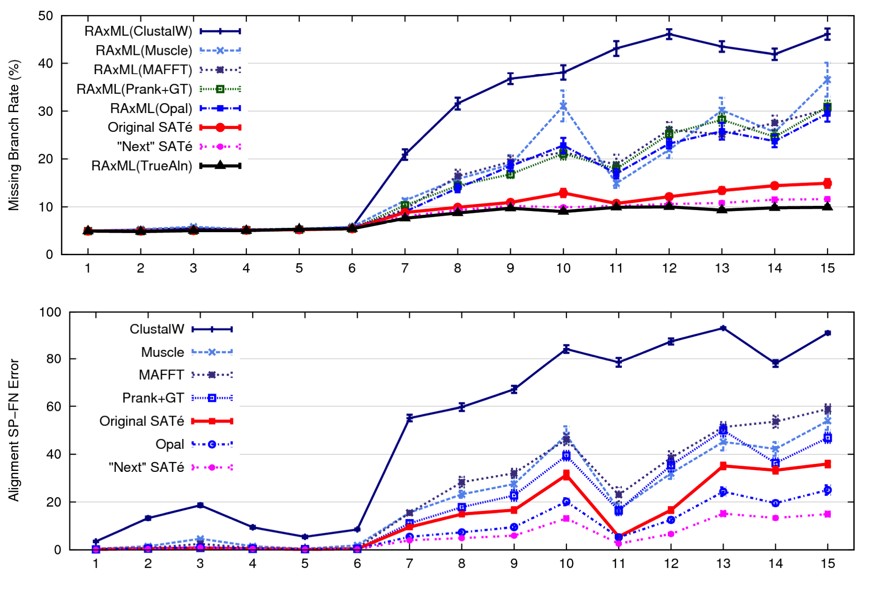
1000 taxon models ranked by difficulty

Slide 74
Example 4: UPP
UPP: Ultra-large alignments using SEPP
Authors: Nam Nguyen, Siavash Mirarab, and Tandy Warnow
Basic idea:
estimate an alignment on a small random subset of the sequence dataset
add all the remaining sequences into the small alignment (one by one, independently), using multiple Hidden Markov Models

Slide 75
UPP vs. HMMER vs. MAFFT (alignment error)
MAFFT-profile alignment strategy not as accurate as
UPP(100,10) or UPP(100,100).

Slide 76
UPP vs. HMMER vs. MAFFT (tree error)
ML on UPP(100,10) and UPP(100,100) alignments both produce
produce better trees than MAFFT.
Decomposition into a family of HMMs improves resultant trees.

Slide 77
Four Boosters
DCM1: improves accuracy of distance-based methods using divide-and-conquer and chordal graph theory
DACTAL: uses divide-and-conquer plus iteration to get a very large tree without needing a multiple sequence alignment
SATé: uses divide-and-conquer plus iteration to co-estimate the multiple sequence alignment and a tree
UPP: uses divide-and-conquer, randomization, and Hidden Markov Models to obtain ultra-large alignments

Slide 78
“Boosters”, or “Meta-Methods”
Meta-methods use divide-and-conquer and iteration (or other techniques) to “boost” the performance of base methods (phylogeny reconstruction, alignment estimation, etc)
Meta-method
Base method M
M*

Slide 79
Summary
Standard alignment and phylogeny estimation methods do not provide adequate accuracy on large datasets.
When markers tend to yield poor alignments and trees, don’t throw out the data – get a better method!

Slide 80
Summary
Computer scientists develop algorithms and software to make it possible for scientists to get improved accuracy in their analyses.
These algorithms involve creative strategies, including divide-and-conquer, iteration, and randomization.
Extensive simulations and data analyses are part of the evaluation process!

Slide 81





Warnow Laboratory
PhD students: Siavash Mirarab¹, Nam Nguyen, and Md. S. Bayzid²
Undergrad: Keerthana Kumar
Lab Website: http://www.cs.utexas.edu/users/phylo
Funding: Guggenheim Foundation, Packard Foundation, NSF, Microsoft Research New England, David Bruton Jr. Centennial Professorship, and TACC (Texas Advanced Computing Center)
¹HHMI International Predoctoral Fellow, ²Fulbright Predoctoral Fellow

Slide 82
DCM1 Decompositions
Input: Set S of sequences, distance matrix d, threshold value
1. Compute threshold graph
2. Perform minimum weight triangulation (note: if d is an additive matrix, then
the threshold graph is provably triangulated).
DCM1 decomposition :
Compute maximal cliques

