Slide 1
Introduction to Phylogenomics and Metagenomics
Tandy Warnow
The Department of Computer Science
The University of Texas at Austin

Slide 2
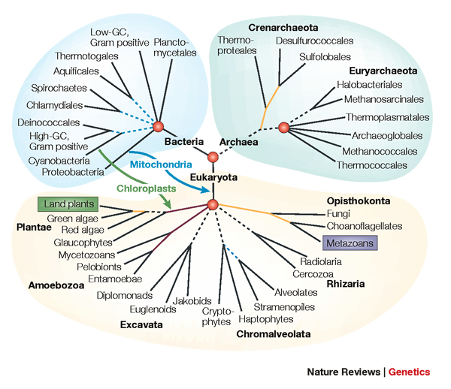
The “Tree of Life”
Applications of phylogenies to:
protein structure and function
population genetics
human migrations
Estimating phylogenies is a complex
analytical task
Large datasets are very hard to analyze with high accuracy

Slide 3
Phylogenetic Estimation: Big Data Challenges
NP-hard problems
Large datasets:
100,000+ sequences
10,000+ genes
“BigData” complexity

Slide 4






Avian Phylogenomics Project
Erich Jarvis,
HHMI
MTP Gilbert,
Copenhagen
G Zhang,
BGI
T. Warnow
UT-Austin
S. Mirarab Md. S. Bayzid UT-Austin UT-Austin
Plus many many other people…
Approx. 50 species, whole genomes
8000+ genes, UCEs
Gene sequence alignments and trees computed using SATé
Challenges:
Maximum likelihood tree estimation on multi-million-site
sequence alignments
Massive gene tree incongruence

Slide 5





1kp: Thousand Transcriptome Project
G. Ka-Shu Wong
U Alberta
J. Leebens-Mack
U Georgia
N. Wickett
Northwestern
N. Matasci
iPlant
T. Warnow, S. Mirarab, N. Nguyen, Md. S.Bayzid
UT-Austin UT-Austin UT-Austin UT-Austin
Plus many many other people…
Plant Tree of Life based on transcriptomes of ~1200 species
More than 13,000 gene families (most not single copy)
Gene Tree Incongruence
Challenge:
Alignment of datasets with > 100,000 sequences
Gene tree incongruence

Slide 6
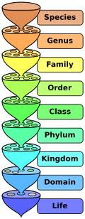
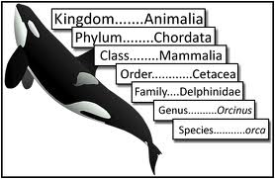
Metagenomic Taxon Identification
Objective: classify short reads in a metagenomic sample
Notes:
The two basic steps in phylogenetic placement is similar to the two phase methods we typically use, align and then place the fragment.
The differences are we align each fragment independently into the backbone tree. We then take each extended alignment and place each fragment independently into the backbone tree.
Two methods to align the query sequences are HMMALIGN, which estimates a hidden markov model on backbone alignemnt, then aligns query sequence. PaPaRa, which estimates ancestoral parsimony state vectors for each each in the reference tree and aligns the query sequence against each state vector. It selects the best scoring alignment.
Two methods that place the query sequence try to optimize the same criterion: find the ML placement given the extended alignment

Slide 7
Basic Questions
1. What is this fragment? (Classify each fragment as well as possible.)
2. What is the taxonomic distribution in the dataset? (Note: helpful to use marker genes.)
3. What are the organisms in this metagenomic sample doing together?
Notes:
The two basic steps in phylogenetic placement is similar to the two phase methods we typically use, align and then place the fragment.
The differences are we align each fragment independently into the backbone tree. We then take each extended alignment and place each fragment independently into the backbone tree.
Two methods to align the query sequences are HMMALIGN, which estimates a hidden markov model on backbone alignemnt, then aligns query sequence. PaPaRa, which estimates ancestoral parsimony state vectors for each each in the reference tree and aligns the query sequence against each state vector. It selects the best scoring alignment.
Two methods that place the query sequence try to optimize the same criterion: find the ML placement given the extended alignment

Slide 8
Phylogenomic pipeline
Select taxon set and markers
Gather and screen sequence data, possibly identify orthologs
Compute multiple sequence alignments for each marker (possibly “mask” alignments)
Compute species tree or network:
  Compute gene trees on the alignments and combine the estimated gene trees, OR
  Perform “concatenation analysis” (aka “combined analysis”)
Get statistical support on each branch (e.g., bootstrapping)
Use species tree with branch support to understand biology

Slide 9
Phylogenomic pipeline
Select taxon set and markers
Gather and screen sequence data, possibly identify orthologs
Compute multiple sequence alignments for each marker (possibly “mask” alignments)
Compute species tree or network:
  Compute gene trees on the alignments and combine the estimated gene trees, OR
  Perform “concatenation analysis” (aka “combined analysis”)
Get statistical support on each branch (e.g., bootstrapping)
Use species tree with branch support to understand biology

Slide 10
This talk
Phylogeny estimation methods
Multiple sequence alignment (MSA)
Species tree estimation methods from multiple gene trees
Phylogenetic Networks
Metagenomics
What we’ll cover this week

Slide 11
Phylogeny Estimation methods

Slide 12
DNA Sequence Evolution
AAGACTT
-3 mil yrs
AAGACTT
-2 mil yrs
AAGGCCT
AAGGCCT
AAGGCCT
AAGGCCT
TGGACTT
TGGACTT
TGGACTT
TGGACTT
-1 mil yrs
AGGGCAT
AGGGCAT
AGGGCAT
TAGCCCT
TAGCCCT
TAGCCCT
AGCACTT
AGCACTT
AGCACTT
AGGGCAT
TAGCCCA
TAGACTT
AGCACAA
AGCGCTT
today
AGGGCAT
TAGCCCA
TAGACTT
AGCACAA
AGCGCTT

Slide 13
Phylogeny Problem
U
V
W
X
Y
AGGGCAT
TAGCCCA
TAGACTT
TGCACAA
TGCGCTT
X
U
Y
V
W

Slide 14
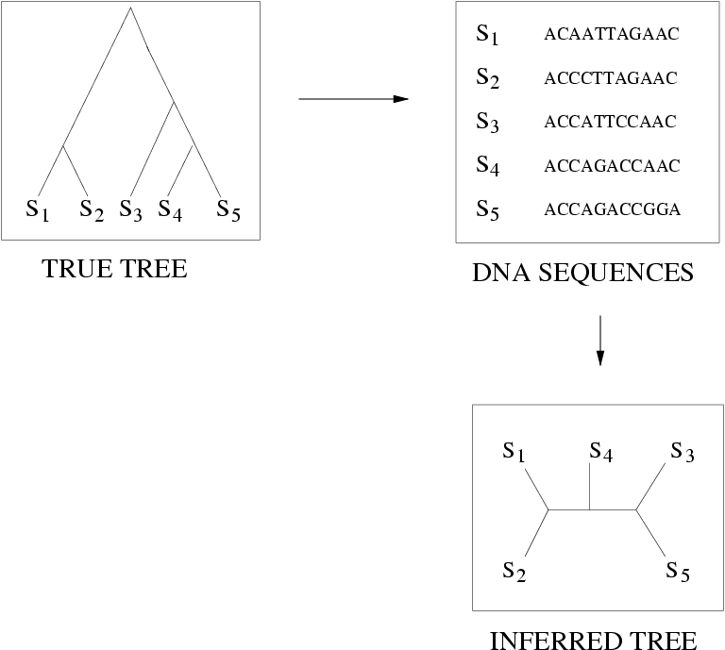
Quantifying Error
FN
FN: false negative
(missing edge)
FP: false positive
(incorrect edge)
50% error rate
FP

Slide 15
Markov Model of Site Evolution
Simplest (Jukes-Cantor):
The model tree T is binary and has substitution probabilities p(e) on each edge e.
The state at the root is randomly drawn from {A,C,T,G} (nucleotides)
If a site (position) changes on an edge, it changes with equal probability to each of the remaining states.
The evolutionary process is Markovian.
More complex models (such as the General Markov model) are also considered, often with little change to the theory.

Slide 16
Statistical Consistency
error
Data
Data are sites in an alignment

Slide 17
Tree Estimation Methods
Maximum Likelihood (e.g., RAxML, FastTree, PhyML)
Bayesian MCMC (e.g., MrBayes)
Maximum Parsimony (e.g., TNT, PAUP*)
Distance-based methods (e.g., neighbor joining)
Quartet-based methods (e.g., Quartet Puzzling)

Slide 18
General Observations
Maximum Likelihood and Bayesian methods – probably most accurate, have statistical guarantees under many statistical models (e.g., GTR). However, these are often computationally intensive on large datasets.
No statistical guarantees for maximum parsimony (can even produce the incorrect tree with high support) – and MP heuristics are computationally intensive on large datasets.
Distance-based methods can have statistical guarantees, but may not be so accurate.

Slide 19
General Observations
Maximum Parsimony and Maximum Likelihood are NP-hard optimization problems, so methods for these are generally heuristic – and may not find globally optimal solutions.
However, effective heuristics exist that are reasonably good (and considered reliable) for most datasets.
  MP: TNT (best?) and PAUP* (very good)
  ML: RAxML (best?), FastTree (even faster but not as thorough), PhyML (not quite as fast but has more models), and others

Slide 20
Estimating The Tree of Life: a Grand Challenge
Most well studied problem:
Given DNA sequences, find the Maximum Likelihood Tree
NP-hard, lots of heuristics (RAxML, FastTree-2, PhyML, GARLI, etc.)

Slide 21
More observations
Bayesian methods: Basic idea – find a distribution of trees with good scores, and so don’t return just the single best tree.
These are even slower than maximum likelihood and maximum parsimony. They require that they are run for a long time so that they “converge”. May be best to limit the use of Bayesian methods to small datasets.
Example: MrBayes.

Slide 22
Distance-based methods

Slide 23
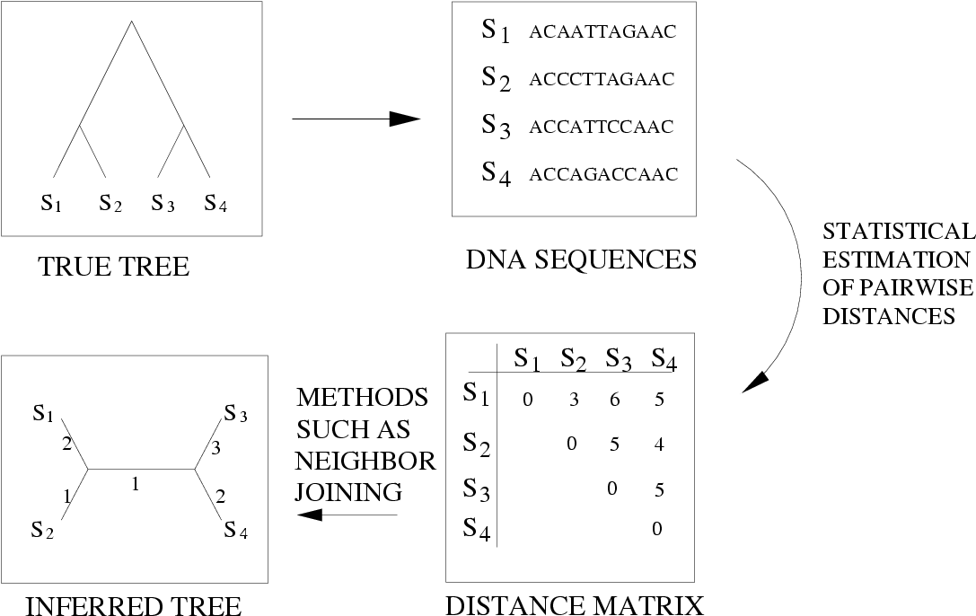
Distance-based estimation

Slide 24
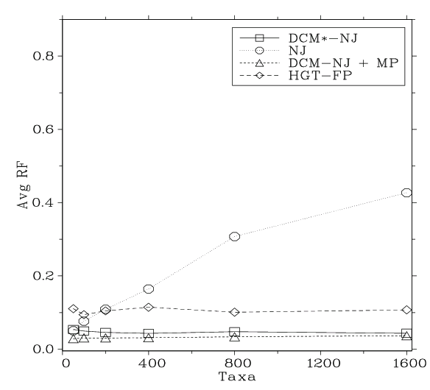
Neighbor Joining on large diameter trees
Simulation study based upon fixed edge lengths, K2P model of evolution, sequence lengths fixed to 1000 nucleotides.
Error rates reflect proportion of incorrect edges in inferred trees.
[Nakhleh et al. ISMB 2001]
0.8
NJ
0.6
Error Rate
0.4
0.2
0
0
400
800
1200
1600
No. Taxa

Slide 25
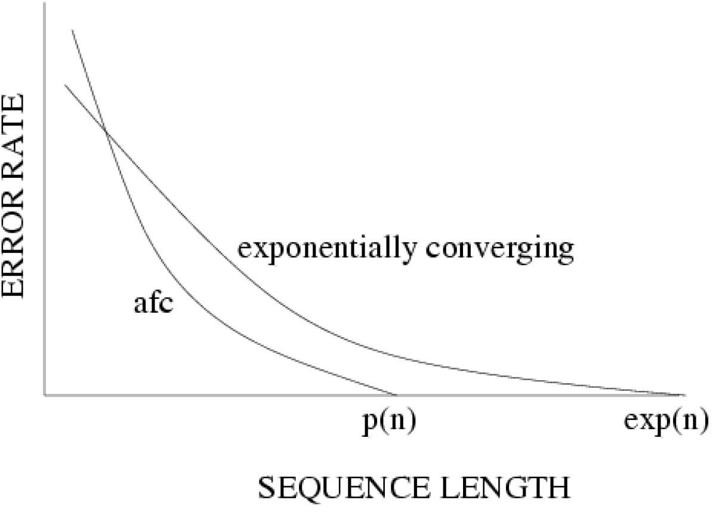
Statistical consistency, exponential convergence, and absolute fast convergence (afc)

Slide 26
DCM1-boosting distance-based methods
[Nakhleh et al. ISMB 2001]
Theorem (Warnow et al., SODA 2001): DCM1-NJ converges to the true tree from polynomial length sequences
0.8
NJ
DCM1-NJ
0.6
Error Rate
0.4
0.2
0
0
400
800
1200
1600
No. Taxa

Slide 27
Large-scale Phylogeny: A grand challenge!
Estimating phylogenies is a complex
analytical task
Large datasets are very hard to analyze with high accuracy
-- many sites not the same
challenge as many taxa!
High Performance Computing is necessary but not sufficient

Slide 28
Summary
Effective heuristics for Maximum likelihood (e.g., RAxML and FastTree) and Bayesian methods (e.g., MrBayes) have statistical guarantees and give good results, but they are slow.
The best distance-based methods also have statistical guarantees and can give good results, but are not necessarily as accurate as maximum likelihood or Bayesian methods.
Maximum parsimony has no guarantees, but can give good results. Some effective heuristics exist (TNT, PAUP*).
However, all these results assume the sequences evolve only with substitutions.

Slide 29
Summary
Effective heuristics for Maximum likelihood (e.g., RAxML and FastTree) and Bayesian methods (e.g., MrBayes) have statistical guarantees and give good results, but they are slow.
The best distance-based methods also have statistical guarantees and can give good results, but are not necessarily as accurate as maximum likelihood or Bayesian methods.
Maximum parsimony has no guarantees, but can give good results. Some effective heuristics exist (TNT, PAUP*).
However, all these results assume the sequences evolve only with substitutions.

Slide 30
The “real” problem
U
V
W
X
Y
AGGGCATGA
AGAT
TAGACTT
TGCACAA
TGCGCTT
X
U
Y
V
W

Slide 31
Indels (insertions and deletions)
Deletion
Mutation
…ACGGTGCAGTTACCA…
…ACCAGTCACCA…
Notes:
31

Slide 32
Multiple Sequence Alignment

Slide 33
Deletion
Substitution
…ACGGTGCAGTTACCA…
Insertion
…ACGGTGCAGTTACC-A…
…AC----CAGTCACCTA…
…ACCAGTCACCTA…
The true multiple alignment
  Reflects historical substitution, insertion, and deletion events
  Defined using transitive closure of pairwise alignments computed on edges of the true tree
Notes:
33
Homology = nucleotides lined up since they come from a common ancestor.
Indel = dash.

Slide 34
Input: unaligned sequences
S1 = AGGCTATCACCTGACCTCCA
S2 = TAGCTATCACGACCGC
S3 = TAGCTGACCGC
S4 = TCACGACCGACA

Slide 35
Phase 1: Alignment
S1 = AGGCTATCACCTGACCTCCA
S2 = TAGCTATCACGACCGC
S3 = TAGCTGACCGC
S4 = TCACGACCGACA
S1 = -AGGCTATCACCTGACCTCCA
S2 = TAG-CTATCAC--GACCGC--
S3 = TAG-CT-------GACCGC--
S4 = -------TCAC--GACCGACA

Slide 36
Phase 2: Construct tree
S1 = AGGCTATCACCTGACCTCCA
S2 = TAGCTATCACGACCGC
S3 = TAGCTGACCGC
S4 = TCACGACCGACA
S1 = -AGGCTATCACCTGACCTCCA
S2 = TAG-CTATCAC--GACCGC--
S3 = TAG-CT-------GACCGC--
S4 = -------TCAC--GACCGACA
S1
S2
S4
S3

Slide 37
Simulation Studies
S1 = AGGCTATCACCTGACCTCCA
S2 = TAGCTATCACGACCGC
S3 = TAGCTGACCGC
S4 = TCACGACCGACA
Unaligned Sequences
S1 = -AGGCTATCACCTGACCTCCA
S2 = TAG-CTATCAC--GACCGC--
S3 = TAG-CT-------GACCGC--
S4 = -------TCAC--GACCGACA
S1 = -AGGCTATCACCTGACCTCCA
S2 = TAG-CTATCAC--GACCGC--
S3 = TAG-C--T-----GACCGC--
S4 = T---C-A-CGACCGA----CA
S1
S2
S1
S4
Compare
S4
S3
S2
S3
True tree and alignment
Estimated tree and alignment

Slide 38
Quantifying Error
FN
FN: false negative
(missing edge)
FP: false positive
(incorrect edge)
50% error rate
FP

Slide 39
Two-phase estimation
Alignment methods
Clustal
POY (and POY*)
Probcons (and Probtree)
Probalign
MAFFT
Muscle
Di-align
T-Coffee
Prank (PNAS 2005, Science 2008)
Opal (ISMB and Bioinf. 2007)
FSA (PLoS Comp. Bio. 2009)
Infernal (Bioinf. 2009)
Etc.
Phylogeny methods
Bayesian MCMC
Maximum parsimony
Maximum likelihood
Neighbor joining
FastME
UPGMA
Quartet puzzling
Etc.
RAxML: heuristic for large-scale ML optimization
Notes:
39

Slide 40
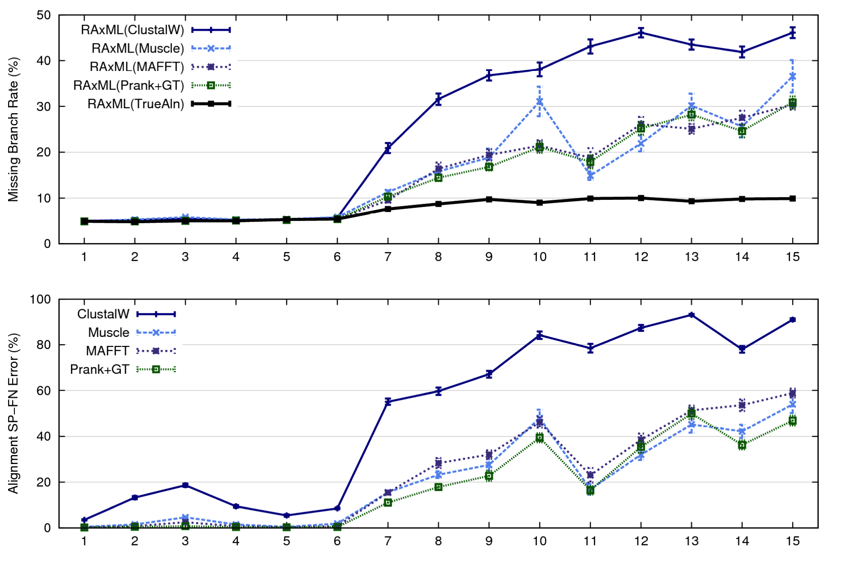
1000-taxon models, ordered by difficulty (Liu et al., 2009)
Notes:
40
1. 2 classes of MC: easy, moderate-to-difficult
2. true alignment
3. 2 classes: ClustalW, everything else
Alignment error, measured this way, isn't a perfect predictor of tree error, measured this way.

Slide 41
Multiple Sequence Alignment (MSA): another grand challenge¹
S1 = AGGCTATCACCTGACCTCCA
S2 = TAGCTATCACGACCGC
S3 = TAGCTGACCGC
…
Sn = TCACGACCGACA
S1 = -AGGCTATCACCTGACCTCCA
S2 = TAG-CTATCAC--GACCGC--
S3 = TAG-CT-------GACCGC--
…
Sn = -------TCAC--GACCGACA
Novel techniques needed for scalability and accuracy
NP-hard problems and large datasets
Current methods do not provide good accuracy
Few methods can analyze even moderately large datasets
Many important applications besides phylogenetic estimation
¹ Frontiers in Massive Data Analysis, National Academies Press, 2013

Slide 42
SATé
SATé (Simultaneous Alignment and Tree Estimation)
Liu et al., Science 2009
Liu et al., Systematic Biology 2012
Public distribution (open source software) and user-friendly GUI

Slide 43
1000-taxon models, ordered by difficulty (Liu et al., 2009)
Notes:
43
1. 2 classes of MC: easy, moderate-to-difficult
2. true alignment
3. 2 classes: ClustalW, everything else
Alignment error, measured this way, isn't a perfect predictor of tree error, measured this way.

Slide 44
Re-aligning on a tree
A
C
Decompose dataset
A
B
C
D
B
D
Align subproblems
A
B
C
D
Estimate ML tree on merged alignment
ABCD
Merge
sub-alignments

Slide 45
SATé Algorithm
Obtain initial alignment and estimated ML tree
Tree
Use tree to compute new alignment
Estimate ML tree on new alignment
Alignment
If new alignment/tree pair has worse ML score, realign using a different decomposition
Repeat until termination condition (typically, 24 hours)

Slide 46
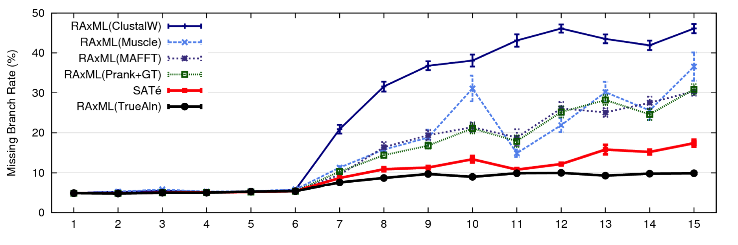
1000 taxon models, ordered by difficulty
24 hour SATé analysis, on desktop machines
(Similar improvements for biological datasets)
Notes:
For moderate-to-difficult datasets, SATe gets better trees and alignments than all other estimated methods. Close to what you might get if you had access to true alignment.
Opens up a new realm of possibility: Datasets currently considered “unalignable” can in fact be aligned reasonably well. This opens up the feasibility of accurate estimations of deep evolutionary histories using a wider range of markers.
TRANSITION: can we do better? What about smaller simulated datasets? And what about biological datasets?

Slide 47
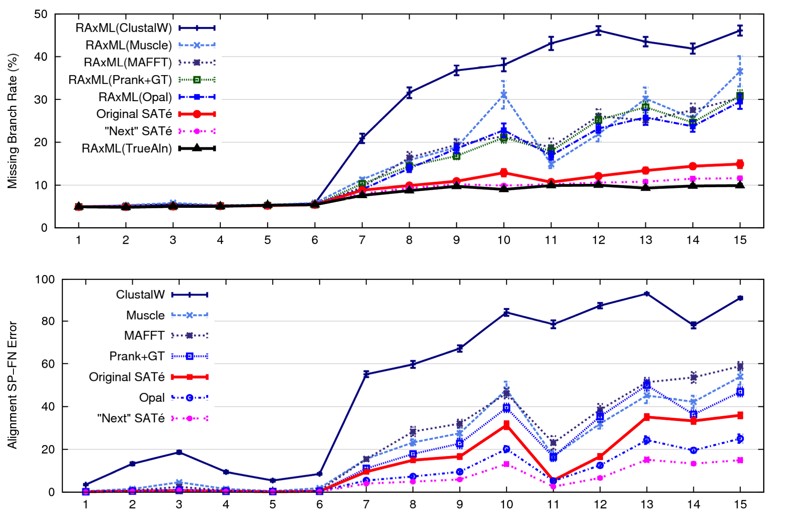
1000 taxon models ranked by difficulty

Slide 48
SATé and PASTA
SATé-1 (Science 2009) can analyze 10,000 sequences
SATé-2 (Systematic Biology 2012) can analyze 50,000 sequences, is faster and more accurate than SATé-1
PASTA (RECOMB 2014) can analyze 200,000 sequences, and is faster and more accurate than both SATé versions.

Slide 49
Tree Error – Simulated data

Slide 50
Alignment Accuracy – Correct columns

Slide 51
Running time

Slide 52
PASTA – tutorial tomorrow
PASTA: Practical Alignments using SATé and TrAnsitivity (Published in RECOMB 2014)
Developers: Siavash Mirarab, Nam Nguyen, and Tandy Warnow
GOOGLE user group
Paper online at http://www.cs.utexas.edu/~tandy/pasta-download.pdf
Software at http://www.cs.utexas.edu/users/phylo/software/pasta/

Slide 53
Co-estimation
PASTA and SATé co-estimate the multiple sequence alignment and its ML tree, but this co-estimation is not performed under a statistical model of evolution that considers indels.
Instead, indels are treated as “missing data”. This is the default for ML phylogeny estimation. (Other options exist but do not necessarily improve topological accuracy.)
Other methods (such as SATCHMO, for proteins) also perform co-estimation, but similarly are not based on statistical models that consider indels.

Slide 54
Other co-estimation methods
Statistical methods:
BAli-Phy (Redelings and Suchard): Bayesian software to co-estimate alignments and trees under a statistical model of evolution that includes indels. Can scale to about 100 sequences, but takes a very long time.
  http://www.bali-phy.org/
StatAlign: http://statalign.github.io/
Extensions of Parsimony
POY (most well known software)
  http://www.amnh.org/our-research/computational-sciences/research/projects/systematic-biology/poy
BeeTLe (Liu and Warnow, PLoS One 2012)

Slide 55
1kp: Thousand Transcriptome Project
G. Ka-Shu Wong
U Alberta
J. Leebens-Mack
U Georgia
N. Wickett
Northwestern
N. Matasci
iPlant
T. Warnow, S. Mirarab, N. Nguyen, Md. S.Bayzid
UT-Austin UT-Austin UT-Austin UT-Austin
Plus many many other people…
Plant Tree of Life based on transcriptomes of ~1200 species
More than 13,000 gene families (most not single copy)
Gene Tree Incongruence
Challenge:
Alignment of datasets with > 100,000 sequences
with many fragmentary sequences

Slide 56
1KP dataset:
More than 100,000 sequences
Lots of fragmentary sequences

Slide 57
Mixed Datasets
Some sequences are very short – much shorter than the full-length sequences – and some are full-length (so mixture of lengths)
Estimating a multiple sequence alignment on datasets with some fragments is very difficult (research area)
Trees based on MSAs computed on datasets with fragments have high error
Occurs in transcriptome datasets, or in metagenomic analyses

Slide 58
Phylogenies from “mixed” datasets
Challenge: Given set of sequences, some full length and some fragmentary, how do we estimate a tree?
Step 1: Extract the full-length sequences, and get MSA and tree
Step 2: Add the remaining sequences (short ones) into the tree.

Slide 59
Phylogenetic Placement
Fragmentary sequences
from some gene
Full-length sequences for same gene, and an alignment and a tree
ACCG
CGAG
CGG
GGCT
TAGA
GGGGG
TCGAG
GGCG
GGG
.
.
.
ACCT
AGG...GCAT
TAGC...CCA
TAGA...CTT
AGC...ACA
ACT..TAGA..A
Notes:
The two basic steps in phylogenetic placement is similar to the two phase methods we typically use, align and then place the fragment.
The differences are we align each fragment independently into the backbone tree. We then take each extended alignment and place each fragment independently into the backbone tree.
Two methods to align the query sequences are HMMALIGN, which estimates a hidden markov model profile for the backbone alignment, and then aligns the query sequence to the model, and PaPaRa, which estimates ancestoral parsimony state vectors for each each in the reference tree and aligns the query sequence against each state vector. It selects the best scoring alignment.
Two methods that place the query sequence try to optimize the same criterion: find the ML placement given the extended alignment

Slide 60
Phylogenetic Placement
Input: Tree and MSA on full-length sequences (called the “backbone tree and backbone MSA”) and a set of “query sequences” (that can be very short)
Output: placement of each query sequence into the “backbone” tree
Several methods for Phylogenetic Placement developed in the last few years

Slide 61
Phylogenetic Placement
Step 1: Align each query sequence to backbone alignment
Step 2: Place each query sequence into backbone tree, using extended alignment
Notes:
The two basic steps in phylogenetic placement is similar to the two phase methods we typically use, align and then place the fragment.
The differences are we align each fragment independently into the backbone tree. We then take each extended alignment and place each fragment independently into the backbone tree.
Two methods to align the query sequences are HMMALIGN, which estimates a hidden markov model on backbone alignemnt, then aligns query sequence. PaPaRa, which estimates ancestoral parsimony state vectors for each each in the reference tree and aligns the query sequence against each state vector. It selects the best scoring alignment.
Two methods that place the query sequence try to optimize the same criterion: find the ML placement given the extended alignment

Slide 62
Phylogenetic Placement
Align each query sequence to backbone alignment
  HMMALIGN (Eddy, Bioinformatics 1998)
  PaPaRa (Berger and Stamatakis, Bioinformatics 2011)
Place each query sequence into backbone tree
  Pplacer (Matsen et al., BMC Bioinformatics, 2011)
  EPA (Berger and Stamatakis, Systematic Biology 2011)
Note: pplacer and EPA use maximum likelihood, and are reported to have the same accuracy.

Slide 63
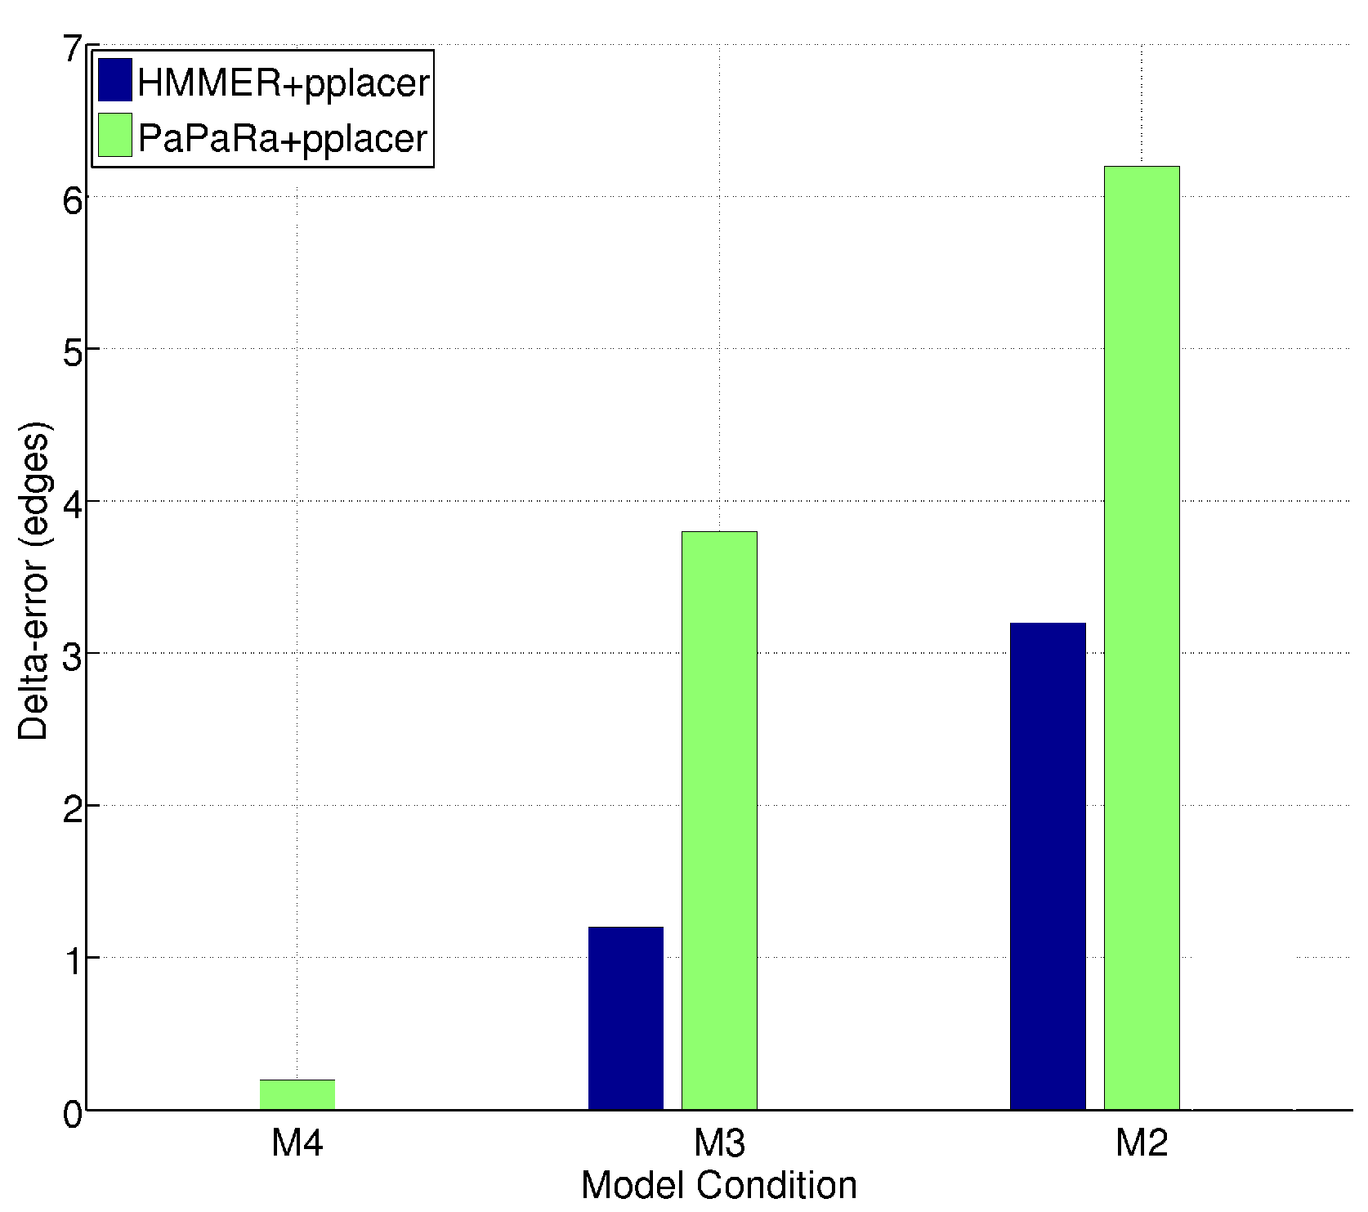
HMMER vs. PaPaRa placement error
0.0
Increasing rate of evolution

Slide 64
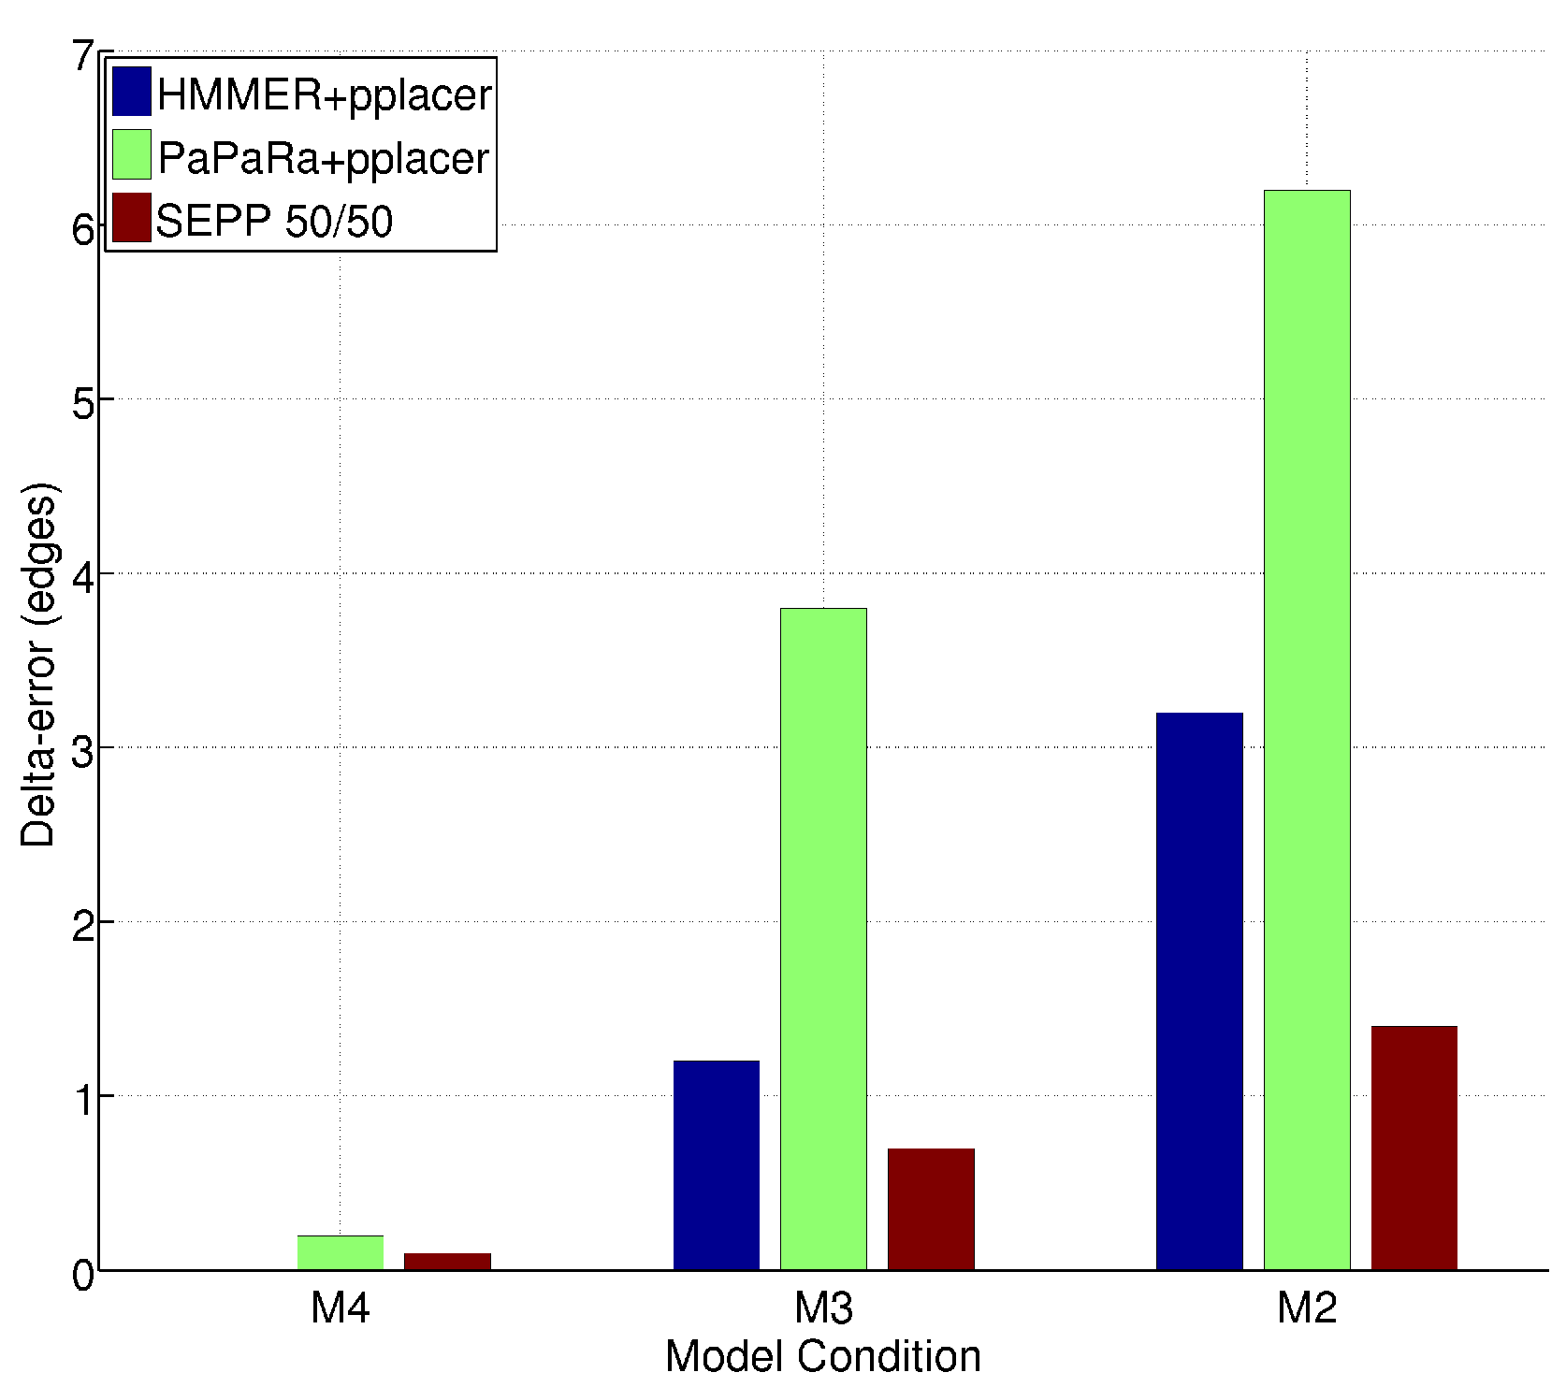
SEPP(10%), based on ~10 HMMs
0.0
0.0
Increasing rate of evolution

Slide 65
SEPP
SEPP = SATé-enabled Phylogenetic Placement
Developers: Nam Nguyen, Siavash Mirarab, and Tandy Warnow
Software available at https://github.com/smirarab/sepp
Paper available at http://psb.stanford.edu/psb-online/proceedings/psb12/mirarab.pdf
Tutorial on Thursday

Slide 66
Summary so far
Great progress in multiple sequence alignment, even for very large datasets with high rates of evolution – provided all sequences are full-length.
Trees based on good MSA methods (e.g., MAFFT for small enough datasets, PASTA for large datasets) can be highly accurate – but sequence length limitations reduces tree accuracy.
Handling fragmentary sequences is challenging, but phylogenetic placement is helpful.
However, all of this is just for a single gene (more generally, a single location in the genome) – no rearrangements, duplications, etc.

Slide 67
Summary so far
Great progress in multiple sequence alignment, even for very large datasets with high rates of evolution – provided all sequences are full-length.
Trees based on good MSA methods (e.g., MAFFT for small enough datasets, PASTA for large datasets) can be highly accurate – but sequence length limitations reduces tree accuracy.
Handling fragmentary sequences is challenging, but phylogenetic placement is helpful.
However, all of this is just for a single gene (more generally, a single location in the genome) – no rearrangements, duplications, etc.

Slide 68
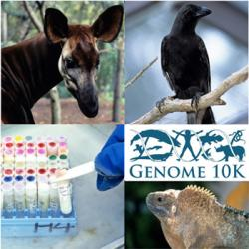
Phylogenomics
(Phylogenetic estimation from whole genomes)

Slide 69
Species Tree Estimation

Slide 70
Not all genes present in all species
gene 1
gene 3
S₁
TCTAATGGAA
S₂
GCTAAGGGAA
gene 2
S₁
TATTGATACA
S₃
TCTAAGGGAA
S₃
TCTTGATACC
S₄
TCTAACGGAA
S₄
GGTAACCCTC
S₄
TAGTGATGCA
S₇
TCTAATGGAC
S₅
GCTAAACCTC
S₇
TAGTGATGCA
S₈
TATAACGGAA
S₆
GGTGACCATC
S₈
CATTCATACC
S₇
GCTAAACCTC

Slide 71
Two basic approaches for species tree estimation
Concatenate (“combine”) sequence alignments for different genes, and run phylogeny estimation methods
Compute trees on individual genes and combine gene trees

Slide 72
Combined analysis
gene 1
gene 2
gene 3
S₁
TCTAATGGAA
? ? ? ? ? ? ? ? ? ?
TATTGATACA
S₂
GCTAAGGGAA
? ? ? ? ? ? ? ? ? ?
? ? ? ? ? ? ? ? ? ?
S₃
TCTAAGGGAA
TCTTGATACC
? ? ? ? ? ? ? ? ? ?
S₄
TCTAACGGAA
GGTAACCCTC
TAGTGATGCA
S₅
? ? ? ? ? ? ? ? ? ?
GCTAAACCTC
? ? ? ? ? ? ? ? ? ?
S₆
? ? ? ? ? ? ? ? ? ?
GGTGACCATC
? ? ? ? ? ? ? ? ? ?
S₇
TCTAATGGAC
GCTAAACCTC
TAGTGATGCA
S₈
TATAACGGAA
? ? ? ? ? ? ? ? ? ?
CATTCATACC

Slide 73
Two competing approaches
gene 1 gene 2 . . . gene k
Species
. . .
Combined
Analysis
Analyze
separately
. . .
Supertree
Method
Notes:
point out that supertree methods take overlaping trees and produce a tree, and that the whole process of first generating small trees and then applying a supertree method is often referred to as the “supertree approach”.

Slide 74
Many Supertree Methods
Matrix Representation with Parsimony
(Most commonly used and most accurate)
MRP
weighted MRP
MRF
MRD
Robinson-Foulds Supertrees
Min-Cut
Modified Min-Cut
Semi-strict Supertree
QMC
Q-imputation
SDM
PhySIC
Majority-Rule Supertrees
Maximum Likelihood Supertrees
and many more ...
Notes:
move to later

Slide 75
Quantifying topological error
c
d
d
a
e
a
c
e
b
True Tree
f
b
Estimated Tree
f
False negative (FN): b ∈ B(T_{true})-B(T_{est.})
False positive (FP): b ∈ B(T_{est.})-B(T_{true})
Notes:
write out exactly what to say about why fn is more important than fp

Slide 76
FN rate of MRP vs. combined analysis
Scaffold Density (%)

Slide 77
SuperFine
SuperFine: Fast and Accurate Supertree Estimation
Systematic Biology 2012
Authors: Shel Swenson, Rahul Suri, Randy Linder, and Tandy Warnow
Software available at http://www.cs.utexas.edu/~phylo/software/superfine/

Slide 78
SuperFine-boosting: improves MRP
Scaffold Density (%)
(Swenson et al., Syst. Biol. 2012)

Slide 79
Summary
Supertree methods approach the accuracy of concatenation (“combined analysis”)
Supertree methods can be much faster than concatenation, especially for whole genome analyses (thousands of genes with millions of sites).
But…

Slide 80
But…
Gene trees may not be identical to species trees:
  Incomplete Lineage Sorting (deep coalescence)
  Gene duplication and loss
  Horizontal gene transfer
This makes combined analysis and standard supertree analyses inappropriate

Slide 81
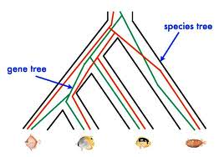
Red gene tree ≠ species tree
(green gene tree okay)

Slide 82
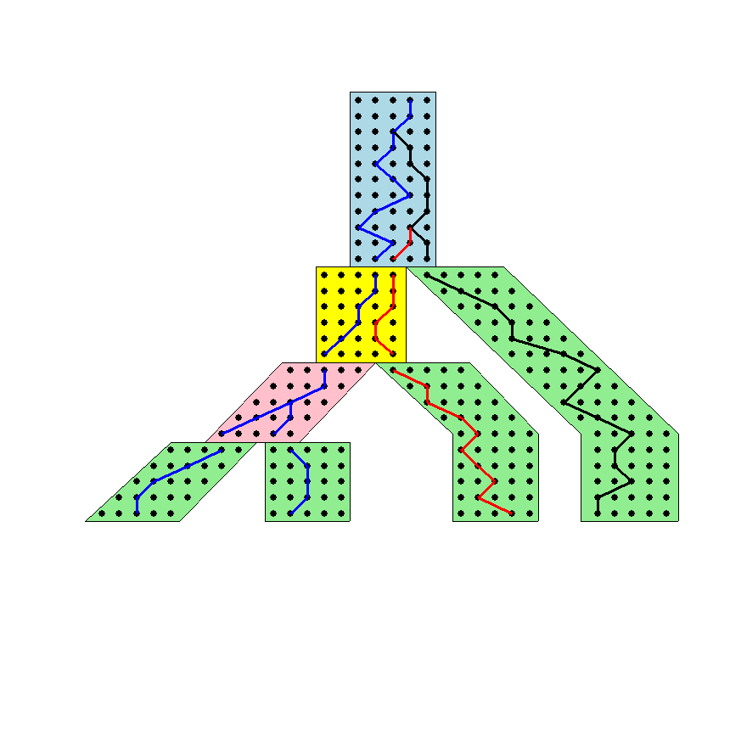




The Coalescent
Courtesy James Degnan
Past
Present

Slide 83
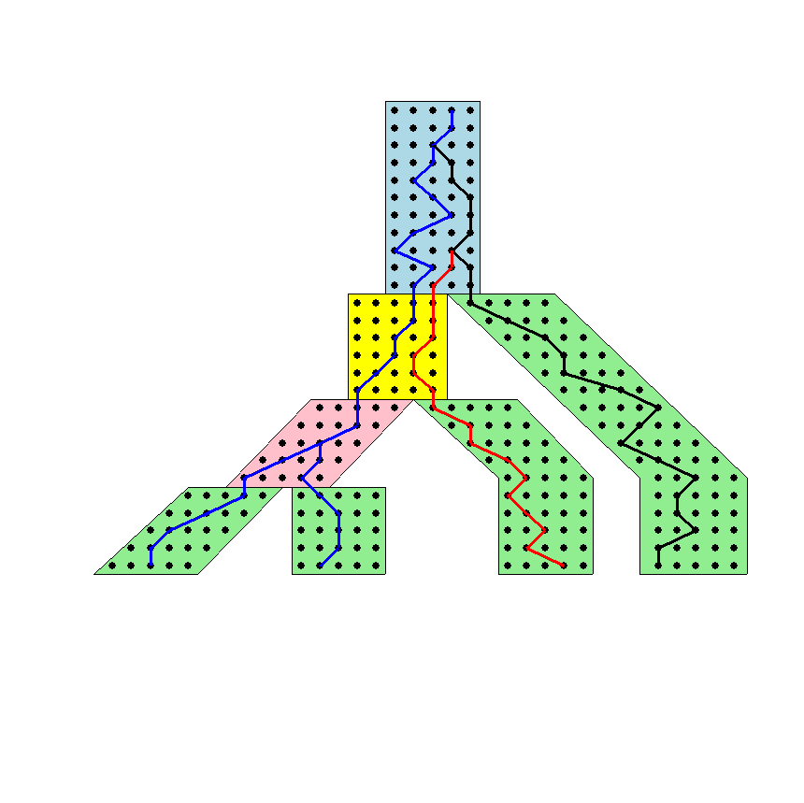
Gene tree in a species tree
Courtesy James Degnan

Slide 84
Deep coalescence
Population-level process
Gene trees can differ from species trees due to short times between speciation events

Slide 85
Incomplete Lineage Sorting (ILS)
2000+ papers in 2013 alone
Confounds phylogenetic analysis for many groups:
  Hominids
  Birds
  Yeast
  Animals
  Toads
  Fish
  Fungi
There is substantial debate about how to analyze phylogenomic datasets in the presence of ILS.

Slide 86
Two competing approaches
gene 1 gene 2 . . . gene k
Species
. . .
Concatenation
Analyze
separately
. . .
Summary Method
Notes:
point out that supertree methods take overlaping trees and produce a tree, and that the whole process of first generating small trees and then applying a supertree method is often referred to as the “supertree approach”.

Slide 87
How to compute a species tree?
. . .
Notes:
point out that supertree methods take overlaping trees and produce a tree, and that the whole process of first generating small trees and then applying a supertree method is often referred to as the “supertree approach”.

Slide 88
MDC: count # extra lineages
Wayne Maddison proposed the MDC (minimize deep coalescence) problem: given set of true gene trees, find the species tree that implies the fewest deep coalescence events
(Really amounts to counting the number of extra lineages)

Slide 89
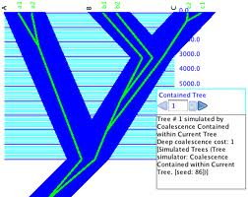

Slide 90
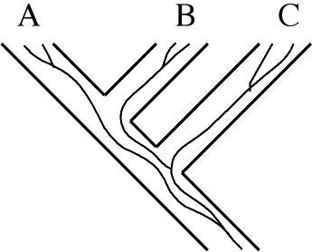

Slide 91
How to compute a species tree?
. . .
Techniques:
MDC?
Most frequent gene tree?
Consensus of gene trees?
Other?
Notes:
point out that supertree methods take overlaping trees and produce a tree, and that the whole process of first generating small trees and then applying a supertree method is often referred to as the “supertree approach”.

Slide 92
Statistically consistent under ILS?
MP-EST (Liu et al. 2010): maximum likelihood estimation of rooted species tree – YES
BUCKy-pop (Ané and Larget 2010): quartet-based Bayesian species tree estimation –YES
MDC – NO
Greedy – NO
Concatenation under maximum likelihood – open
MRP (supertree method) – open

Slide 93
The Debate:
Concatenation vs. Coalescent Estimation
In favor of coalescent-based estimation
  Statistical consistency guarantees
  Addresses gene tree incongruence resulting from ILS
  Some evidence that concatenation can be positively misleading
In favor of concatenation
  Reasonable results on data
  High bootstrap support
  Summary methods (that combine gene trees) can have poor support or miss well-established clades entirely
  Some methods (such as *BEAST) are computationally too intensive to use

Slide 94
Results on 11-taxon datasets with strongILS
*BEAST more accurate than summary methods (MP-EST, BUCKy, etc)
CA-ML: (concatenated analysis) also very accurate
Datasets from Chung and Ané, 2011
Bayzid & Warnow, Bioinformatics 2013

Slide 95
Is Concatenation Evil?
Joseph Heled:
  YES
John Gatesy
  No
Data needed to held understand existing methods and their limitations
Better methods are needed

Slide 96

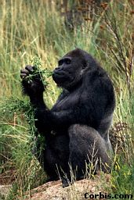


Species tree estimation: difficult, even for small datasets
Orangutan
Gorilla
Chimpanzee
Human
From the Tree of the Life Website,
University of Arizona

Slide 97
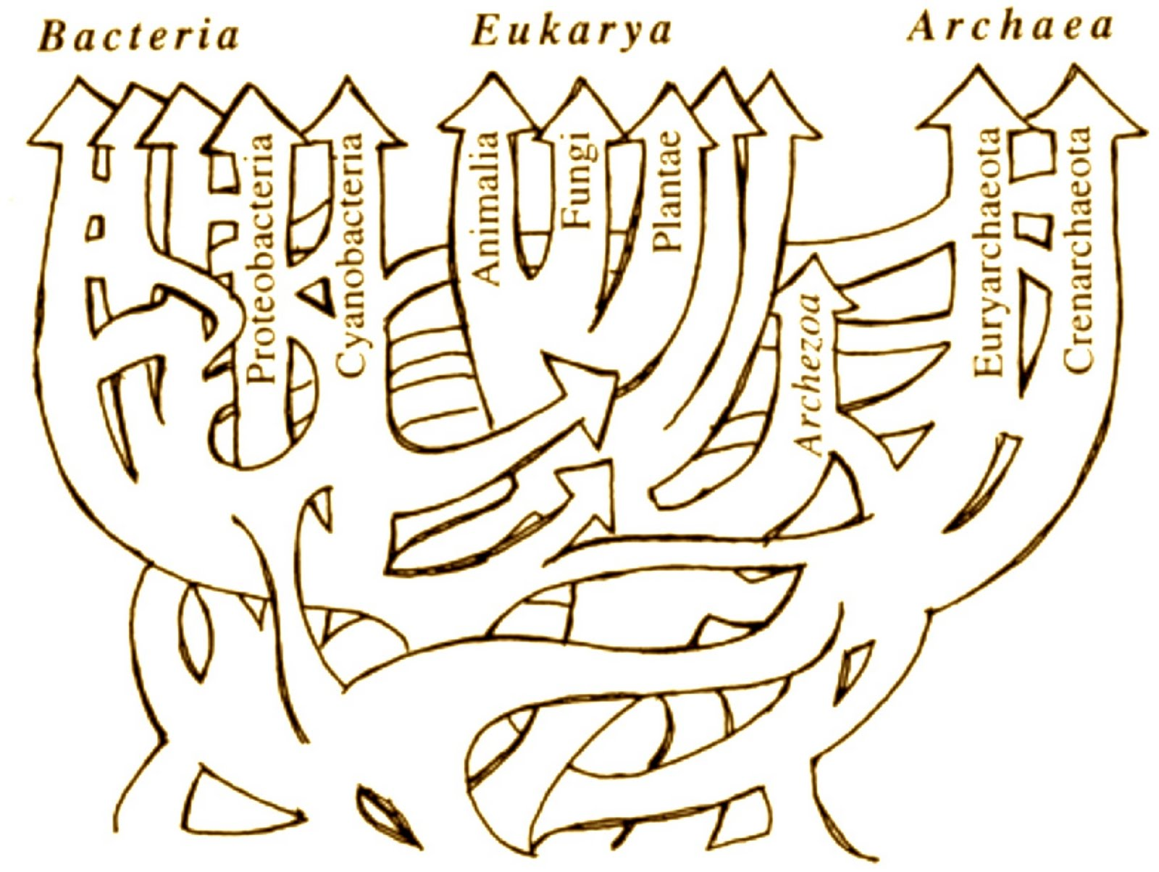
Horizontal Gene Transfer – Phylogenetic Networks
Ford Doolittle

Slide 98
Species tree/network estimation
Methods have been developed to estimate species phylogenies (trees or networks!) from gene trees, when gene trees can conflict from each other (e.g., due to ILS, gene duplication and loss, and horizontal gene transfer).
Phylonet (software suite), has effective methods for many optimization problems – including MDC and maximum likelihood.
Tutorial on Wednesday.
Software available at http://bioinfo.cs.rice.edu/phylonet?destination=node/3

Slide 99
Metagenomic Taxon Identification
Objective: classify short reads in a metagenomic sample
Notes:
The two basic steps in phylogenetic placement is similar to the two phase methods we typically use, align and then place the fragment.
The differences are we align each fragment independently into the backbone tree. We then take each extended alignment and place each fragment independently into the backbone tree.
Two methods to align the query sequences are HMMALIGN, which estimates a hidden markov model on backbone alignemnt, then aligns query sequence. PaPaRa, which estimates ancestoral parsimony state vectors for each each in the reference tree and aligns the query sequence against each state vector. It selects the best scoring alignment.
Two methods that place the query sequence try to optimize the same criterion: find the ML placement given the extended alignment

Slide 100
Two Basic Questions
1. What is this fragment? (Classify each fragment as well as possible.)
2. What is the taxonomic distribution in the dataset? (Note: helpful to use marker genes.)
Notes:
The two basic steps in phylogenetic placement is similar to the two phase methods we typically use, align and then place the fragment.
The differences are we align each fragment independently into the backbone tree. We then take each extended alignment and place each fragment independently into the backbone tree.
Two methods to align the query sequences are HMMALIGN, which estimates a hidden markov model on backbone alignemnt, then aligns query sequence. PaPaRa, which estimates ancestoral parsimony state vectors for each each in the reference tree and aligns the query sequence against each state vector. It selects the best scoring alignment.
Two methods that place the query sequence try to optimize the same criterion: find the ML placement given the extended alignment

Slide 101
SEPP
SEPP: SATé-enabled Phylogenetic Placement, by Mirarab, Nguyen, and Warnow
Pacific Symposium on Biocomputing, 2012 (special session on the Human Microbiome)
Tutorial on Thursday.

Slide 102
Other problems
Genomic MSA estimation:
  Multiple sequence alignment of very long sequences
  Multiple sequence alignment of sequences that evolve with rearrangement events
Phylogeny estimation under more complex models
  Heterotachy
  Violation of the rates-across-sites assumption
  Rearrangements
Estimating branch support on very large datasets

Slide 103

Warnow Laboratory
PhD students: Siavash Mirarab*, Nam Nguyen, and Md. S. Bayzid**
Undergrad: Keerthana Kumar
Lab Website: http://www.cs.utexas.edu/users/phylo
Funding: Guggenheim Foundation, Packard, NSF, Microsoft Research New England, David Bruton Jr. Centennial Professorship, TACC (Texas Advanced Computing Center), and the University of Alberta (Canada)
TACC and UTCS computational resources
* Supported by HHMI Predoctoral Fellowship
** Supported by Fulbright Foundation Predoctoral Fellowship

