Slide 1
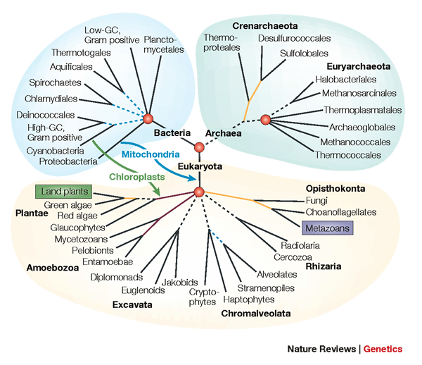
BBCA: Improving the scalability of *BEAST using random binning
Tandy Warnow
The University of Illinois at Urbana-Champaign
Co-authors: Theo Zimmermann (France) and Siavash Mirarab (Texas)

Slide 2

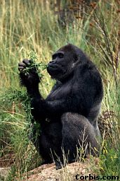


Phylogeny
(evolutionary tree)
Orangutan
Gorilla
Chimpanzee
Human
From the Tree of the Life Website,
University of Arizona

Slide 3
Sampling multiple genes from multiple species
Orangutan
Gorilla
Chimpanzee
Human
From the Tree of the Life Website,
University of Arizona

Slide 4
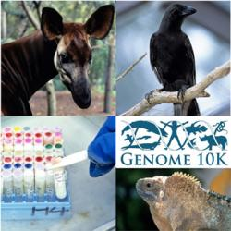
Phylogenomics
(Phylogenetic estimation from whole genomes)

Slide 5
Using multiple genes
gene 1
gene 3
S₁
TCTAATGGAA
S₂
GCTAAGGGAA
gene 2
S₁
TATTGATACA
S₃
TCTAAGGGAA
S₃
TCTTGATACC
S₄
TCTAACGGAA
S₄
GGTAACCCTC
S₄
TAGTGATGCA
S₇
TCTAATGGAC
S₅
GCTAAACCTC
S₇
TAGTGATGCA
S₈
TATAACGGAA
S₆
GGTGACCATC
S₈
CATTCATACC
S₇
GCTAAACCTC

Slide 6
Concatenation
gene 1
gene 2
gene 3
S₁
TCTAATGGAA
? ? ? ? ? ? ? ? ? ?
TATTGATACA
S₂
GCTAAGGGAA
? ? ? ? ? ? ? ? ? ?
? ? ? ? ? ? ? ? ? ?
S₃
TCTAAGGGAA
TCTTGATACC
? ? ? ? ? ? ? ? ? ?
S₄
TCTAACGGAA
GGTAACCCTC
TAGTGATGCA
S₅
? ? ? ? ? ? ? ? ? ?
GCTAAACCTC
? ? ? ? ? ? ? ? ? ?
S₆
? ? ? ? ? ? ? ? ? ?
GGTGACCATC
? ? ? ? ? ? ? ? ? ?
S₇
TCTAATGGAC
GCTAAACCTC
TAGTGATGCA
S₈
TATAACGGAA
? ? ? ? ? ? ? ? ? ?
CATTCATACC

Slide 7
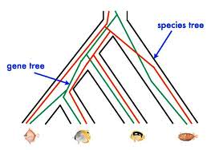
Red gene tree ≠ species tree
(green gene tree okay)

Slide 8








1KP: Thousand Transcriptome Project
Gene Tree Incongruence
G. Ka-Shu Wong
U Alberta
J. Leebens-Mack
U Georgia
N. Wickett
Northwestern
N. Matasci
iPlant
T. Warnow, S. Mirarab, N. Nguyen, Md. S.Bayzid
UT-Austin UT-Austin UT-Austin UT-Austin
1200 plant transcriptomes
More than 13,000 gene families (most not single copy)
Multi-institutional project (10+ universities)
iPLANT (NSF-funded cooperative)
Gene sequence alignments and trees computed using SATe (Liu et al., Science 2009 and Systematic Biology 2012)

Slide 9



Avian Phylogenomics Project
E Jarvis,
HHMI
MTP Gilbert,
Copenhagen
G Zhang,
BGI
T. Warnow
UT-Austin
S. Mirarab Md. S. Bayzid, UT-Austin UT-Austin
Gene Tree Incongruence
Plus many many other people…
Approx. 50 species, whole genomes
8000+ genes, UCEs
Gene sequence alignments computed using SATé (Liu et al., Science 2009 and Systematic Biology 2012)

Slide 10
Gene Tree Incongruence
Gene trees can differ from the species tree due to:
  Duplication and loss
  Horizontal gene transfer
  Incomplete lineage sorting (ILS)

Slide 11
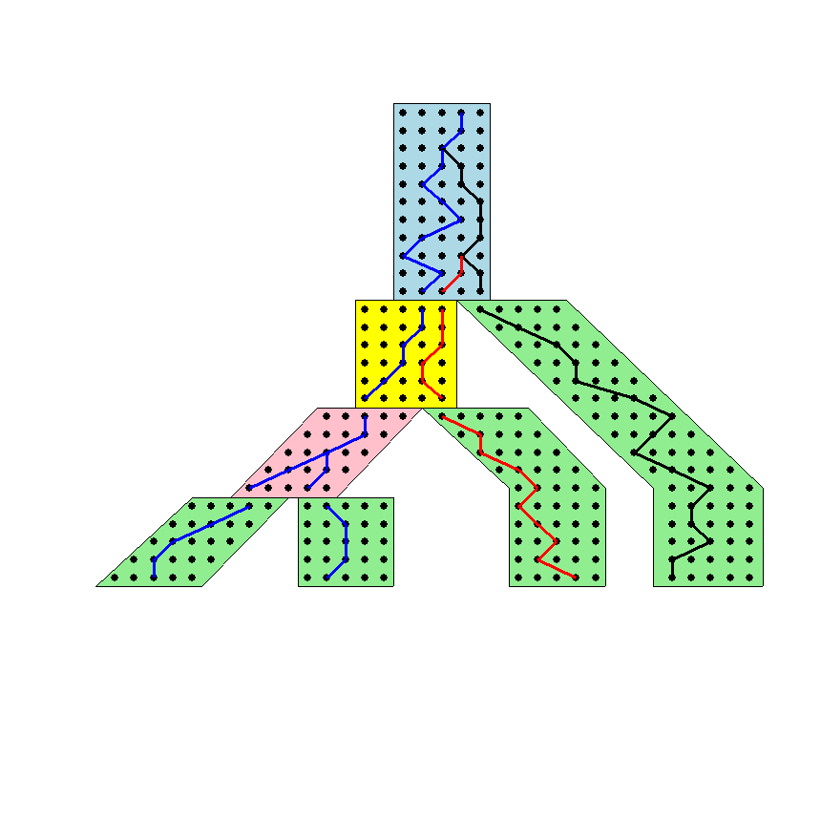




The Coalescent
Courtesy James Degnan
Past
Present

Slide 12
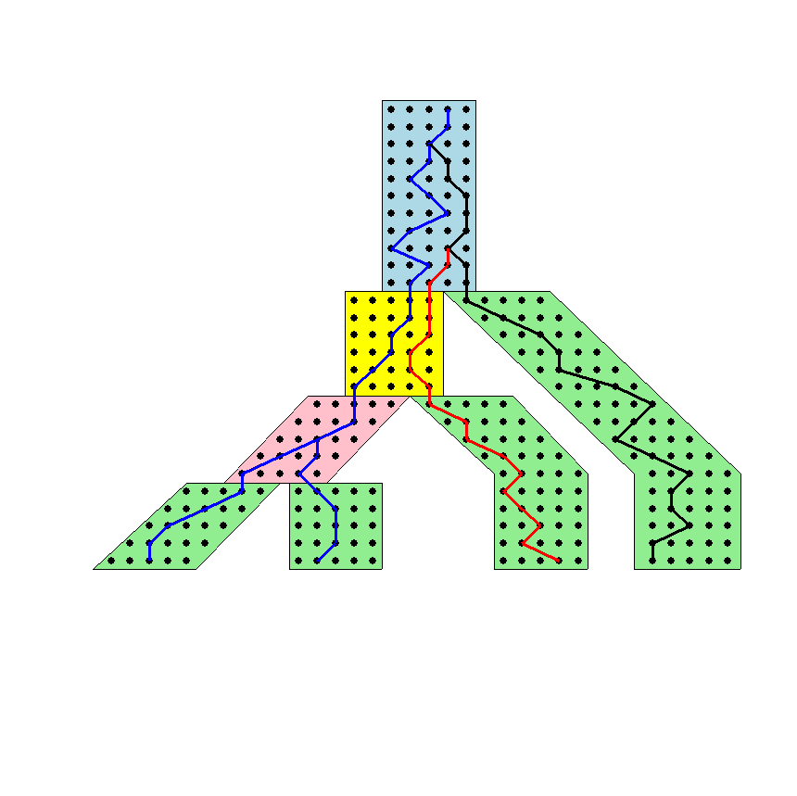
Gene tree in a species tree
Courtesy James Degnan

Slide 13
Lineage Sorting
Population-level process, also called the “Multi-species coalescent” (Kingman, 1982)
Gene trees can differ from species trees due to short times between speciation events or large population size; this is called “Incomplete Lineage Sorting” or “Deep Coalescence”.

Slide 14
Incomplete Lineage Sorting (ILS)
1000+ papers in 2013 alone
Confounds phylogenetic analysis for many groups:
  Hominids
  Birds
  Yeast
  Animals
  Toads
  Fish
  Fungi
There is substantial debate about how to analyze phylogenomic datasets in the presence of ILS.

Slide 15
Key observation:
Under the multi-species coalescent model, the species tree defines a probability distribution on the gene trees
Courtesy James Degnan

Slide 16
Species tree estimation
1- Concatenation: statistically inconsistent (Roch & Steel 2014)
2- Summary methods: can be statistically consistent
3- Co-estimation methods: too slow for large datasets

Slide 17
Two competing approaches
gene 1 gene 2 . . . gene k
Species
. . .
Concatenation
Analyze
separately
. . .
Summary Method
Notes:
point out that supertree methods take overlaping trees and produce a tree, and that the whole process of first generating small trees and then applying a supertree method is often referred to as the “supertree approach”.

Slide 18
Statistically consistent under ILS?
*BEAST (Heled and Drummond 2010): Bayesian co-estimation of gene trees and species trees -- YES
MP-EST (Liu et al. 2010): maximum likelihood estimation of rooted species tree – YES
BUCKy-pop (Ané and Larget 2010): quartet-based Bayesian species tree estimation – YES
ASTRAL (Mirarab et al. 2014): quartet-based method - YES
MDC – NO
Greedy – NO
Concatenation under maximum likelihood – NO (Roch & Steel, submitted)
MRP (supertree method) – open

Slide 19
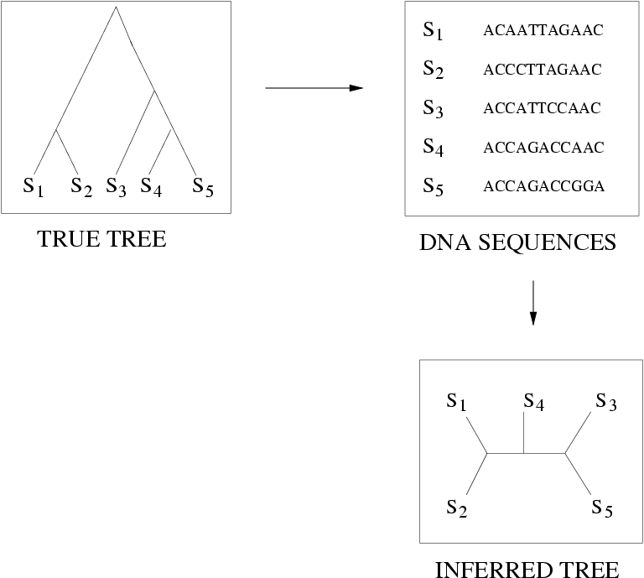
Quantifying Error
FN
FN: false negative
(missing edge)
FP: false positive
(incorrect edge)
FP
50% error rate

Slide 20
Species tree estimation: difficult, even for small datasets!
Orangutan
Gorilla
Chimpanzee
Human
From the Tree of the Life Website,
University of Arizona

Slide 21
Results on 11-taxon datasets with weak ILS
*BEAST more accurate than summary methods (MP-EST, BUCKy, etc)
CA-ML: (concatenated analysis) most accurate
Datasets from Chung and Ané, 2011
Bayzid & Warnow, Bioinformatics 2013

Slide 22
Results on 11-taxon datasets with strongILS
*BEAST more accurate than summary methods (MP-EST, BUCKy, etc)
CA-ML: (concatenated analysis) also very accurate
Datasets from Chung and Ané, 2011
Bayzid & Warnow, Bioinformatics 2013

Slide 23
Gene Tree Estimation:
*BEAST vs. Maximum Likelihood
11-taxon weakILS datasets
17-taxon (very high ILS) datasets
*BEAST produces more accurate gene trees than ML on gene sequence alignments
11-taxon datasets from Chung and Ané, Syst Biol 2012
17-taxon datasets from Yu, Warnow, and Nakhleh, JCB 2011

Slide 24
Impact of Gene Tree Estimation Error on MP-EST
MP-EST has no error on true gene trees, but
MP-EST has 9% error on estimated gene trees
Datasets: 11-taxon strongILS conditions with 50 genes
Similar results for other summary methods (MDC, Greedy, etc.).

Slide 25
Problem: poor gene trees
Summary methods combine estimated gene trees, not true gene trees.
The individual gene sequence alignments in the 11-taxon datasets have poor phylogenetic signal, and result in poorly estimated gene trees.
Species trees obtained by combining poorly estimated gene trees have poor accuracy.

Slide 26
Problem: poor gene trees
Summary methods combine estimated gene trees, not true gene trees.
The individual gene sequence alignments in the 11-taxon datasets have poor phylogenetic signal, and result in poorly estimated gene trees.
Species trees obtained by combining poorly estimated gene trees have poor accuracy.

Slide 27
Problem: poor gene trees
Summary methods combine estimated gene trees, not true gene trees.
The individual gene sequence alignments in the 11-taxon datasets have poor phylogenetic signal, and result in poorly estimated gene trees.
Species trees obtained by combining poorly estimated gene trees have poor accuracy.

Slide 28
TYPICAL PHYLOGENOMICS PROBLEM:
many poor gene trees
Summary methods combine estimated gene trees, not true gene trees.
The individual gene sequence alignments in the 11-taxon datasets have poor phylogenetic signal, and result in poorly estimated gene trees.
Species trees obtained by combining poorly estimated gene trees have poor accuracy.

Slide 29
Species tree estimation
Concatenation – not statistically consistent and can have poor accuracy
Summary methods – can be statistically consistent, but typically have poor accuracy when gene trees have estimation error
Co-estimation methods – can have outstanding accuracy but are too computationally intensive to use on datasets with more than 50 genes

Slide 30
Improving summary methods through binning
Assign genes to “bins”, creating “supergene alignments”
Estimate trees on each supergene alignment using maximum likelihood
Combine the supergene trees together using a summary method
Variants:
Naïve binning (Bayzid and Warnow, Bioinformatics 2013)
Statistical binning (Mirarab, Bayzid, and Warnow, in preparation)

Slide 31
Improving summary methods through binning
Assign genes to “bins”, creating “supergene alignments”
Estimate trees on each supergene alignment using maximum likelihood
Combine the supergene trees together using a summary method
Variants:
Naïve binning (Bayzid and Warnow, Bioinformatics 2013)
Statistical binning (Mirarab, Bayzid, and Warnow, in press)

Slide 32
Statistical binning vs. unbinned
Datasets: 11-taxon strongILS datasets with 50 genes, Chung and Ané, Systematic Biology

Slide 33
*BEAST
The input to *BEAST is a set of gene sequence alignments, and it uses them to co-estimate gene trees and species trees, using a Bayesian MCMC technique.
Bayzid & Warnow (Bioinformatics 2013) showed:
  *BEAST produces more accurate gene trees than maximum likelihood on gene sequence alignments.
  the same accuracy species tree can be obtained by applying summary methods (e.g., MP-EST) to the gene trees produced by *BEAST.
  *BEAST fails to converge on datasets with more than 25 species
  *BEAST failed to converge on 100-gene datasets, even given a week of running time.

Slide 34
BBCA
BBCA = Binned Boosted Coalescent Analysis
Assign genes to “bins” -- randomly
Apply *BEAST to each bin, co-estimating gene trees and species trees on each bin
Combine the gene trees together using a summary method (e.g., MP-EST)
Note: this is a statistically consistent way of using binning, if the size of the bins
Is allowed to grow with the number of genes.

Slide 35
Evaluation
Datasets:
11-taxon simulated datasets, developed by Chung & Ané (Systematic Biology 2011) with 100 genes
12-taxon simulated datasets based on a coalescent analysis of a mammalian clade (Laurasiatheria), with 100 genes; sequence-lengths varied from 500 to 1500 nt.
Methods
*BEAST (24-hour to 168-hour analyses)
BBCA (24-hour and 48-hour analyses), using bins of 25 genes
Concatenation using maximum likelihood (RAxML)
Criteria
Species tree error (Robinson-Foulds distance to true tree)
Failure to converge of MCMC run (% of ESS values below 100)

Slide 36
24-hour BBCA analysis has much lower error than 96-hour *BEAST analysis

Slide 37
24-hour BBCA analysis more accurate than 168-hour *BEAST analysis

Slide 38
BBCA enables *BEAST to converge in less time

Slide 39
Summary
Coalescent-based species tree estimation: provides statistical guarantees in the presence of incomplete lineage sorting
Summary methods (which combine gene trees) have low accuracy in the presence of gene tree estimation error
*BEAST (which co-estimates gene trees and species trees) has higher accuracy, but fails to run on large datasets – convergence problems!
BBCA enables *BEAST to converge on datasets with many genes, and improves topological accuracy
New questions in phylogenetic estimation about impact of error in input data.

Slide 40

Acknowledgments
PhD students: Théo Zimmermann (Ecole Normale Superieure) and Siavash Mirarab (University of Texas at Austin)
Funding: NSF, David Bruton Jr. Centennial Professorship, TACC (Texas Advanced Computing Center), and HHMI Predoctoral Fellowship (to Siavash Mirarab)
TACC and UTCS computational resources

