Slide 1
TIPP: Taxon Identification and Phylogenetic Profiling
Tandy Warnow
The Department of Computer Science
The University of Texas at Austin

Slide 2
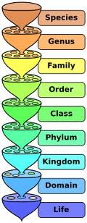
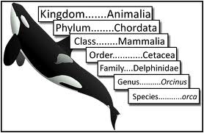
Metagenomic Taxon Identification
Objective: classify short reads in a metagenomic sample
Notes:
The two basic steps in phylogenetic placement is similar to the two phase methods we typically use, align and then place the fragment.
The differences are we align each fragment independently into the backbone tree. We then take each extended alignment and place each fragment independently into the backbone tree.
Two methods to align the query sequences are HMMALIGN, which estimates a hidden markov model on backbone alignemnt, then aligns query sequence. PaPaRa, which estimates ancestoral parsimony state vectors for each each in the reference tree and aligns the query sequence against each state vector. It selects the best scoring alignment.
Two methods that place the query sequence try to optimize the same criterion: find the ML placement given the extended alignment

Slide 3
Two Basic Questions
1. What is this fragment? (Classify each fragment as well as possible.)
2. What is the taxonomic distribution in the dataset? (Note: helpful to use marker genes.)
Notes:
The two basic steps in phylogenetic placement is similar to the two phase methods we typically use, align and then place the fragment.
The differences are we align each fragment independently into the backbone tree. We then take each extended alignment and place each fragment independently into the backbone tree.
Two methods to align the query sequences are HMMALIGN, which estimates a hidden markov model on backbone alignemnt, then aligns query sequence. PaPaRa, which estimates ancestoral parsimony state vectors for each each in the reference tree and aligns the query sequence against each state vector. It selects the best scoring alignment.
Two methods that place the query sequence try to optimize the same criterion: find the ML placement given the extended alignment

Slide 4
SEPP and TIPP
SEPP: SATe-enabled Phylogenetic Placement (Mirarab, Nugyen and Warnow, PSB 2012)
TIPP: Taxon identification and phylogenetic profiling (Nguyen, Mirarab, Liu, Pop, and Warnow, submitted)

Slide 5
This talk
Multiple sequence alignment, indels, and why we need to align sequences
Aligning datasets with fragmentary sequences
SEPP: phylogenetic placement of short sequences into a tree
TIPP: taxonomic identification of fragmentary sequences, and phylogenetic profiling

Slide 6
Indels (insertions and deletions)
Deletion
Mutation
…ACGGTGCAGTTACCA…
…ACCAGTCACCA…
Notes:
6

Slide 7
Deletion
Substitution
…ACGGTGCAGTTACCA…
Insertion
…ACGGTGCAGTTACC-A…
…AC----CAGTCACCTA…
…ACCAGTCACCTA…
The true multiple alignment
  Reflects historical substitution, insertion, and deletion events
  Defined using transitive closure of pairwise alignments computed on edges of the true tree
Notes:
7
Homology = nucleotides lined up since they come from a common ancestor.
Indel = dash.

Slide 8
Input: unaligned sequences
S1 = AGGCTATCACCTGACCTCCA
S2 = TAGCTATCACGACCGC
S3 = TAGCTGACCGC
S4 = TCACGACCGACA

Slide 9
Phase 1: Alignment
S1 = AGGCTATCACCTGACCTCCA
S2 = TAGCTATCACGACCGC
S3 = TAGCTGACCGC
S4 = TCACGACCGACA
S1 = -AGGCTATCACCTGACCTCCA
S2 = TAG-CTATCAC--GACCGC--
S3 = TAG-CT-------GACCGC--
S4 = -------TCAC--GACCGACA

Slide 10
Phase 2: Construct tree
S1 = AGGCTATCACCTGACCTCCA
S2 = TAGCTATCACGACCGC
S3 = TAGCTGACCGC
S4 = TCACGACCGACA
S1 = -AGGCTATCACCTGACCTCCA
S2 = TAG-CTATCAC--GACCGC--
S3 = TAG-CT-------GACCGC--
S4 = -------TCAC--GACCGACA
S1
S2
S4
S3

Slide 11
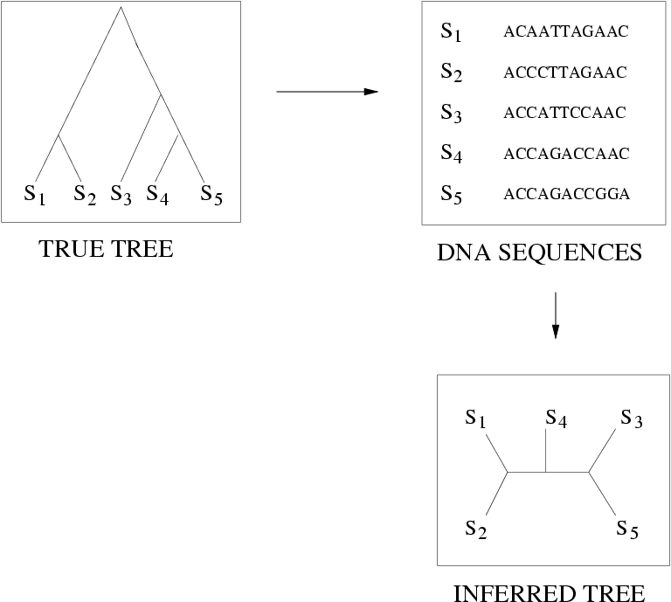
Quantifying Error
FN
FN: false negative
(missing edge)
FP: false positive
(incorrect edge)
50% error rate
FP

Slide 12
Simulation Studies
S1 = AGGCTATCACCTGACCTCCA
S2 = TAGCTATCACGACCGC
S3 = TAGCTGACCGC
S4 = TCACGACCGACA
Unaligned Sequences
S1 = -AGGCTATCACCTGACCTCCA
S2 = TAG-CTATCAC--GACCGC--
S3 = TAG-CT-------GACCGC--
S4 = -------TCAC--GACCGACA
S1 = -AGGCTATCACCTGACCTCCA
S2 = TAG-CTATCAC--GACCGC--
S3 = TAG-C--T-----GACCGC--
S4 = T---C-A-CGACCGA----CA
S1
S2
S1
S4
Compare
S4
S3
S2
S3
True tree and alignment
Estimated tree and alignment

Slide 13
Two-phase estimation
Alignment methods
Clustal
POY (and POY*)
Probcons (and Probtree)
Probalign
MAFFT
Muscle
Di-align
T-Coffee
Prank (PNAS 2005, Science 2008)
Opal (ISMB and Bioinf. 2007)
FSA (PLoS Comp. Bio. 2009)
Infernal (Bioinf. 2009)
Etc.
Phylogeny methods
Bayesian MCMC
Maximum parsimony
Maximum likelihood
Neighbor joining
FastME
UPGMA
Quartet puzzling
Etc.
RAxML: heuristic for large-scale ML optimization
Notes:
13

Slide 14
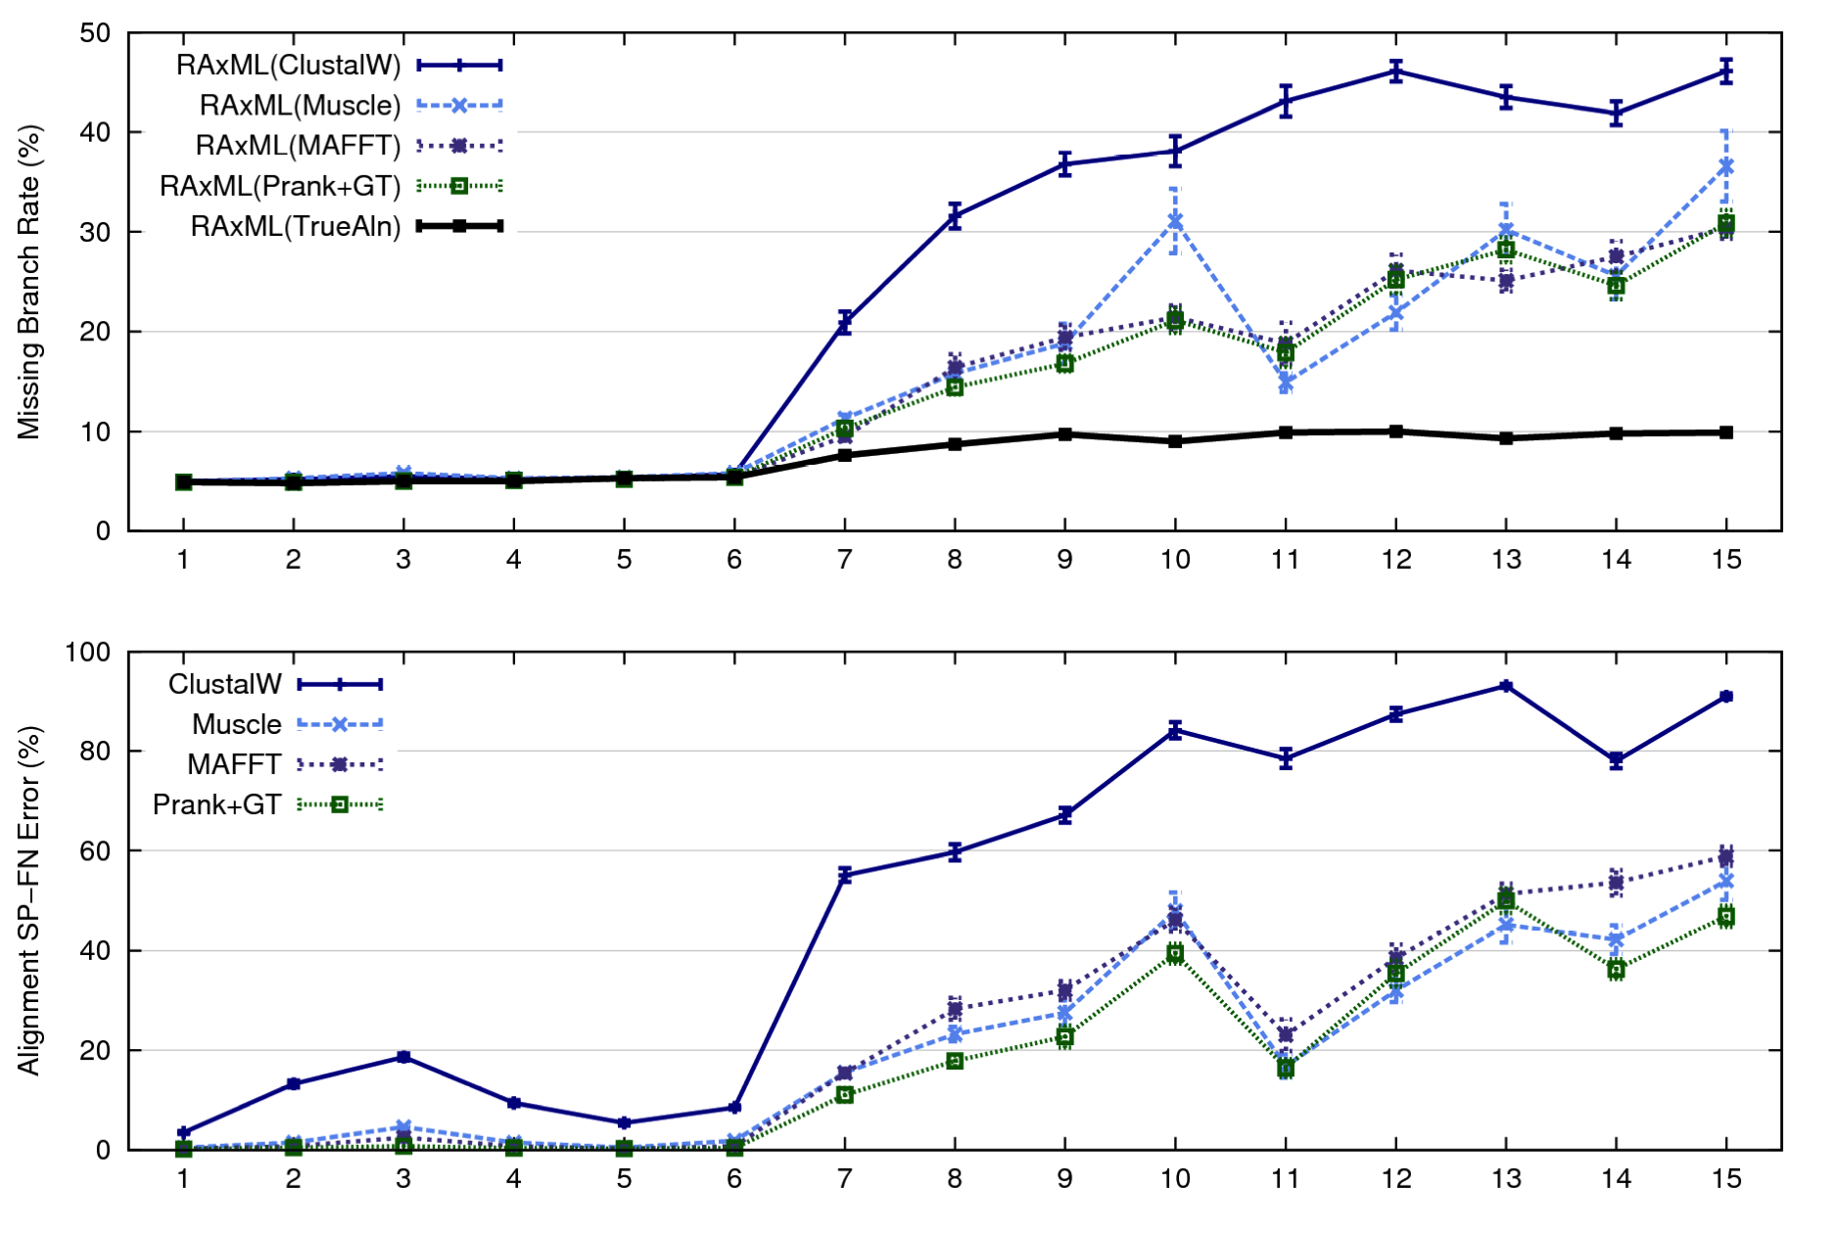
1000-taxon models, ordered by difficulty (Liu et al., 2009)
Notes:
14
1. 2 classes of MC: easy, moderate-to-difficult
2. true alignment
3. 2 classes: ClustalW, everything else
Alignment error, measured this way, isn't a perfect predictor of tree error, measured this way.

Slide 15
Multiple Sequence Alignment (MSA): another grand challenge¹
S1 = AGGCTATCACCTGACCTCCA
S2 = TAGCTATCACGACCGC
S3 = TAGCTGACCGC
…
Sn = TCACGACCGACA
S1 = -AGGCTATCACCTGACCTCCA
S2 = TAG-CTATCAC--GACCGC--
S3 = TAG-CT-------GACCGC--
…
Sn = -------TCAC--GACCGACA
Novel techniques needed for scalability and accuracy
NP-hard problems and large datasets
Current methods do not provide good accuracy
Few methods can analyze even moderately large datasets
Many important applications besides phylogenetic estimation
¹ Frontiers in Massive Data Analysis, National Academies Press, 2013

Slide 16








1kp: Thousand Transcriptome Project
G. Ka-Shu Wong
U Alberta
J. Leebens-Mack
U Georgia
N. Wickett
Northwestern
N. Matasci
iPlant
T. Warnow, S. Mirarab, N. Nguyen, Md. S.Bayzid
UT-Austin UT-Austin UT-Austin UT-Austin
Plus many many other people…
Plant Tree of Life based on transcriptomes of ~1200 species
More than 13,000 gene families (most not single copy)
Gene Tree Incongruence
Challenge:
Alignment of datasets with > 100,000 sequences
with many fragmentary sequences

Slide 18
Phylogenetic Placement
Fragmentary sequences
from some gene
Full-length sequences for same gene, and an alignment and a tree
ACCG
CGAG
CGG
GGCT
TAGA
GGGGG
TCGAG
GGCG
GGG
.
.
.
ACCT
AGG...GCAT
TAGC...CCA
TAGA...CTT
AGC...ACA
ACT..TAGA..A
Notes:
The two basic steps in phylogenetic placement is similar to the two phase methods we typically use, align and then place the fragment.
The differences are we align each fragment independently into the backbone tree. We then take each extended alignment and place each fragment independently into the backbone tree.
Two methods to align the query sequences are HMMALIGN, which estimates a hidden markov model profile for the backbone alignment, and then aligns the query sequence to the model, and PaPaRa, which estimates ancestoral parsimony state vectors for each each in the reference tree and aligns the query sequence against each state vector. It selects the best scoring alignment.
Two methods that place the query sequence try to optimize the same criterion: find the ML placement given the extended alignment

Slide 19
Phylogenetic Placement
Input: Tree T and alignment on full-length sequences, and set Q of query sequences
Output: edge in T for each sequence q in Q.
Applications:
phylogenetic estimation on large datasets with many fragmentary sequences
classifying shotgun metagenomic data (all from the same gene)
Notes:
The two basic steps in phylogenetic placement is similar to the two phase methods we typically use, align and then place the fragment.
The differences are we align each fragment independently into the backbone tree. We then take each extended alignment and place each fragment independently into the backbone tree.
Two methods to align the query sequences are HMMALIGN, which estimates a hidden markov model on backbone alignemnt, then aligns query sequence. PaPaRa, which estimates ancestoral parsimony state vectors for each each in the reference tree and aligns the query sequence against each state vector. It selects the best scoring alignment.
Two methods that place the query sequence try to optimize the same criterion: find the ML placement given the extended alignment

Slide 20
Phylogenetic Placement
Step 1: Align each query sequence to backbone alignment
Step 2: Place each query sequence into backbone tree, using extended alignment
Notes:
The two basic steps in phylogenetic placement is similar to the two phase methods we typically use, align and then place the fragment.
The differences are we align each fragment independently into the backbone tree. We then take each extended alignment and place each fragment independently into the backbone tree.
Two methods to align the query sequences are HMMALIGN, which estimates a hidden markov model on backbone alignemnt, then aligns query sequence. PaPaRa, which estimates ancestoral parsimony state vectors for each each in the reference tree and aligns the query sequence against each state vector. It selects the best scoring alignment.
Two methods that place the query sequence try to optimize the same criterion: find the ML placement given the extended alignment

Slide 21
Phylogenetic Placement
Align each query sequence to backbone alignment
  HMMALIGN (Eddy, Bioinformatics 1998)
  PaPaRa (Berger and Stamatakis, Bioinformatics 2011)
Place each query sequence into backbone tree
  Pplacer (Matsen et al., BMC Bioinformatics, 2011)
  EPA (Berger and Stamatakis, Systematic Biology 2011)
Note: pplacer and EPA use maximum likelihood, and are reported to have the same accuracy.

Slide 22
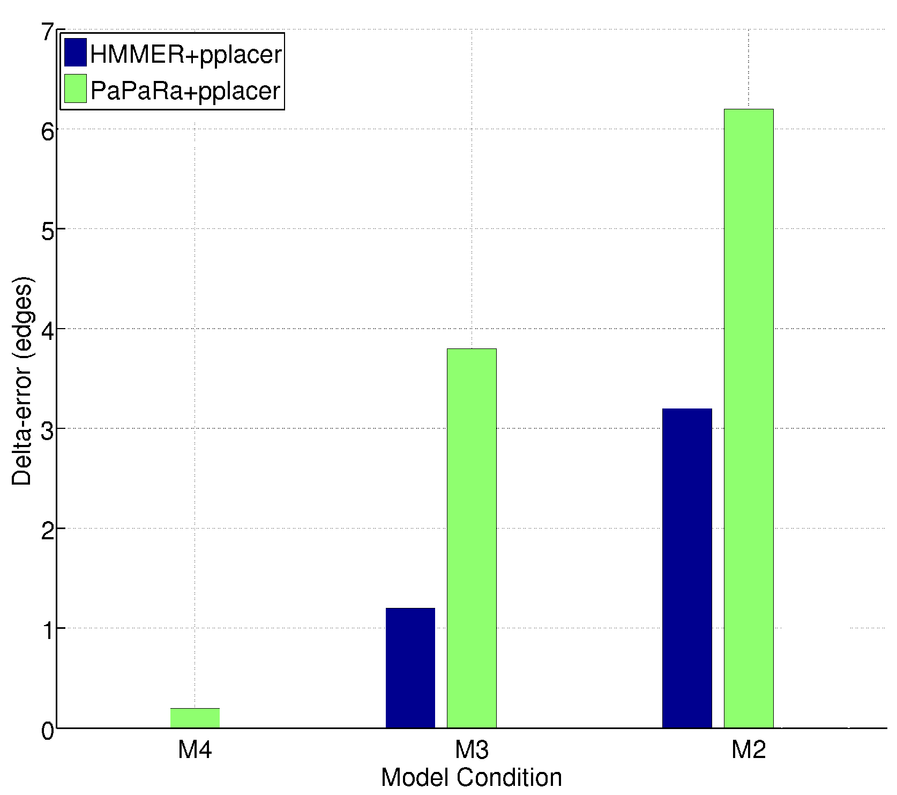
HMMER vs. PaPaRa placement error
0.0
Increasing rate of evolution

Slide 23
HMMER+pplacer
Steps:
1) Build one HMM for the entire alignment
2) Align fragment to the HMM, and insert into alignment
3) Insert fragment into tree to optimize likelihood

Slide 24
Using HMMER
Using HMMER works well…
…except when the dataset has a high evolutionary diameter.

Slide 25
Using HMMER
Using HMMER works well…except when the dataset is big!

Slide 26
One Hidden Markov Model for the entire alignment?

Slide 27
Or 2 HMMs?

Slide 28
Or 4 HMMs?

Slide 29
SEPP
SEPP: SATé-enabled Phylogenetic Placement, by Mirarab, Nguyen, and Warnow
Pacific Symposium on Biocomputing, 2012 (special session on the Human Microbiome)

Slide 30
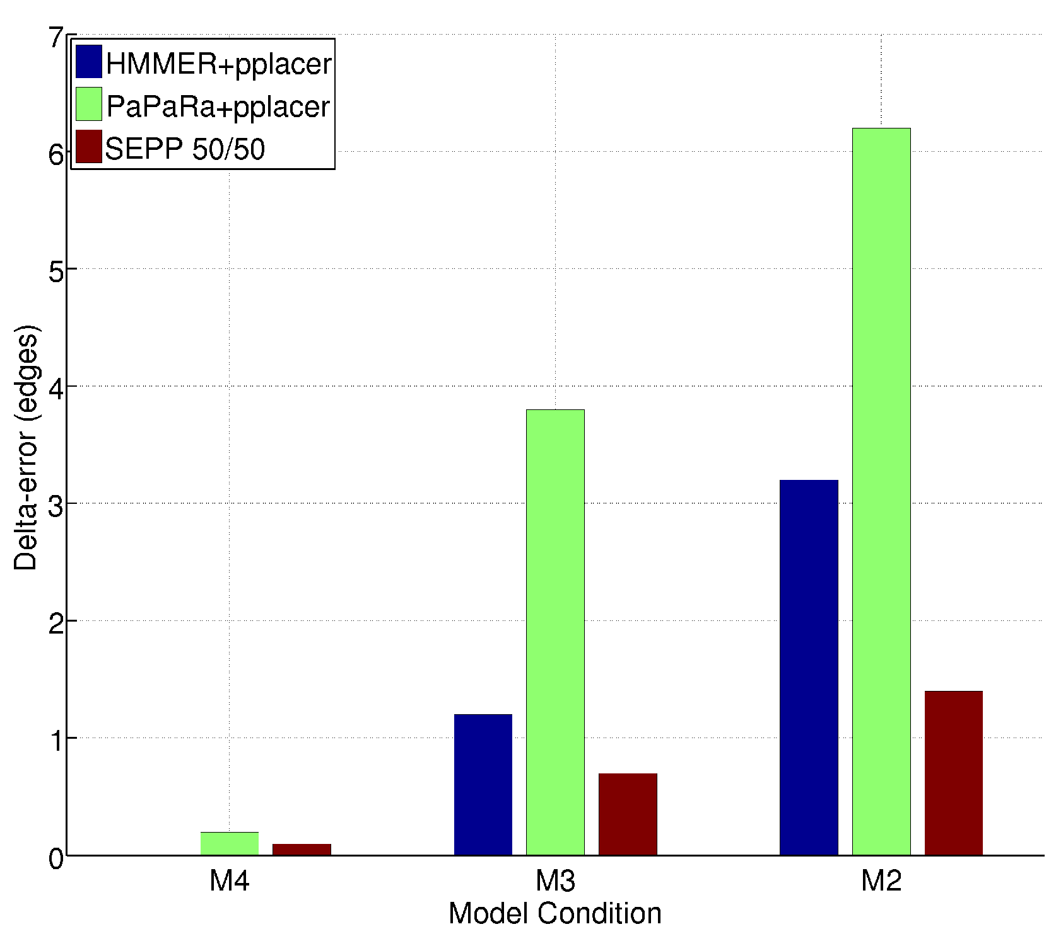
SEPP(10%), based on ~10 HMMs
0.0
0.0
Increasing rate of evolution

Slide 31
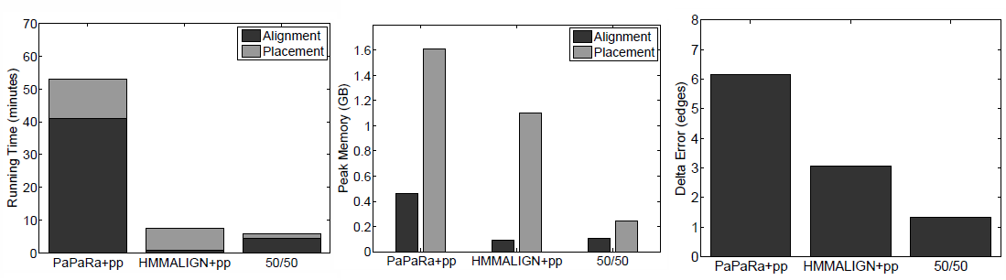
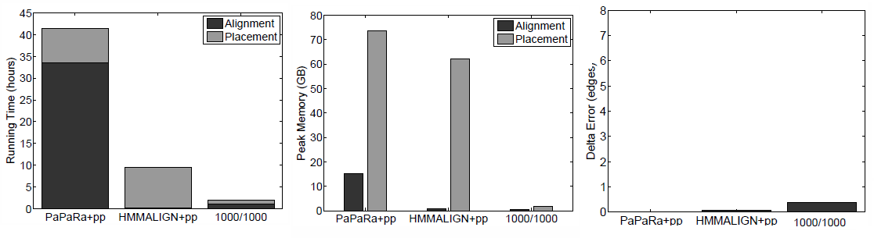
Biological Results
16S.B.ALL dataset, curated alignment/tree, 13k total fragments
For 1 million fragments:
PaPaRa+pplacer: ~133 days
HMMALIGN+pplacer: ~30 days
SEPP 1000/1000: ~6 days

Slide 32
Metagenomic Taxon Identification
Objective: classify short reads in a metagenomic sample
Notes:
The two basic steps in phylogenetic placement is similar to the two phase methods we typically use, align and then place the fragment.
The differences are we align each fragment independently into the backbone tree. We then take each extended alignment and place each fragment independently into the backbone tree.
Two methods to align the query sequences are HMMALIGN, which estimates a hidden markov model on backbone alignemnt, then aligns query sequence. PaPaRa, which estimates ancestoral parsimony state vectors for each each in the reference tree and aligns the query sequence against each state vector. It selects the best scoring alignment.
Two methods that place the query sequence try to optimize the same criterion: find the ML placement given the extended alignment

Slide 33
Two Basic Questions
1. What is this fragment? (Classify each fragment as well as possible.)
2. What is the taxonomic distribution in the dataset? (Note: helpful to use marker genes.)
Notes:
The two basic steps in phylogenetic placement is similar to the two phase methods we typically use, align and then place the fragment.
The differences are we align each fragment independently into the backbone tree. We then take each extended alignment and place each fragment independently into the backbone tree.
Two methods to align the query sequences are HMMALIGN, which estimates a hidden markov model on backbone alignemnt, then aligns query sequence. PaPaRa, which estimates ancestoral parsimony state vectors for each each in the reference tree and aligns the query sequence against each state vector. It selects the best scoring alignment.
Two methods that place the query sequence try to optimize the same criterion: find the ML placement given the extended alignment

Slide 34
Identifying Fragments using Marker Genes
Approach:
  Determine the gene for the fragment (if possible), thus producing a set of “bins” (one for each gene, and a bin for “unclassified”)
  For each gene, classify each fragment:
    Construct a reference alignment and tree for full-length sequences for that gene
    Place each fragment within the tree
    Predict taxon identification (species, genus, etc.) from the placement

Slide 35
TIPP: SEPP + statistics
Using SEPP as a taxon identification technique has high recall but low precision (classifies almost everything)
TIPP: dramatically reduces false positive rate with small reduction in true positive rate, by considering uncertainty in alignment (HMMER) and placement (pplacer)

Slide 36
Taxonomic Identification
Objective: Identify species/genus/family (etc.) for each fragment within the sample.
Methods:
  PhymmBL (Brady & Salzberg, Nature Methods 2009)
  NBC (Rosen, Reichenberger, and Rosenfeld, Bioinformatics 2011)
  Metaphyler (Liu et al., BMC Genomics 2011), from the Pop lab at the University of Maryland
Metaphyler is a marker-based method.
Marker gene are single-copy, universal, and resistant to horizontal transmission.
We test this for the 30 marker genes used in Metaphyler.
Criteria: Correct classification, incorrect classification, or no classification
Notes:
The two basic steps in phylogenetic placement is similar to the two phase methods we typically use, align and then place the fragment.
The differences are we align each fragment independently into the backbone tree. We then take each extended alignment and place each fragment independently into the backbone tree.
Two methods to align the query sequences are HMMALIGN, which estimates a hidden markov model on backbone alignemnt, then aligns query sequence. PaPaRa, which estimates ancestoral parsimony state vectors for each each in the reference tree and aligns the query sequence against each state vector. It selects the best scoring alignment.
Two methods that place the query sequence try to optimize the same criterion: find the ML placement given the extended alignment

Slide 39
Abundance Profiling
Objective: Distribution of the species (or genera, or families, etc.) within the sample.
For example: The distribution of the sample at the species-level is:
50% species A
20% species B
15% species C
14% species D
1% species E
Notes:
The two basic steps in phylogenetic placement is similar to the two phase methods we typically use, align and then place the fragment.
The differences are we align each fragment independently into the backbone tree. We then take each extended alignment and place each fragment independently into the backbone tree.
Two methods to align the query sequences are HMMALIGN, which estimates a hidden markov model on backbone alignemnt, then aligns query sequence. PaPaRa, which estimates ancestoral parsimony state vectors for each each in the reference tree and aligns the query sequence against each state vector. It selects the best scoring alignment.
Two methods that place the query sequence try to optimize the same criterion: find the ML placement given the extended alignment

Slide 40
Abundance Profiling
Objective: Distribution of the species (or genera, or families, etc.) within the sample.
Leading techniques:
  PhymmBL (Brady & Salzberg, Nature Methods 2009)
  NBC (Rosen, Reichenberger, and Rosenfeld, Bioinformatics 2011)
  Metaphyler (Liu et al., BMC Genomics 2011), from the Pop lab at the University of Maryland
  MetaphlAn (Segata et al., Nature Methods 2012), from the Huttenhower Lab at Harvard
Metaphyler and MetaphlAn are marker-based techniques (but use different marker genes).
Marker gene are single-copy, universal, and resistant to horizontal transmission.
Notes:
The two basic steps in phylogenetic placement is similar to the two phase methods we typically use, align and then place the fragment.
The differences are we align each fragment independently into the backbone tree. We then take each extended alignment and place each fragment independently into the backbone tree.
Two methods to align the query sequences are HMMALIGN, which estimates a hidden markov model on backbone alignemnt, then aligns query sequence. PaPaRa, which estimates ancestoral parsimony state vectors for each each in the reference tree and aligns the query sequence against each state vector. It selects the best scoring alignment.
Two methods that place the query sequence try to optimize the same criterion: find the ML placement given the extended alignment

Slide 41
Short fragment datasets: average length at most 100
Long fragment datasets: average length 265 to 969

Slide 42
FACs HC: Fragments simulated from 19 bacterial genomes, all in equal abundance
  (Stranneheim et al. 2010)
FAMeS: Fragments simulated from 113 bacterial and archael genomes, under 3
  different abundance complexity profiles. (Mavromatis et al. 2007)
WebCarma: Fragments simulated from 25 bacterial genomes, all in equal abundance
  (Gerlach and Stoye 2011).

Slide 44
Observations
Classification of fragments:
  TIPP and Metaphyler are methods that use marker genes for taxon identification and phylogenetic profiling. These methods only classify fragments that are assigned to their marker genes. They will fail to classify some fragments.
  TIPP and Metaphlyler are both more accurate than PhymmBL at classifying fragments from the 30 marker genes (perhaps not surprisingly).
  Most methods are affected by sequencing errors, and especially by indels (454 errors). TIPP is fairly robust to 454 error (indels).
Taxonomic profiling:
  Marker-based profiling can produce more accurate taxonomic profiles (distributions) than techniques that attempt to classify all fragments.
  Using marker genes from Metaphyler, TIPP produces more accurate taxonomic distributions (profiles) than Metaphyler.
TIPP uses multiple sequence alignment and phylogenetic placement to improve accuracy. This is probably why TIPP has better robustness to indel errors, and high sensitivity.

Slide 45
SEPP, TIPP, and UPP
SEPP: SATe-enabled Phylogenetic Placement (Mirarab, Nugyen and Warnow, PSB 2012)
TIPP: Taxon identification and phylogenetic profiling (Nguyen, Mirarab, Liu, Pop, and Warnow, submitted)
UPP: Ultra-large multiple sequence alignment using SEPP (Nguyen, Mirarab, Kumar, Wang, Guo, Kim, and Warnow, in preparation)

Slide 46
UPP: Ultra-large alignment using phylogenetic profiles
Objective: highly accurate multiple sequence alignments and trees on ultra-large datasets or that contain fragmentary sequences
Authors: Nam Nguyen et al.
Under review

Slide 47
UPP: basic idea
Input: set S of unaligned sequences
Output: alignment on S
Select random subset X of S
Estimate “backbone” alignment A and tree T on X
Independently align each sequence in S-X to A
Use transitivity to produce multiple sequence alignment A* for entire set S

Slide 48
Alignment error on fragmentary sequence data
PASTA is new SATe
(RECOMB 2014)

Slide 49
UPP vs. MAFFT-profile Running Time

Slide 50
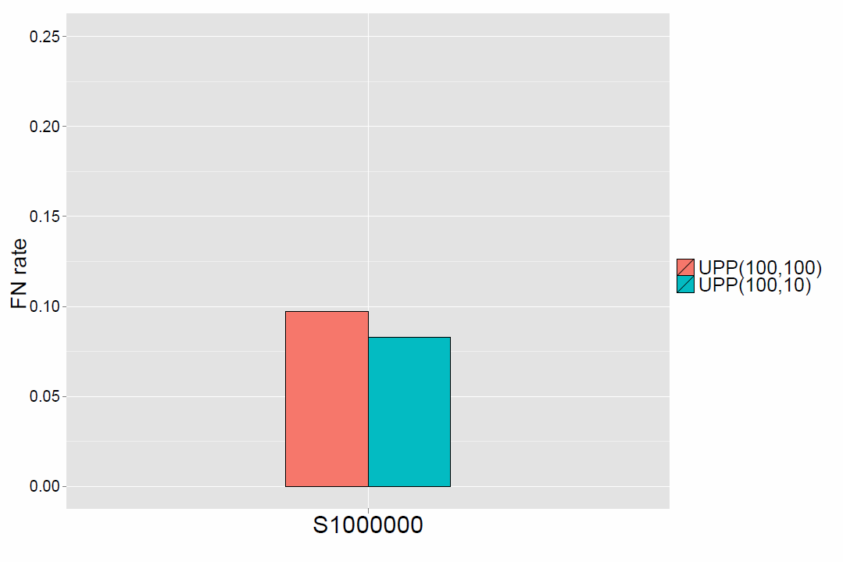
One Million Sequences: Tree Error
UPP(100,100): 1.6 days
using 12 processors
UPP(100,10): 7 days using 12 processors
Note: UPP decomposition improves accuracy

Slide 51

Warnow Laboratory
PhD students: Siavash Mirarab*, Nam Nguyen, and Md. S. Bayzid**
Undergrad: Keerthana Kumar
Lab Website: http://www.cs.utexas.edu/users/phylo
Funding: Guggenheim Foundation, Packard, NSF, Microsoft Research New England, David Bruton Jr. Centennial Professorship, TACC (Texas Advanced Computing Center), and the University of Alberta (Canada)
TACC and UTCS computational resources
* Supported by HHMI Predoctoral Fellowship
** Supported by Fulbright Foundation Predoctoral Fellowship

Slide 52
Input: Unaligned Sequences
S1 = AGGCTATCACCTGACCTCCAAT
S2 = TAGCTATCACGACCGCGCT
S3 = TAGCTGACCGCGCT
S4 = TACTCACGACCGACAGCT
S5 = TAGGTACAACCTAGATC
S6 = AGATACGTCGACATATC

Slide 53
Step 1: Pick random subset
(backbone)
S1 = AGGCTATCACCTGACCTCCAAT
S2 = TAGCTATCACGACCGCGCT
S3 = TAGCTGACCGCGCT
S4 = TACTCACGACCGACAGCT
S5 = TAGGTACAACCTAGATC
S6 = AGATACGTCGACATATC

Slide 54
Step 2: Compute backbone alignment
S1 = -AGGCTATCACCTGACCTCCA-AT
S2 = TAG-CTATCAC--GACCGC--GCT
S3 = TAG-CT-------GACCGC--GCT
S4 = TAC----TCAC—-GACCGACAGCT
S5 = TAGGTAAAACCTAGATC
S6 = AGATAAAACTACATATC

Slide 55
Step 3: Align each remaining sequence to backbone
First we add S5 to the backbone alignment
S1 = -AGGCTATCACCTGACCTCCA-AT-
S2 = TAG-CTATCAC--GACCGC--GCT-
S3 = TAG-CT-------GACCGC—-GCT-
S4 = TAC----TCAC--GACCGACAGCT-
S5 = TAGG---T-A—CAA-CCTA--GATC

Slide 56
Step 3: Align each remaining sequence to backbone
Then we add S6 to the backbone alignment
S1 = -AGGCTATCACCTGACCTCCA-AT-
S2 = TAG-CTATCAC--GACCGC--GCT-
S3 = TAG-CT-------GACCGC--GCT-
S4 = TAC----TCAC—-GACCGACAGCT-
S6 = -AG---AT-A-CGTC--GACATATC

Slide 57
Step 4: Use transitivity to obtain MSA on entire set
S1 = -AGGCTATCACCTGACCTCCA-AT--
S2 = TAG-CTATCAC--GACCGC--GCT--
S3 = TAG-CT-------GACCGC--GCT--
S4 = TAC----TCAC--GACCGACAGCT--
S5 = TAGG---T-A—CAA-CCTA--GATC-
S6 = -AG---AT-A-CGTC--GACATAT-C

Slide 58
UPP: details
Input: set S of unaligned sequences
Output: alignment on S
Select random subset X of S
Estimate “backbone” alignment A and tree T on X
Independently align each sequence in S-X to A
Use transitivity to produce multiple sequence alignment A* for entire set S

Slide 59
UPP: details
Input: set S of unaligned sequences
Output: alignment on S
Select random subset X of S
Estimate “backbone” alignment A and tree T on X
Independently align each sequence in S-X to A
Use transitivity to produce multiple sequence alignment A* for entire set S

Slide 60
UPP (details) – first version
This is essentially SEPP, but with varying size subsets (depending on the dataset’s empirical statistics):
Datasets with at most 1000 sequences, we just run PASTA (improved version of SATe). For larger datasets:
Backbone alignment and tree: Random subset of 1000 sequences, backbone alignment and tree computed using PASTA.
Subset size: depends on backbone alignment average p-distance: small p-distances get small subsets of size 10, large p-distances get large subsets of size k/2, where k = |backbone|.
We decompose the backbone set using SEPP (i.e., the SATe centroid edge decomposition). This creates a collection of disjoint subsets. Each subset gets a HMM (using HMMBUILD). Each sequence is scored against every HMM, and selects the best HMM. The alignment using that HMM is used to add the sequence into the MSA on the full dataset.

Slide 61
UPP(x,y)
Pick random subset X of size x
Compute alignment A and tree T on X
Use SATé decomposition on T to partition X into small “alignment subsets” of at most y sequences
Build HMM on each alignment subset using HMMBUILD
For each sequence s in S-X,
  use HMMALIGN to produce alignment of s to each subset alignment and note the score of each alignment.
  Pick the subset alignment that has the best score, and align s to that subset alignment.
  Use transitivity to align s to the backbone alignment.

Slide 62
Evaluation
Simulated datasets (some have fragmentary sequences):
  10K to 1,000,000 sequences in RNASim (Sheng Guo, Li-San Wang, and Junhyong Kim, arxiv)
  1000-sequence nucleotide datasets from SATe papers
  5000-sequence AA datasets (from FastTree paper)
  10,000-sequence Indelible nucleotide simulation
Biological datasets:
  Proteins: largest BaliBASE and HomFam
  RNA: 3 CRW (Gutell) datasets up to 28,000 sequences

Slide 63
Tree Error on 10K and 50K RNASim datasets
UPP is more accurate
than SATé and MAFFT
Backbones of 100 random sequences
FastTree-2 used to estimate ML trees
Other MSA methods less accurate or cannot run on these data

Slide 64
UPP vs. MAFFT-profile Running Time

Slide 65
One Million Sequences: Tree Error
UPP(100,100): 1.6 days
using 12 processors
UPP(100,10): 7 days using 12 processors
Note: UPP Decomposition improves accuracy

Slide 66
UPP (details) – first version
This is essentially SEPP, but with varying size subsets (depending on the dataset’s empirical statistics):
Backbone alignment and tree: Random subset of 1000 sequences on datasets with more than 1000 sequences, 200 for smaller datasets. SATe alignment and tree on the backbone subset.
Subset size: depends on backbone alignment average p-distance: small p-distances get small subsets of size 10, large p-distances get large subsets of size k/2, where k = |backbone|.
We decompose the backbone set using SEPP (i.e., the SATe centroid edge decomposition). This creates a collection of disjoint subsets. Each subset gets a HMM (using HMMBUILD). Each sequence is scored against every HMM, and selects the best HMM. The alignment using that HMM is used to add the sequence into the MSA on the full dataset.

Slide 67
UPP (details) – second version
Backbone alignment and tree: Same as for first version. (Random subset of 1000 sequences on datasets with more than 1000 sequences. PASTA alignment and tree on the backbone subset.)
Subset size: We decompose the backbone into many subsets of varying sizes (10, 20, 40, 80, …, 640, 1000).
All subsets get HMMs, and the sequence is scored against every HMM – the best scoring HMM is used to align the sequence.

Slide 68
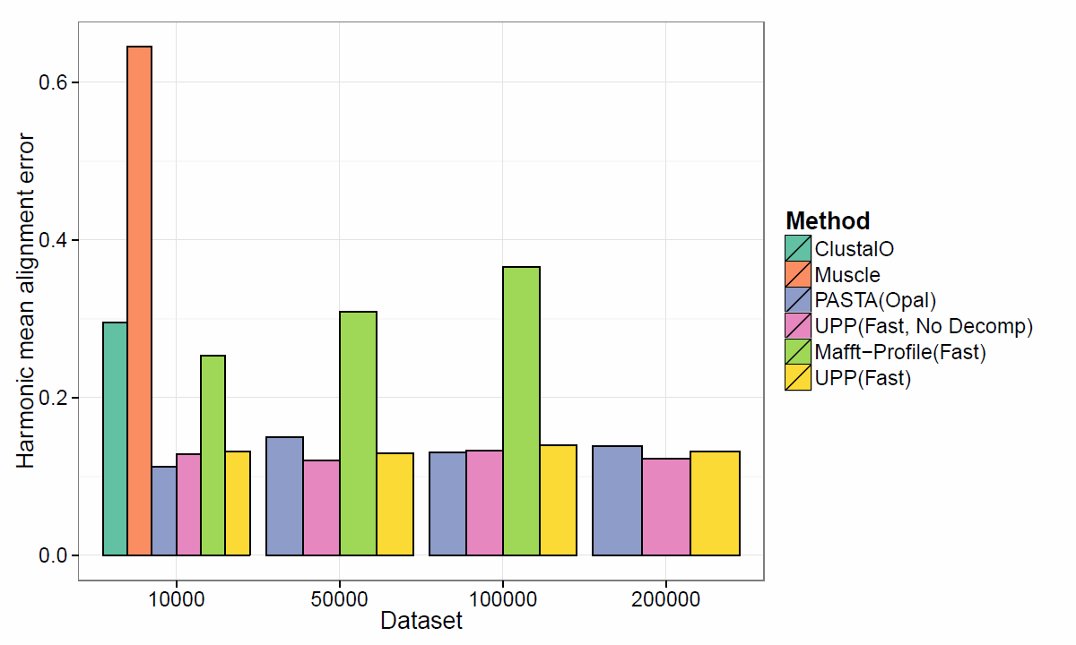
RNASim: Alignment error
UPP(Fast) uses backbones of size 100

Slide 69
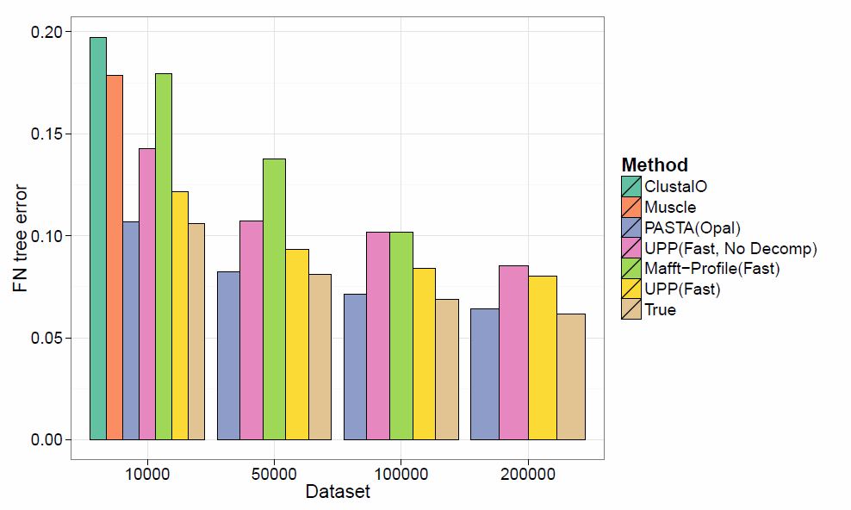
RNASim: Tree error

Slide 70
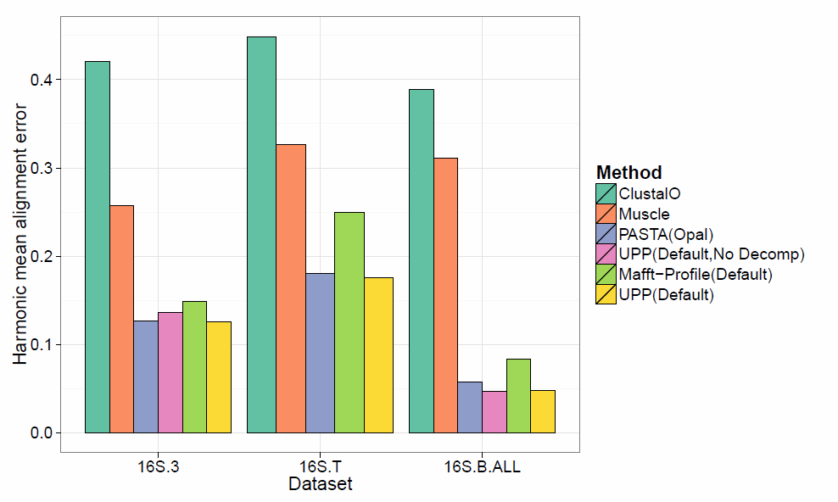
Gutell 16S: Alignment error
Note: UPP(Default,No Decomp)
fails to generate alignment on
all sequences for 16S.T

Slide 71
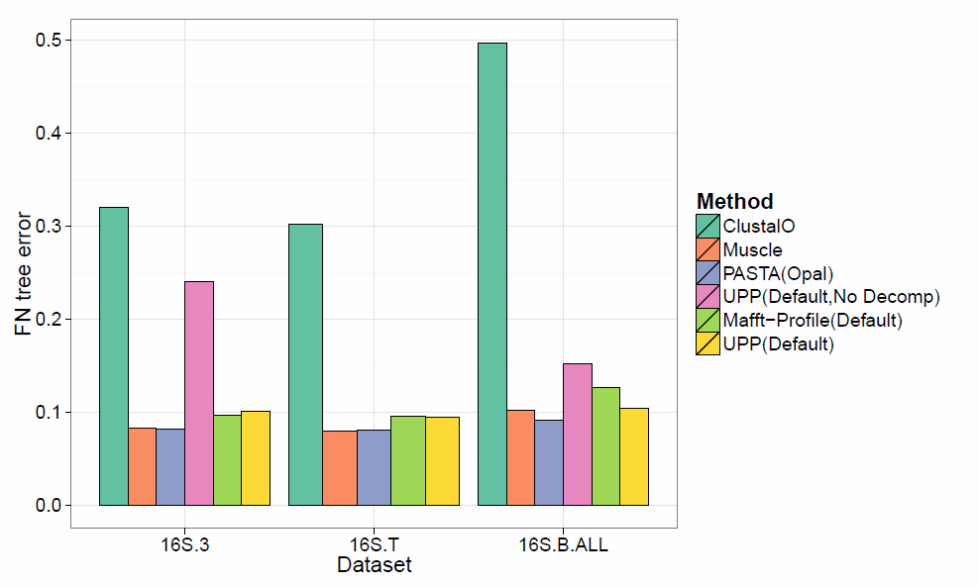
Gutell 16S: Tree error
Note: UPP(Default,No Decomp)
fails to generate alignment on
all sequences for 16S.T

Slide 72
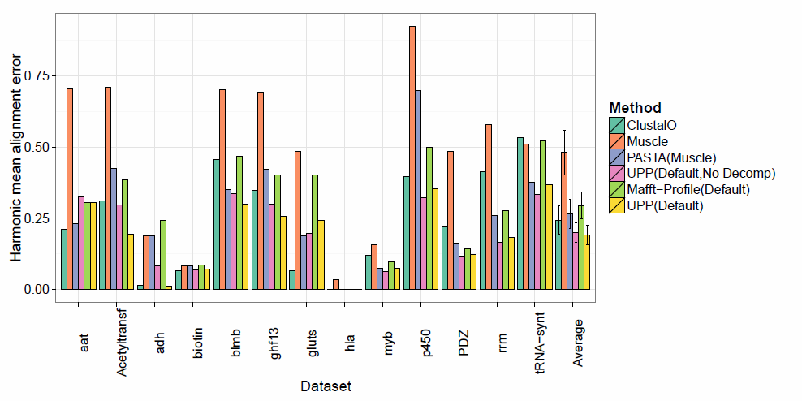
HomFam: Alignment error
Dataset sizes range from 10,000 to 46,000 sequences.

Slide 73
1kp: Thousand Transcriptome Project
G. Ka-Shu Wong
U Alberta
J. Leebens-Mack
U Georgia
N. Wickett
Northwestern
N. Matasci
iPlant
T. Warnow, S. Mirarab, N. Nguyen, Md. S.Bayzid
UT-Austin UT-Austin UT-Austin UT-Austin
Plus many many other people…
Plant Tree of Life based on transcriptomes of ~1200 species
More than 13,000 gene families (most not single copy)
Gene Tree Incongruence
Challenge:
Alignment of datasets with > 100,000 sequences
with many fragmentary sequences

Slide 74
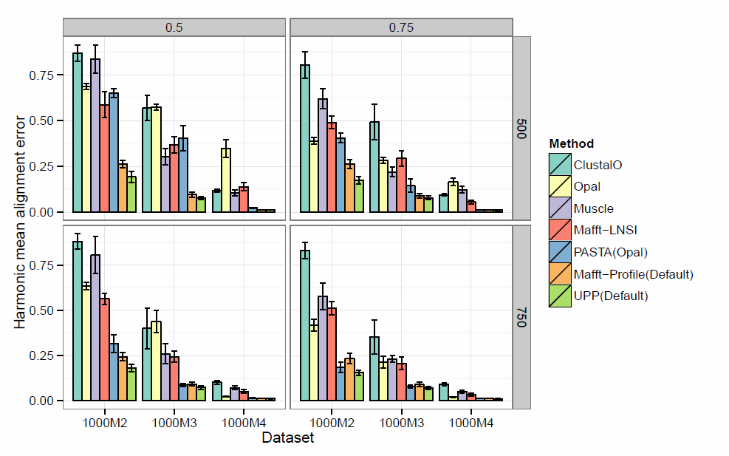
1K fragmentary: Alignment error

Slide 75
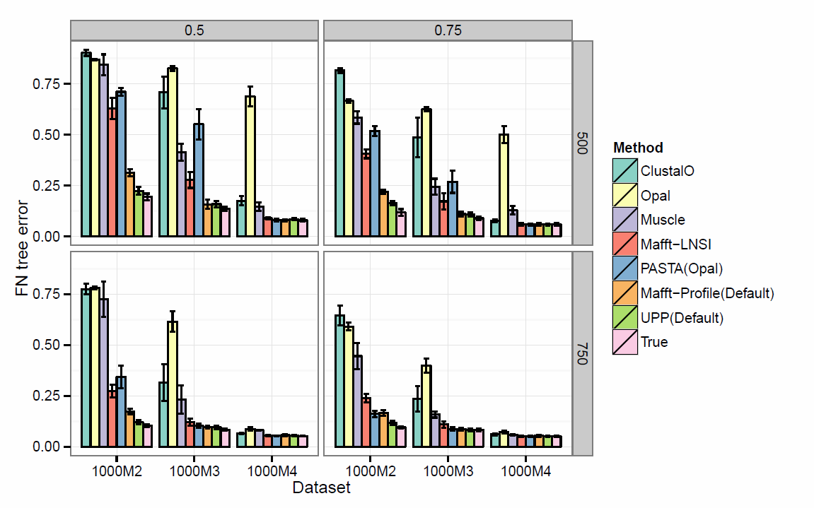
1K fragmentary: Tree error

Slide 76
Future Work
Extending TIPP to non-marker genes
Using the new HMM Family technique in SEPP and UPP
Using external seed alignments in SEPP, TIPP, and UPP
Boosting statistical co-estimation methods by using them in UPP for the backbone alignment and tree

Slide 77
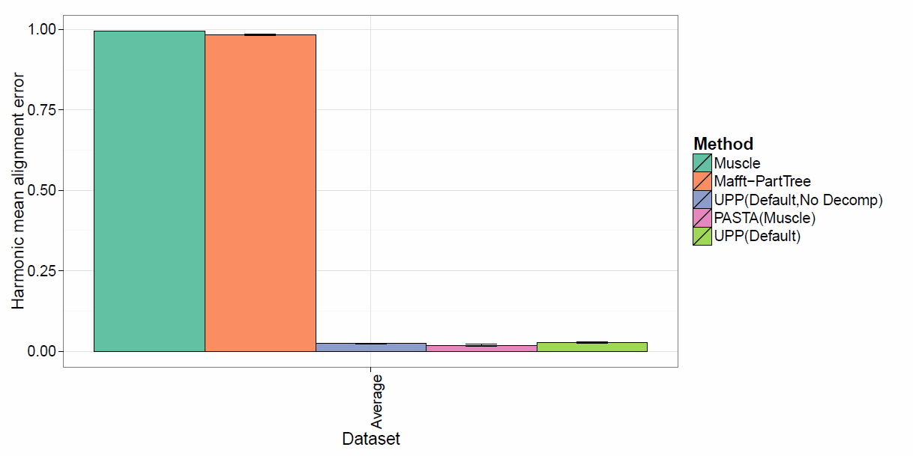
Indelible 10K: Alignment error
Note: ClustalO and Mafft-Profile(Default)
fail to generate an alignment
under this model condition.

Slide 78
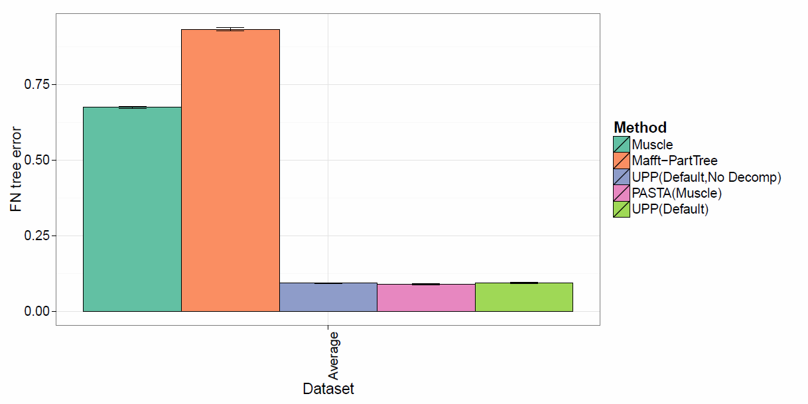
Indelible 10K : Tree error
Note: ClustalO and Mafft-Profile(Default)
fail to generate an alignment
under this model condition.

Slide 79
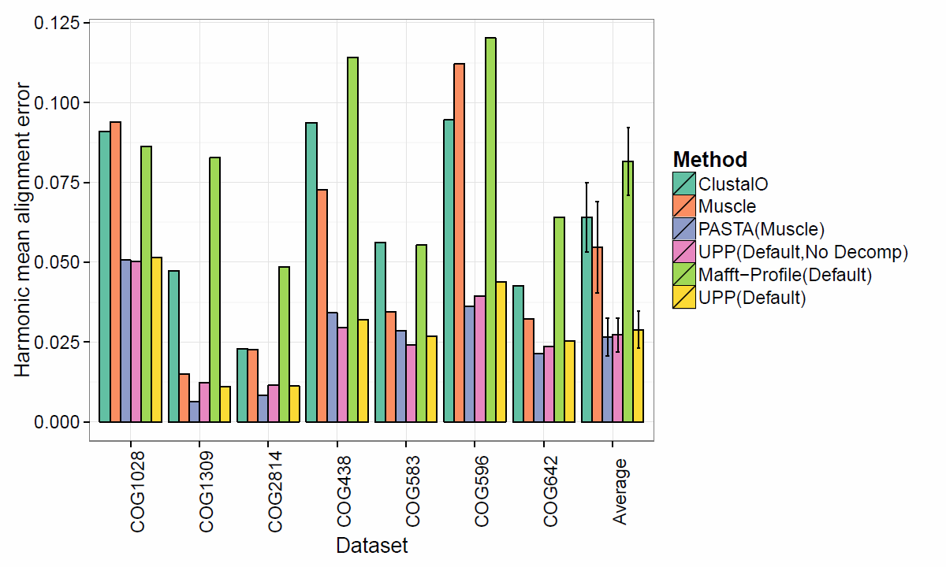
FastTree AA: Alignment error

Slide 80
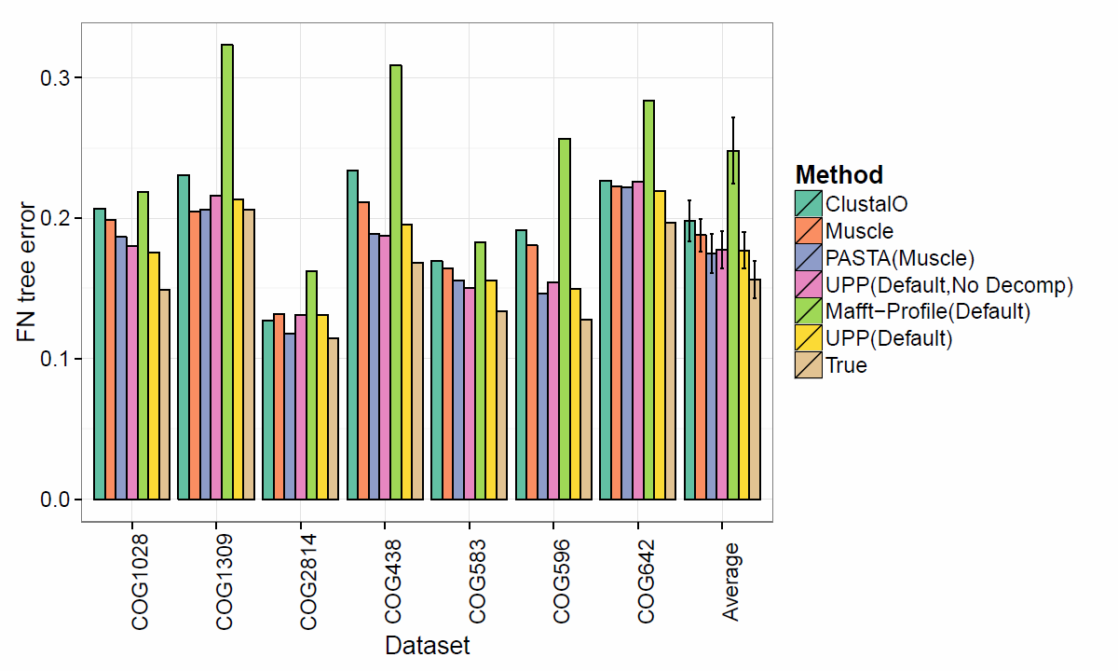
FastTree AA: Tree error

Slide 81
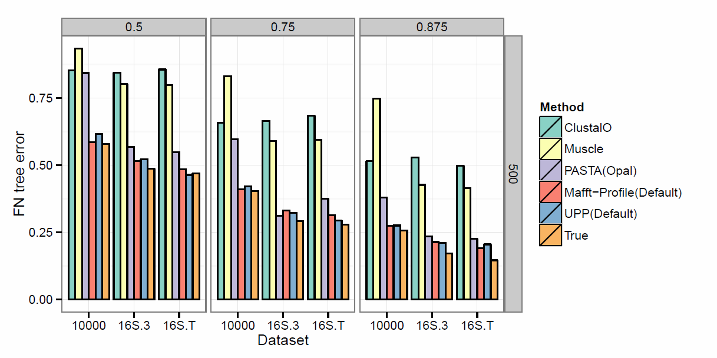
Large fragmentary: Tree error

Slide 82
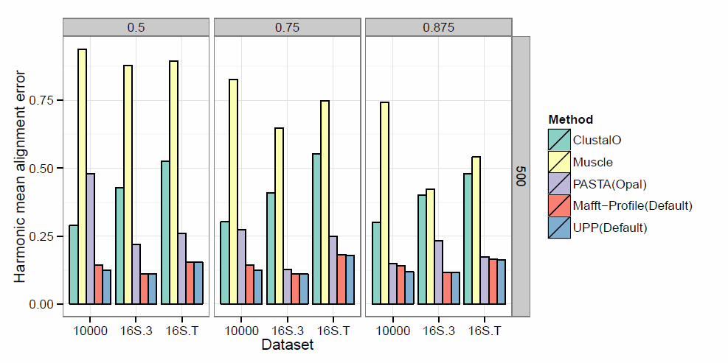
Large fragmentary: Alignment error
10000-sequence dataset from RNASim
16S.3 and 16S.T from Gutell’s Comparative Ribosomal Website (CRW)

