Slide 1
Phylogenomics Symposium and Software School
Co-Sponsored by the
SSB and NSF grant 0733029

Slide 2
NSF DEB 0733029
Large-Scale Simultaneous Multiple Alignment and Phylogeny Estimation
PIs:
Tandy Warnow (UT-Austin)
Randy Linder (UT-Austin)
Mark Holder (Kansas)
Jim Leebens-Mack (Georgia)
Etsuko Moriyama (Nebraska)

Slide 3
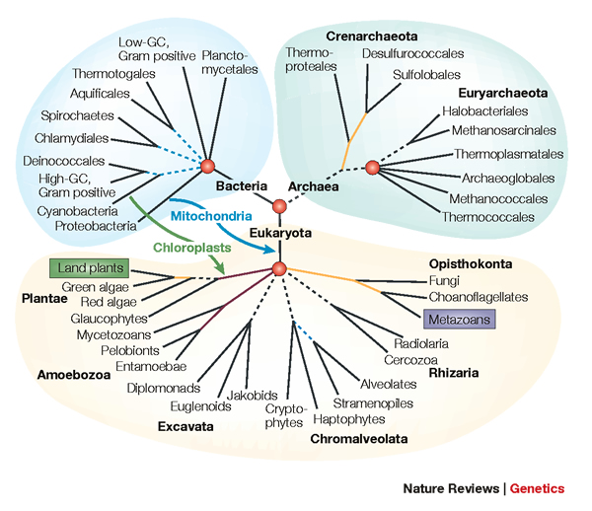
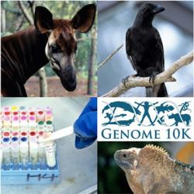
Phylogenomics
(Phylogenetic estimation from whole genomes)

Slide 4
Not all genes present in all species
gene 1
gene 3
S₁
TCTAATGGAA
S₂
GCTAAGGGAA
gene 2
S₁
TATTGATACA
S₃
TCTAAGGGAA
S₃
TCTTGATACC
S₄
TCTAACGGAA
S₄
GGTAACCCTC
S₄
TAGTGATGCA
S₇
TCTAATGGAC
S₅
GCTAAACCTC
S₇
TAGTGATGCA
S₈
TATAACGGAA
S₆
GGTGACCATC
S₈
CATTCATACC
S₇
GCTAAACCTC

Slide 5
Combined analysis
gene 1
gene 2
gene 3
S₁
TCTAATGGAA
? ? ? ? ? ? ? ? ? ?
TATTGATACA
S₂
GCTAAGGGAA
? ? ? ? ? ? ? ? ? ?
? ? ? ? ? ? ? ? ? ?
S₃
TCTAAGGGAA
TCTTGATACC
? ? ? ? ? ? ? ? ? ?
S₄
TCTAACGGAA
GGTAACCCTC
TAGTGATGCA
S₅
? ? ? ? ? ? ? ? ? ?
GCTAAACCTC
? ? ? ? ? ? ? ? ? ?
S₆
? ? ? ? ? ? ? ? ? ?
GGTGACCATC
? ? ? ? ? ? ? ? ? ?
S₇
TCTAATGGAC
GCTAAACCTC
TAGTGATGCA
S₈
TATAACGGAA
? ? ? ? ? ? ? ? ? ?
CATTCATACC

Slide 6
Two competing approaches
gene 1 gene 2 . . . gene k
Species
. . .
Combined
Analysis
Analyze
separately
. . .
Supertree
Method
Notes:
point out that supertree methods take overlaping trees and produce a tree, and that the whole process of first generating small trees and then applying a supertree method is often referred to as the “supertree approach”.

Slide 7
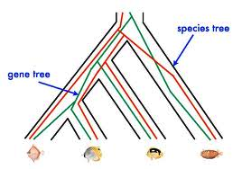
Red gene tree ≠ species tree (green gene tree okay)

Slide 8
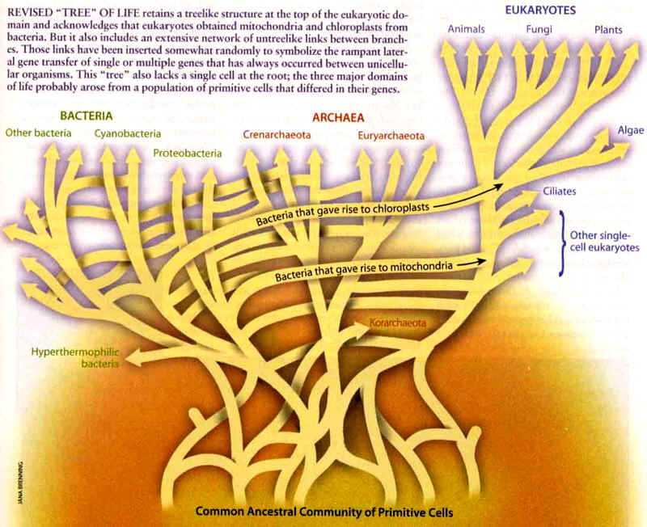
http://www.detectingdesign.com/geneticphylogeny.html

Slide 9
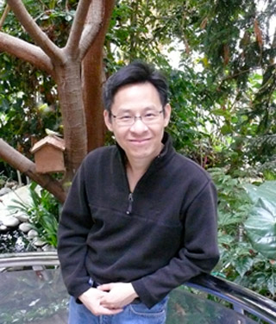
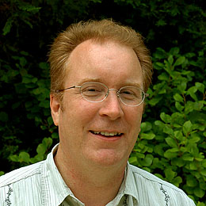
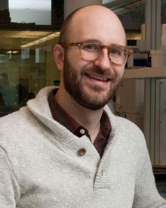
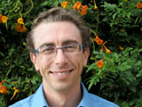
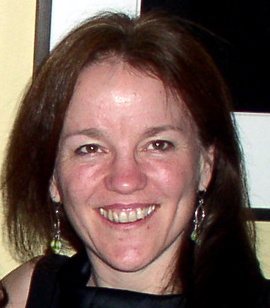
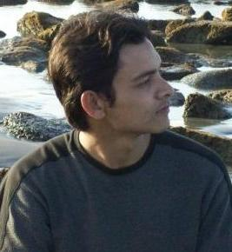
1KP: Thousand Transcriptome Project
G. Ka-Shu Wong
U Alberta
J. Leebens-Mack
U Georgia
N. Wickett
Northwestern
N. Matasci
iPlant
T. Warnow, S. Mirarab, N. Nguyen, Md. S.Bayzid
UT-Austin UT-Austin UT-Austin UT-Austin
1200 plant transcriptomes
More than 13,000 gene families (most not single copy)
iPLANT (NSF-funded cooperative)
Gene sequence alignments and trees computed using SATé
Gene Tree Incongruence

Slide 10
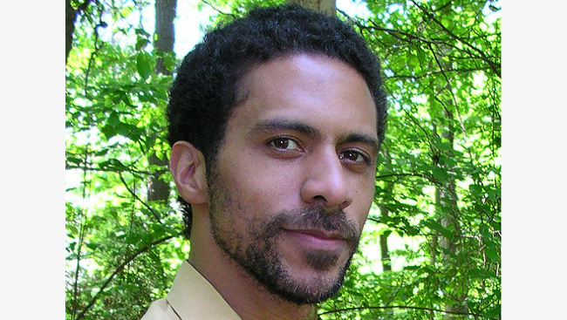
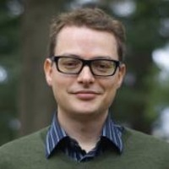
Avian Phylogenomics Project
E Jarvis,
HHMI
MTP Gilbert,
Copenhagen
G Zhang,
BGI
T. Warnow
UT-Austin
S. Mirarab Md. S. Bayzid, UT-Austin UT-Austin
Plus many many other people…
Gene Tree Incongruence
Approx. 50 species, whole genomes
8000+ genes, UCEs
Gene sequence alignments computed using SATé

Slide 11
Software School, Rooms 302 A-C
8:30-9:45: Tutorial 1 (PASTA: Multiple Sequence Alignment), Rooms 302A and 302B.
9:45-10:15 Break
10:15-11:45: Tutorial 3 (GARLI, 302A), Tutorial 6 (Phyldog, 302B), and Tutorial 7 (MulRF, 302C)
11:45-1:15 Lunch
1:15-2:30: Tutorial 5 (ASTRAL, 302A and 302B) and Tutorial 9 (HMMER, 302C)
2:30-3:45: Tutorial 2 (BAli-Phy, 302C), Tutorial 4 (Phylonet, 302B), and Tutorial 8 (Metagenomics, 302A)

Slide 12
Preparing for the Software School
Today: revisit the Software School webpage to make sure you have downloaded and installed everything, and tested the software on your laptop. Contact the organizer of the tutorials you are taking if you are having trouble.
http://www.cs.utexas.edu/users/tandy/softwareschool-2014.html
Tomorrow: come with a fully charged laptop. You may want to plan to go back to your hotel room to recharge your laptop during the lunch break!

Slide 13
Feedback
Your feedback would be very welcome.
Please email the tutorial providers directly if you have suggestions for improvements to the software.
If you use the software in a subsequent study, please let us know!

Slide 14
Symposium
9:00-9:45, Tandy Warnow (large-scale multiple sequence alignment)
9:45-10:15, Coffee Break
10:15-11:00, Nam Nguyen (Taxon identification of metagenomic data)
11:00-11:45, Siavash Mirarab (The Avian Phylogenomics Project)
11:45-1:15 , Lunch Break
1:15-2:00, Jim Leebens-Mack (The Thousand Transcriptome Project)
2:00-2:45, Luay Nakhleh (Phylogenetic Networks)
2:45-3:15 Coffee Break
3:15-4:45 Discussion

