Slide 1


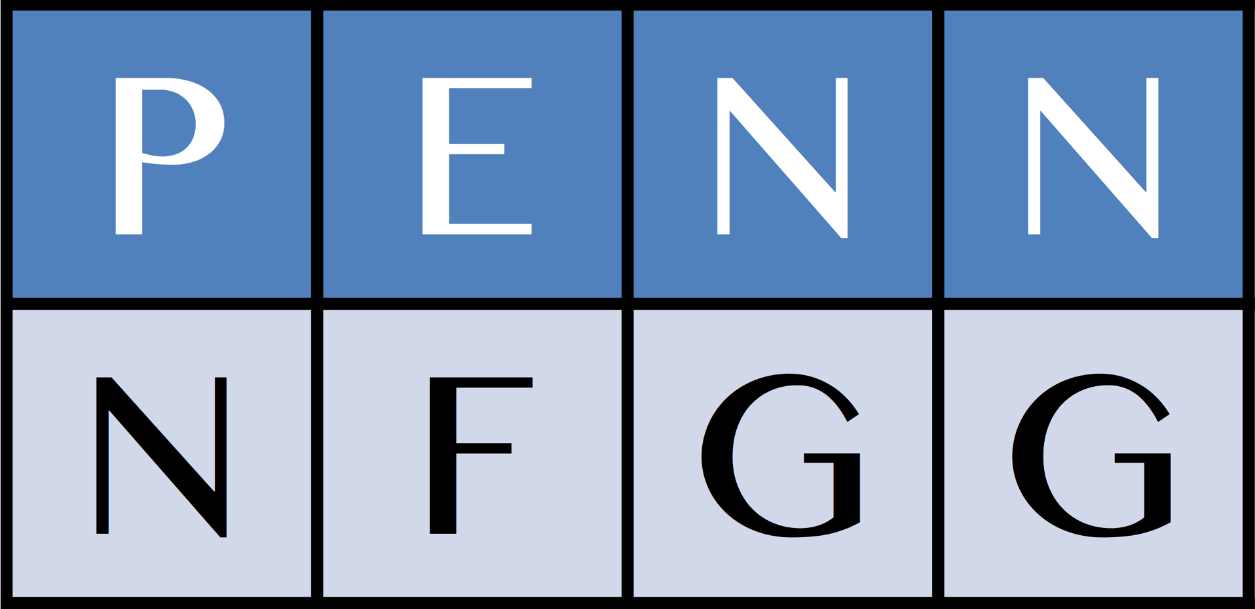
Bioinformatics for
DNA-seq and RNA-seq experiments
Li-San Wang
Department of Pathology and Laboratory Medicine
Penn Institute for Biomedical Informatics
Penn Genome Frontiers Institute
University of Pennsylvania Perelman School of Medicine
Notes:
Thank you for having me here.

Slide 2
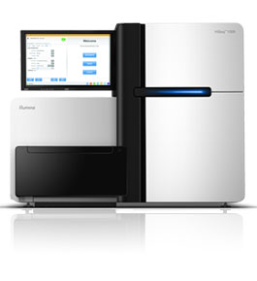
Next Generation Sequencing Technology
Generate reads of billions of short DNA sequences in the order of 100nts in a week
Costs < $5K for resequencing a human genome
Hi-Seq 2000: run 2 flow cells (300Gb each) in ~ 1 week, sequences 6 genomes
Illumina Hi-Seq 2000

Slide 3
Applications of NGS
DNA-Seq resequences genomes to identify variations associated with diseases and traits
Use RNA-Seq to study gene expression activities
Use ChIP-Seq and DNase-Seq to measure protein-DNA interactions and modifications
… Many other types of protocols

Slide 4
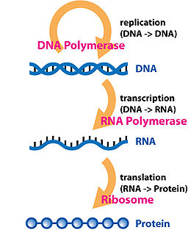
Central Dogma
DNA
RNA
Protein
Phenotypes

Slide 5
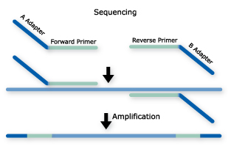
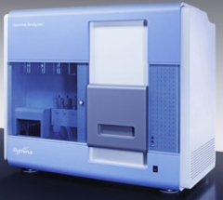
RNA-Seq
Library prep
Reverse Transcription &
DNA fragmentation
RNA
Sequencing and
Analysis
Images: illumina

Slide 6
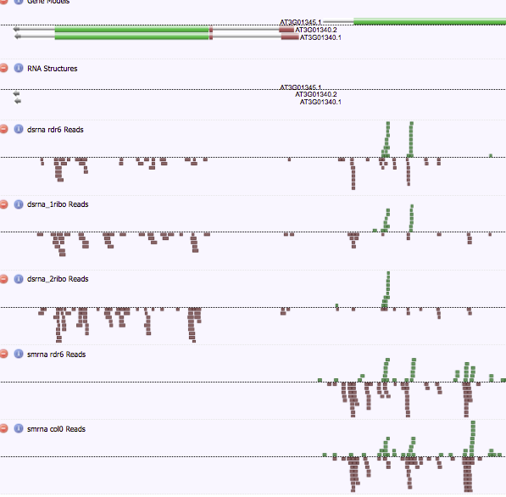
High read heterogeneity along RNA transcripts
Needs to dig deeper!
  Secondary structures
  Functional classes
  Modifications (non-standard nucleotides)
  Visualization
  … and many other questions
Notes:
What actually happens is a lot more complicated than we thought.
Highly heterogeneous, some regions are more expressed than others.

Slide 7
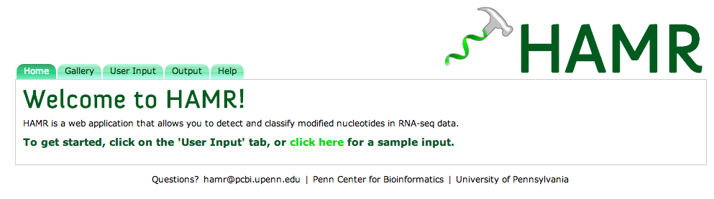
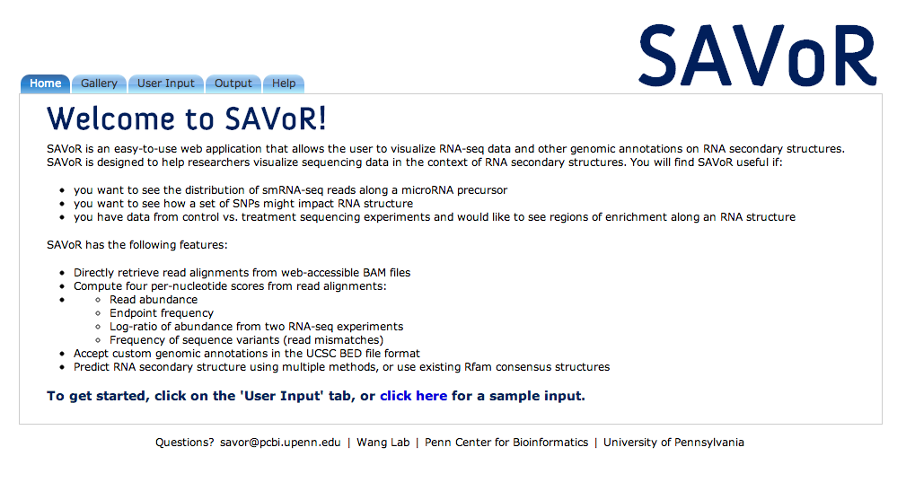
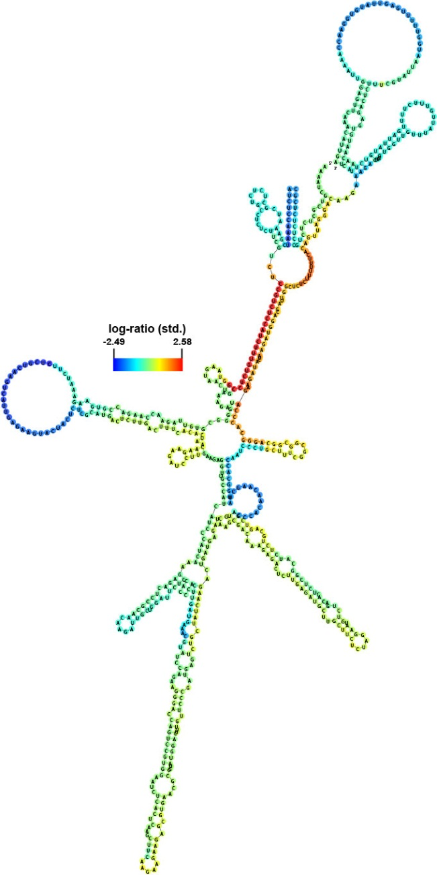
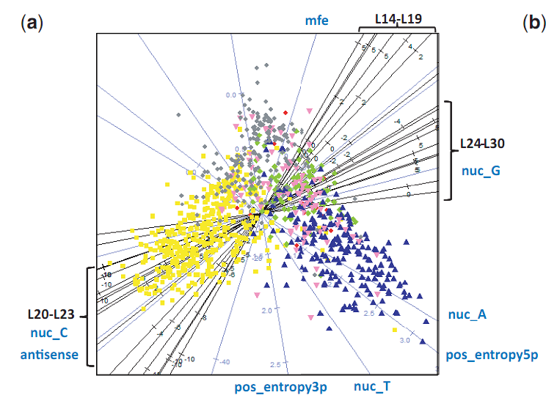
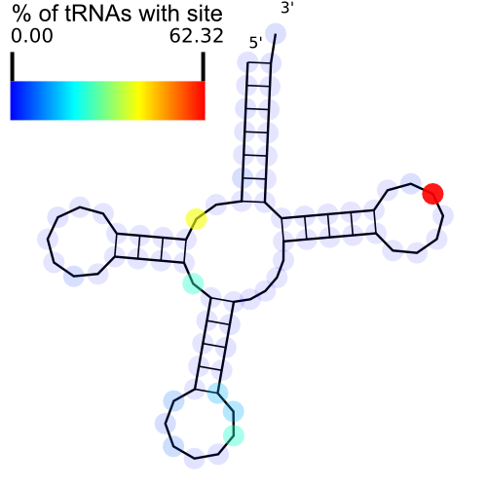
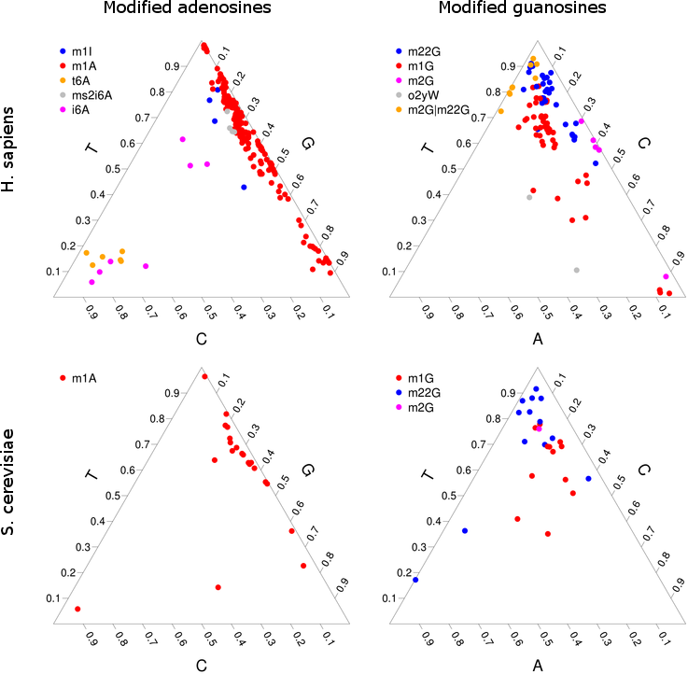
SAVoR: RNA-seq visualization
Fan Li, Paul Ryvkin, Micah Childress, Otto Valladares, Brian Gregory*, Li-San Wang*. SAVoR: a server for sequencing annotation and visualization of RNA structures. Nucleic Acids Research, 2012.
HAMR: Detect RNA modification using RNA-seq
  Paul Ryvkin, Yuk Yee Leung, Micah Childress, Otto Valladares, Isabelle Dragomir, Brian Gregory*, and Li-San Wang*. HAMR: High throughput Annotation of Modified Ribonucleotides. RNA, in press, 2013.
CoRAL: Use small RNA-seq to annotate non-coding RNA function classes
  Yuk Yee Leung, Paul Ryvkin, Lyle Ungar, Brian Gregory*, Li-San Wang*. CoRAL: Predicting non-coding RNAs from small RNA-sequencing data. Nucleic Acids Research, 2013.
RNA-Seq-Fold: Use pairing-informative RNA-seq protocols to estimate secondary structures (in progress)
CoRAL

Slide 8




SAVoR: web-based visualization of RNA-seq data in a structural context
http://tesla.pcbi.upenn.edu/savor/
RNA-seq data +
2nd structure
= SAVoR Plots !
Li et al., NAR 2012

Slide 9
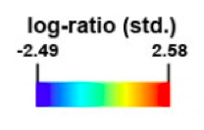
Log-ratio of dsRNA-seq to ssRNA-seq read coverage along the At2g04390.1 transcript.

Slide 10
Modified RNA – Motivation:
Sites with unusual mismatch patterns in RNA-seq
1
2
3
3a
  A in actual sequence, C/G/T are due to 1% base calling error rate
  A/C SNP, G/T are due to 1% error rate
  G/T ratio too far away from 1:1, heterozygotes cannot explain
    A and C rates are too high for base calling error

Slide 11
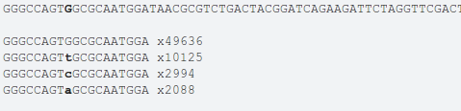
Observed nucleotide pattern
at a known m2G site
In an Alanine tRNA

Slide 12
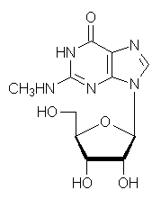
tRNA modifications
guanosine (G)
N-2-methylguanosine (m²G)
6
6
1
5
7
tRNA-modifying protein
1
5
7
2
8
2
8
4
9
4
9
H₂N
3
3
5'
5'
3'
2'
3'
2'
Watson-Crick pairing edge has been modified

Slide 13
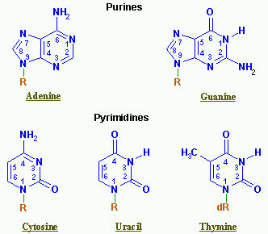
Detecting modified RNAs: change in RT effects when Watson-Crick edge is modified
Watson-Crick edge

Slide 14
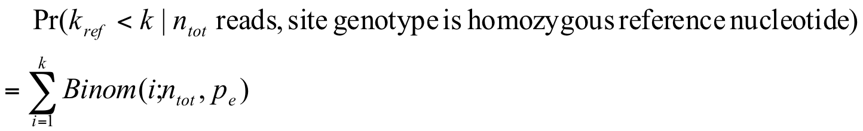
Statistical model for HAMR
H₀¹: homozygous reference, low base calling error
H₀²: heterozygote, low base calling error
In both cases, there should be at most two nucleotides with high frequencies
ML ratio test
Annotation: naïve Bayes model on non-reference allele frequencies

Slide 15
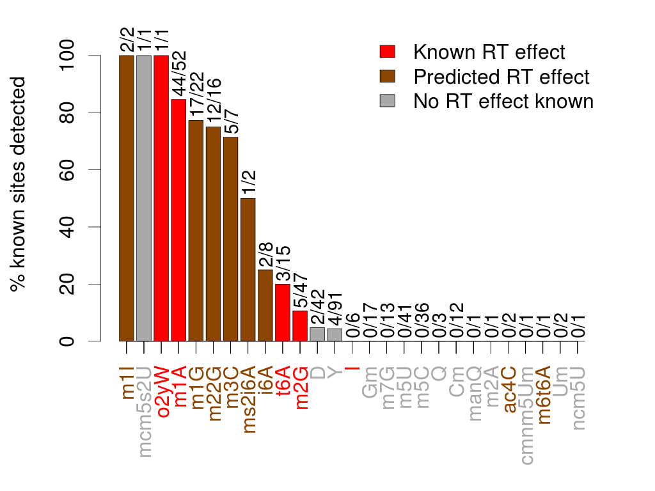
Results
Statistical analysis on known modification sites show this idea works with high specificity

Slide 16
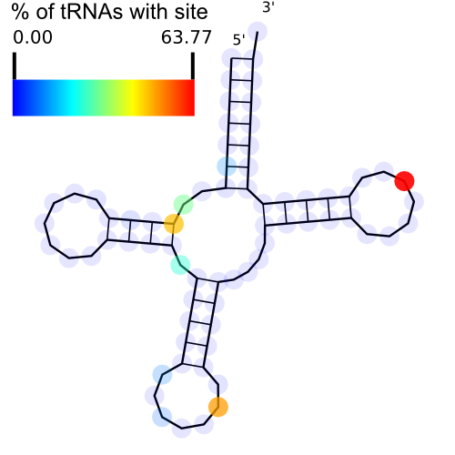
Known modifications
predicted to affect RT
Detected modifications
predicted to affect RT

Slide 17
Our data
Yeast dataset

Slide 18
Classification accuracy
Train on human tRNA data, test on yeast tRNA data
Precursor | Classes | Observations | Accuracy
A | m1A|m1I|ms2i6A, i6A|t6A | 187 | 98%
G | m1G, m2G|m22G | 86 | 79%
U | D, Y | 17 | 96%

Slide 19
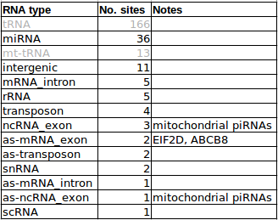
Modifications in other RNAs
Scan the entire smRNA transcriptome for candidate modified sites
* Uniquely mapped reads in 4 libraries
* Removed sites corresponding to read-ends
* Removed sites corresponding to known SNPs

Slide 20
HAMR
High-Throughput Annotation of Modified RNAs
Ryvkin et al., RNA, 2013
http://tesla.pcbi.upenn.edu/hamr/
Please contact us if you are interested!

Slide 21

RNA-seq is more than an expensive digital gene expression microarray
NGS algorithms and experimental protocols should integrate tightly
Bioinformatics
scientists
Bench
scientists

Slide 22
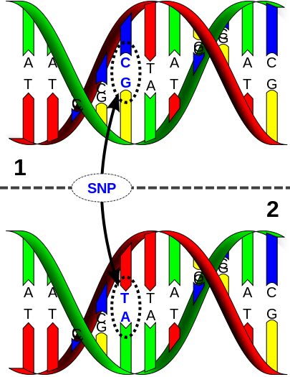
DNA-Seq: find genetic variations linked to traits and diseases
All individuals have small differences between each other
  Single nucleotide polymorphism (SNP) is the most common form
  Other types: indel, copy number variation, rearrangement
Genetic polymorphisms may lead to different phenotypes and diseases
  21 trisomy: Down syndrome
  Substitution 1624G>T of the CFTR gene leads to change of amino acid (G542X) which leads to cystic fibrosis

Slide 23
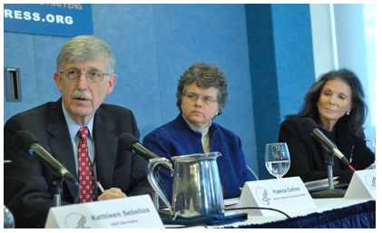

Alzheimer’s Disease Sequencing Project
Announced in Feb. 2012
Participants
  NIA, NHGRI
  ADGC and CHARGE
  Large-Scale Genome Sequencing and Analysis Centers (Broad/Baylor/WashU)
  NACC (phenotype) and NCRAD (sample)
  NIAGADS (data coordinating center)
  NCBI dbGaP/SRA
Design: 584 WGS / 11,000 WES (>300TB data)
WGS data of 584 samples available from our ADSP data portal
Visit ADSP website www.niagads.org/adsp to learn about study design, apply for data access, download data
Photo from http://nihrecord.od.nih.gov/newsletters/2012/03_02_2012/story5.htm

Slide 24
Computational Challenges to Analyzing
DNA-Seq data
Mapping between 100~1000 billion reads to the reference genome with good sensitivity
Variant calling: call SNPs and structural variants reliably
Association: Find susceptibility variants by association tests
Interpretation: Interpret the effect of variants
Data management: Query, store, and distribute 100TBs of data
~~ And that’s just for one project!

Slide 25
Cloud computing using Amazon EC2
Can run hundreds of cores on Amazon EC2 easily
Can share data and programs easily
Very good security
Steep learning curve
  Needs to provide pre-configured workflows/environments allows you to run analysis easily on Amazon
Storing data is very expensive
  $0.1/GB-Month, or $1200/TB-year
  Glacier is 10 times cheaper but also that much slower

Slide 26

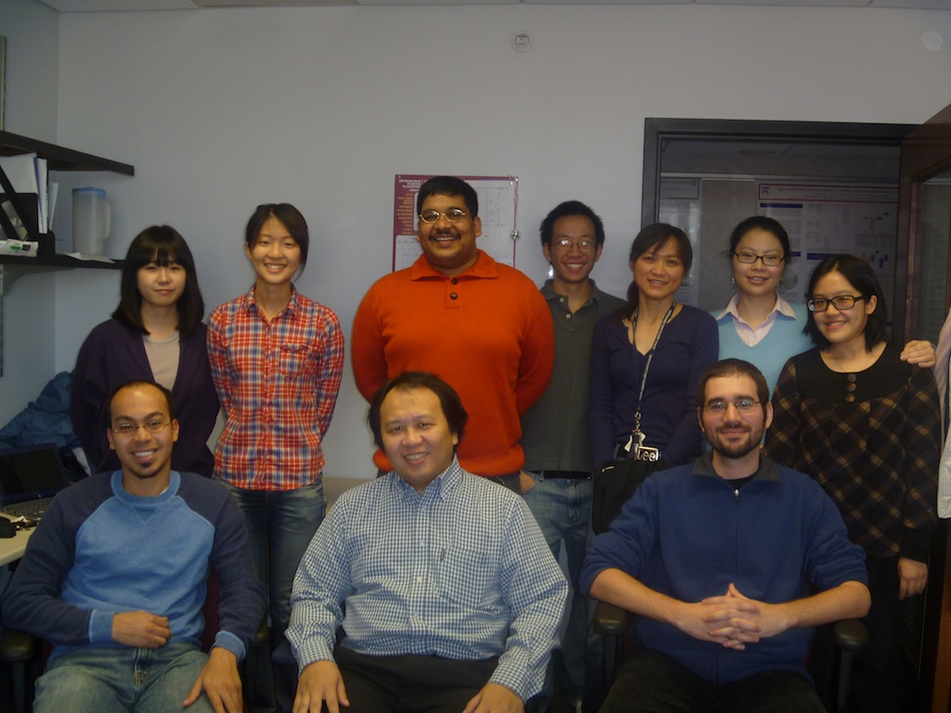
DNA Resequencing
Analysis Workflow (DRAW)
Mapping
Realignment, dedup, uniq, base quality recalibration
Variant detection
Coverage, QC metrics
BWA
Easy to run – invoke phases by five commands, no need to mouse-click like crazy
Memory request based on data size
Support SunGridEngine for cluster computing
Modular architecture, job monitoring, job dependency, auditing, error checking
Runs on Amazon EC2, $582/FC
We are migrating all our NGS pipelines to DRAW architecture
GATK
Picard
Samtools
GATK
Samtools
GATK
Notes:
I want to go back to the workflow of how we processed sequencing data. I divide the workflow into three phases, there are of course a lot more steps. Different software packages were used, such as BWA for mapping, GTATK for variant detection. Running through those programs is straightforward. The challenge, is, however, the sheer amount of data. For example, a flow cell from illumina hiseq typically gives 300Gb of data. It is nearly impossible to process such amount of data without using high performance computing cluster. You just can’t sit there and wait for a process to finish and start the next. And do this for 30 samples each time. And this is where our pipeline comes in. our pipeline generates the commands for submitting jobs on computing cluster. that streamline and automate the entire process.

Slide 27
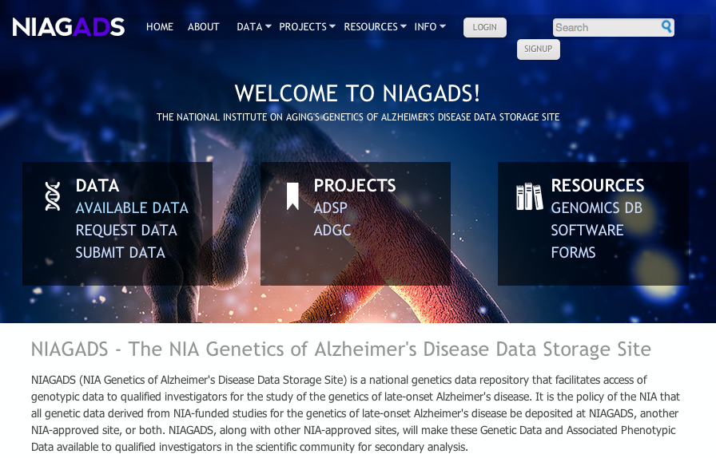
NIA Genetics of Alzheimer’s Disease Data Storage Site (NIAGADS)
Portal to AD genetics studies funded by NIA
Portal for ADSP data
Portal for other large-scale AD sequencing projects (>2,000 whole genomes, >400TB raw data) being developed
Software (DRAW+SneakPeek) and other resources
Signup for user account and news alert at
www.niagads.org

Slide 28

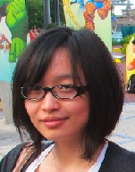


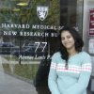


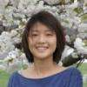

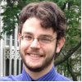
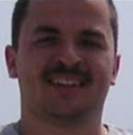
Lab members
Chiao-Feng Lin
Otto Valladares
Tianyan Hu
Fanny Leung
Amanda Partch
Mugdha Khaladkar
Dan Laufer
Micah Childress
John Malamon
Yih-Chi Hwang
Fan Li
Paul Ryvkin
Mitchell Tang
Alex Amlie-Wolf
Pavel Kuksa

Slide 29







Acknowledgements
Schllenberg lab
Gerard Schellenberg
Evan Geller
Laura Cantwell
Gregory Lab
Brian Gregory
Qi Zheng
Isabelle Dragomir
Jamie Yang
Sandeep Jain
CNDR/ADC
John Trojanowski
Virginia Lee
Vivianna Van Deerlin
Steven Arnold
Terry Schuck
Robert Greene
Pathology and Lab Medicine
PSOM/CHOP
David Roth
Nancy Spinner
Dimitrios Monos
Jennifer Morrisette
Robert Daber
Laura Conlin
Ellen Tsai
Avni Santani
Zissimos Mourelatos
Support:
Penn Institute on Aging
PGFI
Alzheimer’s Foundation
CurePSP foundation
NIH: NIA/NIGMS/NIMH/NHGRI
Mingyao Li
John Hogenesch
Nancy Zhang
Sampath Kannan
Lyle Ungar
Sarah Tishkoff
Maja Bucan
Chris Stoeckert
Arupa Ganguly
Kate Nathanson
Alice Chen-Plotkin
Travis Unger

