Slide 1
PASTA: Ultra-large multiple sequence alignment
Siavash Mirarab
Nam Nguyen
Tandy Warnow
University of Texas at Austin

Slide 2
U
V
W
X
Y
AGGTCA
AGATTA
AGACTA
TGGACA
TGCGACT
X
U
Y
V
W

Slide 3
The “real” problem
U
V
W
X
Y
AGGGCATGA
AGAT
TAGACTT
TGCACAA
TGCGCTT
X
U
Y
V
W

Slide 4
Indels (insertions and deletions)
Deletion
Mutation
…ACGGTGCAGTTACCA…
…ACCAGTCACCA…
Notes:
4

Slide 5
Deletion
Substitution
…ACGGTGCAGTTACCA…
Insertion
…ACGGTGCAGTTACC-A…
…AC----CAGTCACCTA…
…ACCAGTCACCTA…
The true multiple alignment
  Reflects historical substitution, insertion, and deletion events
  Defined using transitive closure of pairwise alignments computed on edges of the true tree
Notes:
5
Homology = nucleotides lined up since they come from a common ancestor.
Indel = dash.

Slide 6
Input: unaligned sequences
S1 = AGGCTATCACCTGACCTCCA
S2 = TAGCTATCACGACCGC
S3 = TAGCTGACCGC
S4 = TCACGACCGACA

Slide 7
Phase 1: Alignment
S1 = AGGCTATCACCTGACCTCCA
S2 = TAGCTATCACGACCGC
S3 = TAGCTGACCGC
S4 = TCACGACCGACA
S1 = -AGGCTATCACCTGACCTCCA
S2 = TAG-CTATCAC--GACCGC--
S3 = TAG-CT-------GACCGC--
S4 = -------TCAC--GACCGACA

Slide 8
Phase 2: Construct tree
S1 = AGGCTATCACCTGACCTCCA
S2 = TAGCTATCACGACCGC
S3 = TAGCTGACCGC
S4 = TCACGACCGACA
S1 = -AGGCTATCACCTGACCTCCA
S2 = TAG-CTATCAC--GACCGC--
S3 = TAG-CT-------GACCGC--
S4 = -------TCAC--GACCGACA
S1
S2
S4
S3

Slide 9
Multiple Sequence Alignment (MSA): another grand challenge¹
S1 = AGGCTATCACCTGACCTCCA
S2 = TAGCTATCACGACCGC
S3 = TAGCTGACCGC
…
Sn = TCACGACCGACA
S1 = -AGGCTATCACCTGACCTCCA
S2 = TAG-CTATCAC--GACCGC--
S3 = TAG-CT-------GACCGC--
…
Sn = -------TCAC--GACCGACA
Novel techniques needed for scalability and accuracy
NP-hard problems and large datasets
Current methods do not provide good accuracy
Few methods can analyze even moderately large datasets
Many important applications besides phylogenetic estimation
¹ Frontiers in Massive Data Analysis, National Academies Press, 2013

Slide 10
Two-phase estimation
Alignment methods
Clustal
Probcons (and Probtree)
Probalign
MAFFT
Muscle
T-Coffee
Prank (PNAS 2005, Science 2008)
Opal (ISMB and Bioinf. 2007)
FSA (PLoS Comp. Bio. 2009)
Infernal (Bioinf. 2009)
Etc.
Phylogeny methods
Bayesian MCMC
Maximum parsimony
Maximum likelihood
Neighbor joining
FastME
UPGMA
Quartet puzzling
Etc.
Notes:
10

Slide 11

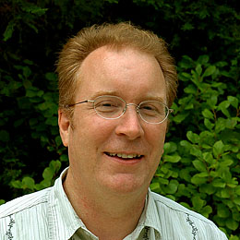
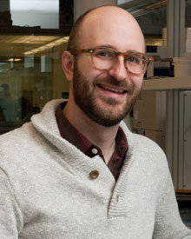

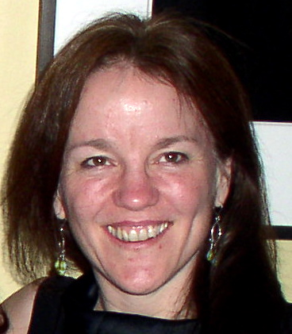



1KP: Thousand Transcriptome Project
G. Ka-Shu Wong
U Alberta
J. Leebens-Mack
U Georgia
N. Wickett
Northwestern
N. Matasci
iPlant
T. Warnow, S. Mirarab, N. Nguyen, Md. S.Bayzid
UT-Austin UT-Austin UT-Austin UT-Austin
1200 plant transcriptomes
More than 13,000 gene families (most not single copy)
iPLANT (NSF-funded cooperative)
First phase of analysis: gene sequence alignments and trees computed using SATé
Next phase of analysis: some single gene datasets with >100,000 sequences, due to gene duplications.

Slide 12
Our large-scale MSA methods
Multiple Sequence Alignment
  SATé (Liu et al., Science 2009 and Systematic Biology 2012) – up to 50,000 sequences
  PASTA (Mirarab et al., RECOMB 2014) – up to 200,000 sequences, excellent accuracy for full-length sequences
  UPP (Mirarab et al., in preparation) – up to 1,000,000 sequences, very good accuracy and robustness to fragmentary sequences

Slide 13
Our large-scale MSA methods
Multiple Sequence Alignment
  SATé (Liu et al., Science 2009 and Systematic Biology 2012) – up to 50,000 sequences
  PASTA (Mirarab et al., RECOMB 2014) – up to 200,000 sequences, excellent accuracy for full-length sequences
  UPP (Mirarab et al., in preparation) – up to 1,000,000 sequences, very good accuracy and robustness to fragmentary sequences

Slide 14
Multiple Sequence Alignment (MSA)
S1: AACGTTACG
S2: ACGTTACCGA
S3: TCGTAACACGA
S4: TACGTTACCCA
Notes:
14

Slide 15
Multiple Sequence Alignment (MSA)
S1: AA-CGTTAC--G-
S2: A--CGTTAC-CGA
S3: T--CGTAACACGA
S4: T-ACG-TAC-CCA
Notes:
15

Slide 16
Two-phase estimation
Alignment methods
Clustal
Probcons (and Probtree)
Probalign
MAFFT
Muscle
T-Coffee
Prank (PNAS 2005, Science 2008)
Opal (ISMB and Bioinf. 2007)
FSA (PLoS Comp. Bio. 2009)
Infernal (Bioinf. 2009)
Etc.
Phylogeny methods
Bayesian MCMC
Maximum parsimony
Maximum likelihood
Neighbor joining
FastME
UPGMA
Quartet puzzling
Etc.
Notes:
16

Slide 17
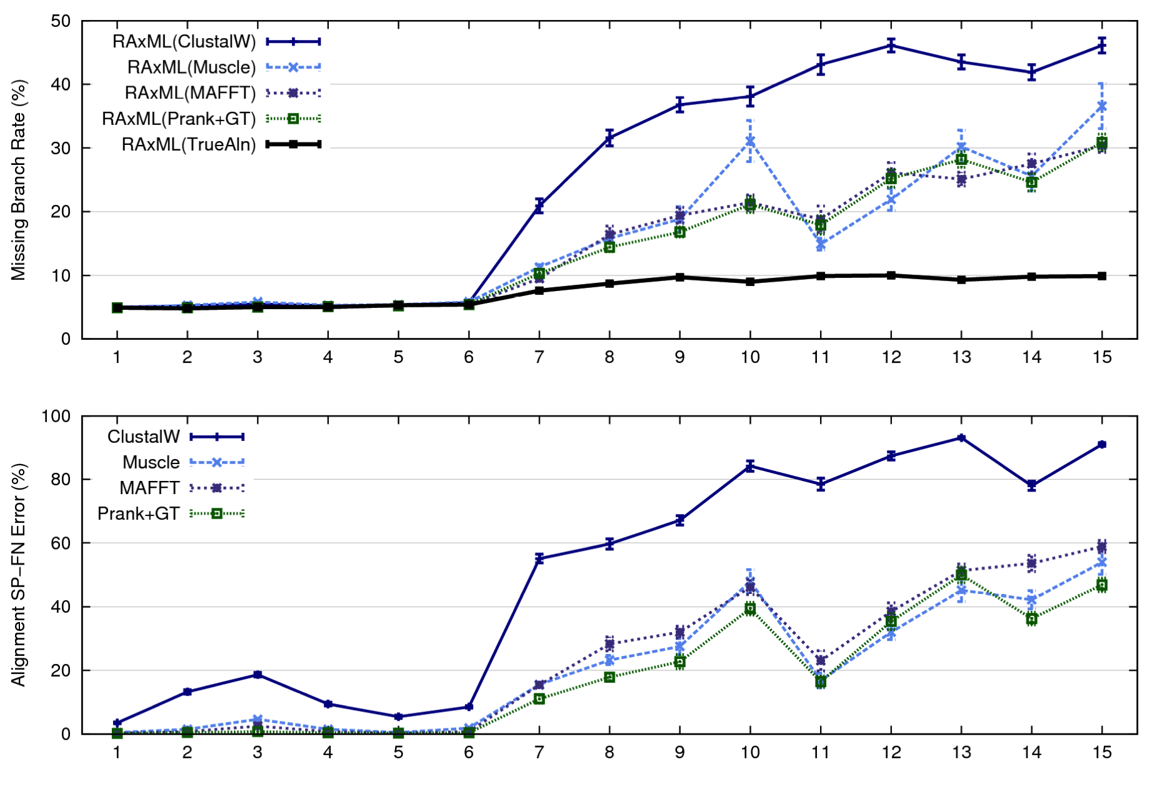
1000-taxon models, ordered by difficulty (Liu et al., 2009)
Notes:
17
1. 2 classes of MC: easy, moderate-to-difficult
2. true alignment
3. 2 classes: ClustalW, everything else
Alignment error, measured this way, isn't a perfect predictor of tree error, measured this way.

Slide 18
Alignments and Trees
Alignment
Clustal
Probcons
Probalign
MAFFT
Muscle
T-Coffee
Prank
Opal
FSA
Infernal
Etc.
Phylogeny methods
Bayesian MCMC
Maximum parsimony
Maximum likelihood
Neighbor joining
FastME
UPGMA
Quartet puzzling
Etc
Co-estimation
BaliPhy
???
SATé
PASTA
Notes:
18

Slide 19
SATé Iteration (Cartoon)
A
C
Decompose dataset
A
B
C
D
B
D
Align subproblems
(MAFFT-L-INS-I)
Estimate ML tree on merged alignment
(RAxML)
Merge sub-alignments
(Muscle/Opal)
ABCD
A
B
C
D
Notes:
Subsets have lower evolutionary distance.

Slide 20
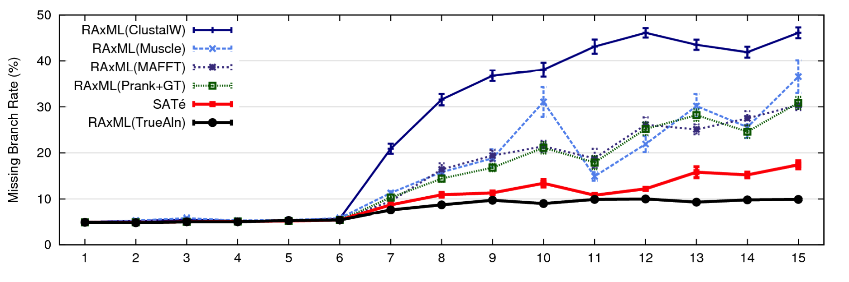
SATé results
1000 taxon models, ordered by difficulty
24 hour SATé analysis, on desktop machines
(Similar improvements for biological datasets)
Notes:
For moderate-to-difficult datasets, SATe gets better trees and alignments than all other estimated methods. Close to what you might get if you had access to true alignment.
Opens up a new realm of possibility: Datasets currently considered “unalignable” can in fact be aligned reasonably well. This opens up the feasibility of accurate estimations of deep evolutionary histories using a wider range of markers.
TRANSITION: can we do better? What about smaller simulated datasets? And what about biological datasets?

Slide 21
SATé-II: centroid edge decomposition
ABCDE
ABC
DE
AB
C
D
E
A
B
Improve scalability and accuracy
(SATé-I limited to 8000 sequences)

Slide 22
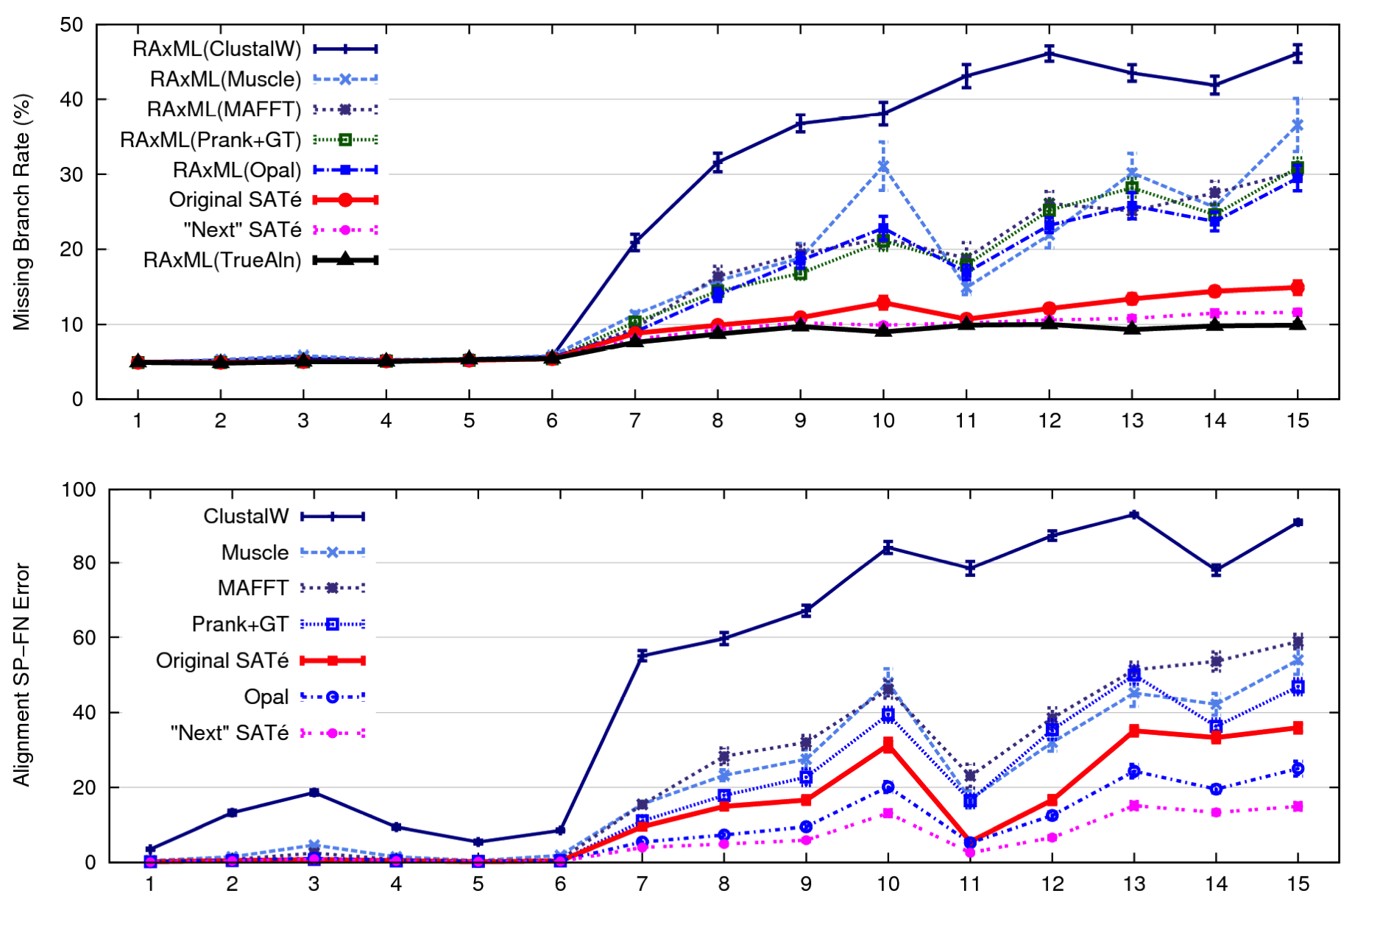
SATé-II results
1000 taxon models ranked by difficulty

Slide 23
SATé-II running time profiling

Slide 24
SATé-II running time profiling

Slide 25
PASTA: SATé-II with a new merging algorithm
A
C
Decompose dataset
A
B
C
D
B
D
Align subproblems
(MAFFT-L-INS-I)
Estimate ML tree on merged alignment
(RAxML)
Merge sub-alignments
(Muscle/Opal)
ABCD
A
B
C
D

Slide 26
Default starting tree
Select 100 sequences randomly (backbone sequences)
Use MAFFT-lnsi to align these 100 sequences
Use HMMER to align the remaining sequences to the alignment on the backbone

Slide 27
SATé-II merging step
ABCDE
ABC
DE
AB
C
D
E
A
B
SATé-II hierarchical merging

Slide 28
PASTA merging: Step 1
D
C
E
B
A
Compute a spanning tree connecting alignment subsets

Slide 29
PASTA merging: Step 2
D
C
E
B
A
CD
CD
AB
BD
AB
DE
BD
DE
Use Opal (or muscle) to merge adjacent subset alignments in the spanning tree

Slide 30
PASTA merging: Step 3
D
C
E
B
A
AB + BD = ABD
ABD + CD = ABCD
ABCD + DE = ABCDE
CD
BD
AB
DE
Use transitivity to merge all pairwise-merged alignments
from Step 2 into final an alignment on entire dataset
Overall: O(n log(n) + L)

Slide 31
Results

Slide 32
SATé-II running time profiling

Slide 33
PASTA vs. SATe2 profiling and scaling

Slide 34
PASTA Running Time and Scalability
One iteration
Using
  12 cpus
  1 node on Lonestar TACC
  Maximum 24 GB memory
Showing wall clock running time
  ~ 1 hour for 10k taxa
  ~ 17 hours for 200k taxa

Slide 35
Evaluation
Datasets:
  Simulated: 10k – 200k sequences (known true alignment/tree), RNASim (Junhyong Kim, UPenn)
  Nucleotide datasets: CRW datasets with 6k to 27k 16S RNA sequences, with structure-based curated alignment and RAxML reference tree on curated alignment (with low bootstrap support edges contracted)
  AA datasets with structural alignments. BAliBASE (320-807 sequences) and HomFam (10K-94K) with small “seed sequence alignments” of structurally aligned sequences.
Alignment accuracy
  Sum-of-pairs: Proportion of shared homologies (mean of SP and modeler score)
  True Column Score: number of columns recovered entirely correctly
Tree error:
  Missing Branch Rate: proportion of branches in the true/reference tree that are not found in the estimated tree
  Estimated trees are always ML (FastTree-II) on estimated alignments
Platform: 12 CPUs, 24 hours maximum running time, TACC

Slide 36
Methods
“Starting tree”:
  Select a random subset of 100 “backbone” sequences
  Estimate an MSA on these sequences (using MAFFT)
  Build a HMMER model on the backbone alignment
  Add the remaining sequences into backbone MSA using HMMER
PASTA: 3 iterations up to 24 hours, starting from “starting tree”, MAFFT for aligning, Opal for pairwise merging
SATé-II: the same exact settings as PASTA
MAFFT-Profile: Similar to “starting tree”, but MAFFT-add command is used to add sequences to the backbone.
Muscle
ClustalW

Slide 37
Tree Error – Simulated data
Simulated RNASim datasets from 10K to 200K taxa
Limited to 24 hours using 12 CPUs
Not all methods could run (missing bars could not finish)

Slide 38
Tree Error – Nucleotide (CRW)
(6k)
(7k)
(27k)

Slide 39
Average Tree Error on AA datasets
BAliBASE amino-acid datasets (302-807 sequences)
RAxML trees on different alignments, using ModelTest

Slide 40
Alignment Accuracy – Correct columns
Showing accuracy! Higher is better!
“Starting alignment” failed
to align one sequence for 16S.T
(hence could not be evaluated)

Slide 41
Alignment Accuracy – Sum of pairs score
“Starting alignment” failed
to align one sequence for 16S.T
(hence could not be evaluated)
Showing accuracy! Higher is better!

Slide 42
Running time

Slide 43
Alignment Accuracy on Large Amino-acid Sequence Datasets
Large biological datasets with curated alignments (HomFam 2 the largest)

Slide 44
PASTA vs. SATe-II
Main difference is how subset alignments are merged together (transitivity instead of Opal/Muscle).
As expected, PASTA is faster and can analyze larger datasets.
Unexpected: PASTA produces more accurate alignments and trees.
Thus, transitivity applied to compatible and overlapping alignments gives a surprisingly accurate technique for merging a collection of alignments.

Slide 45
PASTA vs. SATe-II
For datasets of roughly up to 1000 sequences, there is likely very little difference in either speed or accuracy
For larger datasets, PASTA is faster and more accurate
PASTA tends to generate gappier alignments (due to transitivity merge).
  This reduces FP
  Gappy sites can be masked out

Slide 46
Summary
PASTA gives very accurate alignments and trees for datasets with hundreds of thousands of taxa in less than a day with just a few CPUs.
PASTA Tutorial Friday morning.
PASTA is publically available for MAC and Linux as open-source software
  http://www.cs.utexas.edu/~phylo/software/pasta/
  https://github.com/smirarab/pasta

Slide 47

Warnow Laboratory
PhD students: Siavash Mirarab, Nam Nguyen, and Md. S. Bayzid
Undergrad: Keerthana Kumar
Lab Website: http://www.cs.utexas.edu/users/phylo
Funding: Guggenheim Foundation, Packard Foundation, NSF, Microsoft Research New England, David Bruton Jr. Centennial Professorship, and TACC (Texas Advanced Computing Center). HHMI graduate fellowship to Siavash Mirarab and Fulbright graduate fellowship to Md. S. Bayzid.

