Slide 1
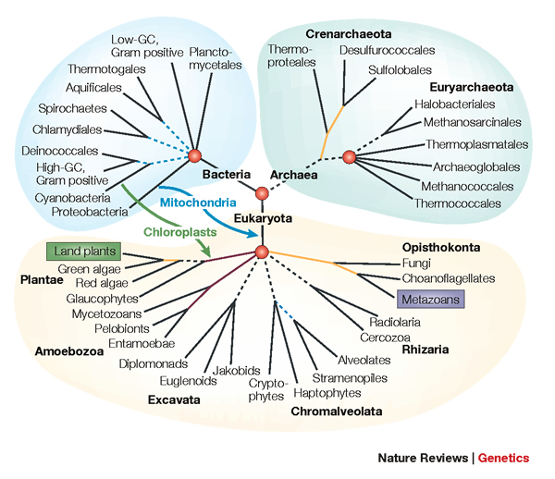
SuperFine, Enabling Large-Scale Phylogenetic Estimation
Shel Swenson
University of Southern California
and
Georgia Institute of Technology

Slide 2

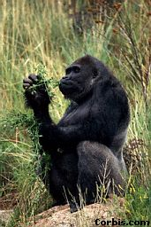


Phylogeny (evolutionary tree)
Orangutan
Gorilla
Chimpanzee
Human
“Nothing in Biology makes sense except in the light of evolution” – Dobhzhansky
1
2
3
(1-3) From the Tree of the Life Website, University of Arizona
Notes:
Phylogenetic estimation is the task of reconstructing evolutionary histories.
We represent these evolutionary histories using a tree with extant species, or species that exist today at the leaves.
The internal vertices or nodes of the tree, the branching points, represent the most recent common ancestor of any species below that vertex.
(Give examples)
*Phylogenies are used as tools across many areas of biology.

Slide 3


Tree of Life, Importance to Biology
Biomedical applications
Mechanisms of evolution
Tracking ancient migrations
Protein structure and function
Drug design
1
We are here
2
3
1) Nature Reviews (Genetics)
2) Howard Hughes Medical Institute (BioInteractive)
3) 1000 Genomes Project
Notes:
One of the grand challenge problems in phylogenetics is to reconstruct the tree of life, and that is to construct a tree that represents the evolutionary history of all species that exist today.
We are not there yet, but we are getting closer. Large scale phylogenetic analyses have applications across biology and biomedicine.
Has helped answer the questions about human origins, supporting the out of africa hypothesis.
Determine which of this year’s strains to use in next year’s flu vaccine
Leads for experimentation
And even forensics – phylogenies have been used as evidence in attempted murder and murder trials where some one is being accused of purposfully infecting someone else with AIDS or Hep-c
useful tools for pharmacologists for analyzing relationships between receptors and associated enzymes. Phylogenetic analysis can help generate hypotheses and leads for experimentation.
1) Nature Reviews (Genetics) http://www.nature.com/nrg/journal/v6/n5/fig_tab/nrg1603_F1.html
2) Howard Hughes Medical Institute (BioInteractive) http://media.hhmi.org/biointeractive/click/Origins/14.html
3) 1000 Genomes Project http://massgenomics.org/2013/04/rare-variants-human-disease.html

Slide 4
DNA sequence evolution (idealized)
AAGACTT
-3 million yrs
AAGACTT
AAGGCCT
TGGACTT
-2 million yrs
AAGGCCT
AAGGCCT
AAGGCCT
TGGACTT
TGGACTT
TGGACTT
AGGGCAT
TAGCCCT
AGCACTT
-1 million yrs
AGGGCAT
AGGGCAT
TAGCCCT
TAGCCCT
AGCACTT
AGCACTT
AGGGCAT
TAGCCCA
TAGACTT
AGCACAA
AGCGCTT
today
AGGGCAT
TAGCCCA
TAGACTT
AGCACAA
AGCGCTT
Notes:
not going to get into the details of what causes mutation/substiturion (shannon)
perhaps mention that a gene is a unit of data (shannon)
be sure to say (and describe) speciation event.

Slide 5
Phylogeny Problem
U
V
W
X
Y
AGGTCA
AGATTA
AGACTA
TGGACA
TGCGACT
X
U
Y
V
W
U
V
W
X
Y

Slide 6
Two basic approaches for tree estimation on multi-gene datasets
Apply phylogeny estimation methods to concatenated (“combined”) sequence alignments for different genes
Compute trees on individual genes and apply a supertree method
This Talk: SuperFine, boosts supertree methods, enabling
faster, more accurate estimation for large scale problems

Slide 7
Using multiple genes
gene 1
gene 3
S₁
TCTAATGGAA
S₂
GCTAAGGGAA
gene 2
S₁
TATTGATACA
S₃
TCTAAGGGAA
S₃
TCTTGATACC
S₄
TCTAACGGAA
S₄
GGTAACCCTC
S₄
TAGTGATGCA
S₇
TCTAATGGAC
S₅
GCTAAACCTC
S₇
TAGTGATGCA
S₈
TATAACGGAA
S₆
GGTGACCATC
S₈
CATTCATACC
S₇
GCTAAACCTC

Slide 8
Concatenation
gene 1
gene 2
gene 3
S₁
TCTAATGGAA
? ? ? ? ? ? ? ? ? ?
TATTGATACA
S₂
GCTAAGGGAA
? ? ? ? ? ? ? ? ? ?
? ? ? ? ? ? ? ? ? ?
S₃
TCTAAGGGAA
TCTTGATACC
? ? ? ? ? ? ? ? ? ?
S₄
TCTAACGGAA
GGTAACCCTC
TAGTGATGCA
S₅
? ? ? ? ? ? ? ? ? ?
GCTAAACCTC
? ? ? ? ? ? ? ? ? ?
S₆
? ? ? ? ? ? ? ? ? ?
GGTGACCATC
? ? ? ? ? ? ? ? ? ?
S₇
TCTAATGGAC
GCTAAACCTC
TAGTGATGCA
S₈
TATAACGGAA
? ? ? ? ? ? ? ? ? ?
CATTCATACC

Slide 9
Two competing approaches
gene 1 gene 2 . . . gene k
Species
. . .
Concatenation
Analyze
separately
. . .
Supertree Method
Notes:
point out that supertree methods take overlaping trees and produce a tree, and that the whole process of first generating small trees and then applying a supertree method is often referred to as the “supertree approach”.

Slide 10
Why use supertree methods?
Missing data
Large dataset sizes
Incompatible data types (e.g., morphological features, biomolecular sequences, gene orders, even distances based upon biochemistry)
Unavailable sequence data (only trees)

Slide 11
Many Supertree Methods
Matrix Representation with Parsimony
(Most commonly used and among most accurate)
MRP
weighted MRP
Min-Cut
Modified Min-Cut
Semi-strict Supertree
MRF
MRD
QILI
SDM
Q-imputation
PhySIC
Majority-Rule Supertrees
Maximum Likelihood Supertrees
and many more ...
Notes:
move to later

Slide 12
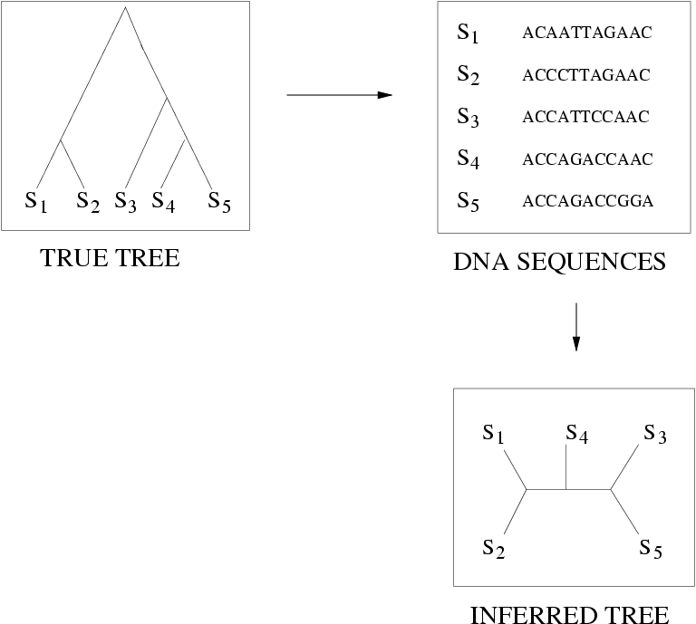
Quantifying Error
FN
FN: false negative
(missing edge)
FP: false positive
(incorrect edge)
FP
50% error rate

Slide 13
FN rate MRP vs. Concatenation
MRP
Concatenation
FN Rate (%)
Scaffold Density (%)
Concatenation is not always an option
We need better supertree methods

Slide 14
FN Rate SuperFine vs. MRP and Concatenation
MRP
SuperFine
Concatenation
FN Rate (%)
Scaffold Density (%)

Slide 15
Running Time SuperFine vs. MRP
(Concatenation is much slower)
MRP
SuperFine
Minutes
MRP 8-12 sec.
SuperFine 2-3 sec.
Scaffold Density (%)
Scaffold Density (%)
Scaffold Density (%)

Slide 16
Idea behind SuperFine
Construct a supertree with low false positive rate
Reduce false negatives by resolving areas of uncertainty using a supertree method Quartet Max Cut
(Swenson et al., Systematic Biology, 2011)
Notes:
fix ideal/real

Slide 17
Bipartitions and refinement
Let B(T) denote the set of (non-trivial) bipartitions induced by the edges of T.
T refines T’ (T’≤T) if B(T) ⊆ B(T’)
Polytomy
c
d
c
a
e
a
d
Refinement
e
b
f
b
f
T
B(T) = {ab|cdef, abc|def, abcd|ef}
T’
B(T’) = {ab|cdef, abc|def}

Slide 18
Idea behind SuperFine
Construct a supertree with low FP using the Strict Consensus Merger (SCM) (Huson et al. 1999)
Reduce FN by resolving each polytomy using a supertree method Quartet Max Cut
Notes:
fix ideal/real

Slide 19
Strict Consensus Merger (SCM)
a
e
b
e
b
a
c
e
b
c
f
a
g
d
f
g
d
f
a
b
b
g
a
c
h
d
c
i
j
h
c
i
j
d
h
d
i
j
Notes:
mention that SCM is a supertree method in and of itself.
describe how it is used: merges pairs of trees until a single tree is left.

Slide 20
Property of SCM: Bipartitions in SCM tree correspond to bipartitions in the source trees
a
e
b
e
b
a
c
e
b
c
f
a
g
d
f
g
d
f
a
b
b
g
a
c
h
d
c
i
j
h
c
i
j
d
h
d
i
j
Swenson, Ph.D. Thesis, 2009

Slide 21
Performance of SCM
Low false positive (FP) rate
(Estimated supertree has few false edges)
High false negative (FN) rate
(Estimated supertree is missing many true edges)
Runs in polynomial time (in the number of source trees and total number of species)
Notes:
Remember to make fp/fn box and mark SCM, and MRP. (add QMC-sparse and QMC-dense later)

Slide 22
Idea behind SuperFine
Construct a supertree with low FP using SCM
Refine the tree to reduce FN by resolving each polytomy using a supertree method (eg. MRP) Quartet Max Cut
Notes:
fix ideal/real

Slide 23
Resolving a single polytomy, v
Step 1: Reduce each source tree to a tree on {1,2,...,d}, where d=degree(v)
Step 2: Apply MRP to the collection of reduced trees, to produce a tree t on leafset {1,2,...,d}
Step 3: Replace the star tree at v by tree t

Slide 24
Back to Our Example
b
e
1
a
1
e
b
1
a
f
g
f
c
6
c
1
d
g
4
5
h
d
i
j
a
b
1
1
1
2
3
h
i
j
4
5
6
c
a
c
e
b
1
h
d
g
f
2
d
i
j
4
3
3
Notes:
mention that rooting matters here
mention theorem

Slide 25
Where We Use the Property
a
e
b
e
b
a
1
f
g
6
c
f
c
4
5
d
g
h
d
i
j
a
b
1
c
2
h
3
4
d
i
j

Slide 26
Step 1: Reduce each source tree to a tree on the set {1,2,...,d}
a
e
b
1
c
f
6
g
d
4
5
a
b
1
2
c
3
4
h
d
i
j

Slide 27
Step 2: Apply MRP to the collection of reduced trees
1
4
5
MRP
1
4
6
5
MRP
1
4
2
6
3
2
3

Slide 28
Replace polytomy using tree from MRP
e
b
b
a
e
c
f
g
a
5
d
g
1
4
c
h
d
i
j
2
3
h
6
f
j
h
i
i
j
a
c
e
b
d
g
f

Slide 29
FN Rate SuperFine vs. MRP and Concatenation
MRP
SuperFine
Concatenation
FN Rate (%)
Scaffold Density (%)

Slide 30
Running Time SuperFine vs. MRP
(Concatenation is much slower)
MRP
SuperFine
Minutes
MRP 8-12 sec.
SuperFine 2-3 sec.
Scaffold Density (%)
Scaffold Density (%)
Scaffold Density (%)

Slide 31
SuperFine: Boosting supertree methods
Superfine+MRP vs. MRP (Swenson et al. 2011)
SuperFine combines the features of the SCM method (polynomial time, low false positive rates) with the lower false negative rate of MRP, to achieve greater accuracy in less time.
Speed-up results from the re-encoding of source trees as smaller trees.
SuperFine+QMC vs. QMC (quartet-based)
QMC (Snir 2008), polynomial time, but infeasible for 500+ taxa
SuperFine+QMC, runs where QMC cannot (Swenson et al. 2010)
SuperFine+MRL vs. MRL (likelihood) (Nguyen et al. 2012)
SuperFine+MRL, faster and more accurate, similar likelihood scores
DACTAL (Nelesen, et al. 2012) Boosting concatenation methods;
uses SuperFine in its divide-and-conquer strategy

Slide 32
Ongoing and Future Work
Supertree Methods
Exploring algorithm design space for SuperFine
Incorporate confidence values from source trees
Species trees from incongruent gene trees
ASTRAL (in progress) – statistically consistent method, genome-scale
Species tree estimation in the presence of missing data
Collaborators: Randy Linder, Rahul Suri, Tandy Warnow
Acknowledgements: Kevin Liu, Serita Nelesen, Li-San Wang
Funding: NSF DEB 0733029, NSF ITR 0331453
Research Outside of Phylogenetics:
Pattern Discovery over Many Weighted Co-Expression Networks (using graph algorithms on distributed cyber-infrastructure)
Collaborators: Wenyuan Li, Viktor Prasanna, Santosh Ravi, Yogesh Simman, and Xianghong Jasmine Zhou
Funding: NSF CCF 1216898, NSF CNS (EAGER) 1355377

