Slide 1
Estimating species trees from multiple gene trees in the presence of ILS
Tandy Warnow
Joint work with Siavash Mirarab,
Md. S. Bayzid, and others

Slide 2

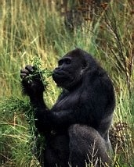


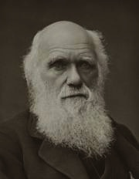
Species Tree
10-13 MYA
6-8 MYA
5-6 MYA
1 MYA
Orangutan
Gorilla
Chimpanzee
Bonobo
Human
From the Tree of the Life Website, University of Arizona
Dates from Lock et al. Nature, 2011

Slide 3
DNA Sequence Evolution
AAGACTT
-3 mil yrs
AAGACTT
-2 mil yrs
AAGGCCT
AAGGCCT
AAGGCCT
AAGGCCT
TGGACTT
TGGACTT
TGGACTT
TGGACTT
-1 mil yrs
AGGGCAT
AGGGCAT
AGGGCAT
TAGCCCT
TAGCCCT
TAGCCCT
AGCACTT
AGCACTT
AGCACTT
AGGGCAT
TAGCCCA
TAGACTT
AGCACAA
AGCGCTT
today
AGGGCAT
TAGCCCA
TAGACTT
AGCACAA
AGCGCTT

Slide 4
Markov Model of Site Evolution
Simplest (Jukes-Cantor):
The model tree T is binary and has substitution probabilities p(e) on each edge e.
The state at the root is randomly drawn from {A,C,T,G} (nucleotides)
If a site (position) changes on an edge, it changes with equal probability to each of the remaining states.
The evolutionary process is Markovian.
More complex models (such as the General Markov model) are also considered, often with little change to the theory.
Maximum Likelihood is a statistically consistent method under the JC model.

Slide 5
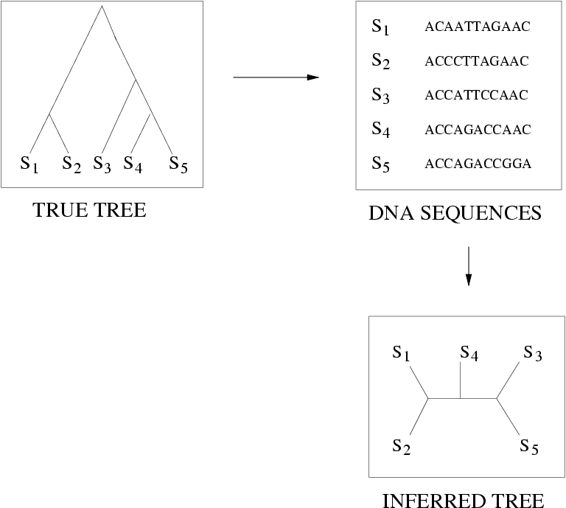
Quantifying Error
FN
FN: false negative
(missing edge)
FP: false positive
(incorrect edge)
50% error rate
FP

Slide 6
Statistical Consistency
error
Data
Data are sites in an alignment

Slide 7
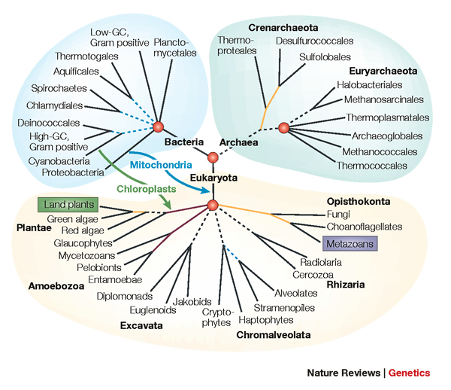
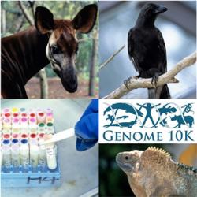
Phylogenomics
(Phylogenetic estimation from whole genomes)

Slide 8
Not all genes present in all species
gene 1
gene 3
S₁
TCTAATGGAA
S₂
GCTAAGGGAA
gene 2
S₁
TATTGATACA
S₃
TCTAAGGGAA
S₃
TCTTGATACC
S₄
TCTAACGGAA
S₄
GGTAACCCTC
S₄
TAGTGATGCA
S₇
TCTAATGGAC
S₅
GCTAAACCTC
S₇
TAGTGATGCA
S₈
TATAACGGAA
S₆
GGTGACCATC
S₈
CATTCATACC
S₇
GCTAAACCTC

Slide 9
Combined analysis
gene 1
gene 2
gene 3
S₁
TCTAATGGAA
? ? ? ? ? ? ? ? ? ?
TATTGATACA
S₂
GCTAAGGGAA
? ? ? ? ? ? ? ? ? ?
? ? ? ? ? ? ? ? ? ?
S₃
TCTAAGGGAA
TCTTGATACC
? ? ? ? ? ? ? ? ? ?
S₄
TCTAACGGAA
GGTAACCCTC
TAGTGATGCA
S₅
? ? ? ? ? ? ? ? ? ?
GCTAAACCTC
? ? ? ? ? ? ? ? ? ?
S₆
? ? ? ? ? ? ? ? ? ?
GGTGACCATC
? ? ? ? ? ? ? ? ? ?
S₇
TCTAATGGAC
GCTAAACCTC
TAGTGATGCA
S₈
TATAACGGAA
? ? ? ? ? ? ? ? ? ?
CATTCATACC

Slide 10
Two competing approaches
gene 1 gene 2 . . . gene k
Species
. . .
Combined
Analysis
Analyze
separately
. . .
Supertree
Method
Notes:
point out that supertree methods take overlaping trees and produce a tree, and that the whole process of first generating small trees and then applying a supertree method is often referred to as the “supertree approach”.

Slide 11
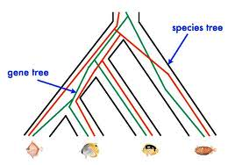
Red gene tree ≠ species tree
(green gene tree okay)

Slide 12








1KP: Thousand Transcriptome Project
G. Ka-Shu Wong
U Alberta
J. Leebens-Mack
U Georgia
N. Wickett
Northwestern
N. Matasci
iPlant
T. Warnow, S. Mirarab, N. Nguyen, Md. S.Bayzid
UT-Austin UT-Austin UT-Austin UT-Austin
1200 plant transcriptomes
More than 13,000 gene families (most not single copy)
iPLANT (NSF-funded cooperative)
Gene sequence alignments and trees computed using SATé
Gene Tree Incongruence

Slide 13



Avian Phylogenomics Project
E Jarvis,
HHMI
MTP Gilbert,
Copenhagen
G Zhang,
BGI
T. Warnow
UT-Austin
S. Mirarab Md. S. Bayzid, UT-Austin UT-Austin
Plus many many other people…
Gene Tree Incongruence
Approx. 50 species, whole genomes
8000+ genes, UCEs
Gene sequence alignments computed using SATé

Slide 14
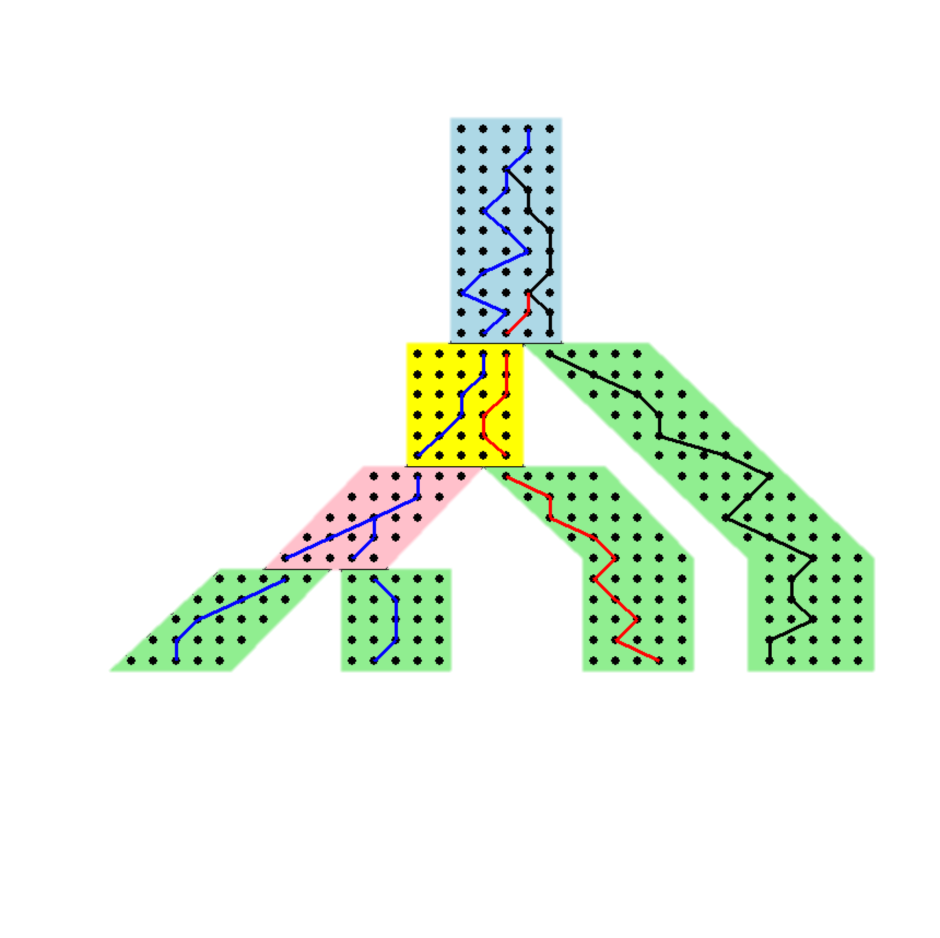
Gene trees inside the species tree (Coalescent Process)
Past
Present
Courtesy James Degnan
Gorilla and Orangutan are not siblings in the species tree, but they are in the gene tree.

Slide 15
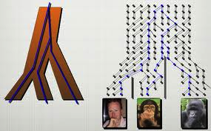
Gene Tree inside a Species Tree

Slide 16
Incomplete Lineage Sorting (ILS)
Two (or more) lineages fail to coalesce in their first common ancestral population
Probability of ILS increases for short branches or large population size (wider branches)
~960 papers in 2013 include phrase “incomplete lineage sorting”
JH Degnan, NA Rosenberg –
Trends in ecology & evolution, 2009

Slide 17

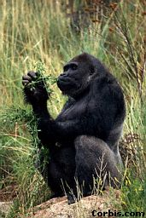


Species tree estimation: difficult, even for small datasets
Orangutan
Gorilla
Chimpanzee
Human
From the Tree of the Life Website,
University of Arizona

Slide 18
How to compute a species tree?
. . .
Techniques:
Most frequent gene tree?
Consensus of gene trees?
Other?
Notes:
point out that supertree methods take overlaping trees and produce a tree, and that the whole process of first generating small trees and then applying a supertree method is often referred to as the “supertree approach”.

Slide 19
Anomaly Zone
Under the multi-species coalescent model, the most probable gene tree may not be the true species tree (the “anomaly zone”) – Degnan & Rosenberg 2006, 2009.
Hence, selecting the most frequent gene tree is not a statistically consistent technique.
However, there are no anomalous rooted 3-taxon trees or unrooted 4-taxon trees – Allman et al. 2011, Degnan 2014. gene trees).

Slide 20
Anomaly Zone
Under the multi-species coalescent model, the most probable gene tree may not be the true species tree (the “anomaly zone”) – Degnan & Rosenberg 2006, 2009.
Hence, selecting the most frequent gene tree is not a statistically consistent technique.
However, there are no anomalous rooted 3-taxon trees or unrooted 4-taxon trees – Allman et al. 2011, Degnan 2014. gene trees).

Slide 21
Anomaly Zone
Under the multi-species coalescent model, the most probable gene tree may not be the true species tree (the “anomaly zone”) – Degnan & Rosenberg 2006, 2009.
Hence, selecting the most frequent gene tree is not a statistically consistent technique.
However, there are no anomalous rooted 3-taxon trees or unrooted 4-taxon trees – Allman et al. 2011, Degnan 2014. gene trees).

Slide 22
Anomaly Zone
Hence, for every 3 species, the most frequent rooted gene tree will be the true rooted species tree with high probability.
(The same thing is true for unrooted 4-leaf gene trees.)

Slide 23
Statistically consistent method
Given set of rooted gene trees, for every three species:
  Compute the induced triplet trees in each gene tree
  Find dominant triplet tree.
If the triplet trees are compatible, it is easy to compute the tree they all agree with.
Otherwise, apply a heuristic to find a tree that satisfies the largest number of dominant triplet trees (NP-hard).

Slide 24
Simple algorithm to construct species tree from unrooted gene trees
Given set of gene trees, for every four species:
  Compute the induced quartet trees in each gene tree
  Find dominant quartet tree
If the quartet trees are compatible, it is easy to compute the tree they all agree with.
Otherwise, apply a heuristic to find a tree that satisfies most of the dominant quartet trees.

Slide 25
Statistical Consistency
error
Data
Data are gene trees, presumed to be randomly sampled true gene trees.

Slide 26
Some statistically consistent methods
Rooted gene trees:
  Simple triplet-based methods for rooted gene trees
  MP-EST (Liu et al. 2010): maximum likelihood estimation of rooted species tree
Unrooted gene trees:
  Simple quartet-based methods for unrooted gene trees
  BUCKy-pop (Ané and Larget 2010): quartet-based Bayesian species tree estimation– ?
Sequence alignments
  *BEAST (Heled and Drummond): co-estimates gene trees and species tree

Slide 27
Some statistically consistent methods
Rooted gene trees:
  Simple triplet-based methods for rooted gene trees
  MP-EST (Liu et al. 2010): maximum likelihood estimation of rooted species tree
Unrooted gene trees:
  Simple quartet-based methods for unrooted gene trees
  BUCKy-pop (Ané and Larget 2010): quartet-based Bayesian species tree estimation– ?
Sequence alignments
  *BEAST (Heled and Drummond): co-estimates gene trees and species tree

Slide 28
Song et al., PNAS 2012
Introduced statistically consistent
method, MP-EST
Used MP-EST to analyze a mammalian dataset with 37 species and 447 genes

Slide 29
Song et al. PNAS 2012
“This study demonstrates that the incongruence introduced by concatenation methods is a major cause of longstanding uncertainty in the phylogeny of eutherian mammals, and the same may apply to other clades. Our analyses suggest that such incongruence can be resolved using phylogenomic data and coalescent methods that deal explicitly with gene tree heterogeneity.”

Slide 30
Springer and Gatesy (TPS 2014)
“The poor performance of coalescence methods [5–8] presumably reflects their incorrect assumption that all conflict among gene trees is attributable to deep coalescence, whereas a multitude of other problems (long branches, mutational saturation, weak phylogenetic signal, model misspecification, poor taxon sampling) negatively impact reconstruction of accurate gene trees and provide more cogent explanations for incongruence [6,7].”
“Shortcut coalescence methods are not a reliable remedy for persistent phylogenetic problems that extend back to the Precambrian. ”

Slide 31
The Debate:
Concatenation vs. Coalescent Estimation
In favor of coalescent-based estimation
  Statistical consistency guarantees
  Addresses gene tree incongruence resulting from ILS
  Some evidence that concatenation can be positively misleading
In favor of concatenation
  Reasonable results on data
  High bootstrap support
  Summary methods (that combine gene trees) can have poor support or miss well-established clades entirely
  Some methods (such as *BEAST) are computationally too intensive to use

Slide 32
Is Concatenation Evil?
Joseph Heled:
  YES
John Gatesy
  No

Slide 33
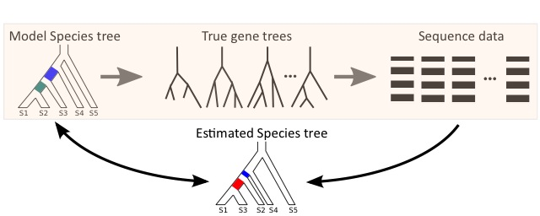
Evaluating methods using simulation
Summary method
  MP-EST (statistically consistent, increasingly popular)
Concatenation
  RAxML (among many good tools for ML)
Notes:
Mention that model species tree are based on parameters estimated using real data.

Slide 34
Data quality: the flip side of phylogenomics
As more genes are sampled, many of them have low quality
  Short sequences
  Uninformative sites
8,500 exons from the Avian project

Slide 35
Poorly resolved gene trees
As more genes are sampled, many of them have low quality
which leads to gene trees with low support (and hence high error)
8,500 exons from the Avian project

Slide 36
Avian-like simulation results
Avian-like simulation; 1000 genes, 48 taxa, high levels of ILS
Better gene trees
Better gene trees
Notes:
Gene tree error matters
Discordance due to error is not distinguished from discordance due to ILS; hence MP-EST over-estimates ILS (under-estimates branch length)

Slide 37
Is Concatenation Evil?
Joseph Heled:
  YES
John Gatesy
  No

Slide 38
Objective
Fast, and able to analyze genome-scale data (thousands of loci) quickly
Highly accurate
Statistically consistent
Convince Gatesy that coalescent-based estimation is okay

Slide 39
ASTRAL
ASTRAL = Accurate Species TRee Algorithm
Authors: S. Mirarab, R. Reaz, Md. S. Bayzid, T. Zimmerman, S. Swenson, and T. Warnow
To appear, Bioinformatics and ECCB 2014
Tutorial on using ASTRAL at Evolution 2014
Open source and freely available

Slide 40
Simple algorithm
Given set of gene trees, for every four species:
  Compute the induced quartet trees in each gene tree
  Find which quartet tree is dominant
If the quartet trees are compatible, it is easy to compute the tree they all agree with.
Otherwise, apply a heuristic to find a tree that satisfies most of the dominant quartet trees.

Slide 41
Simple algorithm
Given set of gene trees, for every four species:
  Compute the induced quartet trees in each gene tree
  Find which quartet tree is dominant
If the quartet trees are compatible, it is easy to compute the tree they all agree with.
Otherwise, apply a heuristic to find a tree that satisfies most of the dominant quartet trees.
Problem: loss of information about confidence/support
in the quartet tree

Slide 42
Median Tree
Define the cost of a species tree T on set S with respect to a set of unrooted gene trees {t₁,t₂,…t_{k}} on set S by:
  Cost(T,S) = d(T,t₁) + d(T,t₂) + … + d(T,t_{k})
  where d(T,t_{i}) is the number of quartets of taxa that T and t_{i} have different topologies.
The optimization problem is to find a tree T of minimum cost with respect to the input set of unrooted gene trees.

Slide 43
Statistical Consistency
Theorem: Let {t₁,t₂,…t_{k}} be a set of unrooted gene trees on set S. Then the median tree is a statistically consistent estimator of the unrooted species tree, under the multi-species coalescent.
Proof: Given a large enough number of genes, then with high probability the most frequent gene tree on any four species is the true species tree. When this holds, then the true species tree has the minimum cost, because it agrees with the largest number of quartet trees.

Slide 44
Statistical Consistency
Theorem: Let {t₁,t₂,…t_{k}} be a set of unrooted gene trees on set S. Then the median tree is a statistically consistent estimator of the unrooted species tree, under the multi-species coalescent.
Proof: Given a large enough number of genes, then with high probability the most frequent gene tree on any four species is the true species tree. When this holds, then the true species tree has the minimum cost, because it agrees with the largest number of quartet trees.

Slide 45
Computing the median tree
This is likely to be an NP-hard problem, so we don’t try to solve it exactly. Instead, we solve a constrained version:
  Input: set of unrooted gene trees {t₁,t₂,…t_{k}} on set S, and set X of bipartitions on S.
  Output: tree T that has minimum cost, subject to T drawing its bipartitions from X.
This problem we can solve in time that is polynomial in n=|S|, k, and |X|.

Slide 46
Default ASTRAL
The default setting for ASTRAL sets X to be the bipartitions in the input set of gene trees.
Theorem: Default ASTRAL is statistically consistent under the multi-species coalescent model.
Proof: given a large enough number of gene trees, some gene tree will have the same topology as the species tree with high probability.

Slide 47
ASTRAL running time
ASTRAL has O(nk|X|²) running time for k genes of n taxa and bipartitions from set X
  O(n³k³) if X is the set of bipartitions from gene trees
Runs in ~3 minutes for 800 genes and 103 taxa
  In contrast, MP-EST takes around a day and does not converge (multiple searches result in widely different trees)

Slide 48
ASTRAL vs. MP-EST
(mammalian simulation)

Slide 49
ASTRAL vs. Concatenation
(mammalian simulation)

Slide 50
Analyses of the Song et al. Mammalian dataset
The placement of Scandentia (Tree Shrew) is controversial.
The ASTRAL analysis agrees with maximum likelihood concatenation analysis of this dataset.

Slide 51
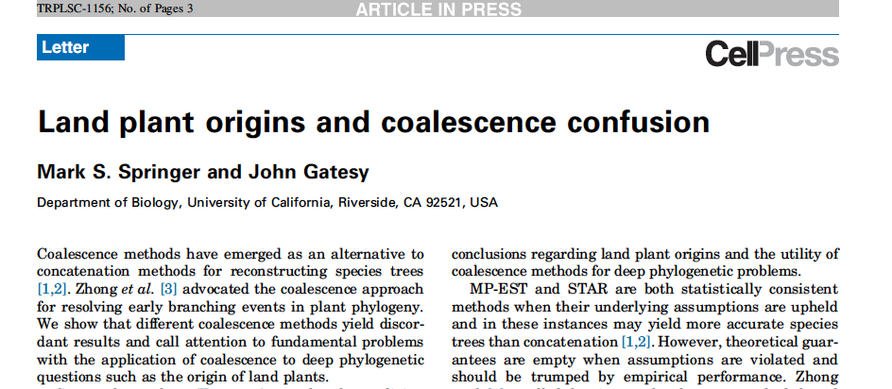

Slide 52
ASTRAL Analysis of Zhong et al. dataset
MP-EST analysis supported Zygnematales as the sister to Land Plants.
The ASTRAL analysis leaves the sister to Land Plants open: it produced one low
support branch (18% BS); collapsing that branch rules out Charales as the
possible sister to land plants.

Slide 53
Summary
ASTRAL is statistically consistent under the multi-species coalescent model.
On the datasets we studied, ASTRAL is more than other summary methods, and typically more accurate than concatenation (except under low levels of ILS). It is also very fast and can analyze very large datasets.
ASTRAL analyses of biological datasets are often closer to concatenation analyses than MP-EST analyses of the same datasets.
Lots of low hanging fruit.

Slide 54

Warnow Laboratory
PhD students: Siavash Mirarab, Nam Nguyen, and Md. S. Bayzid
Undergrad: Keerthana Kumar
Lab Website: http://www.cs.utexas.edu/users/phylo
Funding: Guggenheim Foundation, Packard Foundation, NSF, Microsoft Research New England, David Bruton Jr. Centennial Professorship, and TACC (Texas Advanced Computing Center). HHMI graduate fellowship to Siavash Mirarab and Fulbright graduate fellowship to Md. S. Bayzid.

Slide 55
Impact of using bootstrap gene trees instead of best ML gene trees
Mammalian simulated dataset with 400 genes, 1X ILS level

