Slide 1
TIPP: Taxon Identification and Phylogenetic Profiling
Tandy Warnow
The Department of Computer Science

Slide 2
TIPP
Submitted for publication
Developers Nam Nguyen and Siavash Mirarab (PhD students in Computer Science at UTCS)
Other co-authors: Mihai Pop and Bo Liu (University of Maryland, College Park)

Slide 3
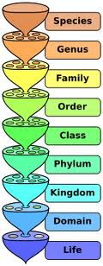
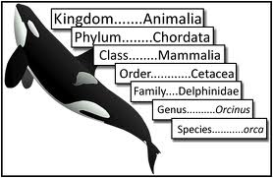
Metagenomic Taxon Identification
Objective: classify short reads in a metagenomic sample
Notes:
The two basic steps in phylogenetic placement is similar to the two phase methods we typically use, align and then place the fragment.
The differences are we align each fragment independently into the backbone tree. We then take each extended alignment and place each fragment independently into the backbone tree.
Two methods to align the query sequences are HMMALIGN, which estimates a hidden markov model on backbone alignemnt, then aligns query sequence. PaPaRa, which estimates ancestoral parsimony state vectors for each each in the reference tree and aligns the query sequence against each state vector. It selects the best scoring alignment.
Two methods that place the query sequence try to optimize the same criterion: find the ML placement given the extended alignment

Slide 4
Two Basic Questions
1. What is this fragment? (Classify each fragment as well as possible.)
2. What is the taxonomic distribution in the dataset? (Note: helpful to use marker genes.)
Notes:
The two basic steps in phylogenetic placement is similar to the two phase methods we typically use, align and then place the fragment.
The differences are we align each fragment independently into the backbone tree. We then take each extended alignment and place each fragment independently into the backbone tree.
Two methods to align the query sequences are HMMALIGN, which estimates a hidden markov model on backbone alignemnt, then aligns query sequence. PaPaRa, which estimates ancestoral parsimony state vectors for each each in the reference tree and aligns the query sequence against each state vector. It selects the best scoring alignment.
Two methods that place the query sequence try to optimize the same criterion: find the ML placement given the extended alignment

Slide 5
Identifying Fragments using Marker Genes
Approach:
  Determine the gene for the fragment (if possible), thus producing a set of “bins” (one for each gene, and a bin for “unclassified”)
  For each gene, classify each fragment:
    Construct a reference alignment and tree for full-length sequences for that gene
    Place each fragment within the tree
    Predict taxon identification (species, genus, etc.) from the placement

Slide 6
Phylogenetic Placement
Fragmentary sequences
from some gene
Full-length sequences for same gene, and an alignment and a tree
ACCG
CGAG
CGG
GGCT
TAGA
GGGGG
TCGAG
GGCG
GGG
.
.
.
ACCT
AGG...GCAT
TAGC...CCA
TAGA...CTT
AGC...ACA
ACT..TAGA..A
Notes:
The two basic steps in phylogenetic placement is similar to the two phase methods we typically use, align and then place the fragment.
The differences are we align each fragment independently into the backbone tree. We then take each extended alignment and place each fragment independently into the backbone tree.
Two methods to align the query sequences are HMMALIGN, which estimates a hidden markov model profile for the backbone alignment, and then aligns the query sequence to the model, and PaPaRa, which estimates ancestoral parsimony state vectors for each each in the reference tree and aligns the query sequence against each state vector. It selects the best scoring alignment.
Two methods that place the query sequence try to optimize the same criterion: find the ML placement given the extended alignment

Slide 7
Phylogenetic Placement
Step 1: Align each query sequence to backbone alignment
Step 2: Place each query sequence into backbone tree, using extended alignment
Notes:
The two basic steps in phylogenetic placement is similar to the two phase methods we typically use, align and then place the fragment.
The differences are we align each fragment independently into the backbone tree. We then take each extended alignment and place each fragment independently into the backbone tree.
Two methods to align the query sequences are HMMALIGN, which estimates a hidden markov model on backbone alignemnt, then aligns query sequence. PaPaRa, which estimates ancestoral parsimony state vectors for each each in the reference tree and aligns the query sequence against each state vector. It selects the best scoring alignment.
Two methods that place the query sequence try to optimize the same criterion: find the ML placement given the extended alignment

Slide 8
Phylogenetic Placement
Align each query sequence to backbone alignment
  HMMALIGN (Eddy, Bioinformatics 1998)
  PaPaRa (Berger and Stamatakis, Bioinformatics 2011)
Place each query sequence into backbone tree
  Pplacer (Matsen et al., BMC Bioinformatics, 2011)
  EPA (Berger and Stamatakis, Systematic Biology 2011)
Note: pplacer and EPA use maximum likelihood, and are reported to have the same accuracy.

Slide 9
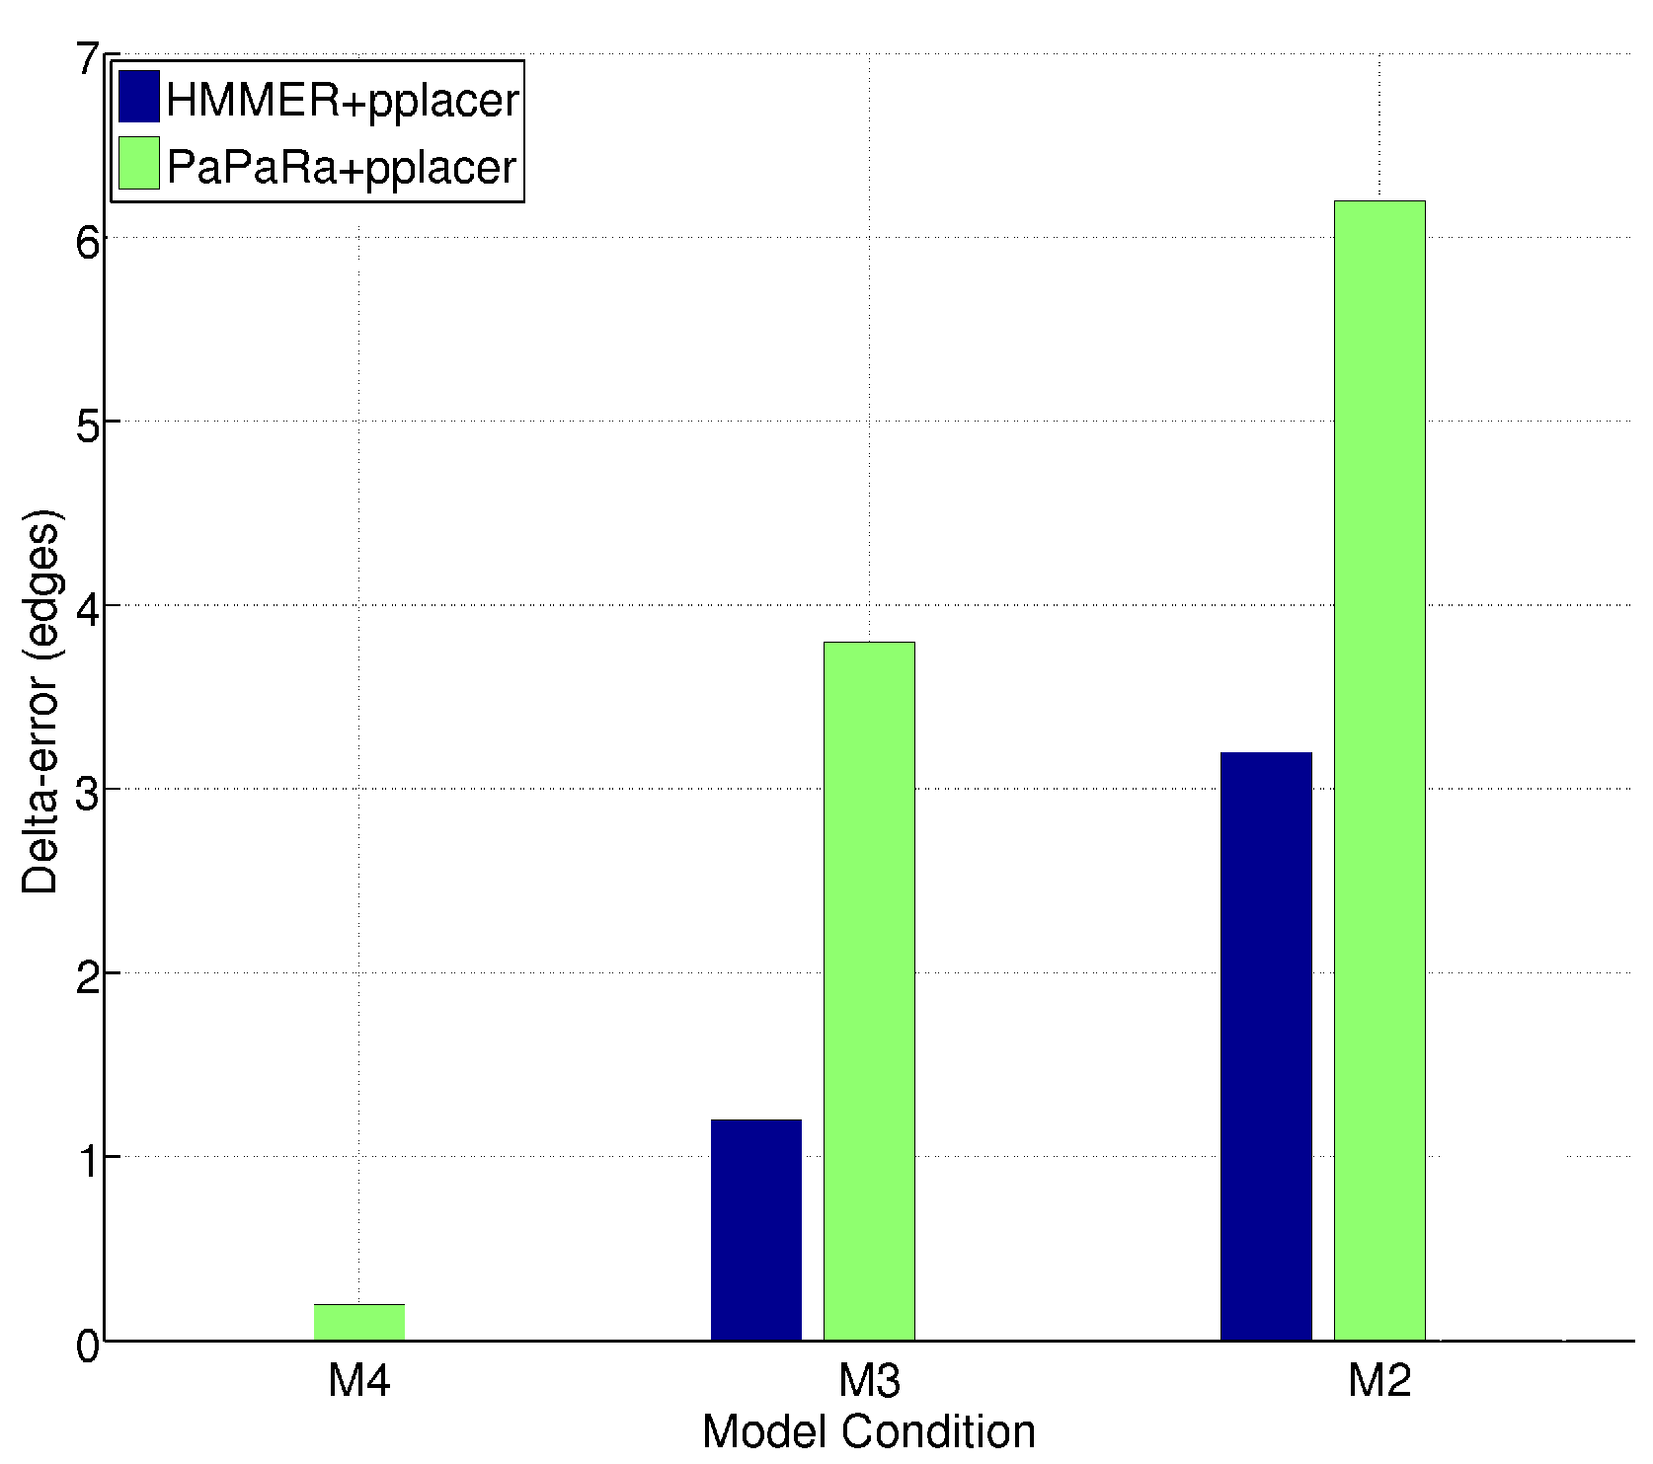
HMMER vs. PaPaRa placement error
0.0
Increasing rate of evolution

Slide 10
HMMER+pplacer
Steps:
1) Build one HMM for the entire alignment
2) Align fragment to the HMM, and insert into alignment
3) Insert fragment into tree to optimize likelihood

Slide 11
One Hidden Markov Model for the entire alignment?

Slide 12
Or 2 HMMs?

Slide 13
Or 4 HMMs?

Slide 14
SEPP
SEPP: SATé-enabled Phylogenetic Placement, by Mirarab, Nguyen, and Warnow
Pacific Symposium on Biocomputing, 2012 (special session on the Human Microbiome)

Slide 15
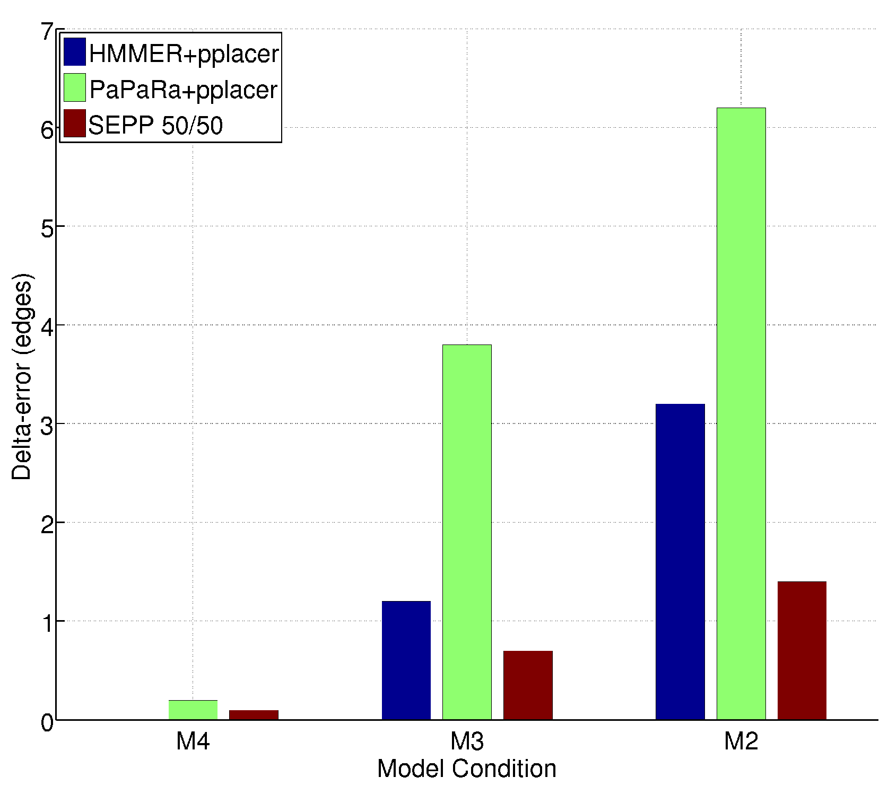
SEPP(10%), based on ~10 HMMs
0.0
0.0
Increasing rate of evolution

Slide 16
TIPP: SEPP + statistics
Using SEPP as a taxon identification technique has high recall but low precision (classifies almost everything)
TIPP: dramatically reduces false positive rate with small reduction in true positive rate, by considering uncertainty in alignment (HMMER) and placement (pplacer)

Slide 17
Taxonomic Identification
Objective: Identify species/genus/family (etc.) for each fragment within the sample.
Methods:
  PhymmBL (Brady & Salzberg, Nature Methods 2009)
  NBC (Rosen, Reichenberger, and Rosenfeld, Bioinformatics 2011)
  Metaphyler (Liu et al., BMC Genomics 2011), from the Pop lab at the University of Maryland
Metaphyler is a marker-based method.
Marker gene are single-copy, universal, and resistant to horizontal transmission.
We test this for the 30 marker genes used in Metaphyler.
Criteria: Correct classification, incorrect classification, or no classification, at each level.
Notes:
The two basic steps in phylogenetic placement is similar to the two phase methods we typically use, align and then place the fragment.
The differences are we align each fragment independently into the backbone tree. We then take each extended alignment and place each fragment independently into the backbone tree.
Two methods to align the query sequences are HMMALIGN, which estimates a hidden markov model on backbone alignemnt, then aligns query sequence. PaPaRa, which estimates ancestoral parsimony state vectors for each each in the reference tree and aligns the query sequence against each state vector. It selects the best scoring alignment.
Two methods that place the query sequence try to optimize the same criterion: find the ML placement given the extended alignment

Slide 20
Abundance Profiling
Objective: Distribution of the species (or genera, or families, etc.) within the sample.
For example: The distribution of the sample at the species-level is:
50% species A
20% species B
15% species C
14% species D
1% species E
Notes:
The two basic steps in phylogenetic placement is similar to the two phase methods we typically use, align and then place the fragment.
The differences are we align each fragment independently into the backbone tree. We then take each extended alignment and place each fragment independently into the backbone tree.
Two methods to align the query sequences are HMMALIGN, which estimates a hidden markov model on backbone alignemnt, then aligns query sequence. PaPaRa, which estimates ancestoral parsimony state vectors for each each in the reference tree and aligns the query sequence against each state vector. It selects the best scoring alignment.
Two methods that place the query sequence try to optimize the same criterion: find the ML placement given the extended alignment

Slide 21
Abundance Profiling
Objective: Distribution of the species (or genera, or families, etc.) within the sample.
Leading techniques:
  PhymmBL (Brady & Salzberg, Nature Methods 2009)
  NBC (Rosen, Reichenberger, and Rosenfeld, Bioinformatics 2011)
  Metaphyler (Liu et al., BMC Genomics 2011), from the Pop lab at the University of Maryland
  MetaphlAn (Segata et al., Nature Methods 2012), from the Huttenhower Lab at Harvard
Metaphyler and MetaphlAn are marker-based techniques (but use different marker genes).
Marker gene are single-copy, universal, and resistant to horizontal transmission.
Notes:
The two basic steps in phylogenetic placement is similar to the two phase methods we typically use, align and then place the fragment.
The differences are we align each fragment independently into the backbone tree. We then take each extended alignment and place each fragment independently into the backbone tree.
Two methods to align the query sequences are HMMALIGN, which estimates a hidden markov model on backbone alignemnt, then aligns query sequence. PaPaRa, which estimates ancestoral parsimony state vectors for each each in the reference tree and aligns the query sequence against each state vector. It selects the best scoring alignment.
Two methods that place the query sequence try to optimize the same criterion: find the ML placement given the extended alignment

Slide 22
Short fragment datasets: average length at most 100
Long fragment datasets: average length 265 to 969

Slide 23
FACs HC: Fragments simulated from 19 bacterial genomes, all in equal abundance
  (Stranneheim et al. 2010)
FAMeS: Fragments simulated from 113 bacterial and archael genomes, under 3
  different abundance complexity profiles. (Mavromatis et al. 2007)
WebCarma: Fragments simulated from 25 bacterial genomes, all in equal abundance
  (Gerlach and Stoye 2011).

Slide 25
Observations
Classification of fragments:
  TIPP and Metaphyler are methods that use marker genes for taxon identification and phylogenetic profiling. These methods only classify fragments that are assigned to their marker genes. They will fail to classify some fragments.
  TIPP and Metaphlyler are both more accurate than PhymmBL at classifying fragments from the 30 marker genes (perhaps not surprisingly).
  Most methods are affected by sequencing errors, and especially by indels (454 errors). TIPP is fairly robust to 454 error (indels).
Taxonomic profiling:
  Marker-based profiling can produce more accurate taxonomic profiles (distributions) than techniques that attempt to classify all fragments.
  Using marker genes from Metaphyler, TIPP produces more accurate taxonomic distributions (profiles) than Metaphyler..
TIPP uses multiple sequence alignment and phylogenetic placement to improve accuracy. This is probably why TIPP has better robustness to indel errors, and high sensitivity.

Slide 26
Future Work
Extending TIPP to non-marker genes. TIPP easily extends as a fragment identification method (as long as the gene is represented in sufficient quantity in existing databases), and preliminary results on 16S genes show very good fragment identification. However, using non-marker genes for abundance profiling requires normalization for multi-copy and missing data.
Implementation for HPC (big data problems).

Slide 27





Warnow Laboratory
PhD students: Siavash Mirarab*, Nam Nguyen, and Md. S. Bayzid**
Undergrad: Keerthana Kumar
Lab Website: http://www.cs.utexas.edu/users/phylo
Funding: Guggenheim Foundation, Packard, NSF, Microsoft Research New England, David Bruton Jr. Centennial Professorship, TACC (Texas Advanced Computing Center), and the University of Alberta (Canada)
TACC and UTCS computational resources
* Supported by HHMI Predoctoral Fellowship
** Supported by Fulbright Foundation Predoctoral Fellowship

Slide 28
UPP: Ultra-large alignment using SEPP¹
Objective: highly accurate multiple sequence alignments and trees on ultra-large datasets
Authors: Nam Nguyen, Siavash Mirarab, and Tandy Warnow
In preparation – expected submission February 2014
¹ SEPP: SATe-enabled phylogenetic placement, Nguyen, Mirarab, and Warnow, PSB 2012

Slide 29
UPP: basic idea
Input: set S of unaligned sequences
Output: alignment on S
Select random subset X of S
Estimate “backbone” alignment A and tree T on X
Independently align each sequence in S-X to A
Use transitivity to produce multiple sequence alignment A* for entire set S

Slide 30
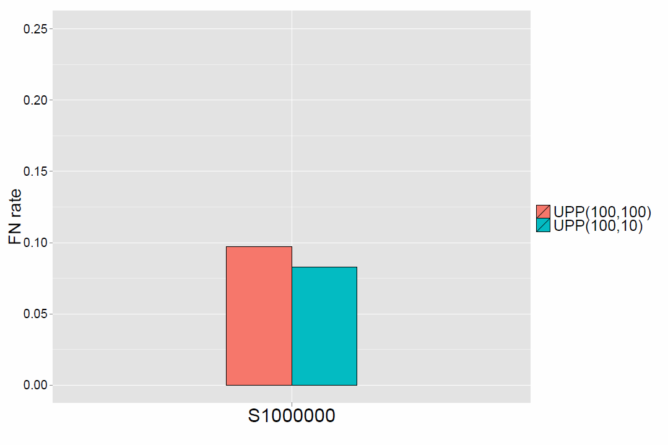
One Million Sequences: Tree Error
UPP(100,100): 1.6 days
using 8 processors (5.7 CPU days)
UPP(100,10): 7 days using 8 processors (54.8 CPU days)
Note: UPP Decomposition improves accuracy

