Slide 1

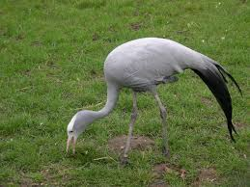
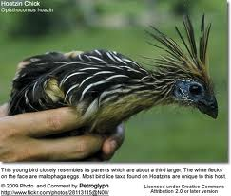




New methods for inferring species trees in the presence of incomplete lineage sorting
Tandy Warnow
The University of Illinois

Slide 2






Avian Phylogenomics Project
Erich Jarvis,
HHMI
MTP Gilbert,
Copenhagen
G Zhang,
BGI
T. Warnow
UT-Austin
S. Mirarab Md. S. Bayzid, UT-Austin UT-Austin
Plus many many other people…
Approx. 50 species, whole genomes
8000+ genes, UCEs
Challenges:
Species tree estimation from conflicting gene trees
Maximum likelihood estimation on a multi-million site
genome-scale alignment
In press

Slide 3
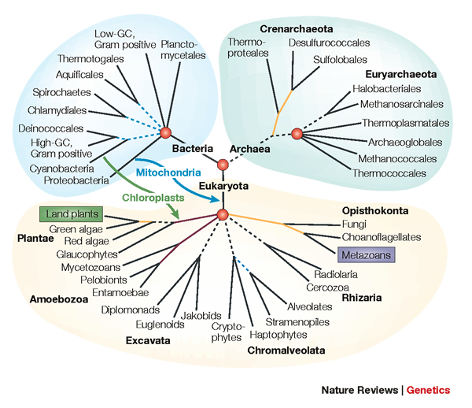
The Tree of Life: Multiple Challenges
Large datasets:
100,000+ sequences
10,000+ genes
Statistical estimation
“BigData” complexity
NP-hard problems
  Large-scale statistical phylogeny estimation
Ultra-large multiple-sequence alignment
Estimating species trees from incongruent gene trees
Supertree estimation
Genome rearrangement phylogeny
Reticulate evolution
Visualization of large trees and alignments
Data mining techniques to explore multiple optima

Slide 4
The Tree of Life: Multiple Challenges
Large datasets:
100,000+ sequences
10,000+ genes
Statistical estimation
“BigData” complexity
NP-hard problems
  Large-scale statistical phylogeny estimation
Ultra-large multiple-sequence alignment
Estimating species trees from incongruent gene trees
Supertree estimation
Genome rearrangement phylogeny
Reticulate evolution
Visualization of large trees and alignments
Data mining techniques to explore multiple optima

Slide 5
This talk
Statistical species tree estimation
  Gene tree conflict due to incomplete lineage sorting
  The multi-species coalescent model
  Identifiability and statistical consistency
  New methods for species tree estimation
    Statistical Binning (in press)
    ASTRAL (Bioinformatics 2014)
  The challenge of gene tree estimation error

Slide 6
DNA Sequence Evolution (Idealized)
AAGACTT
-3 mil yrs
AAGACTT
-2 mil yrs
AAGGCCT
AAGGCCT
AAGGCCT
AAGGCCT
TGGACTT
TGGACTT
TGGACTT
TGGACTT
-1 mil yrs
AGGGCAT
AGGGCAT
AGGGCAT
TAGCCCT
TAGCCCT
TAGCCCT
AGCACTT
AGCACTT
AGCACTT
AGGGCAT
TAGCCCA
TAGACTT
AGCACAA
AGCGCTT
today
AGGGCAT
TAGCCCA
TAGACTT
AGCACAA
AGCGCTT

Slide 7
U
V
W
X
Y
AGGTCA
AGATTA
AGACTA
TGGACA
TGCGACT
X
U
Y
V
W

Slide 8
Markov Model of Site Evolution
Simplest (Jukes-Cantor, 1969):
The model tree T is binary and has substitution probabilities p(e) on each edge e.
The state at the root is randomly drawn from {A,C,T,G} (nucleotides)
If a site (position) changes on an edge, it changes with equal probability to each of the remaining states.
The evolutionary process is Markovian.
The different sites are assumed to evolve independently and identically down the tree (with rates that are drawn from a gamma distribution).
More complex models (such as the General Markov model) are also considered, often with little change to the theory.

Slide 9
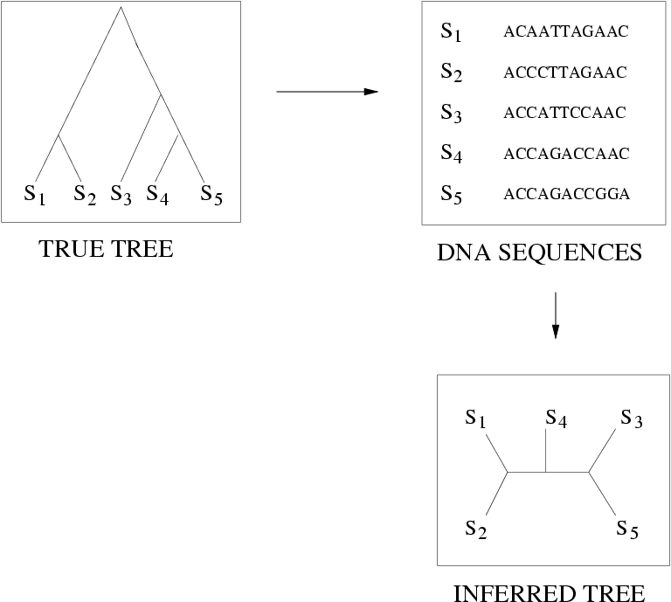
Quantifying Error
FN
FN: false negative
(missing edge)
FP: false positive
(incorrect edge)
FP
50% error rate

Slide 10
Questions
Is the model tree identifiable?
Which estimation methods are statistically consistent under this model?
How much data does the method need to estimate the model tree correctly (with high probability)?
What is the computational complexity of an estimation problem?

Slide 11
Statistical Consistency
error
Data

Slide 12
Statistical Consistency
error
Data
Data are sites in an alignment

Slide 13
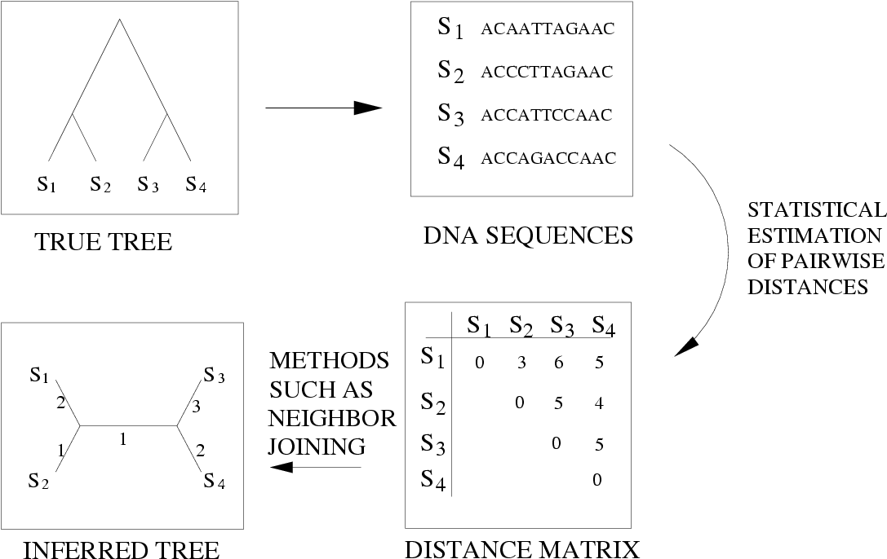
Neighbor Joining (and many other distance-based methods) are statistically consistent under Jukes-Cantor

Slide 14
Questions
Is the model tree identifiable?
Which estimation methods are statistically consistent under this model?
How much data does the method need to estimate the model tree correctly (with high probability)?
What is the computational complexity of an estimation problem?

Slide 15
Answers?
We know a lot about which site evolution models are identifiable, and which methods are statistically consistent.
Some polynomial time afc methods have been developed, and we know a little bit about the sequence length requirements for standard methods.
Just about everything is NP-hard, and the datasets are big.
Extensive studies show that even the best methods produce gene trees with some error.

Slide 16
Answers?
We know a lot about which site evolution models are identifiable, and which methods are statistically consistent.
Some polynomial time afc methods have been developed, and we know a little bit about the sequence length requirements for standard methods.
Just about everything is NP-hard, and the datasets are big.
Extensive studies show that even the best methods produce gene trees with some error.

Slide 17
Answers?
We know a lot about which site evolution models are identifiable, and which methods are statistically consistent.
Some polynomial time afc methods have been developed, and we know a little bit about the sequence length requirements for standard methods.
Just about everything is NP-hard, and the datasets are big.
Extensive studies show that even the best methods produce gene trees with some error.

Slide 18
Answers?
We know a lot about which site evolution models are identifiable, and which methods are statistically consistent.
Some polynomial time afc methods have been developed, and we know a little bit about the sequence length requirements for standard methods.
Just about everything is NP-hard, and the datasets are big.
Extensive studies show that even the best methods produce gene trees with some error.

Slide 19
In other words…
error
Data
Statistical consistency doesn’t guarantee accuracy w.h.p. unless the sequences are long enough.

Slide 20




Phylogeny
(evolutionary tree)
Orangutan
Gorilla
Chimpanzee
Human
From the Tree of the Life Website,
University of Arizona

Slide 21
Sampling multiple genes from multiple species
Orangutan
Gorilla
Chimpanzee
Human
From the Tree of the Life Website,
University of Arizona

Slide 22
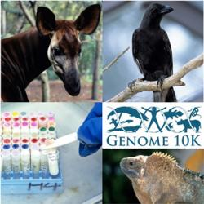
Phylogenomics
(Phylogenetic estimation from whole genomes)

Slide 23
Using multiple genes
gene 1
gene 3
S₁
TCTAATGGAA
S₂
GCTAAGGGAA
gene 2
S₁
TATTGATACA
S₃
TCTAAGGGAA
S₃
TCTTGATACC
S₄
TCTAACGGAA
S₄
GGTAACCCTC
S₄
TAGTGATGCA
S₇
TCTAATGGAC
S₅
GCTAAACCTC
S₇
TAGTGATGCA
S₈
TATAACGGAA
S₆
GGTGACCATC
S₈
CATTCATACC
S₇
GCTAAACCTC

Slide 24
Concatenation
gene 1
gene 2
gene 3
S₁
TCTAATGGAA
? ? ? ? ? ? ? ? ? ?
TATTGATACA
S₂
GCTAAGGGAA
? ? ? ? ? ? ? ? ? ?
? ? ? ? ? ? ? ? ? ?
S₃
TCTAAGGGAA
TCTTGATACC
? ? ? ? ? ? ? ? ? ?
S₄
TCTAACGGAA
GGTAACCCTC
TAGTGATGCA
S₅
? ? ? ? ? ? ? ? ? ?
GCTAAACCTC
? ? ? ? ? ? ? ? ? ?
S₆
? ? ? ? ? ? ? ? ? ?
GGTGACCATC
? ? ? ? ? ? ? ? ? ?
S₇
TCTAATGGAC
GCTAAACCTC
TAGTGATGCA
S₈
TATAACGGAA
? ? ? ? ? ? ? ? ? ?
CATTCATACC

Slide 25
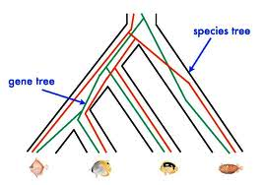
Red gene tree ≠ species tree
(green gene tree okay)

Slide 26
Gene Tree Incongruence
Gene trees can differ from the species tree due to:
  Duplication and loss
  Horizontal gene transfer
  Incomplete lineage sorting (ILS)

Slide 27
Incomplete Lineage Sorting (ILS)
1000+ papers in 2013 alone
Confounds phylogenetic analysis for many groups:
  Hominids
  Birds
  Yeast
  Animals
  Toads
  Fish
  Fungi
There is substantial debate about how to analyze phylogenomic datasets in the presence of ILS.

Slide 28
Species tree estimation: difficult, even for small datasets!
Orangutan
Gorilla
Chimpanzee
Human
From the Tree of the Life Website,
University of Arizona

Slide 29
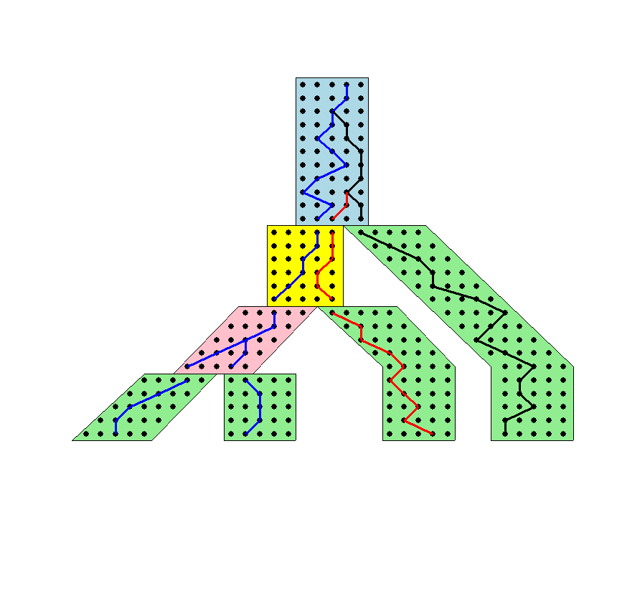




The Coalescent
Courtesy James Degnan
Past
Present

Slide 30
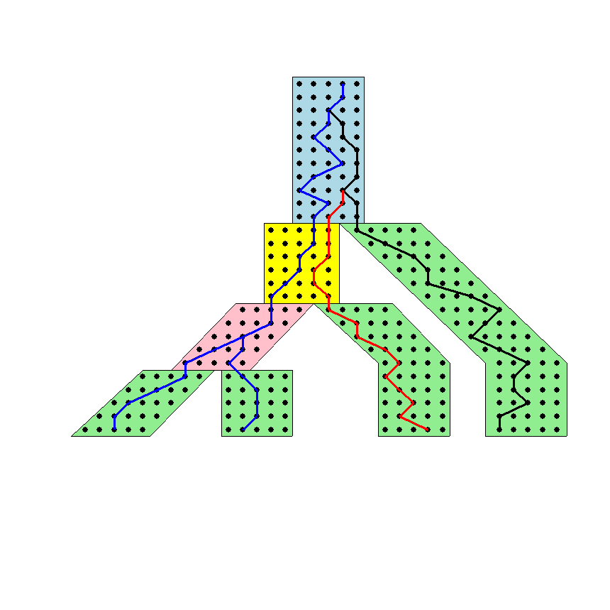
Gene tree in a species tree
Courtesy James Degnan

Slide 31
Lineage Sorting
Population-level process, also called the “Multi-species coalescent” (Kingman, 1982)
Gene trees can differ from species trees due to short times between speciation events or large population size; this is called “Incomplete Lineage Sorting” or “Deep Coalescence”.

Slide 32
Key observation:
Under the multi-species coalescent model, the species tree defines a probability distribution on the gene trees, and is identifiable from the distribution on gene trees
Courtesy James Degnan

Slide 33
Species tree estimation
1- Concatenation: statistically inconsistent (Roch & Steel 2014)
2- Summary methods: can be statistically consistent
3- Co-estimation methods: too slow for large datasets

Slide 34
Two competing approaches
gene 1 gene 2 . . . gene k
Species
. . .
Concatenation
Analyze
separately
. . .
Summary Method
Notes:
point out that supertree methods take overlaping trees and produce a tree, and that the whole process of first generating small trees and then applying a supertree method is often referred to as the “supertree approach”.

Slide 35
How to compute a species tree?
. . .
Notes:
point out that supertree methods take overlaping trees and produce a tree, and that the whole process of first generating small trees and then applying a supertree method is often referred to as the “supertree approach”.

Slide 36
How to compute a species tree?
. . .
Techniques:
Most frequent gene tree?
Consensus of gene trees?
Other?
Notes:
point out that supertree methods take overlaping trees and produce a tree, and that the whole process of first generating small trees and then applying a supertree method is often referred to as the “supertree approach”.

Slide 37
Under the multi-species coalescent model, the species tree defines a probability distribution on the gene trees, and is defined by this distribution.
Courtesy James Degnan
Theorem (Degnan et al., 2006, 2009): Under the multi-species coalescent model, for any three taxa A, B, and C, the most probable rooted gene tree on {A,B,C} is identical to the rooted species tree induced on {A,B,C}.

Slide 38
How to compute a species tree?
. . .
Theorem (Degnan et al., 2006, 2009): Under the multi-species coalescent model, for any three taxa A, B, and C, the most probable rooted gene tree on {A,B,C} is identical to the rooted species tree induced on {A,B,C}.
Notes:
point out that supertree methods take overlaping trees and produce a tree, and that the whole process of first generating small trees and then applying a supertree method is often referred to as the “supertree approach”.

Slide 39
How to compute a species tree?
. . .
. . .
Estimate species
tree for every
3 species
Theorem (Degnan et al., 2006, 2009): Under the multi-species coalescent model, for any three taxa A, B, and C, the most probable rooted gene tree on {A,B,C} is identical to the rooted species tree induced on {A,B,C}.
Notes:
point out that supertree methods take overlaping trees and produce a tree, and that the whole process of first generating small trees and then applying a supertree method is often referred to as the “supertree approach”.

Slide 40
How to compute a species tree?
. . .
. . .
Estimate species
tree for every
3 species
Theorem (Aho et al.): The rooted tree on n species can be computed from its set of 3-taxon rooted subtrees in polynomial time.
Notes:
point out that supertree methods take overlaping trees and produce a tree, and that the whole process of first generating small trees and then applying a supertree method is often referred to as the “supertree approach”.

Slide 41
How to compute a species tree?
. . .
. . .
Estimate species
tree for every
3 species
Combine
rooted
3-taxon
trees
Theorem (Aho et al.): The rooted tree on n species can be computed from its set of 3-taxon rooted subtrees in polynomial time.
Notes:
point out that supertree methods take overlaping trees and produce a tree, and that the whole process of first generating small trees and then applying a supertree method is often referred to as the “supertree approach”.

Slide 42
How to compute a species tree?
. . .
. . .
Estimate species
tree for every
3 species
Combine
rooted
3-taxon
trees
Theorem (Degnan et al., 2009): Under the multi-species coalescent, the rooted species tree can be estimated correctly (with high probability) given a large enough number of true rooted gene trees.
Theorem (Allman et al., 2011): the unrooted species tree can be estimated from a large enough number of true unrooted gene trees.
Notes:
point out that supertree methods take overlaping trees and produce a tree, and that the whole process of first generating small trees and then applying a supertree method is often referred to as the “supertree approach”.

Slide 43
How to compute a species tree?
. . .
. . .
Estimate species
tree for every
4 species
Combine
unrooted
4-taxon
trees
Theorem (Allman et al., 2011, and others): For every four leaves {a,b,c,d}, the most probable unrooted quartet tree on {a,b,c,d} is the true species tree. Hence, the unrooted species tree can be estimated from a large enough number of true unrooted gene trees.
Notes:
point out that supertree methods take overlaping trees and produce a tree, and that the whole process of first generating small trees and then applying a supertree method is often referred to as the “supertree approach”.

Slide 44
Statistical Consistency
error
Data
Data are gene trees, presumed to be randomly sampled true gene trees.

Slide 45
Statistically consistent under ILS?
MP-EST (Liu et al. 2010): maximum likelihood estimation of rooted species tree – YES
BUCKy-pop (Ané and Larget 2010): quartet-based Bayesian species tree estimation –YES
MDC – NO
Greedy – NO
Concatenation under maximum likelihood - NO
MRP (supertree method) – open

Slide 46
Results on 11-taxon datasets with weak ILS
*BEAST more accurate than summary methods (MP-EST, BUCKy, etc)
CA-ML: concatenated analysis) most accurate
Datasets from Chung and Ané, 2011
Bayzid & Warnow, Bioinformatics 2013

Slide 47
Results on 11-taxon datasets with strongILS
*BEAST more accurate than summary methods (MP-EST, BUCKy, etc)
CA-ML: (concatenated analysis) also very accurate
Datasets from Chung and Ané, 2011
Bayzid & Warnow, Bioinformatics 2013

Slide 48
*BEAST co-estimation produces more accurate gene trees than Maximum Likelihood
11-taxon weakILS datasets
17-taxon (very high ILS) datasets
11-taxon datasets from Chung and Ané, Syst Biol 2012
17-taxon datasets from Yu, Warnow, and Nakhleh, JCB 2011
Bayzid & Warnow, Bioinformatics 2013

Slide 49
Impact of Gene Tree Estimation Error on MP-EST
MP-EST has no error on true gene trees, but
MP-EST has 9% error on estimated gene trees
Datasets: 11-taxon strongILS conditions with 50 genes
Similar results for other summary methods (MDC, Greedy, etc.).

Slide 50
Problem: poor gene trees
Summary methods combine estimated gene trees, not true gene trees.
The individual gene sequence alignments in the 11-taxon datasets have poor phylogenetic signal, and result in poorly estimated gene trees.
Species trees obtained by combining poorly estimated gene trees have poor accuracy.

Slide 51
Problem: poor gene trees
Summary methods combine estimated gene trees, not true gene trees.
The individual gene sequence alignments in the 11-taxon datasets have poor phylogenetic signal, and result in poorly estimated gene trees.
Species trees obtained by combining poorly estimated gene trees have poor accuracy.

Slide 52
Problem: poor gene trees
Summary methods combine estimated gene trees, not true gene trees.
The individual gene sequence alignments in the 11-taxon datasets have poor phylogenetic signal, and result in poorly estimated gene trees.
Species trees obtained by combining poorly estimated gene trees have poor accuracy.

Slide 53
TYPICAL PHYLOGENOMICS PROBLEM:
many poor gene trees
Summary methods combine estimated gene trees, not true gene trees.
The individual gene sequence alignments in the 11-taxon datasets have poor phylogenetic signal, and result in poorly estimated gene trees.
Species trees obtained by combining poorly estimated gene trees have poor accuracy.

Slide 54
Addressing gene tree estimation error
Get better estimates of the gene trees
Restrict to subset of estimated gene trees
Model error in the estimated gene trees
Modify gene trees to reduce error
Develop methods with greater robustness to gene tree error
  ASTRAL. Bioinformatics 2014 (Mirarab et al.)
  Statistical binning. In press (Mirarab et al.)

Slide 55
Addressing gene tree estimation error
Get better estimates of the gene trees
Restrict to subset of estimated gene trees
Model error in the estimated gene trees
Modify gene trees to reduce error
Develop methods with greater robustness to gene tree error
  ASTRAL. Bioinformatics 2014 (Mirarab et al.)
  Statistical binning. In press (Mirarab et al.)

Slide 56
Avian Phylogenomics Project
E Jarvis,
HHMI
MTP Gilbert,
Copenhagen
G Zhang,
BGI
T. Warnow
UT-Austin
S. Mirarab Md. S. Bayzid, UT-Austin UT-Austin
Plus many many other people…
Approx. 50 species, whole genomes
14,000 gene trees (introns, exons, and UCEs)
Challenges:
  All 14,000 gene trees were different from each other, but most
  had very poor bootstrap support
  Substantial evidence for incomplete lineage sorting
  MP-EST analysis produced unrealistic tree – likely due to poor
  gene trees
In press (to appear December 2014)

Slide 57
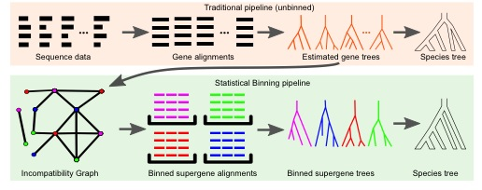
Statistical Binning Procedure
Notes:
  The bins are the color classes, and the objective is a balanced minimum
  vertx coloring of the incompatibility graph; this is NP-hard
  The last step is to combine the supergene trees using a coalescent-based method

Slide 58
Statistical binning vs. unbinned
Mirarab, et al., to appear (in press)
Binning produces bins with approximate 5 to 7 genes each
Datasets: 11-taxon strongILS datasets with 50 genes, Chung and Ané, Systematic Biology

Slide 59
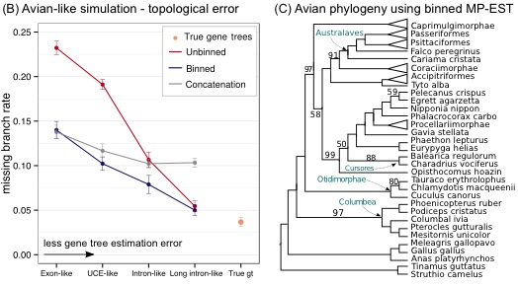
Statistical binning in the Avian Phylogenomics Project
Binning improves the accuracy of MP-EST (Liu et al., 2010), a leading
coalescent-based species tree estimation method, because it improves
gene trees; this also results in improved species tree branch lengths.

Slide 60
Observations
Binning improves the accuracy of estimated gene trees, but also reduces the number of gene trees.
MP-EST (and other methods) produce more accurate species trees given a smaller number of more accurate gene trees.
Thus, the question of data quality vs. data quantity becomes important. (And most “big data” are not high quality data!)

Slide 61
Basic Question
Is it possible to estimate the species tree with high probability given a large enough set of estimated gene trees, each with some non-zero probability of error?

Slide 62

Partial answers
Theorem (Roch & Warnow, in preparation): If gene sequence evolution obeys the strong molecular clock, then statistically consistent estimation is possible – even where all gene trees are estimated based on a single site.
Proof (sketch): Under the multi-species coalescent model, the most probable rooted triplet gene tree on {a,b,c} is the true species tree for {a,b,c}, and this remains true (when the molecular clock holds) even for triplet gene trees estimated on a single site.

Slide 63
Partial answers
Theorem (Roch & Warnow, in preparation): If gene sequence evolution obeys the strong molecular clock, then statistically consistent estimation is possible – even where all gene trees are estimated based on a single site.
Proof (sketch): Under the multi-species coalescent model, the most probable rooted triplet gene tree on {a,b,c} is the true species tree for {a,b,c}, and this remains true (when the molecular clock holds) even for triplet gene trees estimated on a single site.

Slide 64
When molecular clock fails
Without the molecular clock, the estimation of the species tree is based on quartet trees.
Although the most probable quartet tree is still the true species tree, this is no longer true for estimated quartet trees – except for very long sequences.
No positive results established for any of the current coalescent-based methods in use!

Slide 65
When molecular clock fails
Without the molecular clock, the estimation of the species tree is based on quartet trees.
Although the most probable quartet tree is still the true species tree, this is no longer true for estimated quartet trees – except for very long sequences.
No positive results established for any of the current coalescent-based methods in use!

Slide 66
When molecular clock fails
Without the molecular clock, the estimation of the species tree is based on quartet trees.
Although the most probable quartet tree is still the true species tree, this is no longer true for estimated quartet trees – except for very long sequences.
No positive results established for any of the current coalescent-based methods in use!

Slide 67
Summary
Coalescent-based species tree estimation:
Gene tree estimation error impacts species tree estimation.
Statistical binning (in press) improves coalescent-based species tree estimation from multiple genes, used in Avian Phylogenomics Project study (in press).
Trade-off between data quantity and data quality
Identifiability in the presence of gene tree estimation error? Yes under the strong molecular clock, very limited results otherwise.
New questions about statistical inference, focusing on the impact of input error.

Slide 68
Computational Phylogenetics
Interesting combination of different mathematics and computer science:
  statistical estimation under Markov models of evolution
  mathematical modelling
  graph theory and combinatorics
  machine learning and data mining
  heuristics for NP-hard optimization problems
  high performance computing
Testing involves massive simulations

Slide 69
Acknowledgments
PhD students: Siavash Mirarab* and Md. S. Bayzid**
Sebastien Roch (Wisconsin) – work began at IPAM (UCLA)
Funding: Guggenheim Foundation, Packard, NSF, Microsoft Research New England, David Bruton Jr. Centennial Professorship, TACC (Texas Advanced Computing Center), and GEBI.
TACC and UTCS computational resources
* Supported by HHMI Predoctoral Fellowship
** Supported by Fulbright Foundation Predoctoral Fellowship

Slide 70
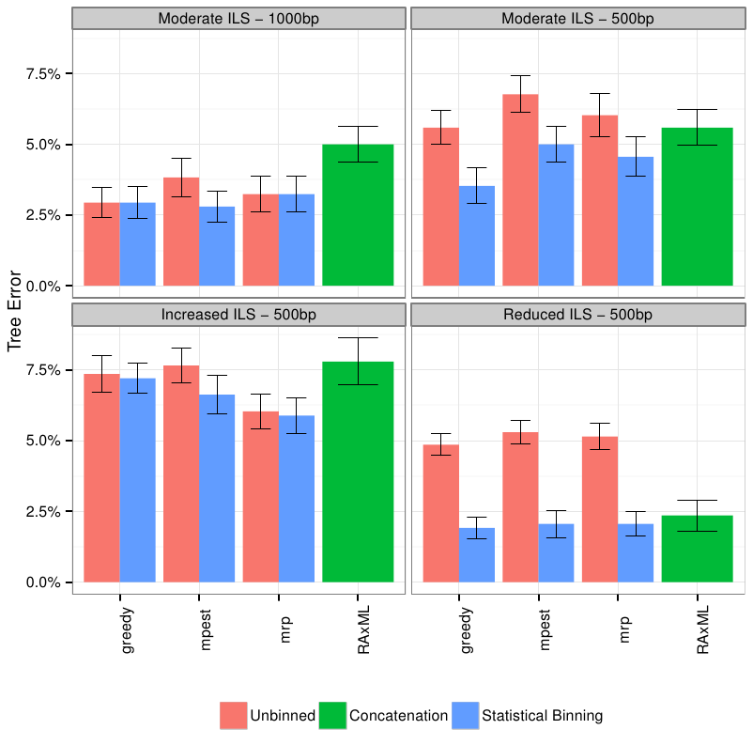
Mammalian simulation
Observation:
Binning can improve summary methods, but amount of improvement depends on method,
amount of ILS, number of gene trees, and gene tree estimation error.
MP-EST is statistically consistent; Greedy and Maximum Likelihood are not; unknown for MRP.
Data (200 genes, 20 replicate datasets) based on Song et al. PNAS 2012

Slide 71
ASTRAL
ASTRAL = Accurate Species TRees ALgorithm
Mirarab et al., ECCB 2014 and Bioinformatics 2014
Statistically-consistent estimation of the species tree from unrooted gene trees

Slide 72
ASTRAL’s approach
Input: set of unrooted gene trees T₁, T₂, …, T_{k}
Output: Tree T* maximizing the total quartet-similarity score to the unrooted gene trees
Theorem:
An exact solution to this problem would be a statistically consistent algorithm in the presence of ILS

Slide 73
ASTRAL’s approach
Input: set of unrooted gene trees T₁, T₂, …, T_{k}
Output: Tree T* maximizing the total quartet-similarity score to the unrooted gene trees
Theorem:
An exact solution to this problem is NP-hard

Slide 74
ASTRAL’s approach
Input: set of unrooted gene trees T₁, T₂, …, T_{k} and set X of bipartitions on species set S
Output: Tree T* maximizing the total quartet-similarity score to the unrooted gene trees, subject to Bipartitions(T*) drawn from X
Theorem:
An exact solution to this problem is achievable in polynomial time!

Slide 75
ASTRAL’s approach
Input: set of unrooted gene trees T₁, T₂, …, T_{k} and set X of bipartitions on species set S
Output: Tree T* maximizing the total quartet-similarity score to the unrooted gene trees, subject to Bipartitions(T*) drawn from X
Theorem:
An exact solution to this problem is achievable in polynomial time!

Slide 76
ASTRAL’s approach
Input: set of unrooted gene trees T₁, T₂, …, T_{k} and set X of bipartitions on species set S
Output: Tree T* maximizing the total quartet-similarity score to the unrooted gene trees, subject to Bipartitions(T*) drawn from X
Theorem:
Letting X be the set of bipartitions from the input gene trees is statistically consistent and polynomial time.

Slide 77
ASTRAL vs.
MP-EST and Concatenation
Mammalian simulation
200 genes, each 500bp
ASTRAL is always more
accurate than MP-EST
ASTRAL is more accurate
than Concatenation-ML
except for very low ILS
Less ILS

Slide 78
Mammalian Simulation Study
Observations:
Binning can improve accuracy, but impact depends on accuracy of estimated gene trees and phylogenetic estimation method.
Binned methods can be more accurate than RAxML (maximum likelihood), even when unbinned methods are less accurate.
Data: 200 genes, 20 replicate datasets, based on Song et al. PNAS 2012
Mirarab et al., to appear

Slide 79
Bin-and-Conquer?
Assign genes to “bins”, creating “supergene alignments”
Estimate trees on each supergene alignment using maximum likelihood
Combine the supergene trees together using a summary method
Variants:
Naïve binning (Bayzid and Warnow, Bioinformatics 2013)
Statistical binning (Mirarab, Bayzid, and Warnow, in preparation)

Slide 80
Bin-and-Conquer?
Assign genes to “bins”, creating “supergene alignments”
Estimate trees on each supergene alignment using maximum likelihood
Combine the supergene trees together using a summary method
Variants:
Naïve binning (Bayzid and Warnow, Bioinformatics 2013)
Statistical binning (Mirarab, Bayzid, and Warnow, to appear, Science)

Slide 81
Statistical binning
Input: estimated gene trees with bootstrap support, and minimum support threshold t
Output: partition of the estimated gene trees into sets, so that no two gene trees in the same set are strongly incompatible.
Vertex coloring problem (NP-hard),
but good heuristics are available (e.g., Brelaz 1979)
However, for statistical inference reasons, we need balanced vertex color classes

Slide 82
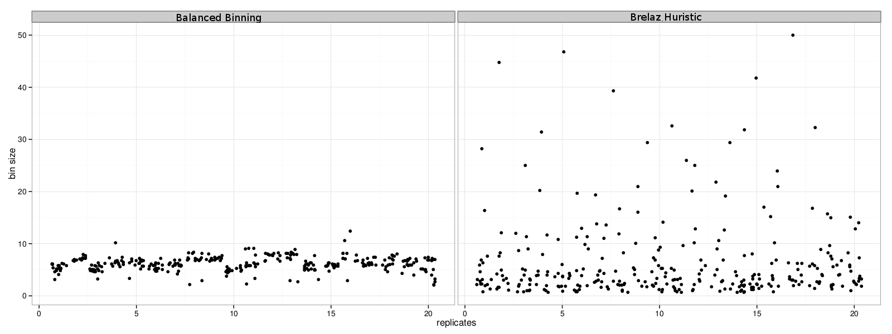
Balanced Statistical Binning
Mirarab, Bayzid, and Warnow, in preparation
Modification of Brelaz Heuristic for minimum vertex coloring.

Slide 83
Avian Phylogenomics Project
E Jarvis,
HHMI
MTP Gilbert,
Copenhagen
G Zhang,
BGI
T. Warnow
UT-Austin
S. Mirarab Md. S. Bayzid, UT-Austin UT-Austin
Gene Tree Incongruence
Plus many many other people…
Strong evidence for substantial ILS, suggesting need for
coalescent-based species tree estimation.
But MP-EST on full set of 14,000 gene trees was considered
unreliable, due to poorly estimated exon trees (very low phylogenetic
signal in exon sequence alignments).

Slide 84
Avian Phylogeny
GTRGAMMA Maximum likelihood analysis (RAxML) of 37 million basepair alignment (exons, introns, UCEs) – highly resolved tree with near 100% bootstrap support.
More than 17 years of compute time, and used 256 GB. Run at HPC centers.
Unbinned MP-EST on 14000+ genes: highly incongruent with the concatenated maximum likelihood analysis, poor bootstrap support.
Statistical binning version of MP-EST on 14000+ gene trees – highly resolved tree, largely congruent with the concatenated analysis, good bootstrap support
Statistical binning: faster than concatenated analysis, highly parallelized.
Avian Phylogenomics Project, in preparation

Slide 85
Avian Phylogeny
GTRGAMMA Maximum likelihood analysis (RAxML) of 37 million basepair alignment (exons, introns, UCEs) – highly resolved tree with near 100% bootstrap support.
More than 17 years of compute time, and used 256 GB. Run at HPC centers.
Unbinned MP-EST on 14000+ genes: highly incongruent with the concatenated maximum likelihood analysis, poor bootstrap support.
Statistical binning version of MP-EST on 14000+ gene trees – highly resolved tree, largely congruent with the concatenated analysis, good bootstrap support
Statistical binning: faster than concatenated analysis, highly parallelized.
Avian Phylogenomics Project, under review

Slide 86
Avian Simulation – 14,000 genes
MP-EST:
  Unbinned ~ 11.1% error
  Binned ~ 6.6% error
Greedy:
  Unbinned ~ 26.6% error
  Binned ~ 13.3% error
8250 exon-like genes (27% avg. bootstrap support)
3600 UCE-like genes (37% avg. bootstrap support)
2500 intron-like genes (51% avg. bootstrap support)

Slide 87
Avian Simulation – 14,000 genes
MP-EST:
  Unbinned ~ 11.1% error
  Binned ~ 6.6% error
Greedy:
  Unbinned ~ 26.6% error
  Binned ~ 13.3% error
8250 exon-like genes (27% avg. bootstrap support)
3600 UCE-like genes (37% avg. bootstrap support)
2500 intron-like genes (51% avg. bootstrap support)

Slide 88
Avian Phylogeny
GTRGAMMA Maximum likelihood analysis (RAxML) of 37 million basepair alignment (exons, introns, UCEs) – highly resolved tree with near 100% bootstrap support.
More than 17 years of compute time, and used 256 GB. Run at HPC centers.
Unbinned MP-EST on 14000+ genes: highly incongruent with the concatenated maximum likelihood analysis, poor bootstrap support.
Statistical binning version of MP-EST on 14000+ gene trees – highly resolved tree, largely congruent with the concatenated analysis, good bootstrap support
Statistical binning: faster than concatenated analysis, highly parallelized.
Avian Phylogenomics Project, under review

Slide 89
Avian Phylogeny
GTRGAMMA Maximum likelihood analysis (RAxML) of 37 million basepair alignment (exons, introns, UCEs) – highly resolved tree with near 100% bootstrap support.
More than 17 years of compute time, and used 256 GB. Run at HPC centers.
Unbinned MP-EST on 14000+ genes: highly incongruent with the concatenated maximum likelihood analysis, poor bootstrap support.
Statistical binning version of MP-EST on 14000+ gene trees – highly resolved tree, largely congruent with the concatenated analysis, good bootstrap support
Statistical binning: faster than concatenated analysis, highly parallelized.
Avian Phylogenomics Project, under review

Slide 90
To consider
Binning reduces the amount of data (number of gene trees) but can improve the accuracy of individual “supergene trees”. The response to binning differs between methods. Thus, there is a trade-off between data quantity and quality, and not all methods respond the same to the trade-off.
We know very little about the impact of data error on methods. We do not even have proofs of statistical consistency in the presence of data error.

Slide 91
Other recent related work
ASTRAL: statistically consistent method for species tree estimation under the multi-species coalescent (Mirarab et al., Bioinformatics 2014)
DCM-boosting coalescent-based methods (Bayzid et al., RECOMB-CG and BMC Genomics 2014)
Weighted Statistical Binning (Bayzid et al., in preparation) – statistically consistent version of statistical binning

Slide 92
Other Research in my lab
Method development for
Supertree estimation
Multiple sequence alignment
Metagenomic taxon identification
Genome rearrangement phylogeny
Historical Linguistics
Techniques:
Statistical estimation under Markov models of evolution
Graph theory and combinatorics
Machine learning and data mining
Heuristics for NP-hard optimization problems
High performance computing
Massive simulations

Slide 93
Research Agenda
Major scientific goals:
Develop methods that produce more accurate alignments and phylogenetic estimations for difficult-to-analyze datasets
Produce mathematical theory for statistical inference under complex models of evolution
Develop novel machine learning techniques to boost the performance of classification methods
Software that:
Can run efficiently on desktop computers on large datasets
Can analyze ultra-large datasets (100,000+) using multiple processors
Is freely available in open source form, with biologist-friendly GUIs

Slide 94
Mammalian simulation
Observation:
Binning can improve summary methods, but amount of improvement depends on: method,
amount of ILS, and accuracy of gene trees.
MP-EST is statistically consistent in the presence of ILS; Greedy is not, unknown for MRP
And RAxML.
Data (200 genes, 20 replicate datasets) based on Song et al. PNAS 2012

Slide 95
Statistically consistent methods
Input: Set of estimated gene trees or alignments, one (or more) for each gene
Output: estimated species tree
  *BEAST (Heled and Drummond 2010): Bayesian co-estimation of gene trees and species trees given sequence alignments
  MP-EST (Liu et al. 2010): maximum likelihood estimation of rooted species tree
  BUCKy-pop (Ané and Larget 2010): quartet-based Bayesian species tree estimation

Slide 96
Naïve binning vs. unbinned: 50 genes
Bayzid and Warnow, Bioinformatics 2013
11-taxon strongILS datasets with 50 genes, 5 genes per bin

Slide 97
Naïve binning vs. unbinned, 100 genes
*BEAST did not converge on these datasets, even with 150 hours.
With binning, it converged in 10 hours.

Slide 98
Naïve binning vs. unbinned: 50 genes
Bayzid and Warnow, Bioinformatics 2013
11-taxon strongILS datasets with 50 genes, 5 genes per bin

Slide 99
Neighbor Joining (and many other distance-based methods) are statistically consistent under Jukes-Cantor

