Slide 1
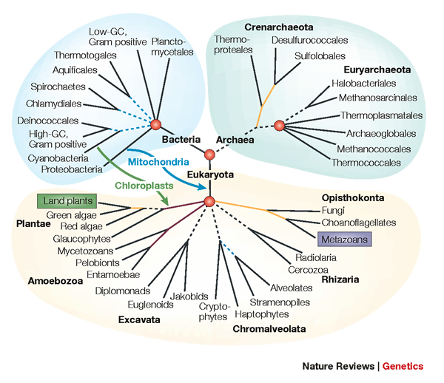
From Gene Trees to Species Trees
Tandy Warnow
The University of Texas at Austin

Slide 2




Phylogeny
(evolutionary tree)
Orangutan
Gorilla
Chimpanzee
Human
From the Tree of the Life Website,
University of Arizona

Slide 3
Estimating The Tree of Life: a Grand Challenge
Most well studied problem:
Given DNA sequences, find the Maximum Likelihood Tree
NP-hard, lots of software (RAxML, FastTree-2, GARLI, etc.)

Slide 4
Estimating The Tree of Life: a Grand Challenge
Novel techniques needed for scalability and accuracy:
NP-hard problems and large datasets
Current methods not good enough on large datasets
HPC is necessary but not sufficient

Slide 5
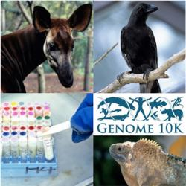
Phylogenomics
(Phylogenetic estimation from whole genomes)

Slide 6
Sampling multiple genes from multiple species
Orangutan
Gorilla
Chimpanzee
Human
From the Tree of the Life Website,
University of Arizona

Slide 7
Using multiple genes
gene 1
gene 3
S₁
TCTAATGGAA
S₂
GCTAAGGGAA
gene 2
S₁
TATTGATACA
S₃
TCTAAGGGAA
S₃
TCTTGATACC
S₄
TCTAACGGAA
S₄
GGTAACCCTC
S₄
TAGTGATGCA
S₇
TCTAATGGAC
S₅
GCTAAACCTC
S₇
TAGTGATGCA
S₈
TATAACGGAA
S₆
GGTGACCATC
S₈
CATTCATACC
S₇
GCTAAACCTC

Slide 8
Two competing approaches
gene 1 gene 2 . . . gene k
Species
. . .
Concatenation
Analyze
separately
. . .
Summary Method
Notes:
point out that supertree methods take overlaping trees and produce a tree, and that the whole process of first generating small trees and then applying a supertree method is often referred to as the “supertree approach”.

Slide 9








1kp: Thousand Transcriptome Project
G. Ka-Shu Wong
U Alberta
J. Leebens-Mack
U Georgia
N. Wickett
Northwestern
N. Matasci
iPlant
T. Warnow, S. Mirarab, N. Nguyen, Md. S.Bayzid
UT-Austin UT-Austin UT-Austin UT-Austin
Plus many many other people…
Plant Tree of Life based on transcriptomes of ~1200 species
More than 13,000 gene families (most not single copy)
Gene sequence alignments and trees computed using SATé (Liu et al., Science 2009 and Systematic Biology 2012)
Gene Tree Incongruence
Challenges:
Multiple sequence alignments of > 100,000 sequences
Gene tree incongruence

Slide 10



Avian Phylogenomics Project
Erich Jarvis,
HHMI
MTP Gilbert,
Copenhagen
G Zhang,
BGI
T. Warnow
UT-Austin
S. Mirarab Md. S. Bayzid, UT-Austin UT-Austin
Plus many many other people…
Approx. 50 species, whole genomes
8000+ genes, UCEs
Gene sequence alignments and trees computed using SATé (Liu et al., Science 2009 and Systematic Biology 2012)
Challenges:
Maximum likelihood on multi-million-site sequence alignments
Massive gene tree incongruence

Slide 11
The Tree of Life: Multiple Challenges
Large datasets:
100,000+ sequences
10,000+ genes
“BigData” complexity
Also:
Ultra-large multiple-sequence alignment
Estimating species trees from incongruent gene trees
Supertree estimation
Genome rearrangement phylogeny
Reticulate evolution
Visualization of large trees and alignments
Data mining techniques to explore multiple optima

Slide 12
The Tree of Life: Multiple Challenges
Large datasets:
100,000+ sequences
10,000+ genes
“BigData” complexity
Also:
Ultra-large multiple-sequence alignment
Estimating species trees from incongruent gene trees
Supertree estimation
Genome rearrangement phylogeny
Reticulate evolution
Visualization of large trees and alignments
Data mining techniques to explore multiple optima
Tomorrow’s talk

Slide 13
The Tree of Life: Multiple Challenges
Large datasets:
100,000+ sequences
10,000+ genes
“BigData” complexity
This talk
Also:
Ultra-large multiple-sequence alignment
Estimating species trees from incongruent gene trees
Supertree estimation
Genome rearrangement phylogeny
Reticulate evolution
Visualization of large trees and alignments
Data mining techniques to explore multiple optima

Slide 14
This talk
Species tree estimation from multiple genes
  Mathematical foundations
  Algorithms
  Data challenges
  New statistical questions
  Avian Phylogenomics

Slide 15
Part I: Gene Tree Estimation

Slide 16
DNA Sequence Evolution (Idealized)
AAGACTT
-3 mil yrs
AAGACTT
-2 mil yrs
AAGGCCT
AAGGCCT
AAGGCCT
AAGGCCT
TGGACTT
TGGACTT
TGGACTT
TGGACTT
-1 mil yrs
AGGGCAT
AGGGCAT
AGGGCAT
TAGCCCT
TAGCCCT
TAGCCCT
AGCACTT
AGCACTT
AGCACTT
AGGGCAT
TAGCCCA
TAGACTT
AGCACAA
AGCGCTT
today
AGGGCAT
TAGCCCA
TAGACTT
AGCACAA
AGCGCTT

Slide 17
Markov Model of Site Evolution
Simplest (Jukes-Cantor, 1969):
The model tree T is binary and has substitution probabilities p(e) on each edge e.
The state at the root is randomly drawn from {A,C,T,G} (nucleotides)
If a site (position) changes on an edge, it changes with equal probability to each of the remaining states.
The evolutionary process is Markovian.
More complex models (such as the General Markov model) are also considered, often with little change to the theory.

Slide 18
U
V
W
X
Y
AGGTCA
AGATTA
AGACTA
TGGACA
TGCGACT
X
U
Y
V
W

Slide 19
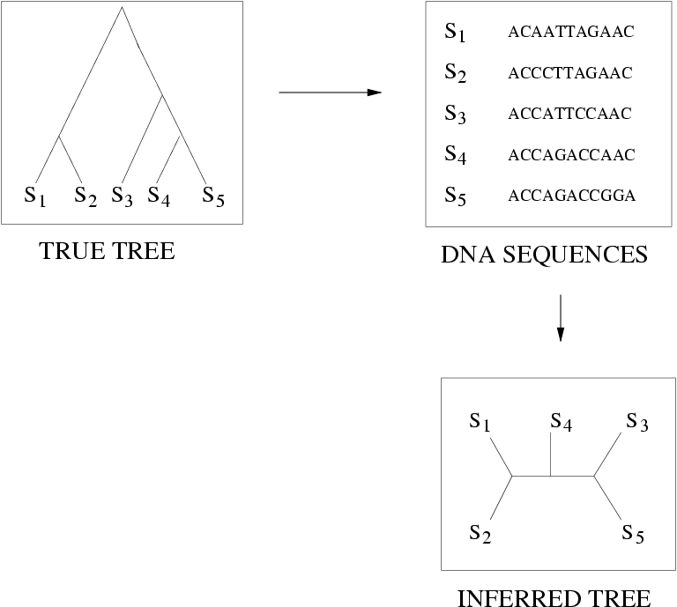
Quantifying Error
FN
FN: false negative
(missing edge)
FP: false positive
(incorrect edge)
FP
50% error rate

Slide 20
Questions
Is the model tree identifiable?
Which estimation methods are statistically consistent under this model?
How much data does the method need to estimate the model tree correctly (with high probability)?
What is the computational complexity of an estimation problem?

Slide 21
Statistical Consistency
error
Data

Slide 22
Statistical Consistency
error
Data
Data are sites in an alignment

Slide 23
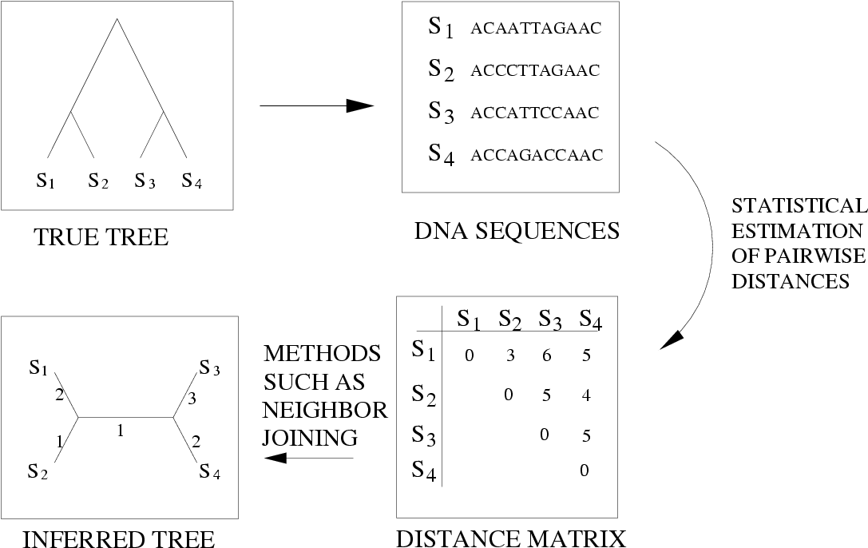
Neighbor Joining (and many other distance-based methods) are statistically consistent under Jukes-Cantor

Slide 24
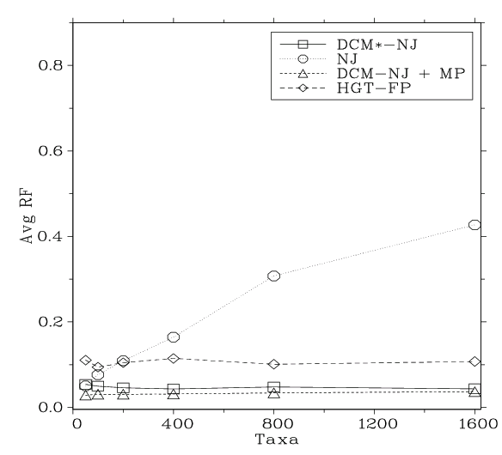
Neighbor Joining on large diameter trees
Simulation study based upon fixed edge lengths, K2P model of evolution, sequence lengths fixed to 1000 nucleotides.
Error rates reflect proportion of incorrect edges in inferred trees.
[Nakhleh et al. ISMB 2001]
0.8
NJ
0.6
Error Rate
0.4
0.2
0
0
400
800
1200
1600
No. Taxa

Slide 25
“Convergence rate” or sequence length requirement
The sequence length (number of sites) that a phylogeny reconstruction method M needs to reconstruct the true tree with probability at least 1-ε depends on
    M (the method)
    ε
    f = min p(e),
    g = max p(e), and
    n = the number of leaves
We fix everything but n.

Slide 26
Theorem (Erdos et al. 1999, Atteson 1999):
Various distance-based methods (including Neighbor joining) will return the true tree with high probability given sequence lengths that are exponential in the evolutionary diameter of the tree (hence, exponential in n).
Proof:
the method returns the true tree if the estimated distance matrix is close to the model tree distance matrix
the sequence lengths that suffice to achieve bounded error are exponential in the evolutionary diameter.

Slide 27
Afc methods (Warnow et al., 1999)
A method M is “absolute fast converging”, or afc, if for all positive f, g, and ε, there is a polynomial p(n) s.t. Pr(M(S)=T) > 1- ε, when S is a set of sequences generated on T of length at least p(n).
Notes:
  1. The polynomial p(n) will depend upon M, f, g, and ε.
  2. The method M is not “told” the values of f and g.

Slide 28
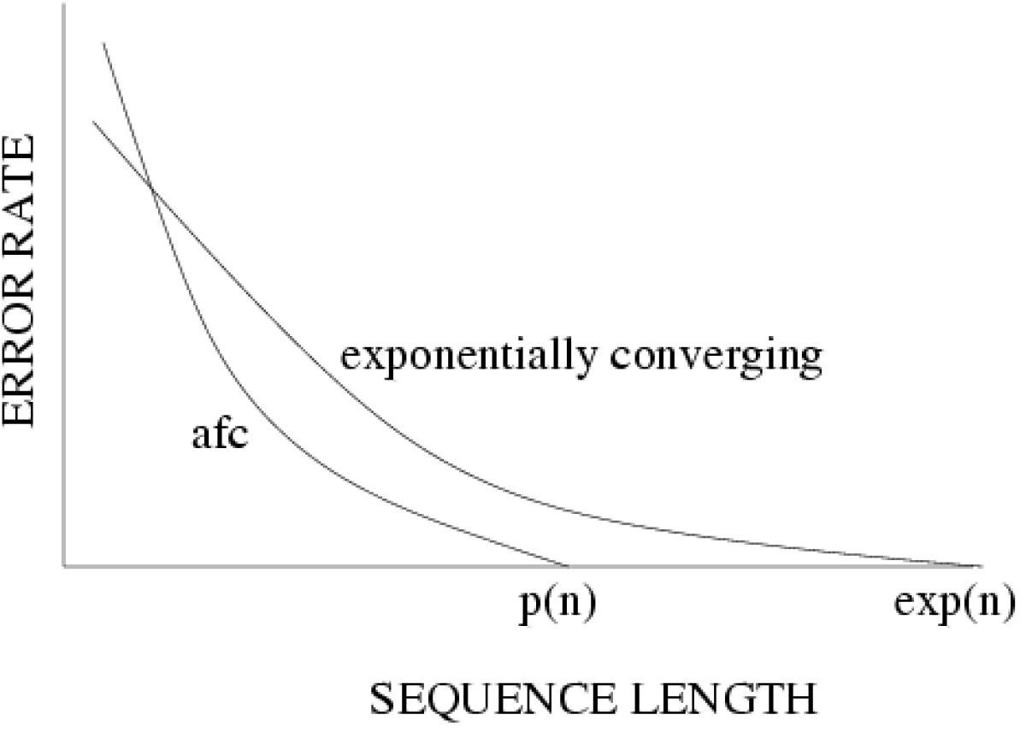
Statistical consistency, exponential convergence, and absolute fast convergence (afc)

Slide 29
Fast-converging methods (and related work)
1997: Erdos, Steel, Szekely, and Warnow (ICALP).
1999: Erdos, Steel, Szekely, and Warnow (RSA, TCS);
Huson, Nettles and Warnow (J. Comp Bio.)
2001: Warnow, St. John, and Moret (SODA);
Nakhleh, St. John, Roshan, Sun, and Warnow (ISMB)
Cryan, Goldberg, and Goldberg (SICOMP);
Csuros and Kao (SODA);
2002: Csuros (J. Comp. Bio.)
2006: Daskalakis, Mossel, Roch (STOC),
Daskalakis, Hill, Jaffe, Mihaescu, Mossel, and Rao (RECOMB)
2007: Mossel (IEEE TCBB)
2008: Gronau, Moran and Snir (SODA)
2010: Roch (Science)
2013: Roch (in preparation)

Slide 30
Neighbor Joining on large diameter trees
Simulation study based upon fixed edge lengths, K2P model of evolution, sequence lengths fixed to 1000 nucleotides.
Error rates reflect proportion of incorrect edges in inferred trees.
[Nakhleh et al. ISMB 2001]
0.8
NJ
0.6
Error Rate
0.4
0.2
0
0
400
800
1200
1600
No. Taxa

Slide 31
DCM1-boosting distance-based methods
[Nakhleh et al. ISMB 2001]
Theorem (Warnow et al., SODA 2001): DCM1-NJ converges to the true tree from polynomial length sequences. Hence DCM1-NJ is afc.
Proof: uses chordal graph theory and probabilistic analysis of algorithms
0.8
NJ
DCM1-NJ
0.6
Error Rate
0.4
0.2
0
0
400
800
1200
1600
No. Taxa

Slide 32
Questions
Is the model tree identifiable?
Which estimation methods are statistically consistent under this model?
How much data does the method need to estimate the model tree correctly (with high probability)?
What is the computational complexity of an estimation problem?

Slide 33
Answers?
We know a lot about which site evolution models are identifiable, and which methods are statistically consistent.
Some polynomial time afc methods have been developed, and we know a little bit about the sequence length requirements for standard methods.
Just about everything is NP-hard, and the datasets are big.
Extensive studies show that even the best methods produce gene trees with some error.

Slide 34
Answers?
We know a lot about which site evolution models are identifiable, and which methods are statistically consistent.
Some polynomial time afc methods have been developed, and we know a little bit about the sequence length requirements for standard methods.
Just about everything is NP-hard, and the datasets are big.
Extensive studies show that even the best methods produce gene trees with some error.

Slide 35
Answers?
We know a lot about which site evolution models are identifiable, and which methods are statistically consistent.
Some polynomial time afc methods have been developed, and we know a little bit about the sequence length requirements for standard methods.
Just about everything is NP-hard, and the datasets are big.
Extensive studies show that even the best methods produce gene trees with some error.

Slide 36
Answers?
We know a lot about which site evolution models are identifiable, and which methods are statistically consistent.
Some polynomial time afc methods have been developed, and we know a little bit about the sequence length requirements for standard methods.
Just about everything is NP-hard, and the datasets are big.
Extensive studies show that even the best methods produce gene trees with some error.

Slide 37
In other words…
error
Data
Statistical consistency doesn’t guarantee accuracy w.h.p. unless the sequences are long enough.

Slide 38
Phylogenomics
(Phylogenetic estimation from whole genomes)
Why do we need whole genomes?
Will whole genomes make phylogeny estimation easy?
How hard are the computational problems?
Do we have sufficient methods for this?

Slide 39
Using multiple genes
gene 1
gene 3
S₁
TCTAATGGAA
S₂
GCTAAGGGAA
gene 2
S₁
TATTGATACA
S₃
TCTAAGGGAA
S₃
TCTTGATACC
S₄
TCTAACGGAA
S₄
GGTAACCCTC
S₄
TAGTGATGCA
S₇
TCTAATGGAC
S₅
GCTAAACCTC
S₇
TAGTGATGCA
S₈
TATAACGGAA
S₆
GGTGACCATC
S₈
CATTCATACC
S₇
GCTAAACCTC

Slide 40
Concatenation
gene 1
gene 2
gene 3
S₁
TCTAATGGAA
? ? ? ? ? ? ? ? ? ?
TATTGATACA
S₂
GCTAAGGGAA
? ? ? ? ? ? ? ? ? ?
? ? ? ? ? ? ? ? ? ?
S₃
TCTAAGGGAA
TCTTGATACC
? ? ? ? ? ? ? ? ? ?
S₄
TCTAACGGAA
GGTAACCCTC
TAGTGATGCA
S₅
? ? ? ? ? ? ? ? ? ?
GCTAAACCTC
? ? ? ? ? ? ? ? ? ?
S₆
? ? ? ? ? ? ? ? ? ?
GGTGACCATC
? ? ? ? ? ? ? ? ? ?
S₇
TCTAATGGAC
GCTAAACCTC
TAGTGATGCA
S₈
TATAACGGAA
? ? ? ? ? ? ? ? ? ?
CATTCATACC

Slide 41
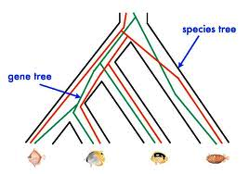
Red gene tree ≠ species tree
(green gene tree okay)

Slide 42
1KP: Thousand Transcriptome Project
Gene Tree Incongruence
G. Ka-Shu Wong
U Alberta
J. Leebens-Mack
U Georgia
N. Wickett
Northwestern
N. Matasci
iPlant
T. Warnow, S. Mirarab, N. Nguyen, Md. S.Bayzid
UT-Austin UT-Austin UT-Austin UT-Austin
1200 plant transcriptomes
More than 13,000 gene families (most not single copy)
Multi-institutional project (10+ universities)
iPLANT (NSF-funded cooperative)
Gene sequence alignments and trees computed using SATe (Liu et al., Science 2009 and Systematic Biology 2012)

Slide 43
Avian Phylogenomics Project
E Jarvis,
HHMI
MTP Gilbert,
Copenhagen
G Zhang,
BGI
T. Warnow
UT-Austin
S. Mirarab Md. S. Bayzid, UT-Austin UT-Austin
Gene Tree Incongruence
Plus many many other people…
Approx. 50 species, whole genomes
8000+ genes, UCEs
Gene sequence alignments computed using SATé (Liu et al., Science 2009 and Systematic Biology 2012)

Slide 44
Gene Tree Incongruence
Gene trees can differ from the species tree due to:
  Duplication and loss
  Horizontal gene transfer
  Incomplete lineage sorting (ILS)

Slide 45
Part II: Species Tree Estimation in the presence of ILS
Mathematical model: Kingman’s coalescent
“Coalescent-based” species tree estimation methods
Simulation studies evaluating methods
New techniques to improve methods
Application to the Avian Tree of Life

Slide 46
Species tree estimation: difficult, even for small datasets!
Orangutan
Gorilla
Chimpanzee
Human
From the Tree of the Life Website,
University of Arizona

Slide 47
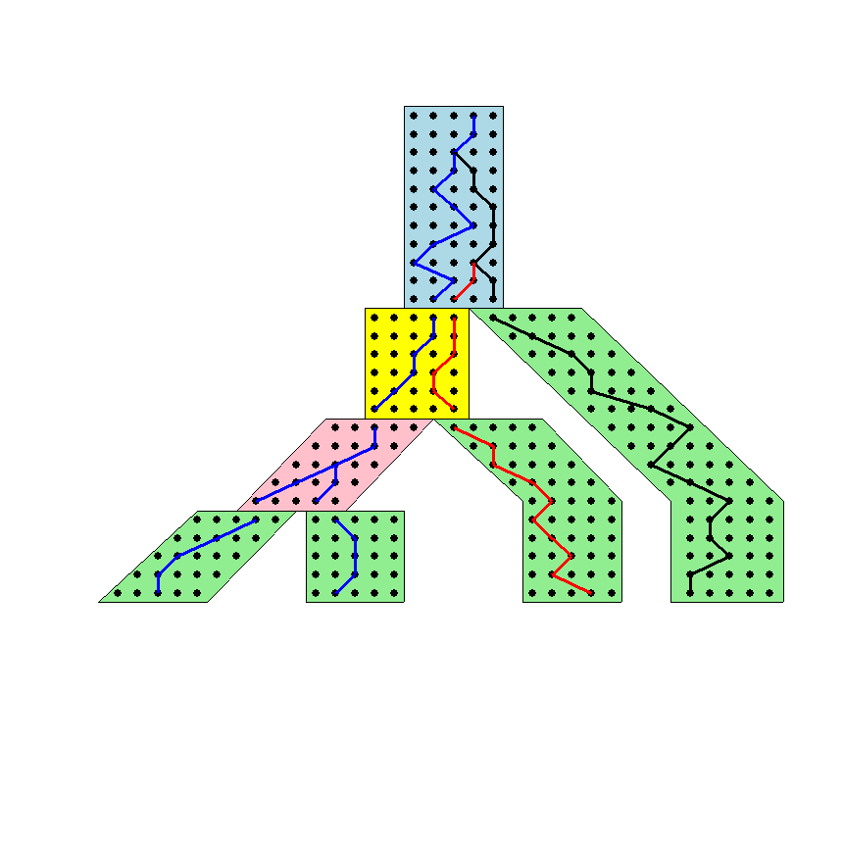




The Coalescent
Courtesy James Degnan
Past
Present

Slide 48
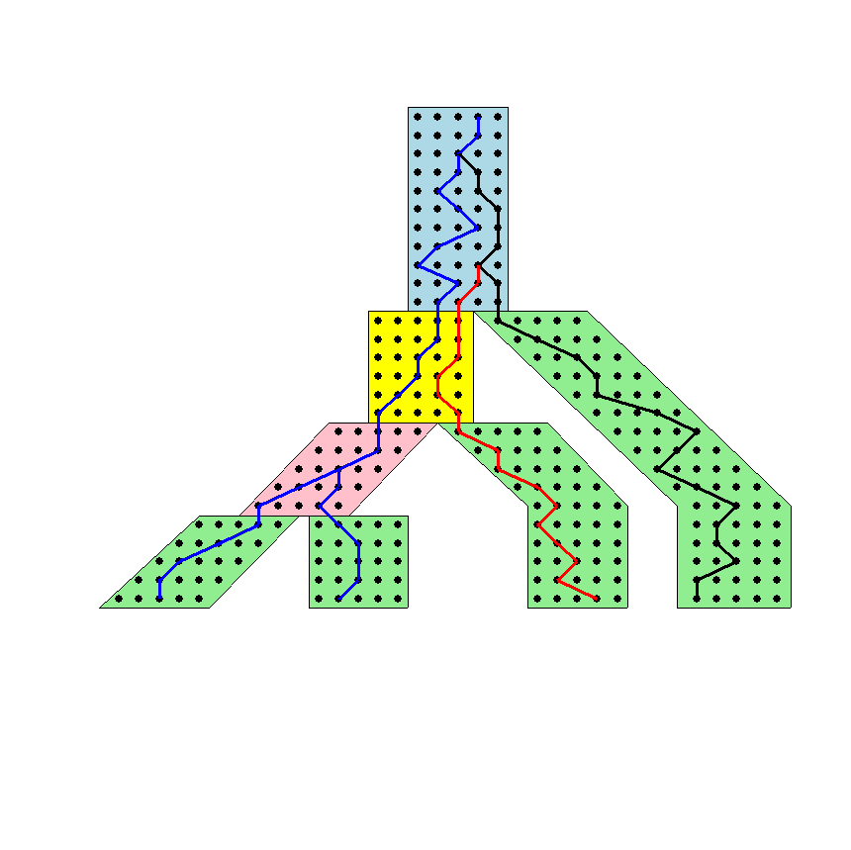
Gene tree in a species tree
Courtesy James Degnan

Slide 49
Lineage Sorting
Population-level process, also called the “Multi-species coalescent” (Kingman, 1982)
Gene trees can differ from species trees due to short times between speciation events or large population size; this is called “Incomplete Lineage Sorting” or “Deep Coalescence”.

Slide 50
Key observation:
Under the multi-species coalescent model, the species tree defines a probability distribution on the gene trees
Courtesy James Degnan

Slide 51
Incomplete Lineage Sorting (ILS)
2000+ papers in 2013 alone
Confounds phylogenetic analysis for many groups:
  Hominids
  Birds
  Yeast
  Animals
  Toads
  Fish
  Fungi
There is substantial debate about how to analyze phylogenomic datasets in the presence of ILS.

Slide 52
Two competing approaches
gene 1 gene 2 . . . gene k
Species
. . .
Concatenation
Analyze
separately
. . .
Summary Method
Notes:
point out that supertree methods take overlaping trees and produce a tree, and that the whole process of first generating small trees and then applying a supertree method is often referred to as the “supertree approach”.

Slide 53
How to compute a species tree?
. . .
Notes:
point out that supertree methods take overlaping trees and produce a tree, and that the whole process of first generating small trees and then applying a supertree method is often referred to as the “supertree approach”.

Slide 54
Under the multi-species coalescent model, the species tree defines a probability distribution on the gene trees
Courtesy James Degnan
Theorem (Degnan et al., 2006, 2009): Under the multi-species coalescent model, for any three taxa A, B, and C, the most probable rooted gene tree on {A,B,C} is identical to the rooted species tree induced on {A,B,C}.

Slide 55
How to compute a species tree?
. . .
Techniques:
MDC?
Most frequent gene tree?
Consensus of gene trees?
Other?
Notes:
point out that supertree methods take overlaping trees and produce a tree, and that the whole process of first generating small trees and then applying a supertree method is often referred to as the “supertree approach”.

Slide 56
How to compute a species tree?
. . .
Theorem (Degnan et al., 2006, 2009): Under the multi-species coalescent model, for any three taxa A, B, and C, the most probable rooted gene tree on {A,B,C} is identical to the rooted species tree induced on {A,B,C}.
Notes:
point out that supertree methods take overlaping trees and produce a tree, and that the whole process of first generating small trees and then applying a supertree method is often referred to as the “supertree approach”.

Slide 57
How to compute a species tree?
. . .
. . .
Estimate species
tree for every
3 species
Theorem (Degnan et al., 2006, 2009): Under the multi-species coalescent model, for any three taxa A, B, and C, the most probable rooted gene tree on {A,B,C} is identical to the rooted species tree induced on {A,B,C}.
Notes:
point out that supertree methods take overlaping trees and produce a tree, and that the whole process of first generating small trees and then applying a supertree method is often referred to as the “supertree approach”.

Slide 58
How to compute a species tree?
. . .
. . .
Estimate species
tree for every
3 species
Theorem (Aho et al.): The rooted tree on n species can be computed from its set of 3-taxon rooted subtrees in polynomial time.
Notes:
point out that supertree methods take overlaping trees and produce a tree, and that the whole process of first generating small trees and then applying a supertree method is often referred to as the “supertree approach”.

Slide 59
How to compute a species tree?
. . .
. . .
Estimate species
tree for every
3 species
Combine
rooted
3-taxon
trees
Theorem (Aho et al.): The rooted tree on n species can be computed from its set of 3-taxon rooted subtrees in polynomial time.
Notes:
point out that supertree methods take overlaping trees and produce a tree, and that the whole process of first generating small trees and then applying a supertree method is often referred to as the “supertree approach”.

Slide 60
How to compute a species tree?
. . .
. . .
Estimate species
tree for every
3 species
Combine
rooted
3-taxon
trees
Theorem (Degnan et al., 2009): Under the multi-species coalescent, the rooted species tree can be estimated correctly (with high probability) given a large enough number of true rooted gene trees.
Theorem (Allman et al., 2011): the unrooted species tree can be estimated from a large enough number of true unrooted gene trees.
Notes:
point out that supertree methods take overlaping trees and produce a tree, and that the whole process of first generating small trees and then applying a supertree method is often referred to as the “supertree approach”.

Slide 61
How to compute a species tree?
. . .
. . .
Estimate species
tree for every
3 species
Combine
rooted
3-taxon
trees
Theorem (Degnan et al., 2009): Under the multi-species coalescent, the rooted species tree can be estimated correctly (with high probability) given a large enough number of true rooted gene trees.
Theorem (Allman et al., 2011): the unrooted species tree can be estimated from a large enough number of true unrooted gene trees.
Notes:
point out that supertree methods take overlaping trees and produce a tree, and that the whole process of first generating small trees and then applying a supertree method is often referred to as the “supertree approach”.

Slide 62
How to compute a species tree?
. . .
. . .
Estimate species
tree for every
3 species
Combine
rooted
3-taxon
trees
Theorem (Degnan et al., 2009): Under the multi-species coalescent, the rooted species tree can be estimated correctly (with high probability) given a large enough number of true rooted gene trees.
Theorem (Allman et al., 2011): the unrooted species tree can be estimated from a large enough number of true unrooted gene trees.
Notes:
point out that supertree methods take overlaping trees and produce a tree, and that the whole process of first generating small trees and then applying a supertree method is often referred to as the “supertree approach”.

Slide 63
Statistical Consistency
error
Data
Data are gene trees, presumed to be randomly sampled true gene trees.

Slide 64
Questions
Is the model tree identifiable?
Which estimation methods are statistically consistent under this model?
How much data does the method need to estimate the model tree correctly (with high probability)?
What is the computational complexity of an estimation problem?

Slide 65
Statistically consistent under ILS?
MP-EST (Liu et al. 2010): maximum likelihood estimation of rooted species tree – YES
BUCKy-pop (Ané and Larget 2010): quartet-based Bayesian species tree estimation –YES
MDC – NO
Greedy – NO
Concatenation under maximum likelihood – open
MRP (supertree method) – open

Slide 66
Results on 11-taxon datasets with weak ILS
*BEAST more accurate than summary methods (MP-EST, BUCKy, etc)
CA-ML: (concatenated analysis) most accurate
Datasets from Chung and Ané, 2011
Bayzid & Warnow, Bioinformatics 2013

Slide 67
Results on 11-taxon datasets with strongILS
*BEAST more accurate than summary methods (MP-EST, BUCKy, etc)
CA-ML: (concatenated analysis) also very accurate
Datasets from Chung and Ané, 2011
Bayzid & Warnow, Bioinformatics 2013

Slide 68
Gene Tree Estimation:
*BEAST vs. Maximum Likelihood
11-taxon weakILS datasets
17-taxon (very high ILS) datasets
*BEAST produces more accurate gene trees than ML on gene sequence alignments
11-taxon datasets from Chung and Ané, Syst Biol 2012
17-taxon datasets from Yu, Warnow, and Nakhleh, JCB 2011

Slide 69
Impact of Gene Tree Estimation Error on MP-EST
MP-EST has no error on true gene trees, but
MP-EST has 9% error on estimated gene trees
Datasets: 11-taxon strongILS conditions with 50 genes
Similar results for other summary methods (MDC, Greedy, etc.).

Slide 70
Problem: poor gene trees
Summary methods combine estimated gene trees, not true gene trees.
The individual gene sequence alignments in the 11-taxon datasets have poor phylogenetic signal, and result in poorly estimated gene trees.
Species trees obtained by combining poorly estimated gene trees have poor accuracy.

Slide 71
Problem: poor gene trees
Summary methods combine estimated gene trees, not true gene trees.
The individual gene sequence alignments in the 11-taxon datasets have poor phylogenetic signal, and result in poorly estimated gene trees.
Species trees obtained by combining poorly estimated gene trees have poor accuracy.

Slide 72
Problem: poor gene trees
Summary methods combine estimated gene trees, not true gene trees.
The individual gene sequence alignments in the 11-taxon datasets have poor phylogenetic signal, and result in poorly estimated gene trees.
Species trees obtained by combining poorly estimated gene trees have poor accuracy.

Slide 73
TYPICAL PHYLOGENOMICS PROBLEM:
many poor gene trees
Summary methods combine estimated gene trees, not true gene trees.
The individual gene sequence alignments in the 11-taxon datasets have poor phylogenetic signal, and result in poorly estimated gene trees.
Species trees obtained by combining poorly estimated gene trees have poor accuracy.

Slide 74
Questions
Is the model species tree identifiable?
Which estimation methods are statistically consistent under this model?
How much data does the method need to estimate the model species tree correctly (with high probability)?
What is the computational complexity of an estimation problem?
What is the impact of error in the input data on the estimation of the model species tree?

Slide 75
Questions
Is the model species tree identifiable?
Which estimation methods are statistically consistent under this model?
How much data does the method need to estimate the model species tree correctly (with high probability)?
What is the computational complexity of an estimation problem?
What is the impact of error in the input data on the estimation of the model species tree?

Slide 76
Addressing gene tree estimation error
Get better estimates of the gene trees
Restrict to subset of estimated gene trees
Model error in the estimated gene trees
Modify gene trees to reduce error
“Bin-and-conquer”

Slide 77
Addressing gene tree estimation error
Get better estimates of the gene trees
Restrict to subset of estimated gene trees
Model error in the estimated gene trees
Modify gene trees to reduce error
“Bin-and-conquer”

Slide 78
Technique #2: Bin-and-Conquer?
Assign genes to “bins”, creating “supergene alignments”
Estimate trees on each supergene alignment using maximum likelihood
Combine the supergene trees together using a summary method
Variants:
Naïve binning (Bayzid and Warnow, Bioinformatics 2013)
Statistical binning (Mirarab, Bayzid, and Warnow, in preparation)

Slide 79
Technique #2: Bin-and-Conquer?
Assign genes to “bins”, creating “supergene alignments”
Estimate trees on each supergene alignment using maximum likelihood
Combine the supergene trees together using a summary method
Variants:
Naïve binning (Bayzid and Warnow, Bioinformatics 2013)
Statistical binning (Mirarab, Bayzid, and Warnow, in preparation)

Slide 80
Statistical binning
Input: estimated gene trees with bootstrap support, and minimum support threshold t
Output: partition of the estimated gene trees into sets, so that no two gene trees in the same set are strongly incompatible.
Vertex coloring problem (NP-hard),
but good heuristics are available (e.g., Brelaz 1979)
However, for statistical inference reasons, we need balanced vertex color classes

Slide 81
Statistical binning
Input: estimated gene trees with bootstrap support, and minimum support threshold t
Output: partition of the estimated gene trees into sets, so that no two gene trees in the same set are strongly incompatible.
Vertex coloring problem (NP-hard),
but good heuristics are available (e.g., Brelaz 1979)
However, for statistical inference reasons, we need balanced vertex color classes

Slide 82
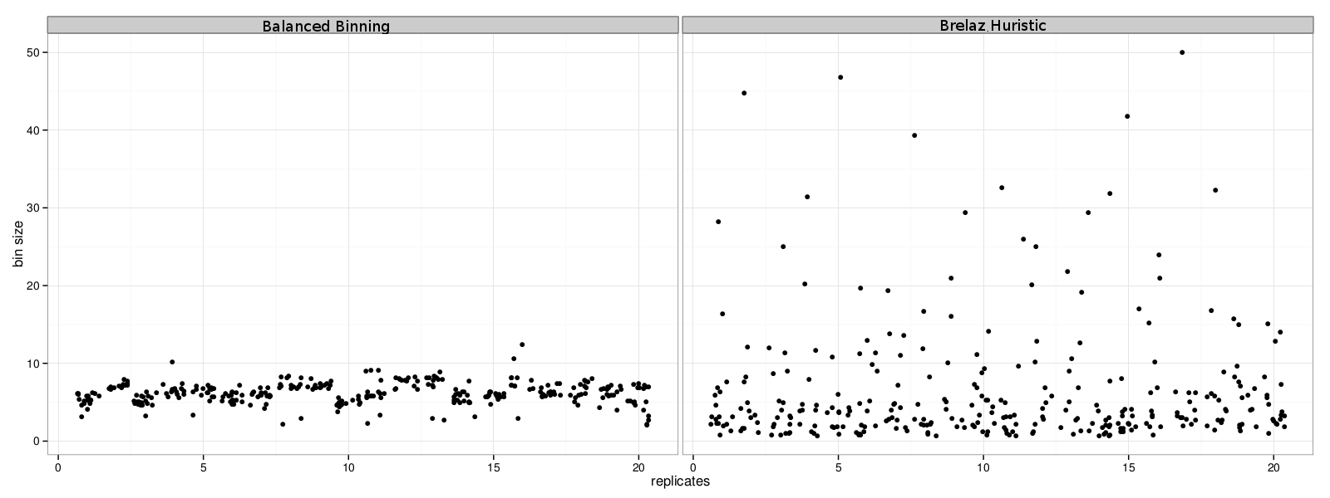
Balanced Statistical Binning
Mirarab, Bayzid, and Warnow, in preparation
Modification of Brelaz Heuristic for minimum vertex coloring.

Slide 83
Statistical binning vs. unbinned
Mirarab, et al. in preparation
Datasets: 11-taxon strongILS datasets with 50 genes, Chung and Ané, Systematic Biology

Slide 84
Mammalian Simulation Study
Observations:
Binning can improve accuracy, but impact depends on accuracy of estimated gene trees and phylogenetic estimation method.
Binned methods can be more accurate than RAxML (maximum likelihood), even when unbinned methods are less accurate.
Data: 200 genes, 20 replicate datasets, based on Song et al. PNAS 2012
Mirarab et al., in preparation

Slide 85
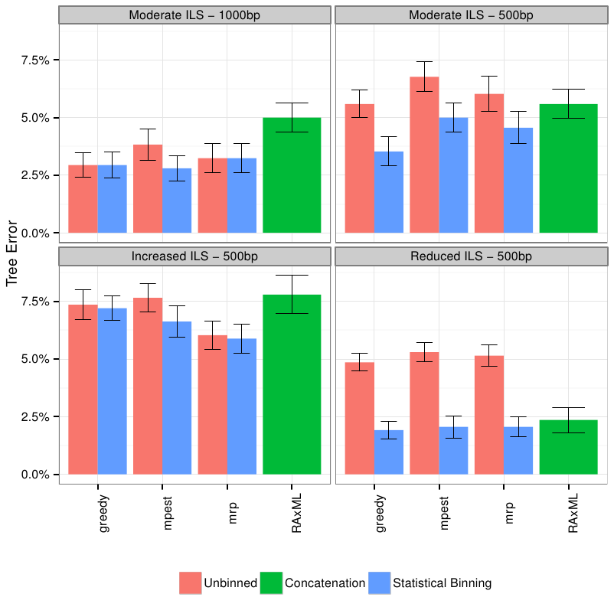
Mammalian simulation
Binning can improve summary methods, but amount of improvement depends on: method,
amount of ILS, and accuracy of gene trees.
MP-EST is statistically consistent in the presence of ILS; Greedy is not, unknown for MRP
and RAxML.
Data (200 genes, 20 replicate datasets) based on Song et al. PNAS 2012

Slide 86
Avian Phylogenomics Project
E Jarvis,
HHMI
MTP Gilbert,
Copenhagen
G Zhang,
BGI
T. Warnow
UT-Austin
S. Mirarab Md. S. Bayzid, UT-Austin UT-Austin
Gene Tree Incongruence
Plus many many other people…
Strong evidence for substantial ILS, suggesting need for
coalescent-based species tree estimation.
But MP-EST on full set of 14,000 gene trees was considered
unreliable, due to poorly estimated exon trees (very low phylogenetic
signal in exon sequence alignments).

Slide 87
Avian Phylogeny
GTRGAMMA Maximum likelihood analysis (RAxML) of 37 million basepair alignment (exons, introns, UCEs) – highly resolved tree with near 100% bootstrap support.
More than 17 years of compute time, and used 256 GB. Run at HPC centers.
Unbinned MP-EST on 14000+ genes: highly incongruent with the concatenated maximum likelihood analysis, poor bootstrap support.
Statistical binning version of MP-EST on 14000+ gene trees – highly resolved tree, largely congruent with the concatenated analysis, good bootstrap support
Statistical binning: faster than concatenated analysis, highly parallelized.
Avian Phylogenomics Project, in preparation

Slide 88
Avian Phylogeny
GTRGAMMA Maximum likelihood analysis (RAxML) of 37 million basepair alignment (exons, introns, UCEs) – highly resolved tree with near 100% bootstrap support.
More than 17 years of compute time, and used 256 GB. Run at HPC centers.
Unbinned MP-EST on 14000+ genes: highly incongruent with the concatenated maximum likelihood analysis, poor bootstrap support.
Statistical binning version of MP-EST on 14000+ gene trees – highly resolved tree, largely congruent with the concatenated analysis, good bootstrap support
Statistical binning: faster than concatenated analysis, highly parallelized.
Avian Phylogenomics Project, in preparation

Slide 89
Avian Simulation – 14,000 genes
MP-EST:
  Unbinned ~ 11.1% error
  Binned ~ 6.6% error
Greedy:
  Unbinned ~ 26.6% error
  Binned ~ 13.3% error
8250 exon-like genes (27% avg. bootstrap support)
3600 UCE-like genes (37% avg. bootstrap support)
2500 intron-like genes (51% avg. bootstrap support)

Slide 90
Avian Simulation – 14,000 genes
MP-EST:
  Unbinned ~ 11.1% error
  Binned ~ 6.6% error
Greedy:
  Unbinned ~ 26.6% error
  Binned ~ 13.3% error
8250 exon-like genes (27% avg. bootstrap support)
3600 UCE-like genes (37% avg. bootstrap support)
2500 intron-like genes (51% avg. bootstrap support)

Slide 91
Avian Phylogeny
GTRGAMMA Maximum likelihood analysis (RAxML) of 37 million basepair alignment (exons, introns, UCEs) – highly resolved tree with near 100% bootstrap support.
More than 17 years of compute time, and used 256 GB. Run at HPC centers.
Unbinned MP-EST on 14000+ genes: highly incongruent with the concatenated maximum likelihood analysis, poor bootstrap support.
Statistical binning version of MP-EST on 14000+ gene trees – highly resolved tree, largely congruent with the concatenated analysis, good bootstrap support
Statistical binning: faster than concatenated analysis, highly parallelized.
Avian Phylogenomics Project, in preparation

Slide 92
Avian Phylogeny
GTRGAMMA Maximum likelihood analysis (RAxML) of 37 million basepair alignment (exons, introns, UCEs) – highly resolved tree with near 100% bootstrap support.
More than 17 years of compute time, and used 256 GB. Run at HPC centers.
Unbinned MP-EST on 14000+ genes: highly incongruent with the concatenated maximum likelihood analysis, poor bootstrap support.
Statistical binning version of MP-EST on 14000+ gene trees – highly resolved tree, largely congruent with the concatenated analysis, good bootstrap support
Statistical binning: faster than concatenated analysis, highly parallelized.
Avian Phylogenomics Project, in preparation

Slide 93
To consider
Binning reduces the amount of data (number of gene trees) but can improve the accuracy of individual “supergene trees”. The response to binning differs between methods. Thus, there is a trade-off between data quantity and quality, and not all methods respond the same to the trade-off.
We know very little about the impact of data error on methods. We do not even have proofs of statistical consistency in the presence of data error.

Slide 94
Basic Questions
Is the model tree identifiable?
Which estimation methods are statistically consistent under this model?
How much data does the method need to estimate the model tree correctly (with high probability)?
What is the computational complexity of an estimation problem?

Slide 95
Additional Statistical Questions
Trade-off between data quality and quantity
Impact of data selection
Impact of data error
Performance guarantees on finite data (e.g., prediction of error rates as a function of the input data and method)
We need a solid mathematical framework for these problems.

Slide 96
Summary
DCM1-NJ: an absolute fast converging (afc) method, uses chordal graph theory and probabilistic analysis of algorithms to prove performance guarantees
Binning: species tree estimation from multiple genes, can improve coalescent-based species tree estimation methods.
New questions in phylogenetic estimation about impact of error in input data.

Slide 97

Warnow Laboratory
PhD students: Siavash Mirarab*, Nam Nguyen, and Md. S. Bayzid**
Undergrad: Keerthana Kumar
Lab Website: http://www.cs.utexas.edu/users/phylo
Funding: Guggenheim Foundation, Packard, NSF, Microsoft Research New England, David Bruton Jr. Centennial Professorship, and TACC (Texas Advanced Computing Center)
TACC and UTCS computational resources
* Supported by HHMI Predoctoral Fellowship
** Supported by Fulbright Foundation Predoctoral Fellowship

Slide 98
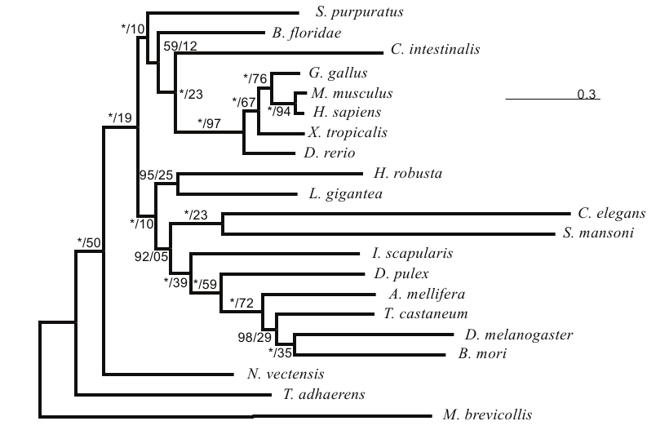
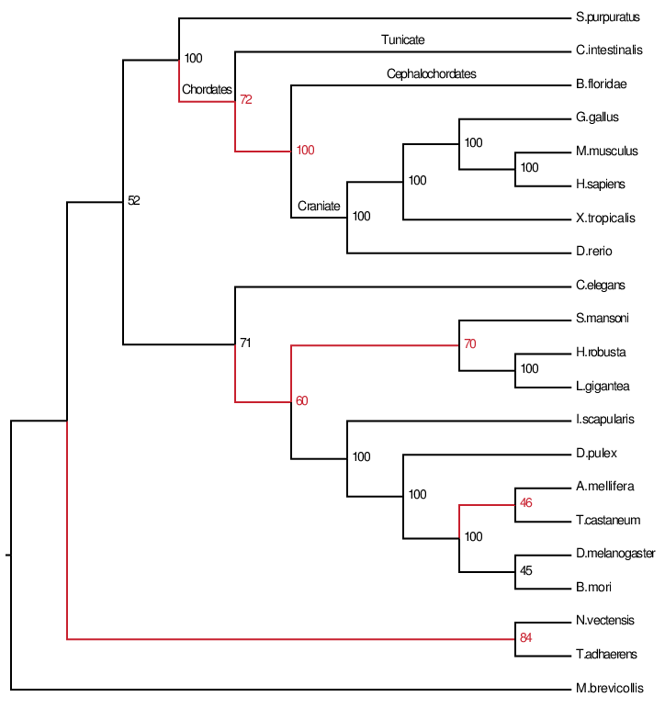
Metazoa Dataset from
Salichos & Rokas - Nature 2013
225 genes and 21 species
UnBinned MP-EST compared to Concatenation using RAxML
  Poor bootstrap support
  Substantial conflict with concatenation (red is conflict - green/black is congruence)
  Strongly rejects (Tunicate,Craniate), a subgroup that is strongly supported in the literature [Bourlat, Sarah J., et al Nature 444.7115 (2006); Delsuc, Frédéric, et al. Genesis 46.11 (2008); Singh, Tiratha R., et al. BMC genomics 10.1 (2009): 534.]
Concatenation
Unbinned MPEST
Notes:
Note:
1- Green are edges that are in both concatenation and binned, but no in unbinned. Dark green has 100% support in concatenation, and light green <100%.
2- Red edges are differences in MPEST runs and concatenation. Binned has only two reds, one with only 32% support, and the other near the root.
3- Tunicate+Craniate is in the binned version, but is not in the unbinned. This clade is well established in literature. Unbinned has 100% support for rejecting it.

Slide 99
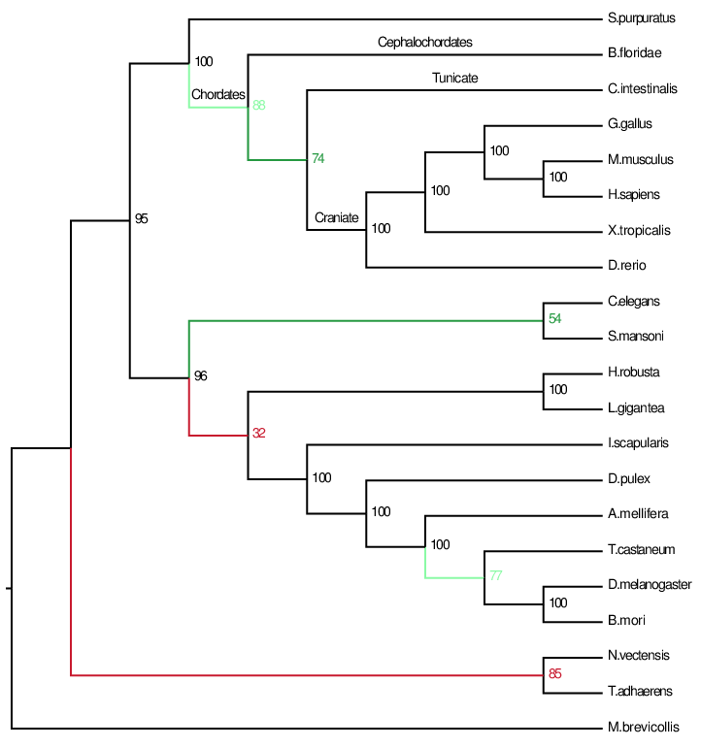
RAxML on combined
datamatrix
Binned MP-EST
MP-EST unbinned

Slide 100
Binned vs. unbinned analyses
75%-threshold for binning
Number of species: 21 for both
Number of “genes”
  Unbinned: 225 genes
  Binned:17 supergenes
Gene tree average bootstrap support
  Unbinned: 47%
  Binned: 78%
Species tree bootstrap support
  Unbinned: avg 83%, 11 above 75%, 10 above 90%
  Binned: avg 89%, 15 above 75%, 12 above 90%

Slide 101
Naïve binning vs. unbinned: 50 genes
Bayzid and Warnow, Bioinformatics 2013
11-taxon strongILS datasets with 50 genes, 5 genes per bin

Slide 102
Naïve binning vs. unbinned, 100 genes
*BEAST did not converge on these datasets, even with 150 hours.
With binning, it converged in 10 hours.

Slide 103
Naïve binning vs. unbinned: 50 genes
Bayzid and Warnow, Bioinformatics 2013
11-taxon strongILS datasets with 50 genes, 5 genes per bin

Slide 104
Avian Simulation study – binned vs. unbinned, and RAxML

Slide 105
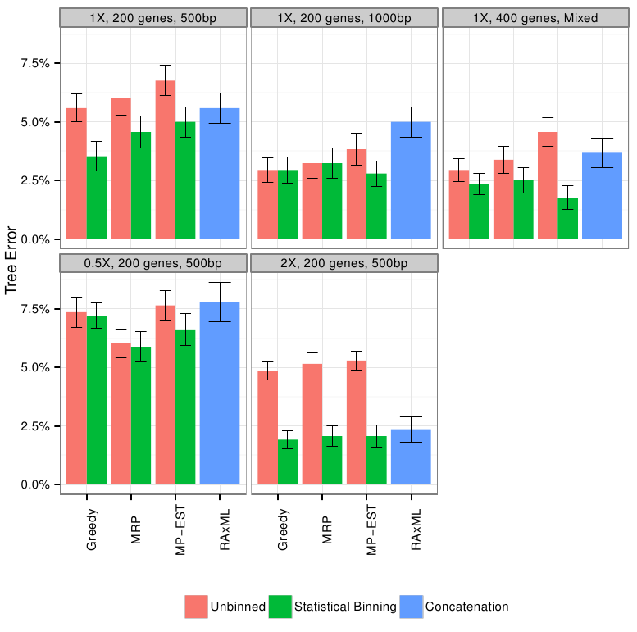
Mammals Simulation

Slide 106
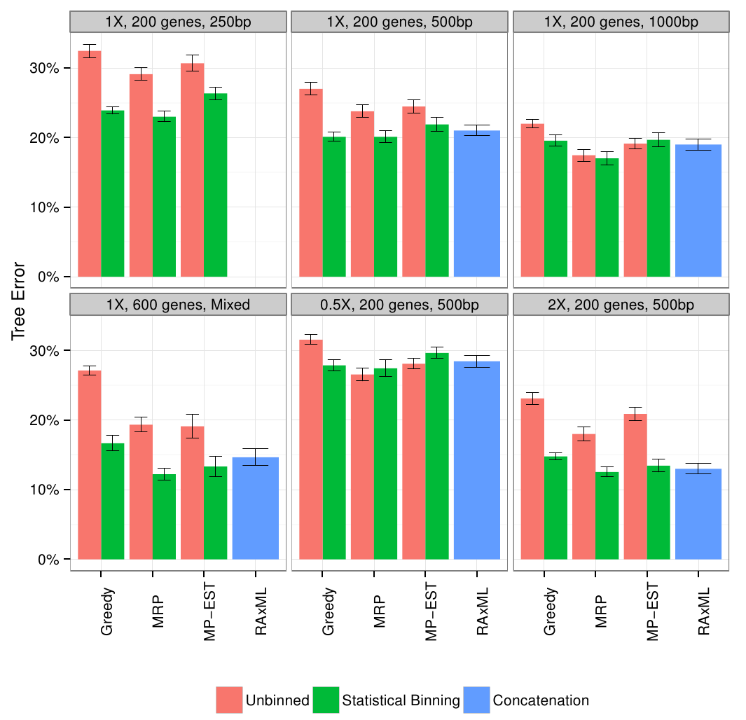
Avian Simulation

