Slide 1
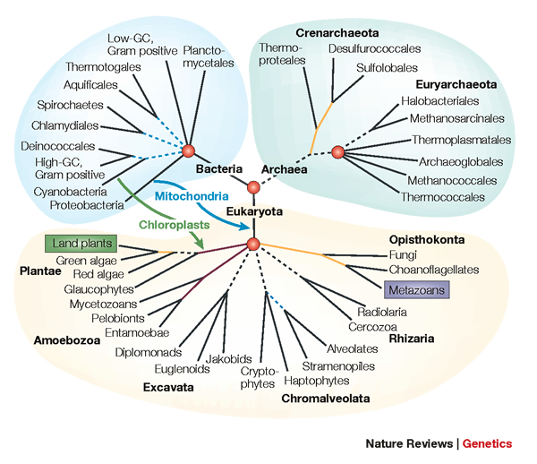
From Gene Trees to Species Trees
Tandy Warnow
The University of Texas at Austin

Slide 2




Phylogeny
(evolutionary tree)
Orangutan
Gorilla
Chimpanzee
Human
From the Tree of the Life Website,
University of Arizona

Slide 3
The “Tree of Life”

Slide 4
The Tree of Life: Importance to Biology
Biomedical applications
Mechanisms of evolution
Environmental influences
Drug Design
Protein structure and function
Human migrations
“Nothing in Biology makes sense except in the light of evolution” - Dobhzhansky

Slide 5
Estimating The Tree of Life: a Grand Challenge
Biomedical applications
Mechanisms of evolution
Environmental influences
Drug Design
Protein structure and function
Human migrations
Novel techniques needed for scalability and accuracy:
NP-hard problems and large datasets
Current methods do not provide good accuracy
HPC is insufficient

Slide 6
Estimating The Tree of Life: a Grand Challenge
Biomedical applications
Mechanisms of evolution
Environmental influences
Drug Design
Protein structure and function
Human migrations
Canonical problem:
Given multiple sequence alignment, find the
Maximum Likelihood Tree
NP-hard, and not solved exactly in practice
Good heuristics, but even these are computationally intensive

Slide 7
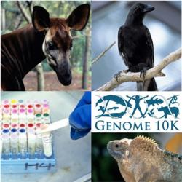
Phylogenomics
(Phylogenetic estimation from whole genomes)
Technique:
Sample multiple genes from multiple species
Produce multiple sequence alignment (MSA) and tree for each gene
Construct species tree from the set of MSAs or trees

Slide 8
Sampling multiple genes from multiple species
Orangutan
Gorilla
Chimpanzee
Human
From the Tree of the Life Website,
University of Arizona

Slide 9
Using multiple genes
gene 1
gene 3
S₁
TCTAATGGAA
S₂
GCTAAGGGAA
gene 2
S₁
TATTGATACA
S₃
TCTAAGGGAA
S₃
TCTTGATACC
S₄
TCTAACGGAA
S₄
GGTAACCCTC
S₄
TAGTGATGCA
S₇
TCTAATGGAC
S₅
GCTAAACCTC
S₇
TAGTGATGCA
S₈
TATAACGGAA
S₆
GGTGACCATC
S₈
CATTCATACC
S₇
GCTAAACCTC

Slide 10
Two competing approaches
gene 1 gene 2 . . . gene k
Species
. . .
Concatenation
Analyze
separately
. . .
Summary Method
Notes:
point out that supertree methods take overlaping trees and produce a tree, and that the whole process of first generating small trees and then applying a supertree method is often referred to as the “supertree approach”.

Slide 11








1kp: Thousand Transcriptome Project
G. Ka-Shu Wong
U Alberta
J. Leebens-Mack
U Georgia
N. Wickett
Northwestern
N. Matasci
iPlant
T. Warnow, S. Mirarab, N. Nguyen, Md. S.Bayzid
UT-Austin UT-Austin UT-Austin UT-Austin
Plus many many other people…
Plant Tree of Life based on transcriptomes of ~1200 species
More than 13,000 gene families (most not single copy)
Gene sequence alignments and trees computed using SATé (Liu et al., Science 2009 and Systematic Biology 2012)
Gene Tree Incongruence
Challenges:
Multiple sequence alignments of > 100,000 sequences
Gene tree incongruence

Slide 12



Avian Phylogenomics Project
Erich Jarvis,
HHMI
MTP Gilbert,
Copenhagen
G Zhang,
BGI
T. Warnow
UT-Austin
S. Mirarab Md. S. Bayzid, UT-Austin UT-Austin
Plus many many other people…
Approx. 50 species, whole genomes
8000+ genes, UCEs
Gene sequence alignments and trees computed using SATé (Liu et al., Science 2009 and Systematic Biology 2012)
Challenges:
Maximum likelihood on multi-million-site sequence alignments
Massive gene tree incongruence

Slide 13
The Tree of Life: Multiple Challenges
Large datasets:
100,000+ sequences
10,000+ genes
“BigData” complexity
Also:
Ultra-large multiple-sequence alignment
Estimating species trees from incongruent gene trees
Supertree estimation
Genome rearrangement phylogeny
Reticulate evolution
Visualization of large trees and alignments
Data mining techniques to explore multiple optima

Slide 14
The Tree of Life: Multiple Challenges
Large datasets:
100,000+ sequences
10,000+ genes
“BigData” complexity
SATé, Liu et al. Science 2009,
UPP and PASTA, in preparation
Also:
Ultra-large multiple-sequence alignment
Estimating species trees from incongruent gene trees
Supertree estimation
Genome rearrangement phylogeny
Reticulate evolution
Visualization of large trees and alignments
Data mining techniques to explore multiple optima

Slide 15
The Tree of Life: Multiple Challenges
Large datasets:
100,000+ sequences
10,000+ genes
“BigData” complexity
Superfine, Swenson
et al., 2012
Also
Ultra-large multiple-sequence alignment
Estimating species trees from incongruent gene trees
Supertree estimation
Genome rearrangement phylogeny
Reticulate evolution
Visualization of large trees and alignments
Data mining techniques to explore multiple optima

Slide 16
The Tree of Life: Multiple Challenges
Large datasets:
100,000+ sequences
10,000+ genes
“BigData” complexity
This talk
Also:
Ultra-large multiple-sequence alignment
Estimating species trees from incongruent gene trees
Supertree estimation
Genome rearrangement phylogeny
Reticulate evolution
Visualization of large trees and alignments
Data mining techniques to explore multiple optima

Slide 17
This talk
Species tree estimation from multiple genes
  Mathematical foundations
  Algorithms
  Data challenges
  New statistical questions
  Avian Phylogenomics

Slide 18
Computational Phylogenetics
Interesting combination of different mathematics:
  statistical estimation under Markov models of evolution
  mathematical modelling
  graph theory and combinatorics
  machine learning and data mining
  heuristics for NP-hard optimization problems
  high performance computing
Testing involves massive simulations

Slide 19
Part I: Gene Tree Estimation

Slide 20
DNA Sequence Evolution (Idealized)
AAGACTT
-3 mil yrs
AAGACTT
-2 mil yrs
AAGGCCT
AAGGCCT
AAGGCCT
AAGGCCT
TGGACTT
TGGACTT
TGGACTT
TGGACTT
-1 mil yrs
AGGGCAT
AGGGCAT
AGGGCAT
TAGCCCT
TAGCCCT
TAGCCCT
AGCACTT
AGCACTT
AGCACTT
AGGGCAT
TAGCCCA
TAGACTT
AGCACAA
AGCGCTT
today
AGGGCAT
TAGCCCA
TAGACTT
AGCACAA
AGCGCTT

Slide 21
Markov Model of Site Evolution
Simplest (Jukes-Cantor, 1969):
The model tree T is binary and has substitution probabilities p(e) on each edge e.
The state at the root is randomly drawn from {A,C,T,G} (nucleotides)
If a site (position) changes on an edge, it changes with equal probability to each of the remaining states.
The evolutionary process is Markovian.
More complex models (such as the General Markov model) are also considered, often with little change to the theory.

Slide 22
U
V
W
X
Y
AGGTCA
AGATTA
AGACTA
TGGACA
TGCGACT
X
U
Y
V
W

Slide 23
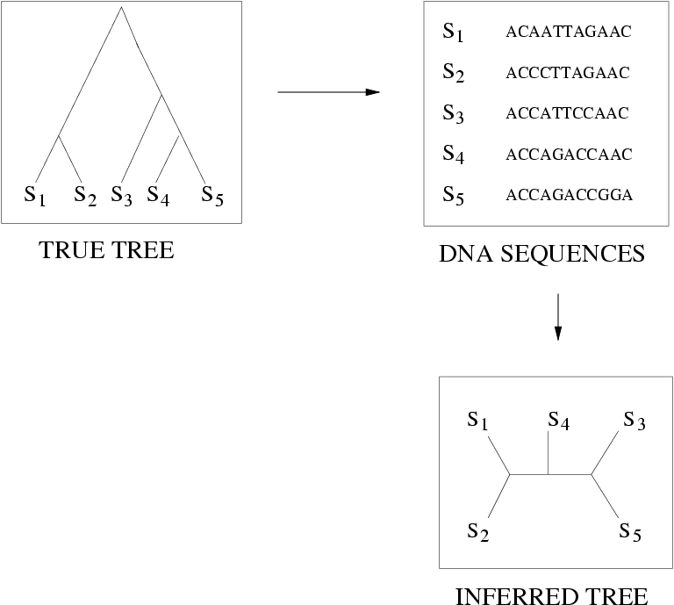
Quantifying Error
FN
FN: false negative
(missing edge)
FP: false positive
(incorrect edge)
FP
50% error rate

Slide 24
Questions
Is the model tree identifiable?
Which estimation methods are statistically consistent under this model?
How much data does the method need to estimate the model tree correctly (with high probability)?
What is the computational complexity of an estimation problem?

Slide 25
Statistical Consistency
error
Data

Slide 26
Statistical Consistency
error
Data
Data are sites in an alignment

Slide 27
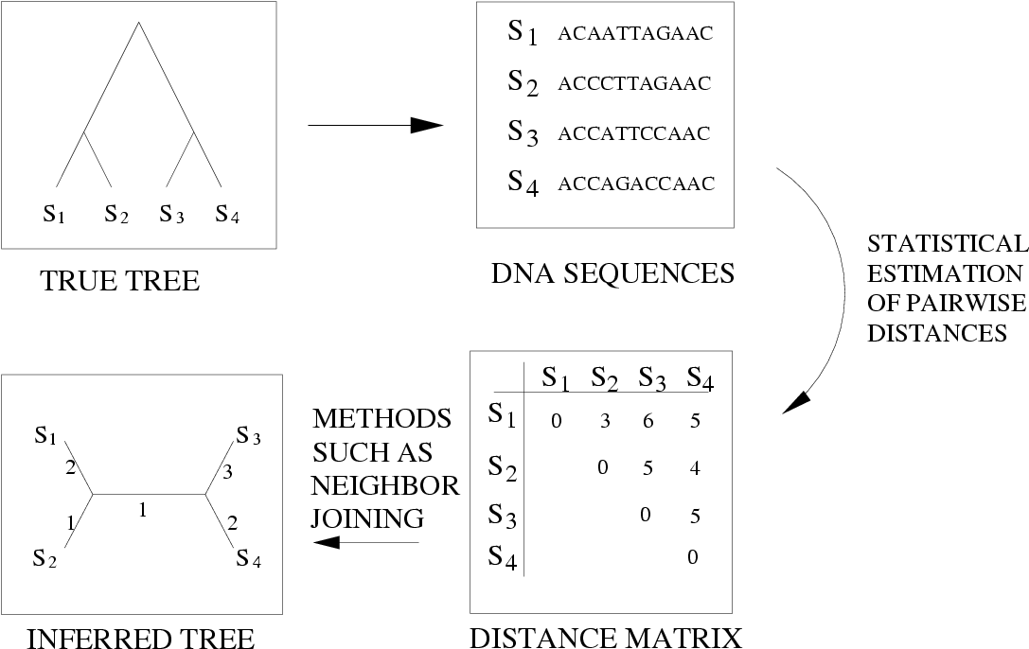
Distance-based estimation

Slide 28
Distance-based methods are statistically consistent under JC
error
Data

Slide 29
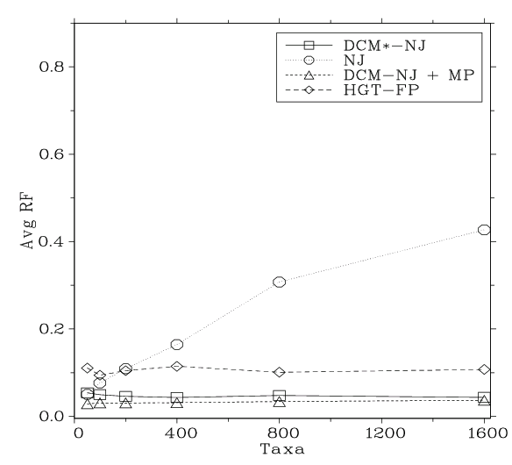
Neighbor Joining on large diameter trees
Simulation study based upon fixed edge lengths, K2P model of evolution, sequence lengths fixed to 1000 nucleotides.
Error rates reflect proportion of incorrect edges in inferred trees.
[Nakhleh et al. ISMB 2001]
0.8
NJ
0.6
Error Rate
0.4
0.2
0
0
400
800
1200
1600
No. Taxa

Slide 30
“Convergence rate” or sequence length requirement
The sequence length (number of sites) that a phylogeny reconstruction method M needs to reconstruct the true tree with probability at least 1-ε depends on
    M (the method)
    ε
    f = min p(e),
    g = max p(e), and
    n = the number of leaves
We fix everything but n.

Slide 31
Theorem (Erdos et al. 1999, Atteson 1999):
Various distance-based methods (including Neighbor joining) will return the true tree with high probability given sequence lengths that are exponential in the evolutionary diameter of the tree.
Proof: show that
the method returns the true tree if the estimated distance matrix is close to the model tree distance matrix
the sequence lengths that suffice to achieve bounded error are exponential in the evolutionary diameter.

Slide 32
Afc methods (Warnow et al., 1999)
A method M is “absolute fast converging”, or afc, if for all positive f, g, and ε, there is a polynomial p(n) s.t. Pr(M(S)=T) > 1- ε, when S is a set of sequences generated on T of length at least p(n).
Notes:
  1. The polynomial p(n) will depend upon M, f, g, and ε.
  2. The method M is not “told” the values of f and g.

Slide 33
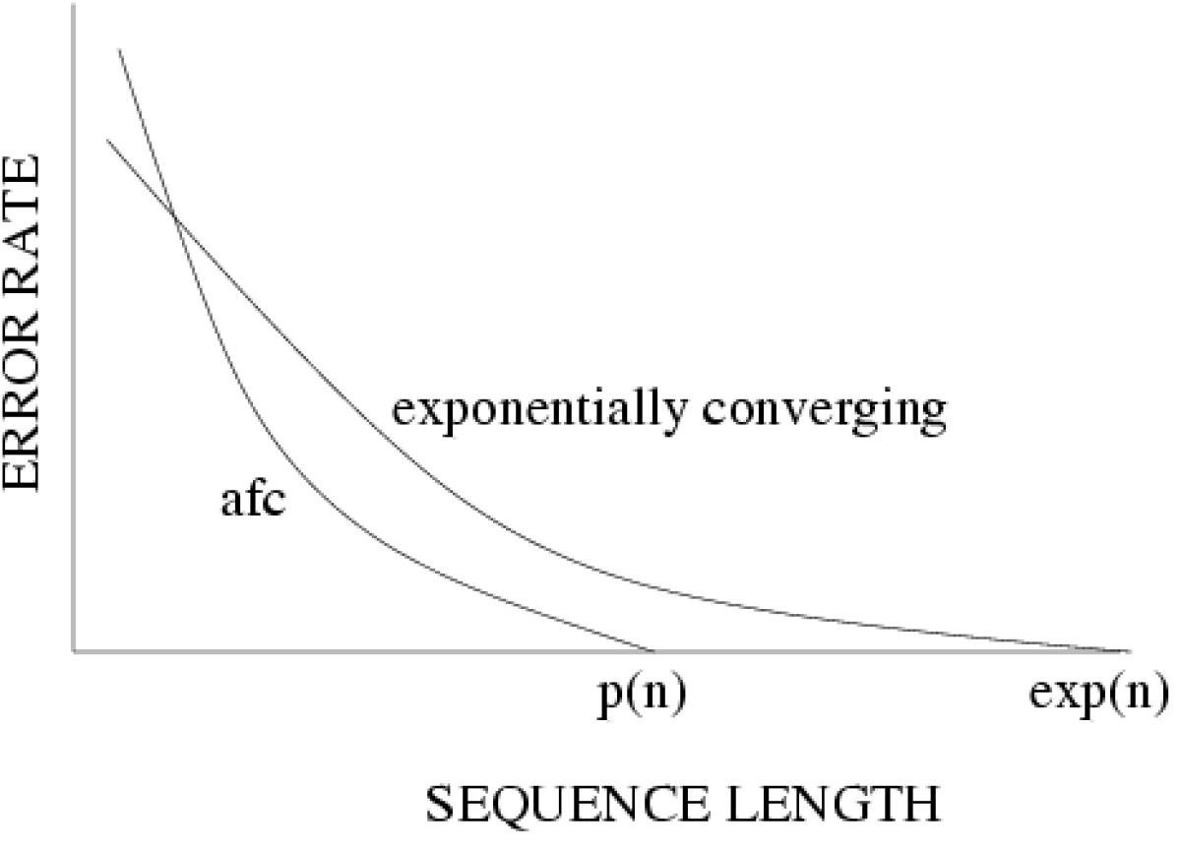
Statistical consistency, exponential convergence, and absolute fast convergence (afc)

Slide 34
Fast-converging methods (and related work)
1997: Erdos, Steel, Szekely, and Warnow (ICALP).
1999: Erdos, Steel, Szekely, and Warnow (RSA, TCS);
Huson, Nettles and Warnow (J. Comp Bio.)
2001: Warnow, St. John, and Moret (SODA);
Nakhleh, St. John, Roshan, Sun, and Warnow (ISMB)
Cryan, Goldberg, and Goldberg (SICOMP);
Csuros and Kao (SODA);
2002: Csuros (J. Comp. Bio.)
2006: Daskalakis, Mossel, Roch (STOC),
Daskalakis, Hill, Jaffe, Mihaescu, Mossel, and Rao (RECOMB)
2007: Mossel (IEEE TCBB)
2008: Gronau, Moran and Snir (SODA)
2010: Roch (Science)
2013: Roch (in preparation)

Slide 35
Neighbor Joining on large diameter trees
Simulation study based upon fixed edge lengths, K2P model of evolution, sequence lengths fixed to 1000 nucleotides.
Error rates reflect proportion of incorrect edges in inferred trees.
[Nakhleh et al. ISMB 2001]
0.8
NJ
0.6
Error Rate
0.4
0.2
0
0
400
800
1200
1600
No. Taxa

Slide 36
DCM1-boosting distance-based methods
[Nakhleh et al. ISMB 2001]
Theorem (Warnow et al., SODA 2001): DCM1-NJ converges to the true tree from polynomial length sequences. Hence DCM1-NJ is afc.
Algorithmic technique:
chordal graph theory
0.8
NJ
DCM1-NJ
0.6
Error Rate
0.4
0.2
0
0
400
800
1200
1600
No. Taxa

Slide 37
Questions
Is the model tree identifiable?
Which estimation methods are statistically consistent under this model?
How much data does the method need to estimate the model tree correctly (with high probability)?
What is the computational complexity of an estimation problem?

Slide 38
Answers?
We know a lot about which site evolution models are identifiable, and which methods are statistically consistent.
Some polynomial time afc methods have been developed, and we know a little bit about the sequence length requirements for standard methods.
Just about everything is NP-hard, and the datasets are big.
Extensive studies show that even the best methods produce gene trees with some error.

Slide 39
Answers?
We know a lot about which site evolution models are identifiable, and which methods are statistically consistent.
Some polynomial time afc methods have been developed, and we know a little bit about the sequence length requirements for standard methods.
Just about everything is NP-hard, and the datasets are big.
Extensive studies show that even the best methods produce gene trees with some error.

Slide 40
Answers?
We know a lot about which site evolution models are identifiable, and which methods are statistically consistent.
Some polynomial time afc methods have been developed, and we know a little bit about the sequence length requirements for standard methods.
Just about everything is NP-hard, and the datasets are big.
Extensive studies show that even the best methods produce gene trees with some error.

Slide 41
Answers?
We know a lot about which site evolution models are identifiable, and which methods are statistically consistent.
Some polynomial time afc methods have been developed, and we know a little bit about the sequence length requirements for standard methods.
Just about everything is NP-hard, and the datasets are big.
Extensive studies show that even the best methods produce gene trees with some error.

Slide 42
In other words…
error
Data
Statistical consistency doesn’t guarantee accuracy w.h.p. unless the sequences are long enough.

Slide 43
Phylogenomics
(Phylogenetic estimation from whole genomes)
Why do we need whole genomes?
Will whole genomes make phylogeny estimation easy?
How hard are the computational problems?
Do we have sufficient methods for this?

Slide 44
Part II: Species Tree Estimation from multiple genes

Slide 45
Using multiple genes
gene 1
gene 3
S₁
TCTAATGGAA
S₂
GCTAAGGGAA
gene 2
S₁
TATTGATACA
S₃
TCTAAGGGAA
S₃
TCTTGATACC
S₄
TCTAACGGAA
S₄
GGTAACCCTC
S₄
TAGTGATGCA
S₇
TCTAATGGAC
S₅
GCTAAACCTC
S₇
TAGTGATGCA
S₈
TATAACGGAA
S₆
GGTGACCATC
S₈
CATTCATACC
S₇
GCTAAACCTC

Slide 46
Concatenation
gene 1
gene 2
gene 3
S₁
TCTAATGGAA
? ? ? ? ? ? ? ? ? ?
TATTGATACA
S₂
GCTAAGGGAA
? ? ? ? ? ? ? ? ? ?
? ? ? ? ? ? ? ? ? ?
S₃
TCTAAGGGAA
TCTTGATACC
? ? ? ? ? ? ? ? ? ?
S₄
TCTAACGGAA
GGTAACCCTC
TAGTGATGCA
S₅
? ? ? ? ? ? ? ? ? ?
GCTAAACCTC
? ? ? ? ? ? ? ? ? ?
S₆
? ? ? ? ? ? ? ? ? ?
GGTGACCATC
? ? ? ? ? ? ? ? ? ?
S₇
TCTAATGGAC
GCTAAACCTC
TAGTGATGCA
S₈
TATAACGGAA
? ? ? ? ? ? ? ? ? ?
CATTCATACC

Slide 47
Concatenation
Challenges:
The most accurate tree estimation methods are heuristics for NP-hard problems (e.g., maximum likelihood).
The tree estimation can be computationally intensive if the concatenated alignment is very large (i.e., has many sequences or many sites).
Concatenation may not be statistically consistent if the genes evolve differently from the species!

Slide 48
Concatenation
Challenges:
The most accurate tree estimation methods are heuristics for NP-hard problems (e.g., maximum likelihood).
The tree estimation can be computationally intensive if the concatenated alignment is very large (i.e., has many sequences or many sites).
Concatenation may not be statistically consistent if the genes evolve differently from the species!

Slide 49
Concatenation
Challenges:
The most accurate tree estimation methods are heuristics for NP-hard problems (e.g., maximum likelihood).
The tree estimation can be computationally intensive if the concatenated alignment is very large (i.e., has many sequences or many sites).
Concatenation may not be statistically consistent if the genes evolve differently from the species!

Slide 50
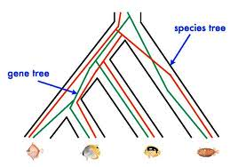
Red gene tree ≠ species tree
(green gene tree okay)

Slide 51
1KP: Thousand Transcriptome Project
Gene Tree Incongruence
G. Ka-Shu Wong
U Alberta
J. Leebens-Mack
U Georgia
N. Wickett
Northwestern
N. Matasci
iPlant
T. Warnow, S. Mirarab, N. Nguyen, Md. S.Bayzid
UT-Austin UT-Austin UT-Austin UT-Austin
1200 plant transcriptomes
More than 13,000 gene families (most not single copy)
Multi-institutional project (10+ universities)
iPLANT (NSF-funded cooperative)
Gene sequence alignments and trees computed using SATe (Liu et al., Science 2009 and Systematic Biology 2012)

Slide 52
Avian Phylogenomics Project
E Jarvis,
HHMI
MTP Gilbert,
Copenhagen
G Zhang,
BGI
T. Warnow
UT-Austin
S. Mirarab Md. S. Bayzid, UT-Austin UT-Austin
Gene Tree Incongruence
Plus many many other people…
Approx. 50 species, whole genomes
8000+ genes, UCEs
Gene sequence alignments computed using SATé (Liu et al., Science 2009 and Systematic Biology 2012)

Slide 53
Part III: Species Tree Estimation
Objective: species tree estimation from multiple incongruent gene trees
Evaluation:
  Theoretical guarantees
  Performance on simulated data
  Impact on biological data analysis

Slide 54
Gene Tree Incongruence
Gene trees can differ from the species tree due to:
  Duplication and loss
  Horizontal gene transfer
  Incomplete lineage sorting

Slide 55
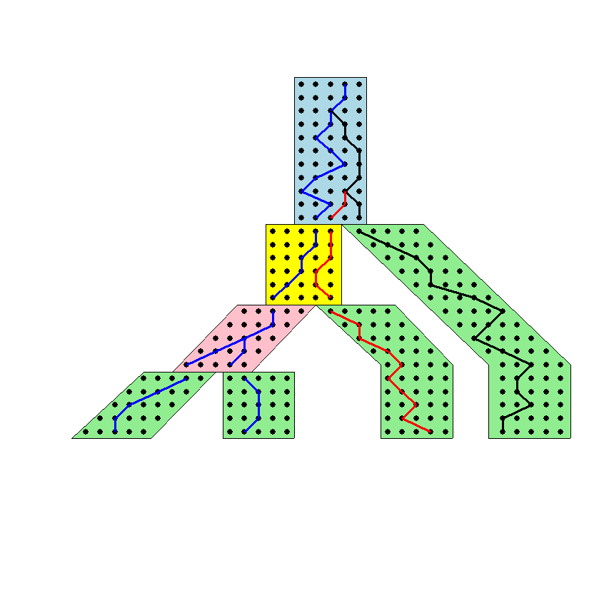




The Coalescent
Courtesy James Degnan
Past
Present

Slide 56
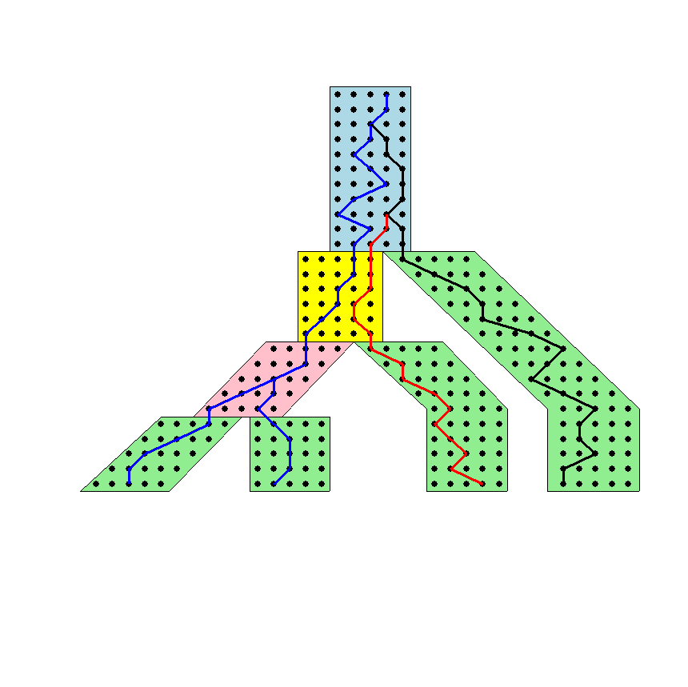
Gene tree in a species tree
Courtesy James Degnan

Slide 57
Lineage Sorting
Population-level process, also called the “Multi-species coalescent” (Kingman, 1982)
Gene trees can differ from species trees due to short times between speciation events or large population size; this is called “Incomplete Lineage Sorting” or “Deep Coalescence”.
Causes difficulty in estimating many species trees (such as human-chimp-gorilla)

Slide 58
Species tree estimation: difficult, even for small datasets!
Orangutan
Gorilla
Chimpanzee
Human
From the Tree of the Life Website,
University of Arizona

Slide 59
Incomplete Lineage Sorting (ILS)
2000+ papers in 2013 alone
Confounds phylogenetic analysis for many groups:
  Hominids
  Birds
  Yeast
  Animals
  Toads
  Fish
  Fungi
There is substantial debate about how to analyze phylogenomic datasets in the presence of ILS.

Slide 60
Key observation:
Under the multi-species coalescent model, the species tree defines a probability distribution on the gene trees
Courtesy James Degnan

Slide 61
Two competing approaches
gene 1 gene 2 . . . gene k
Species
. . .
Concatenation
Analyze
separately
. . .
Summary Method
Notes:
point out that supertree methods take overlaping trees and produce a tree, and that the whole process of first generating small trees and then applying a supertree method is often referred to as the “supertree approach”.

Slide 62
How to compute a species tree?
. . .
Notes:
point out that supertree methods take overlaping trees and produce a tree, and that the whole process of first generating small trees and then applying a supertree method is often referred to as the “supertree approach”.

Slide 63
How to compute a species tree?
. . .
Notes:
point out that supertree methods take overlaping trees and produce a tree, and that the whole process of first generating small trees and then applying a supertree method is often referred to as the “supertree approach”.

Slide 64
How to compute a species tree?
. . .
Techniques:
Most frequent gene tree?
Consensus of gene trees?
Other?
Notes:
point out that supertree methods take overlaping trees and produce a tree, and that the whole process of first generating small trees and then applying a supertree method is often referred to as the “supertree approach”.

Slide 65
Under the multi-species coalescent model, the species tree defines a probability distribution on the gene trees
Courtesy James Degnan
Theorem (Degnan et al., 2006, 2009): Under the multi-species coalescent model, for any three taxa A, B, and C, the most probable rooted gene tree on {A,B,C} is identical to the rooted species tree induced on {A,B,C}.

Slide 66
How to compute a species tree?
. . .
Theorem (Degnan et al., 2006, 2009): Under the multi-species coalescent model, for any three taxa A, B, and C, the most probable rooted gene tree on {A,B,C} is identical to the rooted species tree induced on {A,B,C}.
Notes:
point out that supertree methods take overlaping trees and produce a tree, and that the whole process of first generating small trees and then applying a supertree method is often referred to as the “supertree approach”.

Slide 67
How to compute a species tree?
. . .
. . .
Estimate species
tree for every
3 species
Theorem (Degnan et al., 2006, 2009): Under the multi-species coalescent model, for any three taxa A, B, and C, the most probable rooted gene tree on {A,B,C} is identical to the rooted species tree induced on {A,B,C}.
Notes:
point out that supertree methods take overlaping trees and produce a tree, and that the whole process of first generating small trees and then applying a supertree method is often referred to as the “supertree approach”.

Slide 68
How to compute a species tree?
. . .
. . .
Estimate species
tree for every
3 species
Theorem (Aho et al.): The rooted tree on n species can be computed from its set of 3-taxon rooted subtrees in polynomial time.
Notes:
point out that supertree methods take overlaping trees and produce a tree, and that the whole process of first generating small trees and then applying a supertree method is often referred to as the “supertree approach”.

Slide 69
How to compute a species tree?
. . .
. . .
Estimate species
tree for every
3 species
Combine
rooted
3-taxon
trees
Theorem (Aho et al.): The rooted tree on n species can be computed from its set of 3-taxon rooted subtrees in polynomial time.
Notes:
point out that supertree methods take overlaping trees and produce a tree, and that the whole process of first generating small trees and then applying a supertree method is often referred to as the “supertree approach”.

Slide 70
How to compute a species tree?
. . .
. . .
Estimate species
tree for every
3 species
Combine
rooted
3-taxon
trees
Theorem (Degnan et al., 2009): Under the multi-species coalescent, the rooted species tree can be estimated correctly (with high probability) given a large enough number of true rooted gene trees.
Theorem (Allman et al., 2011): the unrooted species tree can be estimated from a large enough number of true unrooted gene trees.
Notes:
point out that supertree methods take overlaping trees and produce a tree, and that the whole process of first generating small trees and then applying a supertree method is often referred to as the “supertree approach”.

Slide 71
How to compute a species tree?
. . .
. . .
Estimate species
tree for every
3 species
Combine
rooted
3-taxon
trees
Theorem (Degnan et al., 2009): Under the multi-species coalescent, the rooted species tree can be estimated correctly (with high probability) given a large enough number of true rooted gene trees.
Theorem (Allman et al., 2011): the unrooted species tree can be estimated from a large enough number of true unrooted gene trees.
Notes:
point out that supertree methods take overlaping trees and produce a tree, and that the whole process of first generating small trees and then applying a supertree method is often referred to as the “supertree approach”.

Slide 72
How to compute a species tree?
. . .
. . .
Estimate species
tree for every
3 species
Combine
rooted
3-taxon
trees
Theorem (Degnan et al., 2009): Under the multi-species coalescent, the rooted species tree can be estimated correctly (with high probability) given a large enough number of true rooted gene trees.
Theorem (Allman et al., 2011): the unrooted species tree can be estimated from a large enough number of true unrooted gene trees.
Notes:
point out that supertree methods take overlaping trees and produce a tree, and that the whole process of first generating small trees and then applying a supertree method is often referred to as the “supertree approach”.

Slide 73
Statistical Consistency
error
Data
Data are gene trees, presumed to be randomly sampled true gene trees.

Slide 74
Summary methods that are statistically consistent under ILS
Input: Set of estimated gene trees, one (or more) for each gene
Output: estimated species tree
  MP-EST (Liu et al. 2010): maximum likelihood estimation of rooted species tree
  BUCKy-pop (Ané and Larget 2010): quartet-based Bayesian species tree estimation

Slide 75
Impact of Gene Tree Estimation Error on MP-EST
MP-EST has no error on true gene trees, but
MP-EST has 9% error on estimated gene trees
Datasets: 11-taxon strongILS conditions with 50 genes
Similar results for other summary methods (MDC, Greedy, etc.).

Slide 76
Problem: poor gene trees
Summary methods combine estimated gene trees, not true gene trees.
The individual gene sequence alignments in the 11-taxon datasets have poor phylogenetic signal, and result in poorly estimated gene trees.
Species trees obtained by combining poorly estimated gene trees have poor accuracy.

Slide 77
Problem: poor gene trees
Summary methods combine estimated gene trees, not true gene trees.
The individual gene sequence alignments in the 11-taxon datasets have poor phylogenetic signal, and result in poorly estimated gene trees.
Species trees obtained by combining poorly estimated gene trees have poor accuracy.

Slide 78
Problem: poor gene trees
Summary methods combine estimated gene trees, not true gene trees.
The individual gene sequence alignments in the 11-taxon datasets have poor phylogenetic signal, and result in poorly estimated gene trees.
Species trees obtained by combining poorly estimated gene trees have poor accuracy.

Slide 79
TYPICAL PHYLOGENOMICS PROBLEM: many poor gene trees
Summary methods combine estimated gene trees, not true gene trees.
The individual gene sequence alignments in the 11-taxon datasets have poor phylogenetic signal, and result in poorly estimated gene trees.
Species trees obtained by combining poorly estimated gene trees have poor accuracy.

Slide 80
Statistical Consistency
error
Data
Data are gene trees, presumed to be randomly sampled true gene trees.

Slide 81
Questions
Is the model species tree identifiable?
Which estimation methods are statistically consistent under this model?
How much data does the method need to estimate the model species tree correctly (with high probability)?
What is the computational complexity of an estimation problem?
What is the impact of error in the input data on the estimation of the model species tree?

Slide 82
Questions
Is the model species tree identifiable?
Which estimation methods are statistically consistent under this model?
How much data does the method need to estimate the model species tree correctly (with high probability)?
What is the computational complexity of an estimation problem?
What is the impact of error in the input data on the estimation of the model species tree?

Slide 83
Addressing gene tree estimation error
Get better estimates of the gene trees
Restrict to subset of estimated gene trees
Model error in the estimated gene trees
Modify gene trees to reduce error
“Bin-and-conquer”

Slide 84
Addressing gene tree estimation error
Get better estimates of the gene trees
Restrict to subset of estimated gene trees
Model error in the estimated gene trees
Modify gene trees to reduce error
“Bin-and-conquer”

Slide 85
Technique #1: Modify gene trees
Idea: Use statistical technique to identify unreliable aspects of the tree, and modify tree, to produce “constraint tree”.
Example: ignore root, collapse edges in the tree with poor statistical support, remove “rogue taxa”.
Note: need to modify the optimization problems and algorithms.

Slide 86
MDC Problem
MDC (minimize deep coalescence) problem:
  given set of true gene trees, find the species tree that implies the fewest deep coalescence events
Posed by Wayne Maddison, Syst Biol 1997
NP-hard
Than and Nakhleh (PLoS Comp Biol 2009) gave Dynamic Programming algorithm for MDC on binary, rooted gene trees on same set of taxa

Slide 87
MDC*: Extending MDC
Input: Set X of k unrooted, not necessarily binary, not necessarily complete gene trees on taxon set S (and optionally a set C of bipartitions on the taxon set).
Output: Species tree T with Bipartitions(T) drawn from C, and set X* = {t*: t in X}, where each t* is a rooted refinement of t, so as to optimize MDC(X*,T).
Thus, each tree t in X is a constraint on the gene tree t*, and C is a constraint on the species tree T. If C is not provided, then C = {all bipartitions on S}.

Slide 88
MDC*: Extending MDC
Input: Set X of k unrooted, not necessarily binary, not necessarily complete gene trees on taxon set S (and optionally a set C of bipartitions on the taxon set).
Output: Species tree T with Bipartitions(T) drawn from C, and set X* = {t*: t in X}, where each t* is a rooted refinement of t, so as to optimize MDC(X*,T).
Thus, each tree t in X is a constraint on the gene tree t*, and C is a constraint on the species tree T. If C is not provided, then C = {all bipartitions on S}.

Slide 89
Solving MDC*
Theorem (Yu, Warnow, and Nakhleh, 2011): The optimal solution to constrained MDC* can be found in O(|C|²nk) time, where |S|=n and k is the number of gene trees. Hence the optimal solution to MDC* can be found in O(2^{2n}nk).
Bayzid and Warnow J Comp Biol 2012 proves that the YWN 2011 DP algorithm correctly handles incomplete gene trees.
MDC* implemented in Phylonet package (Nakhleh et al.).
Default heuristic uses C = {bipartitions in input gene trees}, and is polynomial in n and k.

Slide 90
MDC vs. MDC*:
Impact of collapsing low support branches
11-taxon datasets with strongILS, 50 gene trees estimated using maximum likelihood.
Phylo-exact solves MDC* optimally, with contracted gene trees are based on 75% bootstrap support threshold.
Similar improvements shown for some other methods.

Slide 91
Technique #2: Bin-and-Conquer?
Assign genes to “bins”
Estimate trees on each supergene alignment using ML
Combine the supergene trees together using a summary method
or
Run *BEAST on the new supergene alignments.
Variants:
Naïve binning (Bayzid and Warnow, Bioinformatics 2013)
Statistical binning (Mirarab, Bayzid, and Warnow, in preparation)

Slide 92
Statistical binning
Given: estimated gene trees with bootstrap support, and minimum support threshold t
Output: partition of the estimated gene trees into sets, so that no two gene trees in the same set are strongly incompatible.
Step 1: For each pair of gene trees, determine if there is a pair of edges, one in each tree, that have bootstrap support at least t and are incompatible. Call such a pair of gene trees t-incompatible.
Step 2: Compute graph, with one vertex for each estimated gene tree, and edges between t-incompatible gene trees.
Step 3: Find a balanced minimum vertex-coloring of the graph (NP-hard problem, so we use a heuristic).
Mirarab, Bayzid, and Warnow (in preparation)

Slide 93
Impact of statistical binning on MDC
Mirarab, Bayzid, and Warnow, in preparation
11-taxon strongILS datasets with 50 genes,
Chung and Ane Systematic Biology

Slide 94
Statistical binning vs. unbinned: other methods
Mirarab, Bayzid, and Warnow, in preparation
11-taxon strongILS datasets with 50 genes, Chung and Ane Systematic Biology

Slide 95
Avian Phylogenomics Project
E Jarvis,
HHMI
MTP Gilbert,
Copenhagen
G Zhang,
BGI
T. Warnow
UT-Austin
S. Mirarab Md. S. Bayzid, UT-Austin UT-Austin
Gene Tree Incongruence
Plus many many other people…
Strong evidence for substantial ILS, suggesting need for
coalescent-based species tree estimation.
But MP-EST on full set of 14,000 gene trees was considered
unreliable, due to poorly estimated exon trees (very low phylogenetic
signal in exon sequence alignments).

Slide 96
Avian Phylogeny
RAxML analysis of 37 million bp alignment (exons, introns, UCEs) – highly resolved tree with near 100% bootstrap support.
Extremely computationally intensive! More than 6000 days (150,000 hours) of compute time, and 256 GB. Run at HPC centers.
Statistical binning version of MP-EST on 14000+ gene trees – highly resolved tree, slightly lower bootstrap support.
Largely congruent with the concatenated analysis.
Very fast to compute (after the gene trees are computed).

Slide 97
To consider
Binning reduces the amount of data (number of gene trees) but can improve the accuracy of individual “supergene trees”. The response to binning differs between methods. Thus, there is a trade-off between data quantity and quality, and not all methods respond the same to the trade-off.
We know very little about the impact of data error on methods. We do not even have proofs of statistical consistency in the presence of data error.

Slide 98
Basic Questions
Is the model tree identifiable?
Which estimation methods are statistically consistent under this model?
How much data does the method need to estimate the model tree correctly (with high probability)?
What is the computational complexity of an estimation problem?

Slide 99
Additional Statistical Questions
Trade-off between data quality and quantity
Impact of data selection
Impact of data error
Performance guarantees on finite data (e.g., prediction of error rates as a function of the input data and method)
We need a solid mathematical framework for these problems.

Slide 100
Summary
DCM1-NJ: an absolute fast converging (afc) method, uses chordal graph theory and probabilistic analysis of algorithms to prove performance guarantees
MDC*: species tree estimation from multiple gene trees, uses graph theory to prove performance guarantee
Binning: species tree estimation from multiple genes, suggests new questions in statistical estimation

Slide 101
Other Research in my lab
Method development for
Supertree estimation
Multiple sequence alignment
Metagenomic taxon identification
Genome rearrangement phylogeny
Historical Linguistics
Techniques:
Statistical estimation under Markov models of evolution
Graph theory and combinatorics
Machine learning and data mining
Heuristics for NP-hard optimization problems
High performance computing
Massive simulations

Slide 102

Warnow Laboratory
PhD students: Siavash Mirarab*, Nam Nguyen, and Md. S. Bayzid**
Undergrad: Keerthana Kumar
Lab Website: http://www.cs.utexas.edu/users/phylo
Funding: Guggenheim Foundation, Packard, NSF, Microsoft Research New England, David Bruton Jr. Centennial Professorship, and TACC (Texas Advanced Computing Center)
TACC and UTCS computational resources
* Supported by HHMI Predoctoral Fellowship
** Supported by Fulbright Foundation Predoctoral Fellowship

Slide 103
Results on 11-taxon datasets with weak ILS
*BEAST more accurate than summary methods (MP-EST, BUCKy, etc)
CA-ML: concatenated analysis) most accurate
Datasets from Chung and Ané, 2011
Bayzid & Warnow, Bioinformatics 2013

Slide 104
Impact of binning on MP-EST
Binning improves MP-EST, and statistical binning can be better than naive
11-taxon strong ILS datasets, 50 genes
Statistical binning based on two different thresholds for “combinability”

Slide 105
*BEAST better than Maximum Likelihood
11-taxon weakILS datasets
17-taxon (very high ILS) datasets
*BEAST produces more accurate gene trees than ML on gene sequence alignments
11-taxon datasets from Chung and Ané, Syst Biol 2012
17-taxon datasets from Yu, Warnow, and Nakhleh, JCB 2011

Slide 106
Statistically consistent methods
Input: Set of estimated gene trees or alignments, one (or more) for each gene
Output: estimated species tree
  *BEAST (Heled and Drummond 2010): Bayesian co-estimation of gene trees and species trees given sequence alignments
  MP-EST (Liu et al. 2010): maximum likelihood estimation of rooted species tree
  BUCKy-pop (Ané and Larget 2010): quartet-based Bayesian species tree estimation

Slide 107
Naïve binning vs. unbinned: 50 genes
Bayzid and Warnow, Bioinformatics 2013
11-taxon strongILS datasets with 50 genes, 5 genes per bin

Slide 108
Naïve binning vs. unbinned, 100 genes
*BEAST did not converge on these datasets, even with 150 hours.
With binning, it converged in 10 hours.

Slide 109
Naïve binning vs. unbinned: 50 genes
Bayzid and Warnow, Bioinformatics 2013
11-taxon strongILS datasets with 50 genes, 5 genes per bin

