Slide 1
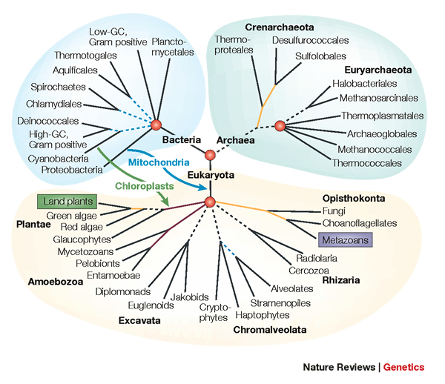
Supertrees and the Tree of Life
Tandy Warnow
The University of Texas at Austin

Slide 2




Phylogeny (evolutionary tree)
Orangutan
Gorilla
Chimpanzee
Human
From the Tree of the Life Website, University of Arizona

Slide 3
Applications of Phylogeny Estimation to Biology
Biomedical applications
Mechanisms of evolution
Environmental influences
Drug Design
Protein structure and function
Human migrations
“Nothing in Biology makes sense except in the light of evolution” - Dobhzhansky

Slide 4
DNA Sequence Evolution (Idealized)
AAGACTT
-3 mil yrs
AAGACTT
-2 mil yrs
AAGGCCT
AAGGCCT
AAGGCCT
AAGGCCT
TGGACTT
TGGACTT
TGGACTT
TGGACTT
-1 mil yrs
AGGGCAT
AGGGCAT
AGGGCAT
TAGCCCT
TAGCCCT
TAGCCCT
AGCACTT
AGCACTT
AGCACTT
AGGGCAT
TAGCCCA
TAGACTT
AGCACAA
AGCGCTT
today
AGGGCAT
TAGCCCA
TAGACTT
AGCACAA
AGCGCTT

Slide 5
U
V
W
X
Y
AGGTCA
AGATTA
AGACTA
TGGACA
TGCGACT
X
U
Y
V
W

Slide 6
Markov Model of Site Evolution
Simplest (Jukes-Cantor, 1969):
The model tree T is binary and has substitution probabilities p(e) on each edge e.
The state at the root is randomly drawn from {A,C,T,G} (nucleotides)
If a site (position) changes on an edge, it changes with equal probability to each of the remaining states.
The evolutionary process is Markovian.
More complex models (such as the General Markov model) are also considered, often with little change to the theory.
Maximum Likelihood is the standard technique used for
large-scale phylogenetic estimation - but it is NP-hard.

Slide 7
Estimating The Tree of Life: a Grand Challenge
Most well studied problem:
Given DNA sequences, find the Maximum Likelihood Tree
NP-hard, lots of heuristics (RAxML, FastTree-2, GARLI, etc.)

Slide 8
The “real” problem
U
V
W
X
Y
AGGGCATGA
AGAT
TAGACTT
TGCACAA
TGCGCTT
X
U
Y
V
W

Slide 9
Indels (insertions and deletions)
Deletion
Mutation
…ACGGTGCAGTTACCA…
…ACCAGTCACCA…
Notes:
9

Slide 10
Deletion
Substitution
…ACGGTGCAGTTACCA…
Insertion
…ACGGTGCAGTTACC-A…
…AC----CAGTCACCTA…
…ACCAGTCACCTA…
The true multiple alignment
Reflects historical substitution, insertion, and deletion events
Defined using transitive closure of pairwise alignments computed on edges of the true tree
Notes:
10
Homology = nucleotides lined up since they come from a common ancestor.
Indel = dash.

Slide 11
Input: unaligned sequences
S1 = AGGCTATCACCTGACCTCCA
S2 = TAGCTATCACGACCGC
S3 = TAGCTGACCGC
S4 = TCACGACCGACA

Slide 12
Phase 1: Alignment
S1 = AGGCTATCACCTGACCTCCA
S2 = TAGCTATCACGACCGC
S3 = TAGCTGACCGC
S4 = TCACGACCGACA
S1 = -AGGCTATCACCTGACCTCCA
S2 = TAG-CTATCAC--GACCGC--
S3 = TAG-CT-------GACCGC--
S4 = -------TCAC--GACCGACA

Slide 13
Phase 2: Construct tree
S1 = AGGCTATCACCTGACCTCCA
S2 = TAGCTATCACGACCGC
S3 = TAGCTGACCGC
S4 = TCACGACCGACA
S1 = -AGGCTATCACCTGACCTCCA
S2 = TAG-CTATCAC--GACCGC--
S3 = TAG-CT-------GACCGC--
S4 = -------TCAC--GACCGACA
S1
S2
S4
S3

Slide 14
Multiple Sequence Alignment (MSA): another grand challenge¹
S1 = AGGCTATCACCTGACCTCCA
S2 = TAGCTATCACGACCGC
S3 = TAGCTGACCGC
…
Sn = TCACGACCGACA
S1 = -AGGCTATCACCTGACCTCCA
S2 = TAG-CTATCAC--GACCGC--
S3 = TAG-CT-------GACCGC--
…
Sn = -------TCAC--GACCGACA
Novel techniques needed for scalability and accuracy
NP-hard problems and large datasets
Current methods do not provide good accuracy
Few methods can analyze even moderately large datasets
Many important applications besides phylogenetic estimation
¹ Frontiers in Massive Data Analysis, National Academies Press, 2013

Slide 15
Phylogenetic Estimation: Multiple Challenges
Large datasets:
100,000+ sequences
10,000+ genes
“BigData” complexity
Gene tree estimation
Ultra-large multiple-sequence alignment
Supertree estimation
Estimating species trees from incongruent gene trees
Genome rearrangement phylogeny
Phylogenetic networks
Visualization of large trees and alignments
Data mining techniques to explore multiple optima

Slide 16
Phylogenetic Estimation: Multiple Challenges
Large datasets:
100,000+ sequences
10,000+ genes
“BigData” complexity
Gene tree estimation
Ultra-large multiple-sequence alignment
Supertree estimation
Estimating species trees from incongruent gene trees
Genome rearrangement phylogeny
Phylogenetic networks
Visualization of large trees and alignments
Data mining techniques to explore multiple optima
Last month’s talk

Slide 17
Phylogenetic Estimation: Multiple Challenges
Large datasets:
100,000+ sequences
10,000+ genes
“BigData” complexity
Gene tree estimation
Ultra-large multiple-sequence alignment
Supertree estimation
Estimating species trees from incongruent gene trees
Genome rearrangement phylogeny
Phylogenetic networks
Visualization of large trees and alignments
Data mining techniques to explore multiple optima
Today’s talk

Slide 18
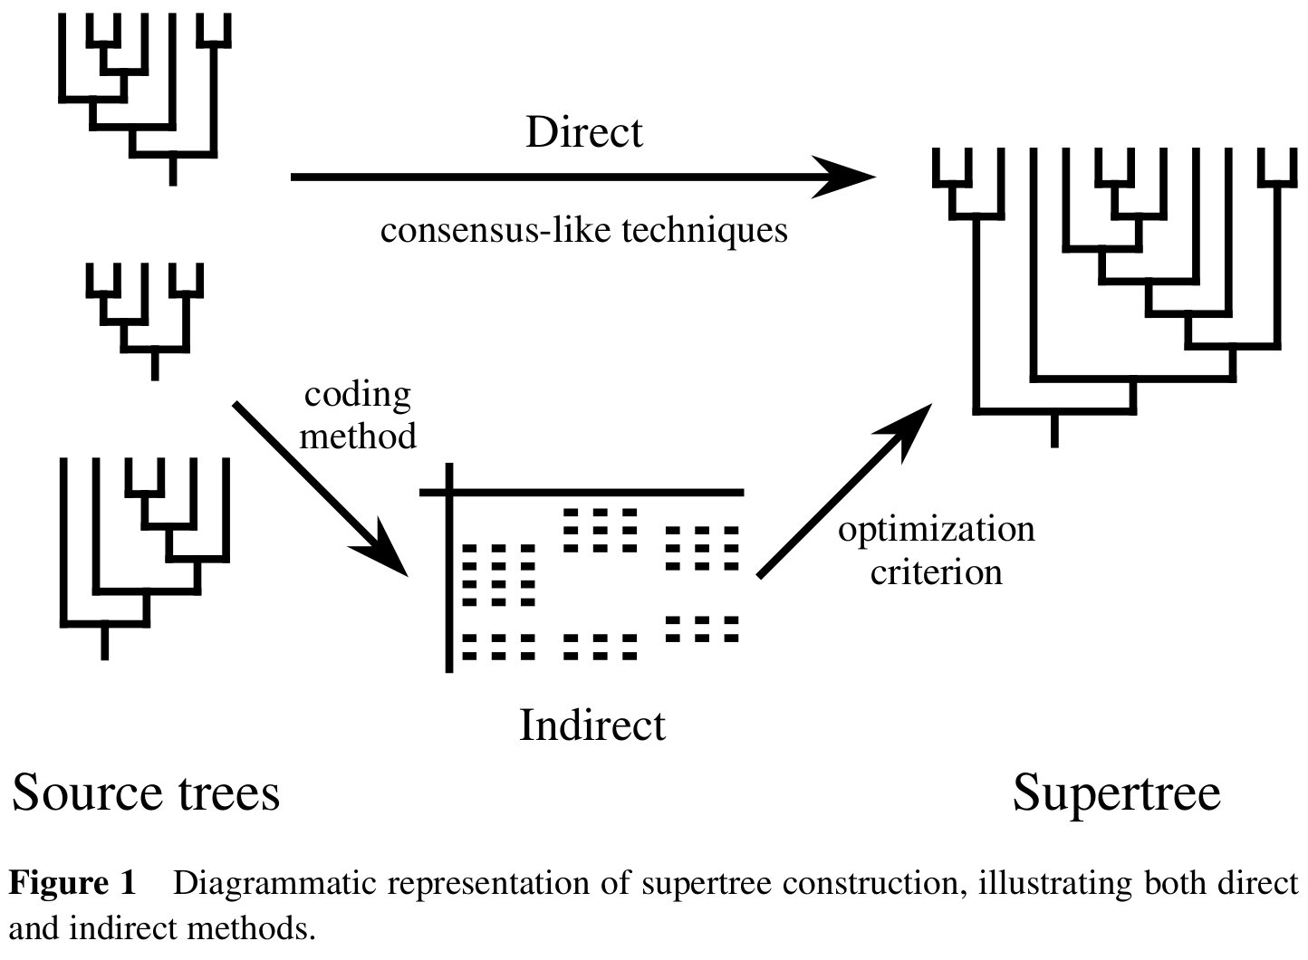
Supertree Approaches
From Bininda-Emonds, Gittleman, and Steel,
Ann. Rev Ecol Syst, 2002

Slide 19
Supertree Methods
Necessary for Estimating the Tree of Life? (Ultra large-scale estimation of alignments and trees may be too difficult to do well.)
Main use: combine trees estimated on smaller subsets of species.
However, supertree methods can also be used within divide-and-conquer algorithms!

Slide 20
Supertree Methods
Necessary for Estimating the Tree of Life? (Ultra large-scale estimation of alignments and trees may be too difficult to do well.)
Main use: combine trees estimated on smaller subsets of species.
However, supertree methods can also be used within divide-and-conquer algorithms!

Slide 21
Supertree Methods
Necessary for Estimating the Tree of Life? (Ultra large-scale estimation of alignments and trees may be too difficult to do well.)
Main use: combine trees estimated on smaller subsets of species.
However, supertree methods can also be used within divide-and-conquer algorithms!

Slide 22
This talk
The Strict Consensus Merger (SCM)
SuperFine (meta-method for supertree methods)
Uses of SuperFine in DACTAL (almost alignment-free tree estimation)
Use of SCM in DCM1-NJ (absolute fast converging method)
Discussion

Slide 23
Research Agenda
Major scientific goals:
Develop methods that produce more accurate alignments and phylogenetic estimations for difficult-to-analyze datasets
Produce mathematical theory for statistical inference under complex models of evolution
Develop novel machine learning techniques to boost the performance of classification methods
Software that:
Can run efficiently on desktop computers on large datasets
Can analyze ultra-large datasets (100,000+) using multiple processors
Is freely available in open source form, with biologist-friendly GUIs

Slide 24
Computational Phylogenetics
Interesting combination of different mathematics:
statistical estimation under Markov models of evolution
mathematical modelling
graph theory and combinatorics
machine learning and data mining
heuristics for NP-hard optimization problems
high performance computing
Testing involves massive simulations

Slide 25
Sampling multiple genes from multiple species
Orangutan
Gorilla
Chimpanzee
Human
From the Tree of the Life Website, University of Arizona

Slide 26
Phylogenomics
gene 1 gene 2 . . . gene k
Species tree estimation from
multiple genes
Species
. . .
Analyze
separately
. . .
Supertree Method
Notes:
point out that supertree methods take overlaping trees and produce a tree, and that the whole process of first generating small trees and then applying a supertree method is often referred to as the “supertree approach”.

Slide 27
Constructing trees from subtrees
Let T|_{A} denote the induced subtree of T on the leafset A
c
d
a
e
c
d
a
f
b
T
f
T|_{{a,c,d,f}}
Question: given induced subtrees of T for many
subsets of taxa -- can you produce the tree T?

Slide 28
Supertree Estimation
Tree Compatibility Problem
Input: Set of trees on subsets of the species set
Output: Tree (if it exists) that agrees with all the input trees
NP-complete problem, and so optimization problems are NP-hard.
Bad news for us, since estimated gene trees will typically disagree with each other!

Slide 29
Supertree Estimation
Tree Compatibility Problem
Input: Set of trees on subsets of the species set
Output: Tree (if it exists) that agrees with all the input trees
NP-complete problem, and so optimization problems are NP-hard.
Bad news for us, since estimated gene trees will typically disagree with each other!

Slide 30
Supertree Estimation
Tree Compatibility Problem
Input: Set of trees on subsets of the species set
Output: Tree (if it exists) that agrees with all the input trees
NP-complete problem, and so optimization problems are NP-hard.
Bad news for us, since estimated gene trees will typically disagree with each other!

Slide 31
Many Supertree Methods
Matrix Representation with Parsimony
(Most commonly used and most accurate)
MRP
weighted MRP
MRF
MRD
Robinson-Foulds Supertrees
Min-Cut
Modified Min-Cut
Semi-strict Supertree
QMC
Q-imputation
SDM
PhySIC
Majority-Rule Supertrees
Maximum Likelihood Supertrees
and many more ...
Notes:
move to later

Slide 32
MRP: Matrix Representation with Parsimony
MRP is an NP-hard optimization problem that solves tree compatibility.
Relies on heuristics for maximum parsimony (another NP-hard problem)
Simulation studies show that heuristics for MRP have better accuracy (in terms of supertree topology) than other standard supertree methods.

Slide 33
“Combined Analysis” (e.g., Maximum Likelihood on the concatenated alignment)
gene 1
gene 2
gene 3
S₁
TCTAATGGAA
? ? ? ? ? ? ? ? ? ?
TATTGATACA
S₂
GCTAAGGGAA
? ? ? ? ? ? ? ? ? ?
? ? ? ? ? ? ? ? ? ?
S₃
TCTAAGGGAA
TCTTGATACC
ML tree estimation
? ? ? ? ? ? ? ? ? ?
S₄
TCTAACGGAA
GGTAACCCTC
TAGTGATGCA
S₅
? ? ? ? ? ? ? ? ? ?
GCTAAACCTC
? ? ? ? ? ? ? ? ? ?
S₆
? ? ? ? ? ? ? ? ? ?
GGTGACCATC
? ? ? ? ? ? ? ? ? ?
S₇
TCTAATGGAC
GCTAAACCTC
TAGTGATGCA
S₈
TATAACGGAA
? ? ? ? ? ? ? ? ? ?
CATTCATACC

Slide 34
Quantifying Tree Error
c
d
d
a
e
a
c
e
b
True Tree
f
b
Estimated Tree
f
False negative (FN): b ∈ B(T_{true})-B(T_{est.})
False positive (FP): b ∈ B(T_{est.})-B(T_{true})
Notes:
write out exactly what to say about why fn is more important than fp

Slide 35
Tree Error of MRP vs. Concatenation with ML
MRP is faster than ML on the concatenated alignment,
but less accurate!

Slide 36
Supertrees vs. Combined Analysis
In favor of Combined Analysis
Improved accuracy for Combined Analysis in many cases
In favor of Supertrees
Many supertree methods are faster than combined analysis
Can combine different types of data
Can handle “heterogeneous” genes (different models of evolution)
Supertree methods can be the only feasible approach for combining trees from previous studies (no sequence data to combine)

Slide 37
Supertrees vs. Combined Analysis
In favor of Combined Analysis
Improved accuracy for Combined Analysis in many cases
In favor of Supertrees
Many supertree methods are faster than combined analysis
Can combine different types of data
Can handle “heterogeneous” genes (different models of evolution)
Supertree methods can be the only feasible approach for combining trees from previous studies (no sequence data to combine)

Slide 38
SuperFine
Systematic Biology, 2012
Authors: Swenson et al.
Objective: Improve accuracy and speed of leading supertree methods

Slide 39
SuperFine-boosting: improves MRP
Scaffold Density (%)
(Swenson et al., Syst. Biol. 2012)

Slide 40
SuperFine
Part I: construct a supertree with low false positives The Strict Consensus
Part II: refine the tree to reduce false negatives by resolving each high degree node (“polytomy”) using a “base” supertree method (e.g., MRP) Quartet Max Cut
Notes:
fix ideal/real

Slide 41
Quantifying Tree Error
c
d
d
a
e
a
c
e
b
True Tree
f
b
Estimated Tree
f
False negative (FN): b ∈ B(T_{true})-B(T_{est.})
False positive (FP): b ∈ B(T_{est.})-B(T_{true})
Notes:
write out exactly what to say about why fn is more important than fp

Slide 42
Obtaining a supertree with low FP
The Strict Consensus Merger (SCM)
SCM of two trees
Computes the strict consensus on the common leaf set
Then superimposes the two trees, contracting more edges in the presence of “collisions”
Notes:
say something about both

Slide 43
Strict Consensus Merger (SCM)
a
e
b
e
b
a
c
e
b
c
f
a
g
d
f
g
d
f
a
b
b
g
a
c
h
d
c
i
j
h
c
i
j
d
h
d
i
j
Notes:
mention that SCM is a supertree method in and of itself.
describe how it is used: merges pairs of trees until a single tree is left.

Slide 44
Theoretical results for SCM
SCM can be computed in polynomial time
For certain types of inputs, the SCM method solves the NP-hard “Tree Compatibility” problem
All splits in the SCM “appear” in at least one source tree (and are not contradicted by any source tree)

Slide 45
Empirical Performance of SCM
Low false positive (FP) rate
(Estimated supertree has few false edges)
High false negative (FN) rate
(Estimated supertree is missing many true edges)
Notes:
Remember to make fp/fn box and mark SCM, and MRP. (add QMC-sparse and QMC-dense later)

Slide 46
Part II of SuperFine
Refine the tree to reduce false negatives by resolving each high degree node (“polytomy”) using a base supertree method (e.g., MRP)
Notes:
fix ideal/real

Slide 47
Resolving a single polytomy, v, using MRP
Step 1: Reduce each source tree to a tree on leafset {1,2,...,d} where d=degree(v)
Step 2: Apply MRP to the collection of reduced source trees, to produce a tree t on {1,2,...,d}
Step 3: Replace the star tree at v by tree t

Slide 48
Part 1 of SuperFine
a
e
b
e
b
a
c
e
b
c
f
a
g
d
f
g
d
f
a
b
b
g
a
c
h
d
c
i
j
h
c
i
j
d
h
d
i
j
Notes:
mention that SCM is a supertree method in and of itself.
describe how it is used: merges pairs of trees until a single tree is left.

Slide 49
Part II, Step 1 of SuperFine
b
e
1
a
1
e
b
1
a
1
f
g
f
6
c
6
c
1
d
4
g
4
5
5
h
d
i
j
a
b
1
1
1
2
3
h
1
i
j
4
5
6
c
a
c
e
b
1
h
2
d
g
f
2
3
d
4
i
j
4
3
3
Notes:
mention that rooting matters here
mention theorem

Slide 50
Relabelling produces small source trees
Theorem: Given
a set of source trees,
SCM tree T,
and a high degree node (“polytomy”) in T,
after relabelling and reducing, each source tree has at most one leaf with each label.

Slide 51
Part II, Step 2: Apply MRP to the collection of reduced source trees
1
4
5
1
4
6
5
MRP
1
4
2
3
6
2
3

Slide 52
Part II, Step 3: Replace polytomy using tree from MRP
e
b
b
a
e
c
f
g
a
5
d
g
1
4
c
h
d
i
j
2
3
h
6
f
j
h
i
i
j
a
c
e
b
d
g
f

Slide 53
SuperFine-boosting: improves MRP
Scaffold Density (%)
(Swenson et al., Syst. Biol. 2012)

Slide 54
SuperFine is also much faster
MRP 8-12 sec.
SuperFine 2-3 sec.
Scaffold Density (%)
Scaffold Density (%)
Scaffold Density (%)

Slide 55
SuperFine-boosting
We have also used SuperFine to “boost” other supertree methods, and obtained similar improvements:
Quartets Max Cut by Sagi Snir and Satish Rao
Matrix Representation with Likelihood (Nguyen et al.)
Improvements are also observed on biological datasets.
Improvement can be low if the gene trees have very poor
accuracy, or have poor overlap patterns.
Parallel implementation (with Keshav Pingali and others)
Open source software distributed through UT-Austin.

Slide 56
Applications of SCM or SuperFine
DACTAL: Divide-and-Conquer Trees (almost) without
Alignments, Nelesen et al., ISMB and Bioinformatics 2012
DCM1-NJ: absolute fast converging method (Warnow et al.,
SODA 2001)

Slide 57
Applications of SCM or SuperFine
DACTAL: Divide-and-Conquer Trees (almost) without
Alignments, Nelesen et al., ISMB and Bioinformatics 2012
DCM1-NJ: absolute fast converging method (Warnow et al.,
SODA 2001)

Slide 58
DACTAL
Divide-and-conquer Trees (almost) without Alignments
ISMB 2012, Nelesen et al.
Objective: to estimate a tree without needing a multiple sequence alignment on the entire dataset.

Slide 59
Multiple Sequence Alignment (MSA): another grand challenge¹
S1 = AGGCTATCACCTGACCTCCA
S2 = TAGCTATCACGACCGC
S3 = TAGCTGACCGC
…
Sn = TCACGACCGACA
S1 = -AGGCTATCACCTGACCTCCA
S2 = TAG-CTATCAC--GACCGC--
S3 = TAG-CT-------GACCGC--
…
Sn = -------TCAC--GACCGACA
Novel techniques needed for scalability and accuracy
NP-hard problems and large datasets
Current methods do not provide good accuracy
Few methods can analyze even moderately large datasets
Many important applications besides phylogenetic estimation
¹ Frontiers in Massive Data Analysis, National Academies Press, 2013

Slide 60
DACTAL
Divide-and-conquer Trees (almost) without Alignments
Technique: divide-and-conquer plus iteration.
Divide dataset into small overlapping subsets
Construct alignments and trees on each subset
Uses SuperFine to combine trees on overlapping subsets.
We show results with subsets of size 200

Slide 61
DACTAL: divide-and-conquer trees (almost) without alignment
BLAST-based
Existing Method:
RAxML(MAFFT)
Unaligned Sequences
Overlapping
subsets
pRecDCM3
A tree for each subset
New supertree method: SuperFine
A tree for the entire dataset

Slide 62
Recursive Decomposition

Slide 63
Recursive Decomposition
Compute decomposition into 4 overlapping subsets

Slide 64
Recursive Decomposition
Compute decomposition into 4 overlapping subsets
And recurse until each
is small enough

Slide 65
Recursive Decomposition
Compute decomposition into 4 overlapping subsets
And recurse until each
is small enough
Default subset size: 200

Slide 66
Current Tree and centroid edge e
e

Slide 67
Current tree around edge e
e

Slide 68
X = {nearest leaves in each subtree} A, B, C, and D are 4 subtrees around e
A
C
X
B
D
A

Slide 69
Decomposition into 4 overlapping sets
C-X
A-X
X
B-X
D-X

Slide 70
4 overlapping subsets: A+X, B+X, C+X, and D+X
C-X
A-X
X
B-X
D-X

Slide 71
Theoretical Guarantee for DACTAL
Theorem: Let S be a set of sequences and S₁,S₂,…,S_{k} be the subsets of S produced by the DACTAL decomposition. Suppose every “short quartet” of the true tree T is in some subset, and suppose we obtain the true tree T_{i} on each S_{i}. Then SuperFine applied to {T₁, T₂, …, T_{k}} produces the true tree T on S.
Proof: Enough to show that there are no collisions during the SCM, since then the constructed tree is uniquely defined by the set {T₁, T₂, …, T_{k}}. But collisions are impossible under the conditions of the theorem.

Slide 72
DACTAL on 1000-taxon simulated datasets
Note: We show results for SATe-1; performance of SATe-2 matches DACTAL.

Slide 73
DACTAL Performance on 16S.T dataset with 7350 sequences.

Slide 74
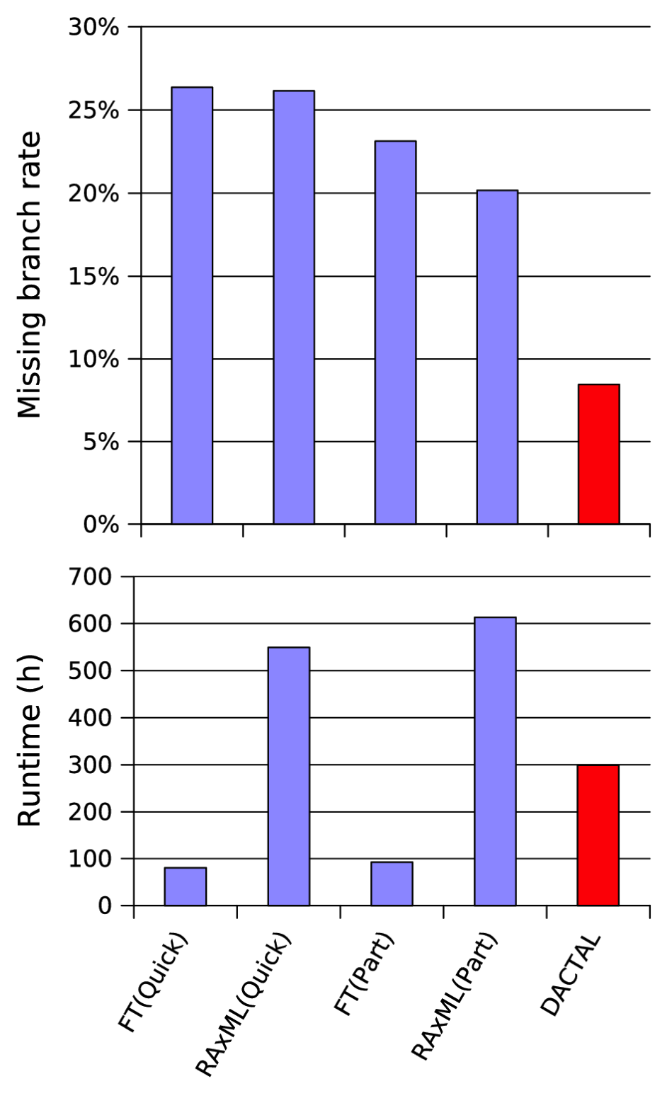
DACTAL more accurate than all standard methods, and much faster than SATé Average results on 3 large RNA datasets (6K to 28K)
DACTAL computes ML(MAFFT) trees on 200-taxon subsets
Benchmark datasets with 6,323 to 27,643 sequences from the CRW (Comparative RNA Database) with structural alignments; reference trees are 75% RAxML bootstrap trees
DACTAL (shown in red) run for 5 iterations starting from FT(Part).
SATé-2 runs but is not more accurate than DACTAL, and takes longer.

Slide 75
Applications of SCM or SuperFine
DACTAL: Divide-and-Conquer Trees (almost) without
Alignments, Nelesen et al., ISMB and Bioinformatics 2012
DCM1-NJ: absolute fast converging method (Warnow et al.,
SODA 2001 and Nakhleh et al. ISMB 2001)

Slide 76
Markov Model of Site Evolution
Simplest (Jukes-Cantor, 1969):
The model tree T is binary and has substitution probabilities p(e) on each edge e.
The state at the root is randomly drawn from {A,C,T,G} (nucleotides)
If a site (position) changes on an edge, it changes with equal probability to each of the remaining states.
The evolutionary process is Markovian.
More complex models (such as the General Markov model) are also considered, often with little change to the theory.

Slide 77
Statistical Consistency
error
Data
Data are sites in an alignment

Slide 78
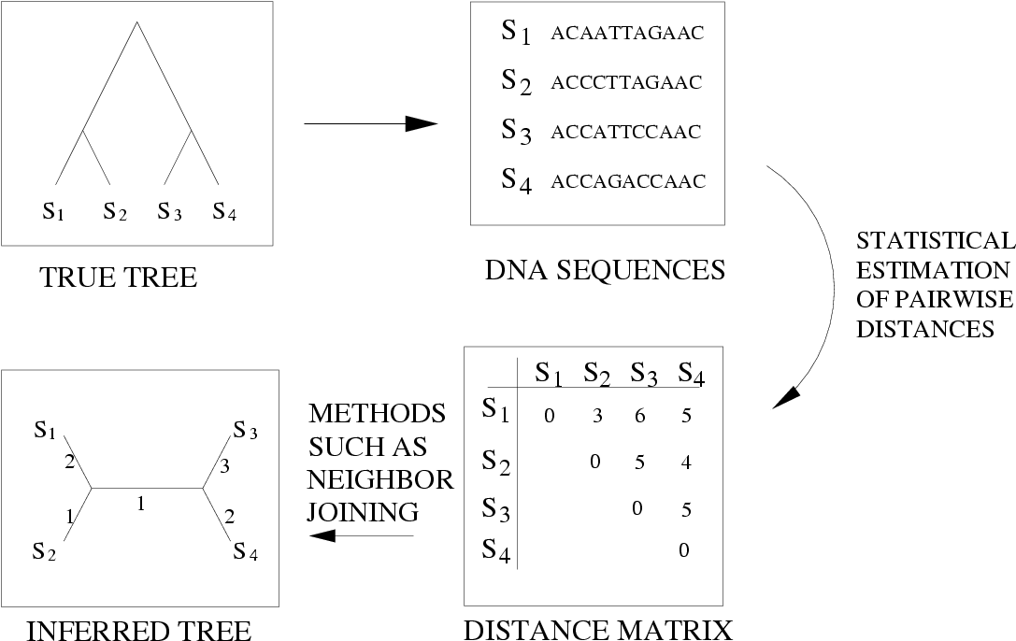
Neighbor Joining (and many other distance-based methods) are statistically consistent under Jukes-Cantor

Slide 79
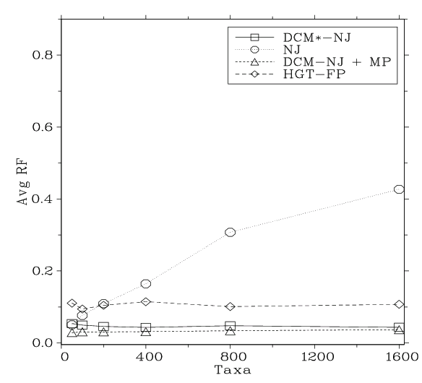
Neighbor Joining on large diameter trees
Simulation study based upon fixed edge lengths, K2P model of evolution, sequence lengths fixed to 1000 nucleotides.
Error rates reflect proportion of incorrect edges in inferred trees.
[Nakhleh et al. ISMB 2001]
0.8
NJ
0.6
Error Rate
0.4
0.2
0
0
400
800
1200
1600
No. Taxa

Slide 80
“Convergence rate” or sequence length requirement
The sequence length (number of sites) that a phylogeny reconstruction method M needs to reconstruct the true tree with probability at least 1-ε depends on
M (the method)
ε
f = min p(e),
g = max p(e), and
n = the number of leaves
We fix everything but n.

Slide 81
afc methods (Warnow et al., 1999)
A method M is “absolute fast converging”, or afc, if for all positive f, g, and ε, there is a polynomial p(n) such that Pr(M(S)=T) > 1- ε, when S is a set of sequences generated on T of length at least p(n).
Notes:
1. The polynomial p(n) will depend upon M, f, g, and ε.
2. The method M is not “told” the values of f and g.

Slide 82
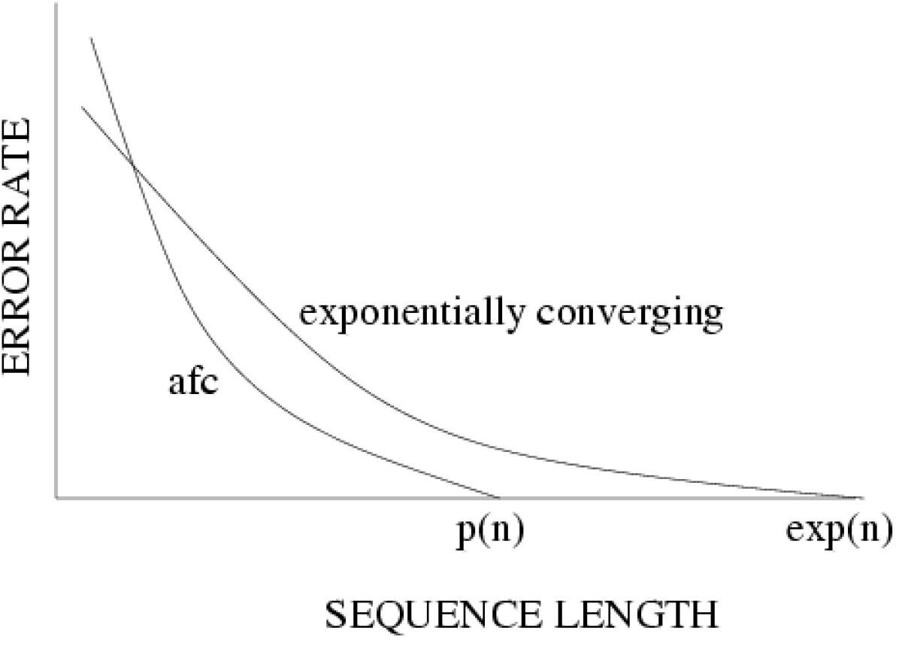
Statistical consistency, exponential convergence, and absolute fast convergence (afc)

Slide 83
Theorem (Erdos et al. 1999, Atteson 1999):
Various distance-based methods (including Neighbor joining) will return the true tree with high probability given sequence lengths that are exponential in the evolutionary diameter of the tree (hence, exponential in n).
Proof:
the method returns the true tree if the estimated distance matrix is close to the model tree distance matrix
the sequence lengths that suffice to achieve bounded error are exponential in the evolutionary diameter.

Slide 84
Fast-converging methods (and related work)
1997: Erdos, Steel, Szekely, and Warnow (ICALP).
1999: Erdos, Steel, Szekely, and Warnow (RSA, TCS);
Huson, Nettles and Warnow (J. Comp Bio.)
2001: Warnow, St. John, and Moret (SODA);
Nakhleh, St. John, Roshan, Sun, and Warnow (ISMB)
Cryan, Goldberg, and Goldberg (SICOMP);
Csuros and Kao (SODA);
2002: Csuros (J. Comp. Bio.)
2006: Daskalakis, Mossel, Roch (STOC),
Daskalakis, Hill, Jaffe, Mihaescu, Mossel, and Rao (RECOMB)
2007: Mossel (IEEE TCBB)
2008: Gronau, Moran and Snir (SODA)
2010: Roch (Science)
2013: Roch (in preparation)

Slide 85
DCM1-boosting: Warnow, St. John, and Moret, SODA 2001
Absolute fast converging
(DCM1-boosted) method
Exponentially
converging
(base) method
DCM1
SQS
The DCM1 phase produces a collection of trees (one for each threshold), and the SQS phase picks the “best” tree.
How to compute a tree for a given threshold:
Handwaving description: erase all the entries in the distance matrix above that threshold, and obtain the threshold graph. Add edges to get a chordal graph. Use the base method to estimate a tree on each maximal clique. Combine the trees together using the Strict Consensus Merger.

Slide 86
DCM1 Decompositions
Input: Set S of sequences, distance matrix d, threshold value
1. Compute threshold graph
2. Perform minimum weight triangulation (note: if d is an additive matrix, then
the threshold graph is provably chordal).
DCM1 decomposition :
Compute maximal cliques

Slide 87
Neighbor Joining on large diameter trees
Simulation study based upon fixed edge lengths, K2P model of evolution, sequence lengths fixed to 1000 nucleotides.
Error rates reflect proportion of incorrect edges in inferred trees.
[Nakhleh et al. ISMB 2001]
0.8
NJ
0.6
Error Rate
0.4
0.2
0
0
400
800
1200
1600
No. Taxa

Slide 88
Chordal graph algorithms yield phylogeny estimation from polynomial length sequences
Theorem (Warnow et al., SODA 2001): DCM1-NJ correct with high probability given sequences of length O(ln n e^{O(ln n)})
Simulation study from Nakhleh et al. ISMB 2001
0.8
NJ
DCM1-NJ
0.6
Error Rate
0.4
0.2
0
0
400
800
1200
1600
No. Taxa

Slide 89
Summary
SuperFine-boosting: boosting the accuracy of supertree methods through divide-and-conquer, theoretical guarantees under some conditions
DACTAL-boosting: highly accurate trees without a full multiple sequence alignment (boosts methods that estimate trees from unaligned sequences)
DCM1-boosting: highly accurate trees from short sequences, polynomial length sequences suffice for accuracy (boosts distance-based methods)

Slide 90
Meta-Methods
Meta-methods “boost” the performance of base methods (e.g., for phylogeny or alignment estimation).
Meta-method
Base method M
M*

Slide 91
Phylogenetic “boosters”
Goal: improve accuracy, speed, robustness, or theoretical guarantees of base methods
Techniques: divide-and-conquer, iteration, chordal graph algorithms, and “bin-and-conquer”
Examples:
DCM-boosting for distance-based methods (1999)
DCM-boosting for heuristics for NP-hard problems (1999)
SATé-boosting for alignment methods (2009 and 2012)
SuperFine-boosting for supertree methods (2012)
DACTAL: almost alignment-free phylogeny estimation methods (2012)
SEPP-boosting for phylogenetic placement of short sequences (2012)
UPP-boosting for alignment methods (in preparation)
PASTA-boosting for alignment methods (submitted)
TIPP-boosting for metagenomic taxon identification (in preparation)
Bin-and-conquer for coalescent-based species tree estimation (2013)

Slide 92
Phylogenetic “boosters”
Goal: improve accuracy, speed, robustness, or theoretical guarantees of base methods
Techniques: divide-and-conquer, iteration, chordal graph algorithms, and “bin-and-conquer”
Examples:
DCM-boosting for distance-based methods (1999)
DCM-boosting for heuristics for NP-hard problems (1999)
SATé-boosting for alignment methods (2009 and 2012)
SuperFine-boosting for supertree methods (2012)
DACTAL: almost alignment-free phylogeny estimation methods (2012)
SEPP-boosting for phylogenetic placement of short sequences (2012)
UPP-boosting for alignment methods (in preparation)
PASTA-boosting for alignment methods (submitted)
TIPP-boosting for metagenomic taxon identification (in preparation)
Bin-and-conquer for coalescent-based species tree estimation (2013)

Slide 93
Phylogenetic “boosters”
Goal: improve accuracy, speed, robustness, or theoretical guarantees of base methods
Techniques: divide-and-conquer, iteration, chordal graph algorithms, and “bin-and-conquer”
Examples:
DCM-boosting for distance-based methods (1999)
DCM-boosting for heuristics for NP-hard problems (1999)
SATé-boosting for alignment methods (2009 and 2012)
SuperFine-boosting for supertree methods (2012)
DACTAL: almost alignment-free phylogeny estimation methods (2012)
SEPP-boosting for phylogenetic placement of short sequences (2012)
UPP-boosting for alignment methods (in preparation)
PASTA-boosting for alignment methods (submitted)
TIPP-boosting for metagenomic taxon identification (in preparation)
Bin-and-conquer for coalescent-based species tree estimation (2013)

Slide 94
Other Research in My Lab
Method development for
Estimating species trees from incongruent gene trees
Multiple sequence alignment
Metagenomic taxon identification
Genome rearrangement phylogeny
Historical Linguistics
Techniques:
Statistical estimation under Markov models of evolution
Graph theory and combinatorics
Machine learning and data mining
Heuristics for NP-hard optimization problems
High performance computing
Massive simulations

Slide 95
Research Agenda
Major scientific goals:
Develop methods that produce more accurate alignments and phylogenetic estimations for difficult-to-analyze datasets
Produce mathematical theory for statistical inference under complex models of evolution
Develop novel machine learning techniques to boost the performance of classification methods
Software that:
Can run efficiently on desktop computers on large datasets
Can analyze ultra-large datasets (100,000+) using multiple processors
Is freely available in open source form, with biologist-friendly GUIs

Slide 96
The Tree of Life: Big Data Challenges
Large datasets:
100,000+ sequences
10,000+ genes
“BigData” complexity
Large numbers of sequences: NP-hard optimization problems and
reasonable heuristics, but very large datasets still difficult.
Multiple Sequence Alignment one of the biggest problems.
Large numbers of genes: NP-hard optimization problems, existing
heuristics not that good. Gene tree conflict is a major issue.
“Big Data” complexity: errors in input, fragmentary and missing data,
model misspecification, etc.

Slide 97





Warnow Laboratory
PhD students: Siavash Mirarab*, Nam Nguyen, and Md. S. Bayzid**
Undergrad: Keerthana Kumar
Lab Website: http://www.cs.utexas.edu/users/phylo
Funding: Guggenheim Foundation, Packard, NSF, Microsoft Research New England, David Bruton Jr. Centennial Professorship, and TACC (Texas Advanced Computing Center)
TACC and UTCS computational resources
* Supported by HHMI Predoctoral Fellowship
** Supported by Fulbright Foundation Predoctoral Fellowship

Slide 98
Computational Phylogenetics
Interesting combination of
statistical estimation under Markov models of evolution
mathematical modelling
graph theory and combinatorics
machine learning and data mining
heuristics for NP-hard optimization problems
high performance computing
Testing involves massive simulations

Slide 99
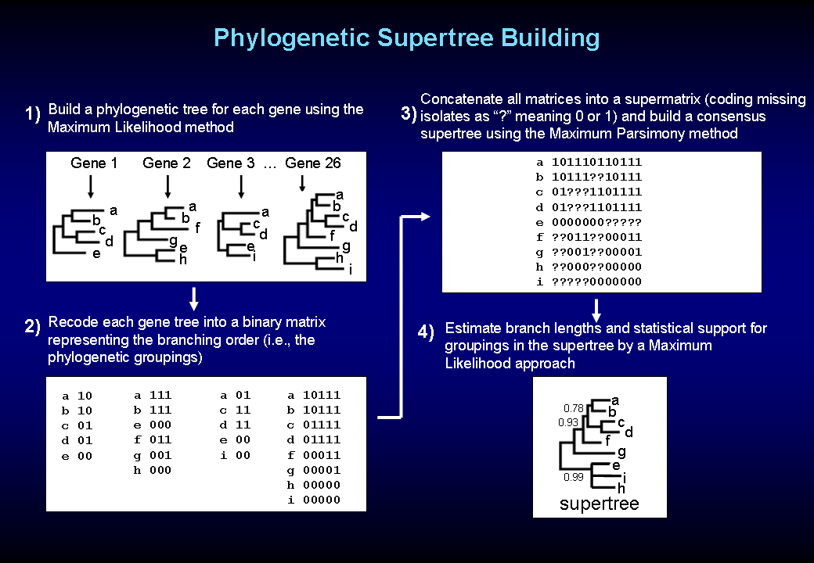
bioteaching.wordpress.com

Slide 100
Part II: Species Tree Estimation in the presence of ILS
Mathematical model: Kingman’s coalescent
“Coalescent-based” species tree estimation methods
Simulation studies evaluating methods
New techniques to improve methods
Application to the Avian Tree of Life

Slide 101
Incomplete Lineage Sorting (ILS)
2000+ papers in 2013 alone
Confounds phylogenetic analysis for many groups:
Hominids
Birds
Yeast
Animals
Toads
Fish
Fungi
There is substantial debate about how to analyze phylogenomic datasets in the presence of ILS.

Slide 102
Species tree estimation: difficult, even for small datasets!
Orangutan
Gorilla
Chimpanzee
Human
From the Tree of the Life Website, University of Arizona

Slide 103
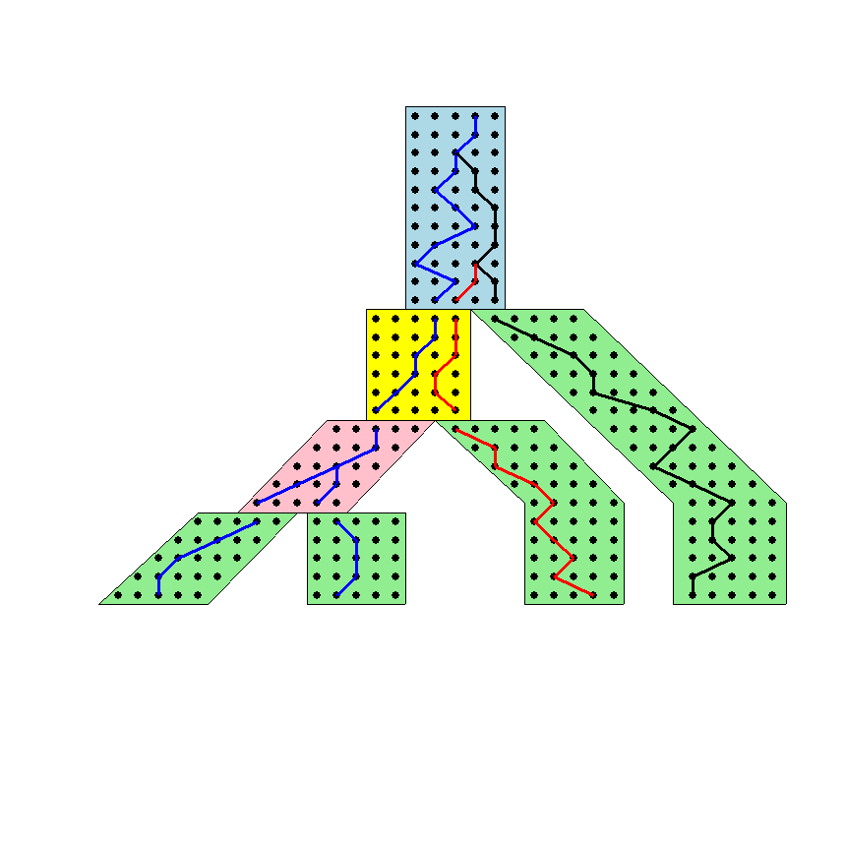




The Coalescent
Courtesy James Degnan
Past
Present

Slide 104
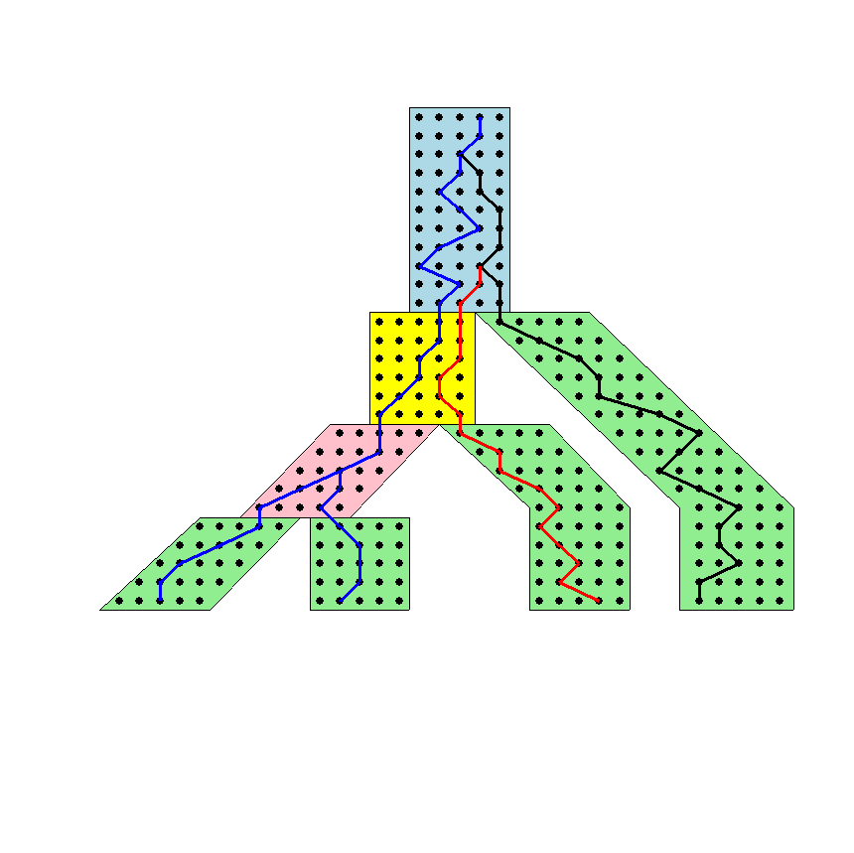
Gene tree in a species tree
Courtesy James Degnan

Slide 105
Lineage Sorting
Population-level process, also called the “Multi-species coalescent” (Kingman, 1982)
Gene trees can differ from species trees due to short times between speciation events or large population size; this is called “Incomplete Lineage Sorting” or “Deep Coalescence”.

Slide 106




1KP: Thousand Transcriptome Project
Gene Tree Incongruence
G. Ka-Shu Wong
U Alberta
J. Leebens-Mack
U Georgia
N. Wickett
Northwestern
N. Matasci
iPlant
T. Warnow, S. Mirarab, N. Nguyen, Md. S.Bayzid
UT-Austin UT-Austin UT-Austin UT-Austin
1200 plant transcriptomes
More than 13,000 gene families (most not single copy)
Multi-institutional project (10+ universities)
iPLANT (NSF-funded cooperative)
Gene sequence alignments and trees computed using SATe (Liu et al., Science 2009 and Systematic Biology 2012)

Slide 107



Avian Phylogenomics Project
E Jarvis,
HHMI
MTP Gilbert,
Copenhagen
G Zhang,
BGI
T. Warnow
UT-Austin
S. Mirarab Md. S. Bayzid, UT-Austin UT-Austin
Gene Tree Incongruence
Plus many many other people…
Approx. 50 species, whole genomes
8000+ genes, UCEs
Gene sequence alignments computed using SATé (Liu et al., Science 2009 and Systematic Biology 2012)

Slide 108
Key observation: Under the multi-species coalescent model, the species tree defines a probability distribution on the gene trees
Courtesy James Degnan

Slide 109
Two competing approaches
gene 1 gene 2 . . . gene k
Species
. . .
Concatenation
Analyze
separately
. . .
Summary Method
Notes:
point out that supertree methods take overlaping trees and produce a tree, and that the whole process of first generating small trees and then applying a supertree method is often referred to as the “supertree approach”.

Slide 110
How to compute a species tree?
. . .
Notes:
point out that supertree methods take overlaping trees and produce a tree, and that the whole process of first generating small trees and then applying a supertree method is often referred to as the “supertree approach”.

Slide 111
How to compute a species tree?
. . .
Techniques:
MDC?
Most frequent gene tree?
Consensus of gene trees?
Other?
Notes:
point out that supertree methods take overlaping trees and produce a tree, and that the whole process of first generating small trees and then applying a supertree method is often referred to as the “supertree approach”.

Slide 112
How to compute a species tree?
. . .
Theorem (Degnan et al., 2006, 2009): Under the multi-species coalescent model, for any three taxa A, B, and C, the most probable rooted gene tree on {A,B,C} is identical to the rooted species tree induced on {A,B,C}.
Notes:
point out that supertree methods take overlaping trees and produce a tree, and that the whole process of first generating small trees and then applying a supertree method is often referred to as the “supertree approach”.

Slide 113
How to compute a species tree?
. . .
. . .
Estimate species
tree for every
3 species
Theorem (Degnan et al., 2006, 2009): Under the multi-species coalescent model, for any three taxa A, B, and C, the most probable rooted gene tree on {A,B,C} is identical to the rooted species tree induced on {A,B,C}.
Notes:
point out that supertree methods take overlaping trees and produce a tree, and that the whole process of first generating small trees and then applying a supertree method is often referred to as the “supertree approach”.

Slide 114
How to compute a species tree?
. . .
. . .
Estimate species
tree for every
3 species
Theorem (Aho et al.): The rooted tree on n species can be computed from its set of 3-taxon rooted subtrees in polynomial time.
Notes:
point out that supertree methods take overlaping trees and produce a tree, and that the whole process of first generating small trees and then applying a supertree method is often referred to as the “supertree approach”.

Slide 115
How to compute a species tree?
. . .
. . .
Estimate species
tree for every
3 species
Combine
rooted
3-taxon
trees
Theorem (Aho et al.): The rooted tree on n species can be computed from its set of 3-taxon rooted subtrees in polynomial time.
Notes:
point out that supertree methods take overlaping trees and produce a tree, and that the whole process of first generating small trees and then applying a supertree method is often referred to as the “supertree approach”.

Slide 116
How to compute a species tree?
. . .
. . .
Estimate species
tree for every
3 species
Combine
rooted
3-taxon
trees
Theorem (Degnan et al., 2009): Under the multi-species coalescent, the rooted species tree can be estimated correctly (with high probability) given a large enough number of true rooted gene trees.
Theorem (Allman et al., 2011): the unrooted species tree can be estimated from a large enough number of true unrooted gene trees.
Notes:
point out that supertree methods take overlaping trees and produce a tree, and that the whole process of first generating small trees and then applying a supertree method is often referred to as the “supertree approach”.

Slide 117
How to compute a species tree?
. . .
. . .
Estimate species
tree for every
3 species
Combine
rooted
3-taxon
trees
Theorem (Degnan et al., 2009): Under the multi-species coalescent, the rooted species tree can be estimated correctly (with high probability) given a large enough number of true rooted gene trees.
Theorem (Allman et al., 2011): the unrooted species tree can be estimated from a large enough number of true unrooted gene trees.
Notes:
point out that supertree methods take overlaping trees and produce a tree, and that the whole process of first generating small trees and then applying a supertree method is often referred to as the “supertree approach”.

Slide 118
How to compute a species tree?
. . .
. . .
Estimate species
tree for every
3 species
Combine
rooted
3-taxon
trees
Theorem (Degnan et al., 2009): Under the multi-species coalescent, the rooted species tree can be estimated correctly (with high probability) given a large enough number of true rooted gene trees.
Theorem (Allman et al., 2011): the unrooted species tree can be estimated from a large enough number of true unrooted gene trees.
Notes:
point out that supertree methods take overlaping trees and produce a tree, and that the whole process of first generating small trees and then applying a supertree method is often referred to as the “supertree approach”.

Slide 119
Statistical Consistency
error
Data
Data are gene trees, presumed to be randomly sampled true gene trees.

Slide 120
Questions
Is the model tree identifiable?
Which estimation methods are statistically consistent under this model?
How much data does the method need to estimate the model tree correctly (with high probability)?
What is the computational complexity of an estimation problem?

Slide 121
Statistically consistent under ILS?
MP-EST (Liu et al. 2010): maximum likelihood estimation of rooted species tree – YES
BUCKy-pop (Ané and Larget 2010): quartet-based Bayesian species tree estimation –YES
MDC – NO
Greedy – NO
Concatenation under maximum likelihood – open
MRP (supertree method) – open

Slide 122
Impact of Gene Tree Estimation Error on MP-EST
MP-EST has no error on true gene trees, but
MP-EST has 9% error on estimated gene trees
Datasets: 11-taxon strongILS conditions with 50 genes
Similar results for other summary methods (MDC, Greedy, etc.).

Slide 123
Problem: poor gene trees
Summary methods combine estimated gene trees, not true gene trees.
The individual gene sequence alignments in the 11-taxon datasets have poor phylogenetic signal, and result in poorly estimated gene trees.
Species trees obtained by combining poorly estimated gene trees have poor accuracy.

Slide 124
Problem: poor gene trees
Summary methods combine estimated gene trees, not true gene trees.
The individual gene sequence alignments in the 11-taxon datasets have poor phylogenetic signal, and result in poorly estimated gene trees.
Species trees obtained by combining poorly estimated gene trees have poor accuracy.

Slide 125
Problem: poor gene trees
Summary methods combine estimated gene trees, not true gene trees.
The individual gene sequence alignments in the 11-taxon datasets have poor phylogenetic signal, and result in poorly estimated gene trees.
Species trees obtained by combining poorly estimated gene trees have poor accuracy.

Slide 126
TYPICAL PHYLOGENOMICS PROBLEM: many poor gene trees
Summary methods combine estimated gene trees, not true gene trees.
The individual gene sequence alignments in the 11-taxon datasets have poor phylogenetic signal, and result in poorly estimated gene trees.
Species trees obtained by combining poorly estimated gene trees have poor accuracy.

Slide 127
Questions
Is the model species tree identifiable?
Which estimation methods are statistically consistent under this model?
How much data does the method need to estimate the model species tree correctly (with high probability)?
What is the computational complexity of an estimation problem?
What is the impact of error in the input data on the estimation of the model species tree?

Slide 128
Questions
Is the model species tree identifiable?
Which estimation methods are statistically consistent under this model?
How much data does the method need to estimate the model species tree correctly (with high probability)?
What is the computational complexity of an estimation problem?
What is the impact of error in the input data on the estimation of the model species tree?

Slide 129
Addressing gene tree estimation error
Get better estimates of the gene trees
Restrict to subset of estimated gene trees
Model error in the estimated gene trees
Modify gene trees to reduce error
“Bin-and-conquer”

Slide 130
Addressing gene tree estimation error
Get better estimates of the gene trees
Restrict to subset of estimated gene trees
Model error in the estimated gene trees
Modify gene trees to reduce error
“Bin-and-conquer”

Slide 131
Technique #2: Bin-and-Conquer?
Assign genes to “bins”, creating “supergene alignments”
Estimate trees on each supergene alignment using maximum likelihood
Combine the supergene trees together using a summary method
Variants:
Naïve binning (Bayzid and Warnow, Bioinformatics 2013)
Statistical binning (Mirarab, Bayzid, and Warnow, in preparation)

Slide 132
Technique #2: Bin-and-Conquer?
Assign genes to “bins”, creating “supergene alignments”
Estimate trees on each supergene alignment using maximum likelihood
Combine the supergene trees together using a summary method
Variants:
Naïve binning (Bayzid and Warnow, Bioinformatics 2013)
Statistical binning (Mirarab, Bayzid, and Warnow, in preparation)

Slide 133
Statistical binning
Input: estimated gene trees with bootstrap support, and minimum support threshold t
Output: partition of the estimated gene trees into sets, so that no two gene trees in the same set are strongly incompatible.
Vertex coloring problem (NP-hard),
but good heuristics are available (e.g., Brelaz 1979)
However, for statistical inference reasons, we need balanced vertex color classes

Slide 134
Statistical binning
Input: estimated gene trees with bootstrap support, and minimum support threshold t
Output: partition of the estimated gene trees into sets, so that no two gene trees in the same set are strongly incompatible.
Vertex coloring problem (NP-hard),
but good heuristics are available (e.g., Brelaz 1979)
However, for statistical inference reasons, we need balanced vertex color classes

Slide 135
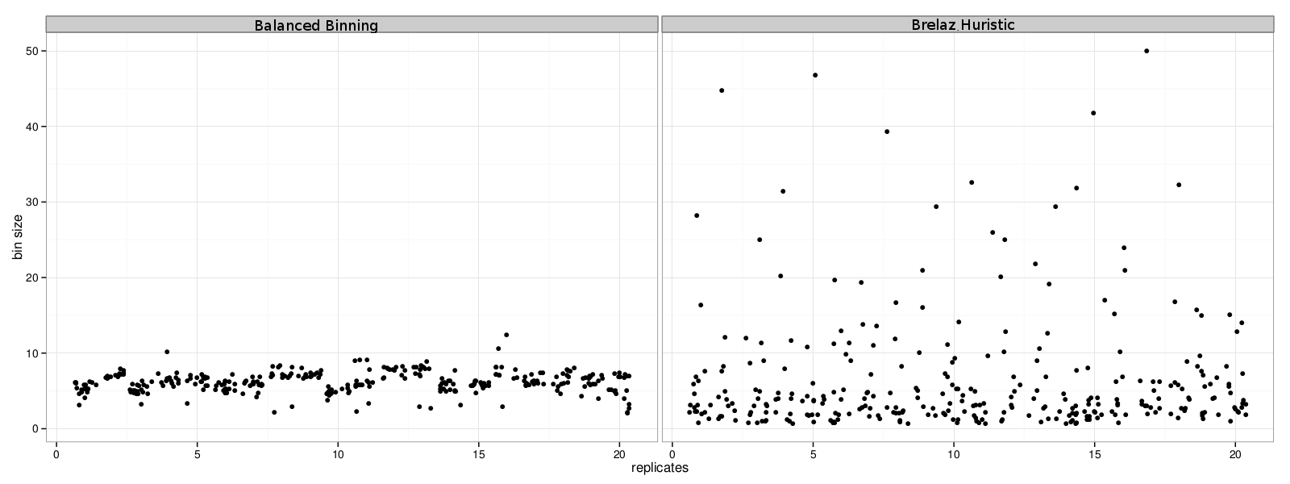
Balanced Statistical Binning
Mirarab, Bayzid, and Warnow, in preparation
Modification of Brelaz Heuristic for minimum vertex coloring.

Slide 136
Statistical binning vs. unbinned
Mirarab, et al. in preparation
Datasets: 11-taxon strongILS datasets with 50 genes, Chung and Ané, Systematic Biology

Slide 137
Avian Phylogenomics Project
E Jarvis,
HHMI
MTP Gilbert,
Copenhagen
G Zhang,
BGI
T. Warnow
UT-Austin
S. Mirarab Md. S. Bayzid, UT-Austin UT-Austin
Gene Tree Incongruence
Plus many many other people…
Strong evidence for substantial ILS, suggesting need for
coalescent-based species tree estimation.
But MP-EST on full set of 14,000 gene trees was considered
unreliable, due to poorly estimated exon trees (very low phylogenetic
signal in exon sequence alignments).

Slide 138
Avian Phylogeny
GTRGAMMA Maximum likelihood analysis (RAxML) of 37 million basepair alignment (exons, introns, UCEs) – highly resolved tree with near 100% bootstrap support.
More than 17 years of compute time, and used 256 GB. Run at HPC centers.
Unbinned MP-EST on 14000+ genes: highly incongruent with the concatenated maximum likelihood analysis, poor bootstrap support.
Statistical binning version of MP-EST on 14000+ gene trees – highly resolved tree, largely congruent with the concatenated analysis, good bootstrap support
Statistical binning: faster than concatenated analysis, highly parallelized.
Avian Phylogenomics Project, in preparation

Slide 139
Avian Phylogeny
GTRGAMMA Maximum likelihood analysis (RAxML) of 37 million basepair alignment (exons, introns, UCEs) – highly resolved tree with near 100% bootstrap support.
More than 17 years of compute time, and used 256 GB. Run at HPC centers.
Unbinned MP-EST on 14000+ genes: highly incongruent with the concatenated maximum likelihood analysis, poor bootstrap support.
Statistical binning version of MP-EST on 14000+ gene trees – highly resolved tree, largely congruent with the concatenated analysis, good bootstrap support
Statistical binning: faster than concatenated analysis, highly parallelized.
Avian Phylogenomics Project, in preparation

Slide 140
Avian Simulation – 14,000 genes
MP-EST:
Unbinned ~ 11.1% error
Binned ~ 6.6% error
Greedy:
Unbinned ~ 26.6% error
Binned ~ 13.3% error
8250 exon-like genes (27% avg. bootstrap support)
3600 UCE-like genes (37% avg. bootstrap support)
2500 intron-like genes (51% avg. bootstrap support)

Slide 141
Avian Simulation – 14,000 genes
MP-EST:
Unbinned ~ 11.1% error
Binned ~ 6.6% error
Greedy:
Unbinned ~ 26.6% error
Binned ~ 13.3% error
8250 exon-like genes (27% avg. bootstrap support)
3600 UCE-like genes (37% avg. bootstrap support)
2500 intron-like genes (51% avg. bootstrap support)

Slide 142
Avian Phylogeny
GTRGAMMA Maximum likelihood analysis (RAxML) of 37 million basepair alignment (exons, introns, UCEs) – highly resolved tree with near 100% bootstrap support.
More than 17 years of compute time, and used 256 GB. Run at HPC centers.
Unbinned MP-EST on 14000+ genes: highly incongruent with the concatenated maximum likelihood analysis, poor bootstrap support.
Statistical binning version of MP-EST on 14000+ gene trees – highly resolved tree, largely congruent with the concatenated analysis, good bootstrap support
Statistical binning: faster than concatenated analysis, highly parallelized.
Avian Phylogenomics Project, in preparation

Slide 143
Avian Phylogeny
GTRGAMMA Maximum likelihood analysis (RAxML) of 37 million basepair alignment (exons, introns, UCEs) – highly resolved tree with near 100% bootstrap support.
More than 17 years of compute time, and used 256 GB. Run at HPC centers.
Unbinned MP-EST on 14000+ genes: highly incongruent with the concatenated maximum likelihood analysis, poor bootstrap support.
Statistical binning version of MP-EST on 14000+ gene trees – highly resolved tree, largely congruent with the concatenated analysis, good bootstrap support
Statistical binning: faster than concatenated analysis, highly parallelized.
Avian Phylogenomics Project, in preparation

Slide 144
To consider
Binning reduces the amount of data (number of gene trees) but can improve the accuracy of individual “supergene trees”. The response to binning differs between methods. Thus, there is a trade-off between data quantity and quality, and not all methods respond the same to the trade-off.
We know very little about the impact of data error on methods. We do not even have proofs of statistical consistency in the presence of data error.

Slide 145
Basic Questions
Is the model tree identifiable?
Which estimation methods are statistically consistent under this model?
How much data does the method need to estimate the model tree correctly (with high probability)?
What is the computational complexity of an estimation problem?

Slide 146
Additional Statistical Questions
Trade-off between data quality and quantity
Impact of data selection
Impact of data error
Performance guarantees on finite data (e.g., prediction of error rates as a function of the input data and method)
We need a solid mathematical framework for these problems.

Slide 147
Summary
SuperFine: improving supertree estimation through divide-and-conquer
Binning: species tree estimation from multiple genes, suggests new questions in statistical estimation
All methods provide improved accuracy compared to existing methods, as shown on simulated and biological datasets.

Slide 148
Mammalian Simulation Study
Observations:
Binning can improve accuracy, but impact depends on accuracy of estimated gene trees and phylogenetic estimation method.
Binned methods can be more accurate than RAxML (maximum likelihood), even when unbinned methods are less accurate.
Data: 200 genes, 20 replicate datasets, based on Song et al. PNAS 2012
Mirarab et al., in preparation

Slide 149
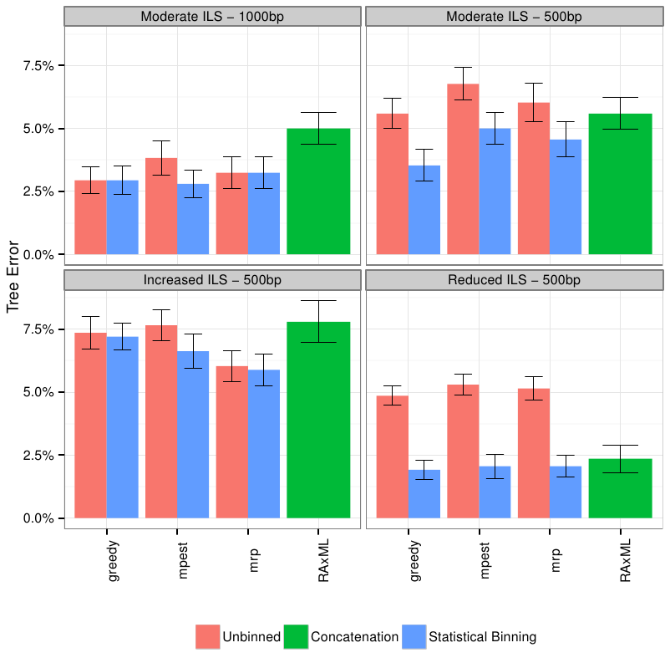
Mammalian simulation
Observation:
Binning can improve summary methods, but amount of improvement depends on: method,
amount of ILS, and accuracy of gene trees.
MP-EST is statistically consistent in the presence of ILS; Greedy is not, unknown for MRP
And RAxML.
Data (200 genes, 20 replicate datasets) based on Song et al. PNAS 2012

Slide 150
Results on 11-taxon datasets with weak ILS
*BEAST more accurate than summary methods (MP-EST, BUCKy, etc)
CA-ML: concatenated analysis) most accurate
Datasets from Chung and Ané, 2011
Bayzid & Warnow, Bioinformatics 2013

Slide 151
*BEAST better than Maximum Likelihood
11-taxon weakILS datasets
17-taxon (very high ILS) datasets
*BEAST produces more accurate gene trees than ML on gene sequence alignments
11-taxon datasets from Chung and Ané, Syst Biol 2012
17-taxon datasets from Yu, Warnow, and Nakhleh, JCB 2011

Slide 152
Statistically consistent methods
Input: Set of estimated gene trees or alignments, one (or more) for each gene
Output: estimated species tree
*BEAST (Heled and Drummond 2010): Bayesian co-estimation of gene trees and species trees given sequence alignments
MP-EST (Liu et al. 2010): maximum likelihood estimation of rooted species tree
BUCKy-pop (Ané and Larget 2010): quartet-based Bayesian species tree estimation

Slide 153
Naïve binning vs. unbinned: 50 genes
Bayzid and Warnow, Bioinformatics 2013
11-taxon strongILS datasets with 50 genes, 5 genes per bin

Slide 154
Naïve binning vs. unbinned, 100 genes
*BEAST did not converge on these datasets, even with 150 hours.
With binning, it converged in 10 hours.

Slide 155
Naïve binning vs. unbinned: 50 genes
Bayzid and Warnow, Bioinformatics 2013
11-taxon strongILS datasets with 50 genes, 5 genes per bin

